Slide 1
The HIPA radio frequency control system application
24th IEEE Real Time Conference Quy Nhon Vietnam
Mario Jurčević, Karina Ambrosch, Benoit Stef

Slide 2
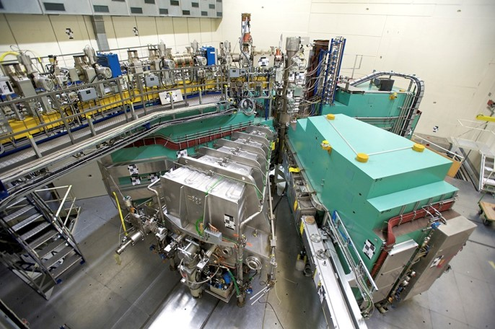
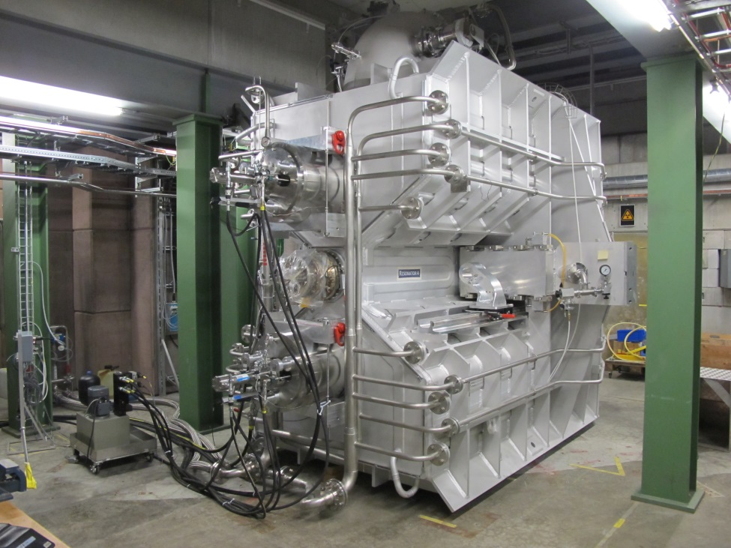
The HIPA radio frequency control system application
Poster ID : 183
Figure 1: HIPA Injector 2 cyclotron
Figure 2: new 50MHz cavity

Slide 3
The HIPA radio frequency control system application
Poster ID : 183
Figure 3: Cavity with amplifier chain and LLRF control system

