Slide 1
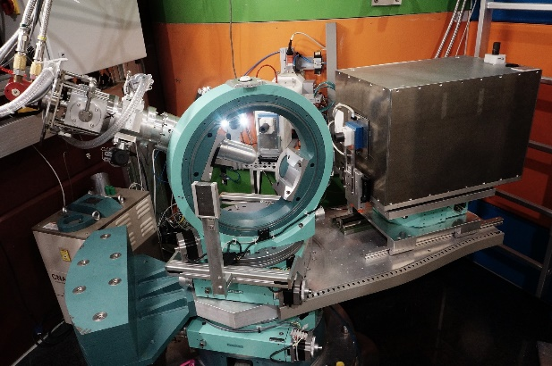
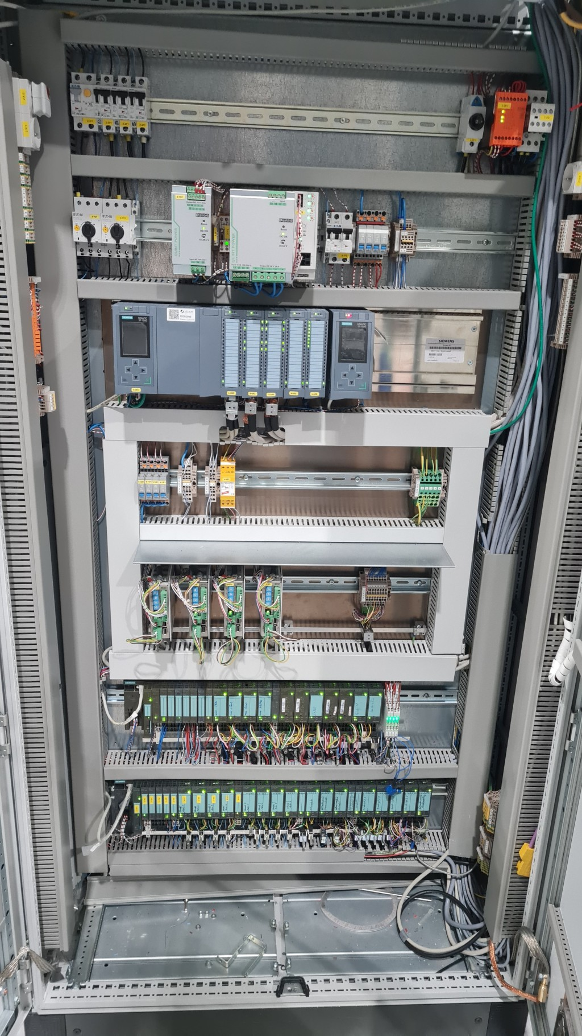
Synchronization between Detector anD Motion in A Neutron Instrument
H. Kleines, F. Suxdorf, M. Meven, W. Luberstetter, G. Brandl; JCNS-2, Forschungszentrum Jülich, Germany
Mono-chromator
Eulerian
Cradle
Detector
Hot single crystal neutron diffractometer HEiDi
  Operated by RWTH Aachen and Forschungszentrum Jülich at fission reactor FRM II
  Motion electronics: Siemens S7-1500 PLC + ET200S decentral periphery
  Detector: ³He detector tube
GOAL: movement during measurement

Slide 2
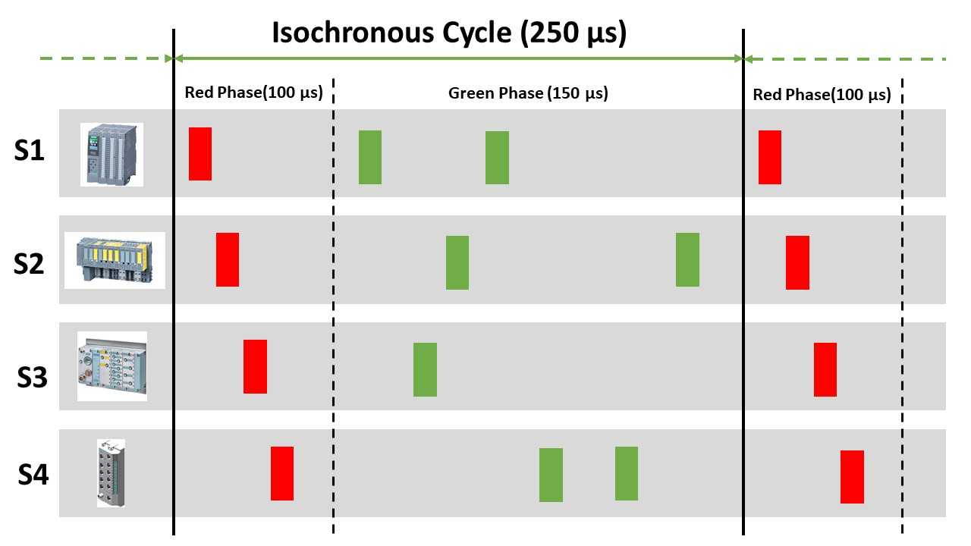
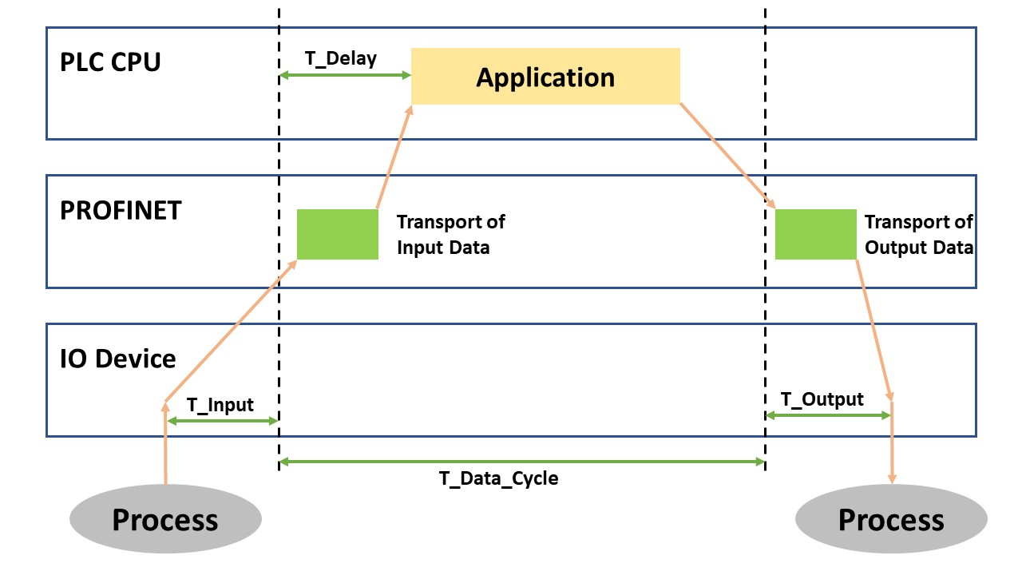
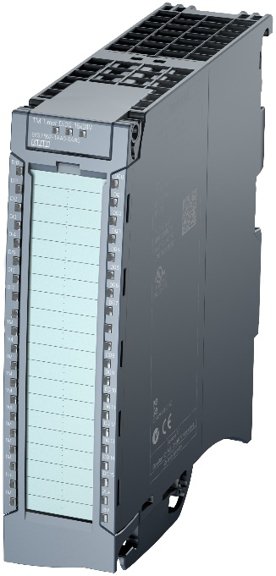
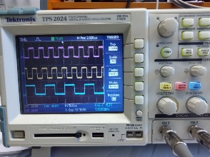
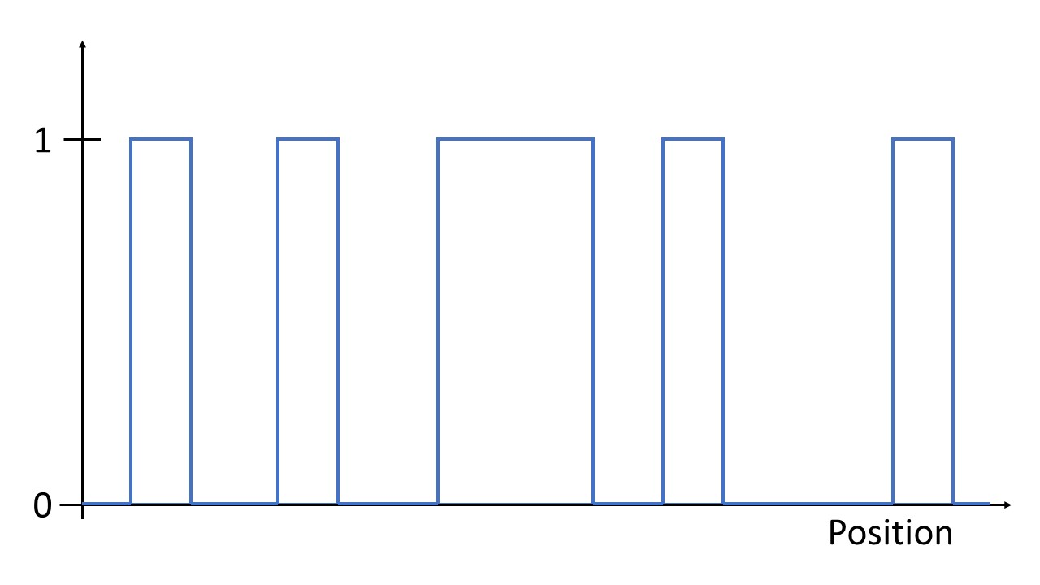
ToolBOX in the Siemens S7-1500 Environment
Profinet IRT
S7-1500 isochronous mode
Time-based IO
CAM Track and Measurement Input
Electronic Gearing

Slide 3
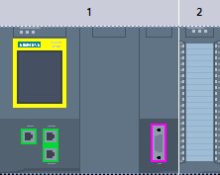
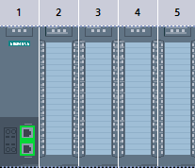
System Architecture
Detector Electronics
(Time resolved counter)
HE-3 Tube
FTPS Server
24 V to TTL
CAM track pulse
4 SSI Encoders
4 Motors
Diagnostic data from measurement input
Feedback of CAM track to measurement input
CAM Tracks
  Position-based histogramming
Diagnostics: Measurement input
First measurements at linear table test system
  Position resolution at 10 mm/s: 3,6 µm
  Potential for improvement
S7-1500 CPU
1517TF-3 PN/DP
DI 32 x 24V DC HF
Profinet IRT
IM 155-5 PN HF
TM PTO 4
TM PosInput 2
TM PosInput 2
TM Timer DIDQ

