Slide 1
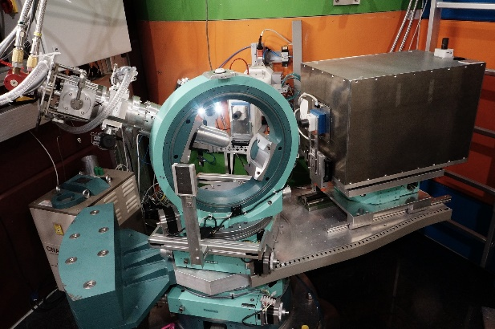
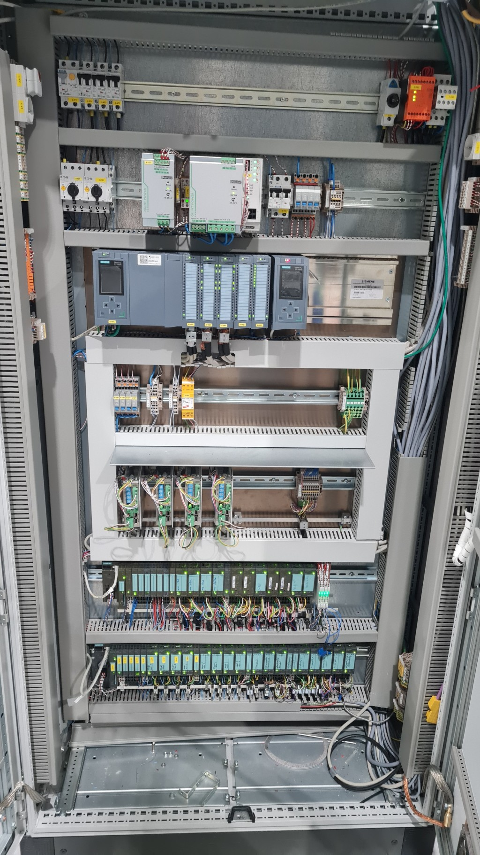
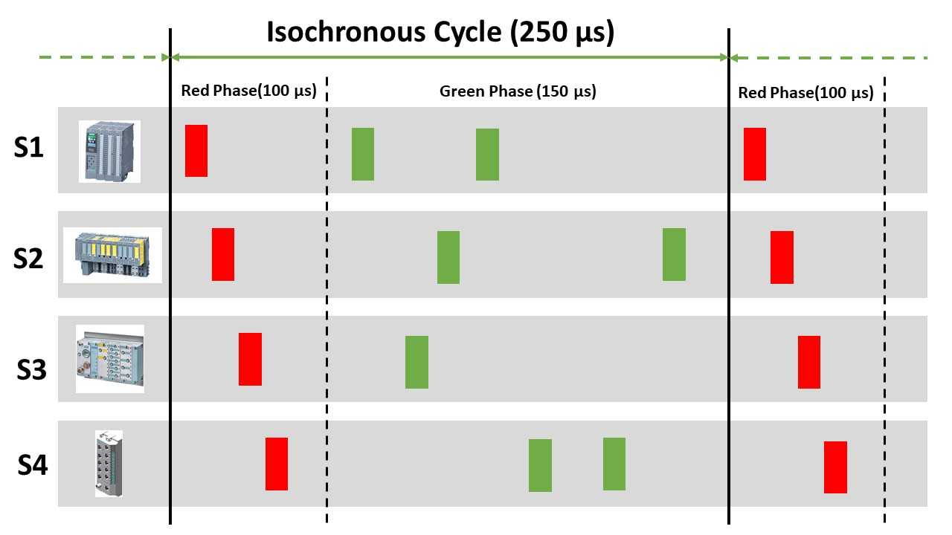
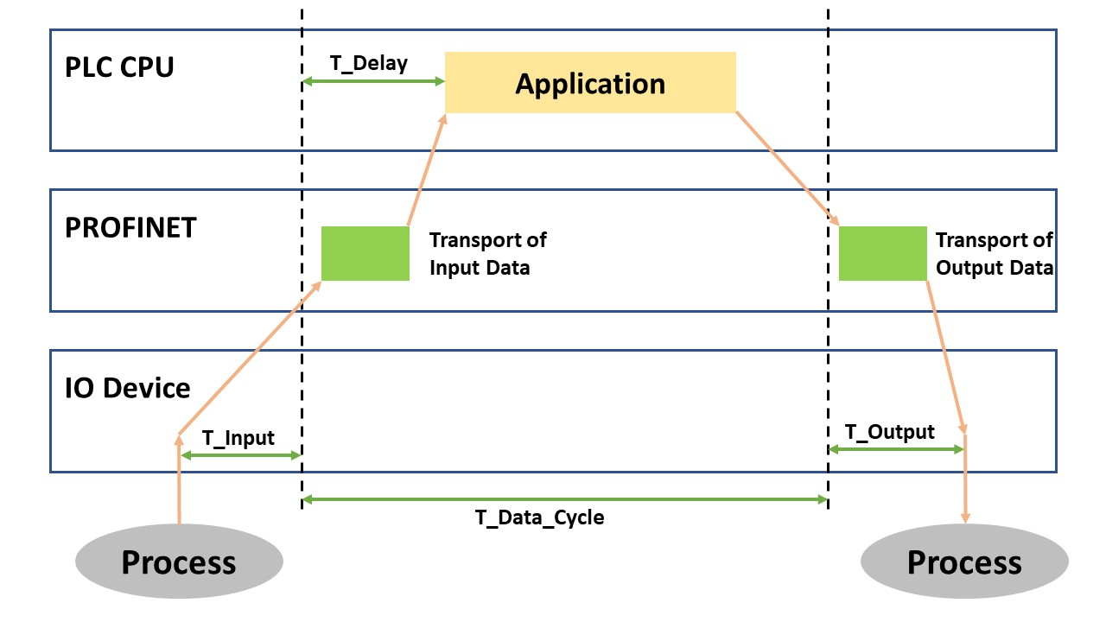
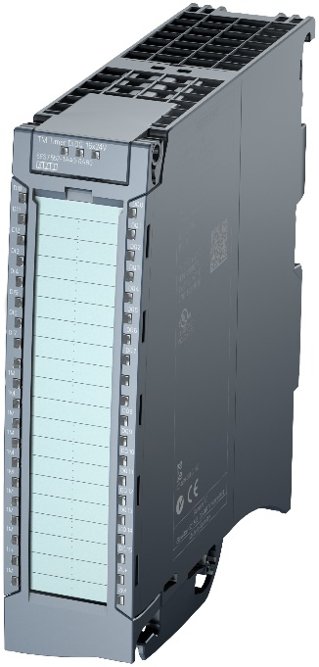
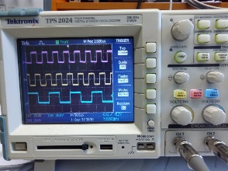
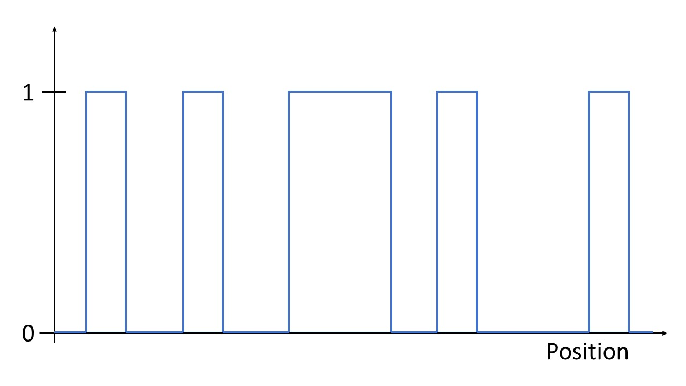
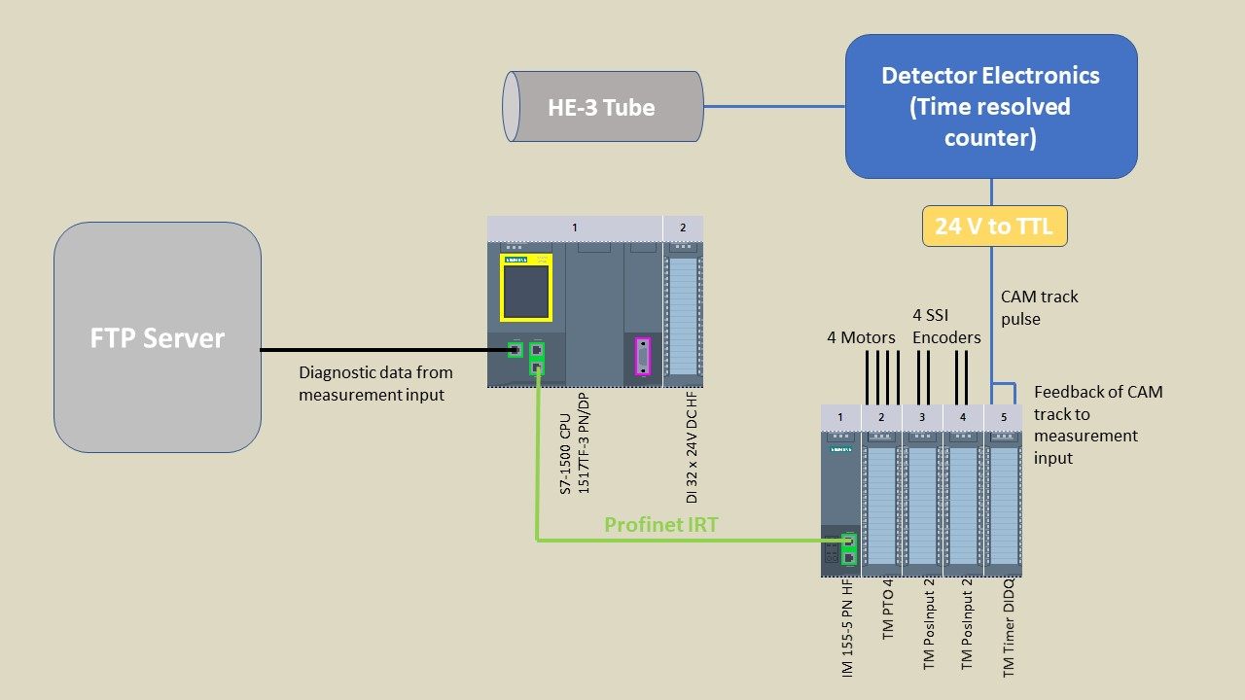
Synchronization between Detector and Motion in a Neutron Instrument
H. Kleines, F. Suxdorf, M. Meven, W. Luberstetter, G. Brandl
JNCS, Forschungszentrum Jülich
Abstract: The single crystal hot neutron diffractometer HEiDi is operated by Forschungszentrum Jülich at the research reactor FRM II in Garching. Core of the instrument is the 4-circle diffractometer, consisting of an Eulerian cradle for the sample and the detector arm. The detector of HEiDi is a single a ³He detector tube. In classical scans, in each step the axes of the 4-circle diffractometer are moved to the desired position and then the measurement is started. A reduction of measurement time can be achieved by measuring also during movement. The necessary synchronization between the motion subsystem and the detector is being implemented. The motion subsystem is based on a Siemens S7-1500 PLC and the synchronization uses its cam track technology objects.
.
Hot Single Crystal Diffractometer HEiDi
Studies on structural and magnetic properties of single crystals using thermal and epithermal neutrons
Located in the experimental hall of research reactor FRM II in Garching
Operated by the Institute of Crystallography, RWTH Aachen University, and JCNS, Forschungszentrum Jülich
Electronics: Siemens S7-1500 + ET200S
Software: DIF4N + Tango
Detector: HE-3 proportional counting tube
Goal: measurement during movement in scan
Monochromator Euler Cradle Detector Siemens S7-1500 PLC
Toolbox
PROFINET IRT
Time synchronization of Profinet stations with PTP
Fixed cycle duration
Scheduled transmission times
Precision: < 1 µs
S7-1500 Isochronous Mode
Constant application SW cycle synchronized with Profinet cycle
IO-Devices also synchronized with Profinet cycle
Time Based IO
Precise scheduling of output pulses
Precise measurement of input pulses
Hardware-supported
Independent of application cycle
Only supported by TM Timer DIDQ
Electronic Gearing
Velocity synchroni-zation between Euler cradle axes ꞷ,χ,φ,θ
Standard PLCopen motion function block MC_GearIn: v_{x} = k * v_{z}
Motion Technology Objects Measuring Input and CAM Track
Measuring Input: precise position reading on pulse edges
CAM Track: output of position-dependent pulse sequences
Geared axis with identical speed
lead axis
Geared axis with half speed
Hardware structure
CAM Track pulses
Position-based histogramming
Status and Outlook
Ongoing tests in lab
Evaluation of synchronization quality
Next steps: installation at HEiDi and integration into HEiDi SW
Next goal: automatic scan in reciprocal space executed on the S7-1500 PLC

