Slide 1
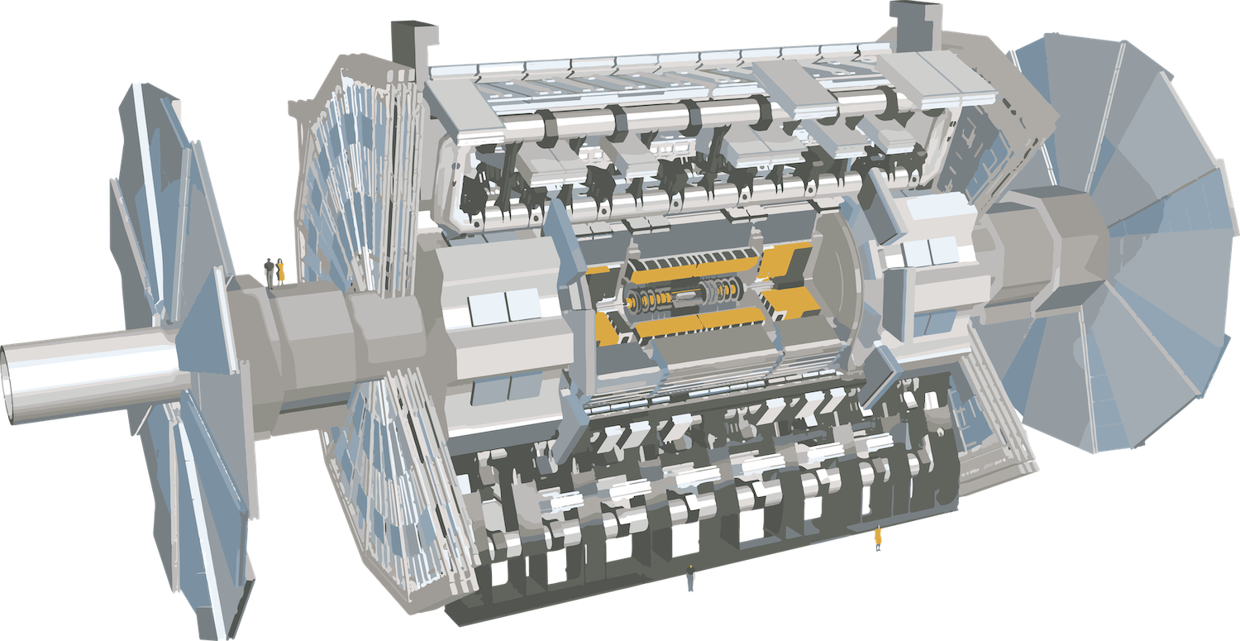


A new methodology of clock phase adjustment in a large-scale clock distribution system for HL-LHC ATLAS TGC front-end electronics
Ren Nagasaka (ICEPP, University of Tokyo) on behalf of the ATLAS Collaboration
Key topic
Methodology of clock phase adjustment
for large-scale electronics system.
  ATLAS Thin Gap Chamber system:
    1,434 front-end electronics.
    1,434 fibers to distribute clock signals for synchronization.
  Requirement on clock phase adjustment:
    Well better than 1 ns precision to guarantee good performance of hit-bunch crossing assignment (BCID), regarding 25 ns bunch spacing of LHC.
      Note: 1 ns also corresponds to precision of signal arrival timing alignment.
      Aim to O(100) ps.
25 m
Thin Gap Chamber
IEEE real time conference, 23 April 2024

Slide 2
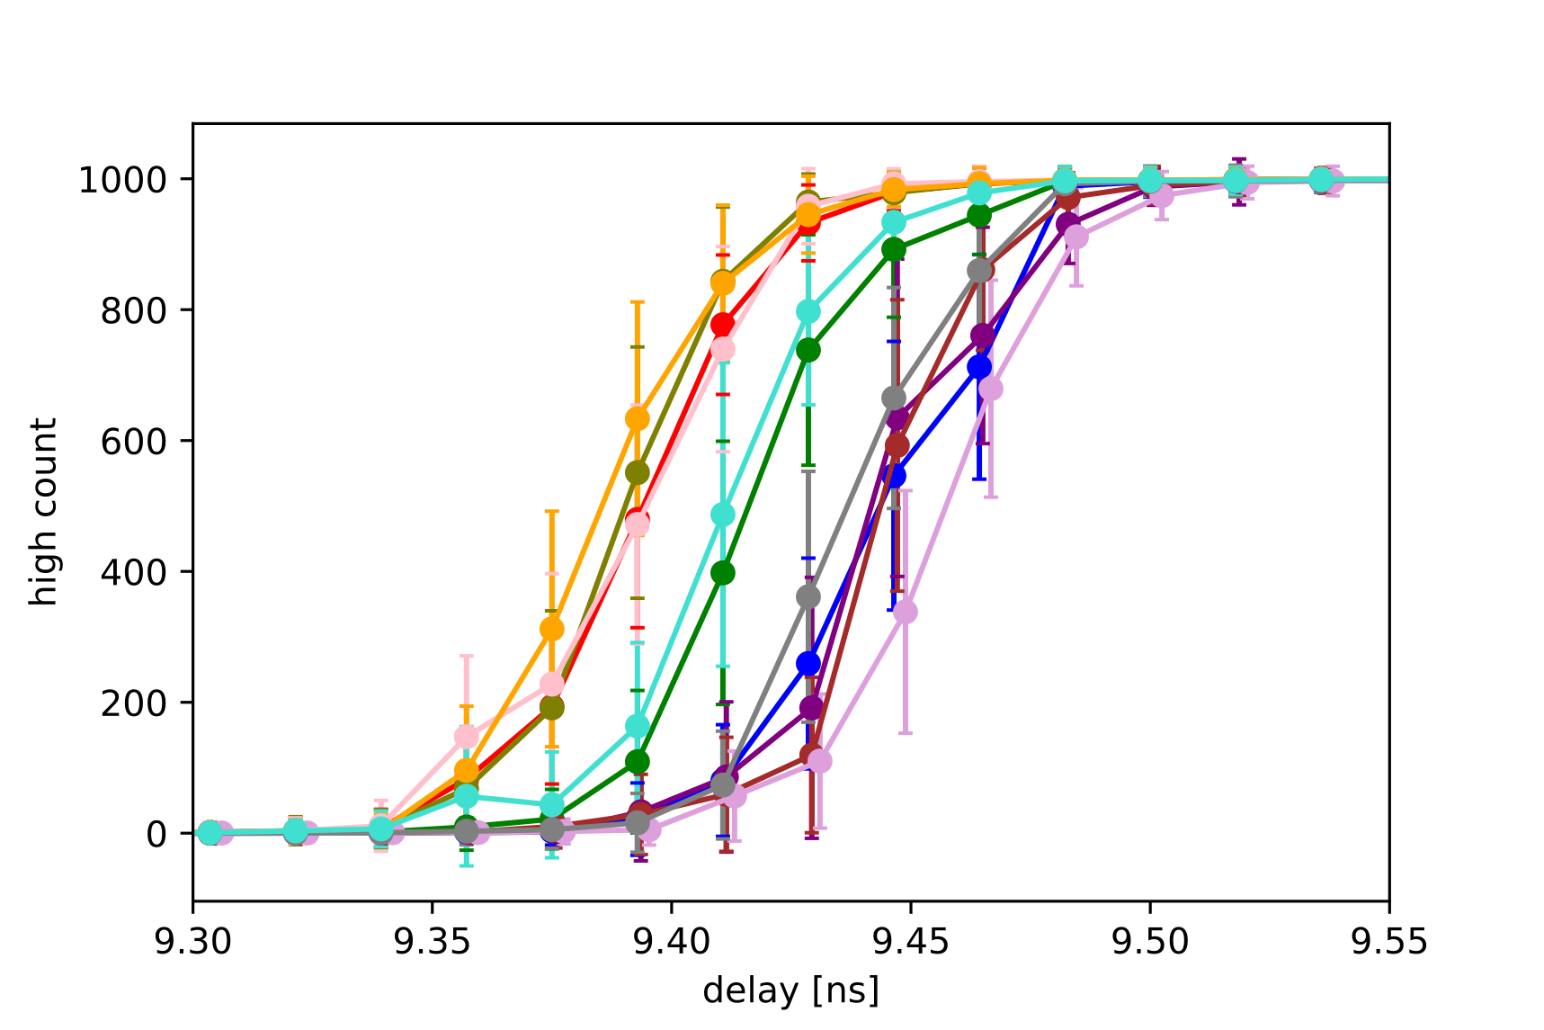
Actual implementation of clock phase adjustment functionality in firmware and software.
  Taking advantage of SoC devices, measurement, and adjustment of clock phase can be done remotely in a semi-automated manner.
Validation of the system and estimation of the precision of the system.
  Reproducibility validation
  Estimation of uncertainty with measurement-driven method.
50 ps
We conclude that phase adjustment of 1.434 front-end electronics can be done with an accuracy of ~ 50 ps (sufficient accuracy for our purpose).
IEEE real time conference, 23 April 2024

