Slide 1
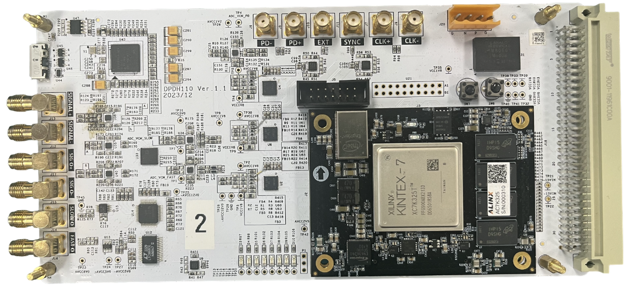
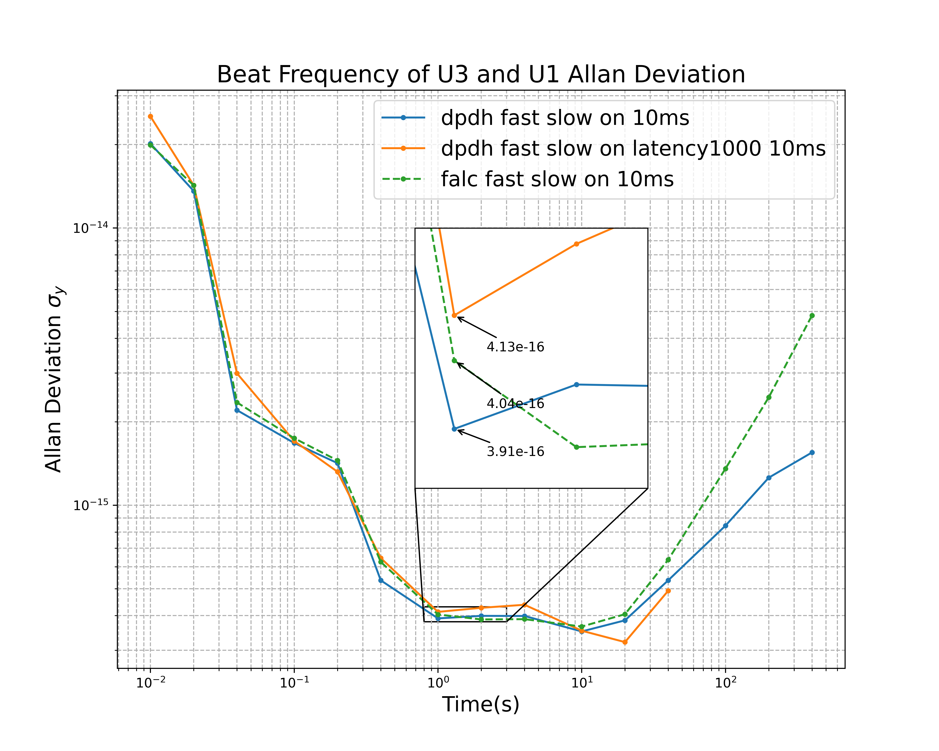
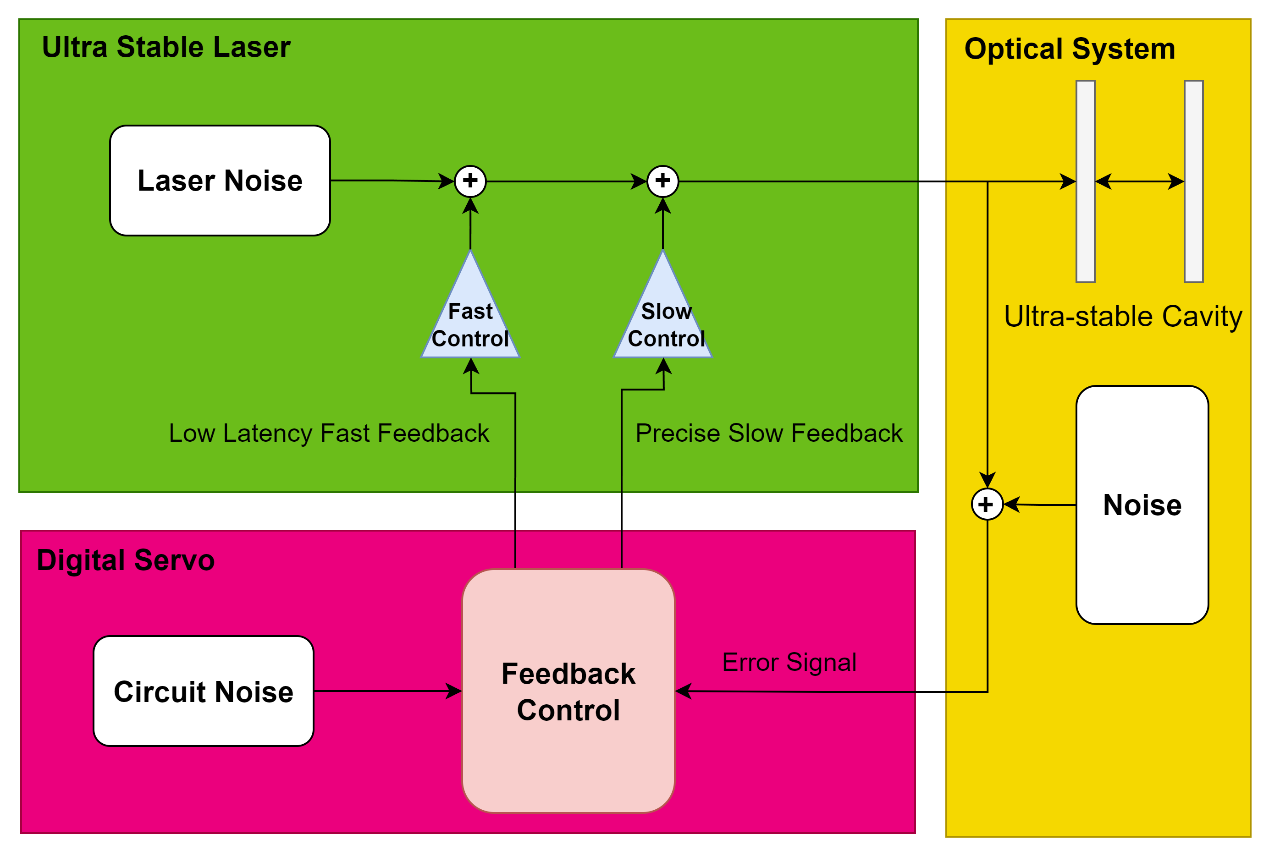
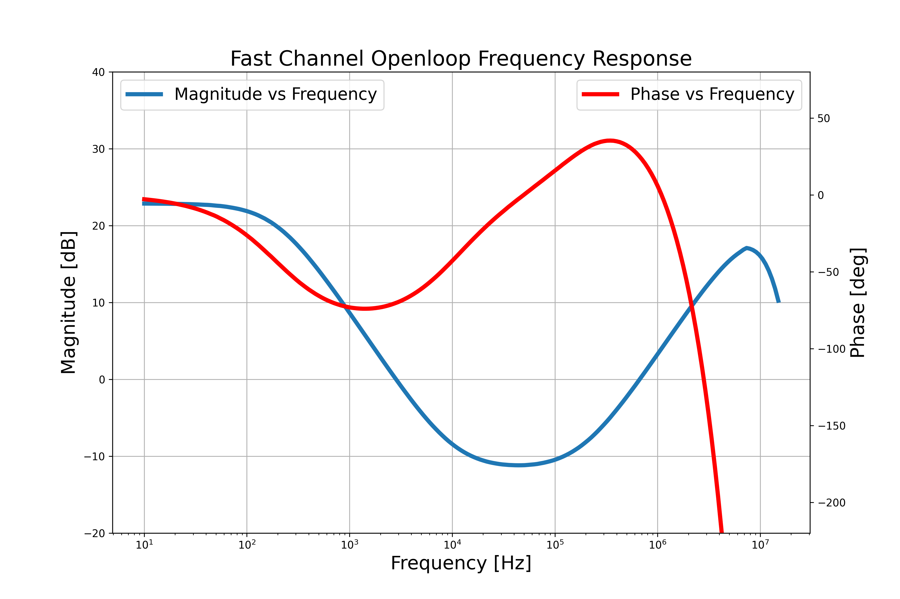

Our Hardware
A Full Digital Servo for
214,614,220,160,499.34 Hz*
Laser Frequency Stabilization
120ns digital latency
1933nV/√Hz@1Hz
Full configurable dual feedback channel
AMO experiements
Atomic clock
More application in ...
*Approximated on 1396.890nm laser with allan deviation at 4e-16
ID #125 A Full Digital Servo for Ultra-Stable Laser Frequency Stabilization
Zhengtao Liu, Yu Wang*, Wenchao Ji, Yi Hu, Xiao Jiang, Changqing Feng, Shubin Liu
State Key Laboratory of Particle Detection and Electronics, University of Science and Technology of China

Slide 2
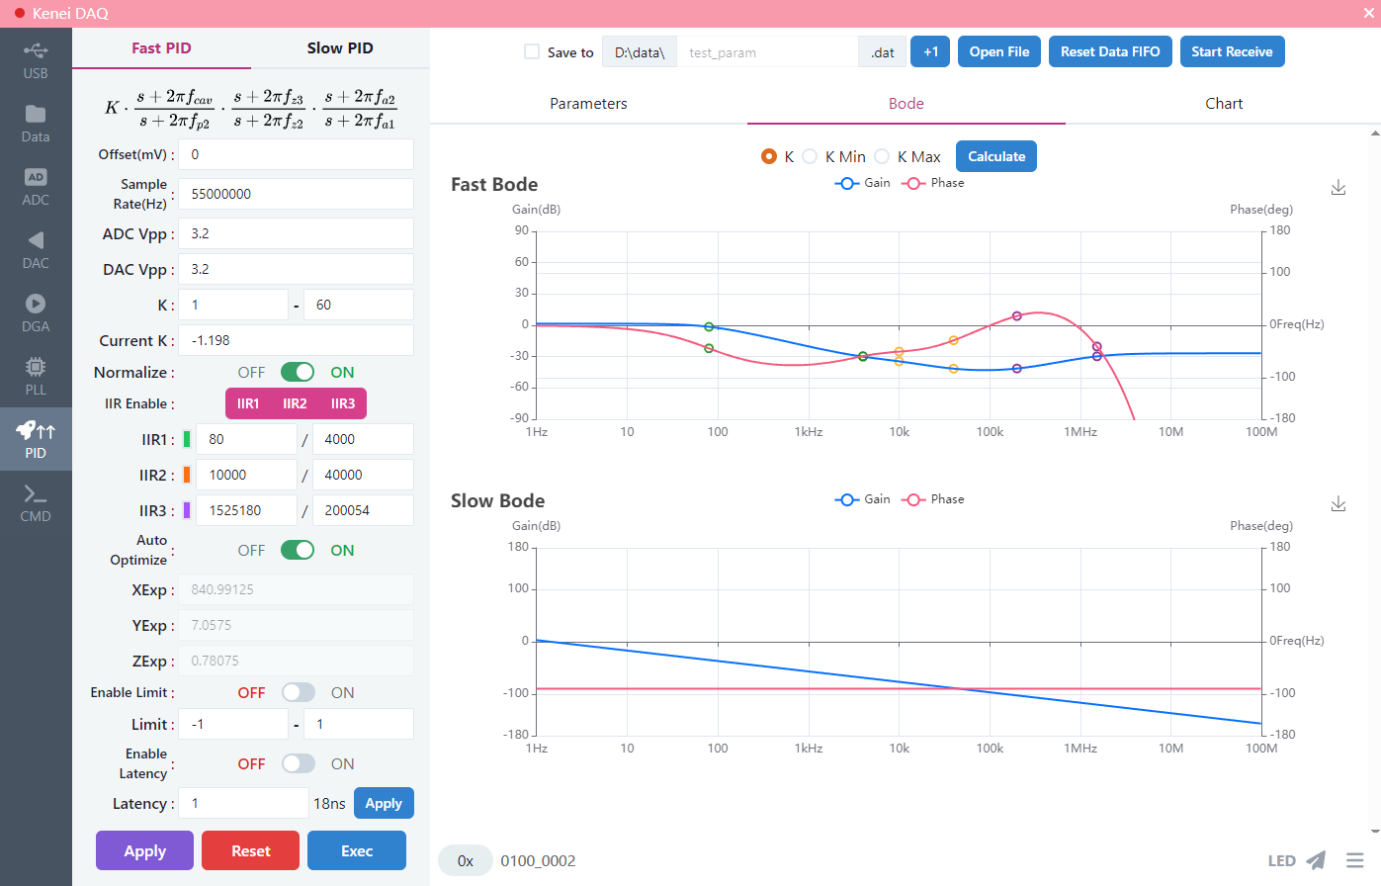
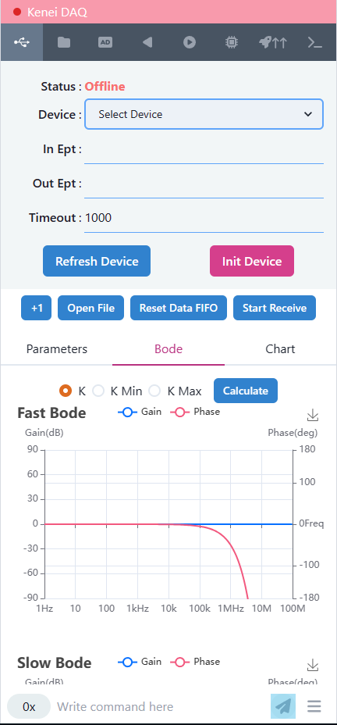
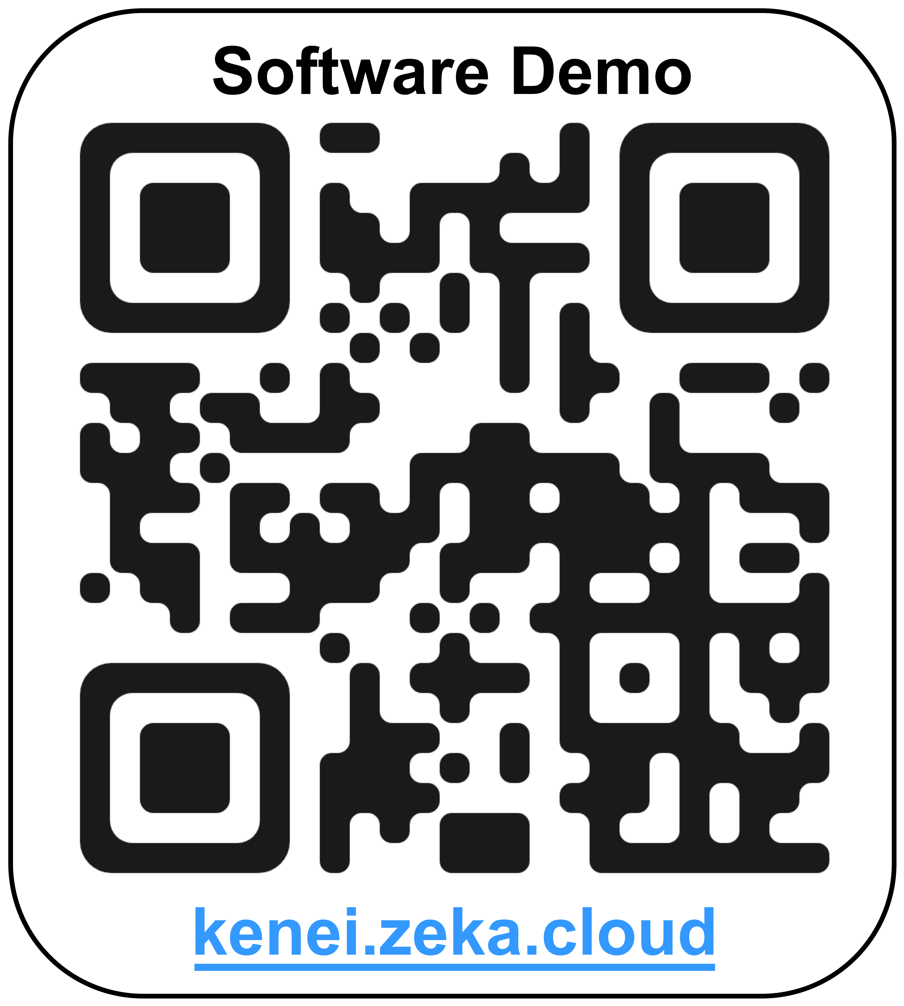
Our Software
React-based frontend - mobile and desktop friendly design
Rust-based USB3.0 high speed backend - high sample rate analysis
Python-based remote webserver backend - multi-platform remote monitor
Data transfer
PID param control
Out of lock notification
ID #125 A Full Digital Servo for Ultra-Stable Laser Frequency Stabilization
Zhengtao Liu, Yu Wang*, Wenchao Ji, Yi Hu, Xiao Jiang, Changqing Feng, Shubin Liu
State Key Laboratory of Particle Detection and Electronics, University of Science and Technology of China

