Slide 1


24th IEEE Real Time Conference
Design of the Front End Electronics for the Prototype of HERD Transition Radiation Detector
Jieyu zhu
on behalf of HERD-TRD Collaboration
25/04/2024
Quy Nhon, Vietnam

Slide 2
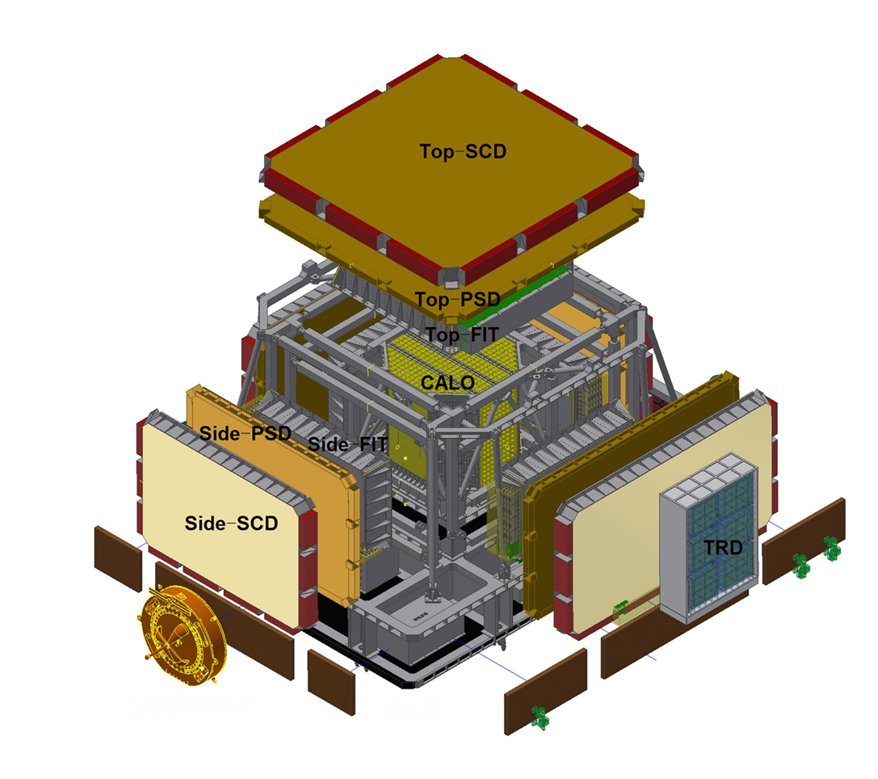
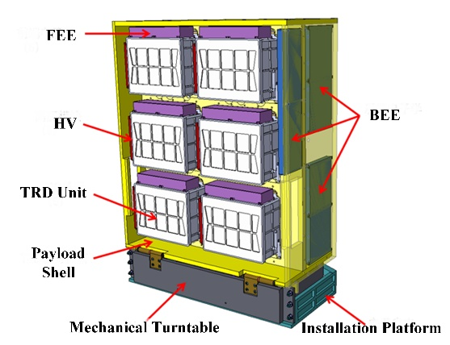
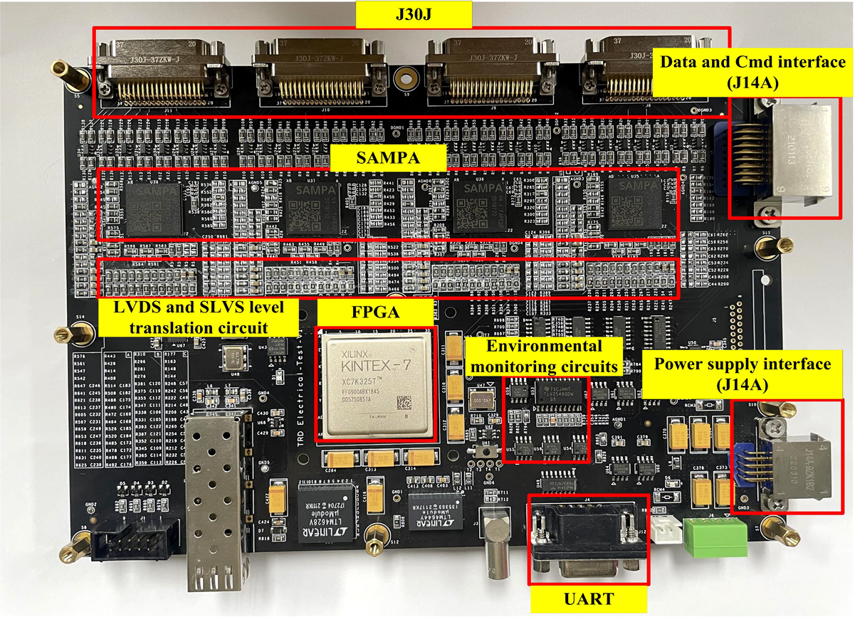
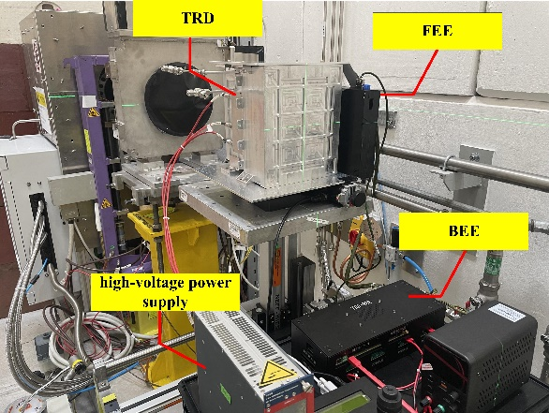
设计需求及难点
——The TRD detector system of HERD
Space astronomy and particle astrophysics experiments planned for installation on the Chinese Space Station in 2027
Challenges in electronics design:
high reliability requirements
Complex space environment
756 Multi-Channel Data Transmission
Selection of validated data
Low power consumption design
HERD
TRD
The sealed gas detector will first large-scale used in space exploration.
FEE
Scientific goals of TRD：
The calibration of the TeV energy range of the CALO.
The detection of high-energy gamma rays.
Beam test in CERN
Based on SAMPA ASIC, we designed the FEE for the prototype of the TRD.

