Slide 1
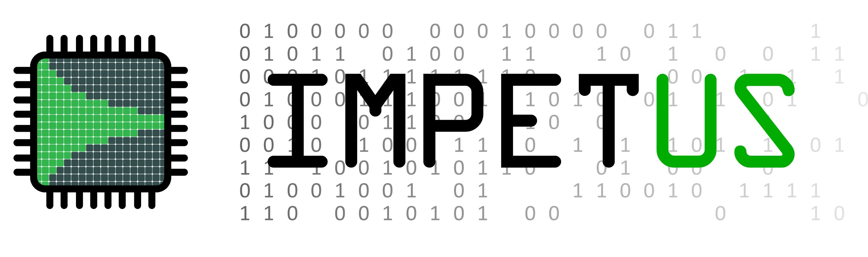

Machine Learning for
Sub-Microsecond
Edge Data Processing
24th IEEE Real Time Conference – Quy Nhon, Vietnam
Audrey Corbeil Therrien
Berthié Gouin-Ferland, Mohammad Mehdi Rahimifar, Quentin Wingering, Ryan Coffee

Slide 2




Sensor Challenges in Physics
Rate
Channel density
Infrastructure
Size
Storage
Therrien, Applied Optics 61 (8), 2022

Slide 3
Sensor Challenges in Physics
Disks
Detector
DAQ
(ASIC/FPGA)
Online analysis nodes
Disks
Detector
EdgeML
Online analysis nodes
Source
Therrien, Applied Optics 61 (8), 2022

Slide 4

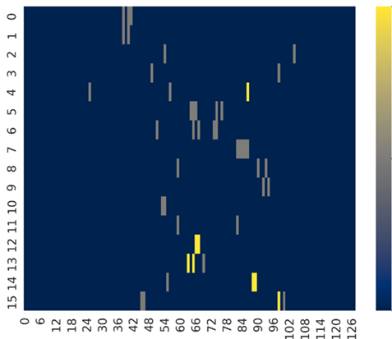


CookieBox
Channel
Photoelectron count
Ne
Energy Levels (0-127)
Event from the CookieBox
Li, Optics Express,26, 2018
Hartmann, Nature Photonics 12, 2018

Slide 5



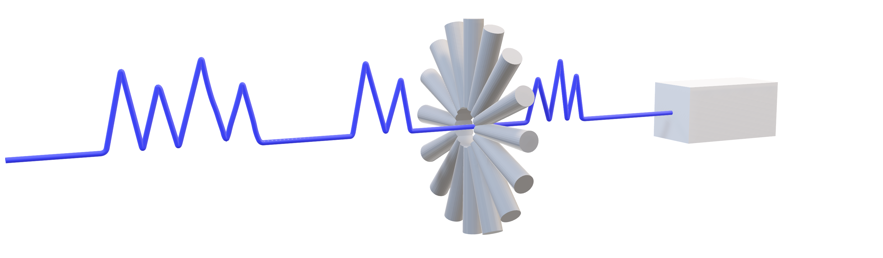
CookieBox
Linac Coherent Light Source II (LCLS-II)
1 MHz X-ray pulses
TB/s generated by experiments
experimental hutch
4 Sub-spikes
2 Sub-spikes
3 Sub-spikes
TB/s
The CookieBox
<TB/s
< 1µs analysis
Buffers

Slide 6
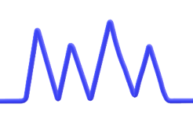


Required Analysis
Channel
Photoelectron count
Energy Levels (0-127)
Event from the CookieBox
time
Analog output from MCP
Energy spectrum per channel
Number of sub-spikes
<1 µs
Gouin-Ferland, Frontiers in Physics 10, 2022

Slide 7
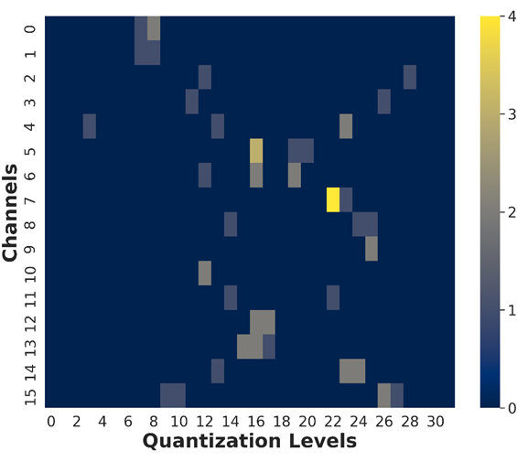
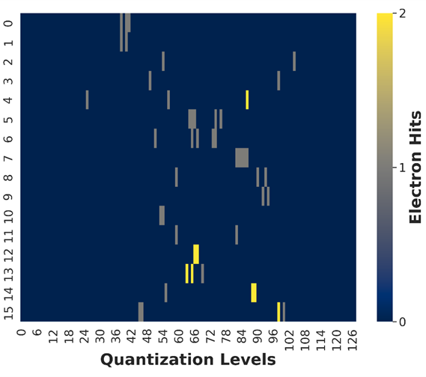
Input Processing for Neural Network
Minimizes the quantization error
Reduces image size
Raw
5 bits
7 bits
Uniform
Photoelectron count
Photoelectron count
Optimized
Energy (eV)
Reduce input bit depth
Reduce input image size
Reduce model size
Lower latency!
Gouin-Ferland, Frontiers in Physics 10, 2022

Slide 8
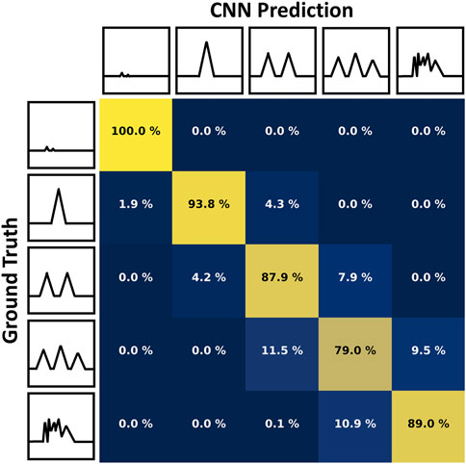
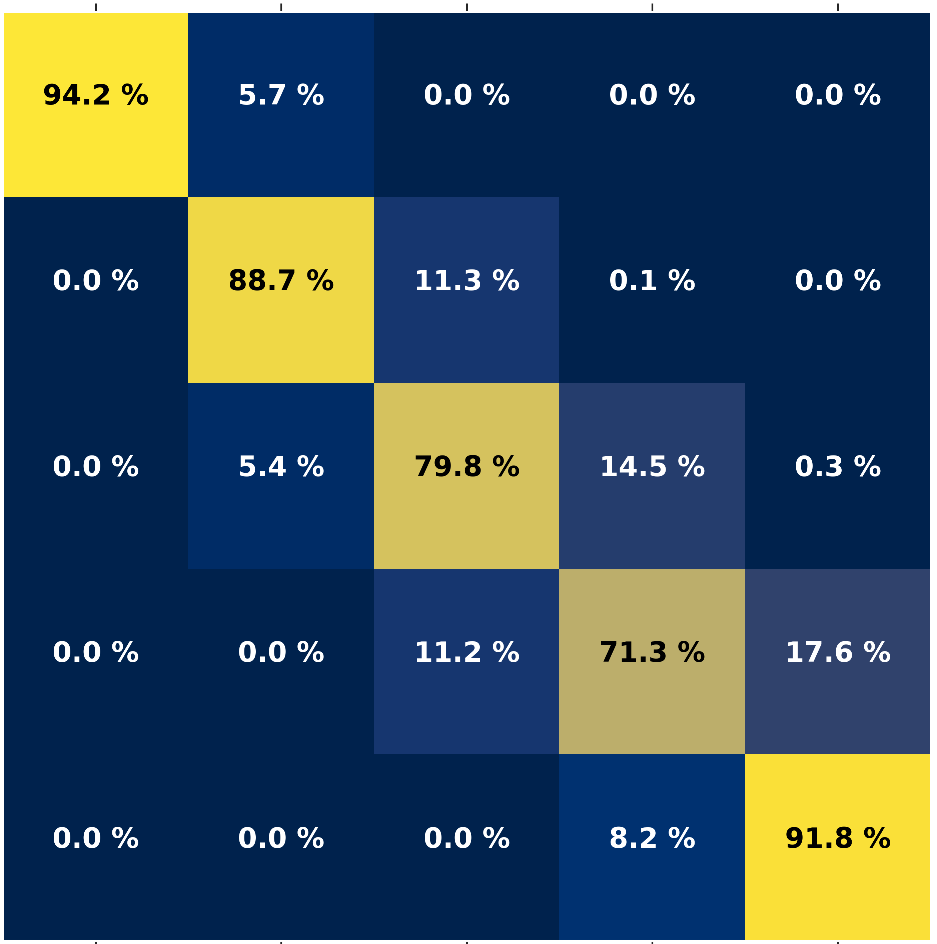
Neural Network
FCNN 5 bit Prediction
NN model | FCNN 5 bit | CNN 5 bit
Parameters | 3,433 | 3,665
Accuracy | 84% | 86%
Loss | SCC | SCC
Optimizer | Adam | Adam
Learning rate | 0.001 | 0.001
Batch size | 256 | 256
Input
32x16
4
RELU
32
RELU
32
RELU
5
Softmax
Output
1x5
Flatten
Rahimifar, Mach. Learn.: Sci. Technol., under review
Gouin-Ferland, Frontiers in Physics 10, 2022

Slide 9

FPGA Synthesis
Rahimifar, Mach. Learn.: Sci. Technol., under review
Data preprocessing
algorithms
Monitoring/
Communication
HLS
Modules
HDL optimization
Synthesis
Keras NN Model
HLS
Model
HLS4ML Configuration
Aarrestad, T. et al, 2021
DOI: 10.1088/2632-2153/ac0ea1

Slide 10
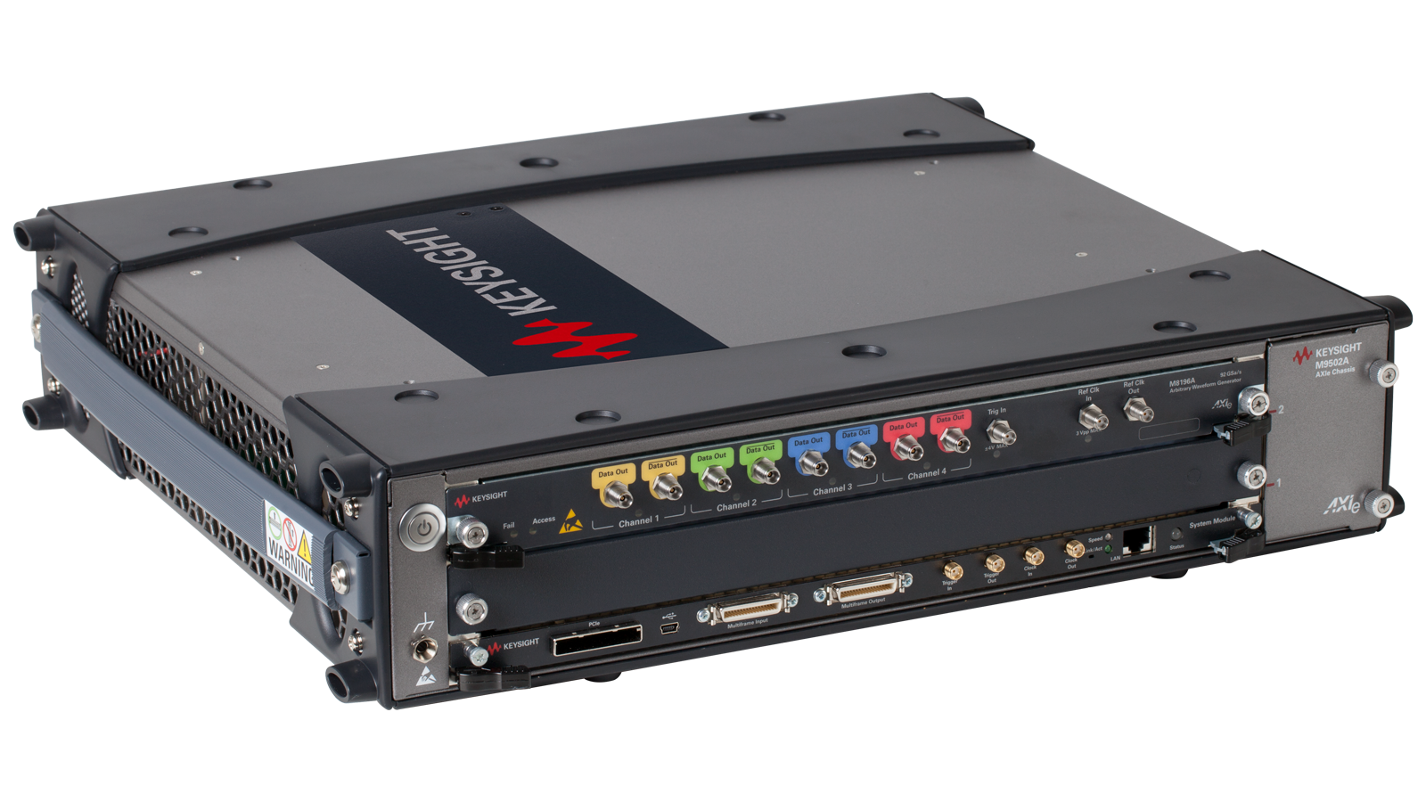
Validation experiment
x2
ADC
FPGA
ADC
ADC
FPGA
FPGA
ADC
ADC
FPGA
ADC
Inference engine
ADC
FPGA
The CookieBox
ADC
Data pre-processing
ADC
8b
6.4 GSps
FPGA
Wingering, NSS 2023
Data
processing
NN model
ADC08DJ3200EVM
Other channels
(Memory)
The AWG
Keysight M8195
VCU128

Slide 11
Validation experiment
Serial mode
Memory mode
Channel 1
Channels 1-16
NN
NN
Memory
Channels 2-16
1/16th throughput acquisition
Measure: Hardware impact on precision
Full speed acquisition
Measure: Latency
Wingering, NSS 2023

Slide 12
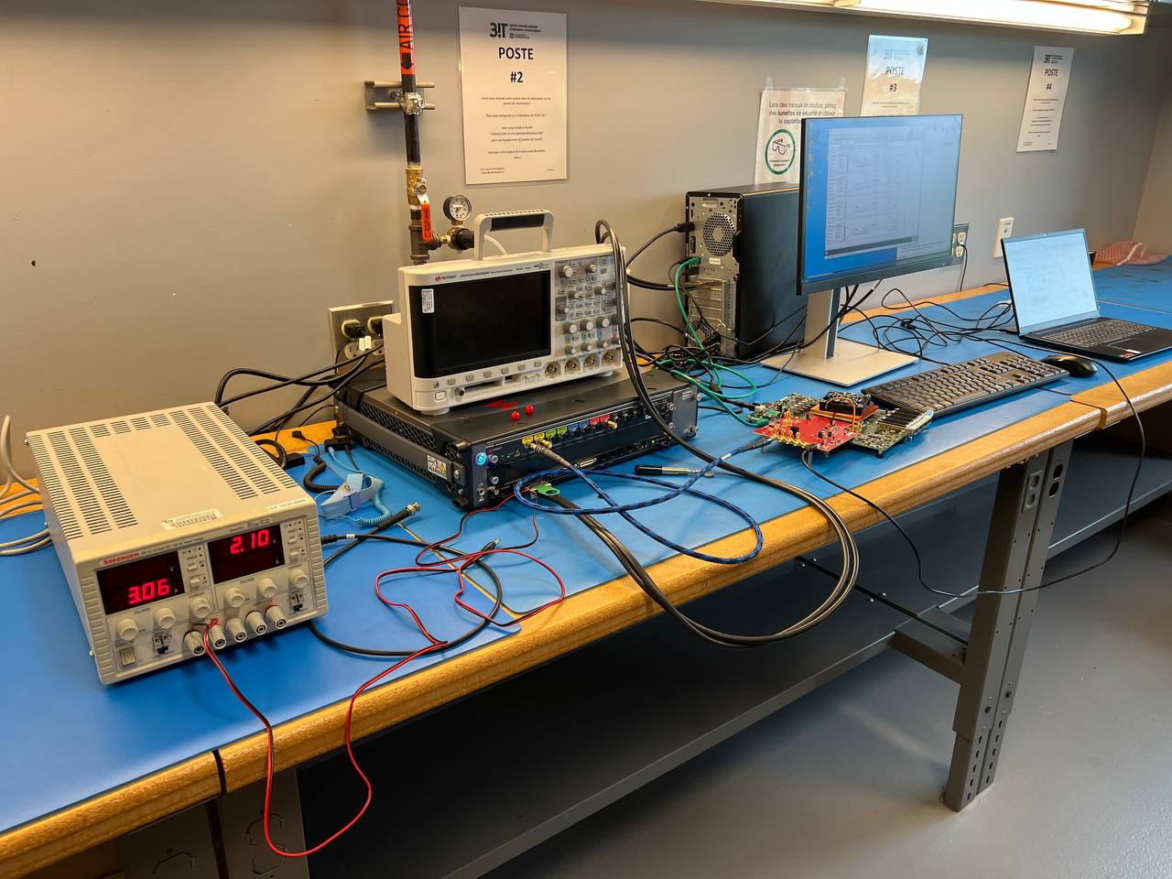
Validation experiment
Wingering, NSS 2023

Slide 13
Results : Footprint and Power
Peak finder
Histogram
ML model
✔
(200 MHz Clock) | Peak finder | Histogram
Latency (µs) | 0.05 | 0.1
DSP | 0 | 0
LUT | 1985 | 580
BRAM | 0 | 0
FF | 2252 | 760
FCNN | CNN
2.8 | 50
141 | 350
14k | 85k
4 | 76
7k | 31k
Total utilisation for initial implementation
VCU128
DSP | FF | LUT | BRAM | Power (W)
141 (2%) | 18k (0,7%) | 20k (1.6%) | 22 (1%) | 5.28
Rahimifar, Wingering, NSS 2023

Slide 14
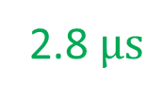
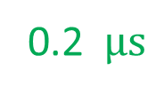
Reaults : Neural Network Optimisation
0.2 $µs$
2.8 $µs$
Rahimifar, Mach. Learn.: Sci. Technol., under review
Rahimifar, Wingering, NSS 2023

Slide 15
Results : Footprint and Power
Peak finder
Histogram
ML model
(200 MHz Clock) | Peak finder | Histogram | FCNN 5 bits Optimized
Latency (µs) | 0.05 | 0.1 | 0.2
DSP | 0 | 0 | 141
LUT | 1985 | 580 | 14k
BRAM | 0 | 0 | 2
FF | 2252 | 760 | 7.1k
Total utilization for optimized serial mode implementation
VCU128
DSP | FF | LUT | BRAM | Power (W)
141 (2%) | 18k (0.7%) | 20k (1.6%) | 22 (1%) | 5.28
Rahimifar, Mach. Learn.: Sci. Technol., under review
Rahimifar, Wingering, NSS 2023

Slide 16
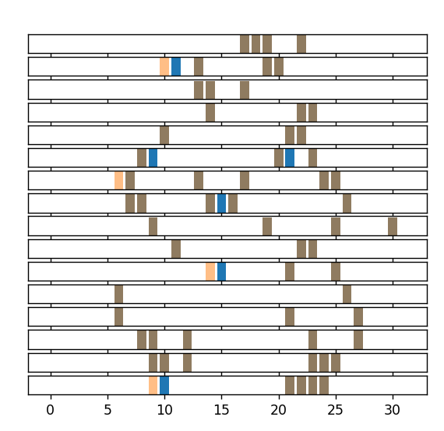
Results : Neural Network
Energy bins
Experimental setup
Serial mode
Neural Network Precision:
Expected on subset = 89 %
Measured on subset = 90 %
Both
Acquired from test bench
Ground truth
Rahimifar, Wingering, NSS 2023

Slide 17
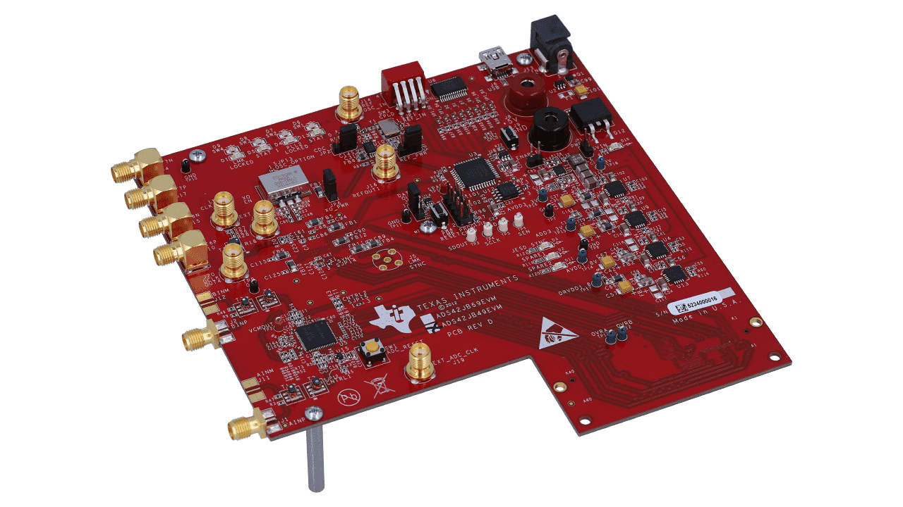
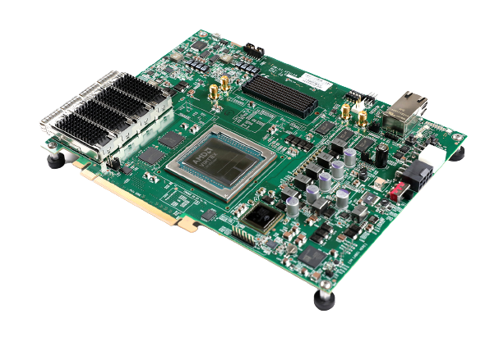
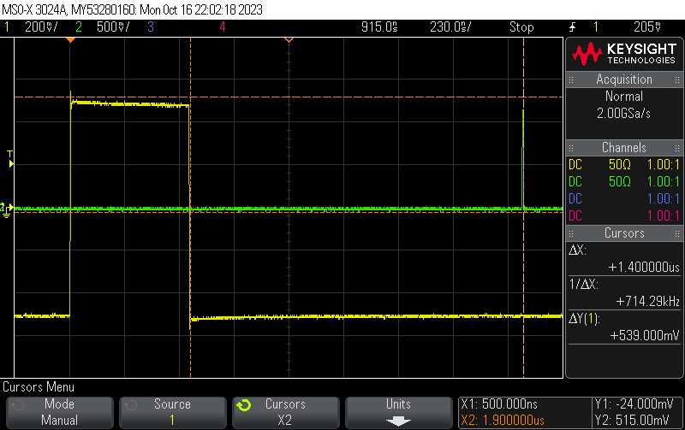

Results : Latency
AWG Markers
(calibration pulse)
ML block output (valid pin)
AWG to ML: 1.4 μs
Pulse width : 1 μs
1.4 µs
0.4 µs
latency
Rahimifar, Wingering, NSS 2023

Slide 18
Summary of results
 | Target | Result
Full single channel validation testbench | End-to-end emulation | End-to-end emulation (except FPGA-FPGA link)
Neural Network Accuracy | ≥ 80 % | 90 % *
FPGA Power | < 10 W | 5.28 W
Total Latency | < 1 µs | 0.4 µs
* On data subset, full validation with noise upcoming

Slide 19
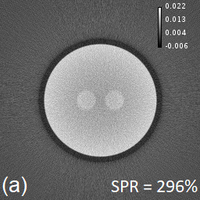
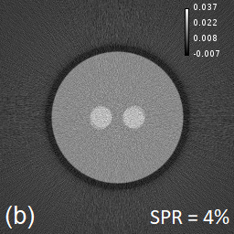
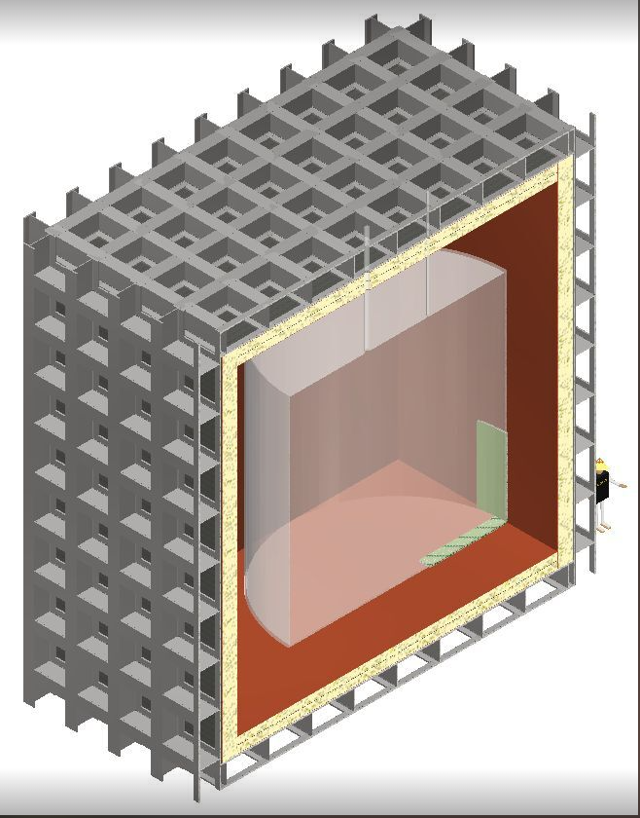

Other projects
Time-of-flight CT
Billion pixel camera
120 TB/s (14x14 po²)
~10 TB/s
Dark matter search
ARGO
Network intrusion
200 m²
>20 Mcps
100 Gbps

Slide 20





Conclusion
Very efficient Machine Learning modules can be integrated for low latency real-time analysis
To achieve high throughput:
Minimize neural network
Maximize pre-processing
Maximize data throughput
Pipeline and parallelize operations
Validate individual steps and system integration
Axe Imagerie Médicale

Slide 21
Backup slides

Slide 22
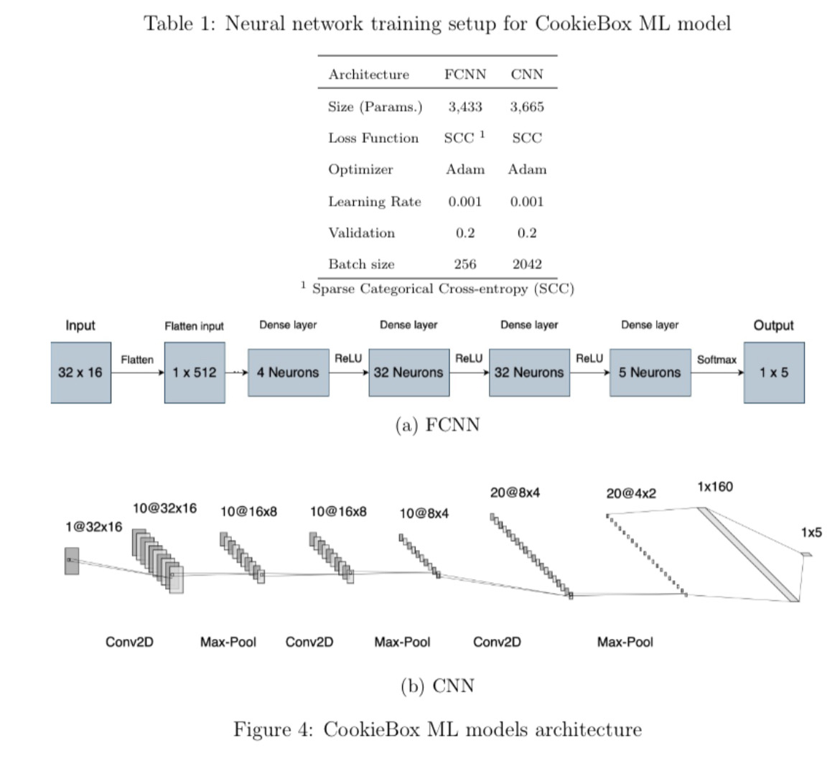
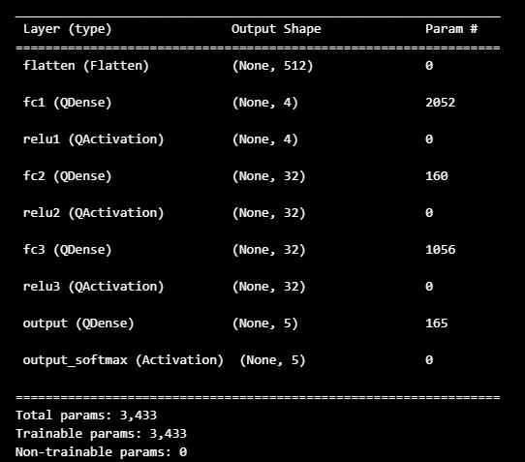

Slide 23
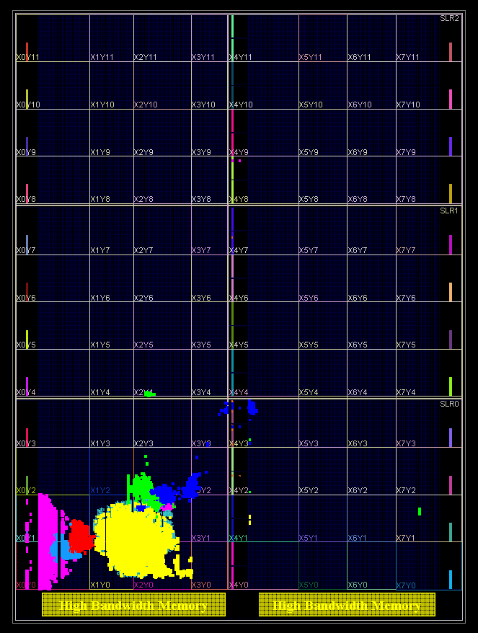
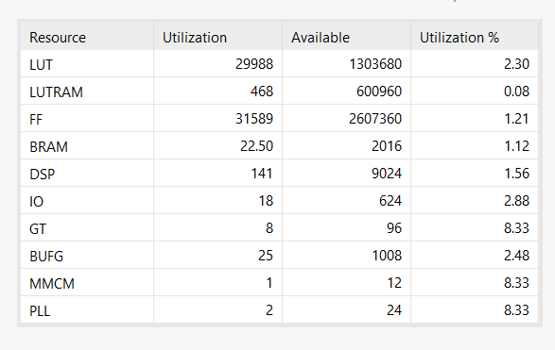
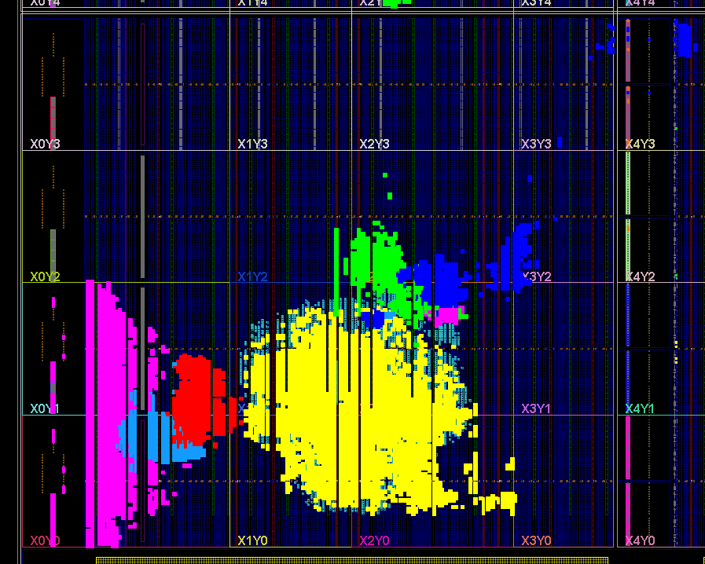
FPGA resources
Serial Mode (Xilinx VCU128)
JESD204B interface
Timestamper (calibration)
Pre-processing
ML block
Microblaze
Ethernet

Slide 24
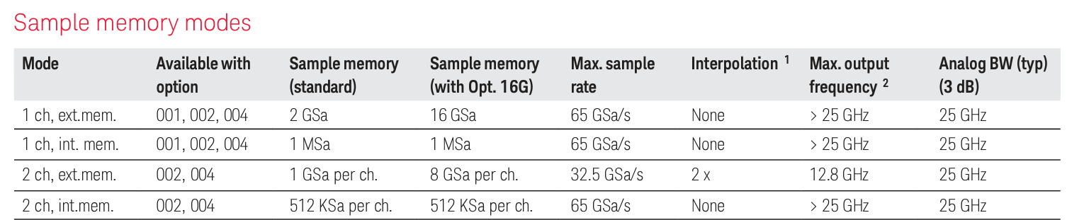
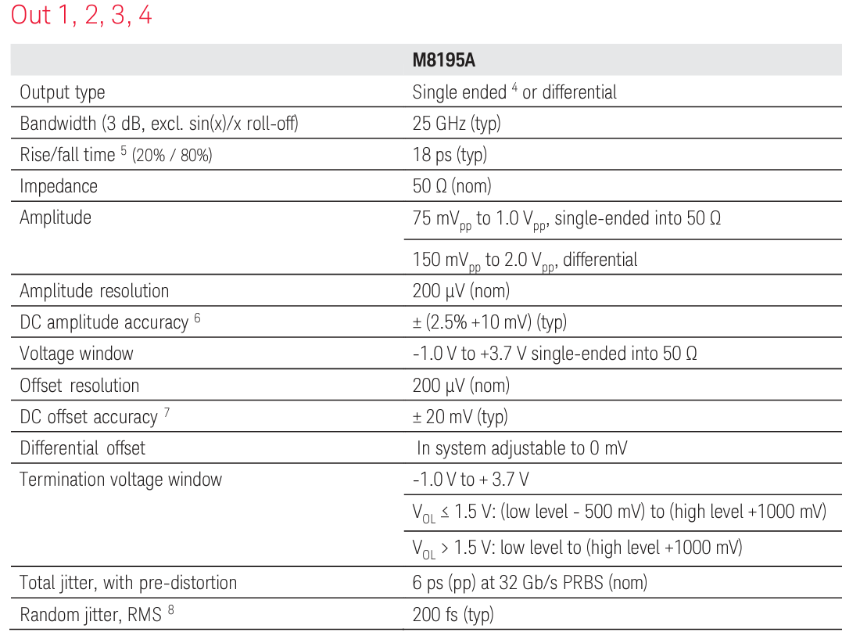
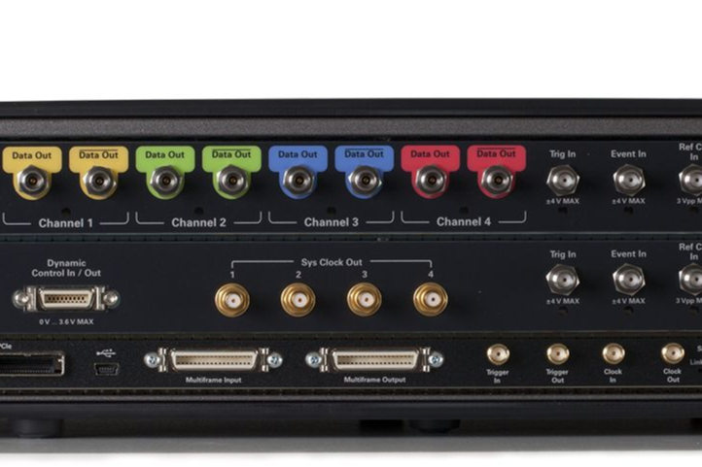
AWG

Slide 25
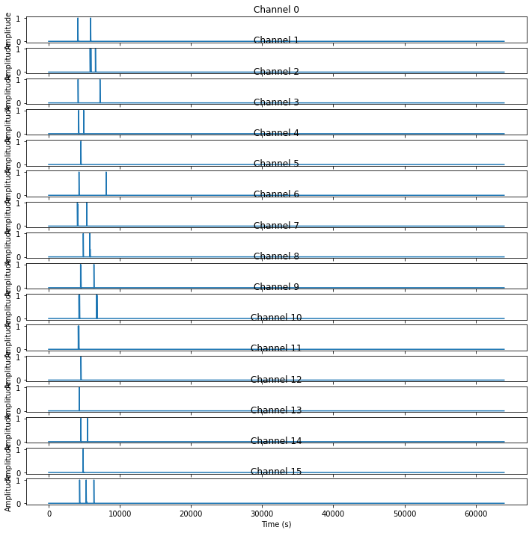
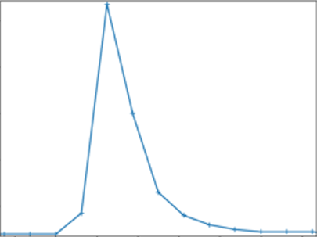
Analog signals

