Slide 1
An FPGA-Based Emulator and Test System for the 3D-SOI chip CPV-4
Chang Xu, Weida Zheng, Yunpeng Lu, Jia Zhou, Hongyu Zhang, Sheng Dong,
Yang Zhou, Jing Dong, Mingyi Dong, Qun Ouyang
Institute of High Energy Physics, Chinese Academy of Sciences
24th IEEE Real Time Conference – Quy Nhon, Vietnam, 22-26 April, 2024
Notes:
I am delighted to have the opportunity to present to you today. My presentation will focus on An FPGA-Based Emulator and Test System for the 3D-SOI chip CPV-4. Thank you for your attention
compact pixel for vertex 4

Slide 2
Outline
  Introduction
  CPV-4 design and 3D integration
  Design and Implementation of CPV-4 Upper tier Emulator
  2.1 Pixel Internal Circuit
  2.2 Readout Circuit
  2.3 Implementation on FPGA
  Testing and Verification System Design
  3.1 CPV-4 Interface Logic
  3.2 IPBUS Implementation
  3.3 DAQ Software Design
Joint debugging
  4.1 Pixel Configuration
  4.2 Electronic Pulse Tests
  Summary
1
24th IEEE Real Time Conference – Quy Nhon, Vietnam, 22-26 April, 2024
Notes:
Before we begin, let‘s take a look at the outline for today’s presentation. The outline will provide an overview of the key points we‘ll be covering, including background information、. This will help you follow along and understand the structure of our discussion."

Slide 3

  1 Introduction——CEPC proposal for particle physics
Circular Electron-Positron Collider (90, 160, 250 GeV)
  Higgs factory (10⁶ Higgs)
    Precision study of Higgs (m_{H}, J^{PC}, couplings), Similar & complementary to ILC
    Looking for hints of new physics
  Z & W factory (10¹⁰ Z⁰)
    Precision test of SM
    Rare decays
  Flavor factory: b, c and QCD studies
Vertex Detector
  High spatial resolution
  Low power consumption
  Low material
2
24th IEEE Real Time Conference – Quy Nhon, Vietnam, 22-26 April, 2024
Notes:
背景介绍：CEPC ,Vertex detector
The Chinese particle physics community has proposed the next-generation electron-positron collider project - the Circular Electron Positron Collider (CEPC).
CEPC will be used to produce the Higgs boson, to produce a large number of Z and W bosons, to study the physics of baryons (b, c, t) and hadron dynamics (QCD).
The construction of the CEPC will involve the use of multiple detectors, each of which must meet high-performance requirements. Among these detectors, the Vertex Detector, positioned as the innermost layer, plays a crucial role in accurately identifying and labeling different types of particles. The Vertex Detector must meet strict requirements for high spatial resolution, particle rate capability, and minimal material usage.

Slide 4
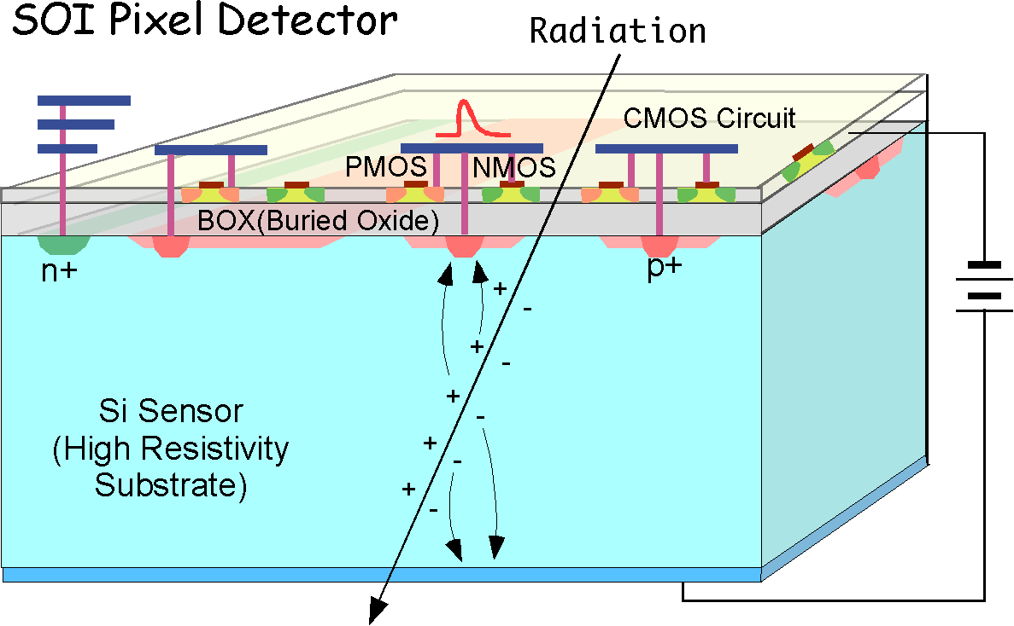
  1 Introduction——Development of SOI Pixel Sensor
Sandwich structure
  Top: Independent signal processing circuit with pixels as the unit (Device Layer), inherits the advantages of SOI integrated circuits
  Middle: SiO₂ insulation layer (metal via array for one-to-one electrical connection)
  Bottom: Sensor diode array with pixels as the unit
200 nm FD-SOI CMOS process（ Device Layer）
  Low leakage low power applications
  1 Poly 5 Metal layers
  MIM Capacitor (1.5 fF/um²), DMOS
  Core voltage = 1.8 V, IO voltage = 1.8/3.3 V
  PDK (Process Design Kit) customized for charged particle and X-ray detection
Flip-chip: Increase integration by using flip-chip technology (3D-SOI)
3
24th IEEE Real Time Conference – Quy Nhon, Vietnam, 22-26 April, 2024
Notes:
In order to meet these performance requirements, we have utilized 3D-SOI technology to design a chip that can be used for the Vertex detector.
During the design process of the CPV-4 chip, SOI technology is utilized, employing a design similar to a sandwich structure, where the circuit layer on the silicon chip is isolated by an insulating layer (SiO2). This design helps to reduce the interaction between the circuit layer and the substrate, thereby enhancing the performance and stability of the integrated circuit.
The 200-nanometer FD-SOI CMOS process is used at the device layer, and a design process kit (PDK) specifically made for charged particle and X-ray detection is employed to achieve high precision and low power consumption.
Additionally, the Flip-chip technology is also employed on the CPV-4 chip to further enhance the integration density of the chip.
在CPV-4芯片的设计过程中，采用了SOI技术，使用类似三明治结构的设计，其中硅片上的电路层被绝缘层（SiO2）隔离。这种设计有助于减少晶体层和衬底之间的相互作用，从而提高集成电路的性能和稳定性。

Slide 5
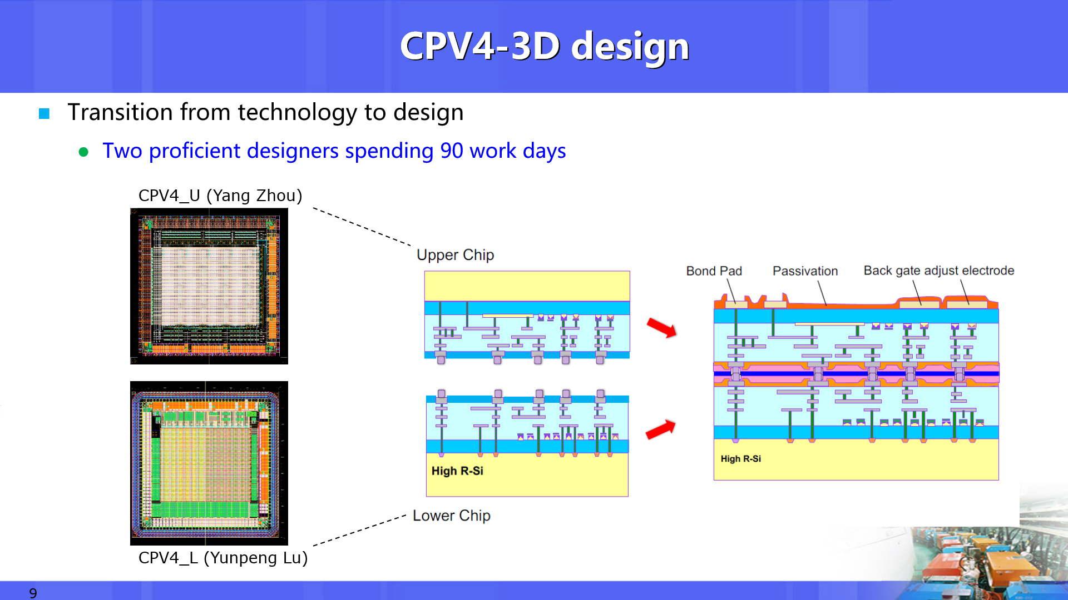
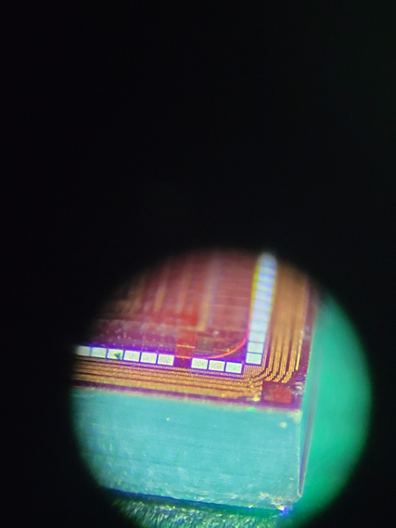
  1 Introduction——3D architecture of CPV(compact pixel for vertex)-4
3D Vertical Integration
    Reduce pixel size to achieve high spatial resolution
    Increase integration for a superior readout scheme (time stamp + low power consumption)
    Provide superior detection performance
CPV-4 is the first trial of 3D design
    Upper Chip：Pixel logic and matrix readout logic
    Lower Chip：PDD sensing diode + amplifier/comparator
    Using gold micro bumps to achieve pixel-level array connections
    Very complex design flow
    3D-compatible DRC(Design Rule Check) and LVS rules
Schematic, Layout
3D VIA Gen.
Schematic, Layout
General DRC, LVS
3D_LVS
（Virtual connect）
General DRC, LVS
Stacking
3D
DRC/LVS rules
Stacking
Dummy bump Gen.
3D_DRC & 3D_LVS2
(Direct connection)
3D-SOI design flow
Upper chip design
Delivery of separate chips 3D processing Delivery of 3D chips
        CPV-4：
          Pixel size: 21.04 μm * 17.24 μm
          Spatial Resolution< 3 μm
          Power Consumption<50 mW/cm²
          Time Resolution< 1 μs
Lower chip design
4
24th IEEE Real Time Conference – Quy Nhon, Vietnam, 22-26 April, 2024
Notes:
上层：flip chip
下层：标准SOI sensor
① 点对点连接
② 减薄和bond pad
The advanced Flip-Chip technology has been adopted in the design of the CPV-4 chip, successfully achieving complex 3D Vertical Integration. This approach allows for reducing pixel size to achieve higher spatial resolution, increasing integration density for improved readout schemes (timestamp + low power consumption), and providing outstanding detection performance. By employing 3D integration technology, the following parameter goals have been achieved, meeting the chip requirements for the CEPC.
In this design, the upper layer chip is responsible for pixel logic and matrix readout logic, while the lower layer chip contains PDD sensing diodes and amplifiers/comparators. To achieve pixel-level array connections, gold micro-bumps are utilized.
The entire design process of the chip is also very complex, requiring separate design.The design should be compatible with 3D DRC (Design Rule Check) and LVS(verification) rules.

Slide 6
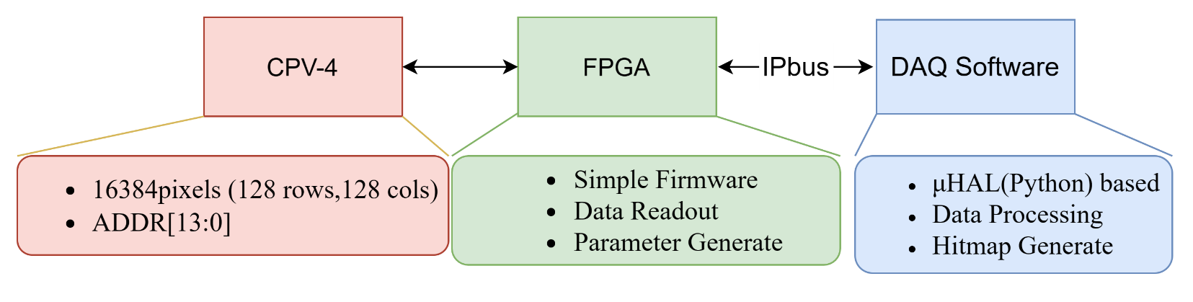
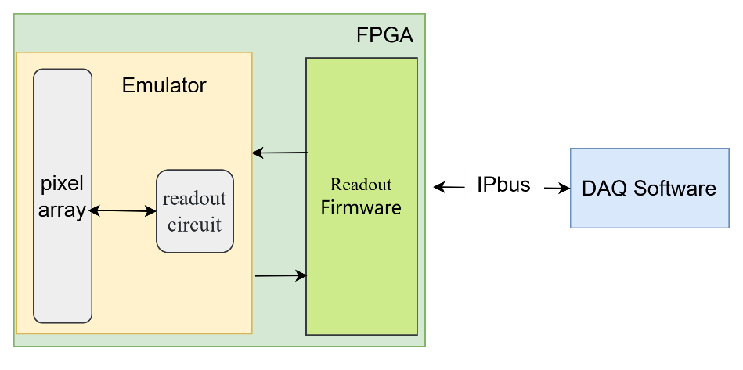
  1 Introduction——The validation of design and process
Challenges
  First trial of 3D design, high technical difficulty
  First time using 3D integration process, low yield
Requirements for the testing and verification system
  Basic function requirements: Chip configuration, data readout
  Tests can be carried out on upper chips, lower chips and 3D chips separately
  Convenient debugging
  Short development cycle
CPV-4 upper tier chip Emulator
  Debugging and verifying the functionality of the test system
  Verifying the logical correctness of the CPV-4 upper chip
CPV-4 Test Verification System Architecture
CPV-4 replaced by Emulator
5
24th IEEE Real Time Conference – Quy Nhon, Vietnam, 22-26 April, 2024
Notes:
the design and production process of CPV-4 has encountered numerous issues and challenges.
Due to the fact that CPV-4 represents the first attempt at 3D design and the initial application of 3D technology in production (it can be said to be the first application of 3D technology in the field of high-energy physics),
Therefore, we developed a test verification system specifically for the CPV-4 chip to test and validate the chip's functionality. It is capable of chip configuration and data reading, and can also perform separate tests on digital chips, and 3D chips. The testing system is easy to debug and has a relatively short development cycle.
Because the chip design process is complex and yield is not high, during the development of the testing and verification system, we also completed the implementation of the CPV-4 upper chip emulator.
It can replace the chip to respond to the test and verification system.
And it can also be used to validate whether the logic of the upper-tier chip is correct.
challeges,comlexity测试验证系统功能复杂性

Slide 7
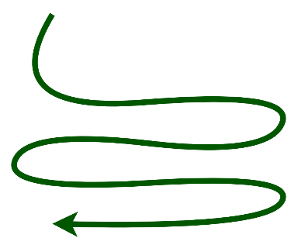
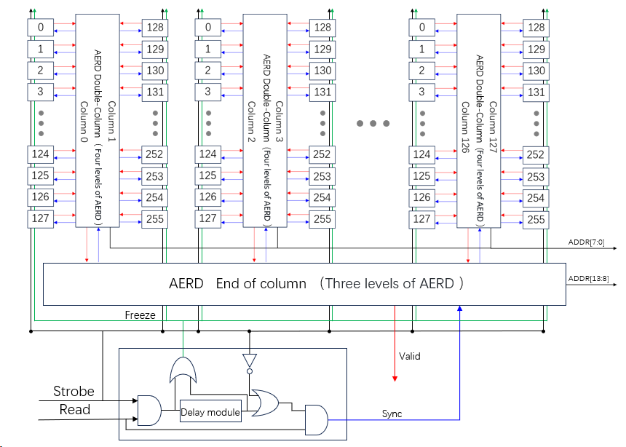
2 Design and Implementation of Emulator
128
Architecture of the CPV-4 upper chip
  Pixel array circuit:
    128(row)×128(col)
    Receive and store hit signals
  Readout circuit:
    Arranged in double columns
    Read out the hit pixel addresses in order of priority（AERD（Asynchronized Encoder Reset Decoder））
Priority
Hit
128
Priority
Upper chip circuit
6
24th IEEE Real Time Conference – Quy Nhon, Vietnam, 22-26 April, 2024
Notes:
Next, a brief explanation of the design and implementation of Emulator.
All functions of the upper chip have been implemented on the emulator.
The circuit logic on the CPV-4 upper-tier chip is mainly divided into two parts: the pixel array circuit and the readout circuit logic.
The pixel array on the chip consists of 128 rows and 128 columns.
The chip's readout circuit is mainly composed of AERD readout modules and they are arranged in a double-column configuration.
It can read out the hit pixel addresses in order of priority.
***加上优先级
像素排列，双列，128……
像素阵列中输入……，输出……
包含数字芯片中全部的像素逻辑和像素读出功能

Slide 8
  2 Design and Implementation of Emulator——Pixel Internal Logic
Hit response：
  Working mode: Continuous mode, Trigger mode
  Input: Dout, Pulse_d
  Pixel state output: State_out
  Sync: Reset the pixel state
  Respond and store hit information
Register control
  Latch_M
  Latch_P
Pixel Internal Circuit
Cnfg_data
D Q
G Q_x
Latch_M
Rowsel_M
Mask_en_x
Colsel
D Q
G
Latch_P
Rowsel_P
Pulse_d
DFF
Latch_2
State_out
Hit
D Q
G
D Q
C
CLR
Latch_1
Analog Front-end Signal
CLK
Dout
D Q
G CLR
Freeze
Strobe
GRST
Sync
7
24th IEEE Real Time Conference – Quy Nhon, Vietnam, 22-26 April, 2024
Notes:
This is the circuit logic of the pixel module in the digital chip.
Each pixel module in the chip can respond to the hit information(Dout and Pulse_d)，Dout is from lower chip, Pulse_d is from upper chip. The Strobe signal is used to select the operation mode of the pixel module. The continuous mode, and the trigger mode.
The signal State_out indicates whether the pixel has been hit and is passed to the Readout Circuit.
If a pixel is hit, the readout circuit will return a sync signal to reset the pixel state.
And these signals here are used to control the value of these registers, so that the pixel can be placed into different working state: masked state and particle response state.
The GRST signal resets the entire pixel array.
The Freeze signal is used to protect the readout process in trigger mode.

Slide 9
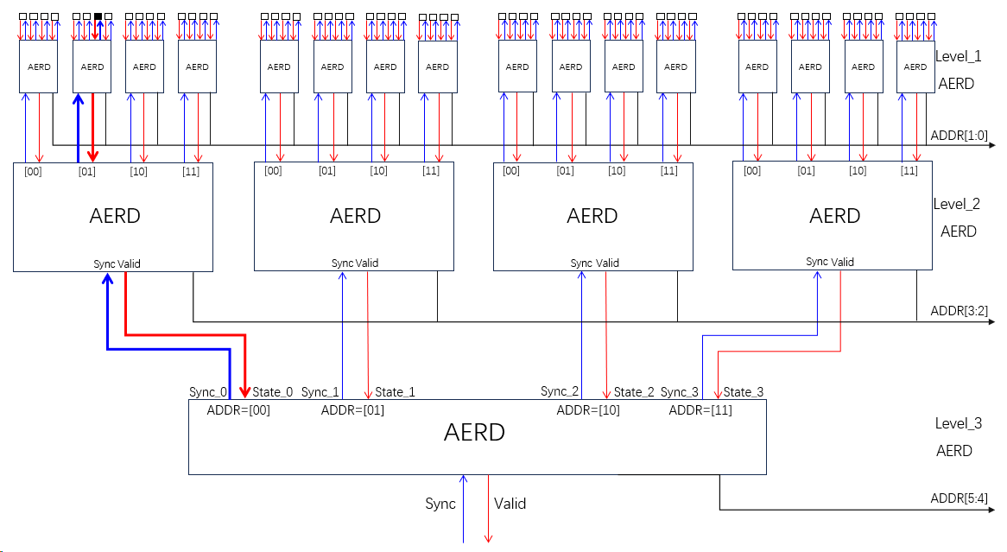
  2 Design and Implementation of Emulator——Readout circuit
Priority of pixel hit
Pixel hit
Upper chip circuit
AERD（Asynchronized Encoder Reset Decoder）
  Four inputs, read out the encoded address, receive sync reset signal
Readout Circuit in CPV-4 upper-tier chip:
  Readout method: Multi-level AERD readout, according to priority, sequentially read out the hit pixels and reset the state of the readout pixels
  Readout structure: 4-level AERD inside the array, 3-level AERD outside the array
  Readout result: Encoded address signal Addr[13:0], valid hit signal
Tree-like cascade method of AERD circuits
8
24th IEEE Real Time Conference – Quy Nhon, Vietnam, 22-26 April, 2024
Notes:
The chip's readout circuit is mainly composed of AERD readout modules.
Each AERD readout module used in the chip has four inputs. The AERD readout module encodes the inputs and outputs the encoded address to address bus by priority when a pixel is hit.
During the readout process, once receiving a sync signal, the higher-level AERD module provides a two-bit address and generate the corresponding Sync signal to reset the lower-level AERD.
In the CPV-4 upper chip, there are four levels of AERD in the pixel array and three levels of AERD outside the pixel array, generating a total of 14-bit addresse signal, and producing valid hit signals, which are then transmitted to the readout firmware on the FPGA.

Slide 10
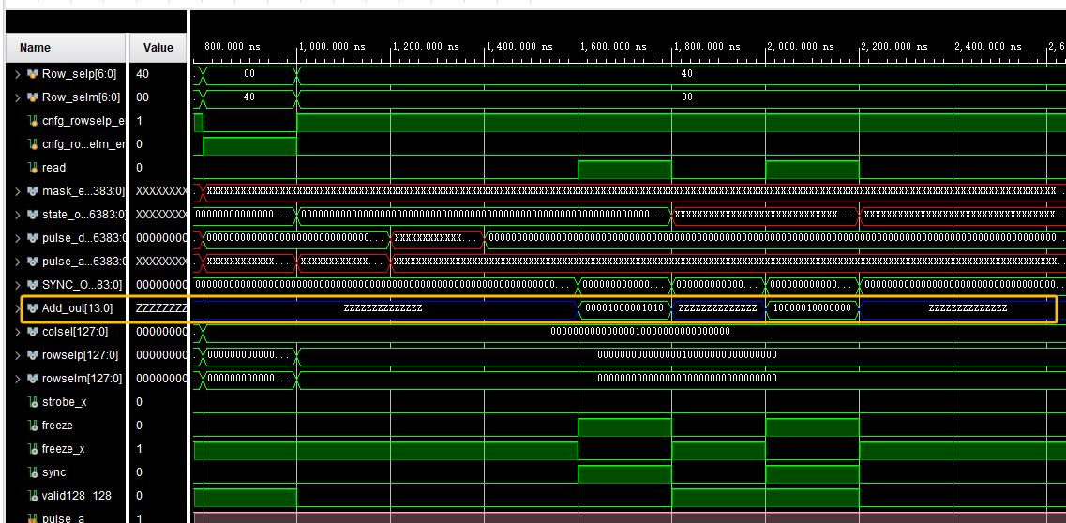
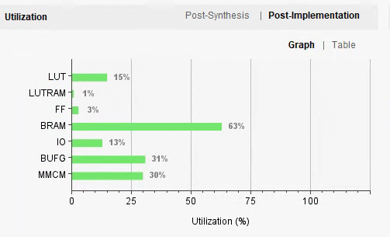
  2 Design and Implementation of Emulator——Implementation on FPGA
            Complete the implementation of the emulator on the FPGA board
            The readout module will also be implemented on the same FPGA board
            Pixel array size: 128(rows)×32(cols)
    Implementation method: Verilog
    FPGA model: XC7K325T
    Readout data: Addr[13:0], valid hit bit
CPV-4 replaced by Emulator
Resource utilization of the emulator and readout firmware
Behavioral Simulation Result of CPV-4 Upper Tier Emulator
Ideal implementation of upper-tier chip circuit
9
24th IEEE Real Time Conference – Quy Nhon, Vietnam, 22-26 April, 2024
Notes:
总结：数字芯片电路逻辑的理想化实现
仿真结果对比
Upper Tier提供了整个3D芯片与外部的逻辑接口
We have implemented all the circuit logic of the CPV-4 upper tier, including the pixel array and readout logic, on the FPGA development board using Verilog language. We have completed the development of a 128×128 scale emulator and conducted behavioral simulation tests. However, due to resource limitations in the FPGA, we are currently able to implement a scale of 128 rows by 32 columns,
It can generate a 14-bit address and a valid hit signal.
The emulator's interface is fully compatible with that of the CPV-4 upper tier, and it can replace the CPV-4 chip to interface with the readout firmware.

Slide 11
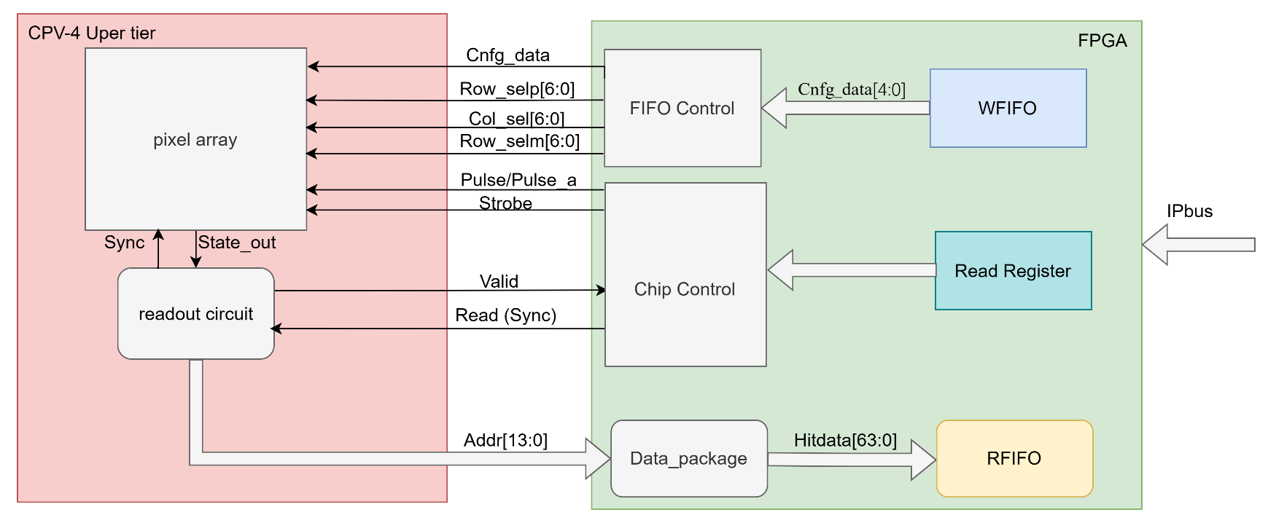
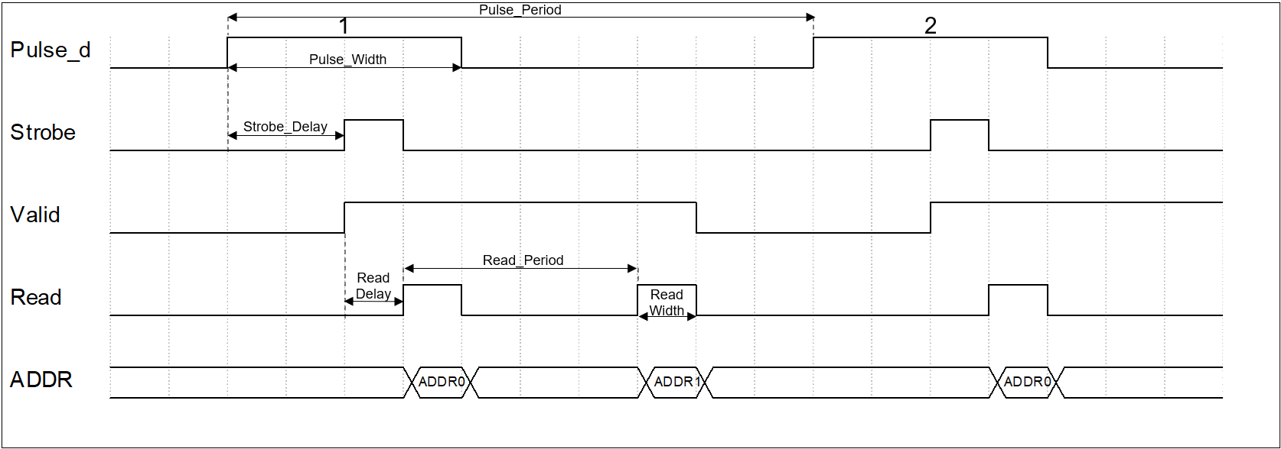
  3 Test system design——CPV-4 Interface Logic
Upper-tier Chip provides the complete logic interface between the 3D chip and the readout firmware.
  Operation mode selection (Strobe)
  Pixel state configuration (Col_sel, Row_selp,Rpw_selm, Cnfg_data)
  Data readout (Read(Sync))
  Pulse testing (Pulse/Pulse_a)
The emulator can be fully compatible with the chip interface logic.
Can respond to various parameters provided by the readout firmware
Every pixel can be selected for state configuration
Simulate different experimental environments to obtain different results
Adjustable parameters
10
24th IEEE Real Time Conference – Quy Nhon, Vietnam, 22-26 April, 2024
Notes:
The upper tier chip provides a complete logical interface between the 3D chip and the readout firmware. This upper tier chip offers a comprehensive logical interface for operation mode selection, register configuration, data readout and pulse testing.
By using these interface logic ,the chip can respond to various parameters provided by the readout firmware
Every pixel in the chip can be selected for state configuration
As a result we can simulate different experimental environments to obtain different results
And the emulator can be fully compatible with the chip interface logic.

Slide 12
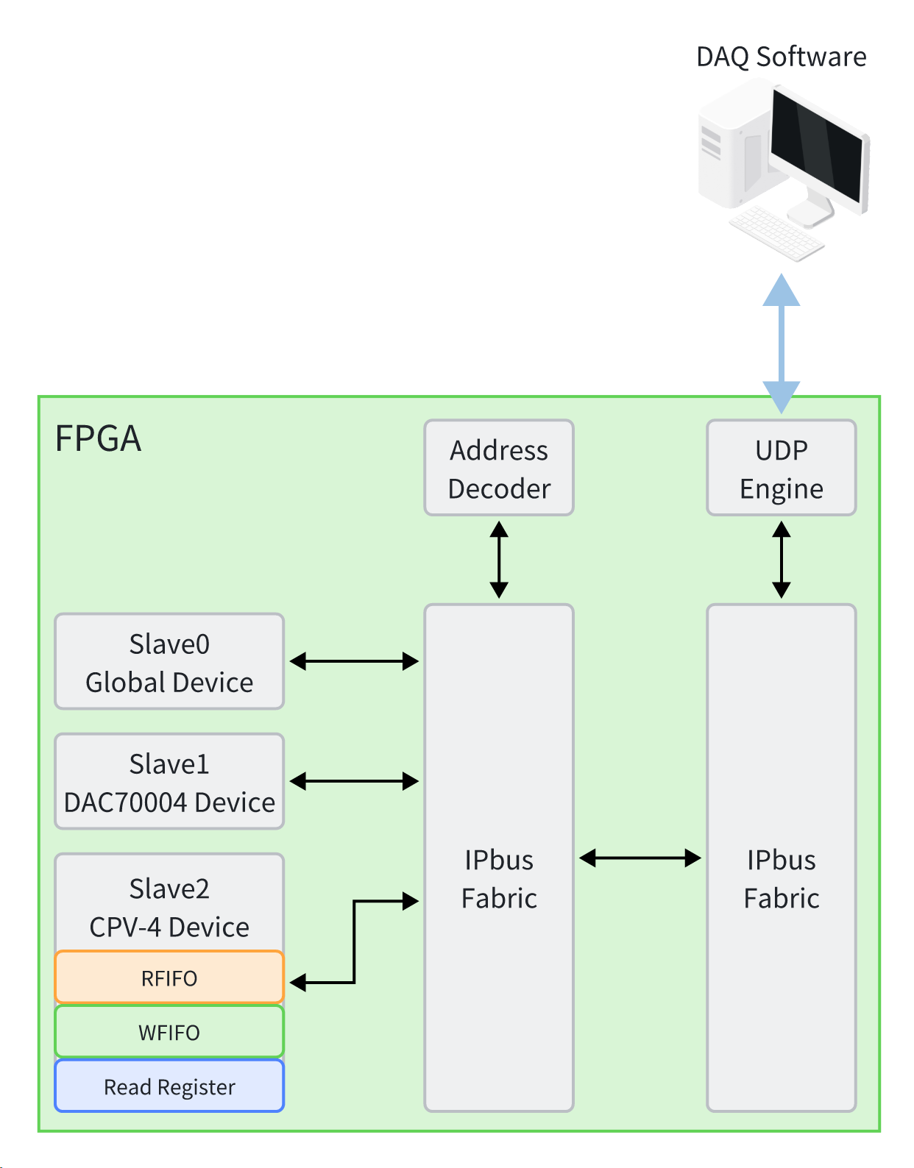
  3 Test system design——IPBUS Implementation
Using the IPbus protocol as the data transfer protocol
    A simple, reliable, IP-based protocol for controlling hardware devices.
    The data transfer capability is sufficient to meet the needs of small-scale detector test systems. (1Gbps)
Three slave devices are developed according to controlling needs:
    Slave 0: Used for system reset logic
    Slave 1: Control the DAC70004(on the chip board)
    Slave 2:
    Sets the working mode and parameters of the CPV-4
    Writes the configuration of each pixel (WFIFO)
    Stores the hit pixel address information(RFIFO)
The IPbus slaves in Firmware
11
24th IEEE Real Time Conference – Quy Nhon, Vietnam, 22-26 April, 2024
Notes:
The IPbus protocol is utilized as the data transmission protocol in the chip testing and validation system. It is a simple and reliable IP-based protocol used for controlling hardware devices.
This protocol features jumbo frames, this enables the IPbus protocol to meet the data transmission rate requirements of small-scale detector testing systems (1Gbps).
To fulfill the various functional requirements of the chip testing and validation system, three slave devices have been developed:
Slave 0: Used for system reset logic.
Slave 1: Controls the DAC.
Slave 2: Sets the operating mode and parameters of CPV-4, writes the configuration for each pixel (WFIFO), stores hit pixel address information in RFIFO, and awaits data collection software to read.

Slide 13
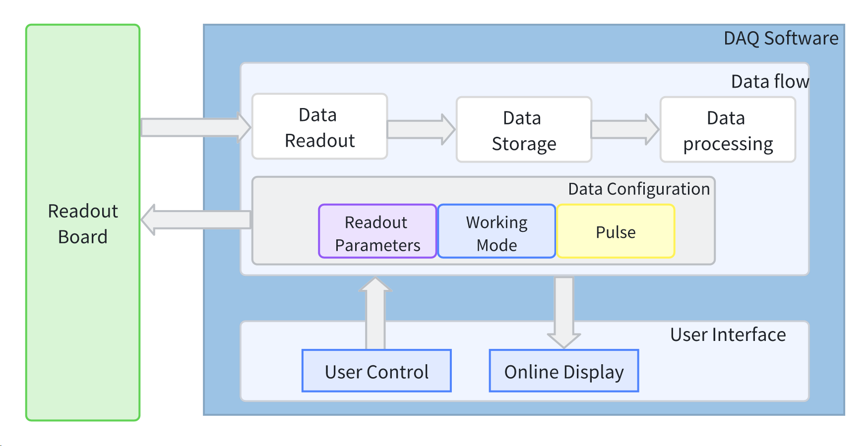
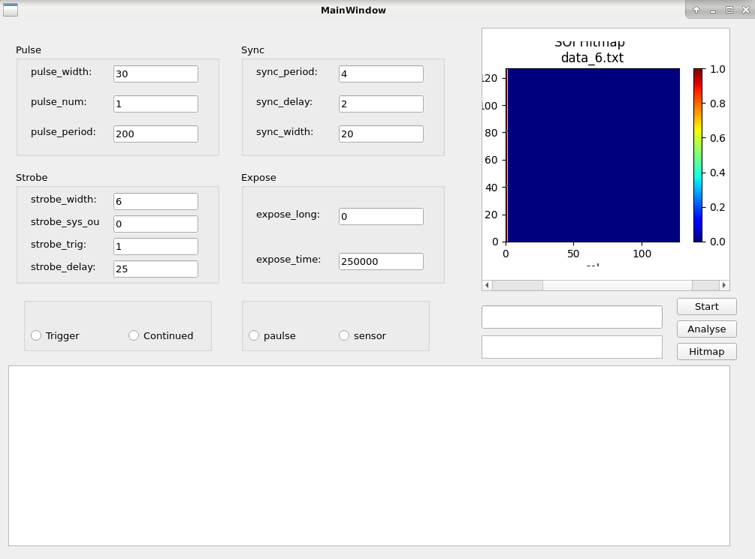
  3 Test system design——DAQ Software
Sensor Parameter Configuration Area
Operating status display
Hitmap display
Architecture of DAQ Software
Developed with Python API
Data flow system
    Data readout: Periodic query and read data from RFIFO.
    Data storage: Save raw data in hexadecimal format to a file.
    Data processing: Decode the data to get addresses, timestamp.
    Configuration: Chip operating modes(FPGA), readout parameters(FPGA), pixel states(CPV-4)
User Interface
    command execution
    Information interaction:
    configuration information
    hitmap display
    operation status display
Implement all the functions required during the chip testing process
12
24th IEEE Real Time Conference – Quy Nhon, Vietnam, 22-26 April, 2024
Notes:
数据流框起来，图改成不是3D的
The DAQ software is mainly divided into two parts: data flow and user interaction.
The data flow system includes functions for data readout, storage, processing, and configuration. In the configuration function, where we can generate any configuration of pixel arrays based on the configuration file for debugging and testing.
The user interface includes command execution and information interaction functions. Users can execute commands and interact with configuration information. Additionally, we also provide hit map display and operation status demonstration.
We have Implement all the functions required during the chip testing process in the DAQ software.

Slide 14
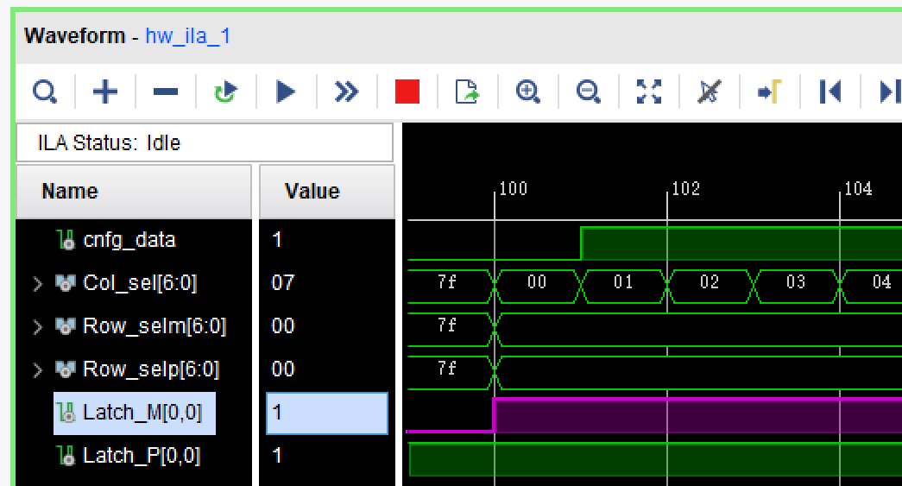
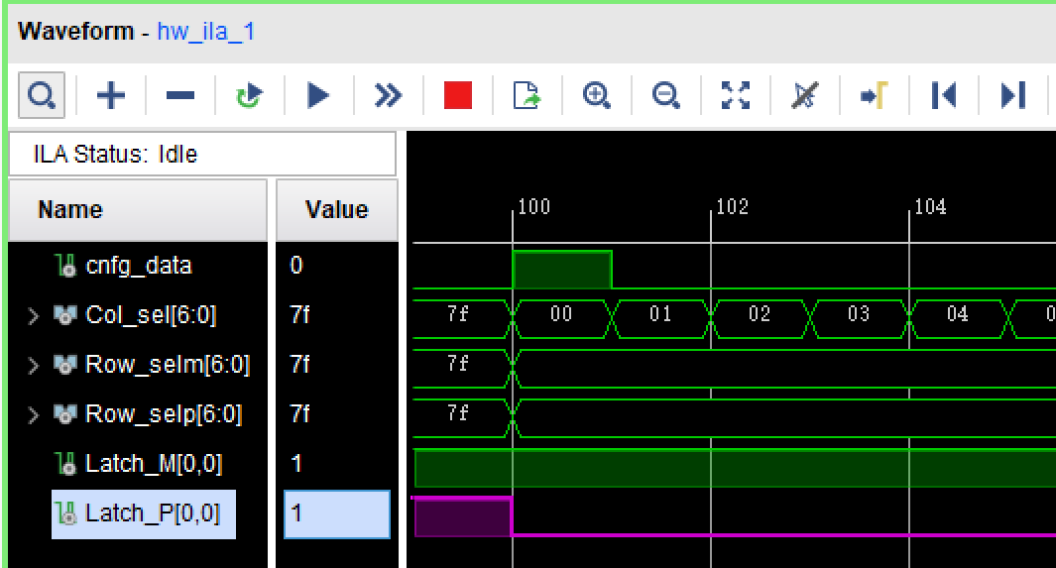

4 Joint debugging with Emulator
Pixel configuration(Pixel[0,0])
Mask_config
Set Latch_M to 1
Pulse_config
Set Latch_P to 0
Cnfg_data
D Q
G Q_x
Latch_M
Pixel configuration successfully
Rowsel_M
Mask_en_x
Colsel
D Q
G
Latch_P
Rowsel_P
Pulse_d
DFF
Latch_2
State_out
Hit
D Q
G
D Q
C
CLR
Latch_1
Analog Front-end Signal
CLK
Dout
D Q
G CLR
Freeze
Strobe
GRST
Sync
13
24th IEEE Real Time Conference – Quy Nhon, Vietnam, 22-26 April, 2024
Notes:
We conducted joint testing using the emulator and the validation system. Firstly, we tested the Pixel Configuration function. In this test, we used the DAQ Software to configure the pixel register at address [0,0] in the emulator and used ILA(Integrated Logic Analyzer) to view the configuration of the pixel register, obtaining the following results:
The configuration of the pixel response mode was completed.

Slide 15
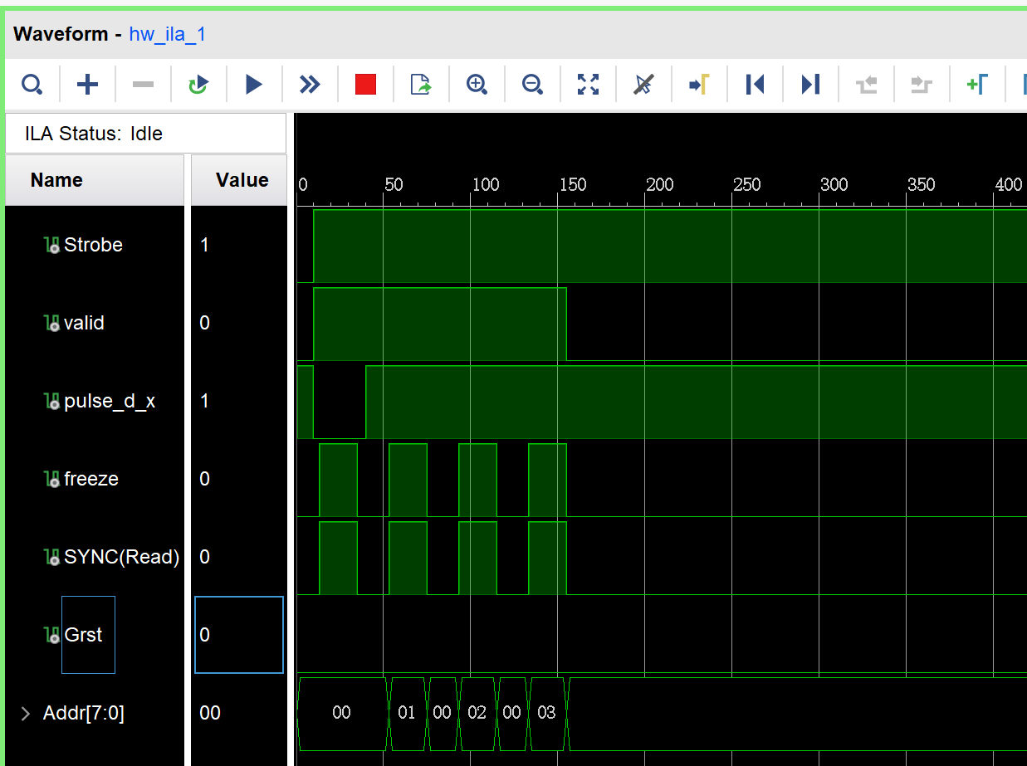
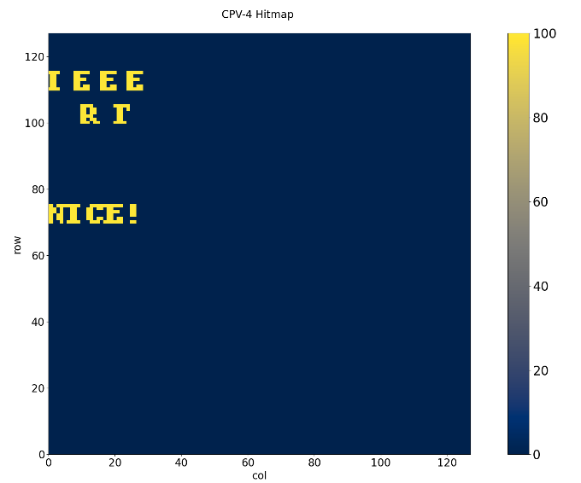
4 Joint debugging with Emulator : Electronic Pulse Tests
  Parameter Setting:
  Integrated Logic Analyzer Results：
Parameters | Emulator
Operation_mode | Continuous
Pulse_Num | 1
Pulse_Width | 3 μs
Read_Period | 4 μs
Read_Delay | 0.2 μs
Read_Width | 2.2 μs
Trigger Mode
Hit valid signal
Electronic Pulse
Readout and reset signal
Pixel address
  Readout Result：
Readout Successfully
Emulator works properly
Parameter configuration function works successfully
Readout results of specific pixel for 100 pulses
14
24th IEEE Real Time Conference – Quy Nhon, Vietnam, 22-26 April, 2024
Notes:
We also conducted testing of the Electronic Pulse function. In this test, following the completion of Pixel Configuration, we sent electronic pulses to the pixels selected in the emulator according to the specified parameters and then read out the hit information.
These are the Integrated Logic Analyzer Results：
The readout was successful.
Additionally, we also performed multiple pulse and specific pixel readout tests, completing the configuration and readout of specific pixels for 100 pulses.
In the next step, we conducted testing of the Electronic Pulse function. In this test, following the completion of Pixel Configuration, we sent electronic pulses to the pixels at addresses [0,0] [0,1] [1,0] [1,1] in the emulator according to the specified parameters and then read out the hit information.
The readout was successful, and the implementation was completed.
Additionally, we also performed multiple pulse and specific pixel readout tests, completing the configuration and readout of specific pixels for 100 pulses.
We also tested the readout performance in different pixel operation modes, and were able to correctly read out the hit pixels.

Slide 16
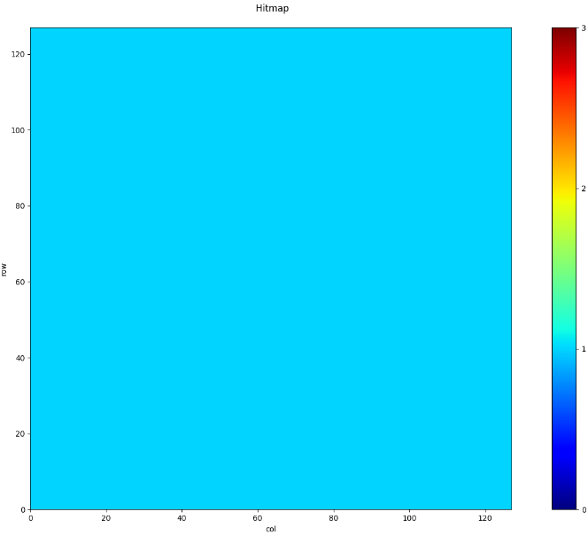
4 Tests on CPV-4
  Tests on the upper chip
  Tests on 3D chip
    Pixel configuration
    Electronic pulse tests
    Driving force is insufficient
    CPV-4 functions properly
Full Array Readout Results of CPV-4 upper Chip
Parameter | Emulator | Upper chip | 3D chip
Operation_mode Pulse_Num Pulse_Width Strobe_Delay Strobe_Width Read_Period Read_Delay Read_Width | Trigger 1 3 μs 2.5 μs 0.6 μs 0.4 μs 0.5 μs 0.2 μs | Trigger 1 3 μs 2.5 μs 0.6 μs 4 μs 0.5 μs 2.2 μs | Trigger 1 3 μs 2.5 μs 0.6 μs 8 μs 0.5 μs 6.3 μs
Comparison of timing parameters between emulator, upper chip, and 3D chip
15
24th IEEE Real Time Conference – Quy Nhon, Vietnam, 22-26 April, 2024
Notes:
The readout was successful, and the implementation was completed.
Additionally, we also performed multiple pulse and specific pixel readout tests, completing the configuration and readout of specific pixels for 100 pulses.
We also tested the readout performance in different pixel operation modes, and were able to correctly read out the hit pixels.
与单独数字芯片相同的是，3D芯片的Read也需要更长的信号宽度以保证低位地址总线的建立时间得到满足。
3D芯片的对比测试验证了3D堆叠的工艺步骤没有对逻辑层功能造成不利影响。
减薄到10 μm的片上逻辑层可以正常工作，具备全部功能以支撑模拟芯片的功能和性能测试。

Slide 17
5 Summary
Developed the CPV-4 upper chip emulator on the FPGA board
  Implemented all functions of the CPV-4 Upper Tier pixel array and readout logic
Testing and verification system
  Implemented parameter configuration and readout functions
Through joint debugging with the CPV-4 upper chip emulator and the testing system, it is proven that:
  Emulator works properly
  The logic of the CPV-4 upper chip is correct
  The testing and verification system is fully functional and runs correctly
The fully functional test and verification system has been used for the testing and verification of the CPV-4 chip
16
24th IEEE Real Time Conference – Quy Nhon, Vietnam, 22-26 April, 2024
Notes:
Summary: A test validation system has been developed to address the functional characteristics of the 3D SOI chip CPV-4. Additionally, a CPV-4 digital chip emulator has been developed to verify the logic of the digital chip circuitry.
Currently, the test validation system has been used for functional measurements of actual chips, and some test results have been obtained.

Slide 18


Thank you!
24th IEEE Real Time Conference ICISE, Quy Nhon, Vietnam

