Slide 1


The Preliminary Design of Data Acquisition System For Jinping Neutrino Experiment
Haoyan Yang, Jiang Lin, Qiutong Pan, Liang Bo,
Tao Xue, Yinong Liu, Jianmin Li
Department of engineering physics, Tsinghua University
2024.4.22 Quy Nhon
Notes:
Hello everyone. My name is Yang Haoyan, from the Department of Engineering Physics of Tsinghua University. Today, I’m very happy to present the preliminary design of the Data Acquisition (DAQ) system for the Jinping Neutrino Experiment.

Slide 2
Context
Introduction
Hardware Design
Firmware Design
Performance Test
Conclusion and Future Work
Notes:
My report consists of five parts. I will first introduce the background of JNE and Tsinghua DAQ system. Then, I will present the performance test and some experiment results.

Slide 3
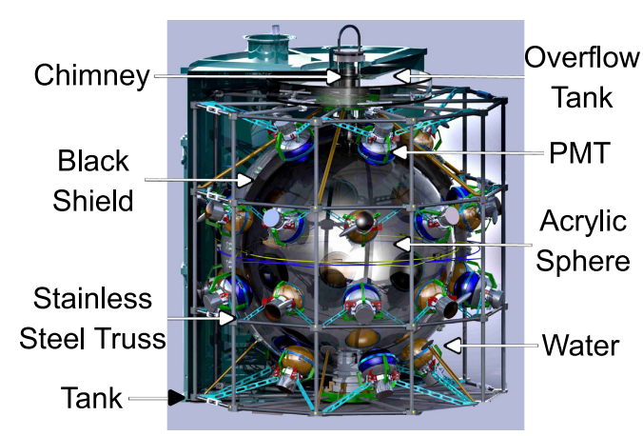
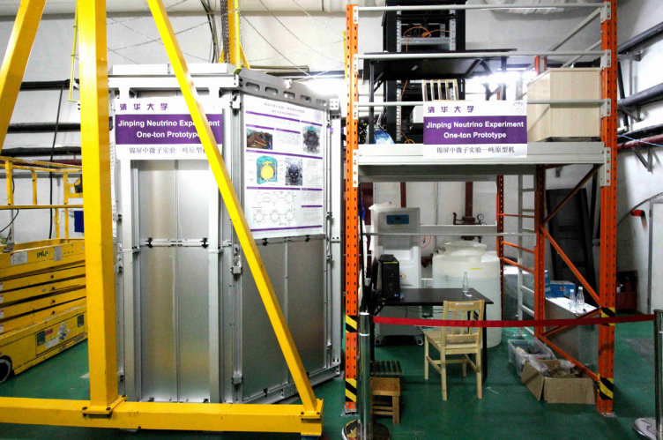
Introduction
Jinping Neutrino Experiment(JNE)
  conducted within the China Jinping Underground Laboratory
  solar neutrino, geo-neutrino and supernova neutrino
  30 PMTs mounted on the exterior of the spherical detector
  30 channels -> 60 channels -> 4000 channels
Notes:
The Jinping Neutrino Experiment (JNE) is located at China Jinping Underground Laboratory. The scientific objective of JNE is to construct a 4000-channel liquid scintillator detector to detect these neutrinos. In 2017, JNE developed a 1-ton prototype for preliminary verification. There are 30 PMTs mounted on the exterior of the spherical detector. JNE is planning an upgrade to the one-ton prototype in the summer of 2024. And the upgrade of the DAQ system is important for the JNE, mainly for the following four reasons.

Slide 4
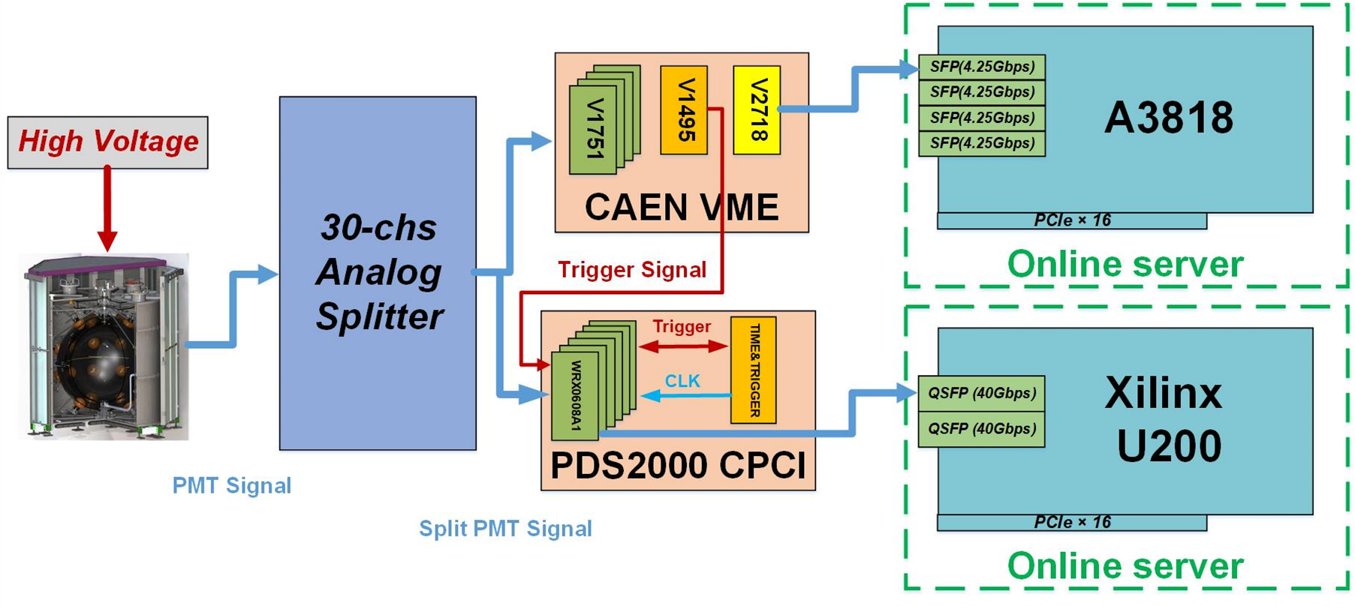
Introduction
DAQ system upgrade
  To increase the data bandwidth of the DAQ system
  To enhance ADC performance, including ENOB and dynamic range
  To enhance the DAQ systems scalability and flexibility
  To verify system stability, providing a foundation for the 60-channel and 4000-channel DAQ systems
Notes:
This figure shows the experiment which verify long-term stability. Our system is compared with CAEN DAQ system which is used by JNE before

Slide 5
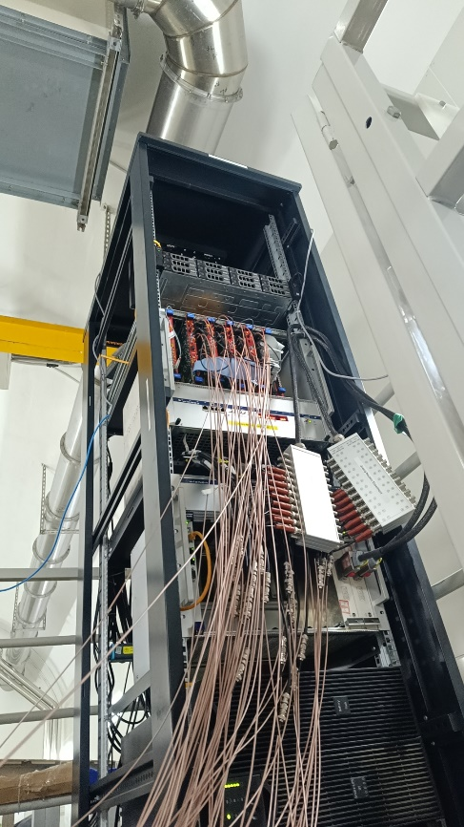
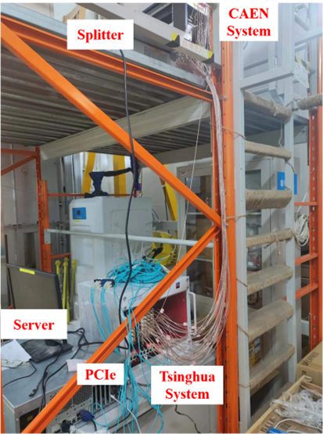
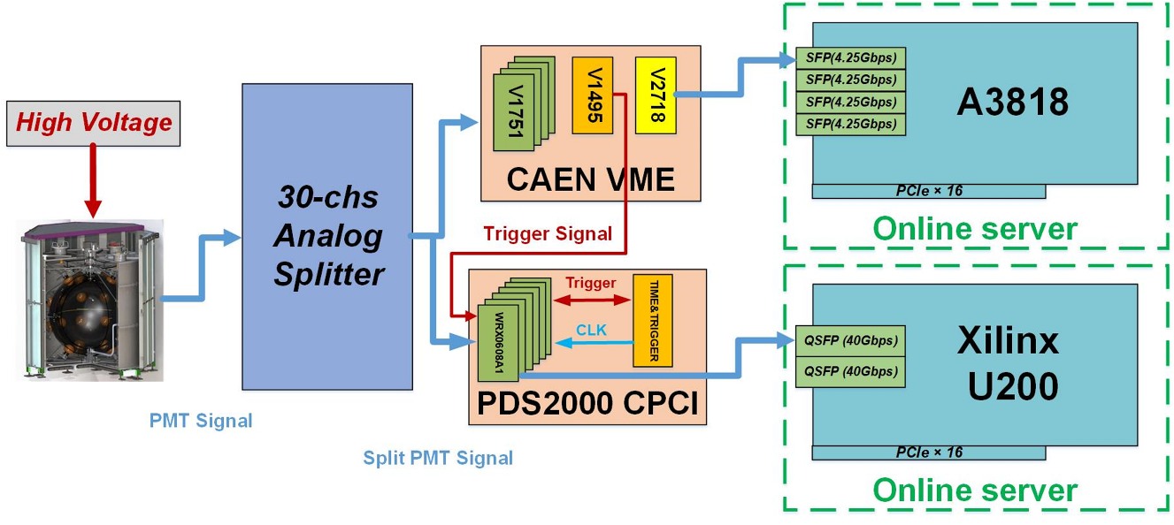
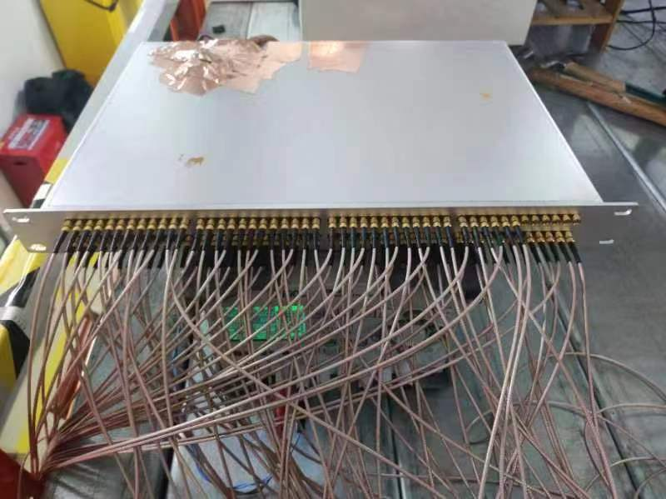
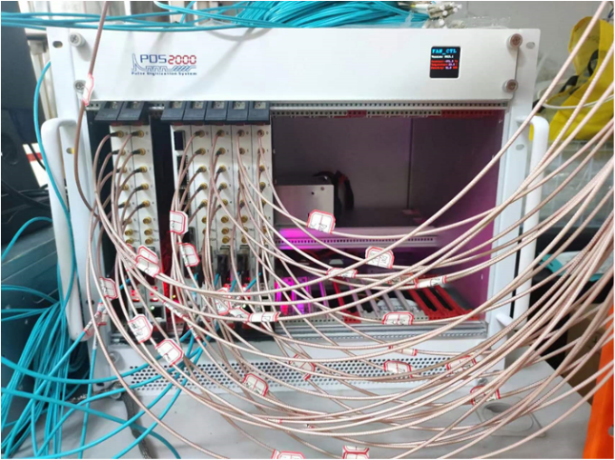
Introduction
DAQ system for JNE
Notes:
There are some picture about the experiment.

Slide 6
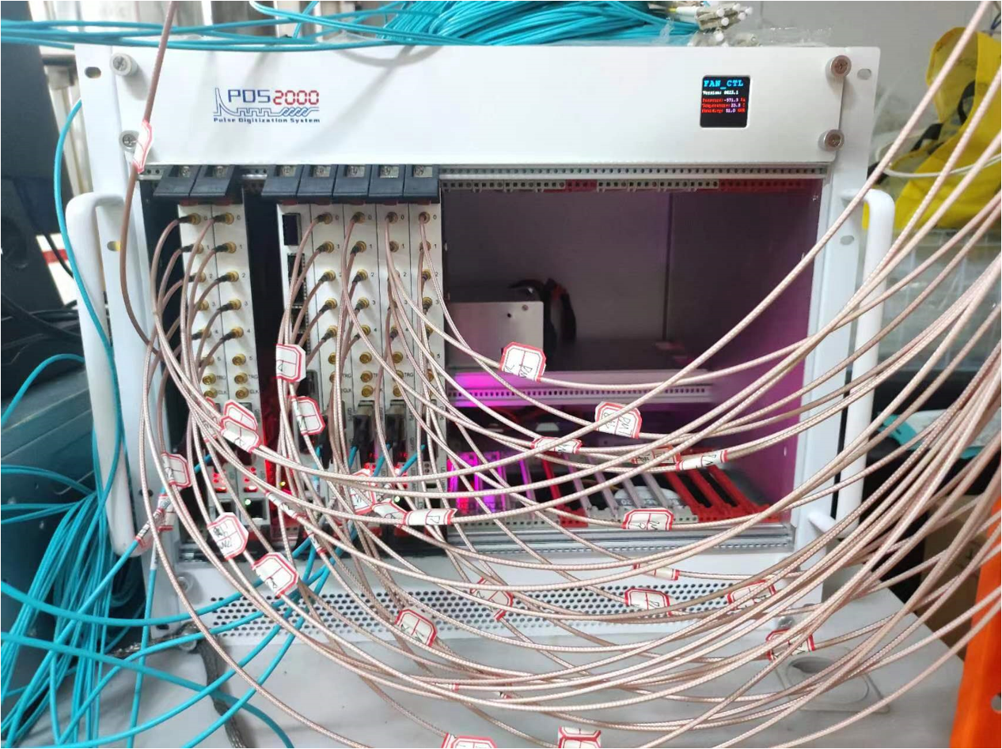
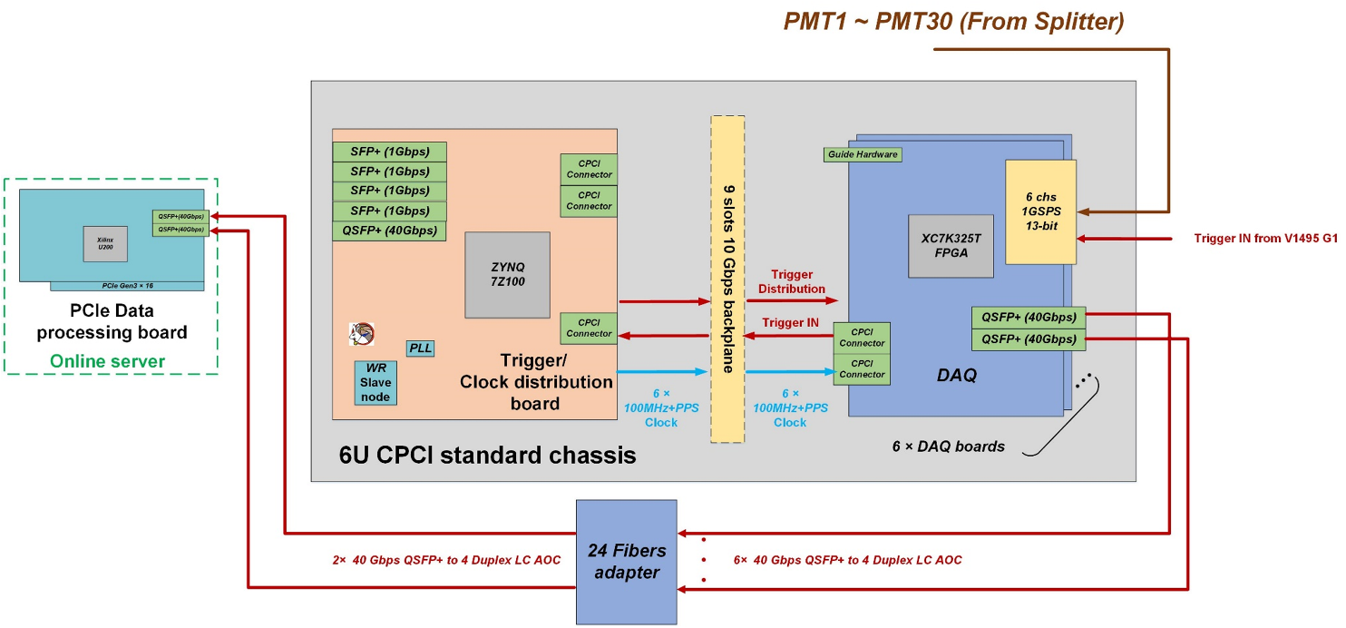
Hardware design
Tsinghua DAQ system for JNE
  1 compact PCI Chassis
  6 DAQ board with 36 ADCs (13-bit / 1GSPS)
  1 Trigger and clock distribution board
  1 Backplane board
  1 PCIe board Xilinx Alveo U200
Notes:
OK I will introduce the Tsinghua DAQ system in detail.
Within a standard six-unit Compact PCI (cPCI) Express chassis. There are six DAQ boards. Each DAQ board is equipped with 6 channels of 13-bit/1GSPS ADC. a Trigger and Clock Distribution board, and a 9-slot high-speed backplane board.
The figure shows how the system works in external trigger mode. The received trigger signals are directly distributed to 6 DAQ boards by the TCD board. After receiving the trigger signal, the DAQ board packages and transmits the collected data to the PCIe board Xilinx U200 via optical fiber. then PCIe board sends data to the server by a 16-lane PCIe Gen3 link.

Slide 7
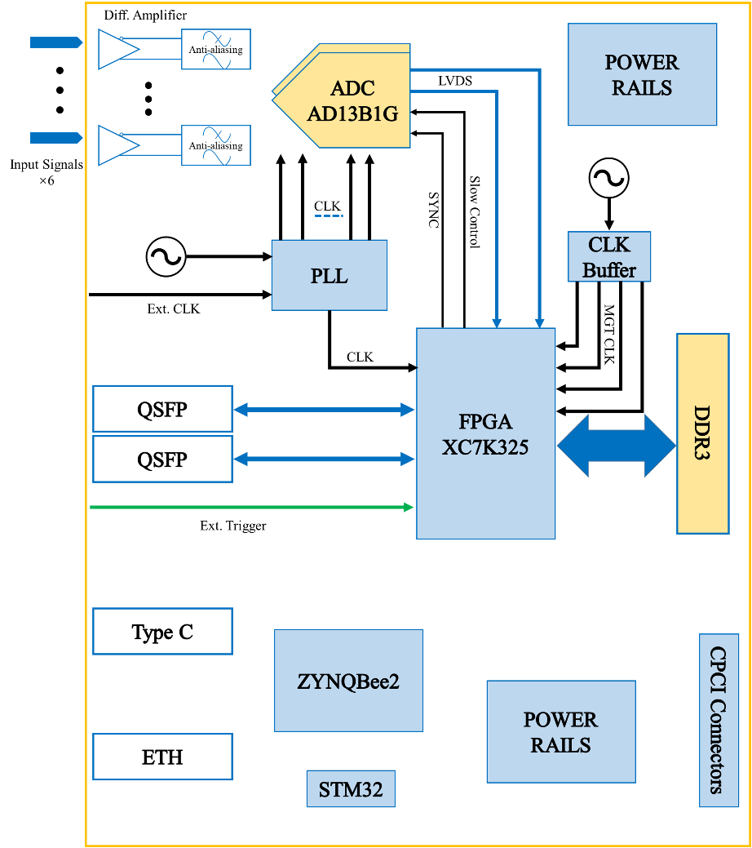
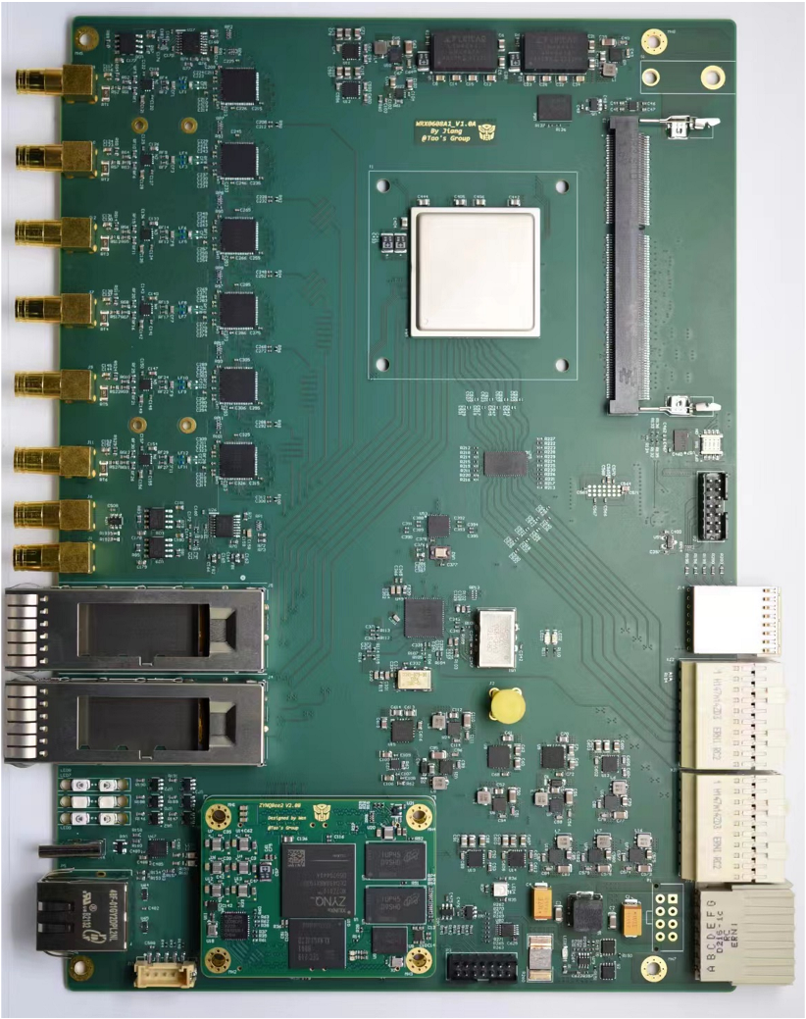
Hardware design
Tsinghua DAQ system
  Board of DAQ
Channel | 6
ADC | 1 GSPS 13-bit
ADC name | ADC13B1G (Tsinghua ASIC)
Analog Input (Full-Scale) | 1.3 Vpp
ADC ENOB Measurement @ 10 MHz (bit) | > 9.8
Buffer | 4 GBytes DDR3
Processor | XC7K325T-FFG900
Data Transfer Rate (Gbps) | ~10 (BackPlane 10Gbps) ~40 (QSFP Fiber)
Notes:
The DAQ board features a 12-layer PCB structure utilizing FR4 material. Its architecture employs FPGA and ZYNQ.
The FPGA XC7K325T manages ADC data processing, digital shaping, online triggering, and high-speed data transmission. The ZYNQ XC7Z010 primarily supervises board slow control and manages online firmware updates.

Slide 8
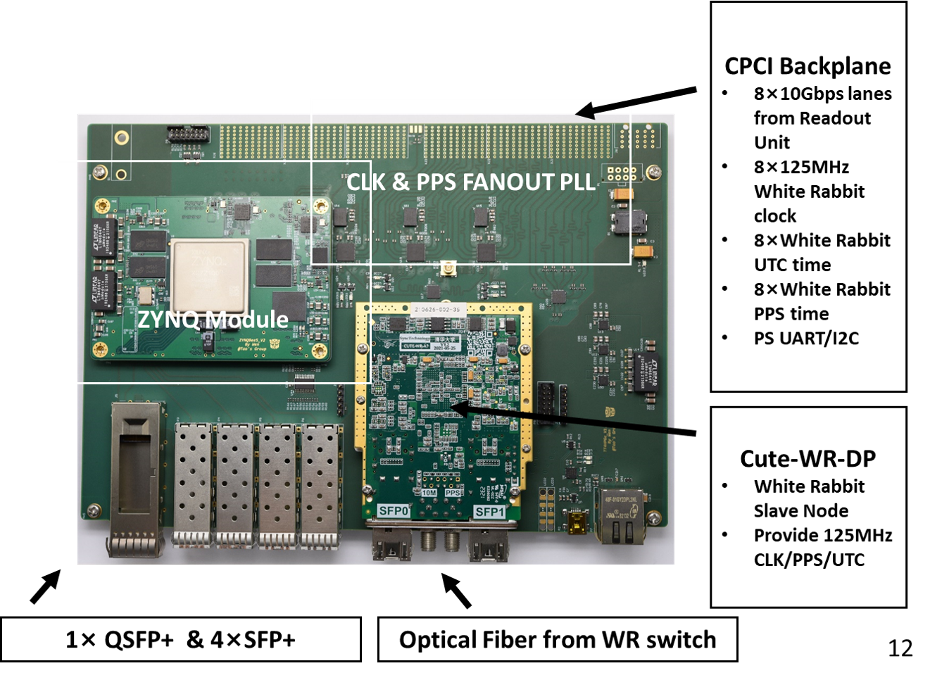
Hardware design
Tsinghua DAQ system
  Board of Trigger and Clock distribution
Data Transfer Rate(Gbps) [To Each DAQ Board] | 10
Data Transfer Rate(Gbps) [Upstream] | 80 (max)
Clock Fanout Channels | 8 (125MHz)
PPS Fanout Channels | 8 (1Hz + TAI TimeStamp)
Notes:
The board of Trigger and clock distribution comprises three main components: the motherboard, the ZYNQ module, and the CUTE-WR-A7 module. Its primary function is the distribution of global trigger and clock signals to all DAQ boards within the chassis in this experiment.

Slide 9
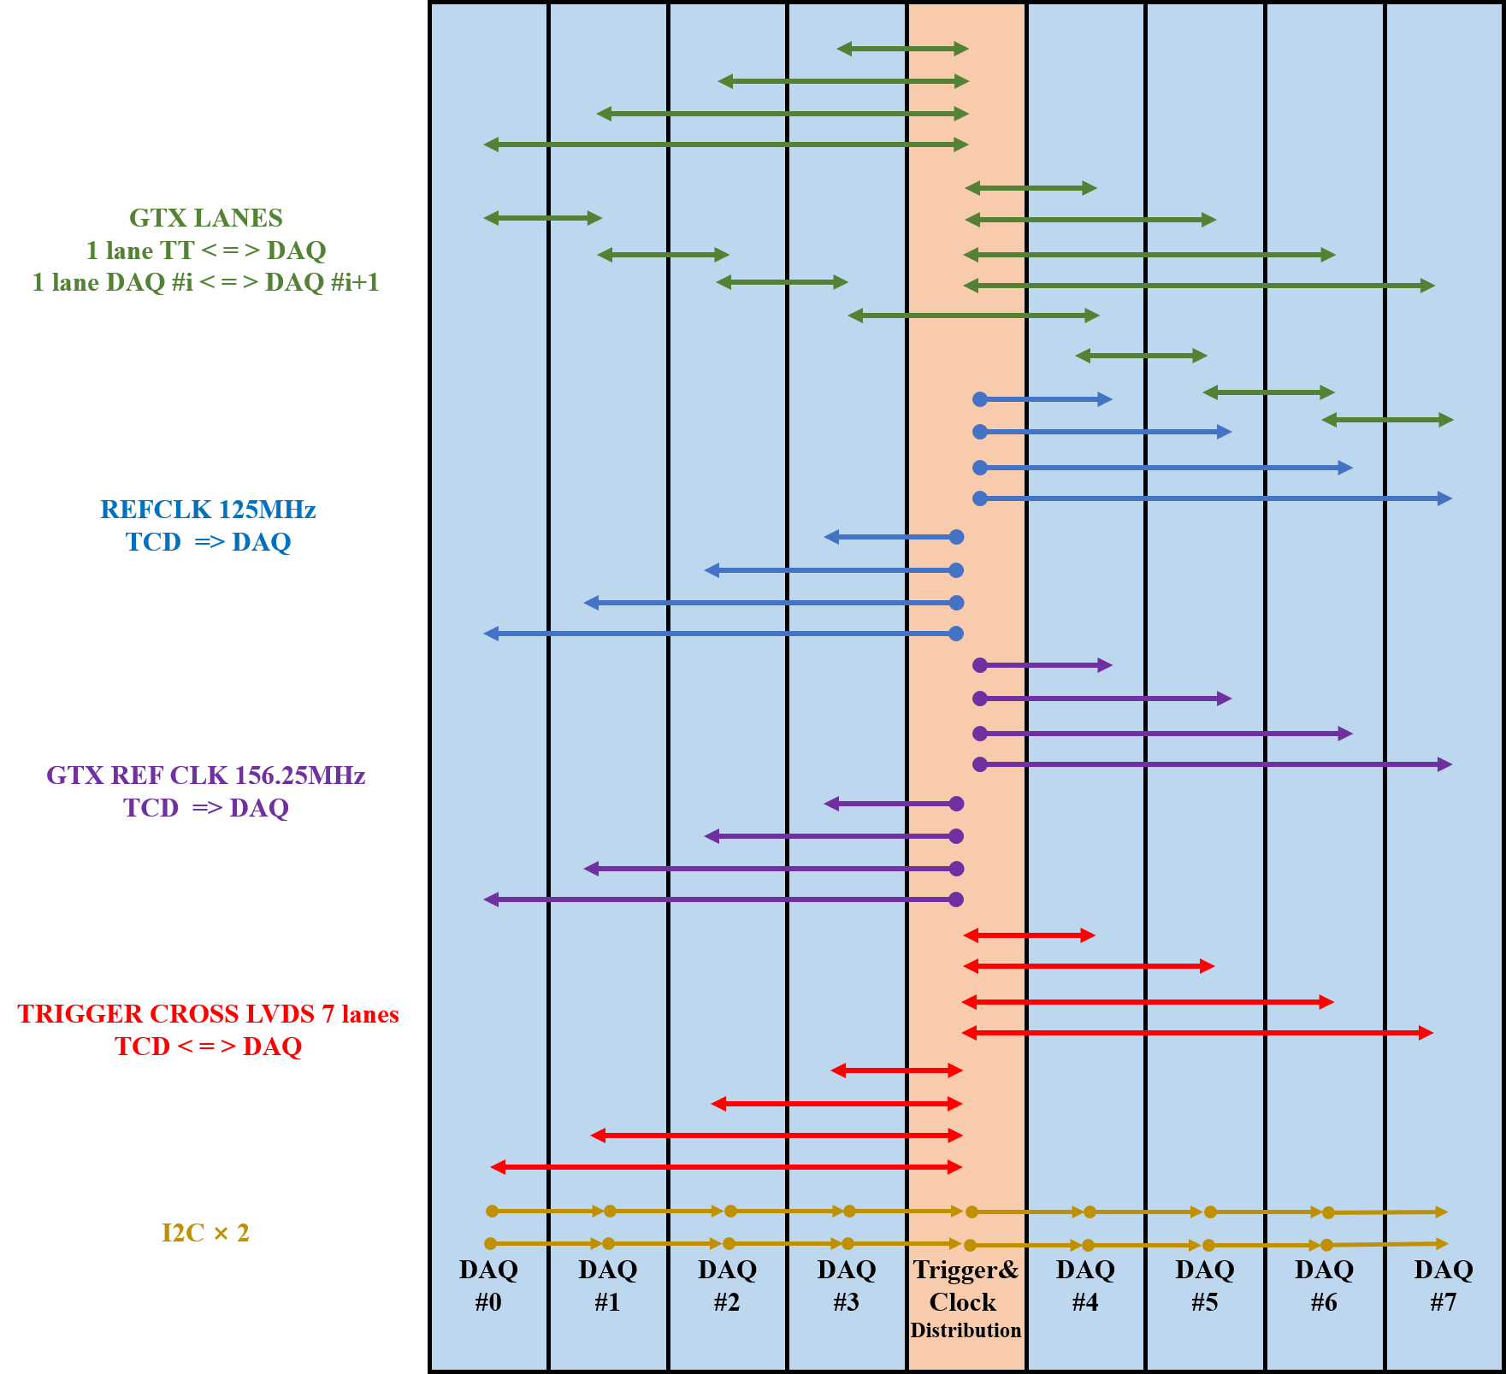
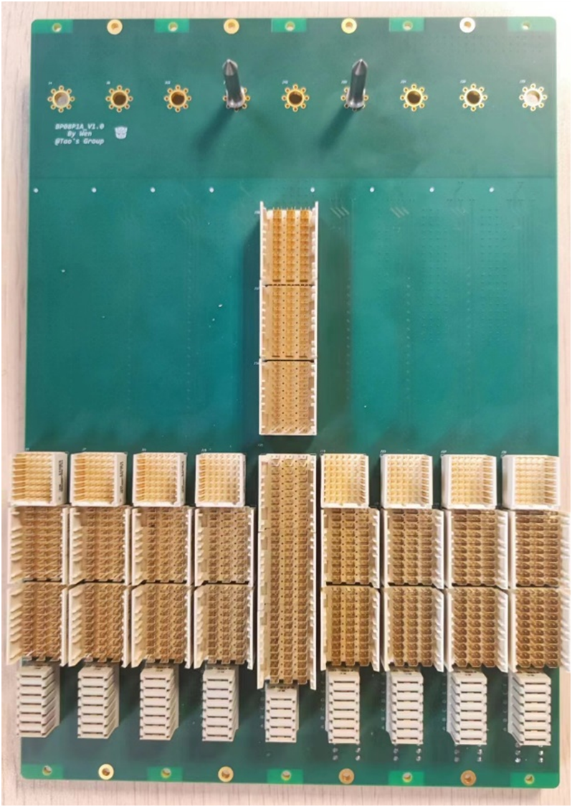
Hardware design
Tsinghua DAQ system
  Board of Backplane
Notes:
The backplane serves as a carrier for high-speed data transmission and synchronous clock distribution. Furthermore, it distributes power to each slot and monitors board status information.
There are one trigger and clock board slot and eight DAQ board slots. There are many links between every slots, such as : GTX lanes, ADC refclk, GT refclk, trigger and and control signal

Slide 10
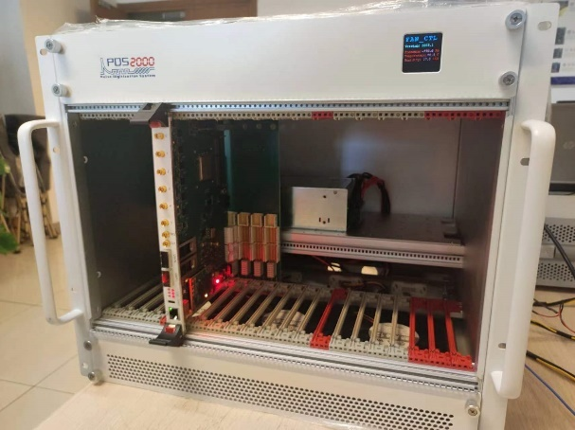
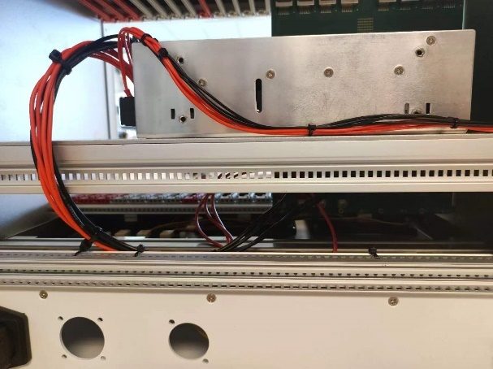
Hardware design
Tsinghua DAQ system
  System chassis
    Cool fans
    Power supply
Notes:
The compact PCI chassis provides sixteen slots for DAQ boards, two for TCD boards, and three for slow control boards. A temperature and pressure monitoring and control system is integrated into the chassis, dynamically control fan speed in real-time. The chassis power supply distributes power through the backplane to the boards in each slot from this 12 V DC source.

Slide 11
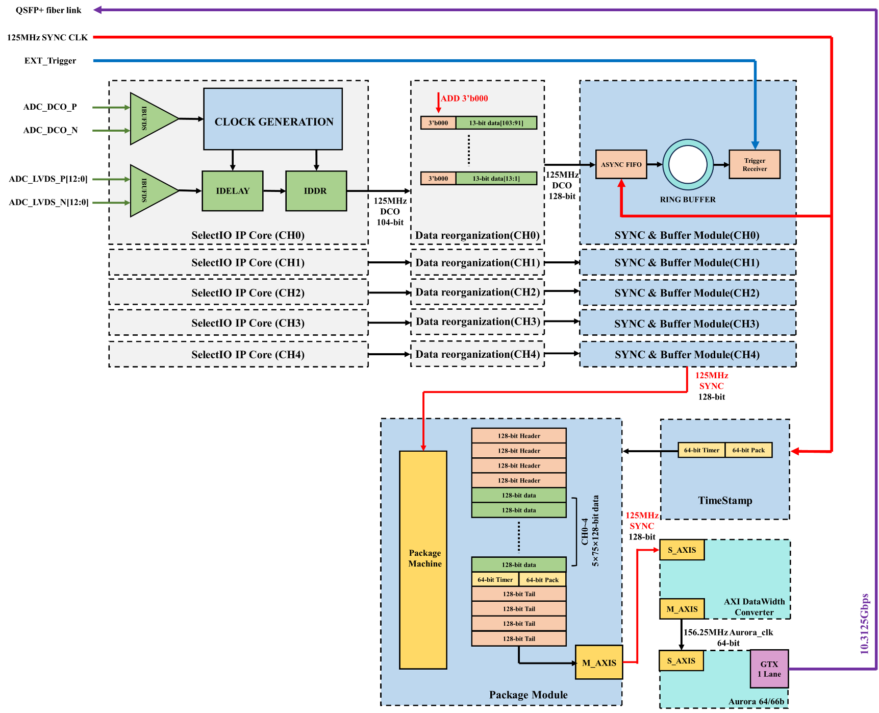
Firmware design
Firmware of DAQ board
  5-channel ADCs data
  600ns waveform(75×128-bit data， 100ns before trigger and 500ns after trigger)
  Data transfer via 10.3125Gbps QSFP+
Notes:
Next, I will present the detail of firmware design. Firstly, the SelectIO IP receives LVDS data from five ADC, with a serialization factor of 8, the sixth ADC is not used. The data cached in the ring buffer. After receiving the external trigger signal, the package module accesses seventy-five 128-bit data from five ring buffer. Each 128-bit data corresponds to an 8nanosecond waveform, with a total of five 600ns waveforms. The complete event packet comprises packet header, waveform data, packet tail, trigger number, and timestamp. The Data is transferred to PCIe board via optical fibre

Slide 12
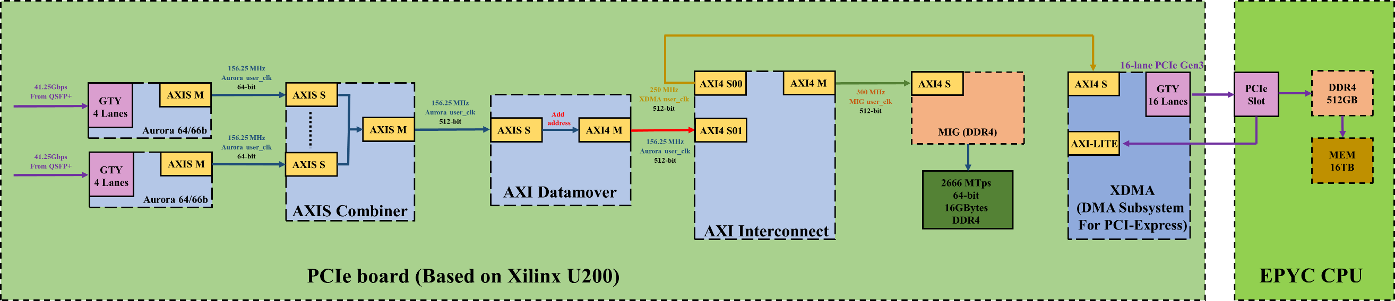
Firmware design
Firmware of PCIe board
  6 DAQ boards data
  DDR4 512MB + 512MB for Ping-Pong reading and writing
  16-lane PCIe Gen3
Notes:
The primary function of the PCIe board involves receiving data from six DAQ boards and transmitting the data to host computer
The XDMA driver is the basis for software function implementation. After loading the XDMA driver, the user program can start data transfer request. Two 512 MB memory spaces are allocated for ping-pong reading and writing, with the entire process managed by the host computer.

Slide 13
Performance test
ENOB of Tsinghua ADC
  IEEE-1241 standard
  Rohde & Schwarz SMA100B
  Improvement is 14%
Board | CH1 | CH2 | CH3 | CH4 | CH5 | CH6
0# | 9.71±0.16 | 9.91±0.15 | 10.09±0.09 | 9.88±0.14 | 9.93±0.07 | 9.36±0.05
1# | 9.66±0.23 | 9.88±0.19 | 10.08±0.11 | 9.89±0.19 | 9.89±0.09 | 9.33±0.06
2# | 9.57±0.25 | 9.90±0.22 | 9.99±0.29 | 9.86±0.20 | 9.90±0.11 | 8.94±0.06
3# | 9.67±0.19 | 9.92±0.15 | 10.09±0.08 | 9.91±0.16 | 9.93±0.08 | 9.33±0.04
4# | 9.05±0.28 | 9.93±0.18 | 10.10±0.12 | 9.91±0.20 | 9.92±0.11 | 9.29±0.06
5# | 9.57±0.16 | 9.88±0.15 | 10.07±0.07 | 9.87±0.14 | 9.84±0.06 | 9.26±0.04
Notes:
You can see the performance test result. The ENOB values of the sixth channel ADC on each DAQ board are obviously lower than other five channels. This phenomenon is due to unreasonable PCB design. Furthermore, the typical ENOB values of Tsinghua ADCs range are from 9.8 to 10.0. It is 14% improvement compared with ENOB values of the CAEN V1751 ADC which is 8.6.

Slide 14
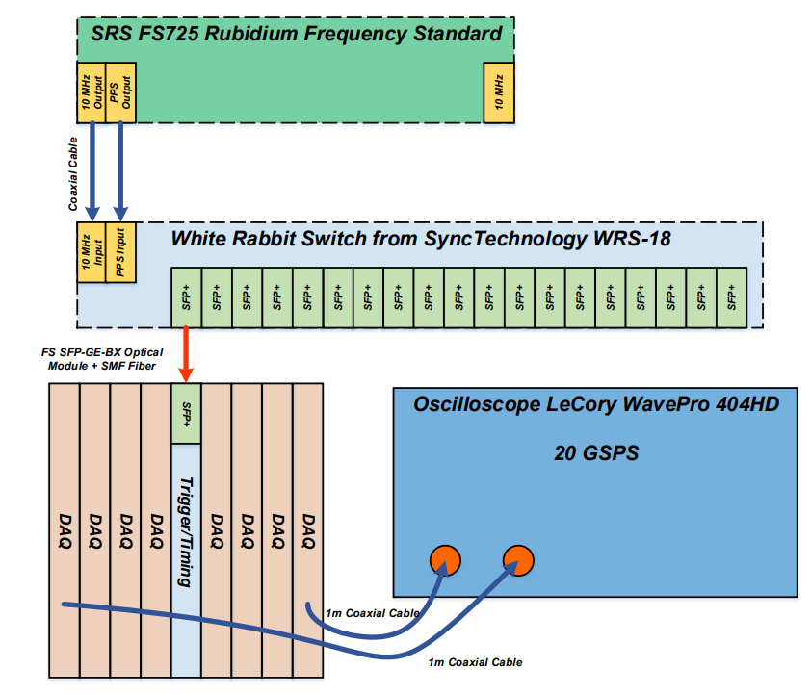
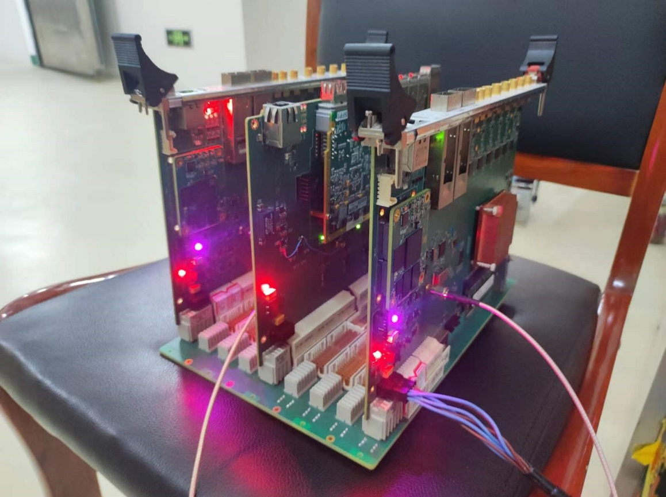
Performance test
Clock skew
  LeCroy WavePro 404HD oscilloscope
  the maximum clock deviation within a single chassis is 85.6 ps
Notes:
Clock synchronization is also crucial for DAQ systems. The Test CLK of the first DAQ board is connected to channel 2 of the oscilloscope, and the Test CLK of subsequent seven DAQ boards is connected to channel 3 in turn.

Slide 15
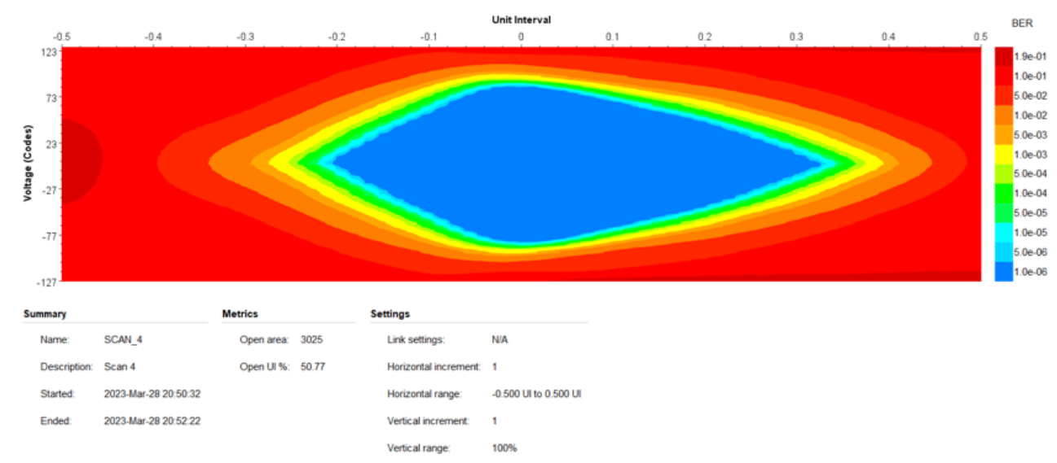
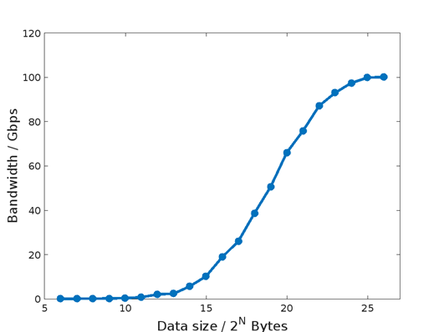
Performance test
High-speed link
  QSFP+ IBERT Far-end test result, Open area > 3000, Open UI > 50%, no BER
  Average bandwidth of 16-lane PCIe Gen3 is up to 100.2Gbps， packet size = 512MB, Counts = 10000
Notes:
We use Xilinx Ibert to test all GT lanes of each DAQ board. the Open area is bigger than 3000 and Open UI exceeds 50%
The bandwidth of the 16-lane PCIe Gen3 is also tested. The average bandwidth of 10,000 transfers, each with a packet size of 512 MB, is 100.2 Gbps.

Slide 16
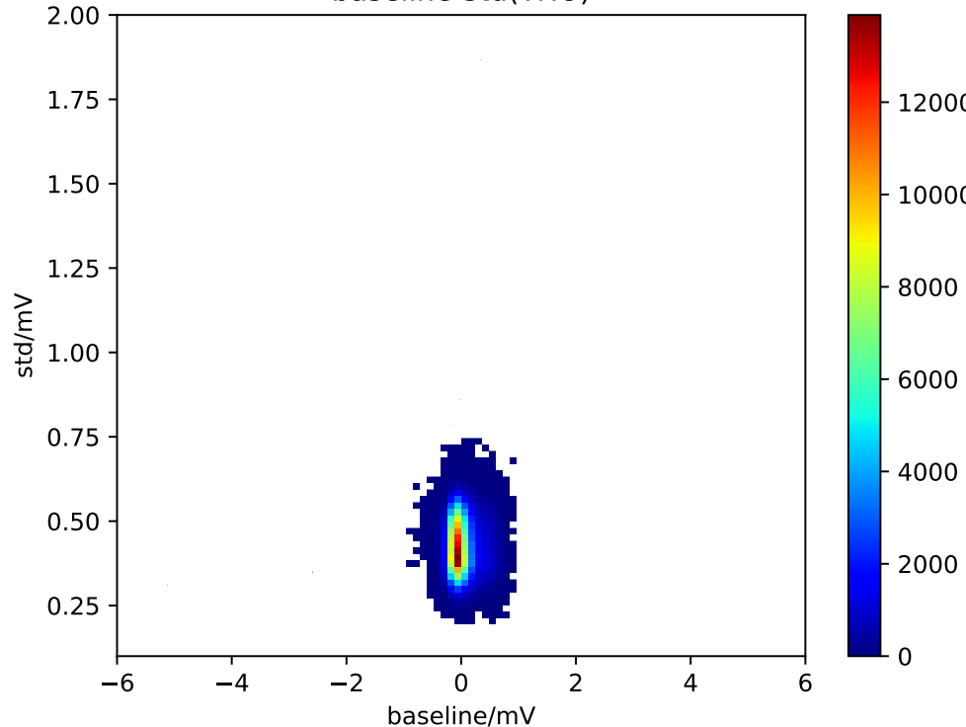
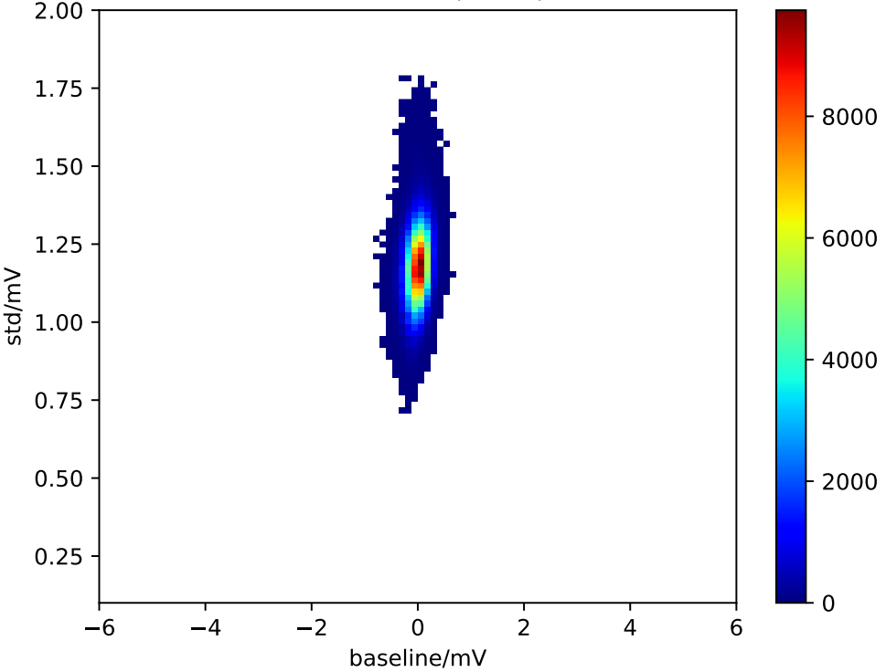
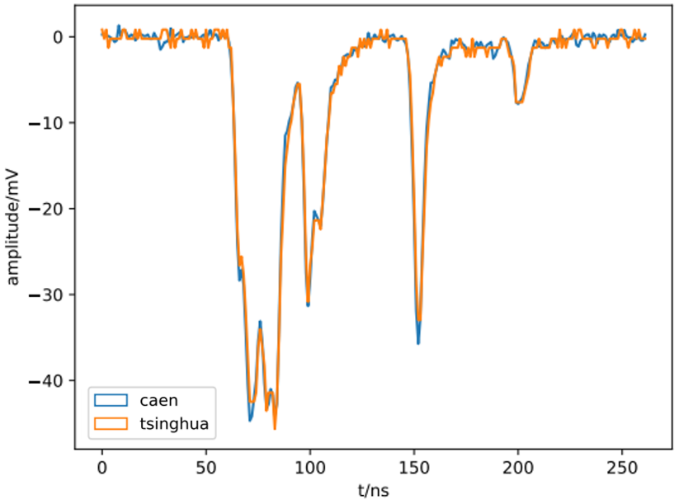
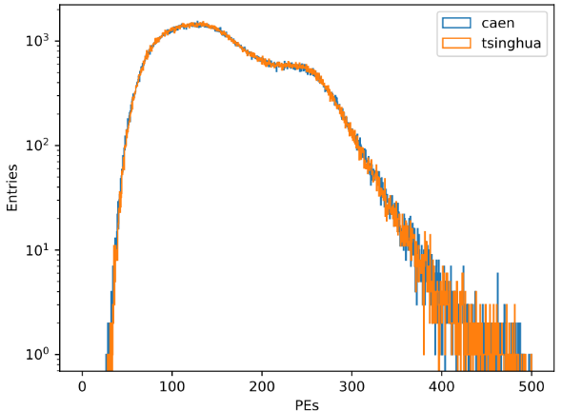
Performance test
Experimental results
THU ADC
CAEN ADC
Average < 3mV
> 400000 Waveforms
Notes:
Two DAQ systems simultaneously collected more than 400,000 events.
It can be seen that the baseline jitter of the Tsinghua DAQ system is less than 0.75 mV, which is better than the V1751 whose baseline jitter is greater than 0.75 mV. These results corroborate the ENOB result, indicating significant improvement in the performance of the Tsinghua ADC.
Furthermore, to assess the data transmission quality of the Tsinghua DAQ system, waveforms collected by both systems were compared individually. demonstrating no packet loss during data transmission. The average absolute difference of all waveform is less than 3 mV. The PE spectrum of thirty PMTs were also compared to verify the accuracy of the waveforms collected by the THDAQ system.

Slide 17
Conclusion
A New DAQ System for JNE has been developed
The ENOB of ADC increase 14%
The bandwidth of PCIe is up to 100.2Gbps, Trigger rate can reach 200k
Stability and flexibility has been proved
Notes:
The conclusion of this report are ass follow:

Slide 18
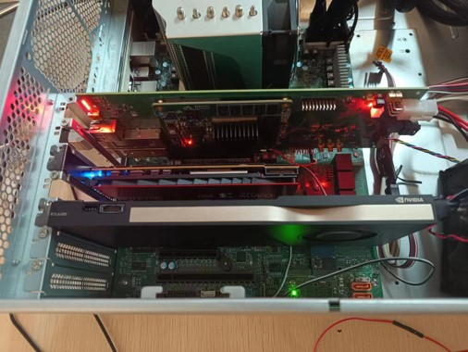
Future Work
KU060 + dual FMC with 8 channels AD9695
Dual QSFP+ and dual 8-lane PCIe Gen3 based on KU060
High-level trigger Based on PCIe P2P between PCIe board and RTX A4000
Notes:
In the future, the dual FMC carrier board utilizing the VPX protocol has been developed successfully. Plans are to upgrade the hardware to a 60-channel data acquisition system based on KU060 and AD9695. PCIe boards based on KU060 are also under development. Additionally, we have implemented the FPGA-GPU P2P transfer, which will facilitate the implementation of high level trigger.

Slide 19
Thanks!
Paper : http://arxiv.org/abs/2404.10373
Email : hy-yang22@mails.Tsinghua.edu.cn
Notes:
Thank you for your listening

