Slide 1


Data Acquisition System for CEPC Vertex Detector Prototype
Chang XU, Jia ZHOU, Yiming CHEN, Hongyu ZHANG
On behalf of CEPC Vertex Detector Group
Institute of High Energy Physics, Chinese Academy of Sciences

Slide 2
Outline
Introduction
  CEPC overview
  Vertex Detector prototype
  Readout Electronics
Design and implementation of Data Acquisition Software
  Data flow
  User Interface
System Test
  Laboratory laser test
  Synchrotron Radiation test at BSRF
  Beam test at DESY
Summary

Slide 3
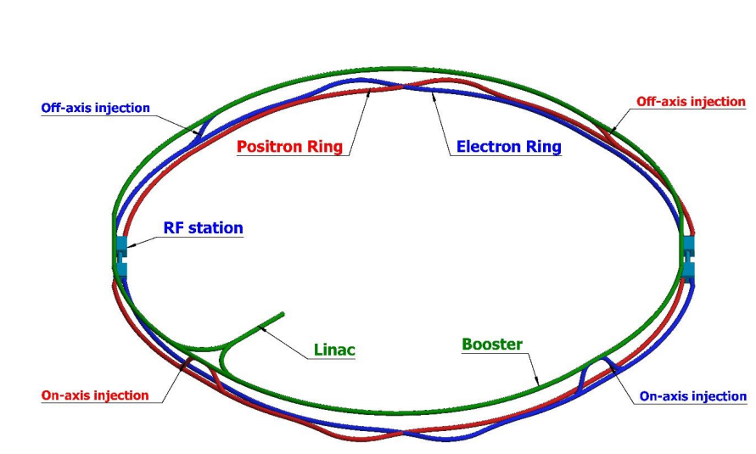
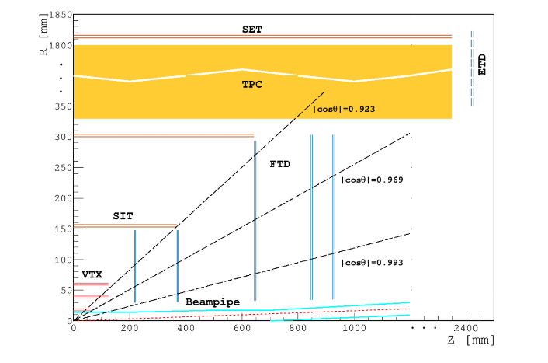
Introduction - CEPC Overview
  CEPC (Circular Electron Positron Collider)
      A proposed Machine to precisely measure the properties and interactions of the Higgs bosons
      100 km long accelerator rings
      240/91/160 GeV for Higgs/Z/WW
  CEPC Baseline Detector:
      Silicon Vertex detector (VTX)
      Inner tracking detector
      Time Projection Chamber (TPC)
      Electromagnetic Calorimeter (ECal)
      Hadron Calorimeter (HCal)
      Muon detector
CEPC

Slide 4
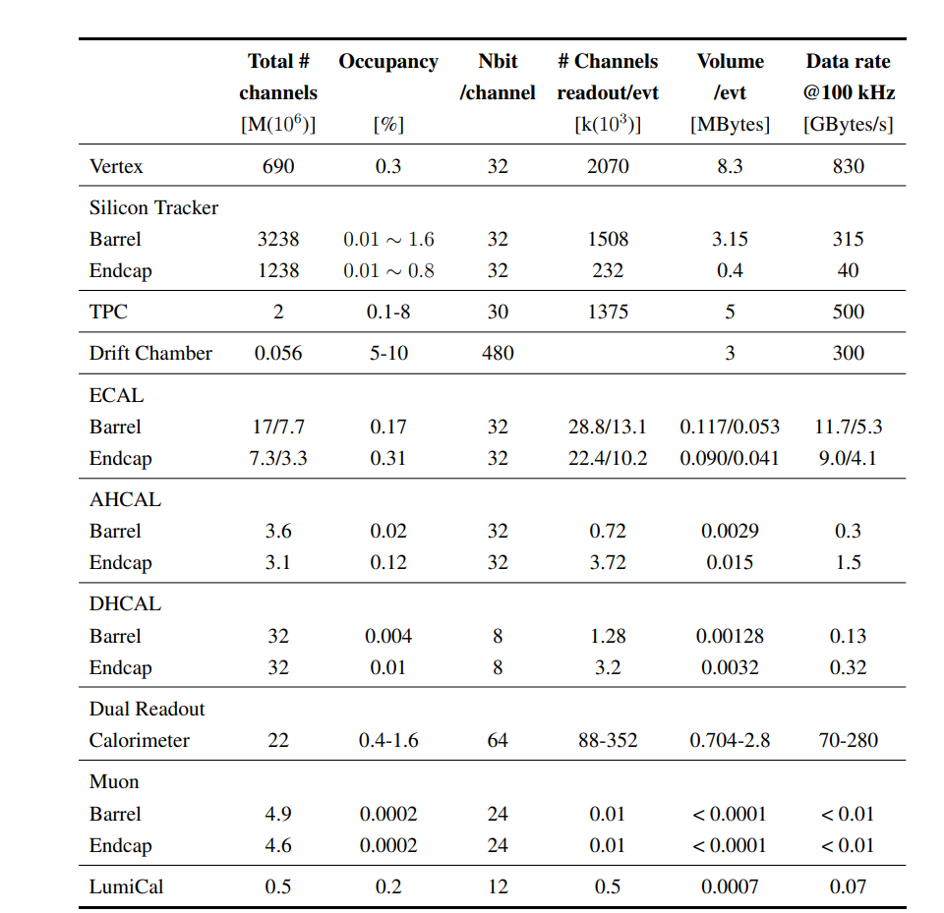
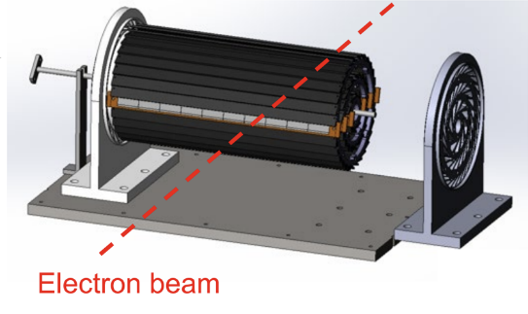
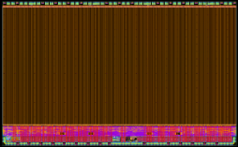
Introduction— CEPC Vertex Detector Prototype
  Characteristics of CEPC Vertex Detector
      Silicon pixel vertex detectors
      High spatial resolution (3-5 μm）
      Low material budget (0.15%X₀)
      Radiation hardness
  Full-scale Vertex Detector Prototype
      CMOS sensor: TaichuPix-3
          Die size: 25.7 mm × 15.9 mm
          Pixel array: 512(row) * 1024(col)
      Double-sided Ladder: 20 sensors per Ladder
      3 layers of Ladders in a cylindrical shape forms a 6-layer vertex detector
TaichuPix-3
Detector module (ladder)
Full size vertex detector Prototype

Slide 5
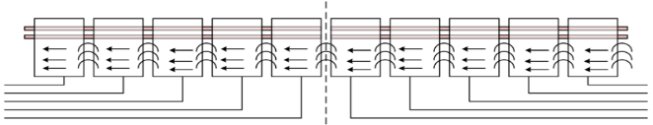
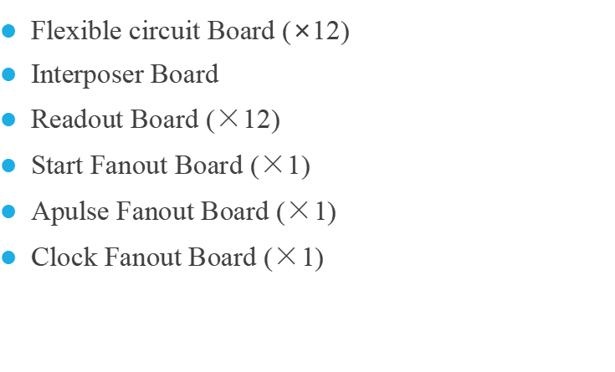
Introduction – Readout Electronics of Vertex Detector Prototype
Flexible circuit Board (×12)
Interposer Board
Readout Board ($×$12)
Start Fanout Board ($×$1)
Apulse Fanout Board ($×$1)
Clock Fanout Board ($×$1)
The overall structure of the detector electronics
Readout electronics schematic

Slide 6
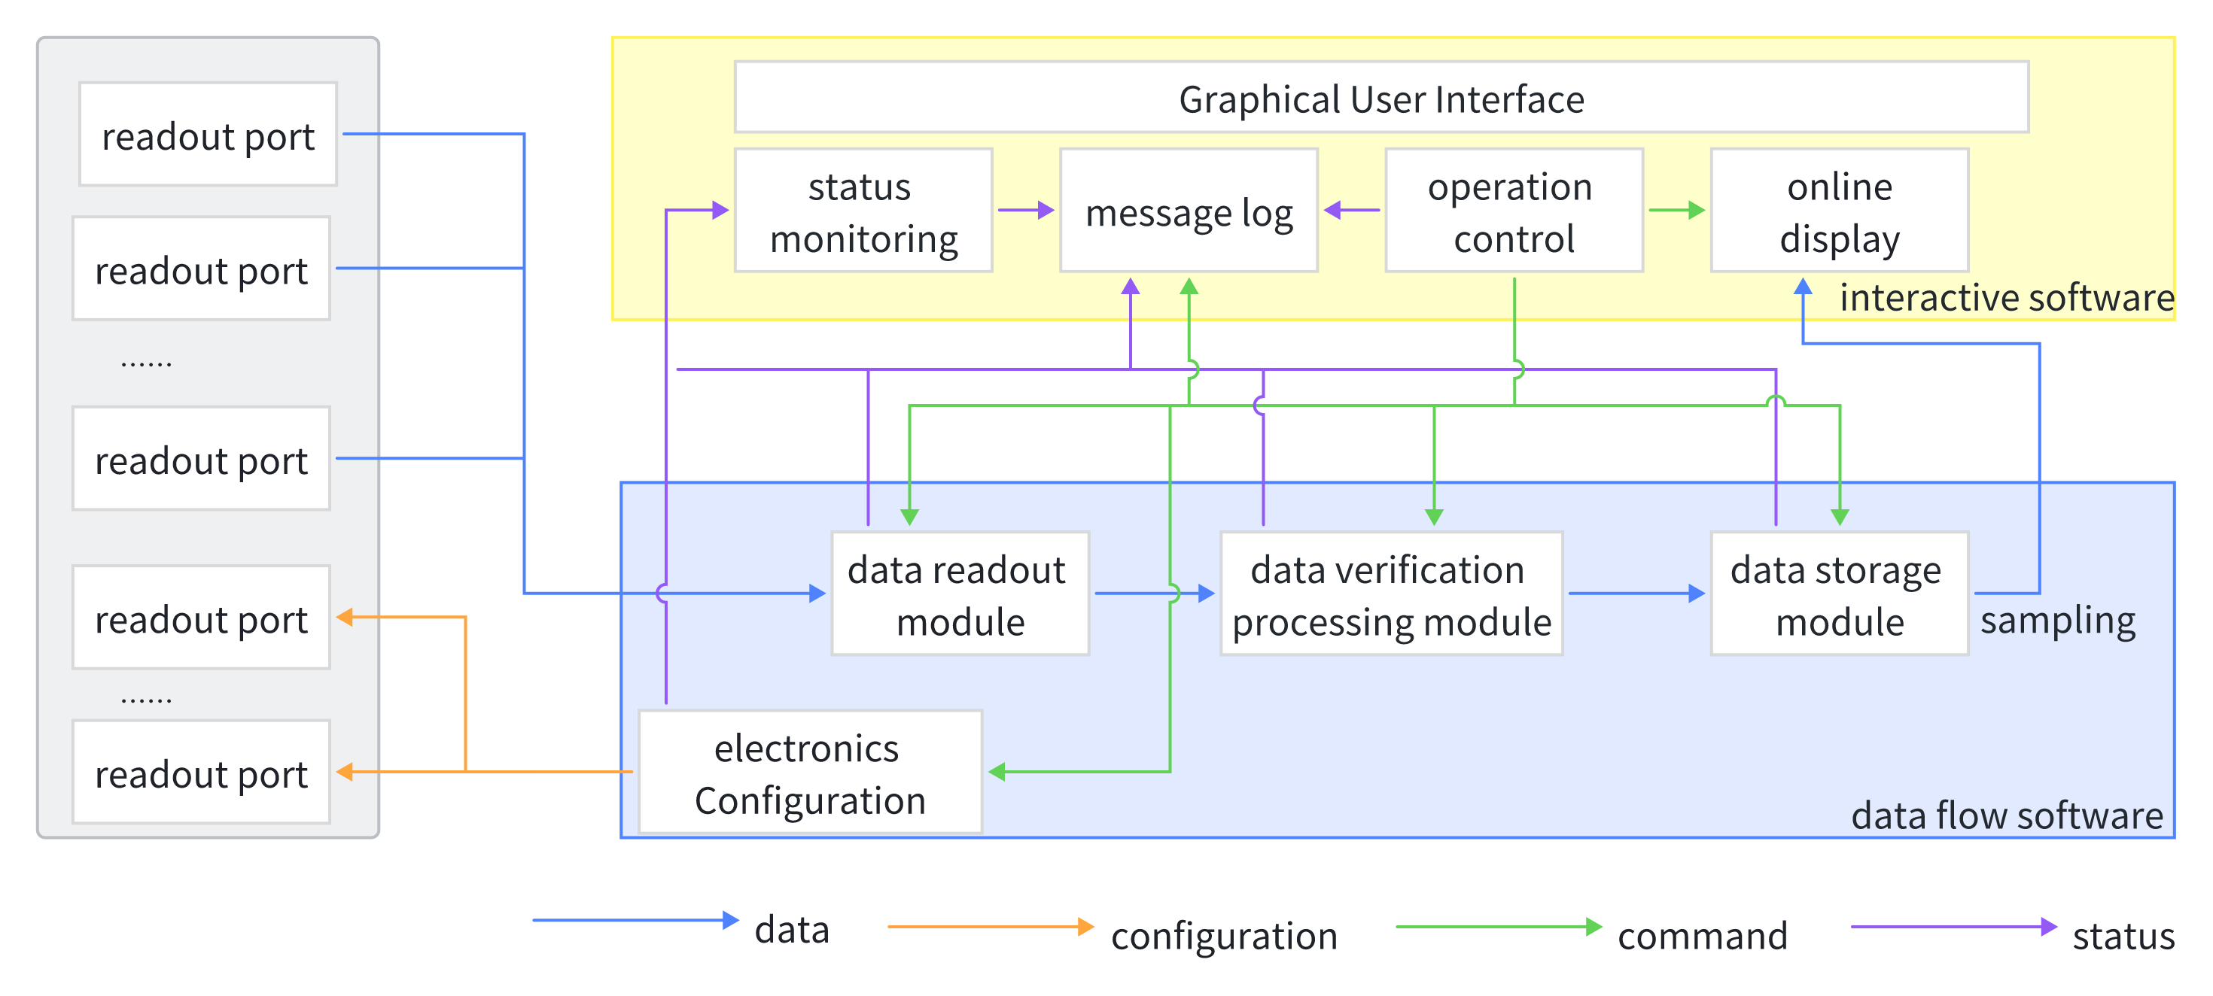
Design and implementation of Data Acquisition Software
Adopting a modular design strategy, with good scalability and easy system deployment and maintenance
Data Flow
  Electronics Configuration
  Raw Data readout from Front-End Electronics
  Data package check
  Online data processing
  Storage
User Interface
  Providing services to the user layer
  Command execution
  Information feedback
  Passing information to the data flow subsystem
Architecture of Data Acquisition Software

Slide 7
Implementation of DAQ Software – Data Flow
Multitasking parallelism: Multithreading
Simple data sharing
low memory usage
easy switching
high CPU utilization
Data transfer: Ring Buffer
Tolerating a certain level of event rate jitter
enhances system stability
Resource management: Finite State Machine
transition between states facilitates the allocation and release of system resources
ensuring smooth and efficient software operation
Multithreaded data readout
Multithreaded data processing

Slide 8
Implementation of DAQ Software – Data Flow
Multitasking parallelism: Multithreading
Simple data sharing
low memory usage
easy switching
high CPU utilization.
Data transfer: Ring Buffer
Tolerating a certain level of event rate jitter
enhances system stability
Resource management: Finite State Machine
transition between states facilitates the allocation and release of system resources
ensuring smooth and efficient software operation
Ring Buffer
Reduce coupling between two threads while providing buffering capability

Slide 9
Implementation of DAQ Software – Data Flow
Multitasking parallelism: Multithreading
Simple data sharing
low memory usage
easy switching
high CPU utilization.
Data transfer: Ring Buffer
Tolerating a certain level of event rate jitter
enhances system stability
Resource management: Finite State Machine
transition between states facilitates the allocation and release of system resources
ensuring smooth and efficient software operation
Data Flow Finite State Machine

Slide 10
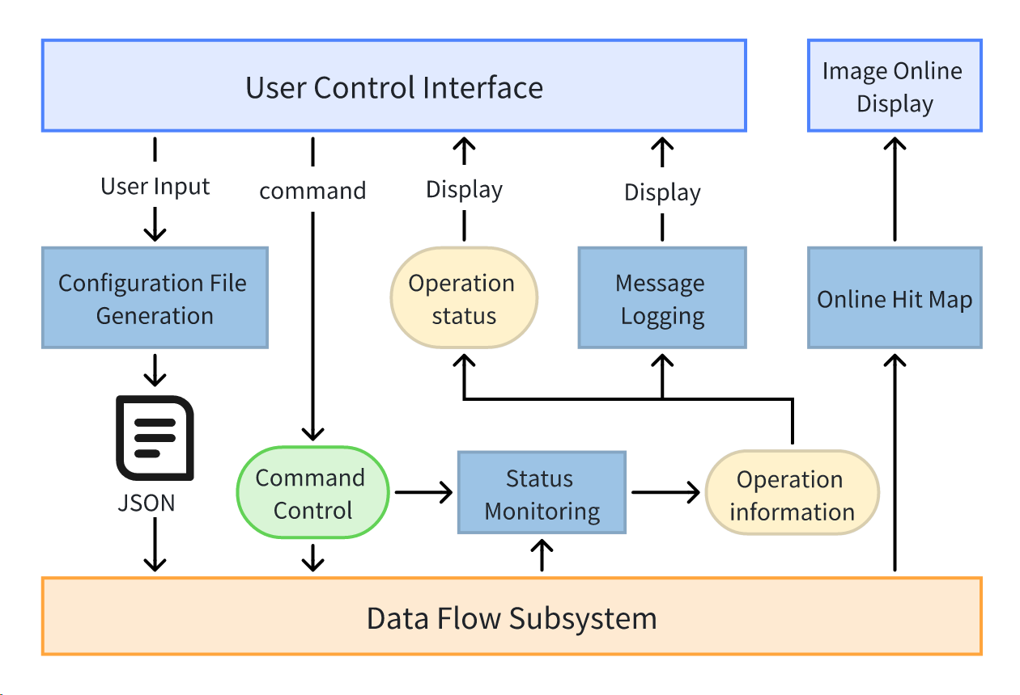
Implementation of DAQ Software – User Interface
Receive control commands from the user and feedback the operational status of the data flow to the user.
Exchange information with the Data Flow subsystem
Modular Design Strategy
  Configuration File Generation Module
  Status Monitoring Module
  Message Logging Module
  Online Hit Map
Developed based on the JavaFX framework
  Rich and visually appealing controls
  Supports importing third-party controls

Slide 11
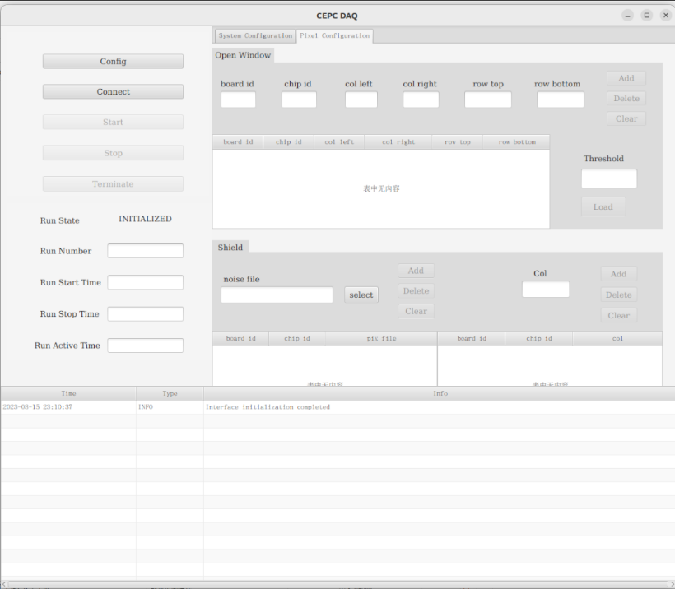
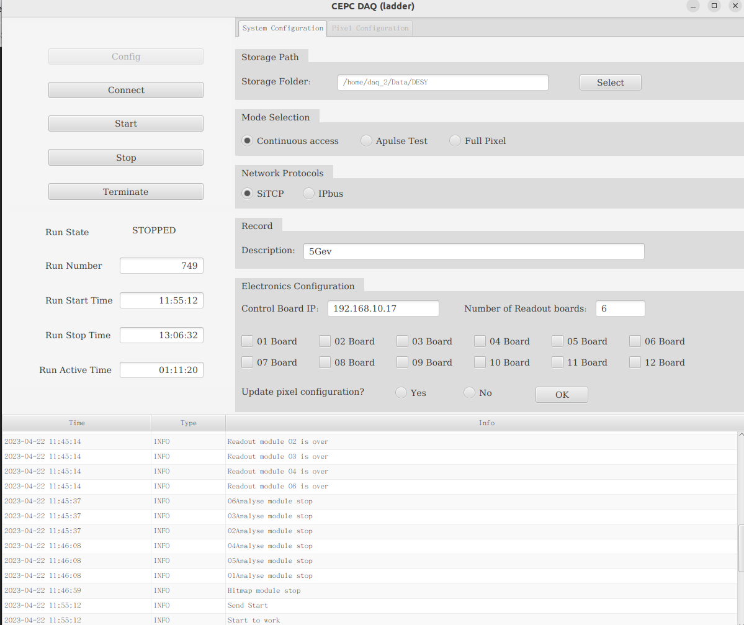
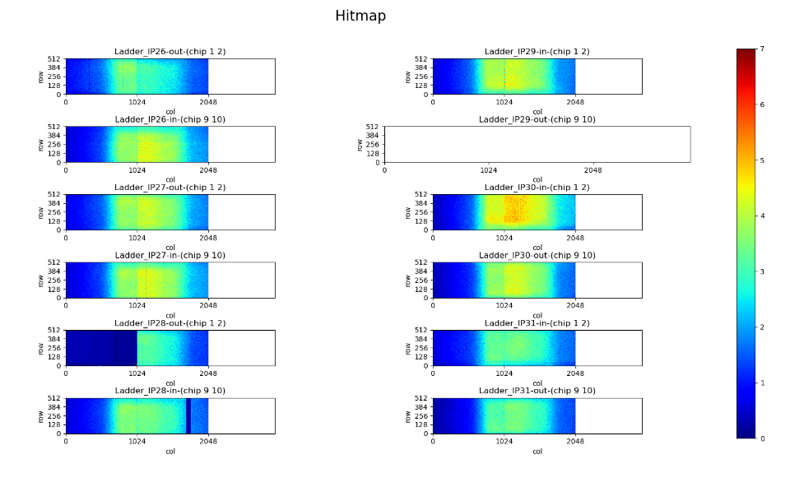
Implementation of DAQ Software – Graphical User Interface
Run Control Area
Configuration Information Area
Sensor Parameter Configuration Area
Status Display Area
Log information Area
Hit map Display

Slide 12
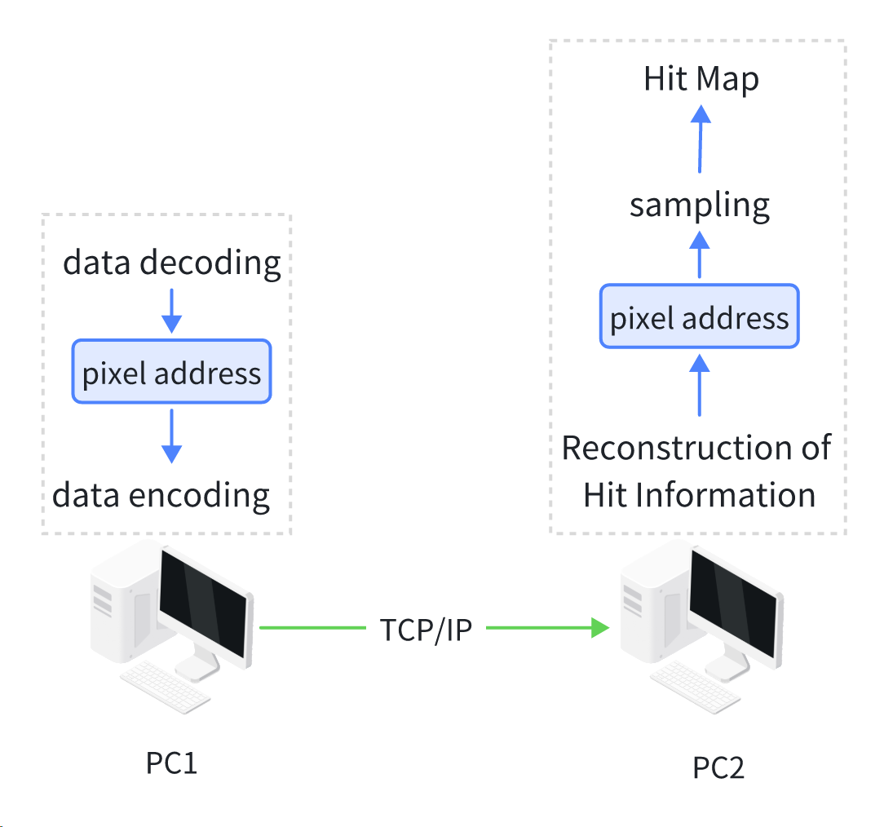
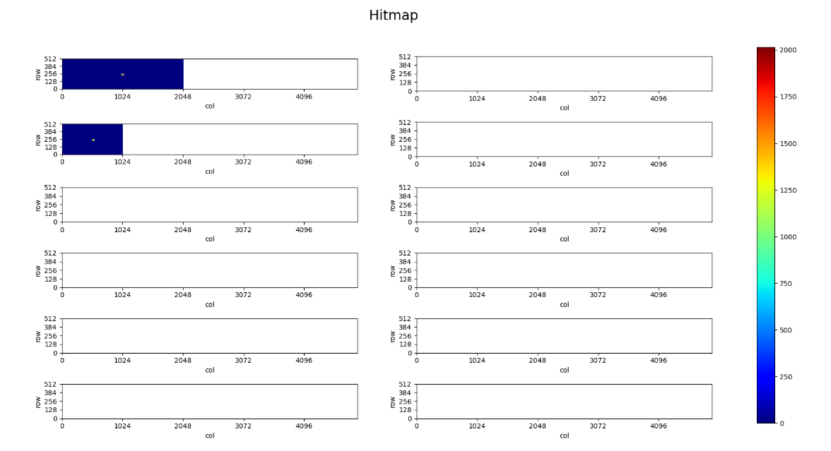
Implementation of DAQ Software – Online Hit Map
Convenient for real-time monitoring of chip operation
Obtains the required data through a TCP connection
    Can be deployed on any computer, has strong flexibility
Organize and fill the drawing data in a Ladder format
    Only fill the parts of the chip where pixels have been hit
    If there is no hit data, no image will be displayed
The Process of Generating an Online Hit Map
Online Hit Information Reconstruction

Slide 13
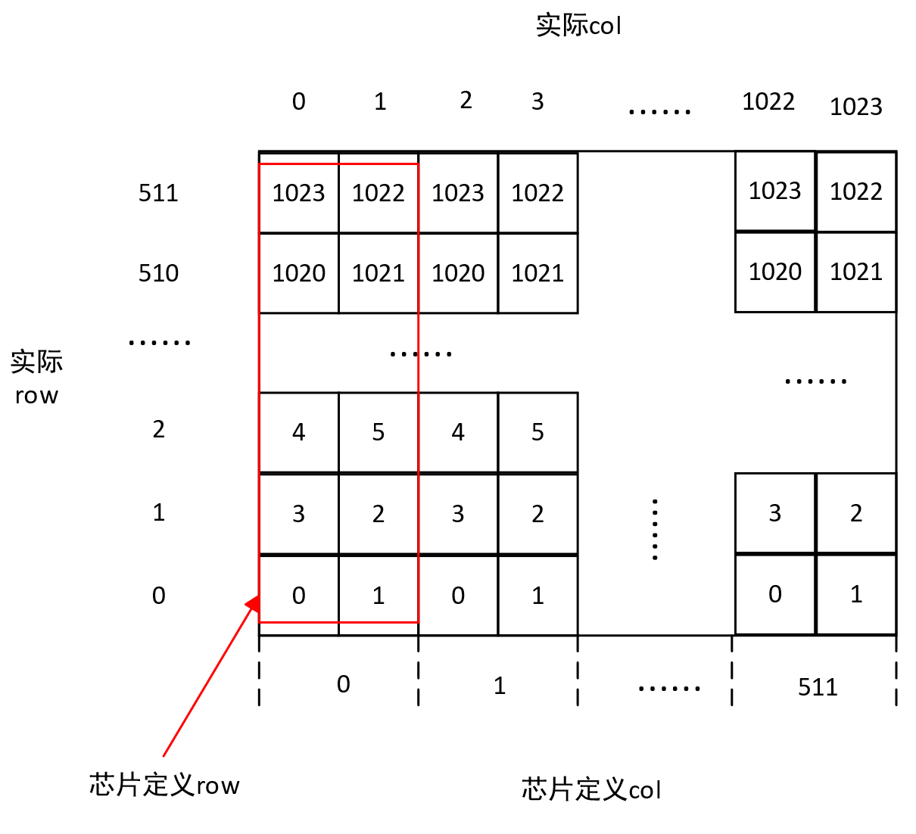
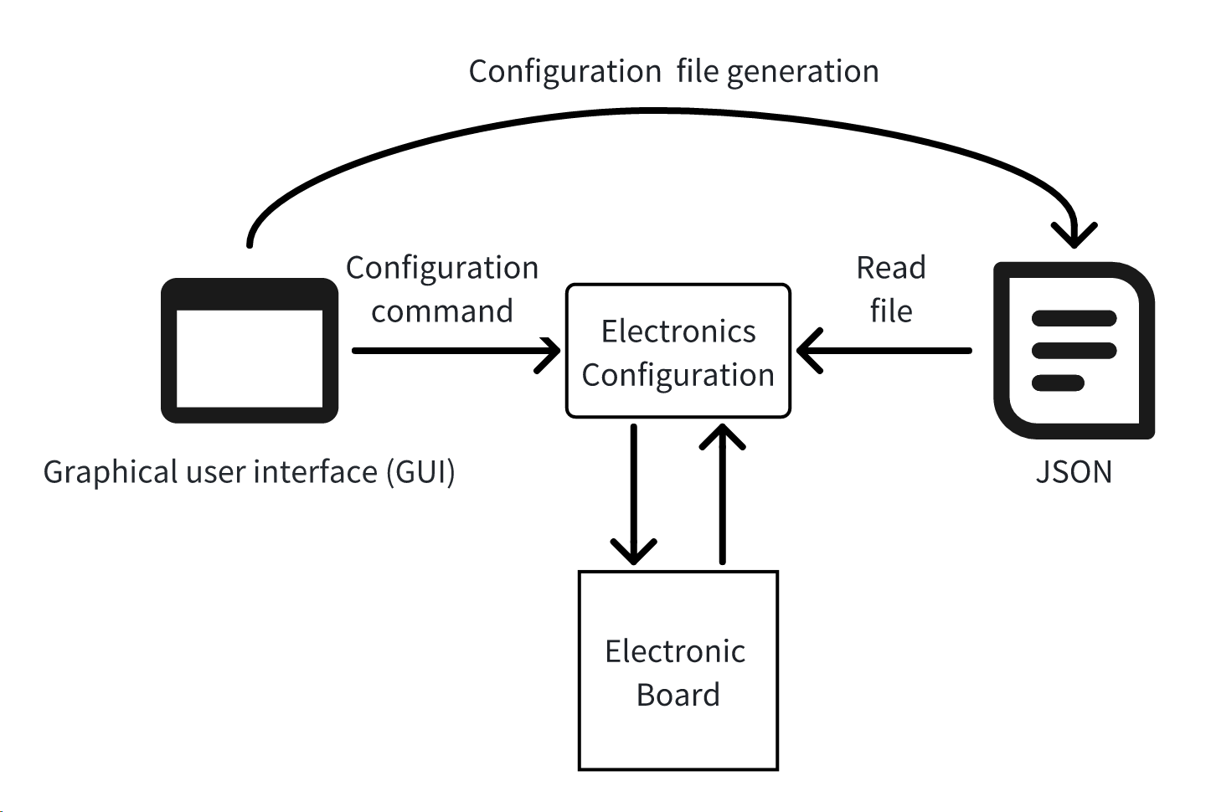
Implementation of DAQ Software – Configuration File Generation
Implement address translation
Generate configuration files in JSON format
Provide support for configuring entire columns as well as window-based configurations
actual column
physical address address in the chip
actual
row
row in chip
column in chip
Chip Pixel Arrangement
Configuration function implementation process

Slide 14
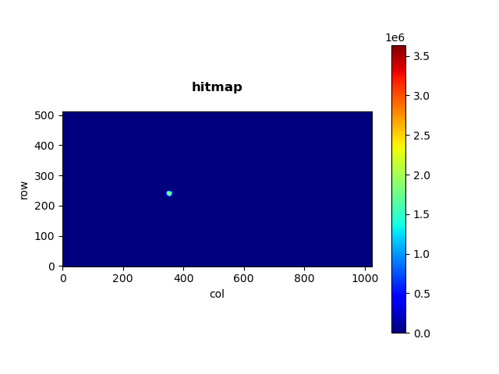
Laboratory Laser Test
Test the functionality and performance of the software
Experimental conditions:
    Single readout board
    The laser emission frequency is gradually adjusted from 50 Hz to 50 kHz
    Data rate: 17 kB/s to 15 MB/s
    Experimental results:
    The software was continuously run for a long time at a data rate of 15 MB/s
    The results indicate that the software can maintain long-term stable operation at high laser frequencies, meeting the requirements of the final beam experiment
Laboratory laser test single chip hit map

Slide 15
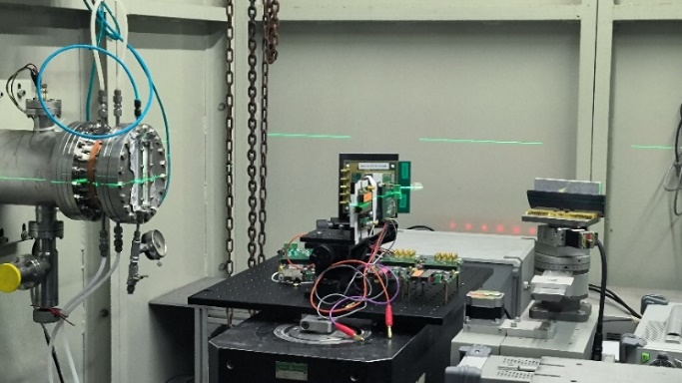
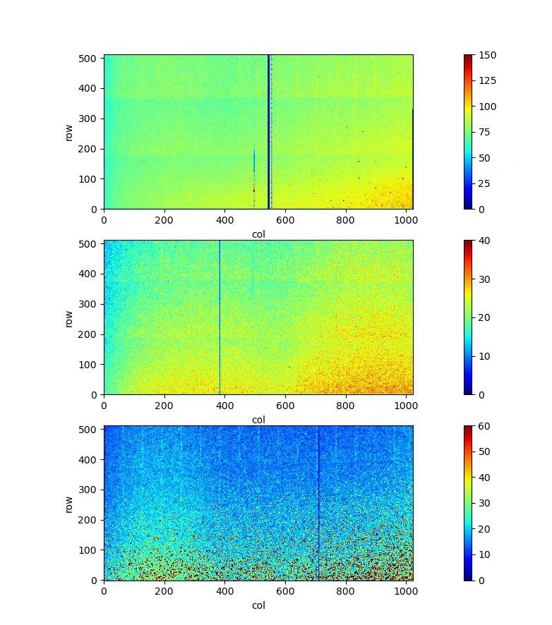
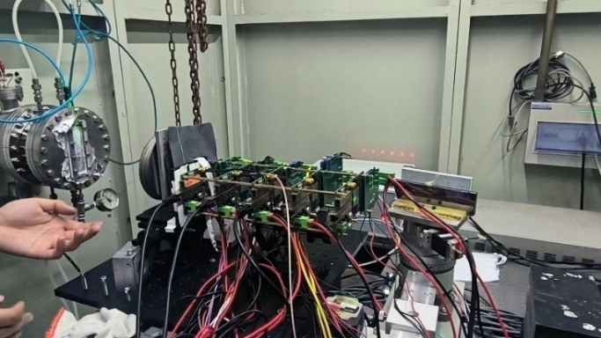
Synchrotron Radiation Experiments
Beijing Synchrotron Radiation Facility (BSRF) Beamline-4W1A
Experimental conditions:
    Full system: Detector, electronics, data acquisition software
    From single readout board to multiple readout boards data acquisition test
    Long-term data acquisition (1~10h)
Experiment results:
    DAQ software operates stably for over 10 hours
    Data readout successfully completed
Single Readout Board Setup
Multi-board Readouts Setup
Accumulated Hit-map

Slide 16
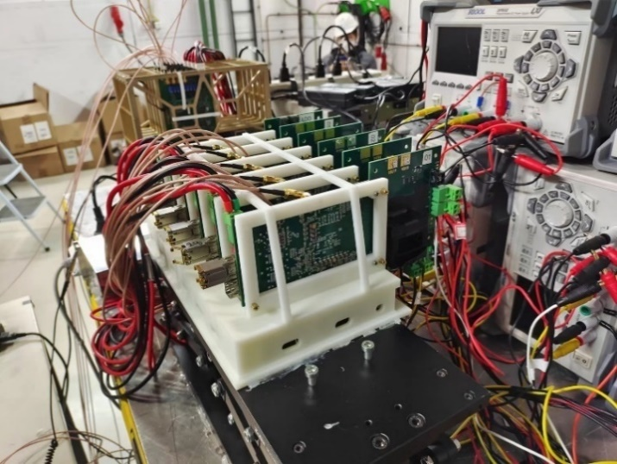
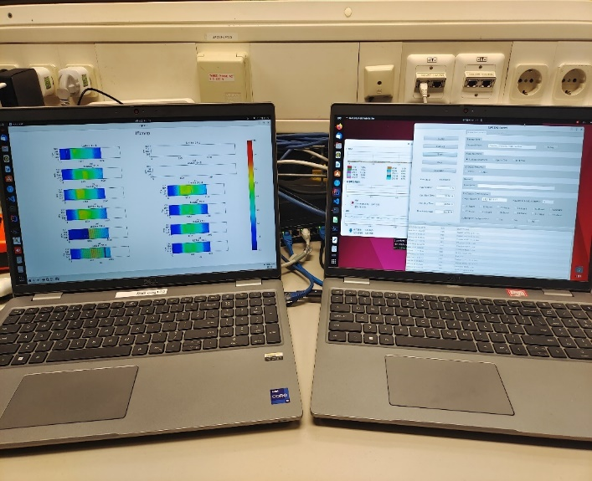
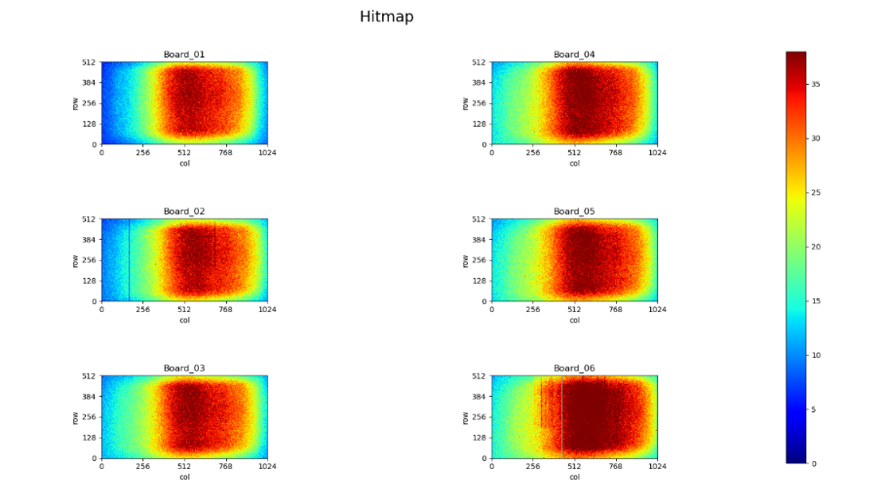
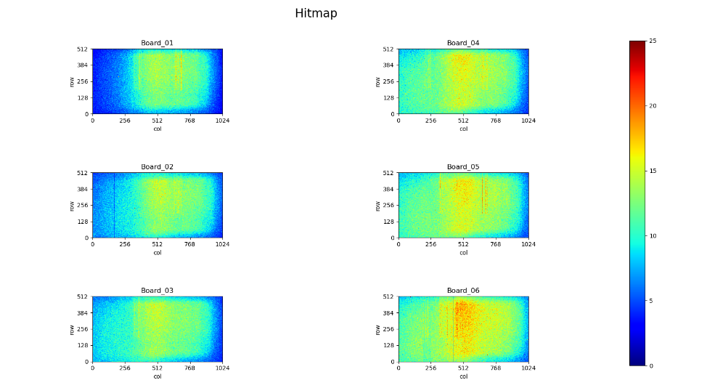
Beamline Test at DESY – Telescope
Test location: DESY T21 Beamline
12/12/2022 – 22/12/2022
Experimental condition：
    The telescope system is composed of 6 layers of TaichuPix-3
    The beam spot size: 1 cm x 1 cm
    Beam energy : 4 - 6 GeV
  Test results：
    A total of 280 runs were conducted, with a data rate of 0.4 - 2.5 MBps
Spatial resolution and efficiency test
Telescope System setup
DAQ software in operation

Slide 17
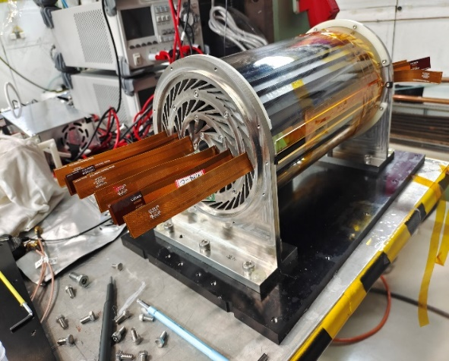
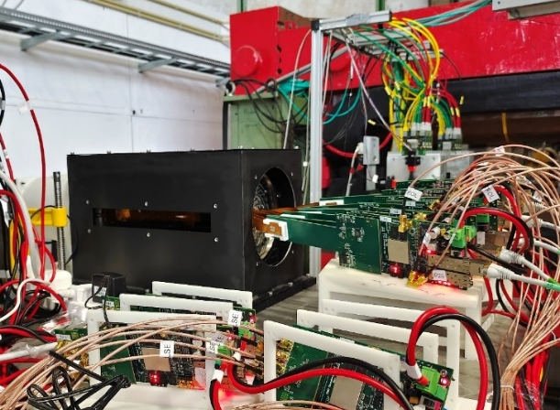
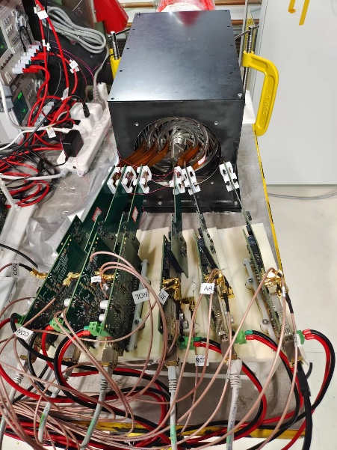
Beamline Test at DESY – Full Size CEPC Vertex Detector Prototype
Test location: DESY T21 Beamline
11/04/2023 – 24/04/2023
Experimental condition：
    Prototype consisting of 6 layers of double-sided ladders
    The first full-size prototype of the CEPC vertex detector
    The beam spot size: 2.5 cm x 2.5 cm
    Main data acquisition beam energies: 5, 5.4, 6 GeV
Test results：
    A total of 303 data acquisitions were conducted (at different thresholds, energies, beam spot positions, and cooling methods)
    Data rate 5-23 MBps, total data volume 4.3 TB
Detector prototype
System setup

Slide 18
Summary
In response to the experimental requirements of the CEPC silicon pixel vertex detector prototype, a cross-platform data acquisition software based on the Java language and JavaFx framework was designed and implemented.
The application of the software in synchrotron experiment and beam experiments has shown that it is fully functional and its performance meets the experimental requirements, and it can operate stably for a long time in complex beam environments.
Data obtained from the two beam experiments has been analyzed. Performance study and results of the prototype system, including spatial resolution and efficiency, are ready to be published.

Slide 19
Acknowledgement
Thanks to DESY for providing the excellent beam facilities!

Slide 20


Thank you for your attention!

