Slide 1
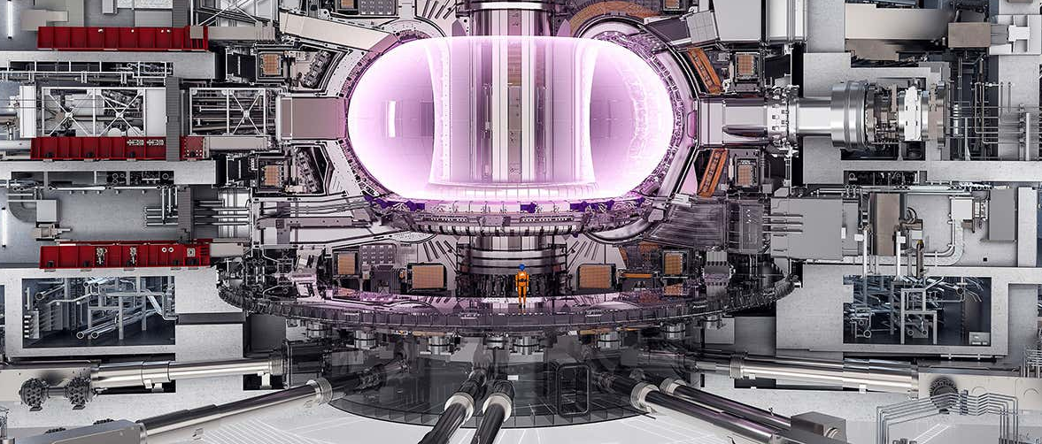
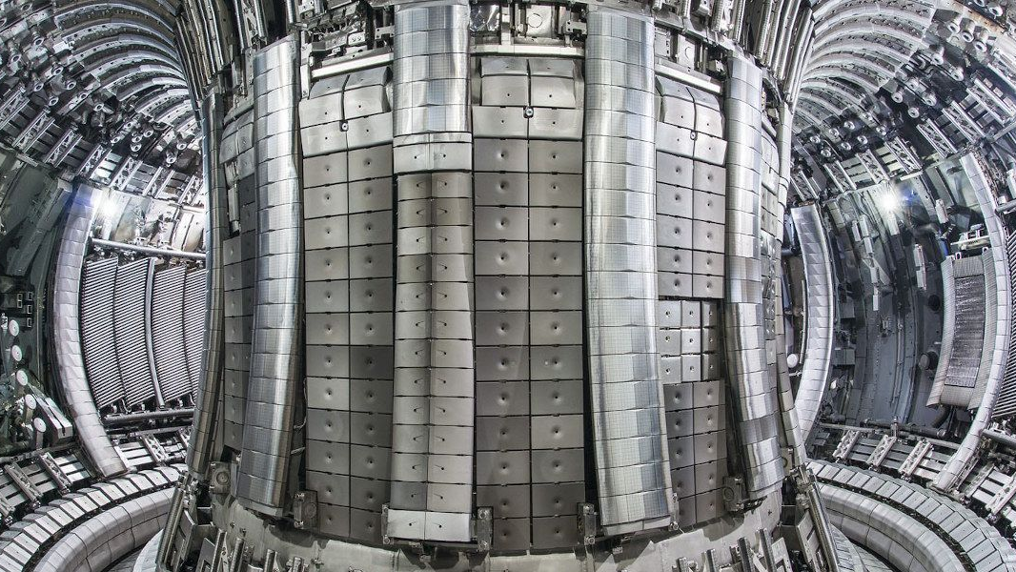



Assessing NI FPGA-based platform with MXIe interface for use in ITER hard real-time investment protection applications
D. Karkinsky¹, A. Marqueta¹, E. Barrera², I. García-Siguero², J. Varlec³, M. Ruiz², M. Sekoranja³, P. Rebollo², and T. Kogovsek³
${}_{}^{1}{\text{ITER}}$ Organization, St. Paul-lez-Durance, 13067 France.
${}_{}^{2}{\text{Instrumentation}}$ and Applied Acoustic Research Group (I2A2), Universidad Politécnica de Madrid, Madrid, Spain.
${}_{}^{3}{\text{Cosylab}},$Gerbičeva ulica 64, 1000 Ljubljana, Slovenia.
ACKNOWLEDGEMENTS
This work was supported under grant PID2022-137680OB-C33 funded by MCIN/AEI/10.13039/501100011033

Slide 2
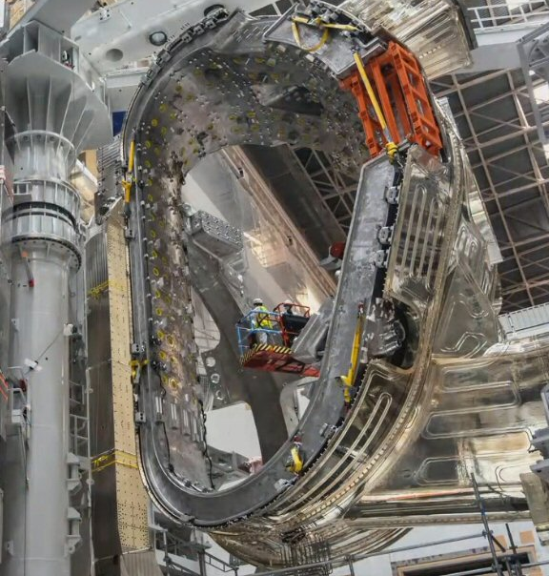
text
OUTLINE
Background
Motivation
Step 1 – IO Timekeeper
Step 2 – Improve the kernel module & MARTe2 interface
Step 3 – MXIe interface management
Validation
Results & Conclusions
text
text
text

Slide 3
Background I
The Interlock Control System (ICS) is the ITER system that implements the Investment Protection Functions, and is responsible for protecting the integrity of the machine against any possible failure
It is divided into different architectures: hardwired, slow (PLC) and fast (FPGA)
The cRIO NI9159 was qualified for use in the design of the ITER ICS Fast Architectures in 2016 using redundant two-chassis architecture in 1oo2D mode
  As part of the qualification IO commissioned open-source Linux drivers,
  Performed detailed analysis of the platform’s internal architecture¹
  Following the IEC 61508 standard guidelines²
  Development through the LabVIEW FPGA tool
MARTe2 application & host with TCN connection
E. Barrera et al., "Implementation of ITER Fast Plant Interlock System Using FPGAs With CompactRIO," IEEE Transactions on Nuclear Science, vol. 65, no. 2, pp. 796-804, Feb. 2018, doi: 10.1109/TNS.2017.2783243.
I. García-Siguero et al., "Verification and Validation of ITER Interlock System Fast Architecture According to IEC 61508 Standard" IEEE Transactions on Nuclear Science, vol. 70, no. 6, pp. 1164-1170, June 2023, doi: 10.1109/TNS.2022.3224780

Slide 4
Background II
The ICS was designed for event-action coordination (pure-logic) in 2016¹
In 2021 the ICS adopted the functions of the Advanced Protection Systems (APS) and the evaluation of the priority of machine stop requests.
  Functions contain elements of dynamic control.
APS:
  detects events with the plasma e.g. disruptions,
  controls shattered pellet injectors to mitigate the disruptions.
ICS Stops request provide a grace-period to conventional layer to reach a desired final state.
  Grace-period requires re-evaluation as events stack-up.
  Expiration causes a request to CIS to escalate to interlock actions.
  All of this led to a change in the paradigm of designed architecture, which caused a number of challenges
Need to synchronize the CompactRIO with the ITER TCN (IEEE1588)
Requirements: jitter of +/- 1 us and worst-case of +/- 5 us
J.L. Fernández-Hernando, D. Carrillo, G. Ciusa, Y. Liu, I. Prieto-Díaz, R. Pedica, S. Sayas, J. Soni, A. Vergara, The ITER interlock system, Fusion Engineering and Design, Volume 129, 2018, Pages 104-108, ISSN 0920-3796,

Slide 5
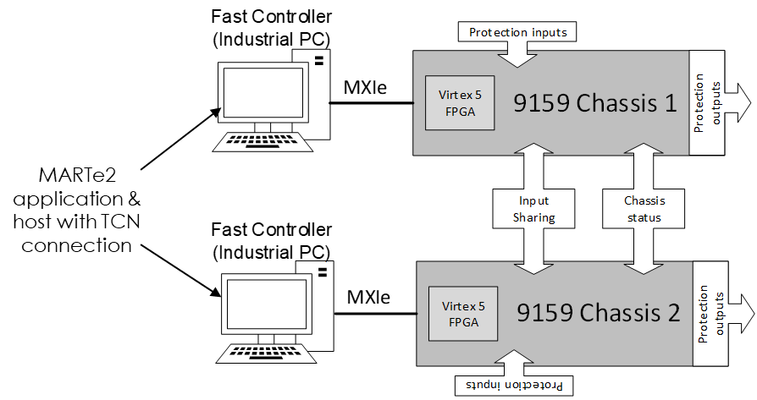
Motivation
Synchronize the chassis with the TCN
Constraints:
1: NI 9159 has no PTP support but the ITER fast controller does.
2: The NI RIO Linux driver has been designed for data-throughput and not for real time.
3: The interface between the chassis and host is a MXIe link

Slide 6
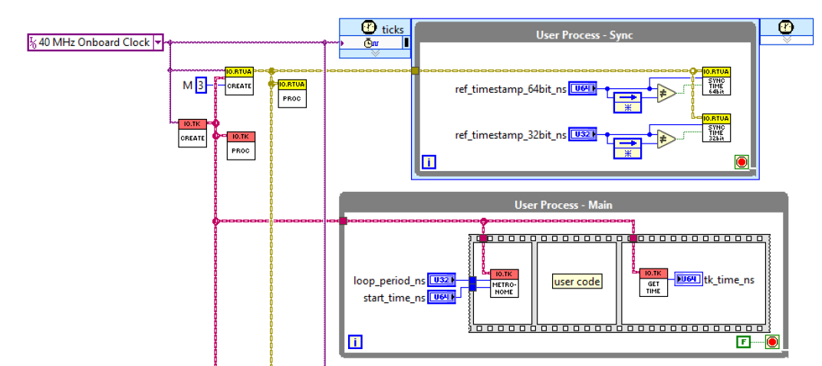
Step 1 – IO Timekeeper
Step 1: Development of IO FPGA Timekeeper Library.
Implements an internal ns counter that is synchronized with PTP time
Provides functions to “wait_until”, “metronome_loop”…
Provides a configurable Proportional Integral (PI) controller. Allows tuning to each particular system.
  Configurable gains, filtering, error rejection and update period
The time value reference must be periodically updated in a LabVIEW register.

Slide 7
IO Timekeeper

Slide 8
Step 2 – Improve the kernel module & MARTe2 interface
Step 2a: Developed a new NI9159 Linux device driver redesigning the current driver to improve real time performance (reduce latency jitter)
  MMIO operations (R/W FPGA Registers)
  Removing unnecessary code (e.g. GPU buffering support)
  Removing unnecessary support for Booleans, uint8 and uint16
  DMA Operations (Host to Target and Target to Host)
  Moving from streaming interface to packet-based interface.
  Providing a zero-timeout polling method to check when a packet is available to be read
  Converting operations to Atomics so that they are not interrupted
  Ported DMA buffers to cache-coherent memory limited to 16 kB (4 Linux pages)
 | Old (Streaming-based) | New (Packet-based)
Read 32-bit FIFO | Std dev = 34 us worst-case = 800 us* | Std dev = 0.2 us worst-case = 4.6 us
Write 32-bit FIFO | - * | Std dev = 1.56 us worst-case = 15.4 us
  *National Instruments information
  Security
  Blocking critical operations on the FPGA for users who do not have privileges (e.g. to download a new bitfile to the FPGA)
  Separate firmware resource query operations
Step 2b: Providing the MARTe2 components for the use of new functions (Interfaces and data sources)

Slide 9
Timekeeper + Kernel Module + MARTe2 Components

Slide 10
Step 3 – MXIe interface management
Step 3a: MARTe2 application employs MXIe temporal segregation
There is no possibility of physical segregation in the MXIe, use temporary segregation.
Perform operations separated in time in a controlled manner minimizing jitter.
  Step 3b: Create a custom Real Time Red Hat tuned profile
  Execute the host applications on a tickless kernel and isolations CPUs

Slide 11
Final Implementation

Slide 12
Validation
  System deployed at UPM facilities

Slide 13
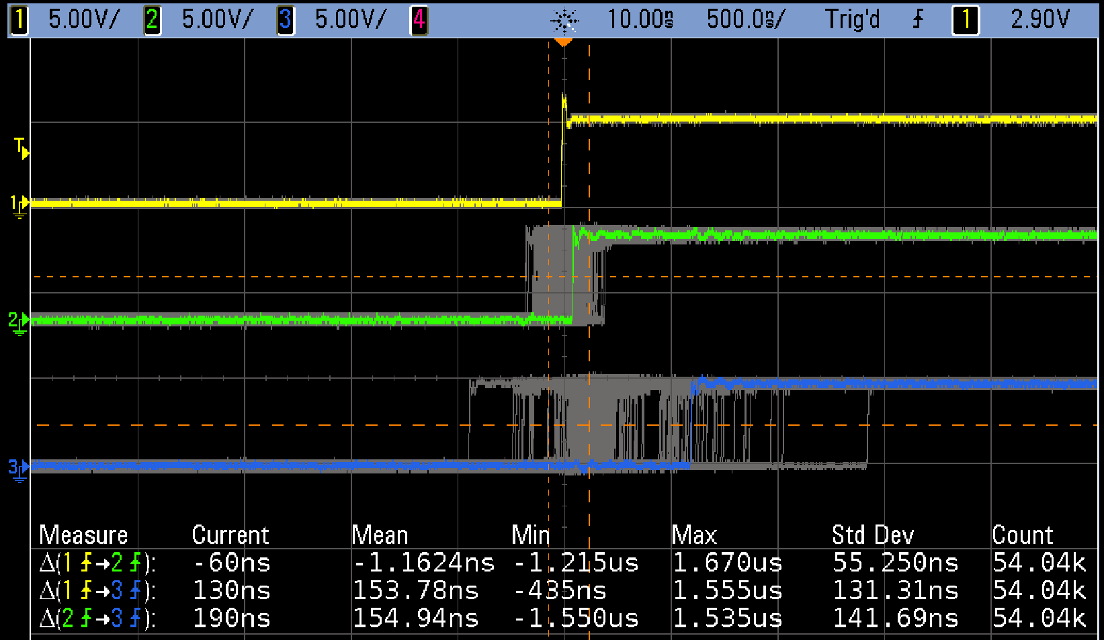
Results & Conclusions
  Test over the full system (with the 3 steps integrated) running 15h.
    System using Time Update and DMAs at 1kHz
 | Std. Dev | Worst-case
Master Clock – Chassis 1 | 55.25 ns | 1698 ns
Master Clock – Chassis 2 | 131.31 ns | 1424 ns
Chassis 1 – Chassis 2 | 141.69 ns | 1705 ns
  Master Clock
  Chassis 1
  Chassis 2
Requirements achieved!

Slide 14
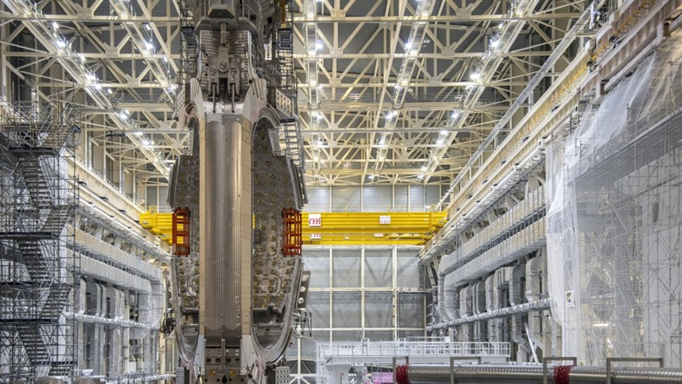
Design and implement the final system and prepare it for commissioning.
Thank you!
Assessing NI FPGA-based platform with MXIe interface for use in ITER hard real-time investment protection applications
D. Karkinsky¹, A. Marqueta¹, E. Barrera², I. García-Siguero², J. Varlec³, M. Ruiz², M. Sekoranja³, P. Rebollo², and T. Kogovsek³
${}_{}^{1}{\text{ITER}}$ Organization, St. Paul-lez-Durance, 13067 France.
${}_{}^{2}{\text{Instrumentation}}$ and Applied Acoustic Research Group (I2A2), Universidad Politécnica de Madrid, Madrid, Spain.
${}_{}^{3}{\text{Cosylab}}\text{, }\text{Gerbi}\text{č}\text{eva} \text{ulica}\text{ 64, 1000 }\text{Ljubljana}\text{, }\text{Slovenia}$.
Responsible: Damien.karkinsky@iter.org
Presenter: i.gsiguero@i2a2.upm.es
ACKNOWLEDGEMENTS
This work was supported under grant PID2022-137680OB-C33 funded by MCIN/AEI/10.13039/501100011033

Slide 15
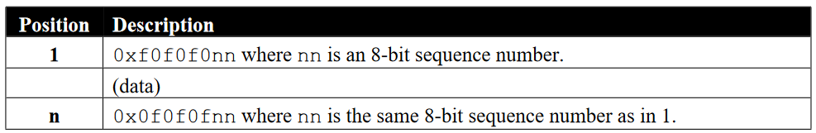
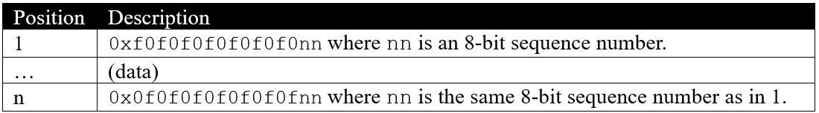
BACKUP SLIDES
Packet-based DMAs

