Slide 1



A High Compression Ratio Channel Multiplexing Method for Micro-pattern Gaseous Detectors
Yu Wang, Shubin Liu, Hao Zhuang, Zhengwu Ding, Yulin Liu,
Changqing Feng, Zhiyong Zhang
On behalf of μSTC group
μSTC ：μ(muon) Scattering tomography & Transmission radiography imaging faCility
University of Science and Technology of China
State Key Laboratory of Particle Detection and Electronics, USTC
24th IEEE Real Time Conference Apr 25, 2024
ICISE, Quy Nhon, Vietnam

Slide 2
Outline
Introduction of MPGD
Multiplexing readout principles
  Basic principles
  Construct the usable multiplexing circuits
Applied in muon imaging experiments
  Channel multiplexing circuits for different size detectors
  Extensible module design
Prototype construction and muography experiments
Summary

Slide 3
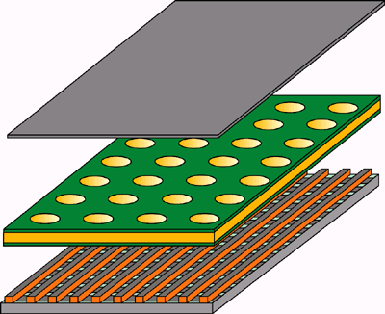
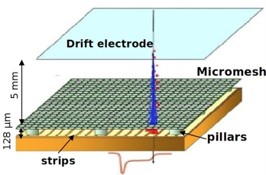
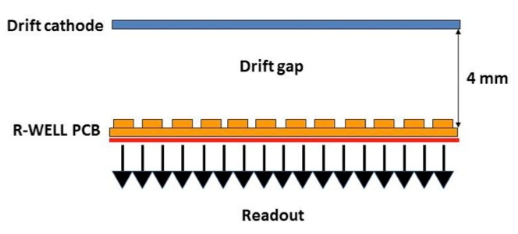
Micro Pattern Gaseous Detectors -- MPGD
Gaseous ionization detectors consisting of microelectronic structures with sub-millimeter distances between anode and cathode electrodes.
  Cost-effectively cover large areas with excellent spatial resolution
  Ability to operate at high incident particle rates
GEM, Micromegas, μRWELL, Thick-GEM, μGroove,…
Micromegas
μRWell
GEM
Credit: https://cerncourier.com/a/a-gem-of-a-detector/
DOI: 10.1088/1748-0221/7/05/C05001
DOI: 10.1088/1748-0221/10/02/P02008

Slide 4
MPGD Readout Principle
Using Micromegas detectors as an example
  A fast electron signal and a relative slow ion signal
  The primary ionization will spread within a range of several millimeters
Typical readout unit
  1D strip, 2D strips
  2D “XVY” pads, 2D pads

Slide 5
MPGD Readout Challenges
Need large mount of readout channels
  The spatial resolution depends on the position measurement
  To obtain fine spatial resolution, the readout unit should be serval hundred micrometers
Need complex readout electronics
  Brings challenges in terms of system complexity, power consumption, processing capability, and cost.

Slide 6
Solutions in Sparse Hit Events
Sparse hit
  Means two particle would not hit the detector “simultaneously”
  ⇒Most of the time, only a few of the channels are fired
  Most of the channels are in state of no signal
  The fired unit at detector sides must be continues
Channel multiplexing method can be applied
Eg：
1. At readout side:ch1 and ch3 are fired
2. The possible hit unit at detector side are
1, 3, 8, 9
3. As the hit unit must be continuous, the real results is D8 and D9

Slide 7
Basic multiplexing readout principles
The construction of multiplexing graph
  ①➁➂➃➄…stand for detector readout units
  1, 2, 3, 4, 5, … stand for number of readout electronics channels
  The mapping of a continuous detector channels to a unique pair of electronics channels
Detector side

Slide 8
Basic multiplexing readout principles
The construction of multiplexing graph
  ①➁➂➃➄…stand for detector readout units
  1, 2, 3, 4, 5, … stand for number of readout electronics channels
  The mapping of a continuous detector channels to a unique pair of electronics channels
Detector side

Slide 9
Basic multiplexing readout principles
The construction of multiplexing graph
  ①➁➂➃➄…stand for detector readout units
  1, 2, 3, 4, 5, … stand for number of readout electronics channels
  The mapping of a continuous detector channels to a unique pair of electronics channels
Detector side

Slide 10
Basic multiplexing readout principles
The construction of multiplexing graph
  ①➁➂➃➄…stand for detector readout units
  1, 2, 3, 4, 5, … stand for number of readout electronics channels
  The mapping of a continuous detector channels to a unique pair of electronics channels
Detector side

Slide 11
Basic multiplexing readout principles
The construction of multiplexing graph
  ①➁➂➃➄…stand for detector readout units
  1, 2, 3, 4, 5, … stand for number of readout electronics channels
  The mapping of a continuous detector channels to a unique pair of electronics channels
Detector side

Slide 12
Basic multiplexing readout principles
The construction of multiplexing graph
  ①➁➂➃➄…stand for detector readout units
  1, 2, 3, 4, 5, … stand for number of readout electronics channels
  The mapping of a continuous detector channels to a unique pair of electronics channels
Detector side

Slide 13
Basic multiplexing readout principles
The construction of multiplexing graph
  ①➁➂➃➄…stand for detector readout units
  1, 2, 3, 4, 5, … stand for number of readout electronics channels
  The mapping of a continuous detector channels to a unique pair of electronics channels
Detector side

Slide 14
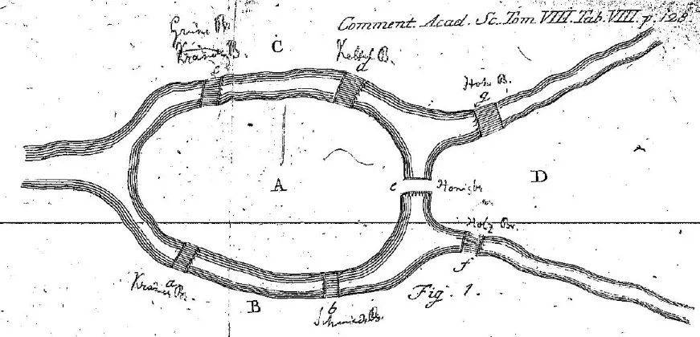

Basic multiplexing readout principles
Multiplexing means construct the Euler path of the graph
  Vertices stand for electronics channels
  Edges stand for readout units of detector
  If a graph has an Euler path
  ⇒It can be used as a multiplexing graph
Seven Bridges of Königsberg

Slide 15
More about multiplexing readout
It not enough to just construct an Euler path
More constrains:
  The distance between two reused channel must be as large as possible
  Each channel of readout electronics should be used in equal

Slide 16
Construct the usable multiplexing graph
Two possible ways:
  The Hamilton path of a complete graph
  The Hamilton path of a bipartite graph
The minimal distance between two reused channel is (N-4)
  N stands for the number of readout electronics channels
  Inspired by these two papers:
    Jimbo Shuji, The Eulerian Recurrent Lengths of Complete Graphs
    Jimbo Shuji, On the Eulerian recurrent lengths of complete bipartite graphs and complete graphs

Slide 17
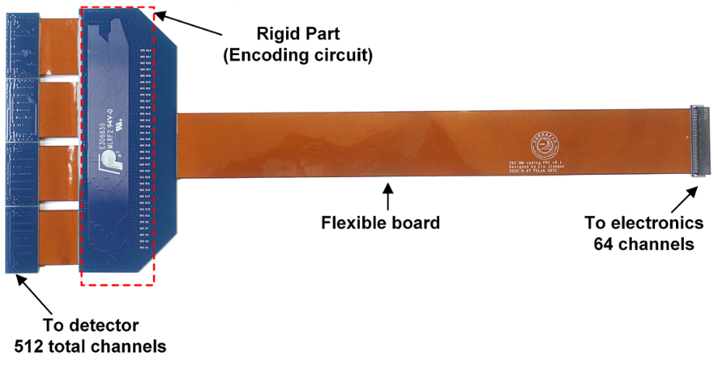
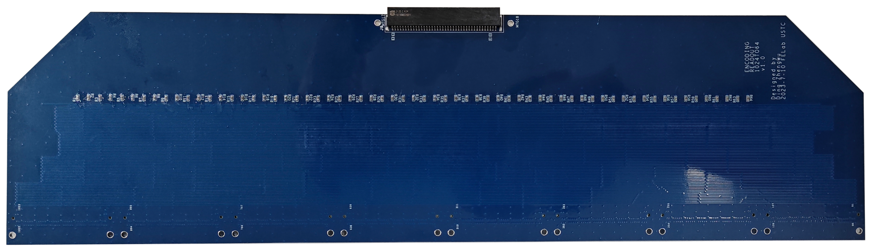
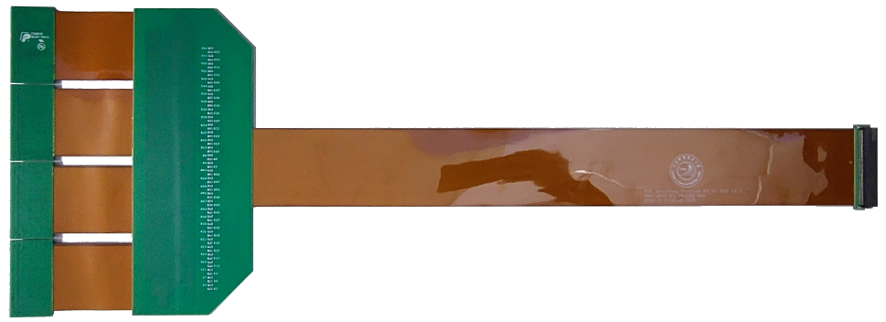
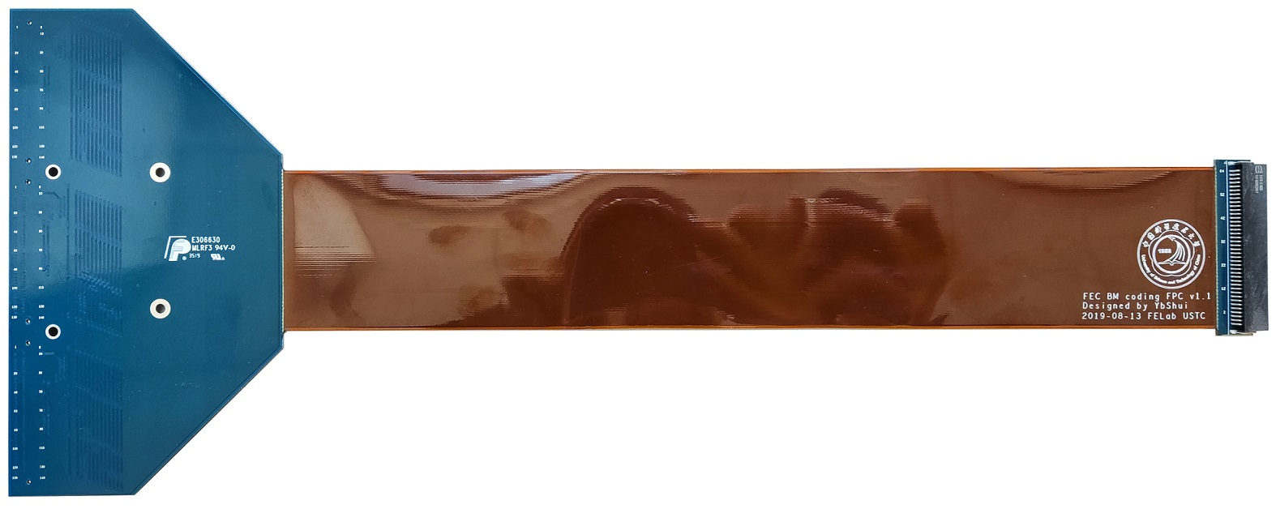
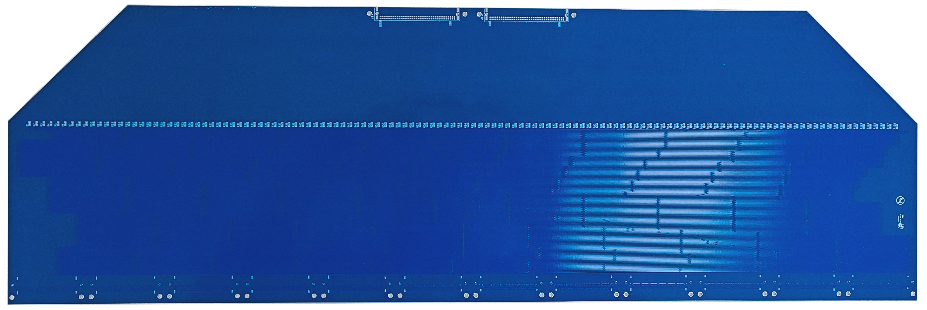
The channel encoding multiplexing circuit
The Eulerian graph theory, to describe the scheme of electronic channel multiplexing
Two different schemes
    Hamilton Circuit Coding Readout Scheme
      For Complete Graphs
      For bipartite graph
Number of chn：512
Compression ratio 8:1
Number of chn：386
Compression ratio 16:1
Number of chn：1024
Compression ratio 6:1
Compression ratio 12:1
Number of chn：1536

Slide 18
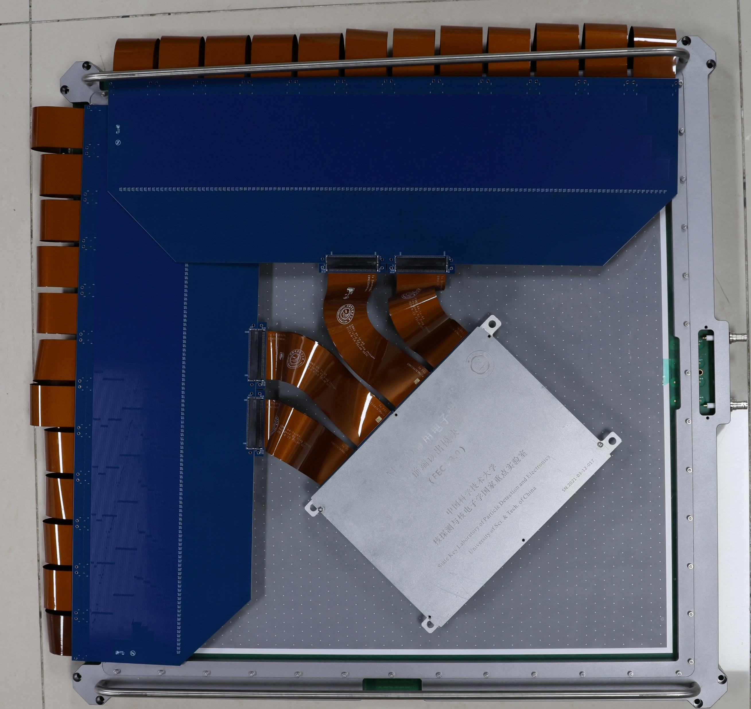
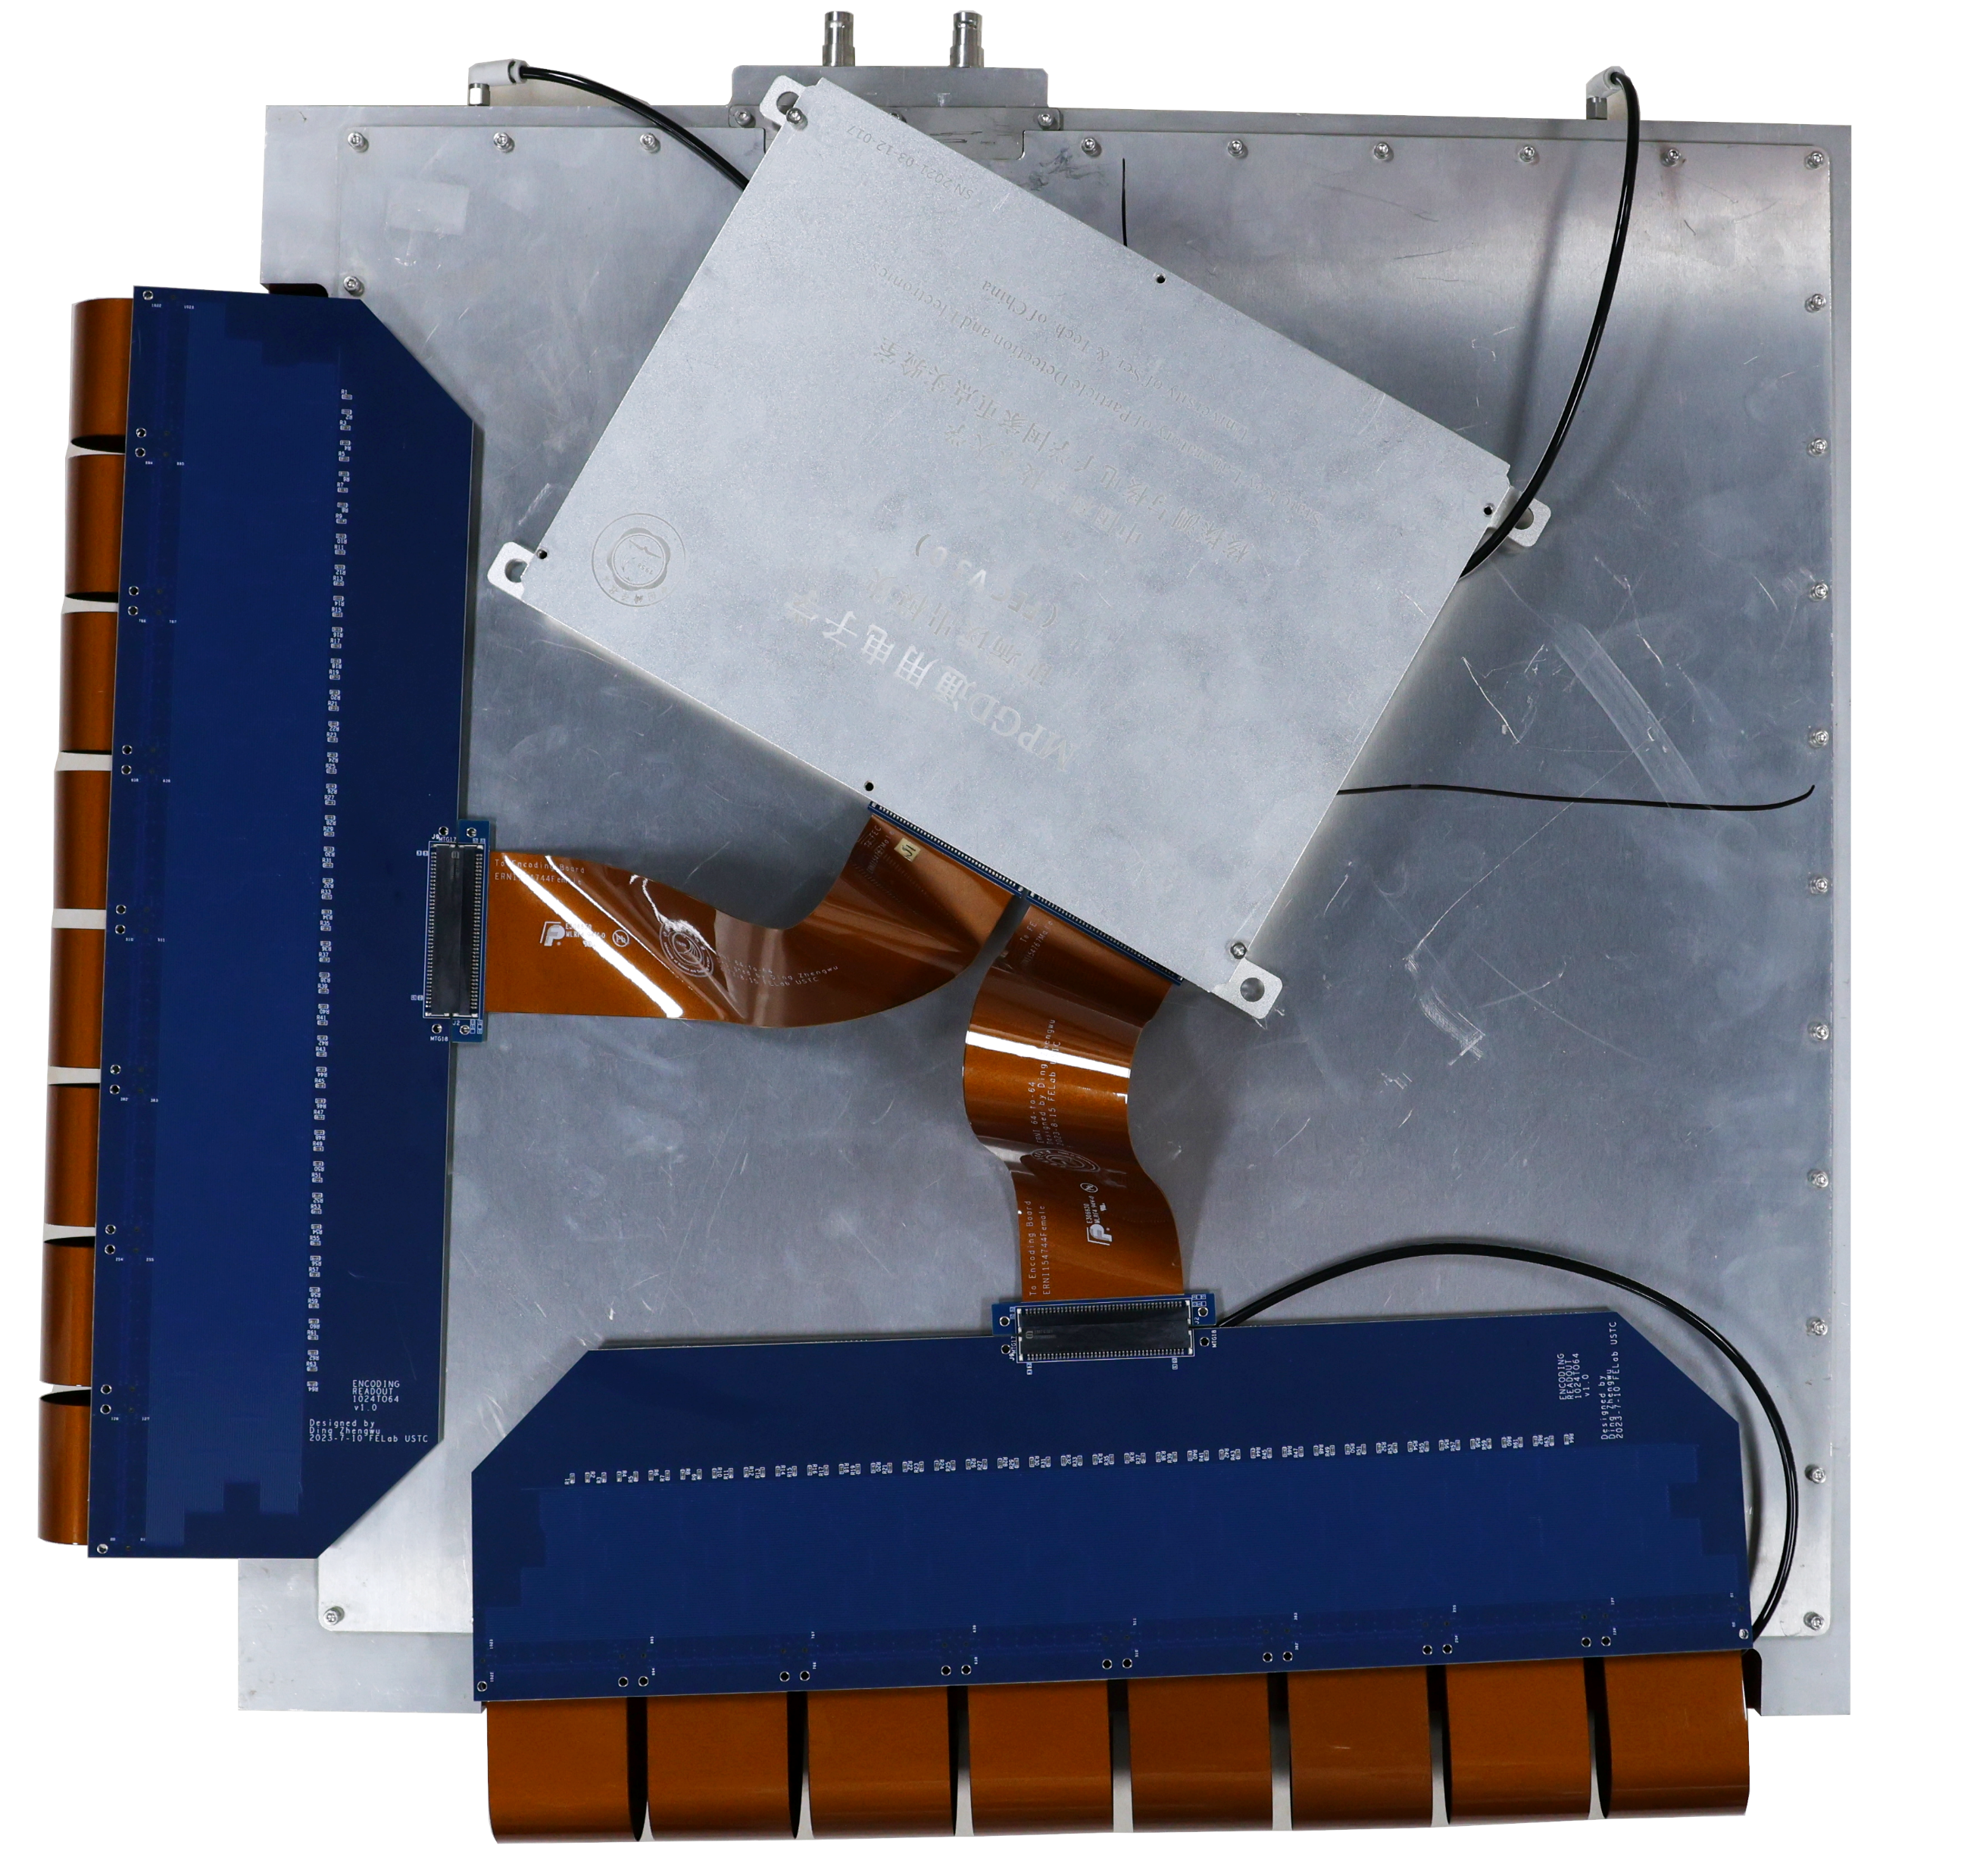
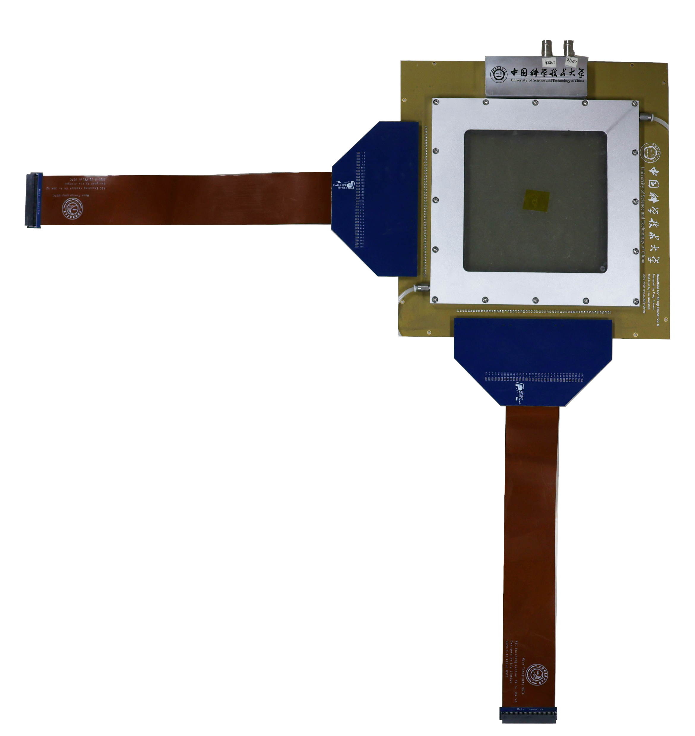
Applied in readout single of Micromegas
Three different type of encoding circuits are designed
  384 detector channels to 64 readout channels
  1024 detector channels to 64 readout channels
  1536 detector channels to 128 readout channels
40cm×40cm
60cm×60cm
15cm×15cm
Num of chn ： 2000
Num of chn ：3000
Num of chn：768

Slide 19
Applied in cosmic-ray muon image
Cosmic muons are produced by cascade of reactions induced by primary cosmic-ray accelerated at astrophysical sources
It can be used as a natural probe to “inspect” the inner structure of the large objects.
Muon Tomography
Muon Radiography
Muon Metrology
Muon
Structure to be measured
floor slab

Slide 20
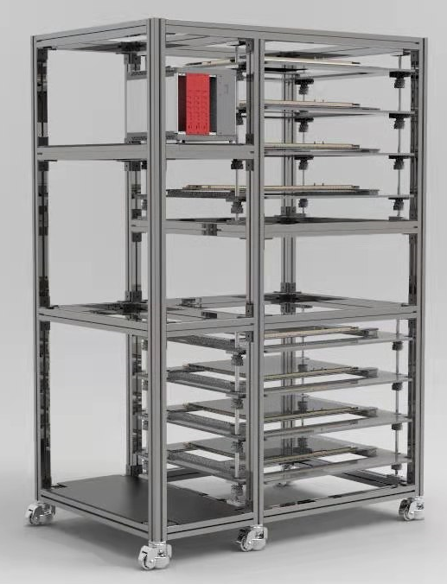
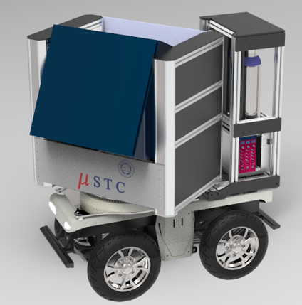
Schematic design
μSTC ：μ(muon) Scattering tomography & Transmission
radiography imaging faCility
μSTC-T for tomography
μSTC-R for radiography
Design goals:
Up to 60 ×60 cm² active area;
< 200 μm spatial resolution for single detector layer;
Rotatable horizontally and vertically for μSTC-R.

Slide 21
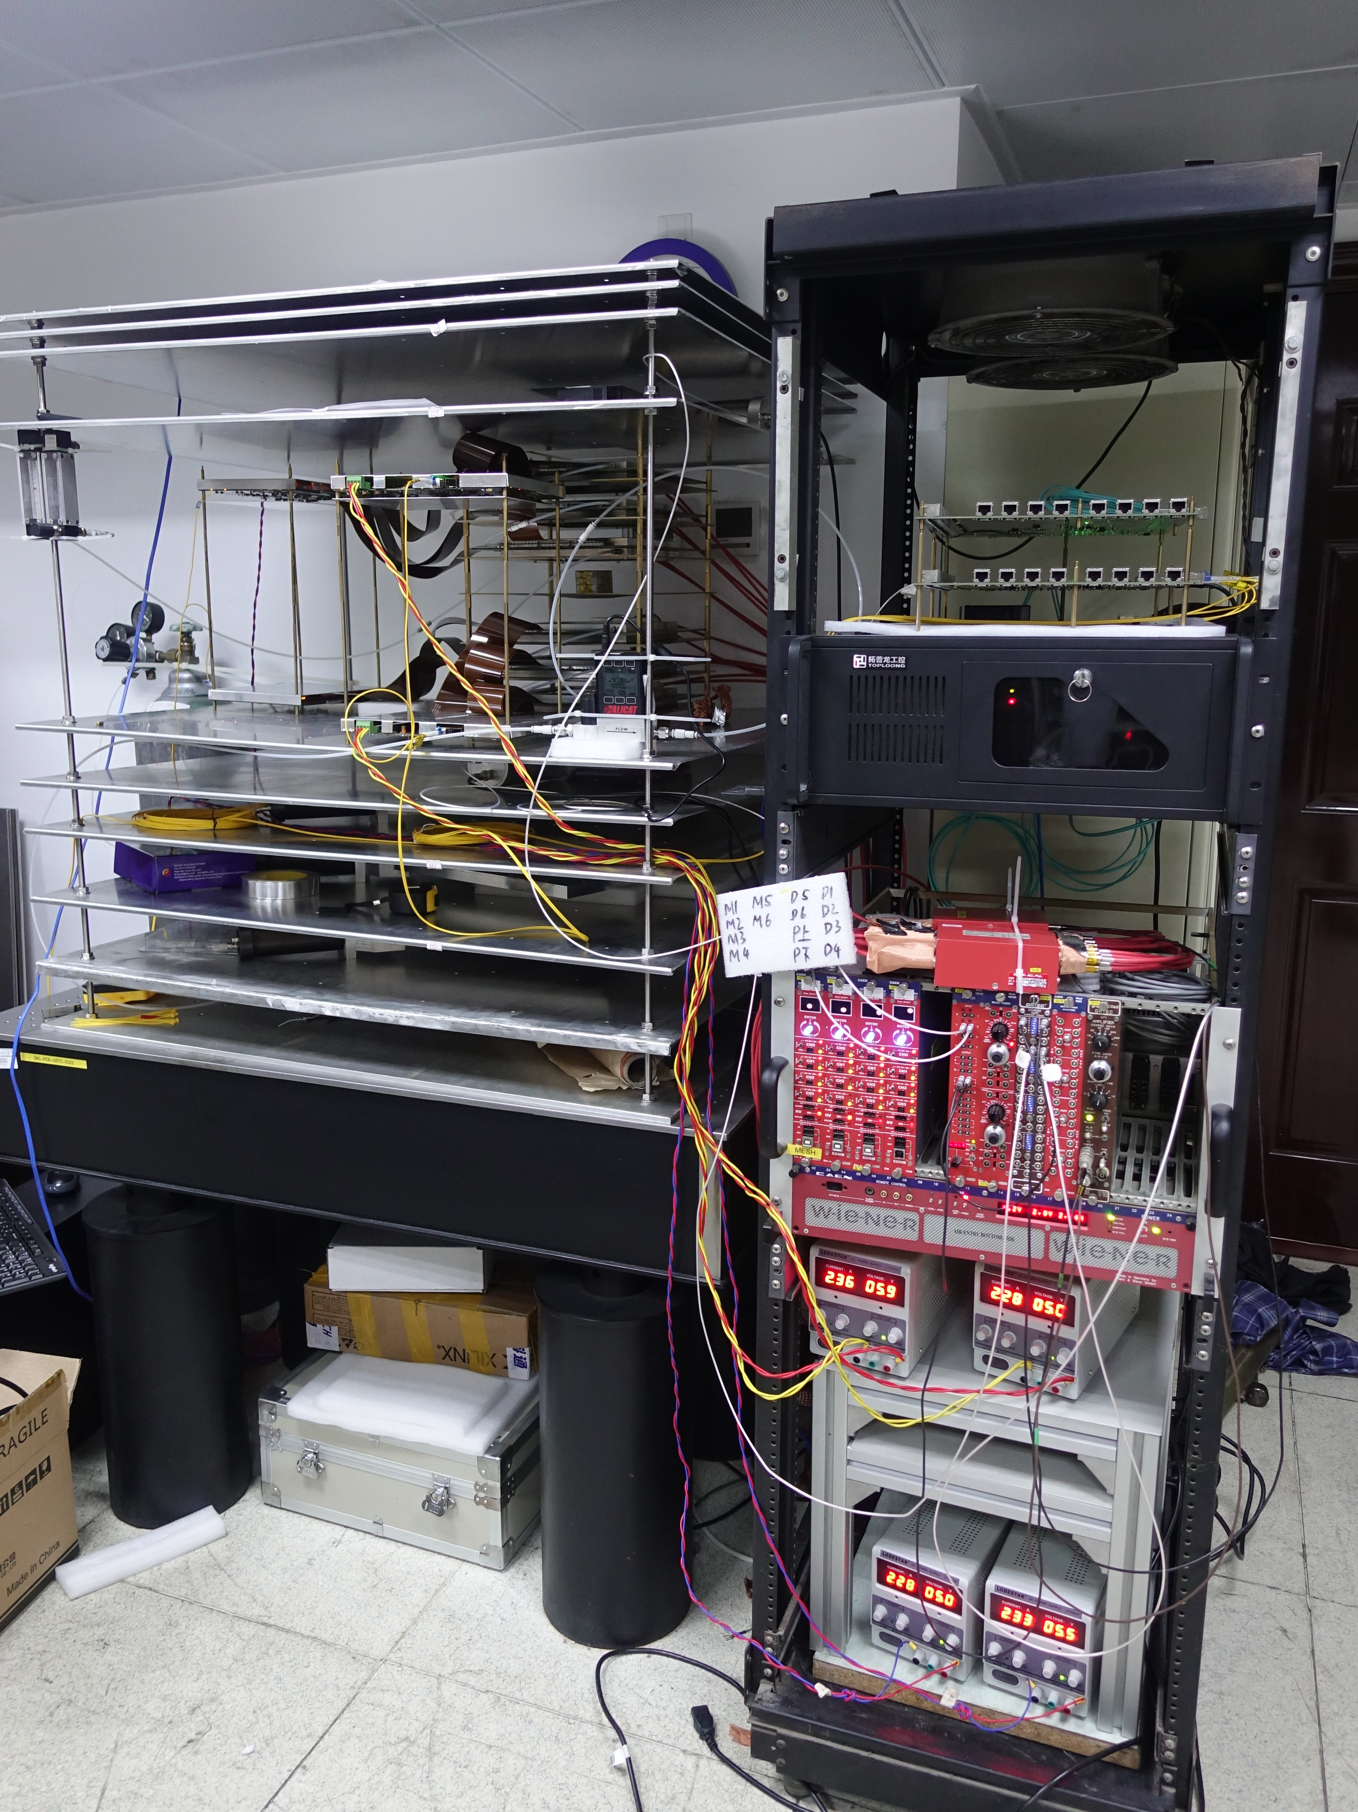
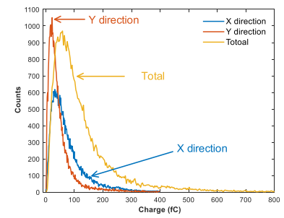
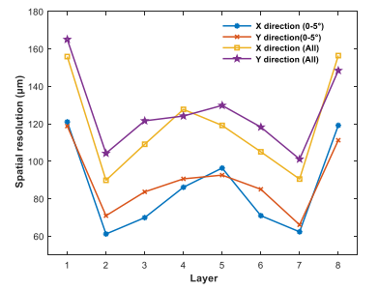
Small size prototype for tomography
First μSTC-T prototype:
  8 layers of 15cm×15cm Micromegas
  ~100 μm resolution
  Compression ratio 6:1
MIP spectrum
Position resolution

Slide 22
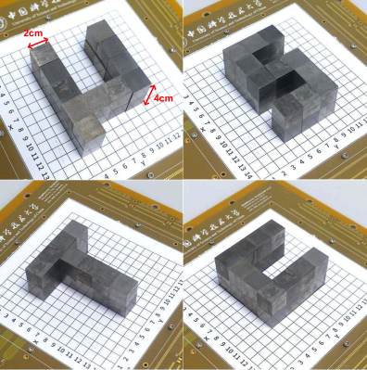
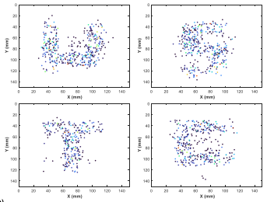
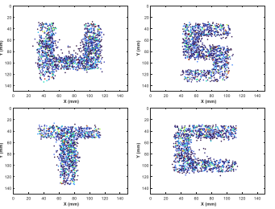
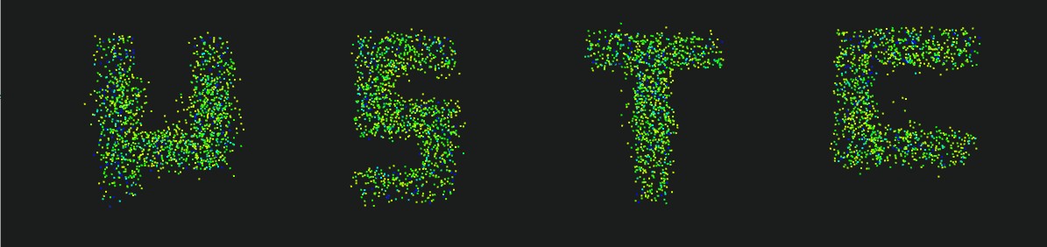
Small size prototype for tomography
First μSTC-T prototype: tomography with small size objects
2 cm
4-hour exposure
24-hour exposure

Slide 23
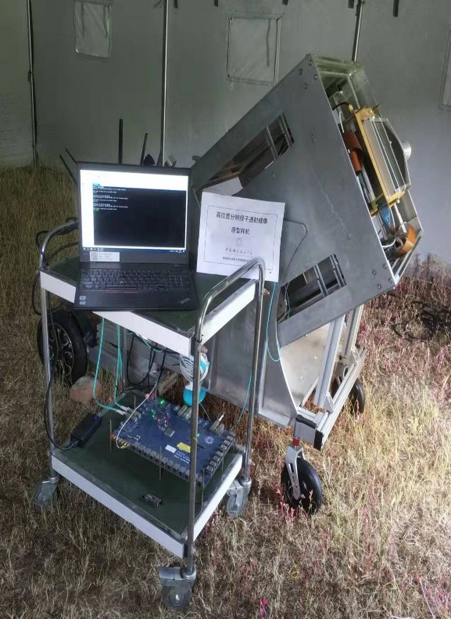
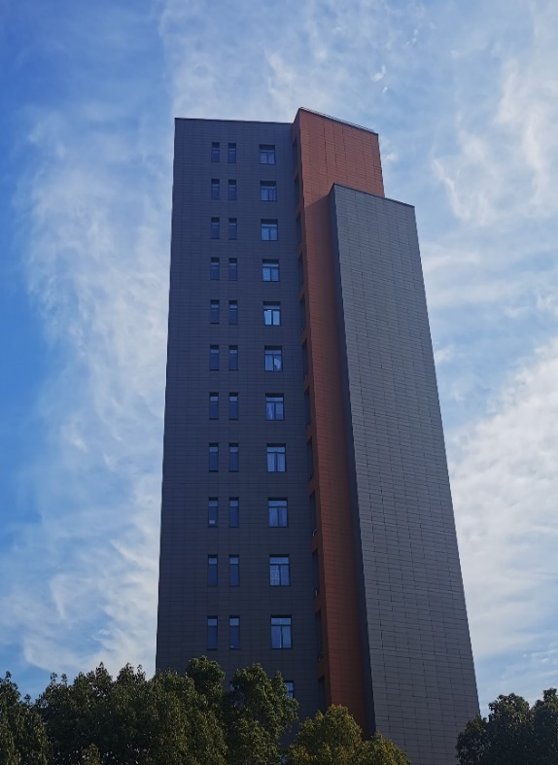
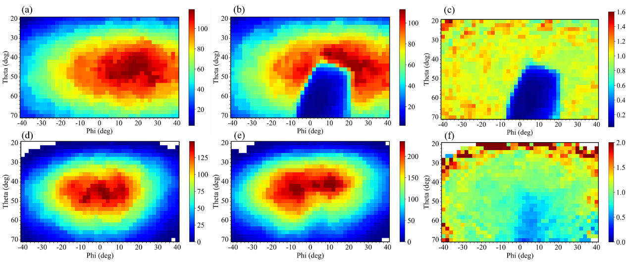
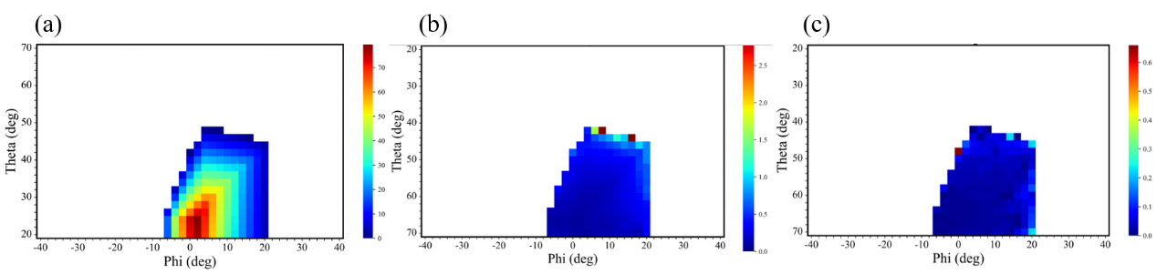
Small size prototype for radiography
First μSTC-R prototype:
  4 layers of 15cm×15cm Micromegas
  ~100 μm resolution
Radiography with a building for verification test

Slide 24
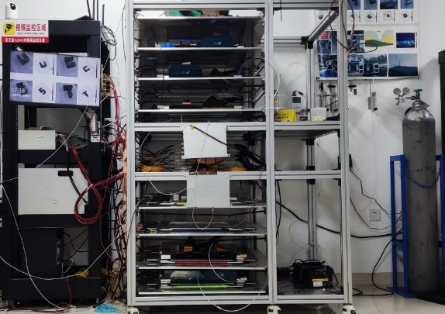
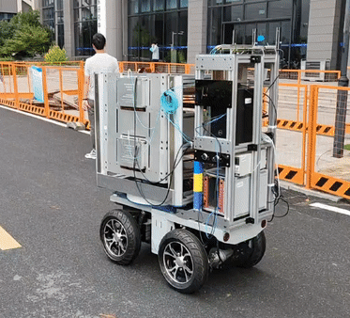
Middle size prototype
Second generation of μSTC prototypes: (2021.01-now)
  Upgrading with the larger detectors of 40 ×40 cm²
  Compression ratio 8:1 and 16:1
Tomography μSTC-T-G2
8layer, total number of channel: 16k
Radiography μSTC-R-G2
4layer, total number of channel: 8k

Slide 25
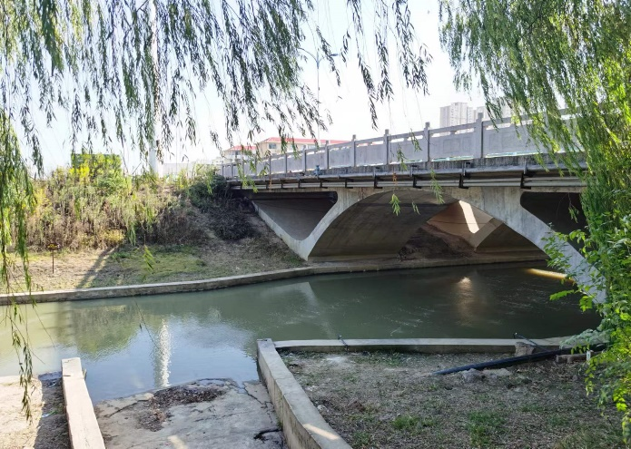
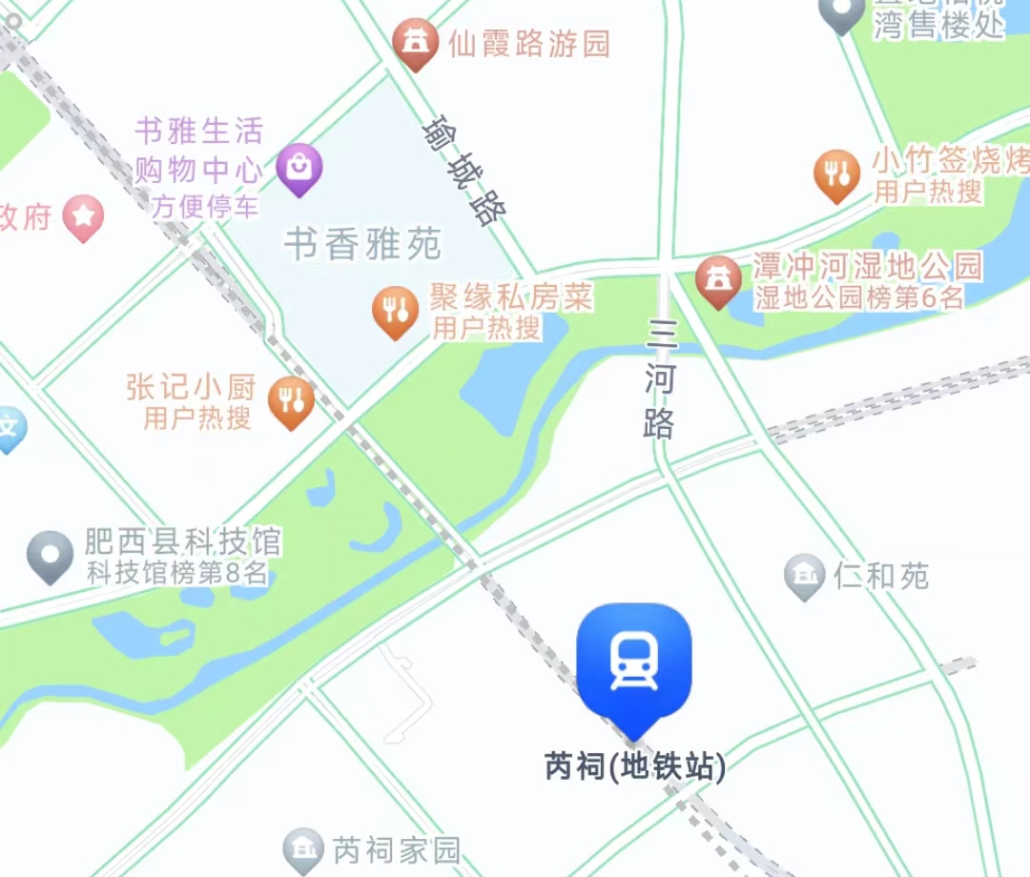
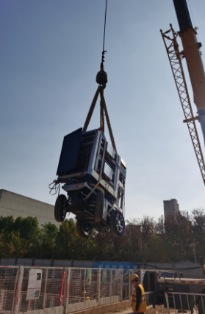
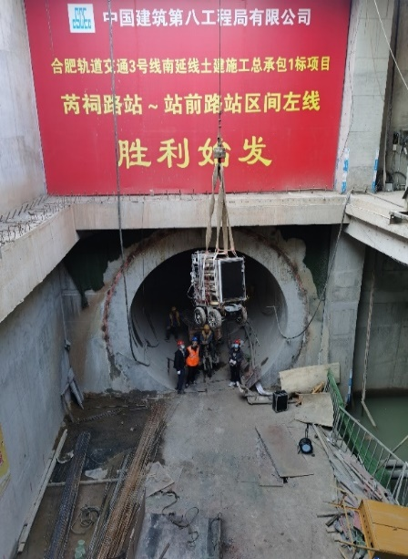
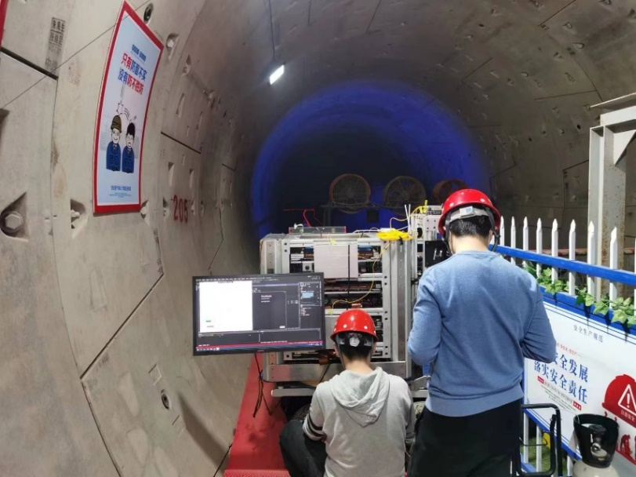
Radiography in subway tunnel
A river flows over the tunnel
Operating Environment: Construction site
  Large amount of dust
  Presence of water vapor
  Strong vibrations
Adaptability to harsh environments confirmed
Device successfully operated in challenging conditions

Slide 26
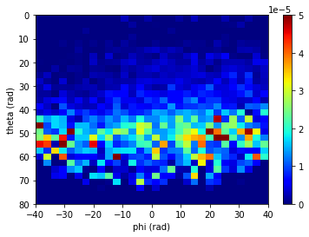
The device is placed inside the tunnel, aligned at a 30-degree angle to the river channel
  Measure muon flux in both the 30° and -30°directions
  Test for river data: 12 days
  Test for reference data: 6 days

Slide 27

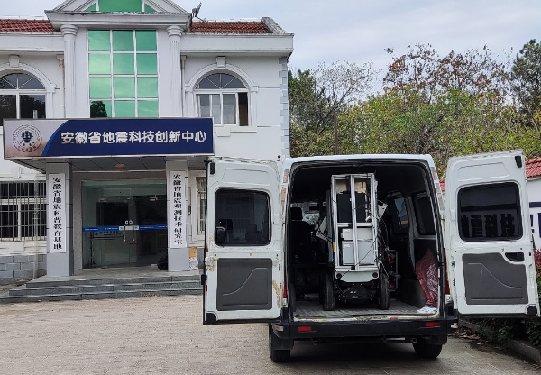
Radiography of Mt. Dashu
An ancient volcano formed 65 million years ago
Nearby the urban area of Hefei city
Altitude of the mountain and facility （μSTC-R-G2） is 280m and 60 m respectively

Slide 28

Radiography of Mt. Dashu
The μSTC-R-G2 was set at horizontal angle
  Recording muons from both mountain side and the other side (for reference)
Test for duration more than 4 months
  Winter -> Next Spring
Device

Slide 29
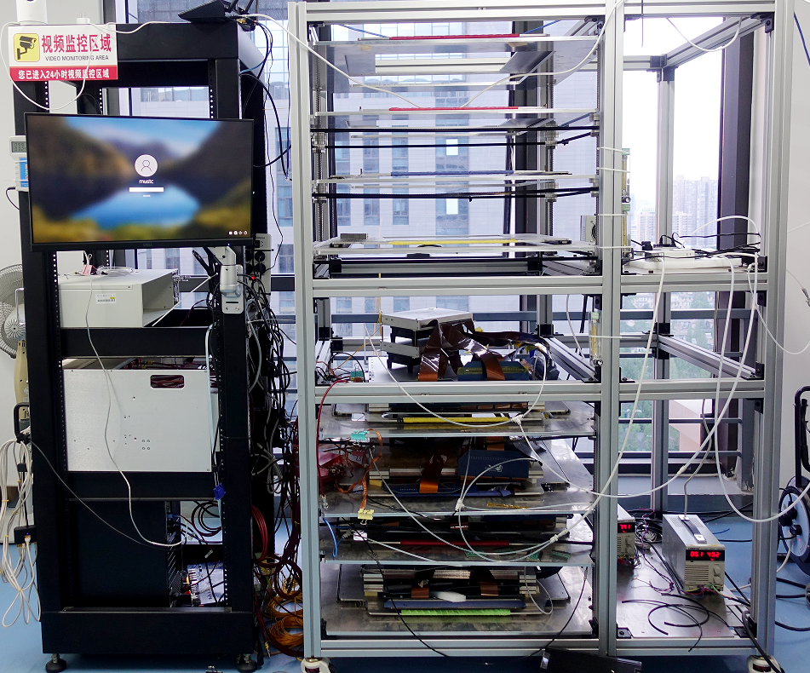

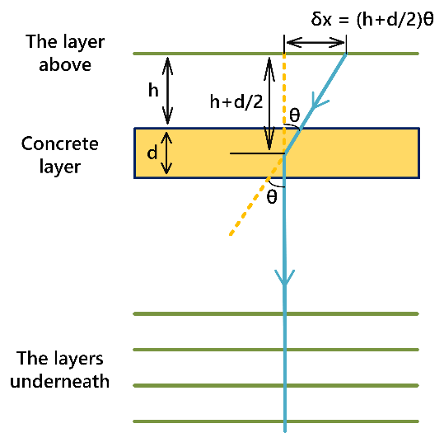
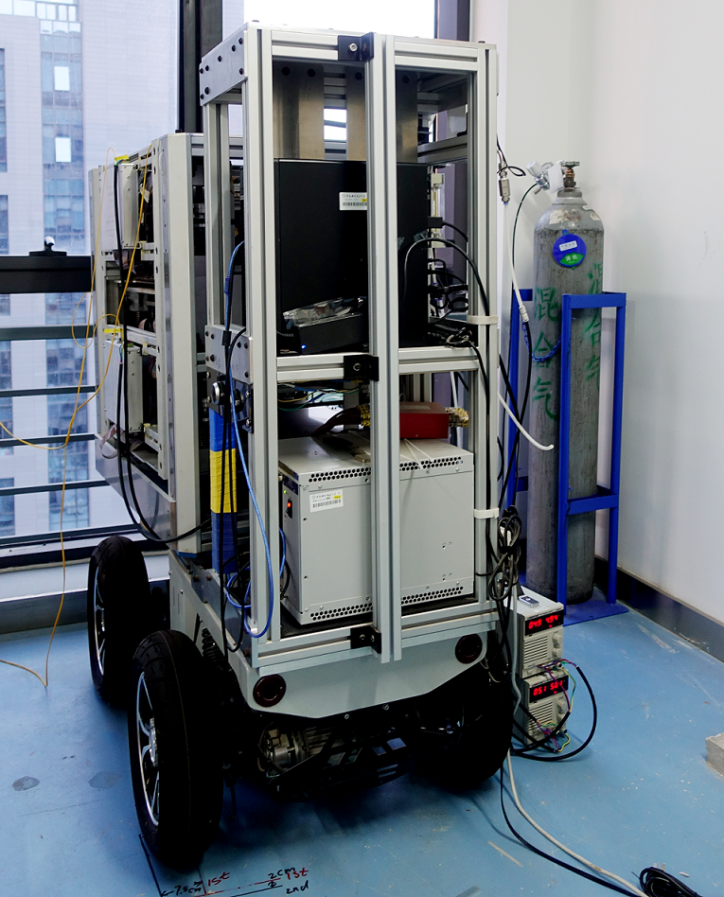
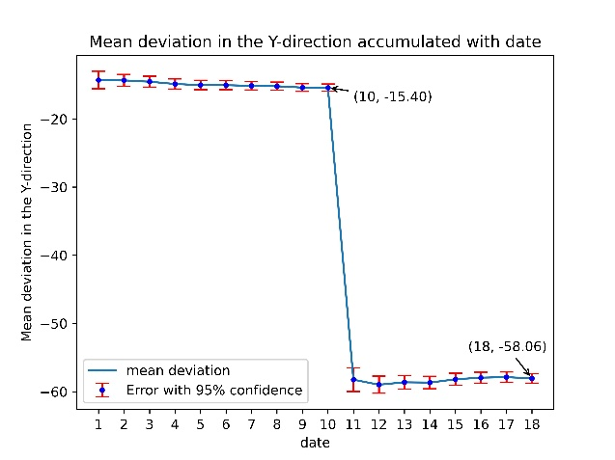
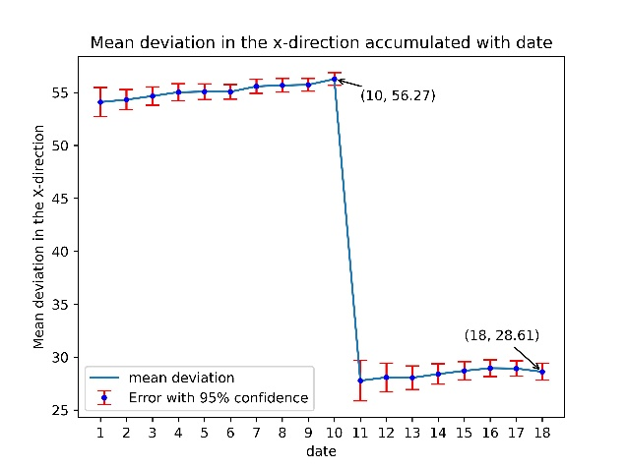
Muon metrology: displacement measurement experiment
Measuring Tiny Displacements of Large-scale Objects Using Muon Trajectories as Straight Lines
  Two sets of devices collaborating
14th floor
13th floor

Slide 30
Summary
We prosed serval channel multiplexing readout methods for the MPGDs and designed the readout circuits
We built high resolution facilities (μSTC) for muography study using Micromegas detector, low noise electronics and encoding readout method.
We carried out the experimental tests on high-z samples (tungsten, lead, etc.), subway tunnel, and an ancient volcano. The performance including high resolution, Long-term stability and environmental adaptability were verified.
Outlook
Higher compression ration circuit can be designed and test
A larger detector device is under construction and will shorten the imaging time.
Thank you！Cảm ơn！
This work was partially supported by the National Science Fund for Distinguished Young Scholars under Grant 12025504, and also by the Young Scientists Fund of the National Natural Science Foundation of China (Grant No. 12205297)

