Slide 1

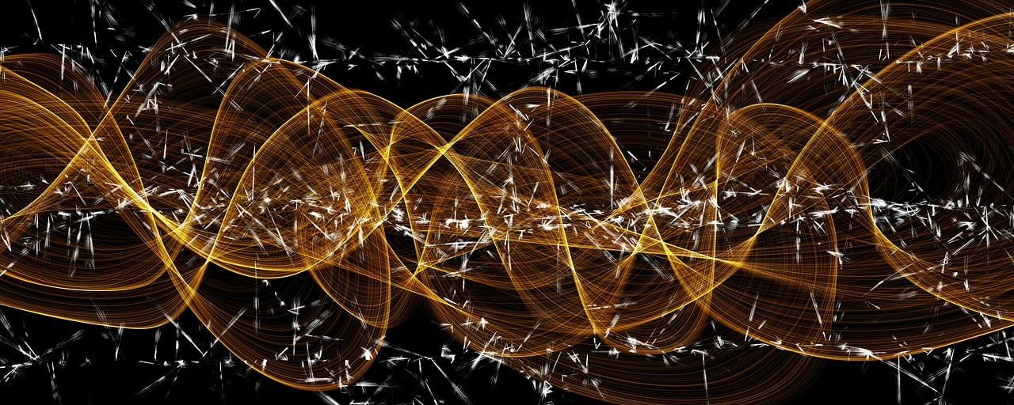
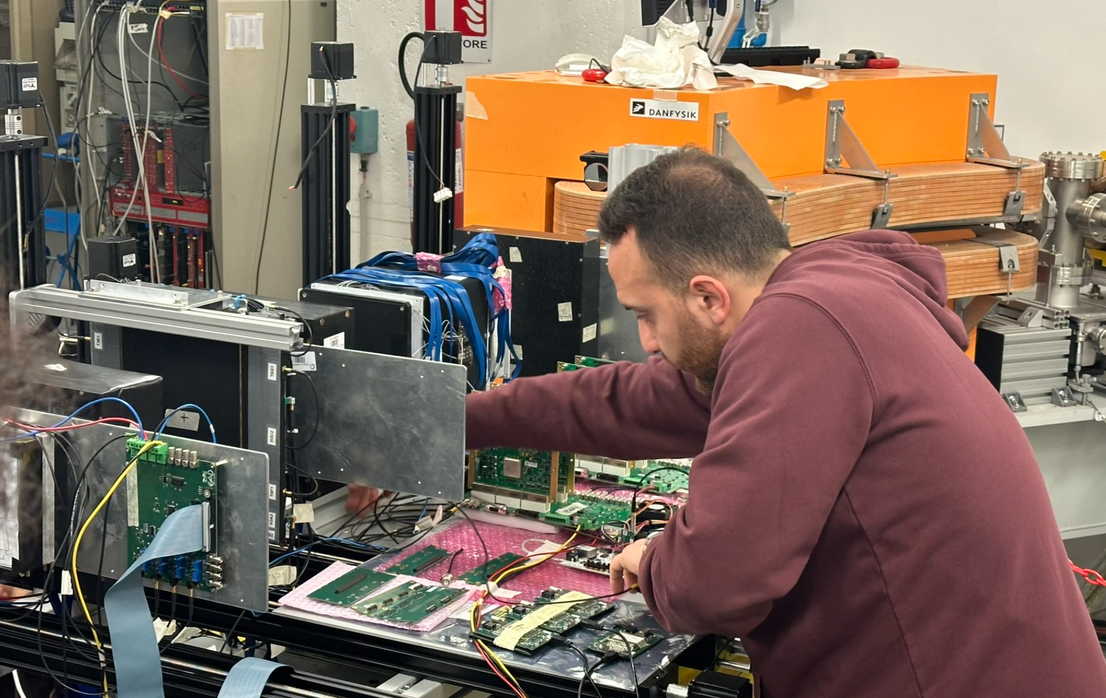
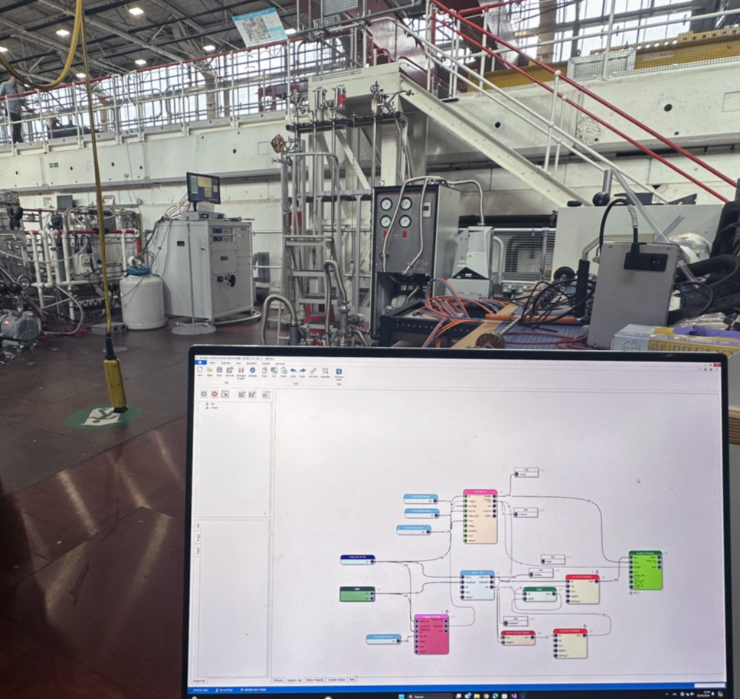
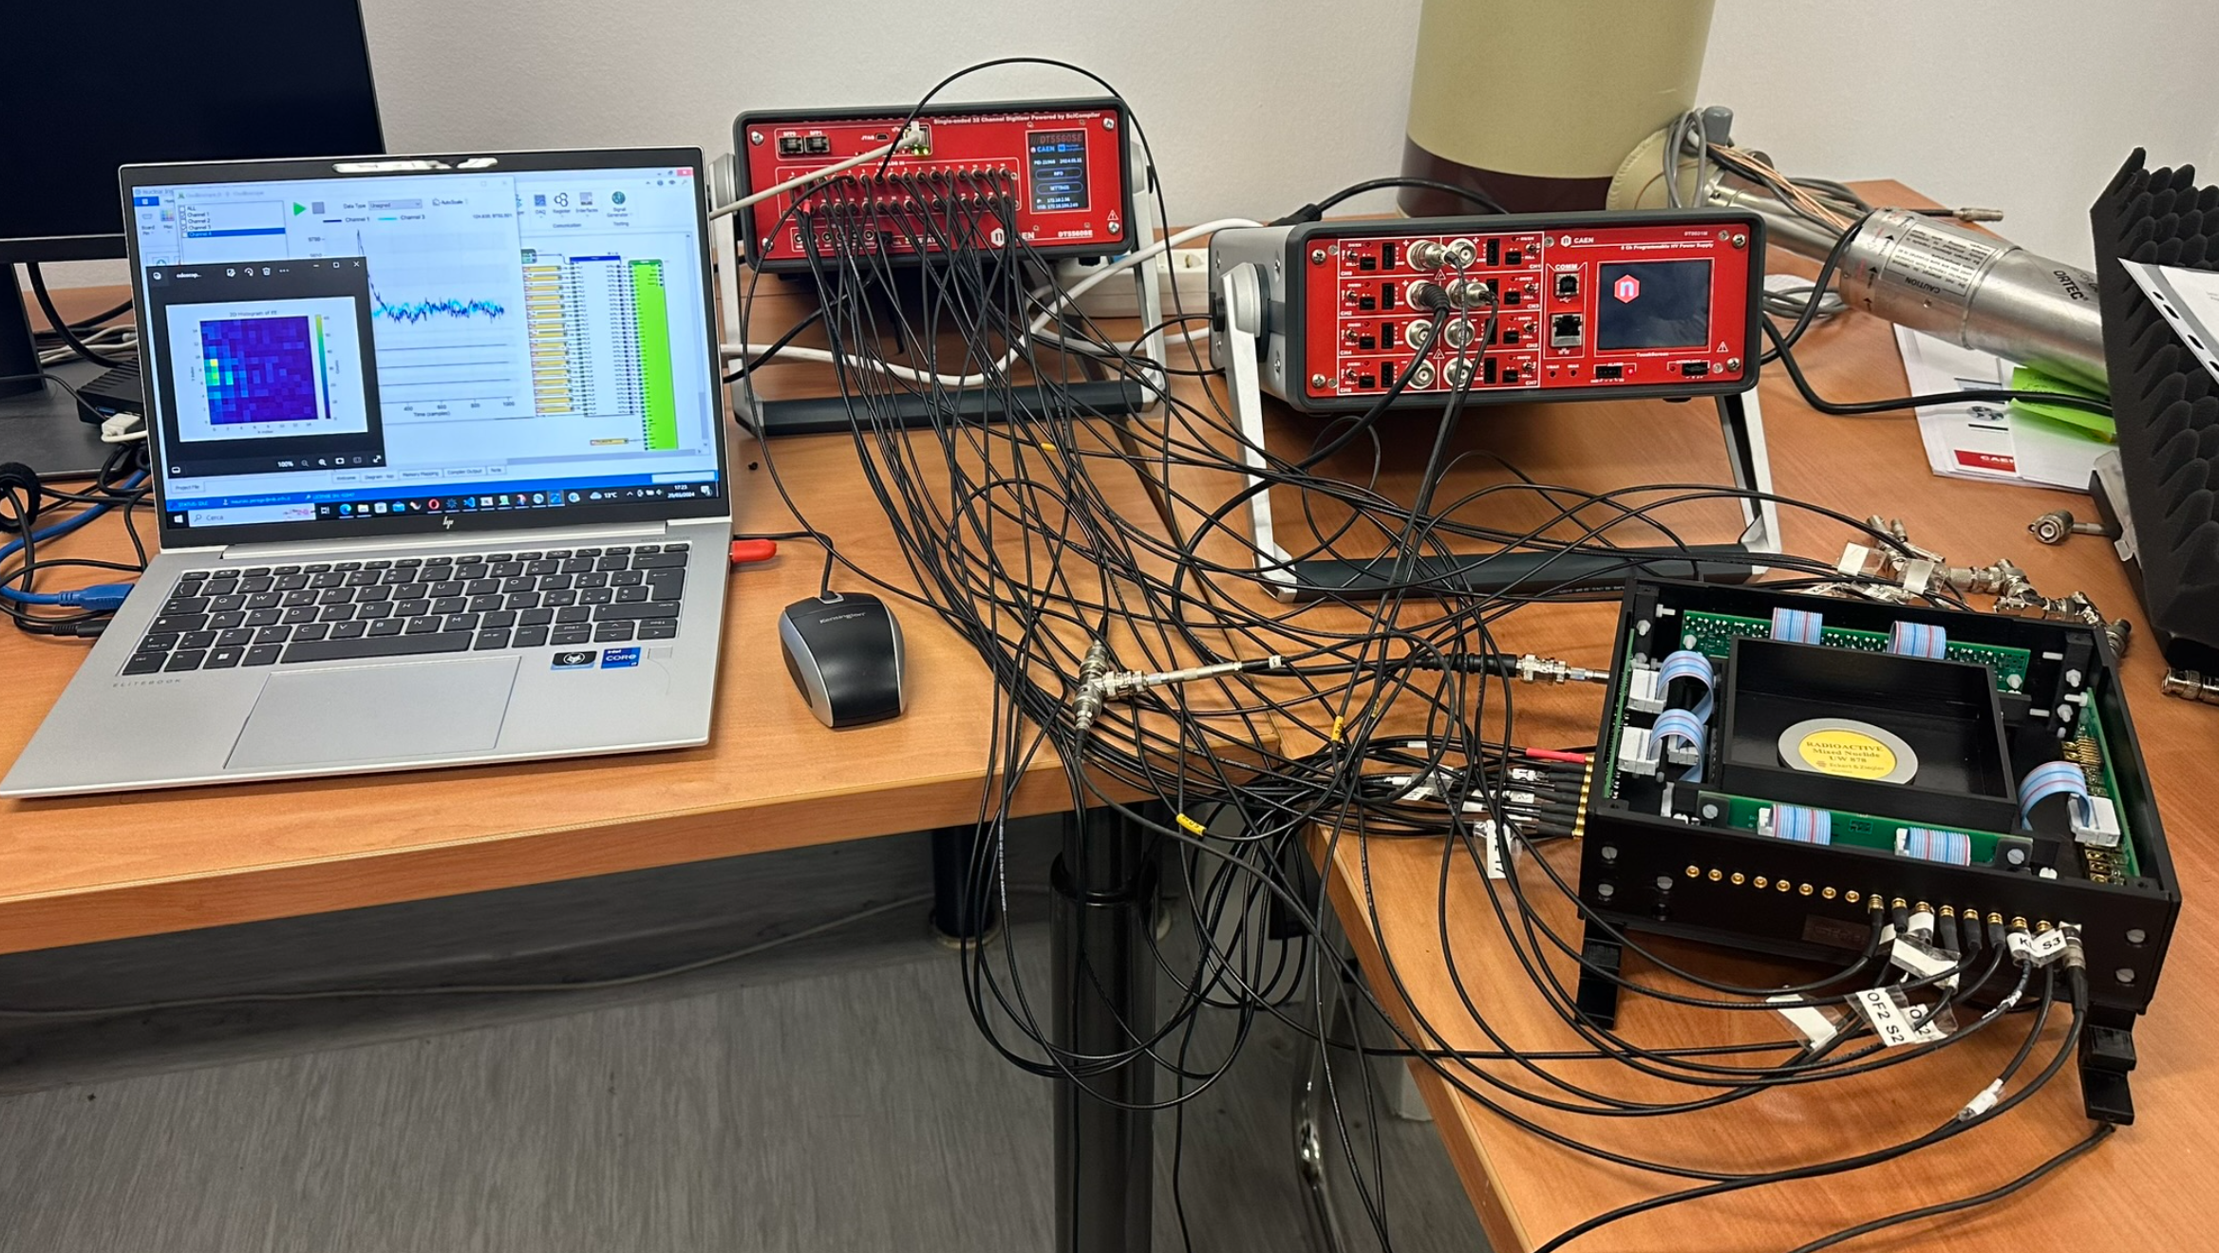

Simplified Firmware Development for Open FPGA Platforms in DAQ Systems using Sci-Compiler
A. Abba
F. Caponio
V. Arosio
C. Tintori
L. Colombini
D. Bianchi
M. Petruzzo
Y. Venturini
A. Cusimano
L. Ferrentino
M. Venaruzzo
Notes:
Today, we're diving into the world of Sci-Compiler, an ingenious tool that's revolutionizing the way we create, manage, and deploy firmware for cutting-edge scientific research. Whether you're a physicist seeking to unravel the mysteries of the cosmos, a medical researcher on the cusp of a new discovery, or an engineer designing the next generation of detectors, Sci-Compiler is your gateway to turning complex hardware into a symphony of synchronized signals and data.

Slide 2
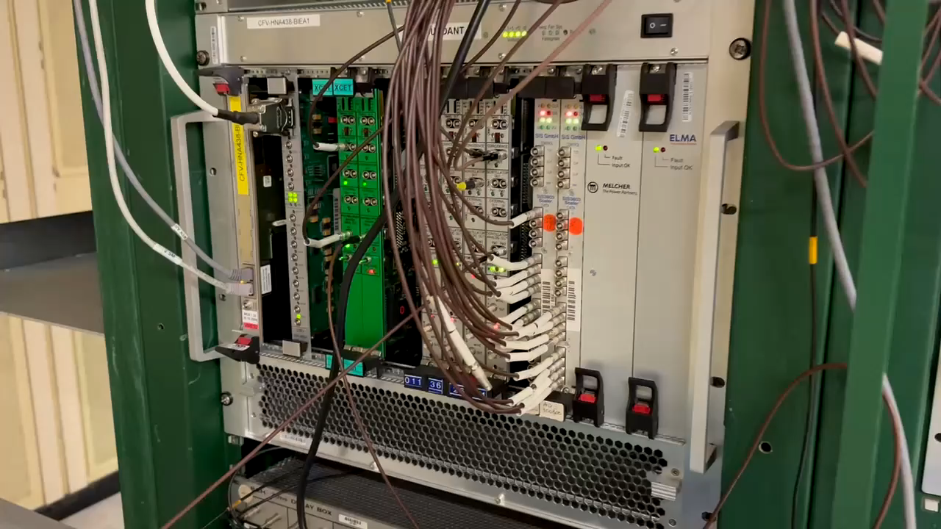
Notes:
In the last 60 years of physics experiments traditional solution to implement trigger logic and readout systems involve the usage of several function specific modules connected each other with cables. The system function is indeed defined by the kind of module used (for coincidence, delay, digitizer, oscilloscope, tdc) and the way they are interconnected. The large number of cables and the vendor specific module configuration made quite complex the debug and maintaining of complex system with a large number of channels

Slide 3
Replace modular Electronics with FPGA
ADC
FPGA
Ethernet / USB
CUSTOM FIRMWARE
ANALOG
INPUT
ADC
DIGITAL
OUTPUT
ADC
DIGITAL
INPUT
Notes:
Within an FPGA device, any bespoke logic or processing algorithm can be materialized by coding it in a specialized programming language. Traditional setups, crammed with hundreds of logic modules, Multichannel Analyzers (MCA), and digitizers, can now be elegantly consolidated into a single board. This board utilizes ADCs to digitize analog signals, manages discriminated signals through digital input output, and employs an FPGA to execute logic functions and manage data readout with precision and efficiency.

Slide 4
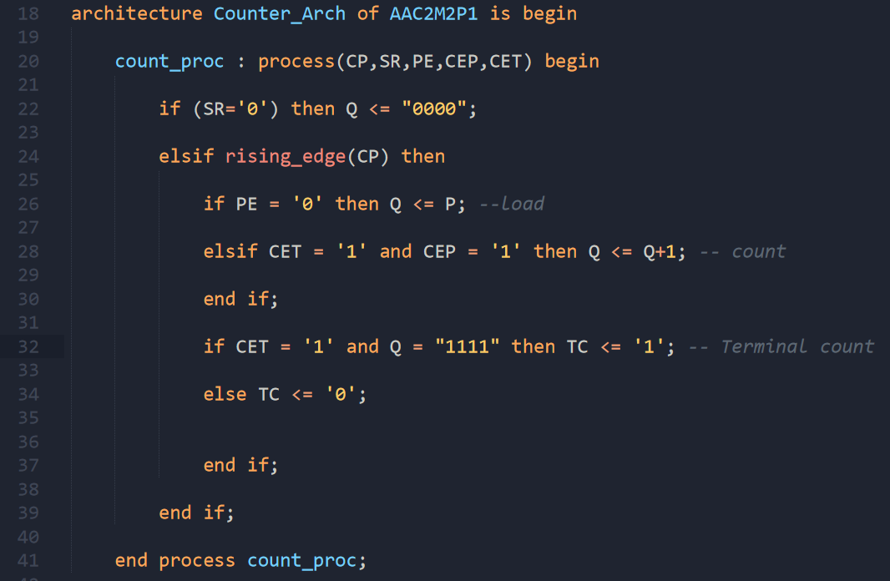
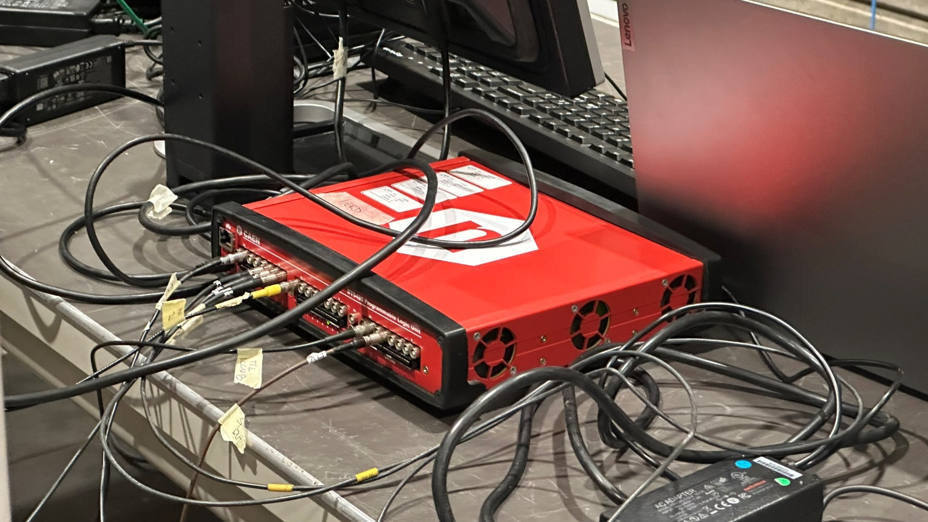
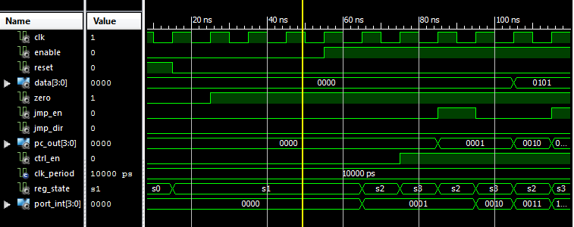
Developing in VHDL/Verilog is hard and time consuming.
VHDL or Verilog programming skills
Notes:
Design firmware for FPGAs demands proficiency in specialized programming languages such as VHDL or Verilog, coupled with an in-depth understanding of the electronic circuits that materialize when the FPGA compiler transforms the human-designed firmware into a machine-configurable file, known as a bitstream. Typically, users articulate their desired logic functions or algorithms through code; however, the compiler's output more closely resembles an intricate electronic circuit rather than traditional software. This complexity significantly steepens the learning curve for those looking to harness the full potential of FPGA devices.

Slide 5
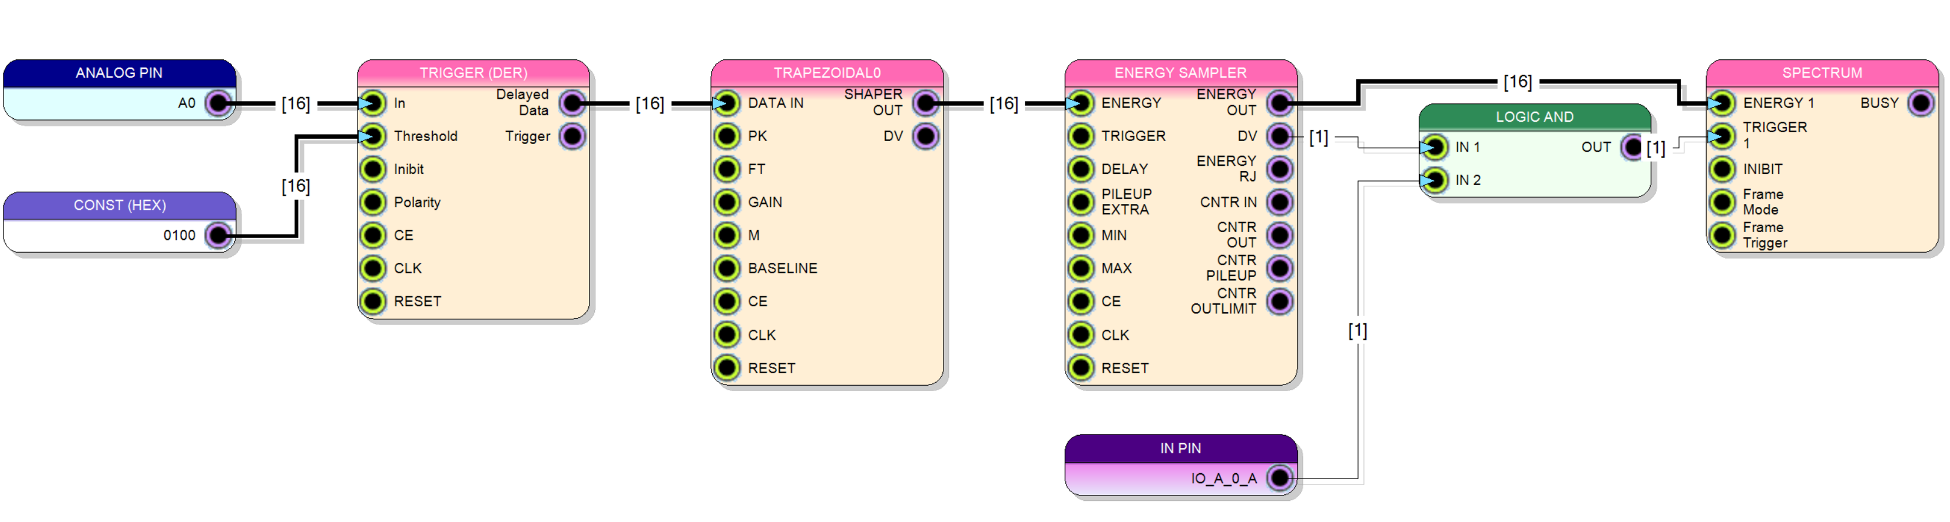
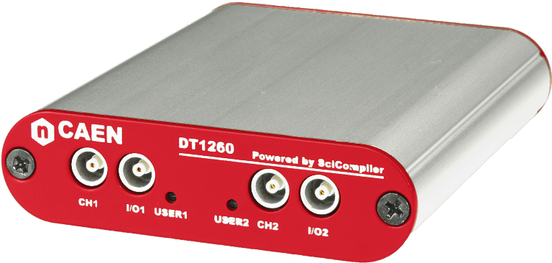
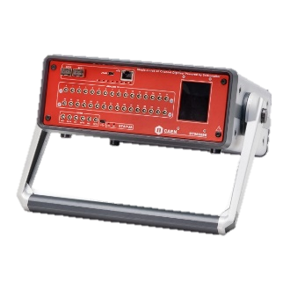
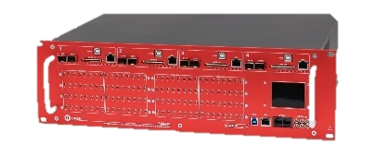

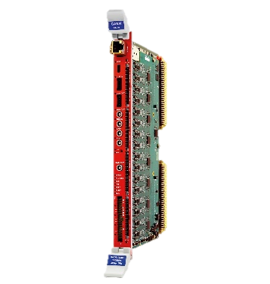
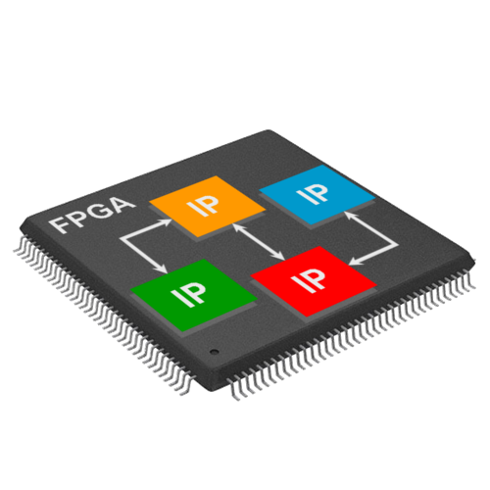
CAEN Solution: OpenFPGA digitizers + SciCompiler firmware generator
OpenFPGA Digitizers
Notes:
CAEN and Nuclear Instruments have pioneered a transformative solution that accelerates the transition from traditional electronics to FPGA based readout and processing systems. Together, we've unveiled a new generation of digitizers featuring open FPGAs. These digitizers are designed with the end-user in mind, offering the flexibility to reconfigure firmware with ease through our groundbreaking Sci-Compiler software, which utilizes intuitive visual programming. Users can concentrate solely on crafting their unique algorithms via a block diagram interface, while Sci-Compiler seamlessly translates this design into a functional bitstream, effectively bridging the gap between concept and execution.

Slide 6
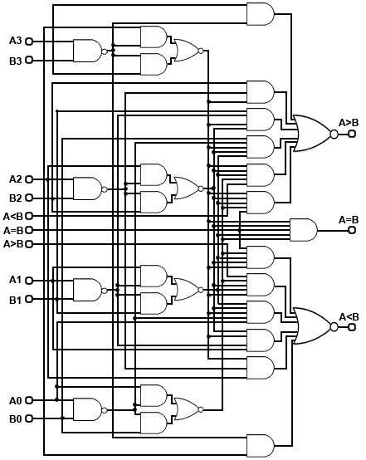
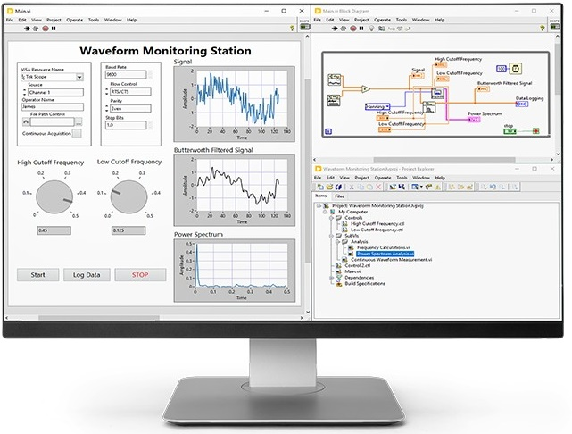
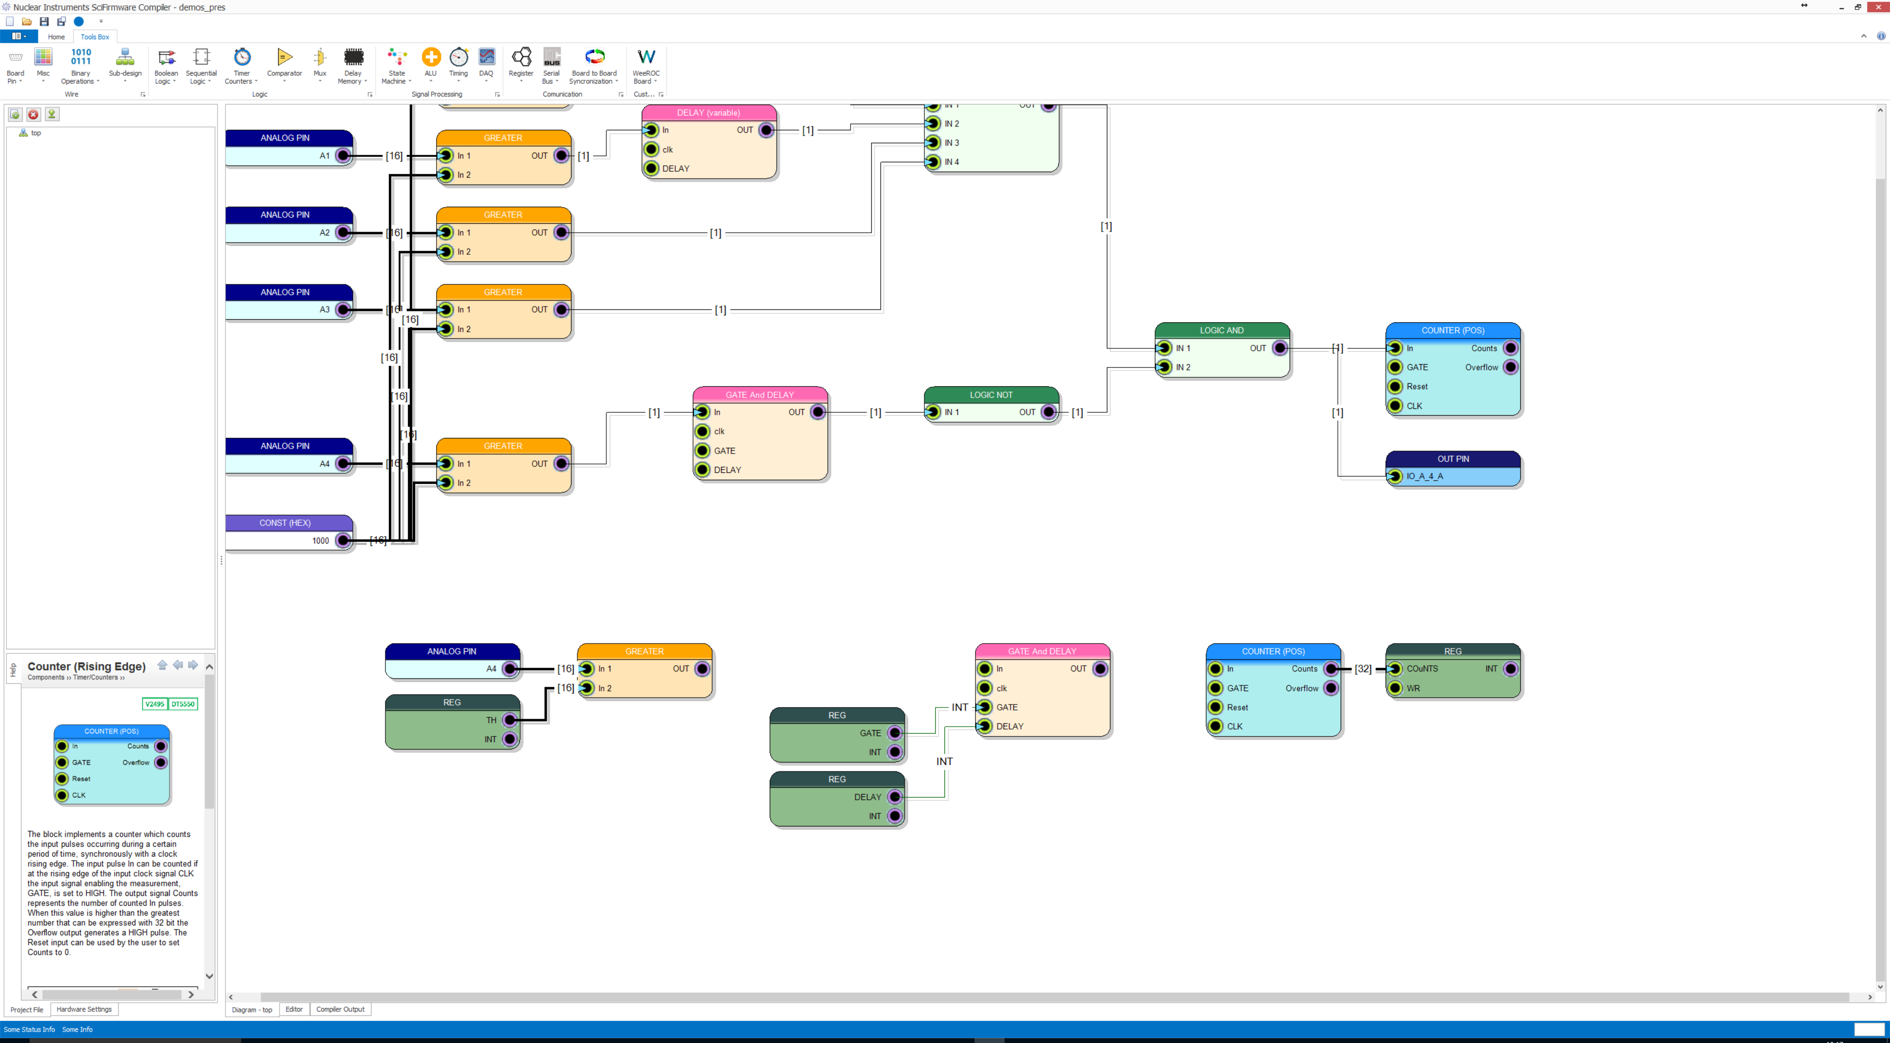
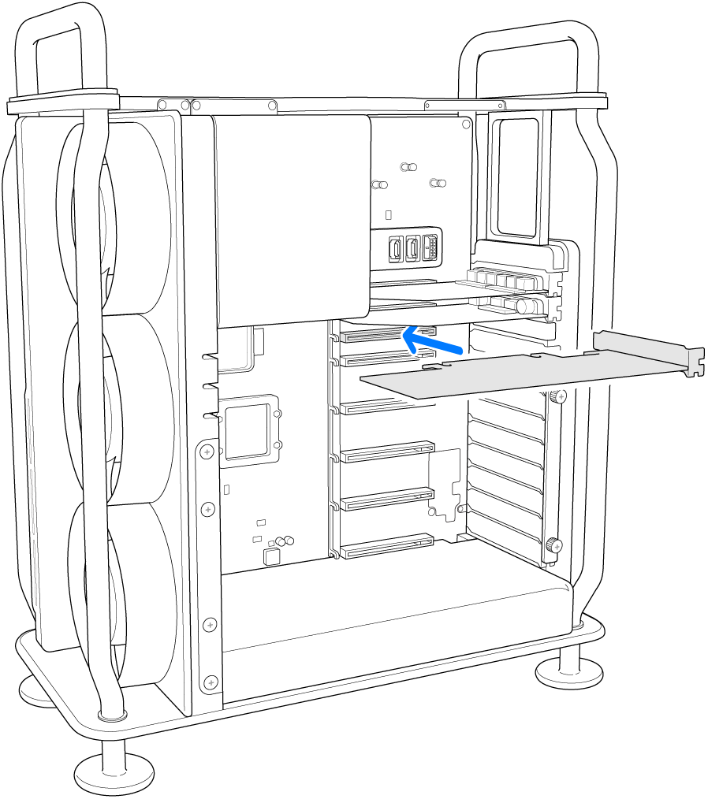
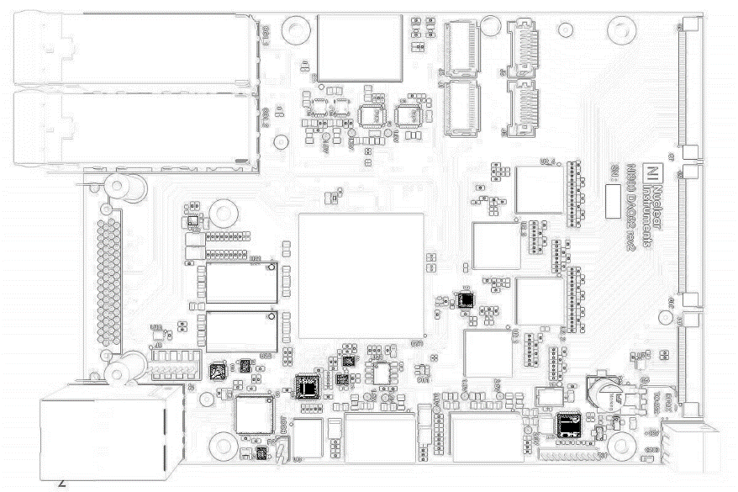
Sci-Compiler generates firmware
Limited parallelism
High delay (ms)
Full parallelism
Low delay (ns)
DAQ
Other VPL (like Labview) generate code for CPU
running inside DAQ computer
Generate FPGA firmware that «runs» directly inside the DAQ
Notes:
Sci-Compiler is very different from other visual programming software such as Labview. Labview typically generates software that runs on the PC in which the DAQ is inserted, processing data in near real-time. The DAQ is limited to digitizing the data, while it is the acquisition PC's CPU that processes them. Sci-Compiler generates firmware that directly processes the data within the DAQ in strict real-time. This means that it can fully exploit the parallelism of the FPGA, with a computing capacity much higher than that of the PC, and have delays in producing the processing result on the scale of nanoseconds rather than milliseconds as happens with software running on a PC.

Slide 7
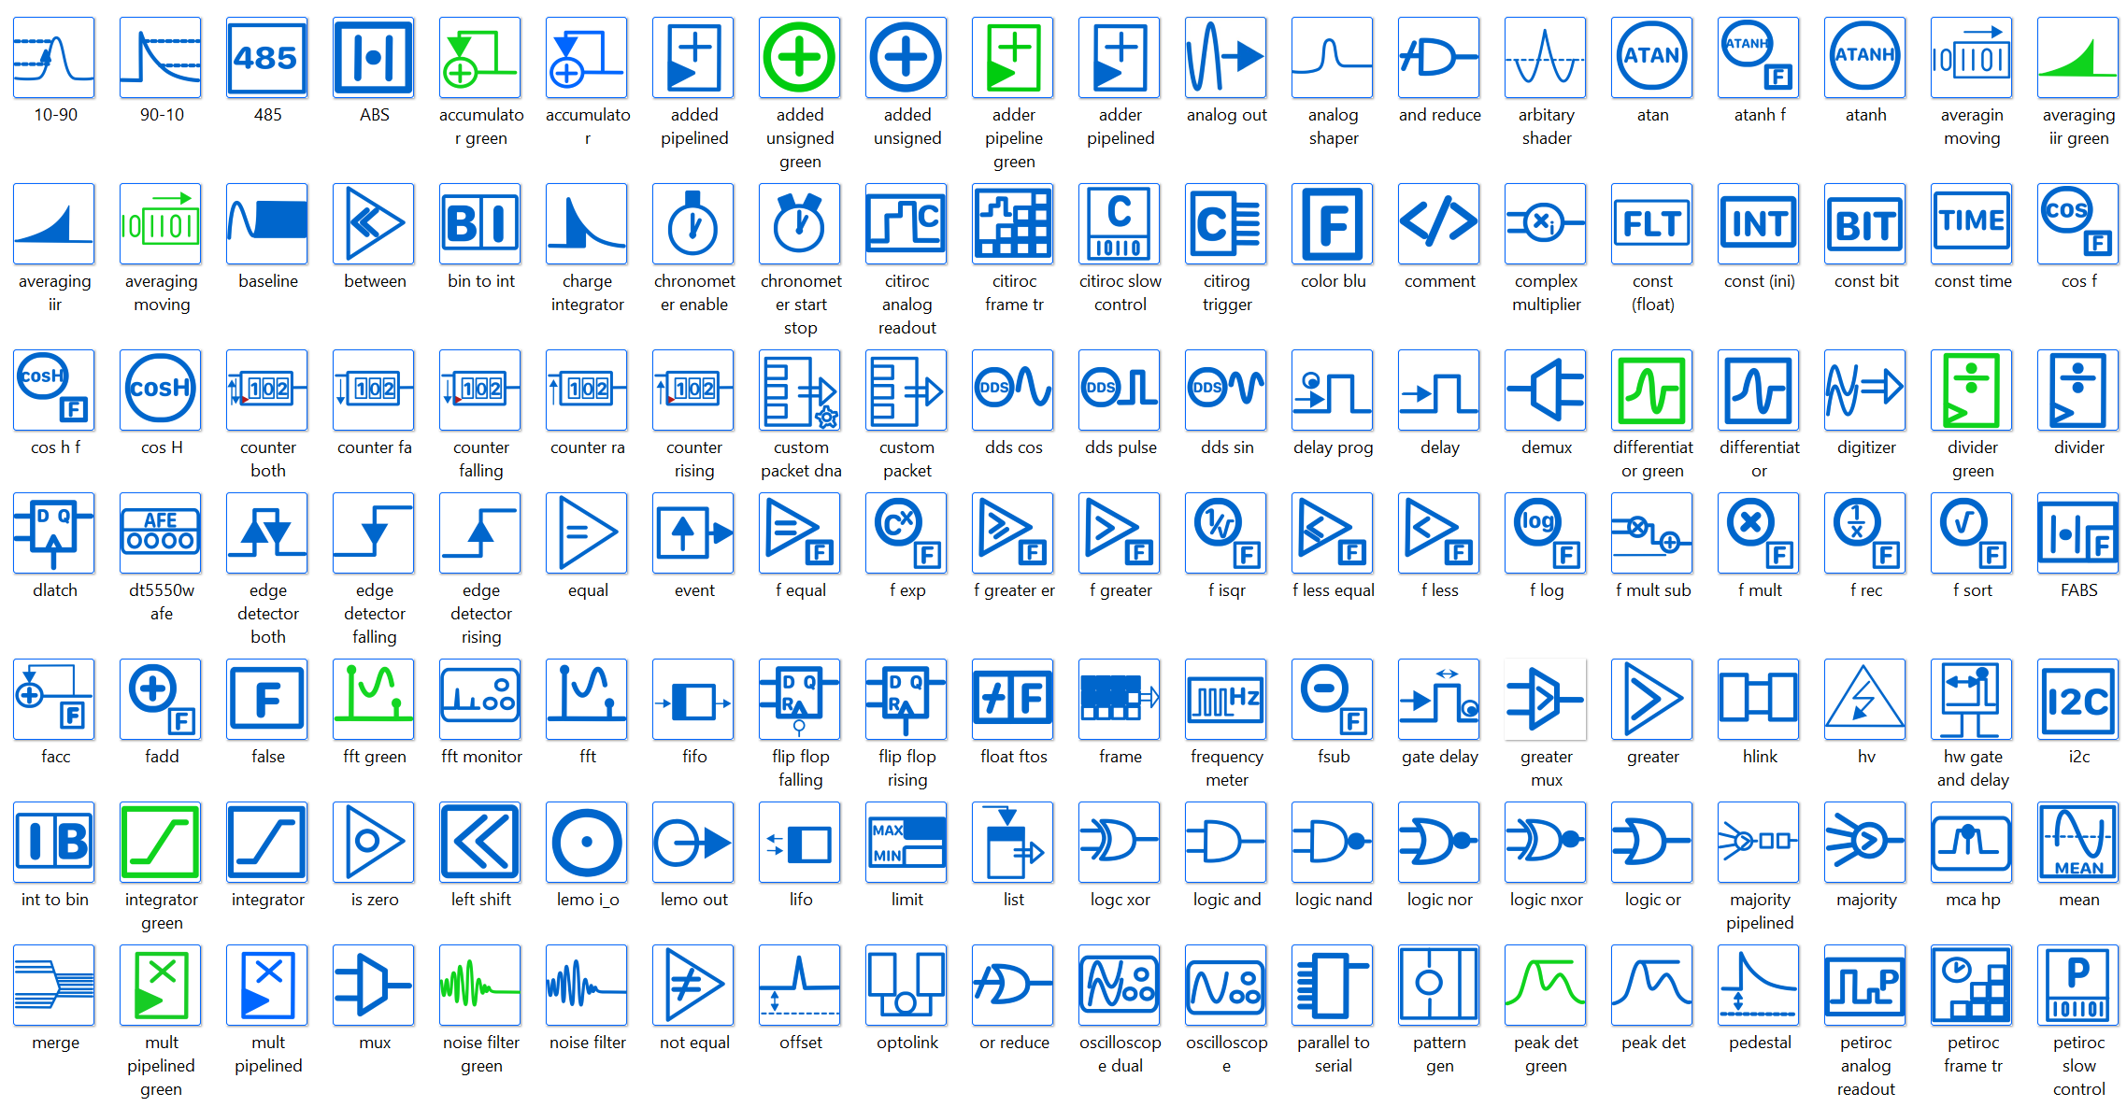
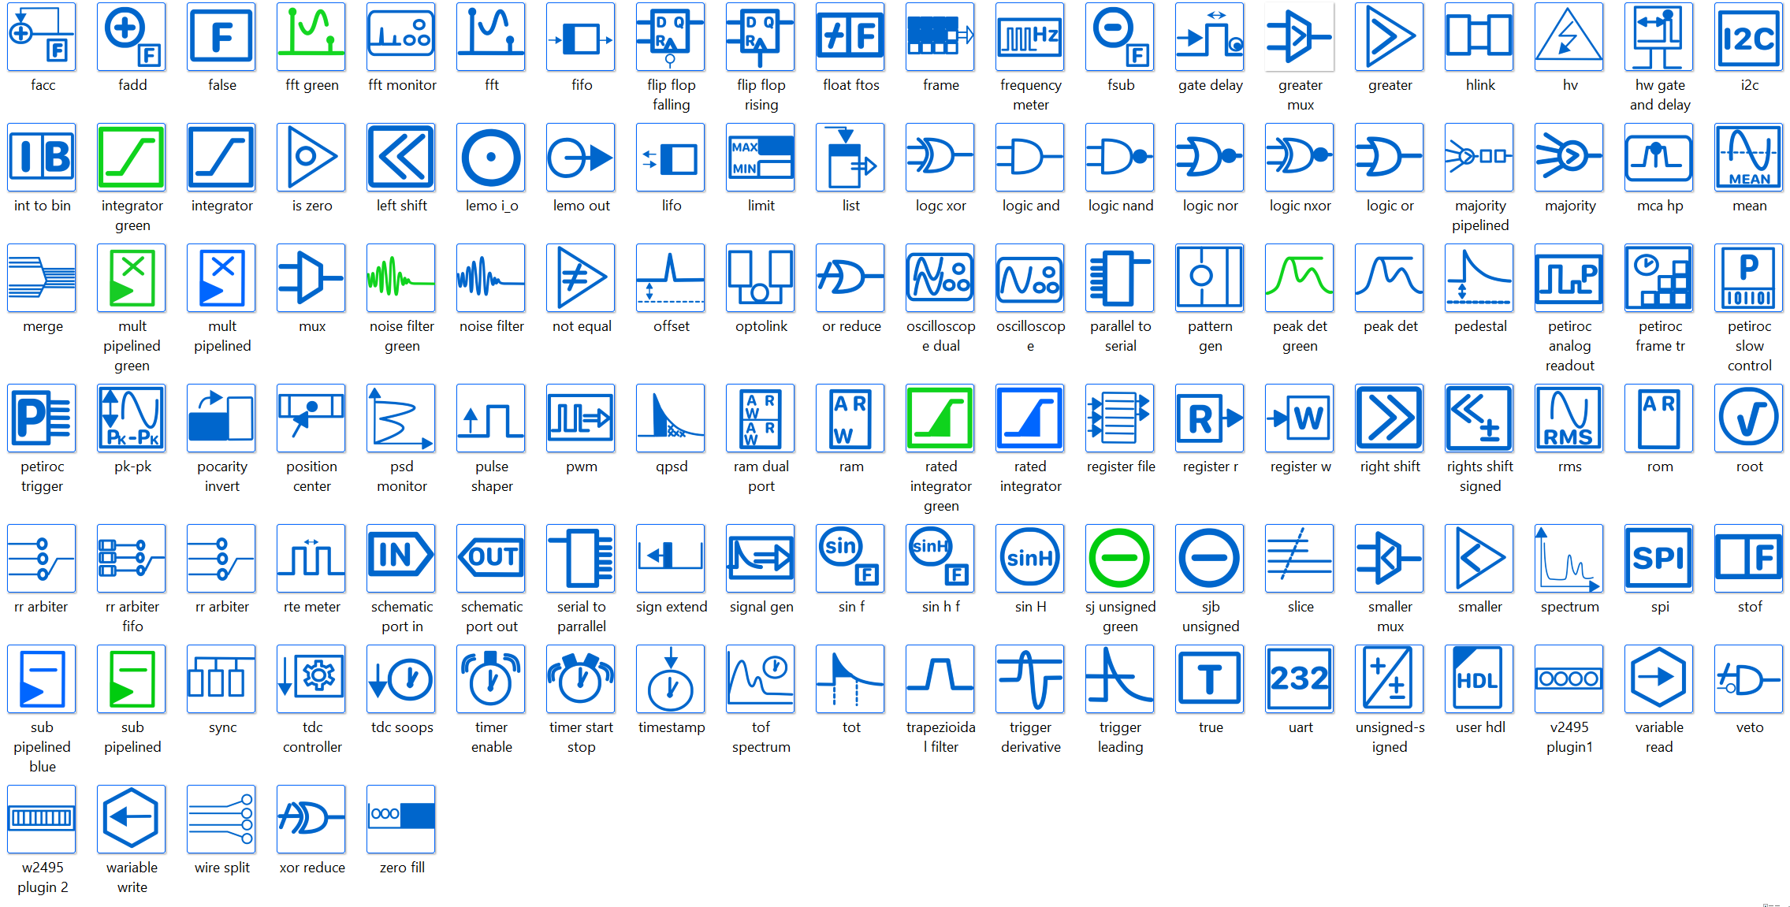
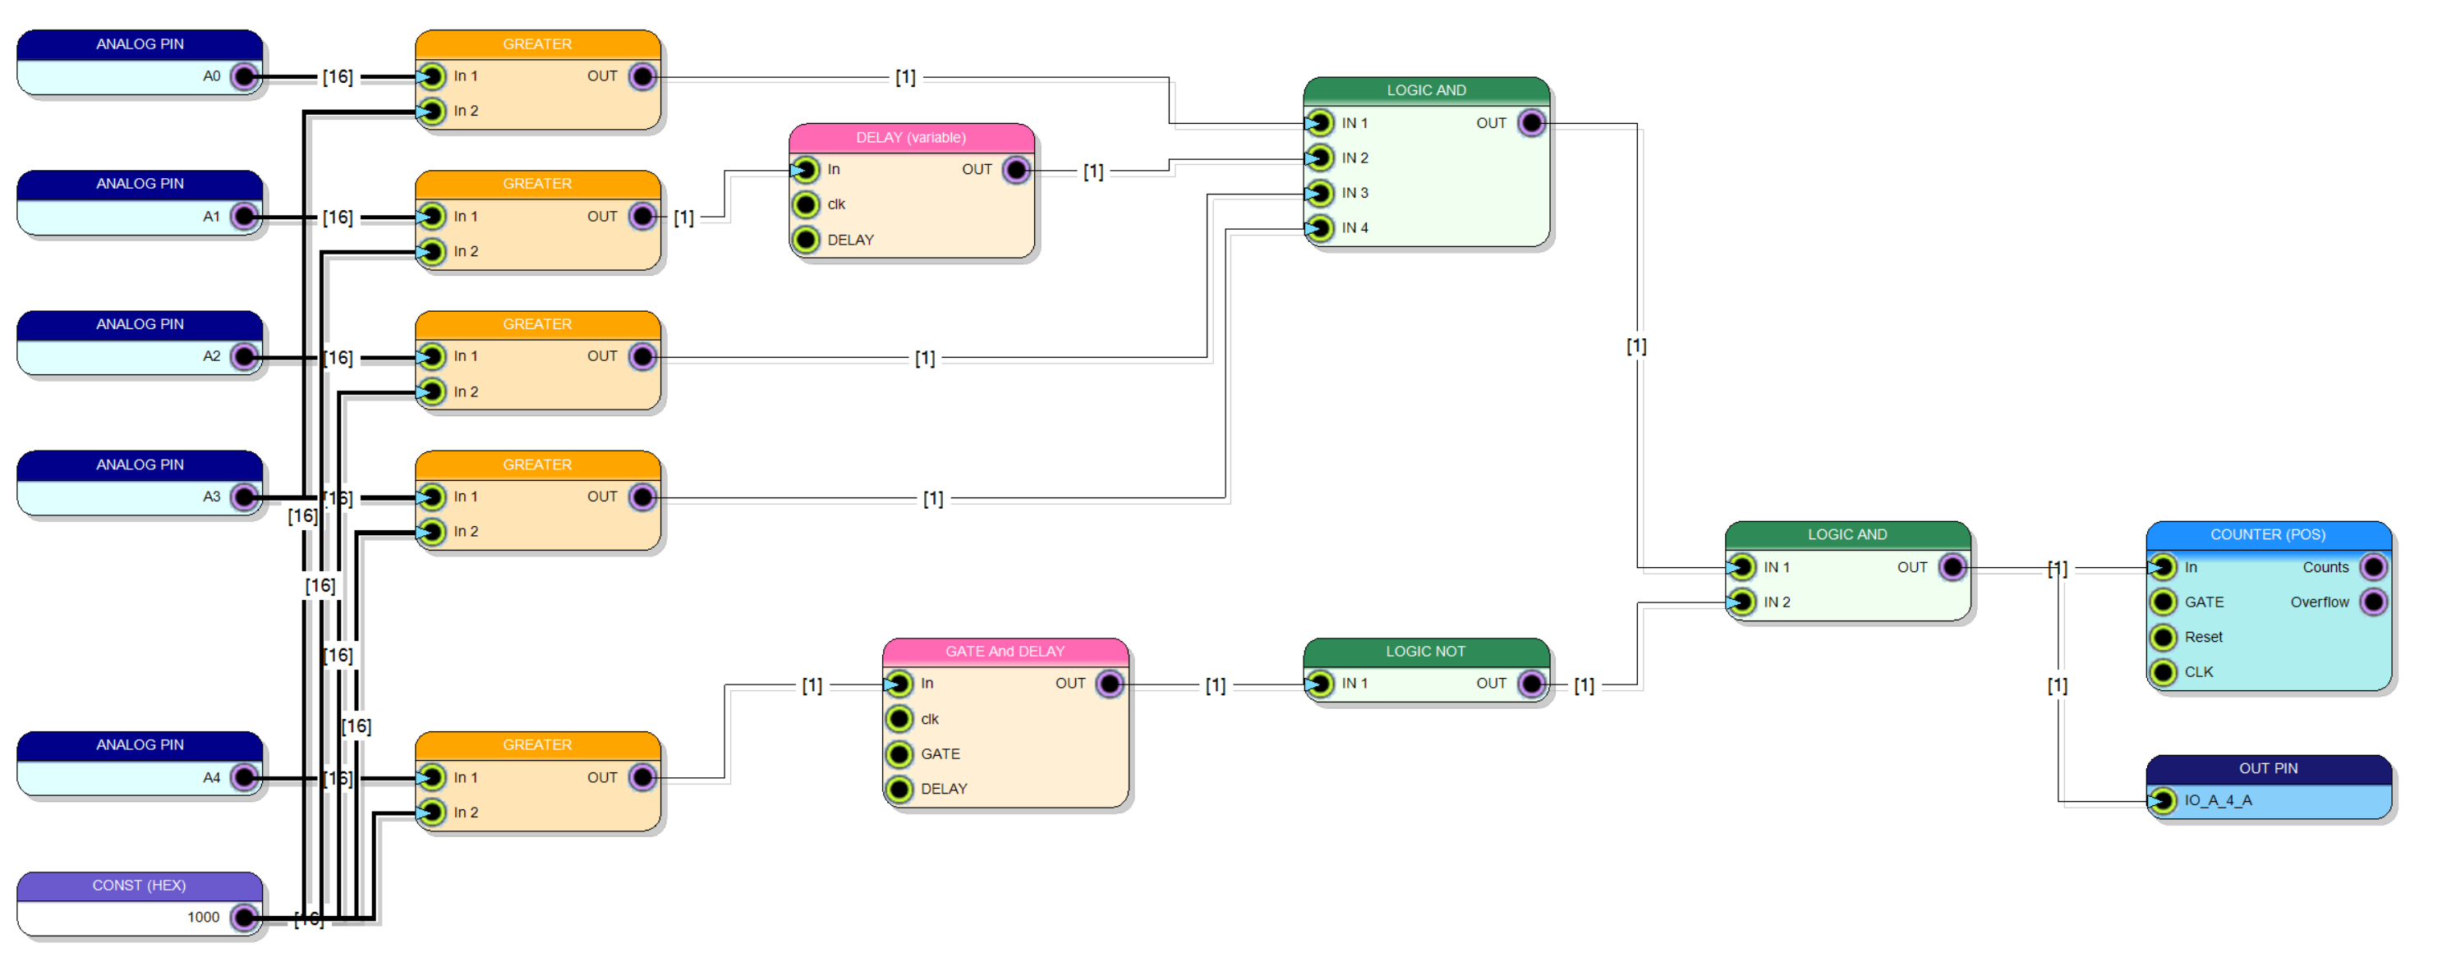


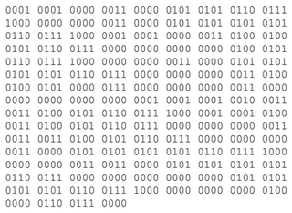
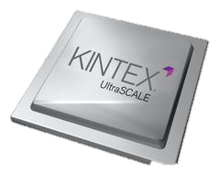
SciCompiler: ip integrator software
IP – Virtual Instruments
USER DESIGN
BUILDER ENGINE
Notes:
SciCompiler is integrated with a vast library of virtual instrument IPs, streamlining the firmware development process. Users design their firmware visually with a block diagram, which SciCompiler then expertly converts into VHDL code. It proceeds to compile the project utilizing industry-standard tools from Xilinx or Intel and seamlessly downloads the compiled firmware directly to the FPGA.

Slide 8



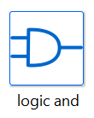


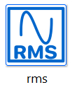
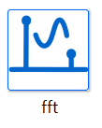




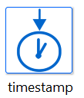



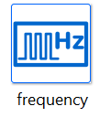
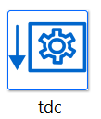
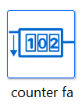
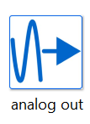
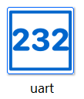
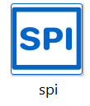
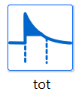
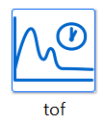

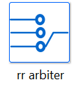
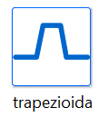
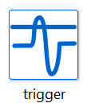
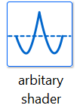
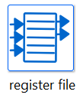

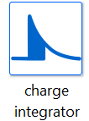
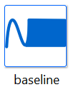
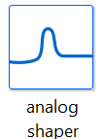
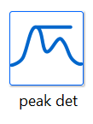
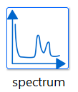
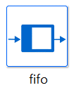



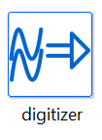
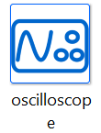
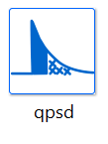


LOGIC
MATH
I/O
TIME
SCICOMPILER
IP CORES
LIBRARY
READOUT
shaper
ENERGY
MEMORY
SHAPE
Notes:
SciCompiler comes equipped with an extensive suite of IPs that facilitate a wide array of functions, from digital logic and mathematical operations to sophisticated algorithms. These include charge integration, trapezoidal filtering, peak detection, analog shaping, time-to-digital conversion, and center-of-mass calculations. Additionally, specialized IPs are readily available for tasks such as waveform digitization, data readout, and system configuration

Slide 9



Examples of what you can do with Sci-Compiler
PHA with trapezoidal filter,
charge integration, peak detector,
or user custom algorithm
Convert any complex trigger logic into a single board, diagram based design
Realtime calculation of PSD using
several algorithms operating on
both exponential shape (for scintillators) or rise time (for He3)
Notes:
Sci-Compiler is a versatile tool designed to enhance scientific research and data analysis. Let's delve into some practical examples of what Sci-Compiler can do for us.
Imagine performing Pulse Height Analysis (PHA) with unparalleled precision. Sci-Compiler integrates a trapezoidal filter, charge integration and peak detection. Not only that, but it also allows the incorporation of user-custom algorithms, offering flexibility to meet specific experimental needs.
In the realm of trigger logic, complexity is a common hurdle. Sci-Compiler elegantly converts intricate trigger sequences into a single-board, diagram-based design. This simplifies the setup without compromising the sophistication of your logic systems.
Now, consider the real-time calculation of Pulse Shape Discrimination. Sci-Compiler does this using multiple algorithms that analyze both exponential tails, commonly found in scintillators, and rise time, essential for Helium-3 detectors. This functionality is critical for instantaneous analysis, which is essential in many advanced scientific applications.

Slide 10


Examples of what you can do with Sci-Compiler
Reconstruction of interaction point
in position sense detector
Realtime calculation of FFT with no deadtime (can be used to implement trigger)
Time of flight spectroscopy, high resolution multichannel TDC
Notes:
Moving forward, the reconstruction of interaction points in position-sensitive detectors is another task Sci-Compiler manages effortlessly. This capability is vital for enhancing the accuracy of spatial measurements in detectors, a cornerstone in many fields of research like neutron physics.
Moreover, Sci-Compiler can execute real-time Fast Fourier Transform calculations with no deadtime. This feature is crucial for implementing sophisticated triggers in data acquisition systems, ensuring that no vital information is missed during measurements.
Sci-Compiler brings to the table high-resolution time-of-flight spectroscopy and multichannel Time-to-Digital Conversion (TDC), advancing the frontiers of temporal resolution in experiments.

Slide 11



Examples of what you can do with Sci-Compiler
Implementation of any custom filter, digital conversion of analog filter, advanced fixed and floating point math
Analog signal generation with DDS, Cordic or LUT based
Realtime calculation of signal statistical parameter
Notes:
Customization is key in data processing, and Sci-Compiler stands out by enabling the implementation of any custom filter. It allows for the digital conversion of analog filters and the utilization of advanced fixed and floating-point math operations, opening doors to unprecedented data analysis techniques.
For analog signal generation, Sci-Compiler harnesses Direct Digital Synthesis (DDS), CORDIC algorithms, or Look-Up Table based methods, providing a wide range of options for precise waveform creation.
Lastly, the real-time calculation of signal statistical parameters is an invaluable feature of Sci-Compiler, offering immediate insights into the data's underlying statistical behaviors.

Slide 12




(ESS) LOKI, BIFROST, MIRACLES, CSPEC, VESPA more than 10K channels
Real time processing from 5000 channels to readout straw tubes for LOKI experiment @ ESS.
ESS BIFROST, MIRACLES and VESPA, CSPEC are using R5560 and SciCompiler for readout
Davide Raspino - ISIS
Notes:
The European Spallation Source has strategically embraced the capabilities of the R5560 module, enhanced by the versatility of SciCompiler, to the data acquisition systems for a suite of their instruments. These include the likes of LOKI, BIFROST, MIRACLES, and VESPA, each a cornerstone in their exploration of neutron science.
At the heart of this technological symphony is the R5560 with a firmware that has been tailored using SciCompiler to meet the intricate demands of neutron instrumentation.
You can see the straw tubes testing system, the digitizer rack and the validation test results on LARMOR, ISIS performed last year.

Slide 13









(ESS) LOKI, BIFROST, MIRACLES, CSPEC, VESPA more than 10K channels
Notes:
The European Spallation Source has strategically embraced the capabilities of the R5560 module, enhanced by the versatility of SciCompiler, to the data acquisition systems for a suite of their instruments. These include the likes of LOKI, BIFROST, MIRACLES, and VESPA, each a cornerstone in their exploration of neutron science.
At the heart of this technological symphony is the R5560 with a firmware that has been tailored using SciCompiler to meet the intricate demands of neutron instrumentation.
You can see the straw tubes testing system, the digitizer rack and the validation test results on LARMOR, ISIS performed last year.

Slide 14







(UNIMIB) Fiber Hodoscope CHNET MAXI
32X + 32Y scintillating fiber
Readout using DT5560 digitizer, with PHA and coincidence trigger
Real time image reconstruction using SciSDK and Python
Will be installed and test on CRONOS ISIS detector in May 2024
Massimiliano Clemenza - UNIMIB
Notes:
Let's pivot to practical, real-world applications where SciCompiler has been utilized effectively. A prime example is 'Ardesia', an X-ray spectrometer developed by the Politecnico di Milano. Leveraging SciCompiler, the team was able to develop firmware capable of high-rate X-ray spectroscopy.
The instrument at the core of these tests was the DT5560. This particular hardware was chosen for its compatibility and ability to handle the demands of high-rate data acquisition. The firmware developed via SciCompiler for the DT5560 demonstrated remarkable performance: the system was tested to nearly 2.7 million counts per second; despite these high count rates, the spectrometer maintained a good resolution and a deadtime near to 0.

Slide 15







(POLIMI) Ardesia 16 channels SDD read-out
SDD matrix 4x4 detector
Front end: 4 channel Cube ASIC designed at PoliMI
Achieving high throughput with minimal dead time
Good energy resolution.
Fe⁵⁵ Spectrum
1% dead time, 250 eV @ 2.5 Mcps OCR
7% dead time, 230 eV @ 2.4 Mcps OCR
19% dead time, 200 eV @ 2 Mcps OCR
Evaluation of the Maximum Throughput of ARDESIA-16 with Different Digital Pulse Processors – B. Pedretti
Notes:
Let's pivot to practical, real-world applications where SciCompiler has been utilized effectively. A prime example is 'Ardesia', an X-ray spectrometer developed by the Politecnico di Milano. Leveraging SciCompiler, the team was able to develop firmware capable of high-rate X-ray spectroscopy.
The instrument at the core of these tests was the DT5560. This particular hardware was chosen for its compatibility and ability to handle the demands of high-rate data acquisition. The firmware developed via SciCompiler for the DT5560 demonstrated remarkable performance: the system was tested to nearly 2.7 million counts per second; despite these high count rates, the spectrometer maintained a good resolution and a deadtime near to 0.

Slide 16



(NIKHEF) Sub-ns Time of flight measurament with DCFD
Sub-ns time of flight of correlated gamma measurement using DT5550, PMTs and a custom firmware developed using SciCompiler
Auke Colijn - Nikhef
Notes:
At Nikhef prof Auke Colijn, is using the Digital Constant Fraction Discrimination IP of SciCompiler implements sub-ns time of flight measurement of in-coincidence events.

Slide 17






(IRSN) Position sense He3 tube
Real time calculation of neutron interaction point using He3 tubes. 32 channels realtime center of mass and energy spectrum calculation.
picture from IRSN
Notes:
SciCompiler has been used by IRSN to readout He3 position sense tubes to estimate in real-time neutron interaction point using center of mass algorithm calculated on the signal amplitude on the two sides of the tubes.

Slide 18







(ISIS) Realtime PSD on GS20 scintillator and Nanoparticles detectors
DAQ 121, 1 GSPS 14 bit Advanced DSP
Innovative Neutron detectors test beam with good gamma/neutron separation
Reatime PSD SciCompiler Firmware
Notes:
SciCompiler has been used by IRSN to readout He3 position sense tubes to estimate in real-time neutron interaction point using center of mass algorithm calculated on the signal amplitude on the two sides of the tubes.

Slide 19






(CNR) IFOX Sensor – Italian Fast Oxygen Sensor
Set up of the preclinical study by using the iFOX sensor (A), the Mechanical Ventilator Milano (MVM) (B) and the lung simulator ASL 5000 (C).
Marchio registrato numero
302022000044975
gabriele.croci@unimib.it or marco.tardocchi@istp.cnr.it
Notes:
Within the vibrant field of medical physics, SciCompiler is playing a pivotal role in an ambitious project aimed at revolutionizing oxygen sensing. The project's centerpiece is the development of a high-speed oxygen sensor, designed to deliver oxygen concentration data with an incredibly short delay of just 1 millisecond from the moment of acquisition. This breakthrough has the potential to significantly enhance patient monitoring by providing real-time feedback on oxygen levels, a critical parameter in numerous medical scenarios.
At the heart of this sensor lies the innovative use of Silicon Photomultipliers (SiPMs), which are renowned for their sensitivity. These SiPMs detect the faintest light signals produced by oxygen-sensitive reactions, converting them into electrical signals for analysis.
The data processing prowess of SciCompiler is then harnessed to implement a Fast Fourier Transform (FFT) algorithm. This algorithm is crucial; it dissects the signal into its frequency components, allowing for the precise determination of oxygen concentration levels. The speed and accuracy of the FFT within SciCompiler are what enable this sensor to achieve its remarkable 1ms response time.

Slide 20

Notes:
A very clear graphical interface allows to pick virtual instruments from the catalog

Slide 21
Notes:
place and connect in the block diagram area

Slide 22
Notes:
SciCompiler boasts a user-friendly graphical interface that enables users to effortlessly select virtual instruments from an extensive catalog, and then place and interconnect them within a block diagram workspace. Comprehensive online support is readily available, offering detailed guidance for all the virtual instruments

Slide 23

Implementation of PHA
Notes:
In this demonstration, we capture and digitize the analog signal emanating from a scintillator-coupled Photomultiplier Tube (PMT). This signal is then processed through a Pulse Height Analysis (PHA) chain that is based on a trapezoidal filter. The purpose of this sophisticated processing chain is to compute the energy spectrum in real-time.
The processing sequence consists of several key components: the trigger, the trapezoidal filter, the flat-top sampler, and the spectrum calculator.

Slide 24










Open-FPGA Board architecture
Primary function of a firmware:
ADC/DAC
MEMORY
I/O
Control the board acquisition process
FRAMEWORK
Processing data
CONFIGURATION
READOUT
Transfer data to and from readout PC/Server
USER DEFINED
PROCESSING LOGIC
Notes:
Let's clarify the division of the firmware in each open hardware card. The firmware is partitioned into two primary components: the framework and the processing logic.
The framework acts as the backbone of the card, expertly handling the ADC and D to A, signal acquisition for both analog and digital inputs, memory management, and communication. It supports various communication protocols such as Ethernet, USB, or optical links, showcasing its versatile connectivity options.
In essence, the framework is designed to manage the entire board seamlessly and transparently from the user's perspective. Users are not burdened with the intricacies of framework configuration; instead, they can dedicate their focus entirely to the development of their unique processing algorithms within the processing logic component.
This is where Sci-Compiler steps in. It intelligently molds the framework to conform to the user's block diagram design. By doing so, Sci-Compiler bridges the gap between complex hardware management and the user's need for a tailored processing logic. It ensures that the user's algorithm is perfectly integrated within the hardware, functioning optimally within the predefined system architecture.
This division not only optimizes the development workflow but also significantly reduces the time from concept to deployment, making it an efficient tool for innovators and researchers alike.

Slide 25






Data readout
USB / ETH
LOCAL
BUS
BRIDGE
LOCAL BUS
Notes:
Each time a user places an object on the block diagram—be it a register, an oscilloscope, a list, or a spectrum—that has an endpoint capable of being read from or written to, Sci-Compiler takes a crucial step. It dynamically allocates an address space within the framework for this endpoint, effectively bridging the object to the internal local bus of the instrument.
The software and readout libraries operating on the acquisition computer can then address each endpoint. This can be done using either the direct address or the name of the endpoint, allowing for the necessary operations to interact with the object. This level of integration simplifies the interaction, making it user-friendly and highly efficient.
In practice, this means that users can focus on the higher-level aspects of their design, without getting entangled in the low-level details of memory management and bus communication. Sci-Compiler does the heavy lifting, ensuring each component is accessible and controllable as intended.

Slide 26



Data readout
Generate Firmware
Visual Firmware Debug
RESOURCE EXPLORER
Data Readout
Notes:
Sci-Compiler is a comprehensive suite composed of three interrelated tools, each serving a pivotal role in the workflow of firmware generation and data acquisition.
First, we have the SciCompiler itself. This is the core engine where the design and generation of firmware take place transforming your block diagrams into real, executable firmware for your hardware.
Next in our toolkit is the Resource Explorer. Consider this the diagnostician of the suite. The Resource Explorer is instrumental during the debugging phase
Lastly, SciSDK, which stands for Sci-Compiler Software Development Kit. This library is essential for data readout

Slide 27





Data readout – Resource explorer and SDK
Notes:
Turning our attention to the Resource Explorer, this is a simply graphical software that serves as the window into the firmware's soul. With its intuitive graphical user interface, the Resource Explorer enumerates all the endpoints embedded within the firmware. The true power of the Resource Explorer lies in its ability to interact with these endpoints. Whether it's performing a readout of data or configuring settings, all of this can be done directly within the interface. And the most striking feature? All this functionality is at your fingertips without writing a single line of code.

Slide 28

Web Interface available on all new instruments
www.scicompiler.cloud
Notes:
On new instruments a web interface readout software is available. This interface allows to readout the date from the firmware directly from the instrument without using any external software. The web interface graphical layout automatically adapt itself to the firmware structure, creating a functional UI for the custom firmware

Slide 29














Data readout – Resource explorer and SDK
Available open source on GitHUB
https://github.com/NuclearInstruments/SCISDK
Works on: Windows, Linux
Compatible with Raspberry PI
Available on: PIP, NPM, and APT (for Ubuntu) and ANT (java)
Works inside Jupyter Lab, pre installed on new instruments
Documentation and examples available here:
https://nuclearinstruments.github.io/SCISDK/
Notes:
SciSDK stands as the gateway for data acquisition from all compatible open hardware boards. This library is a testament to the open-source community, as it is freely available on GitHub for anyone to use, modify, and distribute.
The accessibility of SciSDK is one of its strongest features. It is cross-platform, with availability for both Windows and Linux systems. Runs event on Raspberry PI. For Windows users, it is distributed as compiled binaries in the form of releases on GitHub. Linux users, specifically those using Ubuntu, can conveniently install it via the apt package manager.
In Python, a wrapper for the library is provided on PyPI, ensuring easy integration into Python projects. Similarly, Node.js users can find the package on npm, and the Java community can access it through Ant.
Diving deeper into the architecture of SciSDK, we find it is composed of several layers:
At the base, we have the Hardware Abstraction Layer (HAL), which utilizes device-specific libraries to perform low-level memory accesses on the instrument.
Above HAL, there are drivers that facilitate the interaction with endpoints generated by SciCompiler. These drivers are crucial as they decode the data into a usable form.
The firmware manager is an intelligent component that identifies the available endpoints in the firmware and instantiates the corresponding drivers to interact with them.
Moreover, the library's versatility is highlighted by its compatibility with a plethora of programming languages and environments, including Python, C, C++, C#, VB.NET, LabVIEW, Node.js, Java, CERN's Root, and MATLAB..

Slide 30



Data readout – Resource explorer and SDK
Just enter in your terminal to start using SciSDK
pip install scisdk
Notes:
Utilizing SciSDK within LabVIEW allows users to leverage the advanced data processing and analysis power of custom firmware, generated with Sci-Compiler, while benefiting from LabVIEW's intuitive drag-and-drop interface and its vast library of pre-built functions and subroutines. This integration is particularly advantageous for engineers and scientists who are accustomed to LabVIEW's environment but wish to extend their system's capabilities with sophisticated, tailor-made firmware.

Slide 31

Heirarchical design
FILTER
TOP
FILTER
Notes:
SciCompiler's advanced architecture allows for the management of hierarchical designs. This powerful feature enables designers to create complex systems by encapsulating functionality into discrete modules or blocks, which can then be nested within higher-level systems.
The hierarchical design has several advantages:
Modularity: By breaking down a complex system into manageable parts, it simplifies the design process. Each module can be developed and tested independently, increasing efficiency and reducing errors.
Reusability: Once a module is created, it can be reused in different parts of the system or even in entirely new projects. This not only saves time but also ensures consistency across different designs.
Maintainability: When changes or updates are needed, they can be made at the module level without affecting the entire system. This localized approach to system updates makes maintenance more straightforward and less risky.

Slide 32


Heirarchical design
PEAK_FINDER
Notes:
Scalability: Hierarchical designs allow for easy expansion. New layers of functionality can be added as the need arises without overhauling the existing system structure.
Clarity: A hierarchical structure makes it easier to understand the overall design of the system. It allows designers and stakeholders to visualize the flow and interaction between different system components more clearly.
Collaboration: Different teams can work on separate modules concurrently, optimizing development time and resource allocation.

Slide 33
Multi-channel design
CH1 - FILTER
TOP
CH2 - FILTER
CH3 - FILTER
CH1
(FILTER)
CH2
(FILTER)
CH3
(FILTER)
Notes:
SciCompiler excels in its ability to simplify the creation of multi-channel designs without the need for duplicating block diagrams. It does so by harnessing the power of hierarchical design, a method that allows for clean and organized replication of sub-designs across multiple channels.
Within any level of the hierarchical tree, designers can specify that a particular sub-design should be instantiated multiple times to create parallel channels. This feature is invaluable for applications requiring simultaneous processing of multiple signals or data streams, as it streamlines the development process.

Slide 34



Multi-channel design
x4
Notes:
Moreover, Sci-Compiler provides the flexibility to designate which interfaces are to be shared across all channels and which are unique to each. This means that common interface like a threshold, a gain can be centralized in a single common port, while individual signal processing paths can be separated for each channel.

Slide 35

Integrated simulation
Save your time → Compile can require hours, simulation few seconds
Simpler debug → You can inspect any net and signal
Better test coverage → You can insert critical signal to check how firmware perform
Notes:
SciCompiler is not only a tool for firmware generation but also a powerful simulation platform. It enables users to simulate the generated code, which offers a multitude of benefits for the development and debugging process.
Time Efficiency: Traditional compilation, especially for complex designs, can be a time-consuming process, often requiring several hours to complete. SciCompiler's simulation feature, however, can execute in a matter of seconds. This rapid turnaround saves valuable time, allowing for more iterations and faster progress in the development cycle.
Streamlined Debugging: With the ability to simulate the code, debugging becomes a far simpler task. SciCompiler allows for the inspection of any net or signal within the design. This granular level of control and visibility means that potential issues can be identified and resolved with greater ease.
Enhanced Test Coverage: A crucial aspect of firmware development is test coverage. SciCompiler's simulation capability enables the insertion of critical signals to test how the firmware will perform under specific conditions. This means that you can simulate edge cases and challenging scenarios, ensuring that the firmware is robust and reliable before deployment.

Slide 36


Integrated simulation
Generate analog signal to replace ADC data stream
Write script to simulate
Register RW
Notes:
SciCompiler incorporates a comprehensive detector emulator, a sophisticated tool that generates test signals, or stimuli, simulating the behavior of real detectors connected to the firmware inputs.
Firmware ADC input can be replaced in simulation with different data sources:
Data Sequences: Users can load sequences of data previously gathered from real acquisitions or software simulations. This feature is particularly useful for replaying real-world scenarios or testing the firmware's response to known conditions.
Signal Generation: For more dynamic testing, users can rely on the built-in signal generator (detector emulator). This component is capable of simulating various signal shapes, such as exponential decay or pulse signals, as well as more complex features like spectra, Poissonian temporal distributions, pileup effects, and noise..
Users have the option to write simple scripts in VBA. These scripts can simulate configuration register accesses, allowing users to mimic the way the firmware would be interacted with in the readout software.

Slide 37

Integrated simulation
Notes:
The output of the simulation can be graphically visualized or dumped on file.

Slide 38





Remote Compile Service based on MyCAEN Cloud
Design entry with SciCompiler
Upload project on the cloud
Remote Compile on MyCaen
Notes:
SciCompiler introduces an innovative solution to overcome the challenges of lengthy compilation times and the substantial disk space required for FPGA compiler installations. This is achieved through a service known as remote customization.
The concept is straightforward yet powerful. Instead of compiling projects locally on your own machine, SciCompiler allows you to send your project to a dedicated CAEN server. This server is optimized for FPGA compilation tasks. By utilizing remote compilation, you save on both the computational resources of your local machine and the disk space that would otherwise be consumed by the installation of a full-fledged FPGA compiler. This process is handled entirely within the SciCompiler environment, providing a seamless experience. You continue to work on your designs locally, and with just a few clicks, you can offload the heavy lifting of compilation to the remote server. he transmission of your project to the CAEN server is secured, ensuring that your proprietary designs are protected

Slide 39






Remote Compile Service based on MyCAEN Cloud
Download the firmware compiled
Install the firmware on the device
Notes:
SciCompiler will notify you that the compilation process is complete. This notification can happen within the SciCompiler interface or on MyCAEN. Within the SciCompiler environment, you will have the option to download the newly compiled firmware. With the firmware downloaded, SciCompiler facilitates the programming of the target device.

Slide 40






DT5550
DT5560
DT1260
V2495
SCICOMPILER
OPENFPGA
HARDWARE PLATFORMS
V2730
V2740/5
DT550W
R5560SE
R5560
Notes:
SciCompiler supports a diverse array of open FPGA boards, catering to a wide range of applications and performance requirements. The compatibility spectrum includes boards varying from single-channel modules to those offering up to 128 channels per module. This variety ensures that whether you're dealing with small-scale experiments or large, complex systems, there's a board that fits the need.
The sampling rates of these boards are just as varied, ranging from 65 MSPS (Mega-Samples Per Second) to a robust 500 MSPS. This range allows for precise selection based on the temporal resolution and signal speed required for your specific detector

Slide 41

UPCOMING SYSTEM: WaveJET 5GSPS, 8 channels digitizer
PRELIMINARY
Ultra FAST 5 GSPS Digitizer and Realtime Processor
“VERSION A”
Analog Input:
2 x 5 Gsps, 14 bit
8 x 2.5 Gsps, 14 bit
Analog Output:
8 x 10 Gsps, 14bit
“VERSION B”
Analog Input:
8 x 5 Gsps, 14 bit
Analog Output:
8 x 10 Gsps, 14bit
Programmable oscilloscope-like analog front-end
Fully supported by Sci-Compiler
Integrated solid-state disk for long time (up to hours) acquisition
Ethernet and USB3 connectivity (optical optional)
Notes:
I'm excited to share a sneak peek into the future developments enhancing the SciCompiler-compatible board lineup. Currently, in the development pipeline, is a groundbreaking new family of FPGA boards equipped with ultra-high-speed ADCs and DACs, engineered to push the boundaries of data acquisition and signal generation.
This new family boasts ADCs capable of sampling at staggering speeds of 2.5 GSPS and 5 GSPS at a resolution of 14 bits. Such capabilities enable the capture of extremely fast, precise analog signals, turning fleeting electrical phenomena into rich, digital data for analysis.
Complementing the ADCs, these boards will also feature DACs that operate at 10 GSPS. This high-speed data output is not just about generating signals; it's about enabling these boards to be integrated into fast control loops. This is particularly relevant for particle accelerator applications, where rapid and precise control of beam dynamics is crucial.
The combination of high-speed ADCs and DACs on the same board opens up new possibilities:
Real-Time Analysis: The fast sampling rates allow for real-time data processing in applications such as RF signal analysis and radar signal processing.
Control Systems: The boards can be used within fast control loops, with nanosecond scale processing delay.
High-Frequency Signal Generation: With 10 GSPS DACs, these boards can generate complex waveforms at RF frequencies.
These developments signal SciCompiler's commitment to innovation, ensuring that our hardware stays at the cutting edge of technology, meeting the ever-evolving demands of scientific research and industrial applications.

Slide 42

UPCOMING SYSTEM: DIGITAL CHARGE INTEGRATION @ 5GHz
PRELIMINARY
Notes:
The advent of these new high-speed ADC converter presents a series of technological challenges and exciting opportunities for SciCompiler. No FPGA can process data at a raw clock rate of 5 GHz; therefore, SciCompiler must innovate to accommodate this ultra-high-speed data. The solution lies in parallel processing: SciCompiler is being enhanced to process multiple samples within a single clock cycle, which operates at a lower frequency.
To achieve this, we are developing a new set of processing blocks designed to operate in parallel, handling multiple samples concurrently. This parallelization ensures that the functionality of algorithms at these high sampling rates is preserved, despite the lower frequency of the processing clock.
For instance, let's consider the implementation of a Charge Integration QDC (Quantitative Digital Calorimetry). In this example, the Trigger, QDC, and Oscilloscope blocks have been adapted to utilize this new technology. They are now capable of leveraging parallel processing techniques to manage the data influx from the 2.5 GSPS and 5 GSPS ADCs.
This development necessitates a sophisticated approach to design within SciCompiler:
Parallel Processing Blocks: New blocks are being created to effectively handle multiple samples in parallel, ensuring that the throughput matches the input sampling rate.
Maintained Functionality: Despite the parallelization, the integrity and functionality of algorithms remain consistent with their lower-frequency counterparts.
These advancements are not merely incremental; they represent a significant leap forward for SciCompiler, as it paves the way for handling the next generation of high-speed data acquisition and signal processing requirements.

Slide 43



UPCOMING SYSTEM: TRAPEZOIDAL PHA @ 5GHz
PRELIMINARY
Parallelized version of Trapezoidal Filter available in Sci-Compiler for new ultra-high-speed digitizer
Diamond detector + Custom InGAs Amplifier + Xilinx RFSoC
Implementation of multi-GHz digital shaper for high-rate nuclear spectroscopy – A. Abba
Notes:
We’ve achieved a significant milestone by parallelizing the trapezoidal filter. This enhancement is not just a technical improvement; it's a transformative upgrade that allows the filter to operate effectively at a staggering 5 GHz. The implications of this are profound, as it enables shaping times down to an ultra-fast 3.3 ns. We open up new horizons for cutting-edge detectors that are designed to function at incredibly high rates like diamonds detectors and ultra-fast scintillator.

