Slide 1
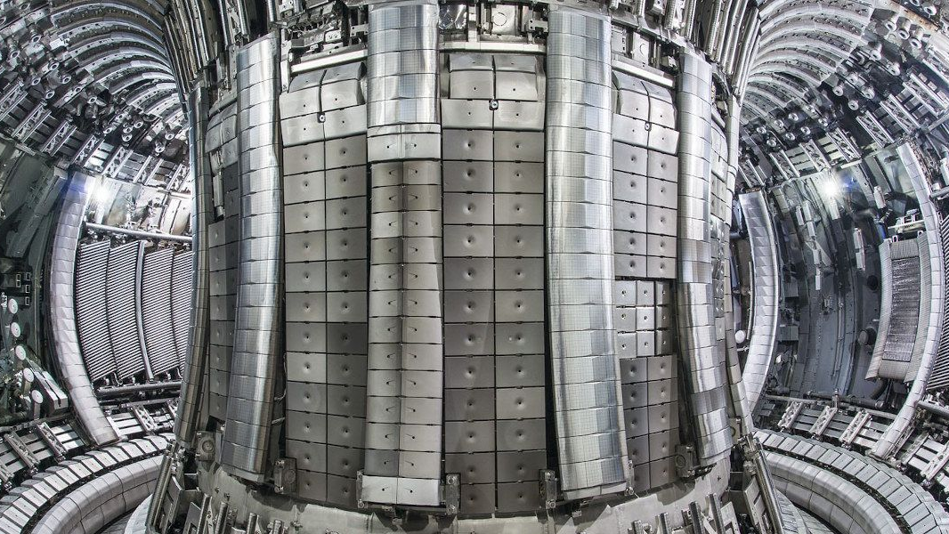


Integration of Hardware Acceleration Techniques in
Real-Time Framework using FPGA devices
C. González, M. Ruiz, A. Carpeño, A. Piñas , V. Costa, J. Nieto, E. Barrera
Universidad Politécnica de Madrid
c.gonzalezb@alumnos.upm.es
24th IEEE REAL TIME CONFERENCE
April 22-26 2024
ICISE, Quy Nhon, Vietnam

Slide 2
Outline
Motivation
  ITER Real-Time Framework (RTF)
  AMD XILINX VITIS acceleration technique
Tools and methodology
Results
  Vector add
  Matrix Multiplication: GEMM from BLAS
Conclusion
Future Work
Notes:
This is the outline of the presentation:
First, a motivation section, where I will introduce the ITER Real-Time Framework, the AMD Xilinx Vitis acceleration techniques, And, I will talk about the objectives that we have set.
Next, the tools and the methodology used to achieve our objectives.
In the results section, two applications will be presented to demonstrate the advantages of using hardware accelerators on the ITER real-time framework.
And finally, the conclusions and the future work.

Slide 3
Motivation
The use of specific software frameworks to develop and deploy real-time applications is essential in the control systems used in big-science facilities
Some software frameworks have been implemented in the experimental fusion devices to simplify the development and deployment of real-time applications
  MARTe
  ITER Real-Time Framework (RTF)
C. Neto, Sartori,F, Piccolo, F, Vitelli, R, De Tommasi, G, Zabeo, L et al., "MARTe: A Multiplatform Real-Time Framework" in IEEE Transactions on Nuclear Science, vol. 57, no. 2, pp. 479-486, April 2010,
https://doi.org/10.1109/TNS.2009.2037815
Kadziela M., Jablonski B., Perek P., and Makowski D., “Evaluation of the ITER Real-Time Framework for Data Acquisition and Processing from Pulsed Gigasample Digitizers”. Journal of Fusion Energy, vol.39, pp. 261–269, November 2020. https://doi.org/10.1007/s10894-020-00264-3
Notes:
In the context of big science facilities, it is essential to use specialized software frameworks to develop and deploy real-time applications for the Instrumentation and Control systems.
Experimental fusion devices have implemented several frameworks, including MARTe (which stands for Multithreaded Application Real-Time executor) and the ITER Real-Time Framework.
This work focuses on ITER Real-Time framework.

Slide 4
Motivation
ITER RTF is a collection of software tools that provides common services and capabilities for building real-time applications on a distributed control system integrated into the ITER Codac Core System
The key element in RTF is the Function Block (FB) that performs from simple operations to complex algorithms
Reducing the execution time of specific FBs may be crucial for some specific experiments
Perek, P., Makowski, D., Kadziela, M., Lee, W. R., Zagar, A., Simrock, et al. “Evaluation of ITER Real-Time Framework in plasma diagnostics applications”, Fusion Engineering and Design, 192. July 2023, https://doi.org/10.1016/j.fusengdes.2023.113623
Notes:
ITER Real-Time Framework is a collection of software tools that provides common services and capabilities for building real-time applications on a highly distributed control system:
Here we have a schematic of The ITER real-time system which comprises several interconnected computer nodes, each capable of hosting one or more real-time processes. Each real-time process can contain one or more real-time applications, which, in turn, can run one or more threads.
The key elements in the Real-Time Framework are the Function Blocks, which are the components responsible for the desired operation.
Function Blocks can run in different threads, processes, or nodes, each function block accepts inputs and produces outputs.
A Function Block can perform a simple operation or a complex algorithm.
Reducing the execution time of specific Function Blocks may be crucial for some experiments.

Slide 5
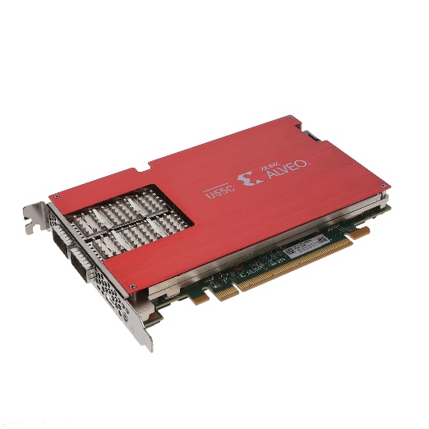
Motivation
Implement specific hardware to solve specific problems (Hardware accelerator)
C-type language to implement the hardware functions
OpenCL Runtime to manage the hardware accelerator
PCIe card sharing memory with the host computer
AMD XILINX hardware acceleration design cycle
Vitis Unified Software Platform Documentation Application Acceleration Development. UG1393 (v2023.2) December 13, 2023.
Notes:
Our objective is:
To Provide an alternative to optimize the throughput and reduce the latency for Real-Time Framework Function Blocks using specific hardware (hardware accelerators) to solve specific problems.
To make it easier for other function block developers to accelerate processes through hardware, we propose:
To use C-type language to implement the hardware functions.
And, the OpenCL Runtime to manage the hardware accelerator.
And, in this approximation we use an:
PCI express card sharing memory with the host computer
And the AMD XILINX hardware design cycle which defines the host and the device designs flow:
Here you can see, the host code, which is compiled and linked like a normal Linux C++ program. But it relies on the Xilinx Runtime, which is a set of libraries to manage the hardware accelerator.
And the hardware logic, which is linked with the platform’s hardware and software information to create a binary file with the programmable logic.
Both, the host and device designs communicate with the hardware accelerator through the PCI express port.

Slide 6
Tools and Methodology
Use of ITER CODAC Core System (RHEL 8.5)
Use of RT Linux Kernel and XILINX XRT
Use of a XILINX Alveo U55C card
Use of AMD VITIS for HLS
Use of C++ 14 for software development in ITER RTF
Implementation of two applications:
  Vector add
  Matrix Multiplications
Measure the execution time with RTF profiler and AMD Vitis Profiler
Notes:
The hardware platform defined by ITER CODAC to run the real-time applications is an industrial computer based on PICMG 1.3 standards known as ITER fast controller.
The fast controller installs Red Hat Enterprise Linux 8.5 operating system and the ITER CODAC CORE SYSTEM 7.1
We install an AMD XILINX ALVEO U55C PCI Express card on the fast controller.
So, at this point, we have an AMD XILINX card connected to a Fast controller with the Real-Time Linux kernel.
We have integrated the Xilinx Runtime on the fast controller, which is necessary for the operation of the card.
In the figure on the slide, you can see a schematic of our implementation:
The Real-Time Framework defines Non-Real-Time functions to perform all the tasks that don’t need to be performed as a real-time process.
We have implemented a Hardware Management Non-Real-Time function for the initial configuration of the hardware.
On the other hand, in the Real-Time Function Block, the CPU only writes the input data to the shared memory, coordinates the execution of the processes in the FPGA, and reads the results.
The hard process is performed by the FPGA.
The FPGA is programmed in HLS using AMD Vitis tools.
HLS stands for High Level Synthesis. The C-type Xilinx language for programming FPGA.
Everything related to the Real-Time Framework is programmed in C++ 14.
We developed two applications, - which I will talk about in the next section -, and measured the execution times using both the Real-Time Framework Profiler and the AMD Vitis Profiler.

Slide 7
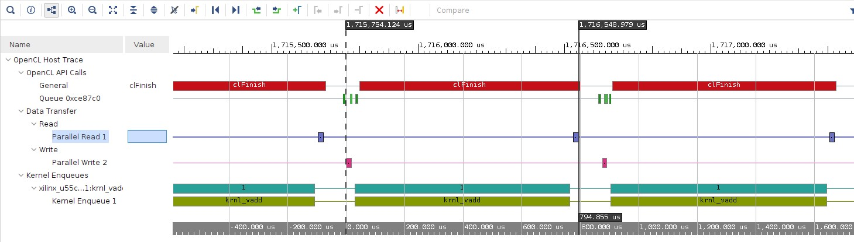
Results: adding vectors N times
N | CPU (us) | FPGA (us)
 | RTF profiler | RTF profiler
1 | 35.6 ± 1.8 | 208.0 ± 18.0
10 | 346.1 ± 2.3 | 338.5 ± 13.0
20 | 692.4 ± 13.4 | 465.0 ± 45.0
30 | 1037.3 ± 15.1 | 607.0 ± 24.0
40 | 1384.8 ± 21.4 | 744.0 ± 26.0
50 | 1731.2 ± 27.0 | 897.0 ± 15.0
N | Vitis Analyzer (us)
 | Kernel | Write | Read
1 | 61 ± 6 | 32 ± 6 | 22 ± 4
10 | 183 ± 7 | 31 ± 7 | 21 ± 3
20 | 322 ± 13 | 31 ± 7 | 21 ± 7
30 | 464 ± 6 | 33 ± 7 | 20 ± 3
40 | 600 ± 15 | 31 ± 6 | 20 ± 3
50 | 740 ± 8 | 33 ± 7 | 22 ± 4
Mean value and standard deviation
Vectors of 4096 floats
3000 executions
Notes:
Here we have our “hello world”. The vectors addition is the simplest example provided by AMD XILINX to introduce the user to application development with the Vitis tools.
So, we integrate this simple example on the Real-Time Framework to evaluate the feasibility, and the functionality.
At the deployment stage, we used three Function Blocks. Each running in a thread. Two Function-Blocks to generate random data. And, the third one reads the data and does the addition.
To do this, an isolated CPU by the Real-Time Linux kernel, runs the host executable, which, as I said, writes data to shared memory, coordinates the execution of the process in the FPGA, and reads the results. The FPGA does the addition.
The size of the vectors is 4096 floating-point numbers.
We also develop a vector addition on the CPU to compare results.
Function Blocks run continuously. The means and the standard deviations presented in this work were obtained with at least 3000 Function-Blocks executions.
As you can see in the first row of the Real-Time Framework Profiler results table, the CPU completes the addition in 35us, while the FPGA takes 208us.
So, for this simple process, the CPU is superior.
But, if the addition would have to be performed N times, that is, if the process would be more complex, the use of the FPGA starts to make sense.
In the subsequent rows of the same table, we can see how the FPGA performs the additions faster than the CPU, as the number of the additions increases.

Slide 8
Results: Matrix Multiplication
Use of BLAS library for XILINX VITIS
+ X
square matrix size | CPU (ms) | FPGA (ms)
 | RTF profiler | RTF profiler
64 | 0.25 ± 0.002 | 0.13 ± 0.009
128 | 2.00 ± 0.007 | 0.22 ± 0.012
256 | 22.00 ± 0.038 | 0.76 ± 0.014
512 | 222.00 ± 0.112 | 4.11 ± 0.009
1024 | 1828.88 ± 1.180 | 26.418 ± 0.020
3000 executions
Square Matrix Size | Vitis Analyzer (us)
 | Kernel | Write | Read
64 | 40 ± 9 | 30 ± 3 | 30 ± 3
128 | 80 ± 3 | 60 ± 2 | 60 ± 2
256 | 380 ± 5 | 180 ± 3 | 180 ± 3
512 | 2800 ± 5 | 640 ± 3 | 640 ± 3
1024 | 21400 ± 8 | 2500 ± 4 | 2500 ± 5
https://docs.amd.com/r/en-US/Vitis_Libraries/blas/overview.html
Notes:
To see this more clearly, we have used a Matrix Multiplication example.
This is a Basic Linear Algebra Subroutine provided by AMD Xilinx that multiplies two matrices and then adds one. Only, C is equal to A per B plus X.
And similarly to the previous example, we also implemented the CPU version of this process to compare results.
The results were obtained by processing different sizes of square matrices.
If the square matrix size is 64, the FPGA does the process in 130 us while the CPU does it in 250 us. Note that the CPU column is in milliseconds.
But as the matrix size increases, we see a huge advantage for the FPGA, to the point where the difference is over 1.8 seconds at a size of 1024.
On this slide, but also on the previous one, we can see the execution times of the Vitis Analyzer Profiler.
Here we have the FPGA kernel execution times and the write and read times from the host to the shared memory.
The sum of these times will always be less than the Real-Time Framework Profiler times, but they are approximate.
The difference between these times is because the Real-Time Framework Profiler takes additional times into account. These additional times are related to the function block gateways that are required to transfer data between function blocks.
Finally, we also present the standard deviation of the results.
It is important to mention again that we isolate the CPUs to run the Function Blocks to reduce the undesirable interferences that may increase standard deviation.

Slide 9
Conclusions
Integration of AMD XILINX hardware acceleration technique in ITER RTF framework
Test with an ITER fast controller configured with an ALVEO U55C and the XILINX XRT using the Red Hat real-time preemptive kernel (4.18.0-348.23.1.rt7.153)
  No significant issues with the system's latency
  It requires a specific configuration of the kernel parameters and isolates the specific interruptions of the xocl kernel module
Two applications have been implemented, showing the acceleration obtained using the FPGA
  The gain obtained with complex matrix multiplication (1024x1024) is 98% of the time used by the CPU
Notes:
So, we integrate an AMD XILINX hardware acceleration technique in the ITER Real-Time Framework
We test an ITER fast controller configured with an ALVEO U55C and the XILINX runtime using the Red Hat Linux Enterprise:
During this process, there were no significant problems with system latency.
However, it requires a special configuration of the Linux kernel parameters and isolation of the specific interrupts of the XILINX OpenCL module.
We have implemented two applications that show the acceleration obtained using the FPGA:
The gain obtained with square matrix multiplication of size 1024 is 98% of the time used by the CPU.
Hardware acceleration techniques in Real-Time Framework become more and more important as the complexity of the processes increases.
After evaluating the ITER Real-Time Framework, we believe that it could be the standard framework for developing and deploying real-time applications on big science facilities. However, it is important to integrate hardware accelerators within Function Blocks to perform some processes and algorithms.

Slide 10
Future Work
Application to the ITER diagnostics systems implemented with the MTCA platforms, which includes AMC boards with UltraScale MPSoC.
Investigate the accuracy of the results provided by the profiling tools, and the impact on the latency of the buffer movement implemented by the XILINX XRT.
Notes:
And we are planning:
Develop an Application for the ITER diagnostics systems implemented with the MicroTCA platforms, including AMC boards with UltraScale MPSoC.
In other words, explore more hardware solutions that could be integrated on the RTF, while evaluating these solutions with more complex algorithms.
And, we will Investigate the accuracy of the results provided by the profiling tools, and the impact on the latency of the buffer movement implemented by the XILINX RunTime.

Slide 11

Project funded by Spanish AEI
Projects:
  PID2019-108377RB-C33 MCIN/AEI/10.13039/501100011033
  PID2022-137680OB-C33 MCIN/AEI/10.13039/501100011033, FEDER, EU
Notes:
Thank you very much

Slide 12
Integration of Hardware Acceleration Techniques in
Real-Time Framework using FPGA devices
Thank you for your attention
C. González, M. Ruiz, A. Carpeño, A. Piñas , V. Costa, J. Nieto, E. Barrera
Universidad Politécnica de Madrid
c.gonzalezb@alumnos.upm.es
24th IEEE REAL TIME CONFERENCE
April 22-26 2024
ICISE, Quy Nhon, Vietnam
Notes:
I will be happy to answer any questions you may have.

