Slide 1
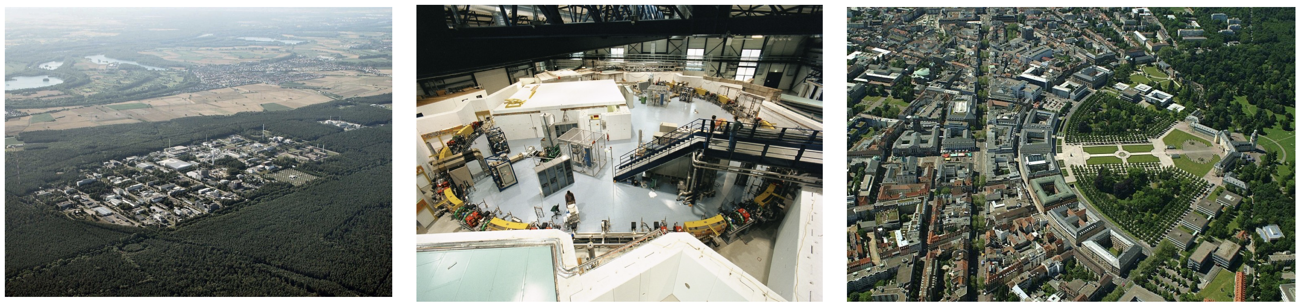
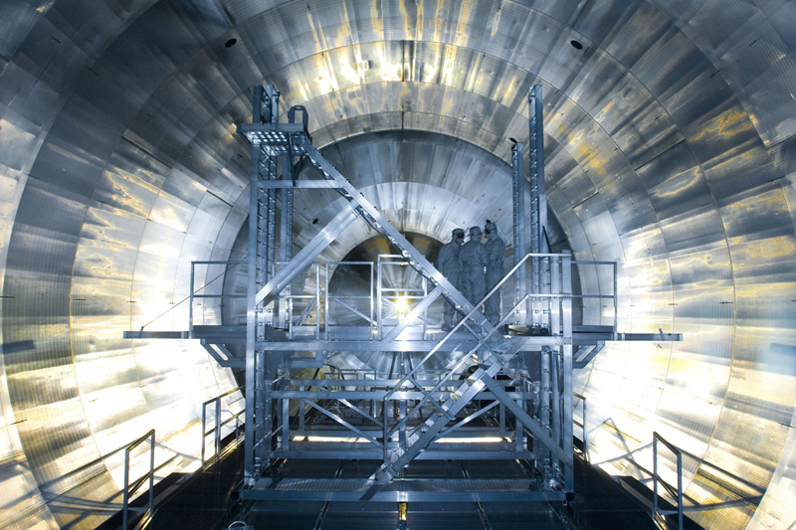
Enhancing Real-time Data Monitoring Display
through Video Streaming Technology
Nicholas Tan Jerome, Suren Chilingaryan, and Andreas Kopmann
Research Center
KATRIN Experiment
University

Slide 2



Motivation: High-speed Imaging
Commercial high frame rate cameras are becoming affordable
CCD and CMOS systems deliver an upper frame rate near 5000 fps, 10 GB/s
Complicates data storage
Lack of studies and solutions in process monitoring and quality control
Data
Concept to deal with data at such a rate and size
Notes:
Fig. 1 A: A liquid splash drawn by Worthington using spark illumination. B: High-speed photography of the milk drop
coronet by Harold Edgerton, the inventor of the electronic flash stroboscope (1936). The milk drop hits a thin layer of fluid,
spreads and creates a corona which breaks up due to surface tension [28]. C: A Splash of Red: a 2-mm droplet of red dye
impacting on a thin layer of milk. High-speed photography reveals crown formation with tips of entrained milk covering the
rim of the coronet. Jets extend from the tips, breaking up the white satellite droplets with a splash of red (movie online).
CCD (Charge-Coupled Device) and CMOS (Complementary Metal-Oxide-Semiconductor) systems deliver an upper frame rate near 5000 fps
store-first-analyze-later approach, where memory
copies quickly exhaust available memory bandwidth and
become performance bottlenecks.

Slide 3
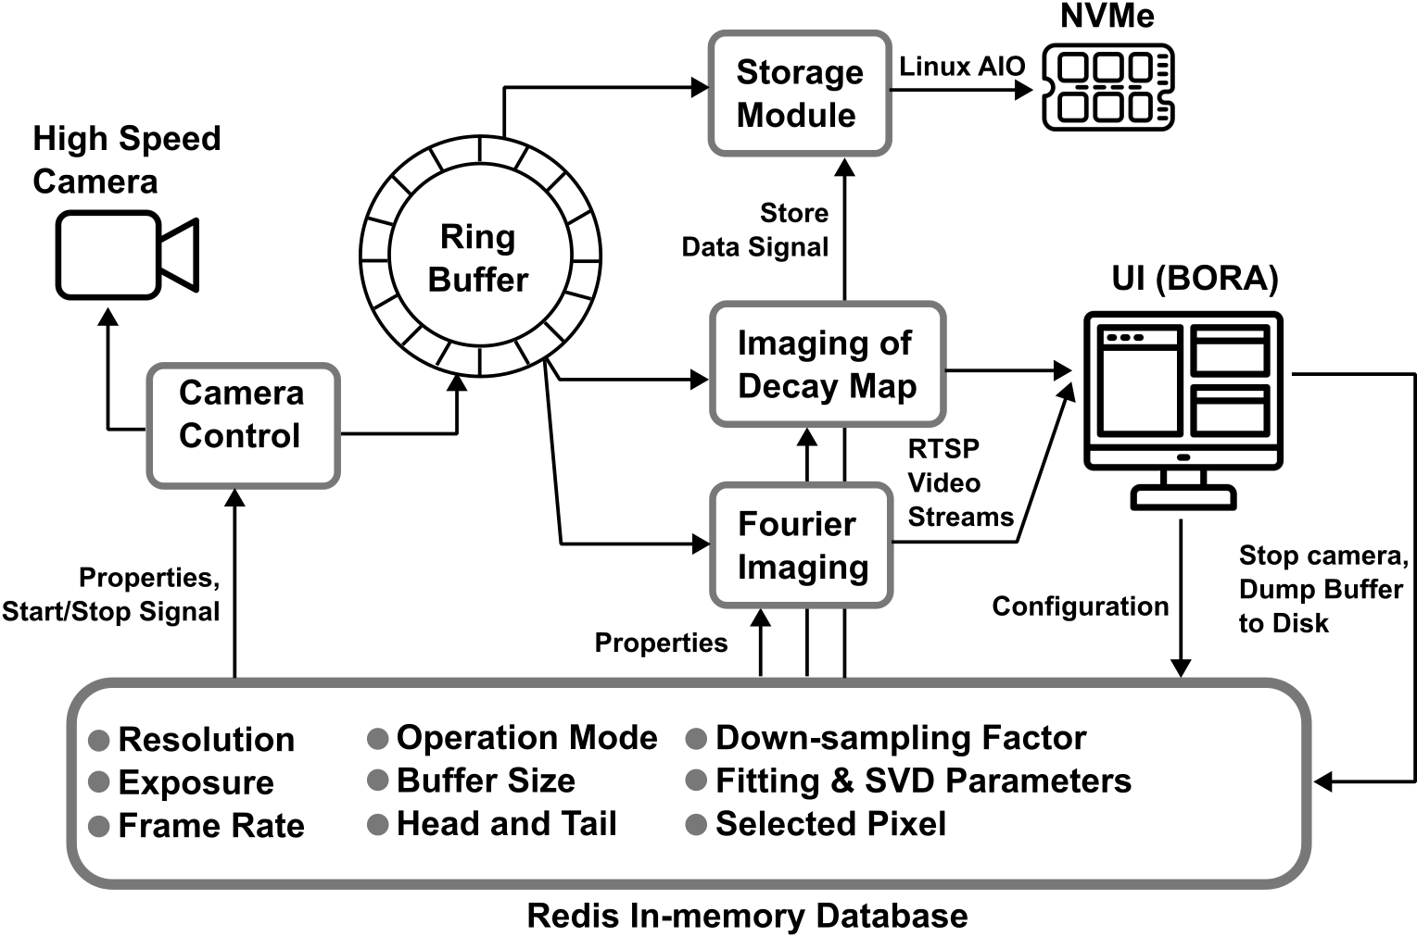
Our Idea: Encode Data in Video Streams
Backend System
Frontend System
Video Stream
Methods

Slide 4
Test Setup: Backend Ring Buffer
Simple mode: the camera captures a set number of frames and stores them in a ring buffer
Trigger mode: the ring buffer is constantly receiving and storing the acquired data in a FIFO mode. Upon receiving a trigger signal, the data in the buffer can be isolated and processed.
Compression mode: During compression mode, only processed data is saved to the disk
Distribution mode: the ring buffer will be duplicated across multiple processing computers, each responsible for various data processing and storage tasks.
Notes:
Simple mode. In simple mode, the camera captures a set
number of frames and stores them in a ring buffer. We expect
the ring buffer to be large enough to contain the entire data set.
The buffered data can be analyzed using the provided preview
application, with the option to save or delete it.
Trigger mode. The ring buffer is constantly receiving and
storing the acquired data. When the buffer space is full, the
oldest data gets replaced. The process remains ongoing until
a trigger signal is received, signifying the detection of the
relevant data in the buffer. The trigger signal can be generated
either automatically with the help of a pre-trained ML model
or manually through an online monitoring application by the
operator. Upon receiving a signal, the data in the buffer is
saved, while data acquisition continues until the buffer is filled.
Concurrently, operators can examine the buffered data and save
it entirely or just a specific portion.
Compression mode. During compression mode, only processed
data is saved to the disk, while raw camera data is
discarded. Similar to the trigger mode, the data is continuously
written to the ring buffer. The compression application
processes buffer data and writes a reduced data stream directly
to the disk in real-time.
Distribution mode. A data-distribution mode will facilitate
our platform’s scalability and ability to handle increased camera
frame rates. In this mode, the ring buffer will be duplicated
across multiple processing computers, each responsible for
various data processing and storage tasks.

Slide 5
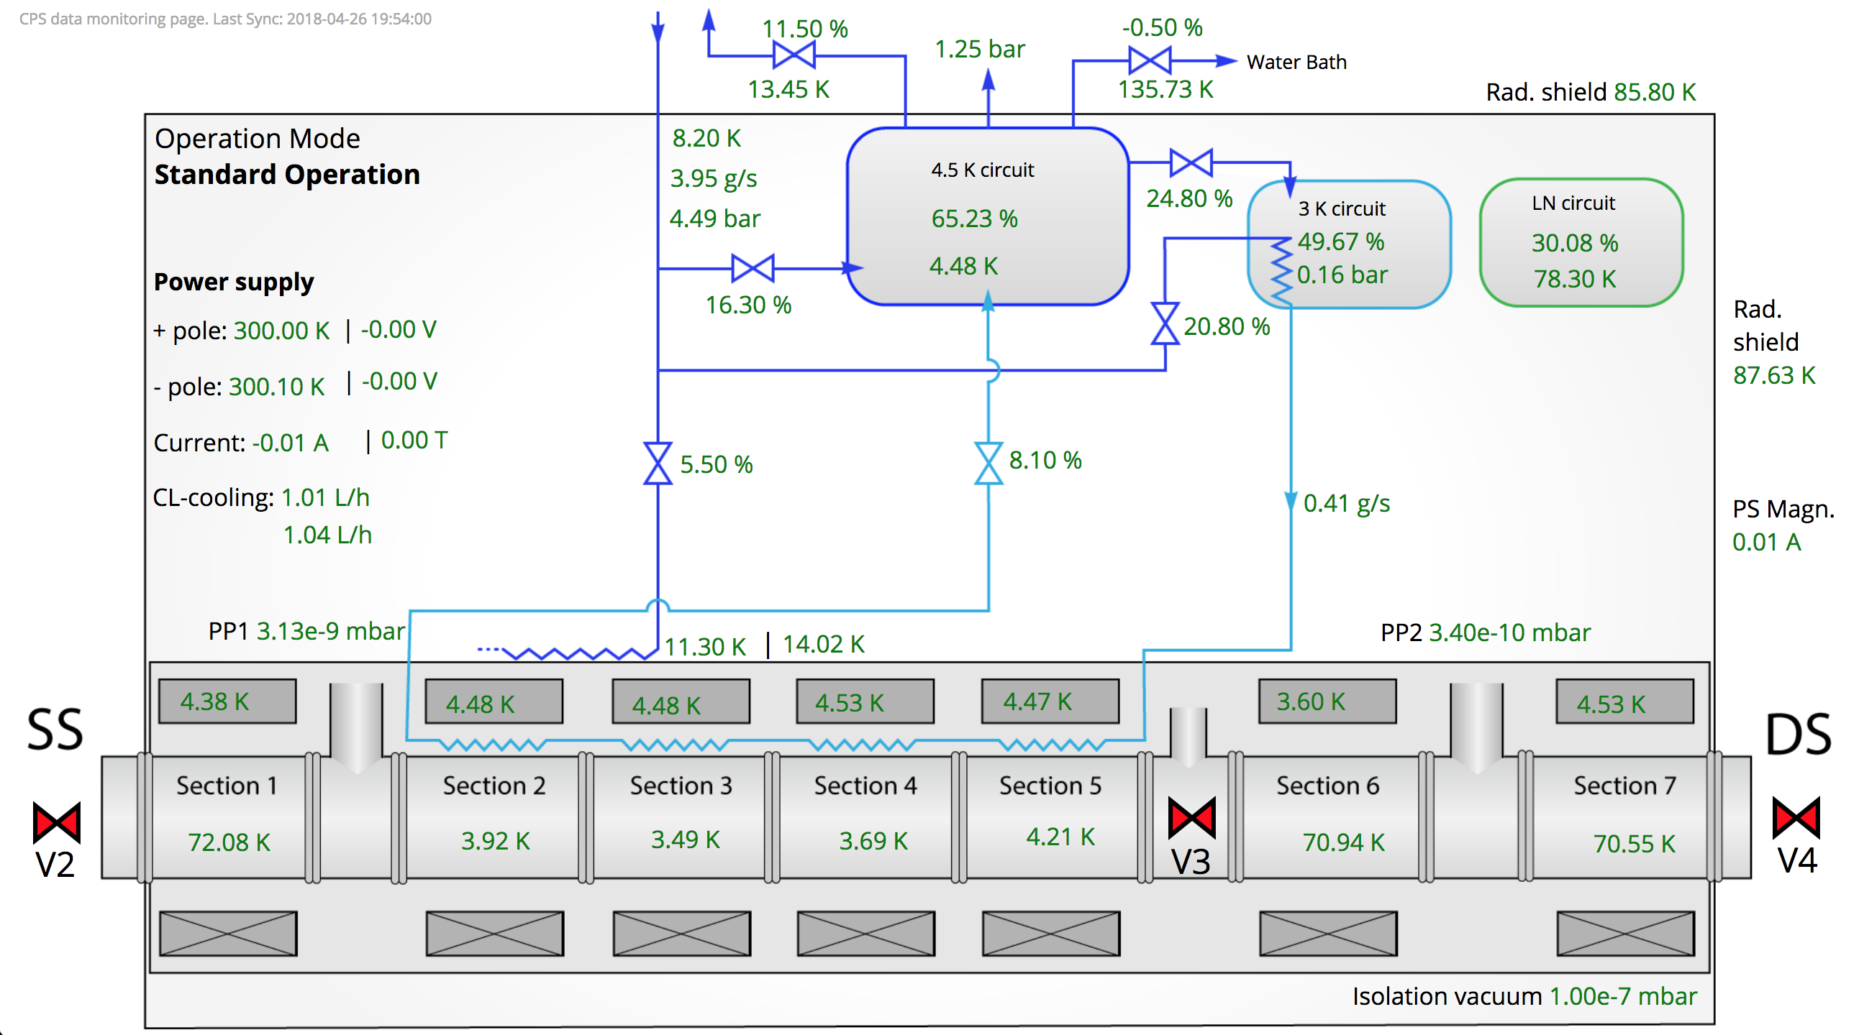
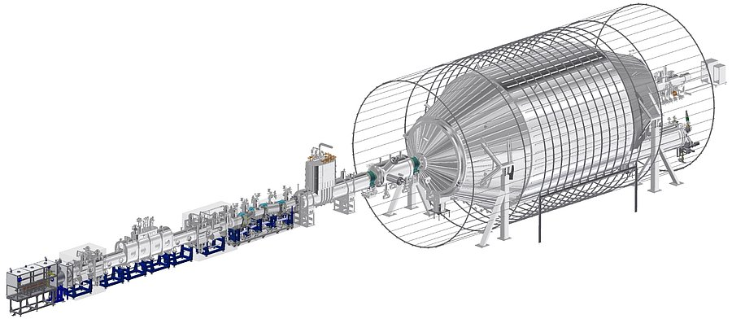
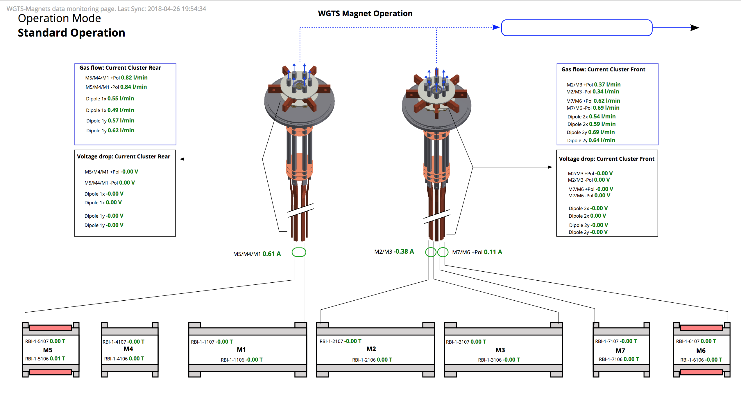
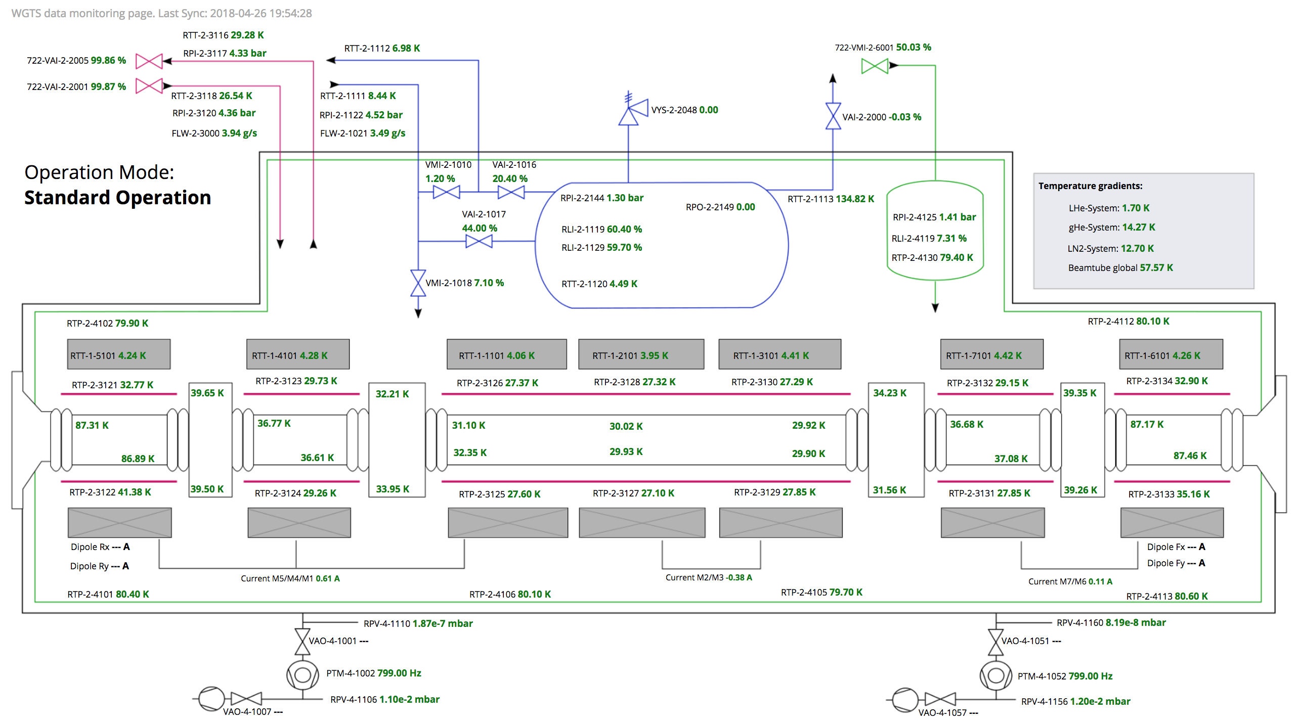

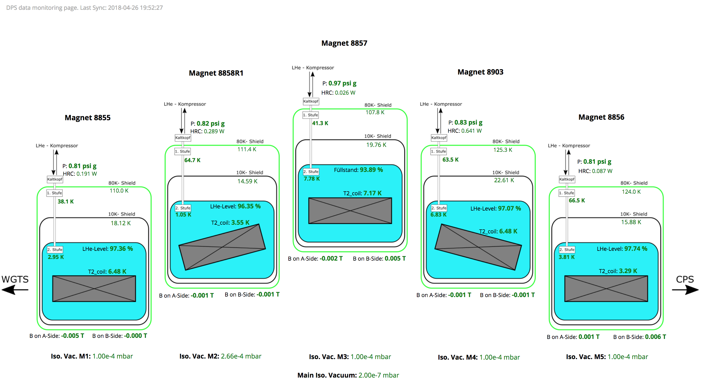
Test Setup: Frontend UI (BORA)
Lightweight UI framework that integrate multiple data sources into a single view.
Originally motivated within the KATRIN experiment as the visual panels for operation monitoring.
Based on the concept that helps the scientists
to build monitoring displays with least efforts.
Notebook and Redis integration
https://github.com/kit-ipe/bora
Notes:
Simple mode. In simple mode, the camera captures a set
number of frames and stores them in a ring buffer. We expect
the ring buffer to be large enough to contain the entire data set.
The buffered data can be analyzed using the provided preview
application, with the option to save or delete it.
Trigger mode. The ring buffer is constantly receiving and
storing the acquired data. When the buffer space is full, the
oldest data gets replaced. The process remains ongoing until
a trigger signal is received, signifying the detection of the
relevant data in the buffer. The trigger signal can be generated
either automatically with the help of a pre-trained ML model
or manually through an online monitoring application by the
operator. Upon receiving a signal, the data in the buffer is
saved, while data acquisition continues until the buffer is filled.
Concurrently, operators can examine the buffered data and save
it entirely or just a specific portion.
Compression mode. During compression mode, only processed
data is saved to the disk, while raw camera data is
discarded. Similar to the trigger mode, the data is continuously
written to the ring buffer. The compression application
processes buffer data and writes a reduced data stream directly
to the disk in real-time.
Distribution mode. A data-distribution mode will facilitate
our platform’s scalability and ability to handle increased camera
frame rates. In this mode, the ring buffer will be duplicated
across multiple processing computers, each responsible for
various data processing and storage tasks.

Slide 6
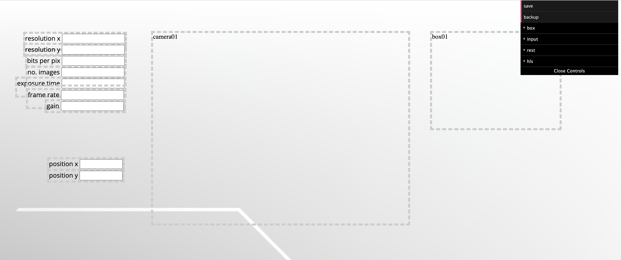
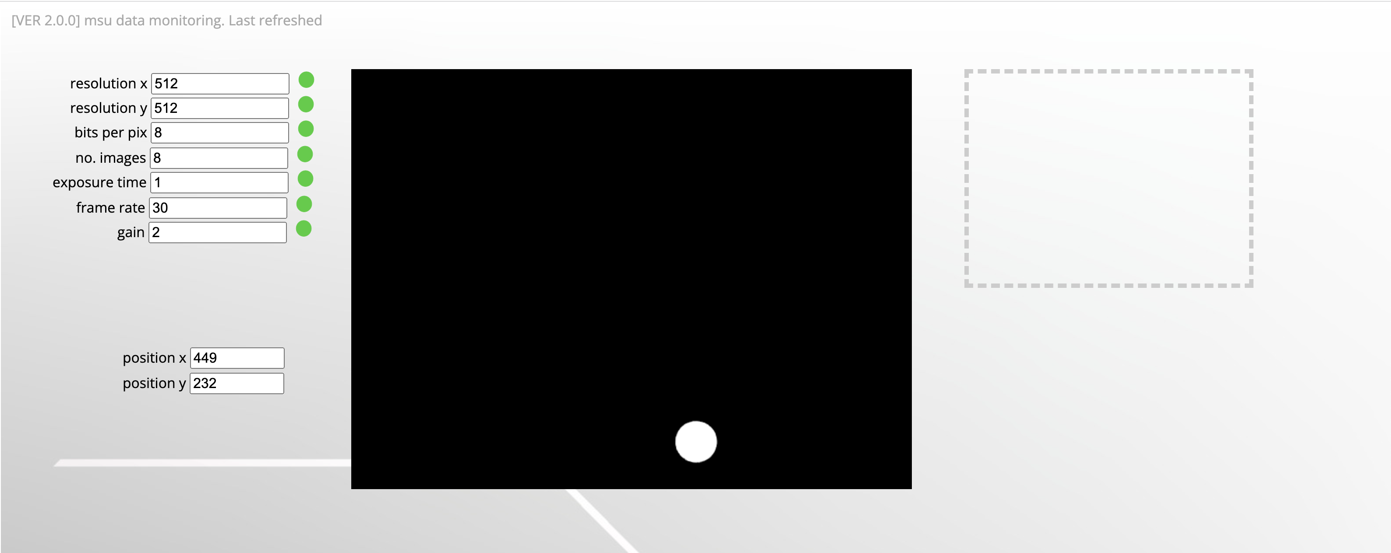
Test Setup: Frontend UI (BORA)
Designer
/designer
Input
Widget
Video
Widget
Box
Widget
Data
Display
/status
Notes:
Fig. 1 A: A liquid splash drawn by Worthington using spark illumination. B: High-speed photography of the milk drop
coronet by Harold Edgerton, the inventor of the electronic flash stroboscope (1936). The milk drop hits a thin layer of fluid,
spreads and creates a corona which breaks up due to surface tension [28]. C: A Splash of Red: a 2-mm droplet of red dye
impacting on a thin layer of milk. High-speed photography reveals crown formation with tips of entrained milk covering the
rim of the coronet. Jets extend from the tips, breaking up the white satellite droplets with a splash of red (movie online).
CCD (Charge-Coupled Device) and CMOS (Complementary Metal-Oxide-Semiconductor) systems deliver an upper frame rate near 5000 fps
store-first-analyze-later approach, where memory
copies quickly exhaust available memory bandwidth and
become performance bottlenecks.

Slide 7
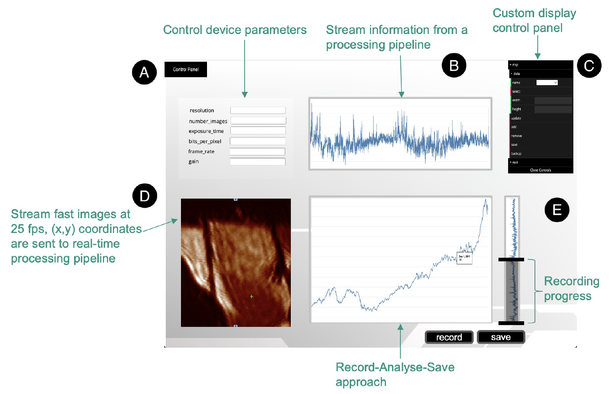
Test Setup: Frontend UI (BORA)
Notes:
Fig. 1 A: A liquid splash drawn by Worthington using spark illumination. B: High-speed photography of the milk drop
coronet by Harold Edgerton, the inventor of the electronic flash stroboscope (1936). The milk drop hits a thin layer of fluid,
spreads and creates a corona which breaks up due to surface tension [28]. C: A Splash of Red: a 2-mm droplet of red dye
impacting on a thin layer of milk. High-speed photography reveals crown formation with tips of entrained milk covering the
rim of the coronet. Jets extend from the tips, breaking up the white satellite droplets with a splash of red (movie online).
CCD (Charge-Coupled Device) and CMOS (Complementary Metal-Oxide-Semiconductor) systems deliver an upper frame rate near 5000 fps
store-first-analyze-later approach, where memory
copies quickly exhaust available memory bandwidth and
become performance bottlenecks.

Slide 8

Bringing Video Streams to the Web
Web browser does not support many video formats
Evaluate technologies to bring video streams to browser with low-latencies:
  HLS (HTTP Live Streaming)
  MPEG-Websocket
  WebRTC ((Web Real-Time Communication)
RTSP
(VP8 Format)
Video
Streaming Approaches
Video Encoding
Video transcoding
(FFMPEG)
Video Decoding
Notes:
Simple mode. In simple mode, the camera captures a set
number of frames and stores them in a ring buffer. We expect
the ring buffer to be large enough to contain the entire data set.
The buffered data can be analyzed using the provided preview
application, with the option to save or delete it.
Trigger mode. The ring buffer is constantly receiving and
storing the acquired data. When the buffer space is full, the
oldest data gets replaced. The process remains ongoing until
a trigger signal is received, signifying the detection of the
relevant data in the buffer. The trigger signal can be generated
either automatically with the help of a pre-trained ML model
or manually through an online monitoring application by the
operator. Upon receiving a signal, the data in the buffer is
saved, while data acquisition continues until the buffer is filled.
Concurrently, operators can examine the buffered data and save
it entirely or just a specific portion.
Compression mode. During compression mode, only processed
data is saved to the disk, while raw camera data is
discarded. Similar to the trigger mode, the data is continuously
written to the ring buffer. The compression application
processes buffer data and writes a reduced data stream directly
to the disk in real-time.
Distribution mode. A data-distribution mode will facilitate
our platform’s scalability and ability to handle increased camera
frame rates. In this mode, the ring buffer will be duplicated
across multiple processing computers, each responsible for
various data processing and storage tasks.

Slide 9
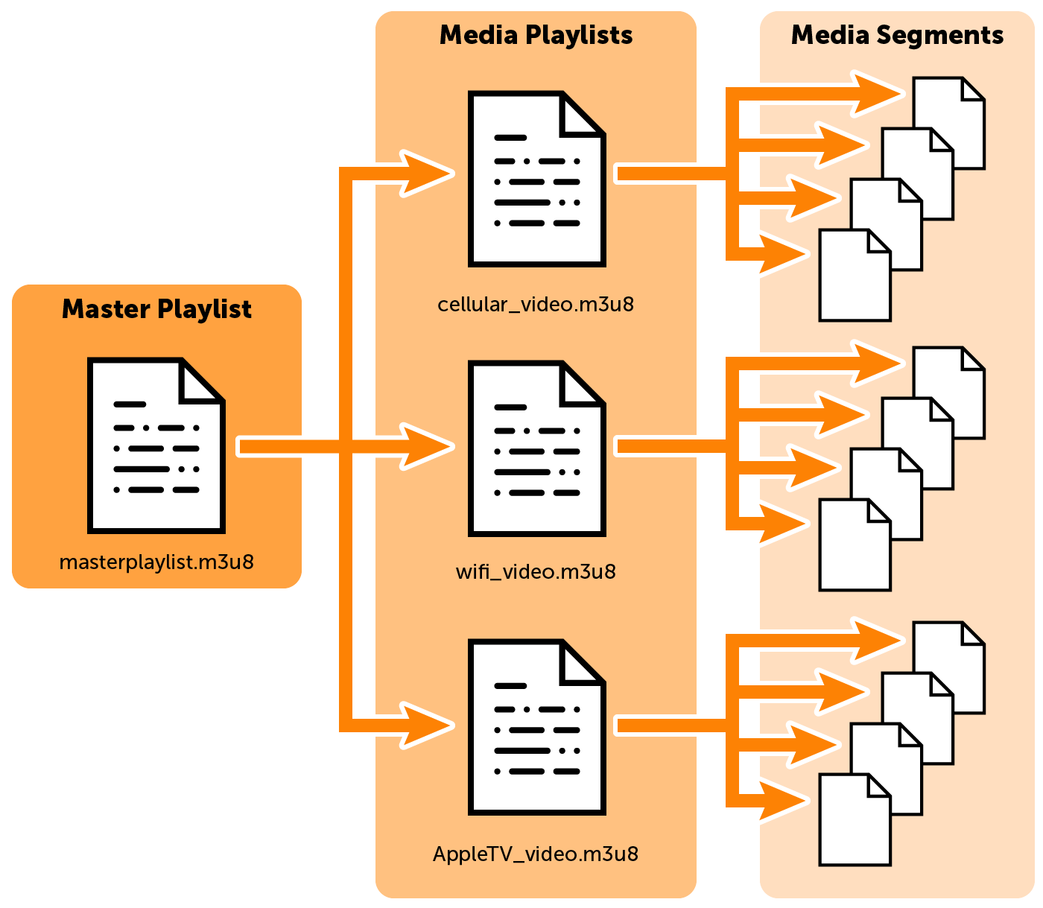
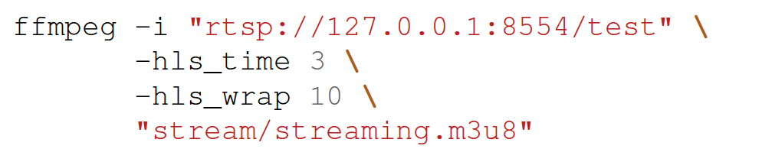
  HLS
Video Decoding
HTTP Live Streaming
Writes to a .m3u8 playlist file
The playlist manages the MPEG-TS-segment files
<video> tag
RTSP
(VP8 Format)
HLS
Video Encoding
Video transcoding
(FFMPEG)
Notes:
Simple mode. In simple mode, the camera captures a set
number of frames and stores them in a ring buffer. We expect
the ring buffer to be large enough to contain the entire data set.
The buffered data can be analyzed using the provided preview
application, with the option to save or delete it.
Trigger mode. The ring buffer is constantly receiving and
storing the acquired data. When the buffer space is full, the
oldest data gets replaced. The process remains ongoing until
a trigger signal is received, signifying the detection of the
relevant data in the buffer. The trigger signal can be generated
either automatically with the help of a pre-trained ML model
or manually through an online monitoring application by the
operator. Upon receiving a signal, the data in the buffer is
saved, while data acquisition continues until the buffer is filled.
Concurrently, operators can examine the buffered data and save
it entirely or just a specific portion.
Compression mode. During compression mode, only processed
data is saved to the disk, while raw camera data is
discarded. Similar to the trigger mode, the data is continuously
written to the ring buffer. The compression application
processes buffer data and writes a reduced data stream directly
to the disk in real-time.
Distribution mode. A data-distribution mode will facilitate
our platform’s scalability and ability to handle increased camera
frame rates. In this mode, the ring buffer will be duplicated
across multiple processing computers, each responsible for
various data processing and storage tasks.

Slide 10
  MPEG-Websocket
FFMPEG to convert RTSP to MPEG-TS-Stream
JS-Web-assembly MPEG1 Video Decoder
<canvas> tag --- WebGL & Canvas 2D Renderer
RTSP
(VP8 Format)
RTSP->MPEG
Websocket
Video Encoding
Video transcoding
(FFMPEG)
Video Decoding
Notes:
Simple mode. In simple mode, the camera captures a set
number of frames and stores them in a ring buffer. We expect
the ring buffer to be large enough to contain the entire data set.
The buffered data can be analyzed using the provided preview
application, with the option to save or delete it.
Trigger mode. The ring buffer is constantly receiving and
storing the acquired data. When the buffer space is full, the
oldest data gets replaced. The process remains ongoing until
a trigger signal is received, signifying the detection of the
relevant data in the buffer. The trigger signal can be generated
either automatically with the help of a pre-trained ML model
or manually through an online monitoring application by the
operator. Upon receiving a signal, the data in the buffer is
saved, while data acquisition continues until the buffer is filled.
Concurrently, operators can examine the buffered data and save
it entirely or just a specific portion.
Compression mode. During compression mode, only processed
data is saved to the disk, while raw camera data is
discarded. Similar to the trigger mode, the data is continuously
written to the ring buffer. The compression application
processes buffer data and writes a reduced data stream directly
to the disk in real-time.
Distribution mode. A data-distribution mode will facilitate
our platform’s scalability and ability to handle increased camera
frame rates. In this mode, the ring buffer will be duplicated
across multiple processing computers, each responsible for
various data processing and storage tasks.

Slide 11
  WebRTC
Direct communication like P2P
Removes transcoding step
Video control element
<video> tag
Signal Server
Websocket
Websocket
RTSP
(VP8 Format)
peer-to-peer
Video Encoding
Video Decoding
Notes:
Simple mode. In simple mode, the camera captures a set
number of frames and stores them in a ring buffer. We expect
the ring buffer to be large enough to contain the entire data set.
The buffered data can be analyzed using the provided preview
application, with the option to save or delete it.
Trigger mode. The ring buffer is constantly receiving and
storing the acquired data. When the buffer space is full, the
oldest data gets replaced. The process remains ongoing until
a trigger signal is received, signifying the detection of the
relevant data in the buffer. The trigger signal can be generated
either automatically with the help of a pre-trained ML model
or manually through an online monitoring application by the
operator. Upon receiving a signal, the data in the buffer is
saved, while data acquisition continues until the buffer is filled.
Concurrently, operators can examine the buffered data and save
it entirely or just a specific portion.
Compression mode. During compression mode, only processed
data is saved to the disk, while raw camera data is
discarded. Similar to the trigger mode, the data is continuously
written to the ring buffer. The compression application
processes buffer data and writes a reduced data stream directly
to the disk in real-time.
Distribution mode. A data-distribution mode will facilitate
our platform’s scalability and ability to handle increased camera
frame rates. In this mode, the ring buffer will be duplicated
across multiple processing computers, each responsible for
various data processing and storage tasks.

Slide 12
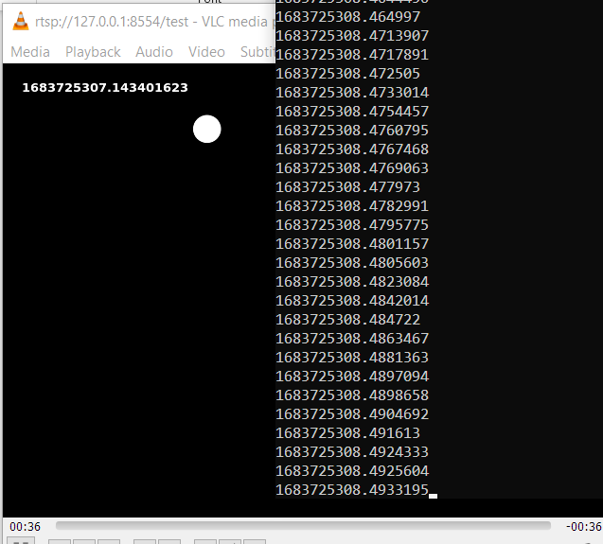

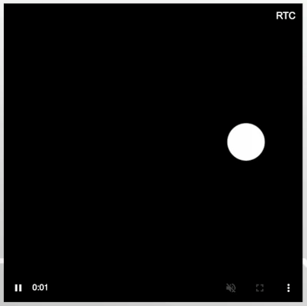
Evaluation
We created a C++ prototype RTSP source using the GST template library.
We look into transmission latency and start-up delay
Codes are available:
https://github.com/kit-ipe/bora/tree/master/misc/rtsp_streaming
Notes:
Simple mode. In simple mode, the camera captures a set
number of frames and stores them in a ring buffer. We expect
the ring buffer to be large enough to contain the entire data set.
The buffered data can be analyzed using the provided preview
application, with the option to save or delete it.
Trigger mode. The ring buffer is constantly receiving and
storing the acquired data. When the buffer space is full, the
oldest data gets replaced. The process remains ongoing until
a trigger signal is received, signifying the detection of the
relevant data in the buffer. The trigger signal can be generated
either automatically with the help of a pre-trained ML model
or manually through an online monitoring application by the
operator. Upon receiving a signal, the data in the buffer is
saved, while data acquisition continues until the buffer is filled.
Concurrently, operators can examine the buffered data and save
it entirely or just a specific portion.
Compression mode. During compression mode, only processed
data is saved to the disk, while raw camera data is
discarded. Similar to the trigger mode, the data is continuously
written to the ring buffer. The compression application
processes buffer data and writes a reduced data stream directly
to the disk in real-time.
Distribution mode. A data-distribution mode will facilitate
our platform’s scalability and ability to handle increased camera
frame rates. In this mode, the ring buffer will be duplicated
across multiple processing computers, each responsible for
various data processing and storage tasks.

Slide 13
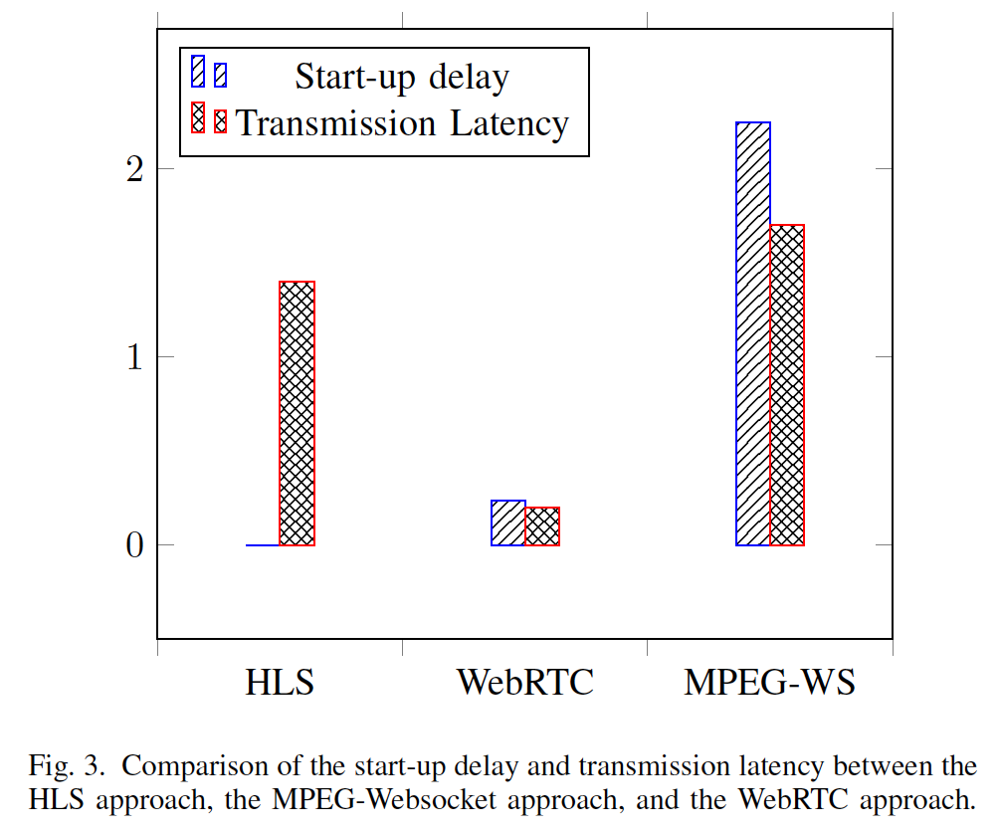
Evaluation
Zero start-up delay for HLS doesn’t mean good performance, rather the file is readily processed
Higher transmission latencies for HLS and MPEG-WS show the overhead from video transcoding, and video decoding of the MPEG-TS format.
Decoding MPEG-TS involves parsing the container and decoding the compressed video format
Start-up delay by the WebRTC shows the overhead of the signaling procedures and the low transmission latency is the video decoding of the VP8 format.
Notes:
Simple mode. In simple mode, the camera captures a set
number of frames and stores them in a ring buffer. We expect
the ring buffer to be large enough to contain the entire data set.
The buffered data can be analyzed using the provided preview
application, with the option to save or delete it.
Trigger mode. The ring buffer is constantly receiving and
storing the acquired data. When the buffer space is full, the
oldest data gets replaced. The process remains ongoing until
a trigger signal is received, signifying the detection of the
relevant data in the buffer. The trigger signal can be generated
either automatically with the help of a pre-trained ML model
or manually through an online monitoring application by the
operator. Upon receiving a signal, the data in the buffer is
saved, while data acquisition continues until the buffer is filled.
Concurrently, operators can examine the buffered data and save
it entirely or just a specific portion.
Compression mode. During compression mode, only processed
data is saved to the disk, while raw camera data is
discarded. Similar to the trigger mode, the data is continuously
written to the ring buffer. The compression application
processes buffer data and writes a reduced data stream directly
to the disk in real-time.
Distribution mode. A data-distribution mode will facilitate
our platform’s scalability and ability to handle increased camera
frame rates. In this mode, the ring buffer will be duplicated
across multiple processing computers, each responsible for
various data processing and storage tasks.

Slide 14

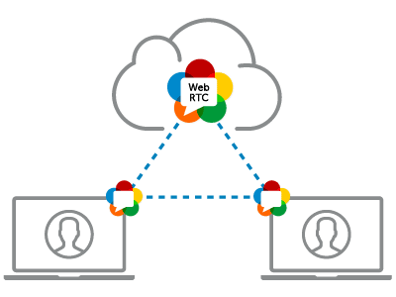
Conclusion
Examines real-time video streaming methods for monitoring high frame rates through web browsers as the client medium
  HLS, MPEG-Websocket, WebRTC
The evaluation assessed the start-up delay and transmission latency of HLS, MPEG-Websocket, and WebRTC methods.
The suggested system architecture, which integrates a shared memory ring buffer framework and the BORA frontend framework, offers a foundation for processing and displaying high-speed imaging data.
Ring Buffer
UI (BORA)
WebRTC
Notes:
Simple mode. In simple mode, the camera captures a set
number of frames and stores them in a ring buffer. We expect
the ring buffer to be large enough to contain the entire data set.
The buffered data can be analyzed using the provided preview
application, with the option to save or delete it.
Trigger mode. The ring buffer is constantly receiving and
storing the acquired data. When the buffer space is full, the
oldest data gets replaced. The process remains ongoing until
a trigger signal is received, signifying the detection of the
relevant data in the buffer. The trigger signal can be generated
either automatically with the help of a pre-trained ML model
or manually through an online monitoring application by the
operator. Upon receiving a signal, the data in the buffer is
saved, while data acquisition continues until the buffer is filled.
Concurrently, operators can examine the buffered data and save
it entirely or just a specific portion.
Compression mode. During compression mode, only processed
data is saved to the disk, while raw camera data is
discarded. Similar to the trigger mode, the data is continuously
written to the ring buffer. The compression application
processes buffer data and writes a reduced data stream directly
to the disk in real-time.
Distribution mode. A data-distribution mode will facilitate
our platform’s scalability and ability to handle increased camera
frame rates. In this mode, the ring buffer will be duplicated
across multiple processing computers, each responsible for
various data processing and storage tasks.

Slide 15
Thank You

