Slide 1
Development and Test of a 48-optical Ports High Precision Clock Distributor Board
D. Calvet, E. Molina,
Irfu, CEA Paris-Saclay, France
denis.calvet@cea.fr
emmanuel.molina-gonzalez@cea.fr

Slide 2

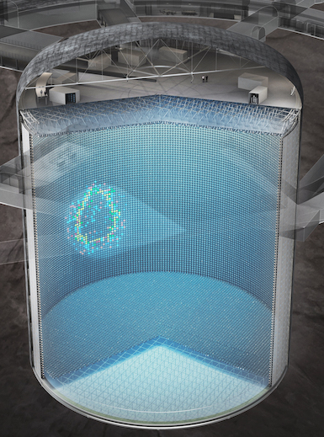
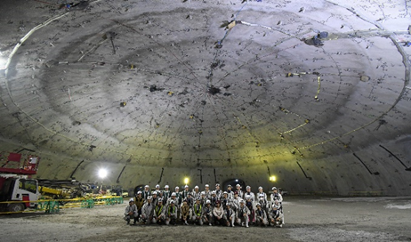
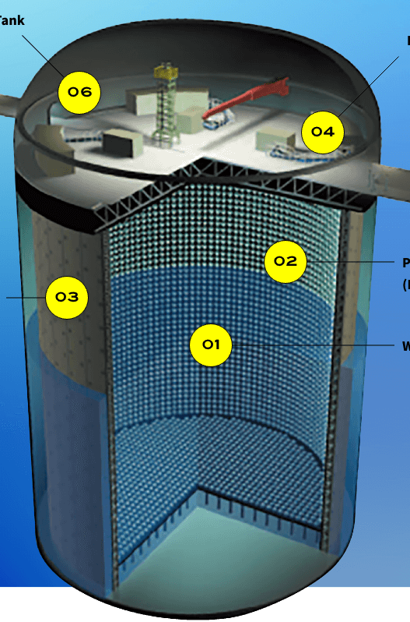
High Precision Clock Distribution, Hyper-K case
  Some physics experiment require larger and larger detection volumes and increasing channel counts
  Synchronizing electronics spread across large space with high precision (e.g. few 10’s ps) is required
  Example: next generation neutrino observatory Hyper-Kamiokande
  Constructed 1996; in operation
  50,000 ton water target
  39 m diameter x 42 m height
  ~12.000 phototubes
  Data taking from 2027
  260,000 ton water target
  68 m diameter x 71 m height
  ~20.000 phototubes
October 2023: completion of the excavation of the dome of the cavern (69 m diameter)

Slide 3
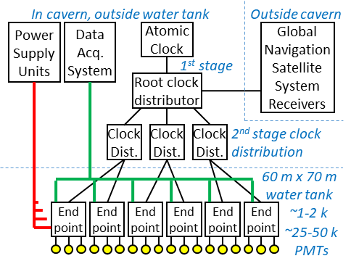
Requirements for Hyper-K, System Architecture
Main requirements
  Distinct path for synchronization and DAQ
  Synchro. path: 125 MHz clock + 125 Mbps data min.
  Stable phase offset after system reconfiguration
  ≤100 ps rms clock jitter at all end-points
  Up to 1000-2000 end-points
Proposed architecture
  Two stage clock distribution tree
  48-port distributors to scale up to 2308 end-points
  Based on modern FPGAs and optical technology

Slide 4

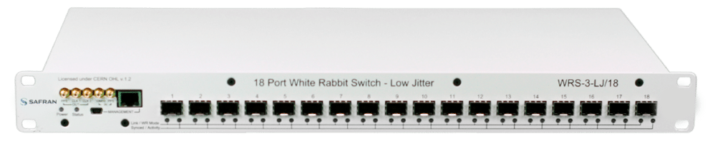

Beyond Common Clock Distribution Solutions
Present landscape
  Many designs rely on FPGA high-speed SerDes for clock and synchronous data distribution
  Clock and Data Recovery circuit (CDR) within SerDes block produces a copy of the transmitter clock
  WhiteRabbit, started at CERN, combines the idea with Ethernet. It’s standard, commercially available.
https://www.white-rabbit.tech/
Why search for alternatives?
  Based on Super-K experience, Hyper-K, will have distinct clock and DAQ paths. Using a White Rabbit network solely for synchronization + a regular Ethernet network for DAQ does not seem judicious
  Available WR switch (v.3) is an aging product (Virtex 6); v.4 in development following its own planning
  → R&D on synchronization for Hyper K moved towards custom solutions developped internally

Slide 5
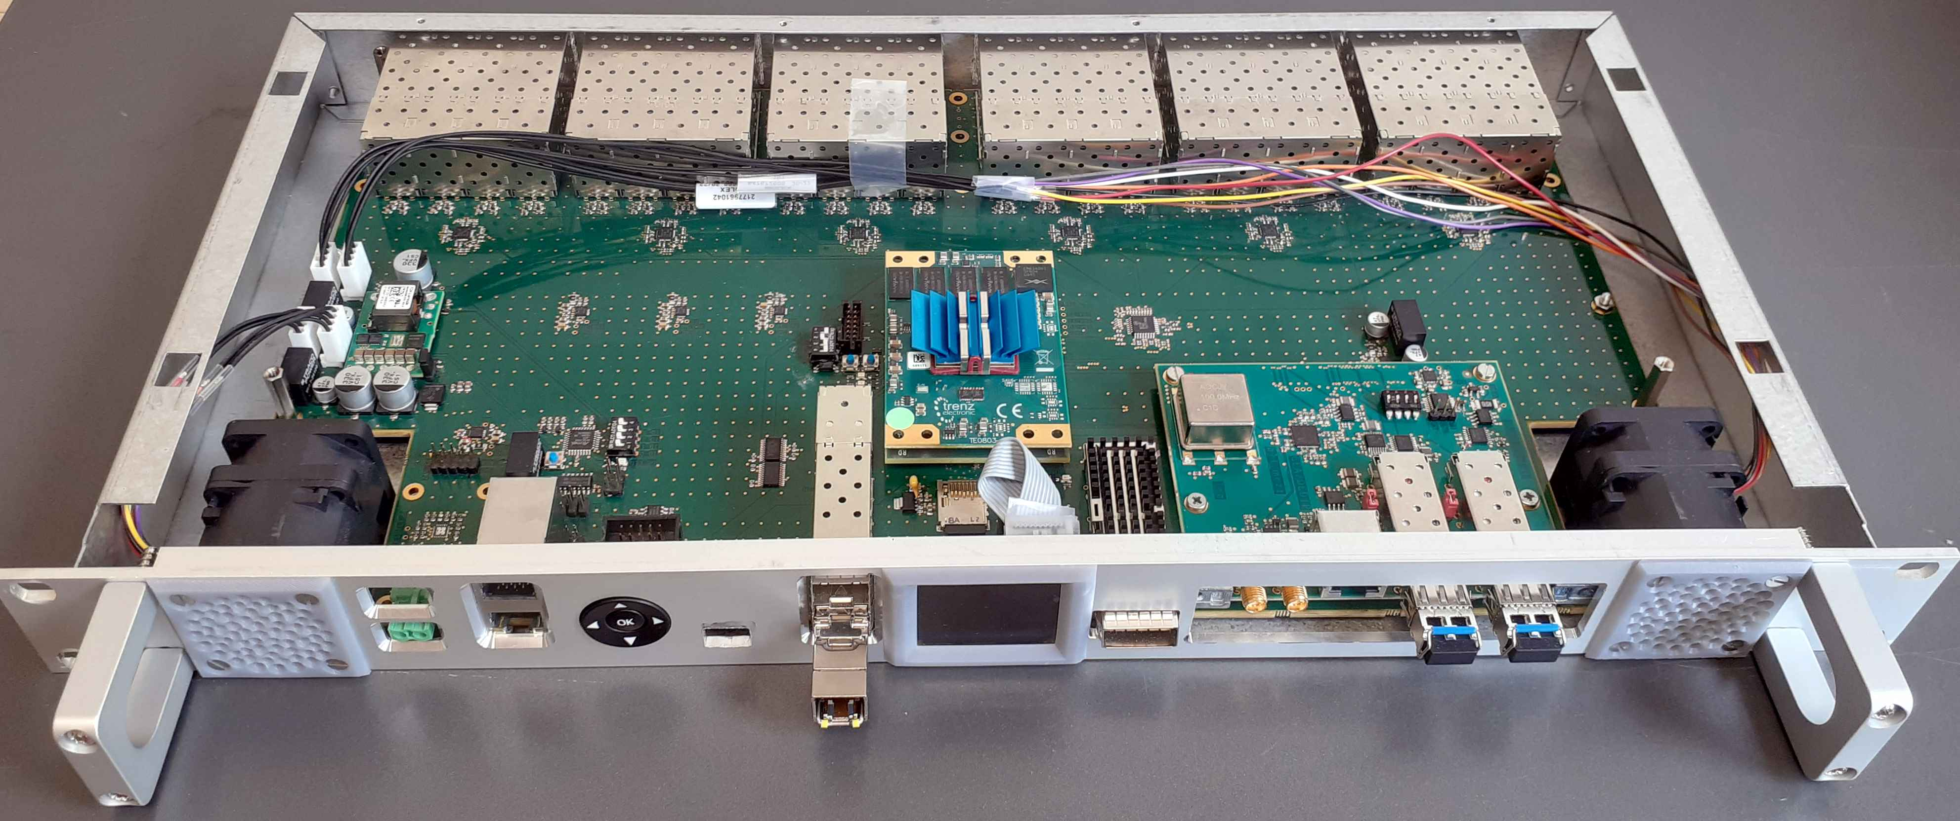
48-Port Clock Distributor Board
Up to 48-SFP transceivers
1:8 fanout chip
Standard 1U x 19’’ enclosure
Commercial
System-on-Module
(Trenz – Zynq UltraScale+)
Dual
fan
Redundant 24 V input
Dual Gigabit Ethernet (GTR)
OLED
Display
QSFP
(4 x GTH)
Versatile Clock Mezzanine Card
RS485
  Small available number of high speed SerDes (4 GTH) assigned to high troughput interface while more numerous ordinary I/O’s drive up to 48 SFPs: 48 TX in 6 groups via 1:8 fanout chips + 48 individual RX
  Proprietary serial protocol implemented on UltraScale+ ISERDESE3/OSERDESE3 primitives

Slide 6
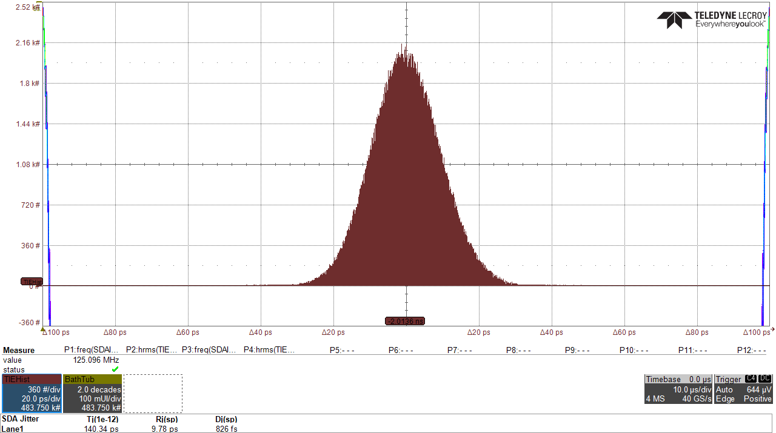
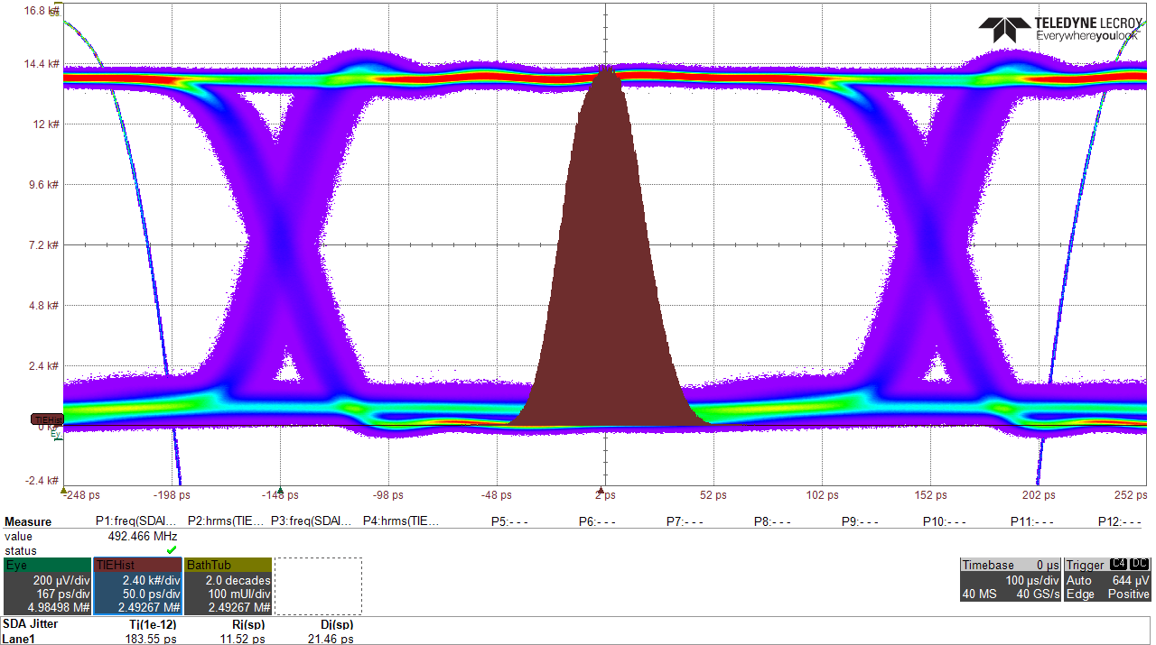
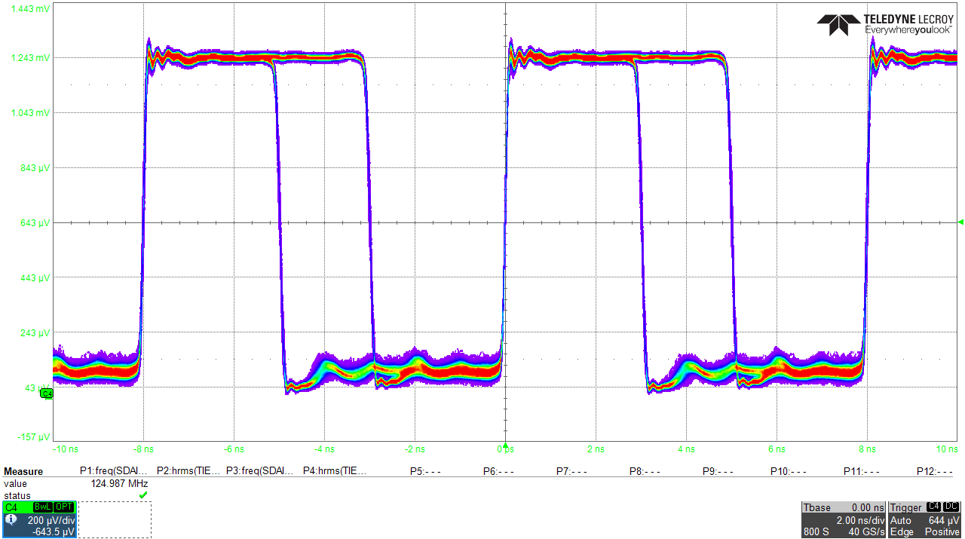
Transmit Operation – Jitter Performance
×6
  Depending on serializer inputs (8-bit x 125 MHz) various operating modes: clock up to 500 MHz, serial data up to 1 Gbps and sub-multiples rates
  6 TX groups of 8 SFPs can be set to a different mode independently
125 MHz
osc.
125 MHz
OSERDESE3
1→8
fanout
chip
D₀
8
8
Data(7..0)
D₁
6
SFP
Q
TX_{in}
…
D₇
FPGA
500 MHz DDR
  TX mode: 125 MHz clock fanout
  SFP port #8: R_{j} < 10 ps D_{j} < 1 ps
  TX mode: 1 Gbps PRBS data
  SFP port #8: R_{j} < 15 ps D_{j} = 21.4 ps
  TX mode: 125 MHz clock duty cycle modulated by 125 Mbps PRBS data
  SFP port #8: R_{j} < 10 ps D_{j} = 1 ps

Slide 7
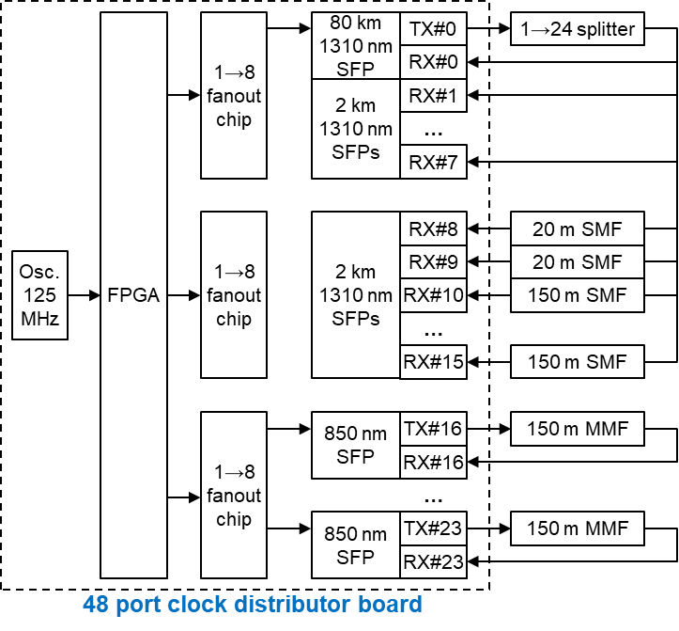
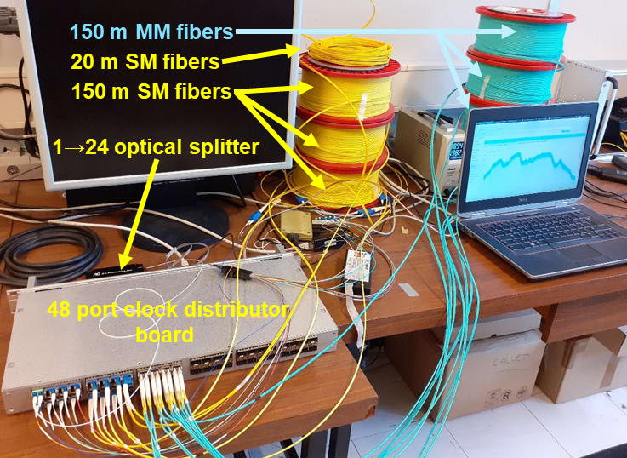
Test Setup for Longer Term Measurements
  Logic based on ”Digital Dual Mixer Time Difference (DDMTD)” (used in WhiteRabbit) is implemented in FPGA to track phase shifts between local clock and echo clocks returned by TX to RX loop-back fibers
P. Moreira, P. Alvarez, J. Serrano, I. Darwezeh and T. Wlostowski, "Digital dual mixer time difference for sub-nanosecond time synchronization in Ethernet", in Proc. IEEE International Frequency Control Symposium, Newport Beach, CA, USA, 2010, pp. 449-453

Slide 8
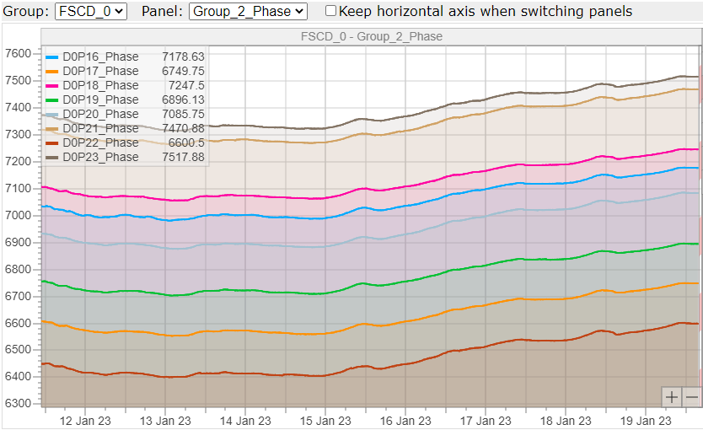
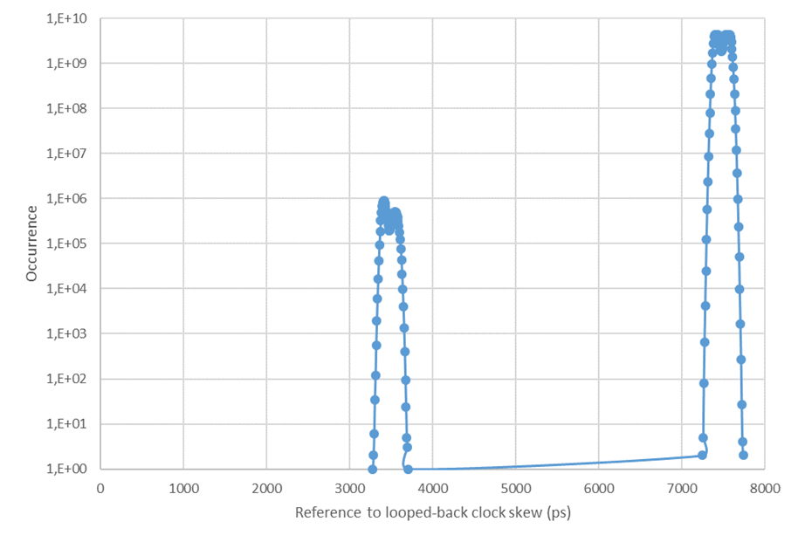
Distributed Clock Phase Variations Over 1 Week
  Group of 8 ports in 125 MHz clock distribution mode
  TX to RX loopback on 8 ports by 150 m MMF fibers
  200 ps p.p. drift measured; 6 °C p.p. temperature var.
  Histogram of reference clock to echo clock phase differences on one port (125 kHz measurement rate)
  Spurious peak, 4 orders magnitude smaller than main, probably caused by imperfections in DDMTD logic, but no other deviant points

Slide 9
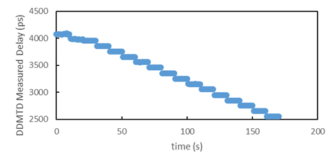
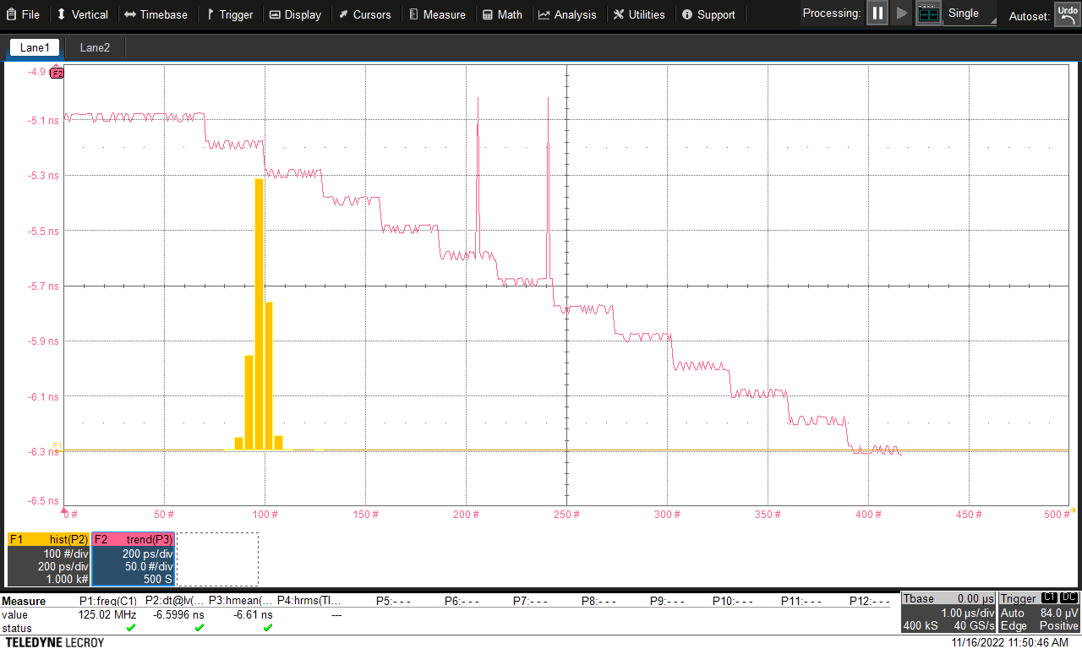
Adding a Programmable Delay on TX Path
Differential probe
Oscilloscope
O/E converter
1 ns
×6
125 MHz
osc.
125 MHz
OSERDESE3
1→8
fanout
chip
1 ns
Results obtained with DDMTD logic
D₀
ODELAYE3
Data(7..0)
D₁
6
8
SFP
8
Q
TX_{in}
…
125 MHz
clock
D₇
500 MHz
DDR
Fixed or
modulated
FPGA
  UltraScale+ OSERDESE3 can be followed by a 512-tap calibrated delay line, ODELAYE3, cascadable up to 3. Delay tap resolution: 2.1-12 ps
  ODELAYE3 set to perform 12 delay steps of 100 ps
  Expected delay jumps verified with an oscilloscope
  Phase steps also correctly measured by DDMTD logic

Slide 10
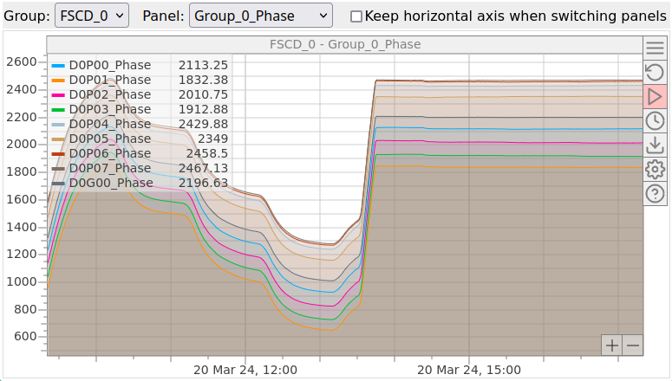
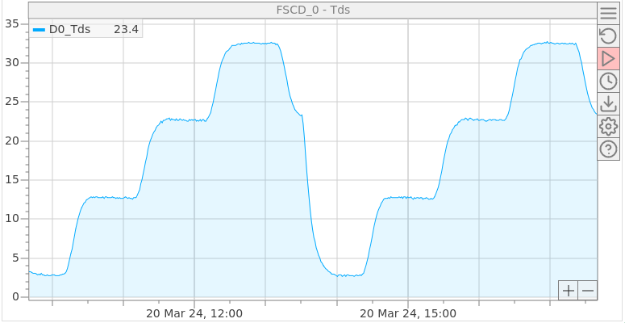
Clock Fanout Phase Regulation with ODELAYE3
  Demonstrator set for 125 MHz clock fanout
  1 TX port drives 150 m SM fiber + 1:8 optical splitter looped-back to 8 RX ports
  All hardware placed in a climatic chamber set at 0°C to 30°C in 4 steps of 10°C
Phase regulation OFF
Phase regulation ON
Measured clock distributor board temperature
Phase 125 MHz reference to 8 clocks looped backed (DDMTD method)
  Designed a corrector on embedded processor tuning ODELAYE3 to stabilize distributed clock phase drift
  For 30°C variations: delay variations ~1.2 ns without regulation and ~6 ps with regulation

Slide 11
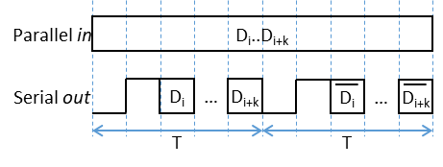
Simultaneous Serial Data Reception and Clock Round-trip Monitoring on FPGA Ordinary Inputs
  Previous tests use loop-back clock on RX port to measure phase difference with the reference. But recovered clock not provided by serial data receiver made from ordinary FPGA input pins.
  How an ordinary FPGA input pair can simultaneously receive serial data and monitor echo clock phase?
  Proposed solution: use specific encoding to introduce a fixed periodic pattern, e.g. ”01” in the serial stream
  Send user data bits followed by their complement at the next cycle
Receiver
input
Clock at
(F-ΔF)
Resulting
signal
Magnified periodic pattern – keep to trigger DDMTD block
Oscillating pattern – remove with a digital filter

Slide 12
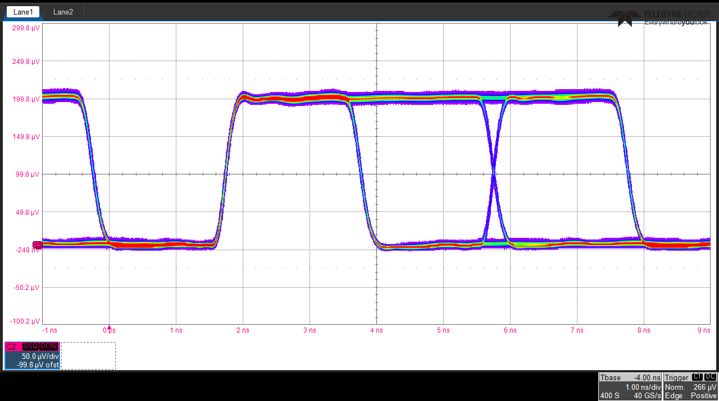
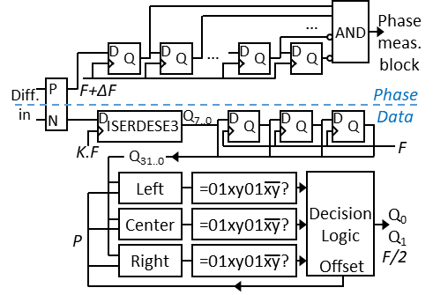
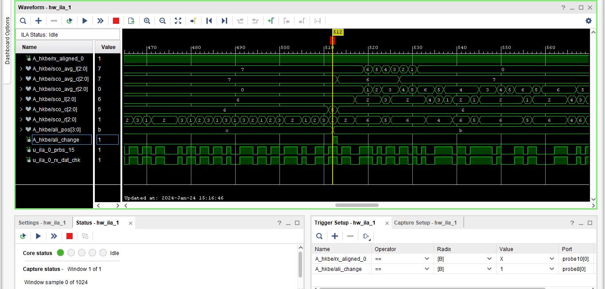
Dual Function Receiver on a Differential Input
Digital filter removes oscillating part of serial stream sampled at (F-∆F)
  Measured 500 MBd serial stream embedding 125 MHz periodic pattern and 125 Mbps user data (coding efficiency: 25%)
FPGA diff. IN
diff. OUT buffer
Deserializer oversamples received serial input at x2 rate.
For 3 adjacent positions, logic calculates how close are received groups of bits from the plausible pattern
Decision logic selects the optimal set of samples and adjusts the sampling offset if necessary
  PRBS pattern sent is verified at receiver using an Integrated Logic Analyzer (ILA) in FPGA fabric

Slide 13
GTP Transceiver Reception from OSERDESE3
This block converts incoming 8-bit words @31.25 MHz to outgoing 2-bit words @125 MHz preserving the original word boundaries and phase alignment
This block converts the 2-bit words @125 MHz stream into the original data frame and extracts its different field content
User Data
250 Mbps
serial data
500 Mbd
RESET
2
125 MHz
XOR
Manchester
Encoder
OSERDESE3
SFP
SFP
GTP
SerDes
16
Pattern
Comparator
Logic
16
Manchester
Decoder
8
Word
Converter
2
De-serializer
2
4
125 MHz
31.25 MHz
31.25 MHz
PLL
125 MHz
4 Phase
Identifier
2
Framing
pattern
“11110000”
250 MHz
DDR
Sender OSERDESE3
Receiver GTP
This blocks XOR’s user data with a constant framing pattern used by the receiver to delineate parallel data words
This blocks checks if the framing pattern is found, and resets the GTP until success
When synchronization has been gained, this clock has a fixed offset with that of the framing pattern on the sender side
This block labels each of the four 125 MHz cycles that come when multiplying by 4 the 31.25 MHz recovered clock
  Typically, FPGA ordinary I/O’s and high speed SerDes overlap in the 500-1500 Mbps region
  Example shown uses 250 Mbps user data with Manchester encoding leading to 500 Mbd on media
  Instead of comma insertion, user data are XOR’ed with a framing pattern to align received data

Slide 14
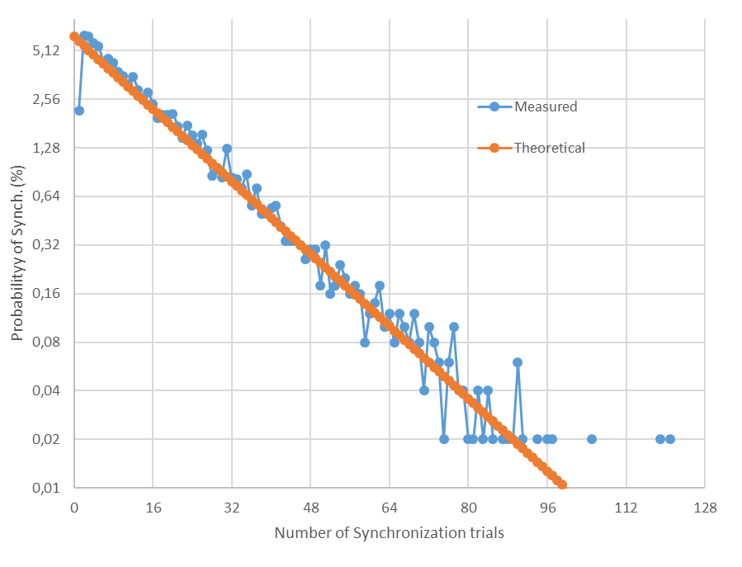
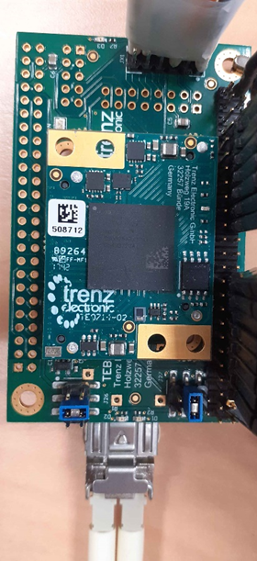
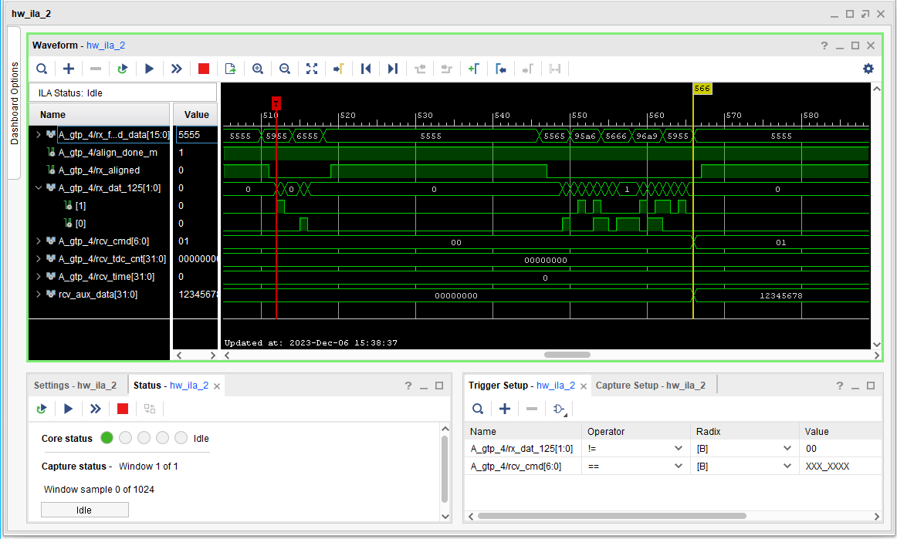
GTP Transceiver Reception from OSERDESE3
Number of trials to reach proper alignment
User data reception checked with Integrated Logic Analyzer
Artix 7 GTP receiver used for interoperability tests with OSERDESE3 sender
  At 500 MBd, a GTP in 16-bit parallel interface mode produces a 31.25 MHz recovered clock
  Recovered clock can have 16 possible phase offsets, 2 ns apart, compared to the 500 MHz serial clock
  For deterministic latency, select the only recovered clock that makes the framing pattern appear at output
  At link startup, GTP is reset until the recovered clock has the desired phase offset (probability p = 1/16)
  Probability of correct synchronization after exactly N trials: p * (1 – p)^{(N-1)}

Slide 15
8B/10B Serial Transmission with OSERDESE3
  8B/10B is a popular method for serial communication. Supported in FPGA high-speed transceivers
  FPGA I/O SerDes in most recent devices, e.g. Xilinx UltraScale+, only support serialization factor 2:1, 4:1 and 8:1 but no longer 5:1 or 10:1 (Xilinx 7 family). User has to build the equivalent function in fabric
8
8B/10B
encoder
10
10:1
PISO
1.25 GBd
8
8B/10B
encoder
10
Gear
box
8
8:1
PISO
1.25 GBd
User
data
User
data
1250 MHz
PLL
PLL
156.25 MHz
125 MHz
125 MHz
1250 MHz
GTx Transceiver
OSERDESE3
FPGA fabric
FPGA fabric
FPGA high speed transceiver scheme
FPGA ordinary I/O scheme
  For precise clock distribution applications, logic and clock domain crossings must have fixed latency
  How can this be implemented?

Slide 16
Deterministic Latency 10B-8B Gear Box
Data 0
Data 1
Data 2
Data 3
Data 4
Data 5
Data 6
Data 8
Data 9
Data 7
User data
8
8B-10B Encoder
125 MHz
10
Encoded data 0
Encoded data 1
Encoded data 2
Encoded data 3
Encoded data 4
Encoded data 5
Encoded data 7
Encoded data 8
Encoded data 6
Encoded data 0
Encoded data 1
Encoded data 2
Encoded data 3
Encoded data 4
Encoded data 6
Encoded data 7
Encoded data 5
Encoded data 0
Encoded data 1
Encoded data 2
Encoded data 3
Encoded data 5
Encoded data 6
Encoded data 4
Encoded data 0
Encoded data 1
Encoded data 2
Encoded data 4
Encoded data 5
Encoded data 3
40-bit Register A
Shifts by 10 bits every 8 ns
40
Byte 9
Byte 4
Byte 3
Byte 4
Byte 8
Byte 2
Byte 3
Byte 7
Byte 1
Byte 2
Byte 6
Byte 4
Byte 0
Byte 1
Byte 4
Byte 5
156.25 MHz
Byte 3
40-bit Register B
Shifts by 8 bits every 6.4 ns
8
625 MHz DDR
8:1 PISO
1.25 GBd
CLK_125
-1
0
1
2
3
4
5
6
7
8
CLK_156_25
-1
0
1
2
3
4
5
6
7
8
9
10
  Clocks are edged aligned every 4 periods of clock A (125 MHz) and 5 periods of clock B (156.25 MHz)
  40 bits parallel data transferred from Register A to B when both clock edges are aligned (31.25 MHz)

Slide 17
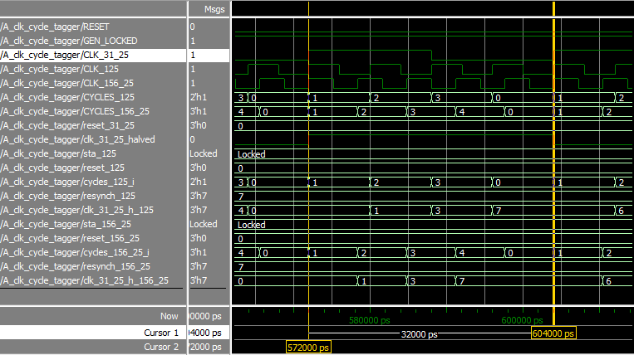
Clock Cycle Numbering Logic for Gear Box
PLL
125 MHz
D
Input clocks
Numbered clock cycles
125 MHz
156.25 MHz
toggle
31.25 MHz
Q
31.25 MHz
(15.625 MHz)
toggle
AND
Mod 4 Counter
D
Q
SET
D
125 MHz
Q
toggle
AND
Mod 5 Counter
D
Q
SET
D
156.25 MHz
Q
  PLL generates clock at frequency of greatest common divisor of two other clocks. Divide it by 2 in logic
  Detect rising edges of this toggling signal to send SET signals to the counters numbering clock cycles

Slide 18
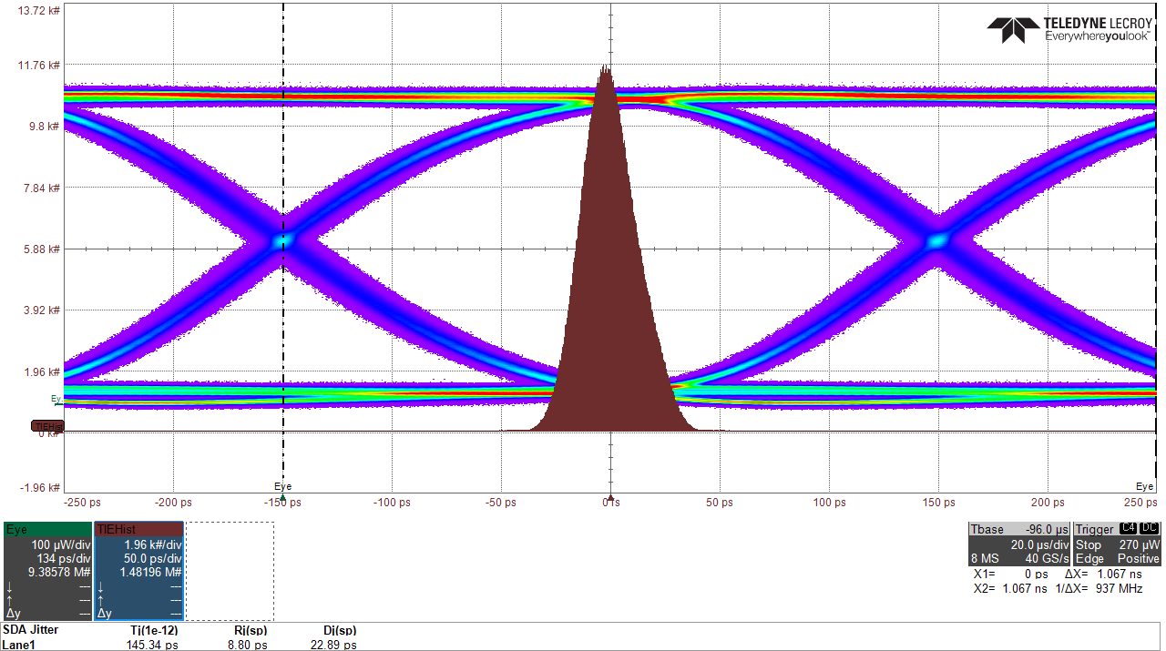
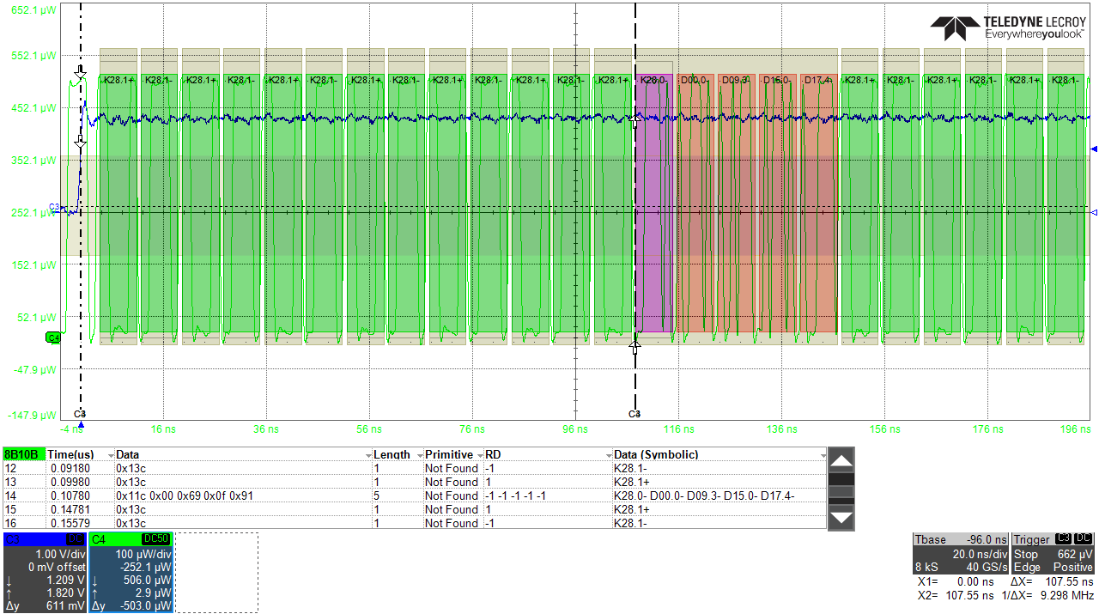
Fixed Latency 8B/10B Encoder on OSERDESE3
  TX stream: idle commas (K28.1); Messages: start comma (K28.0) + 32-bit counter (4 Data symbols)
  Correct data reception and decoding in oscilloscope
  Serial line rate: 1 Gbps user data; 1.25 Gbd on fiber
  Optical probe with bandwidth limited to 2.5 GHz
  Deterministic latency upon board power cycling verified using a debug pin of the sender FPGA
  Demonstrates capability of UltraScale+ HP I/O for deterministic latency 8B-10B encoding @1.25 Gbd
  Pathway to implement synchronous Gigabit Ethernet on plain FPGA I/O’s (only TX part shown here)

Slide 19
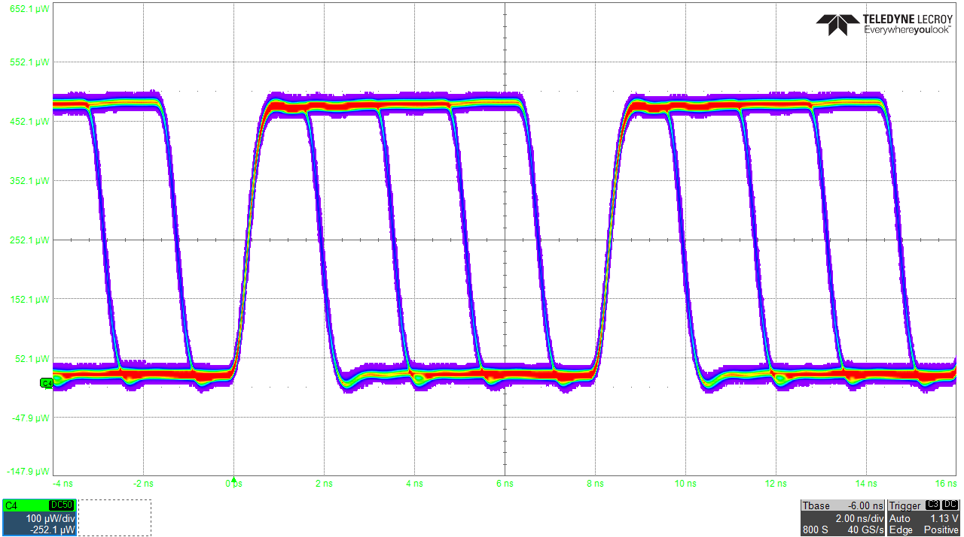
Sending 250 Mbps Data on top a 125 MHz Clock
2
Timing content
Fixed
header
“01”
Gear
box
8:1
PISO
5
4
625 MBd
User
data
D₀
Encoder
3
D₁
PLL
156.25 MHz
125 MHz
625 MHz SDR
OSERDESE3
Data content
FPGA fabric
Data
Symbol
Data
Symbol
  650 MBd stream is 125 MHz clock with modulated duty cycle: 20%, 40%, 60%, 80%
  2 bits of user data per 8 ns period, i.e. 250 Mbps
  A scrambler shall be used to keep DC balance
00
10
01
11
  Advantage of clock duty cycle modulation for data transport: clock extraction by ordinary PLL (no CDR)
  D. Calvet, “Clock-Centric Serial Links for the Synchronization of Distributed Readout Systems”, IEEE Trans. Nucl. Sci., Vol. 67, N°8, pp. 1912-1919, Aug. 2020

Slide 20
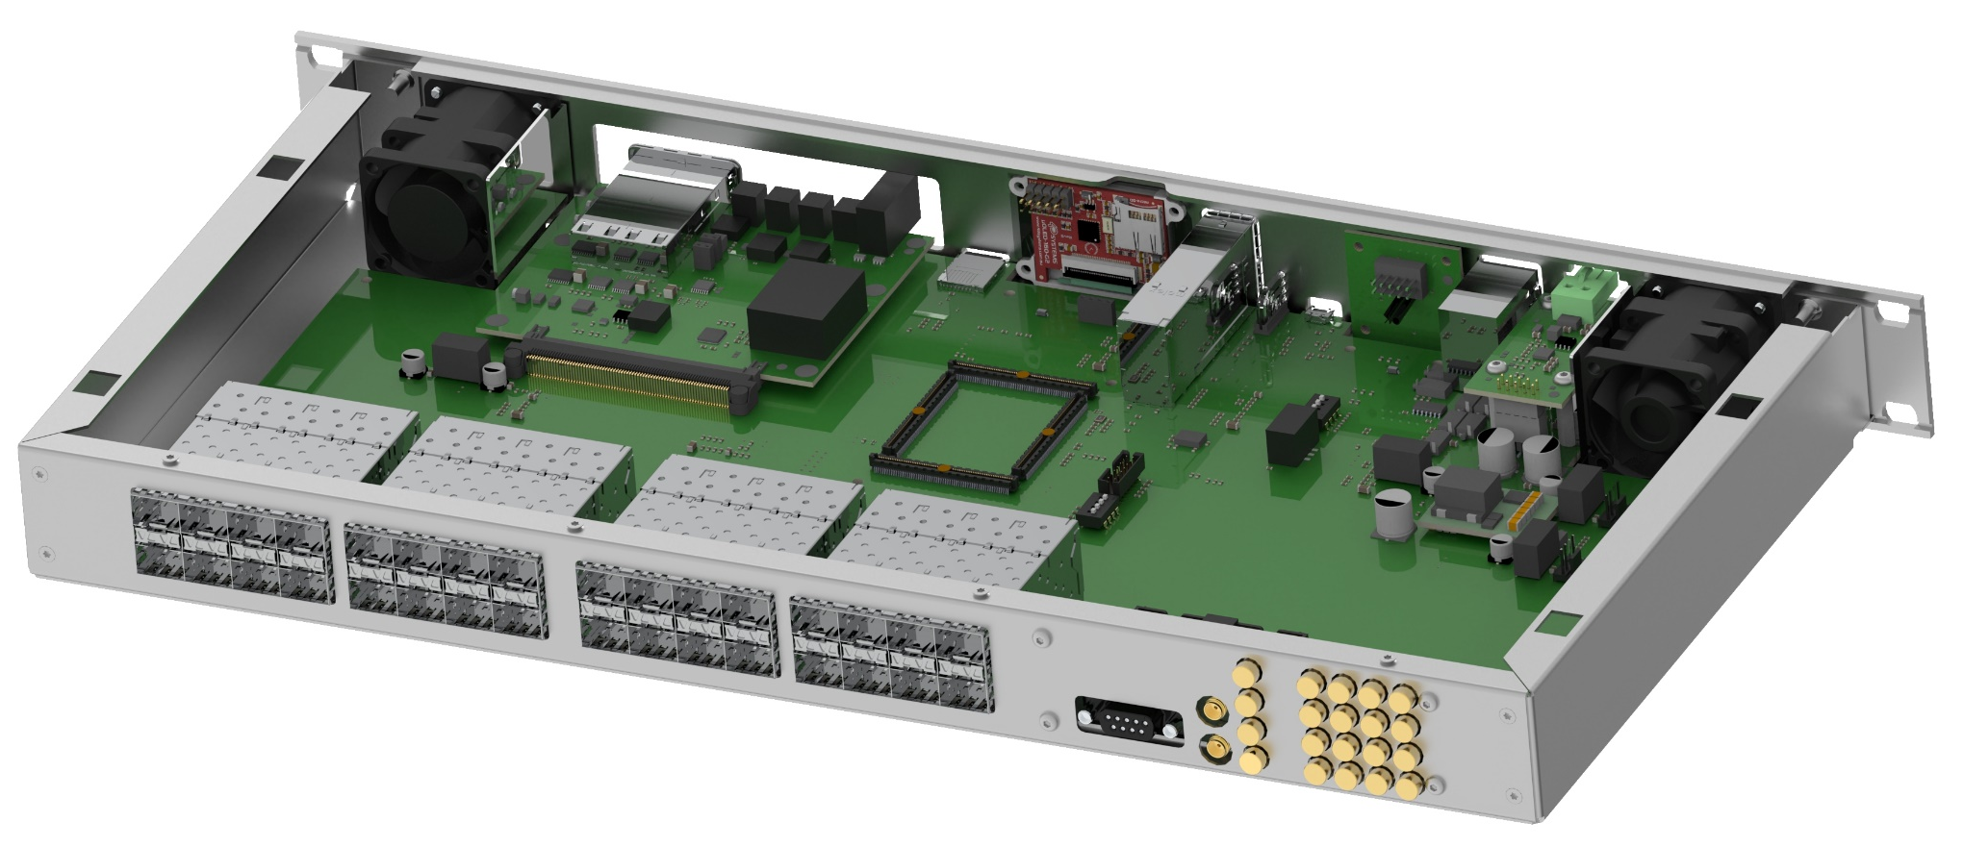
Summary and Perspectives
  Successful contruction of a 48-port clock distributor demonstrator
  Using FPGA I/O primitives for serial communication with deterministic latency are a viable option
  After review, the Hyper-K collaboration opted for a synchronization system composed of custom-made distributors arranged in a 2-stage tree
  The 2nd stage distributors (Lpnhe) and end-points (INFN) will use the traditional and more established approach based on high speed FPGA SerDes (1 Gbps net bandwidth + 8B-10B encoding)
  The 1st stage distributor (Irfu) will re-use some of the concepts and techniques developed in this R&D
    Same overall architecture
    Number of optical port reduced to 32
    Serial communication using FPGA I/O’s
    Additional low speed I/O’s at rear panel
Hyper-K First Stage Clock Distributor board (in design)

