Slide 1
High-Throughput Data Processing at FRIB Using ESnet
Aaron Chester
Data Acquisition Scientist
chester@frib.msu.edu
25 April 2024

Slide 2
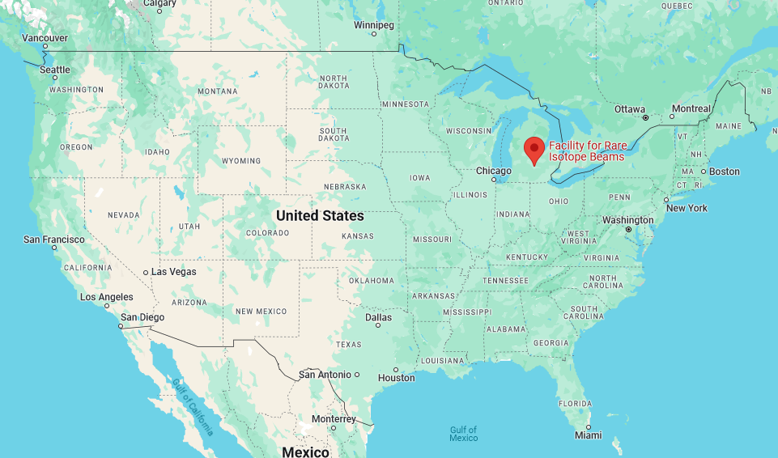
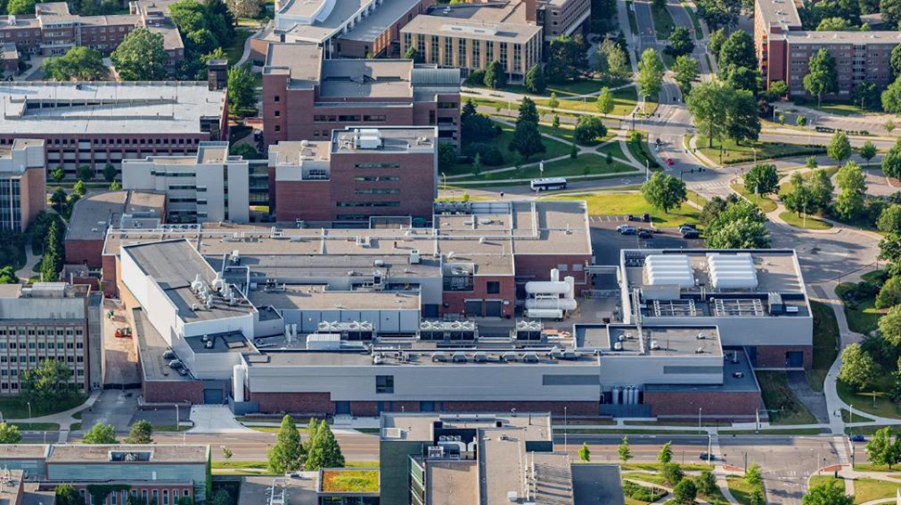
The Facility for Rare Isotope Beams (FRIB)
FRIB is a scientific user facility funded by the US Department of Energy Office of Science (DOE-SC), Michigan State University (MSU), and the State of Michigan
  Open to researchers from around the world
  User Organization: 1800 members (125 colleges and universities, 13 national labs, 53 countries)
  Experimental program began in May, 2022
Key feature of FRIB: high-power LINAC, 400 kW at 200 MeV/u for ²³⁸U
  Beams from oxygen to uranium
FRIB also provides stopped and low-energy re-accelerated beams (< 12 MeV/u)
Access to atomic nuclei across the nuclear chart at a range of energies
Map data © 2024 Google, INEGI

Slide 3

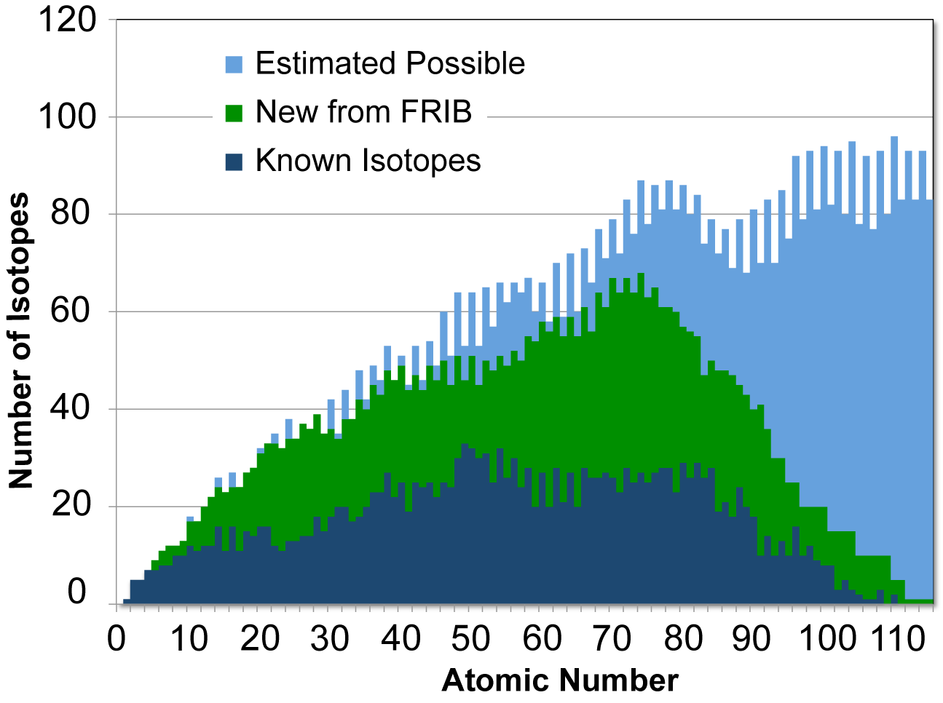



The FRIB Experimental Program
Nuclear structure
  How does subatomic matter arrange itself and how does it evolve?
  What combinations of neutrons and protons form bound atomic nuclei?
Nuclear astrophysics
  How are the chemical elements created?
  What is the nature of matter at extreme temperatures and densities?
Fundamental symmetries
  Why is there more matter than antimatter?
  Are neutrinos their own antiparticles?
Societal applications and benefits
  Medicine, energy, material sciences, environment, workforce development, etc.
Erler et al., Nature 486 (2012) 509-512.

Slide 4
How to Make the FRIB Experimental Program a Success?
Detector development: higher rate, improved resolution, …
  Adoption of new technologies
Upgrade and develop new data acquisition (DAQ) systems
  Extensibility, flexibility, portability (containers)
  Library of solutions for different detector and hardware types
  Contributions from users (GitHub)
  Collaboration with other laboratories
Adopt new computing solutions to reduce time to enable discoveries and improve decision-making during experiments
  Local computing cluster
  High-speed network connecting local storage to high-performance computing (HPC) centers

Slide 5
A High-Throughput Data Processing Pipeline for FRIB
1
2
3
FRIB
NERSC
ESnet + Globus
Leverage DOE’s Energy Sciences Network (ESnet) for high-speed data transfer and the National Energy Research Scientific Computing Center’s (NERSC) Perlmutter supercomputer in Berkeley, CA for data processing
Components of the system
  Data acquisition
  Data transfer and pipeline management: ESnet and Globus Flows
  Parallel processing at NERSC (or other HPC facility)
Experiment-motivated development starting in 2019

Slide 6
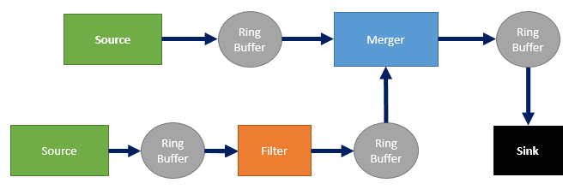
1: FRIBDAQ Readout Architecture
Software suite (C++, Tcl, Python) that provides a flexible and extensible framework for handling the data flow produced by nuclear physics experiments
Support for a wide variety of electronics: VME, CAMAC, CAEN and XIA digitizers, GET, …
Manage the data stream by breaking it into smaller pieces
Event-building based on timestamps
Flexible trigger configuration
ReadoutGUI
ReadoutGUI is the “conductor” of the system
  Pipeline management, data recording, consolidation of data to output, …
Outputs data
Input/output (i.e. data integrity, format conversion...)
Multiple input/ single output
Reads data
Diagnostic sink
Diagnostic sink

Slide 7
1: FRIBDAQ Upgrades Enable High-Rate Data Taking
Process-level pipeline parallelism for readout
  Separate readout and timestamp sorting
Zero-copy whenever possible
Common operations (e.g., fit an ADC trace) implemented via plugin libraries
Support parallel task distribution via OpenMPI or ZeroMQ
Event-editing software:
  Classifier + Filter (parallel software trigger)
  Appender (adds user code info to events)
  Editor (edits events)
Ring buffer
Ring buffer
Event builder
Ring buffer
Readout
Orderer
Disk
Worker 1
Worker 2
…
Timestamp re-sort
Output

Slide 8
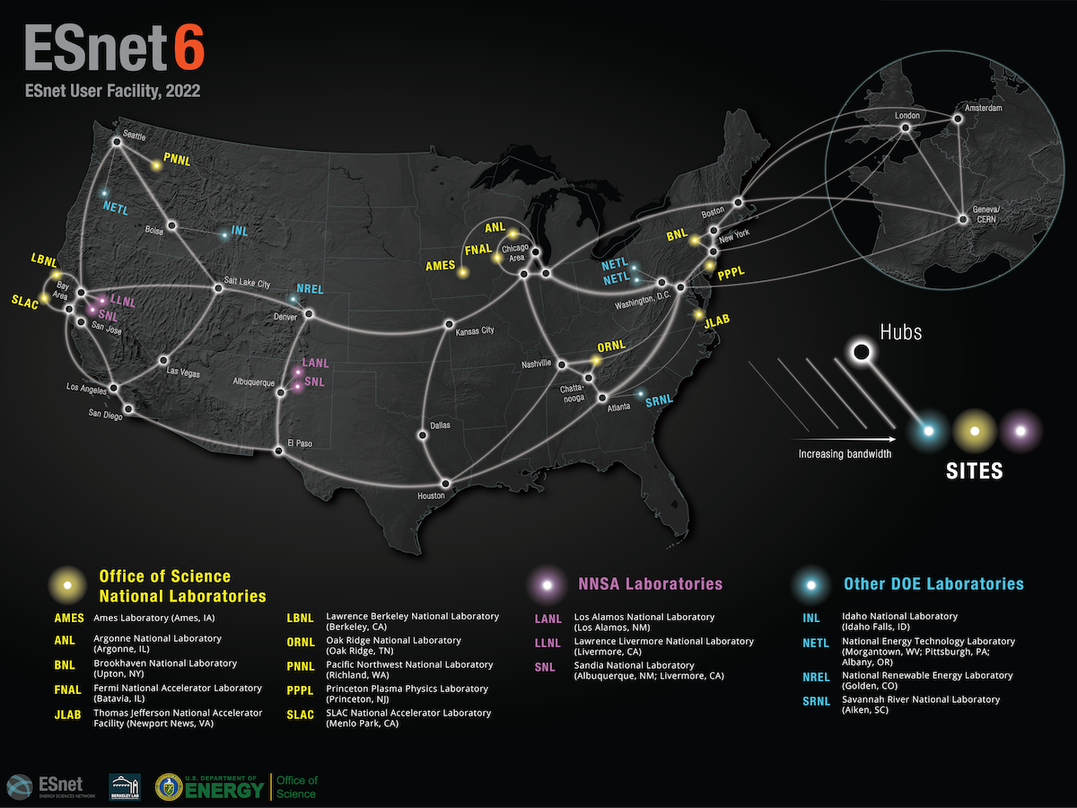
2: ESnet Infrastructure at FRIB
ESnet: high-performance, unclassified network funded by DOE-SC
Multiple 100 Gbps optical channels totaling 46 Tbps bandwidth
Infrastructure at FRIB
  2x 100 Gbps connections to ESnet managed by DOE
  FRIB “Science DMZ”¹: provides storage and network connection between FRIB experiments and ESnet
https://www.es.net/about/
¹“Demilitarized zone”

Slide 9
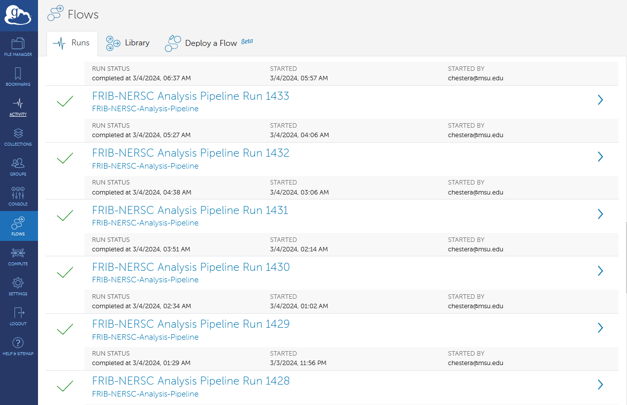
2: Automated Data Processing With Globus Flows
“Secure, managed automation of complex workflows at scale”
  Common tasks implemented via hosted “action providers” (e.g. data transfer)
  Globus Compute provides a “function as a service” (FaaS) platform for remote execution of user code
  Error handling
Action providers and other operations can be assembled into a workflow
Python-based SDKs¹ for Globus and Globus Compute
  Register applications, configure inputs, run, manage results
Web-based monitoring
Data processing workflow:
  Acquire data at FRIB
  Transfer raw data to NERSC via ESnet
  Process data remotely at NERSC
  Transfer processed data back to FRIB via ESnet
¹Software development kit
https://docs.globus.org/api/flows/

Slide 10
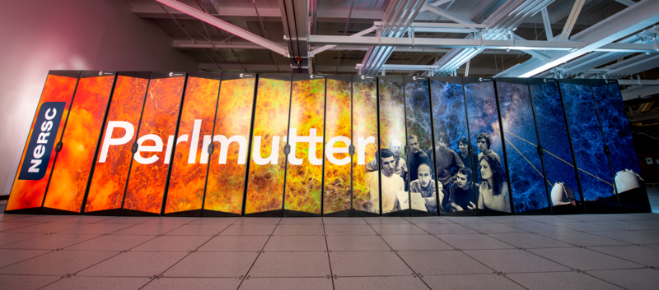
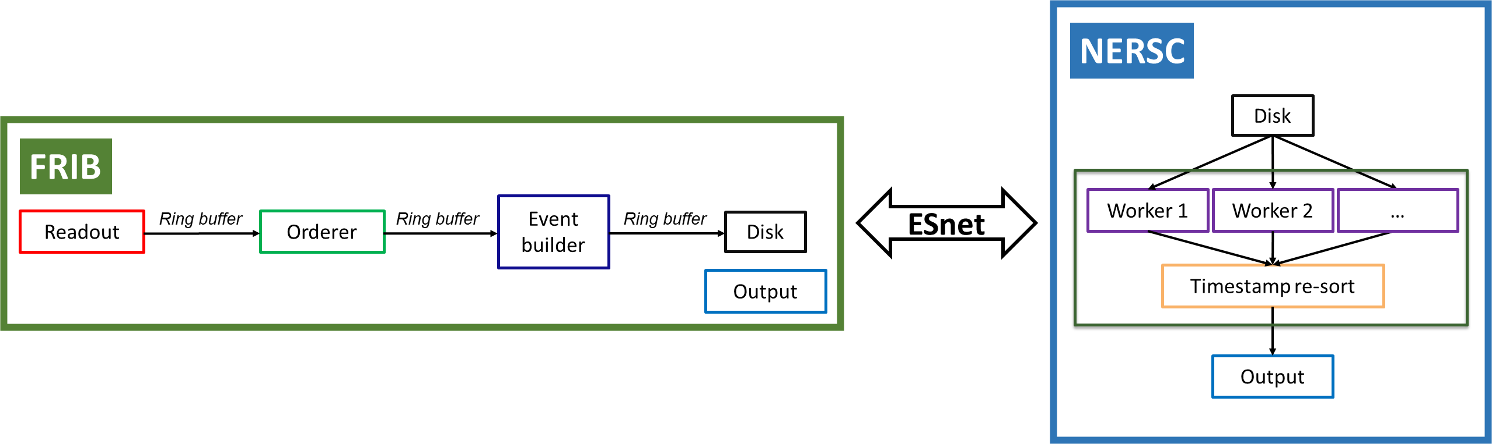
3: Data Processing at NERSC
NERSC is the “primary scientific computing facility for DOE-SC”
It houses the Perlmutter supercomputer:
  Over 1700 GPU and 3000 CPU nodes
  All-flash, 35 PB Lustre scratch file system for fast I/O
  #12 in the TOP500 as of November 2023
  Job scheduling via Slurm
  Container support using Shifter
https://www.nersc.gov/news-publications/galleries/nersc-systems-photos/
Globus Compute FaaS
  Containers allow us to reconstruct the FRIB runtime environment on Perlmutter
Editor software: fit ADC traces, store fit results
  Search for rare events, characterize their properties
https://www.nersc.gov/about/; A. Chester et al., Phys. Rev. C 104 (2021) 054314; A. Chester et al., Phys. Rev. C 105 (2022) 024319

Slide 11
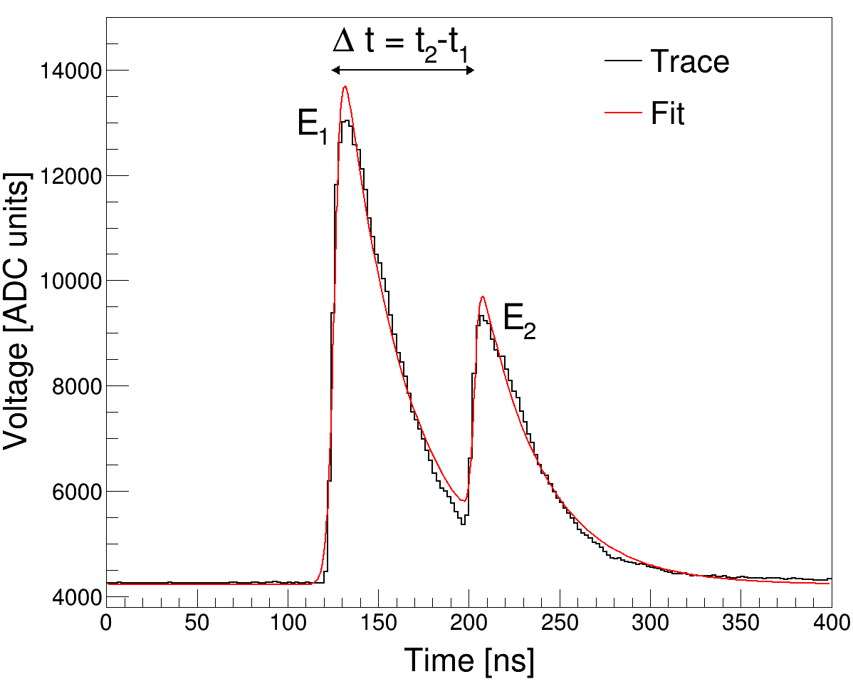
3: Data Processing at NERSC
NERSC is the “primary scientific computing facility for DOE-SC”
It houses the Perlmutter supercomputer:
  Over 1700 GPU and 3000 CPU nodes
  All-flash, 35 PB Lustre scratch file system for fast I/O
  #12 in the TOP500 as of November 2023
  Job scheduling via Slurm
  Container support using Shifter
https://www.nersc.gov/news-publications/galleries/nersc-systems-photos/
Globus Compute FaaS
  Containers allow us to reconstruct the FRIB runtime environment on Perlmutter
Editor software: fit ADC traces, store fit results
  Search for rare events, characterize their properties
https://www.nersc.gov/about/; A. Chester et al., Phys. Rev. C 104 (2021) 054314; A. Chester et al., Phys. Rev. C 105 (2022) 024319

Slide 12
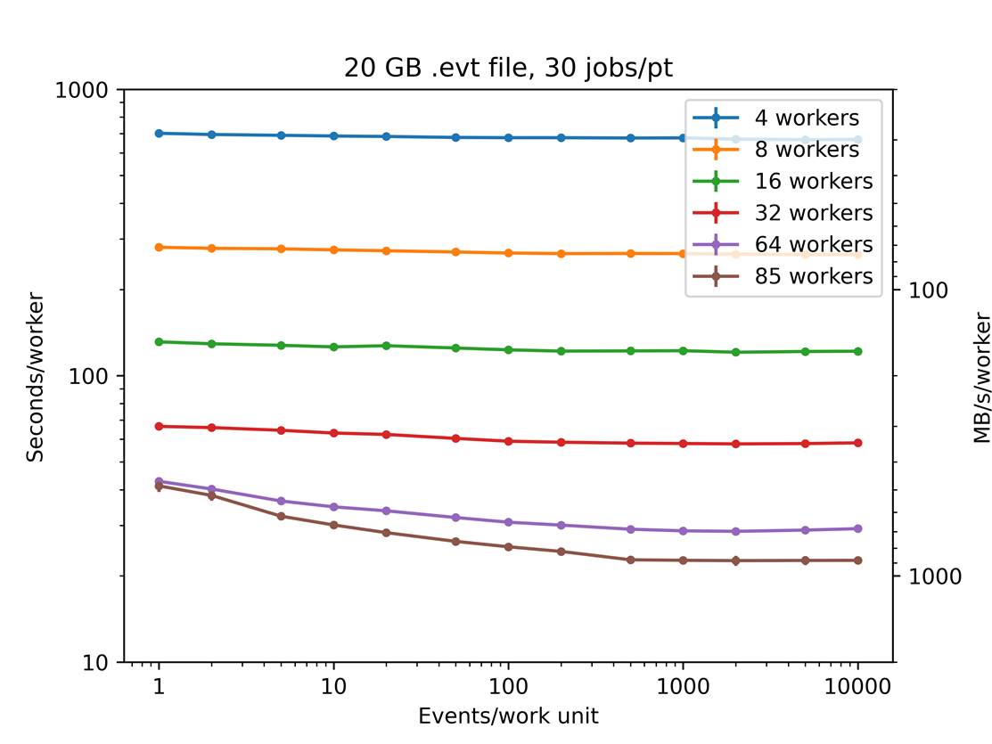
3: Data Processing at NERSC: Proof of Principle
Free parameters:
  Number of MPI workers
  Number of events per work unit passed to each worker
Tested using production data from the first FRIB experiment
  Fit 2.7M traces (~1.4 GB trace data) from a single channel
  Trace template detector response model
Running conditions at NERSC:
  I/O from node-accessible scratch space
  Request entire node, allocation at the mercy of the Slurm scheduler
  Nodes are equivalent

Slide 13
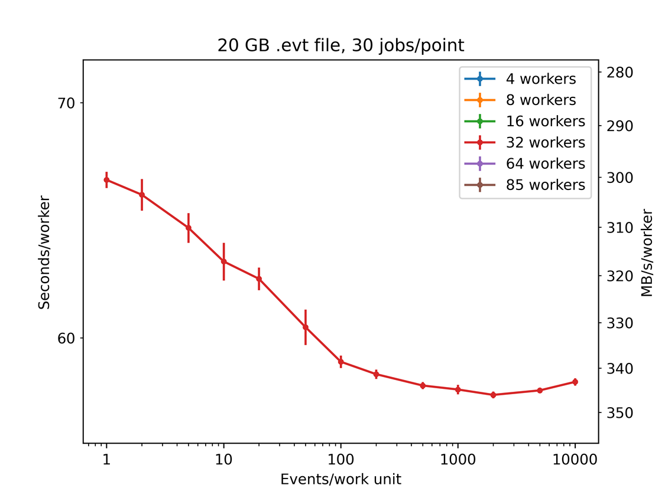
3: Data Processing at NERSC: Proof of Principle
Free parameters:
  Number of MPI workers
  Number of events per work unit passed to each worker
Tested using production data from the first FRIB experiment
  Fit 2.7M traces (~1.4 GB trace data) from a single channel
  Trace template detector response model
Running conditions at NERSC:
  I/O from node-accessible scratch space
  Request entire node, allocation at the mercy of the Slurm scheduler
  Nodes are equivalent

Slide 14
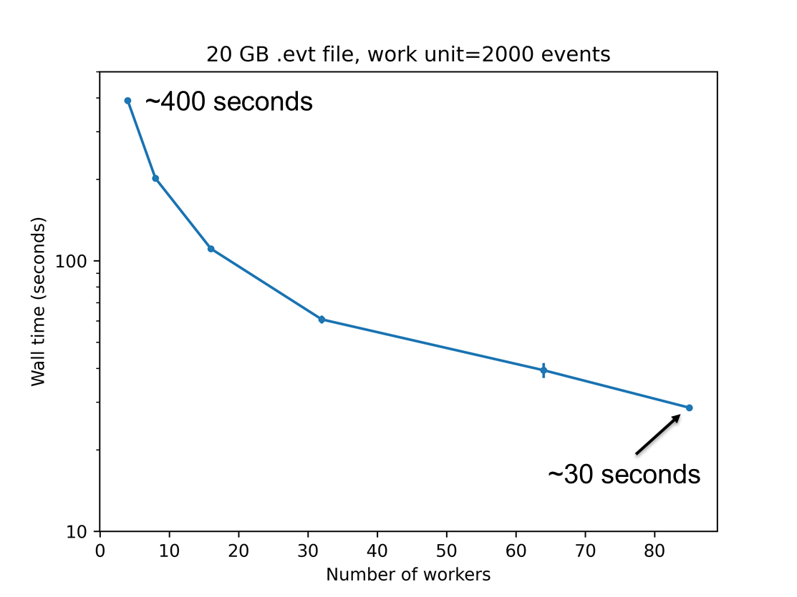
3: Data Processing at NERSC: Proof of Principle
Free parameters:
  Number of MPI workers
  Number of events per work unit passed to each worker
Tested using production data from the first FRIB experiment
  Fit 2.7M traces (~1.4 GB trace data) from a single channel
  Trace template detector response model
Running conditions at NERSC:
  I/O from node-accessible scratch space
  Request entire node, allocation at the mercy of the Slurm scheduler
  Nodes are equivalent

Slide 15
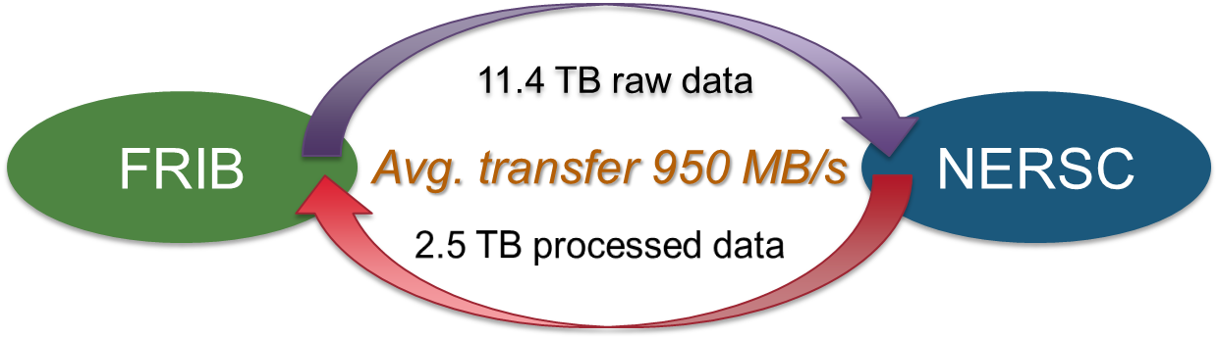
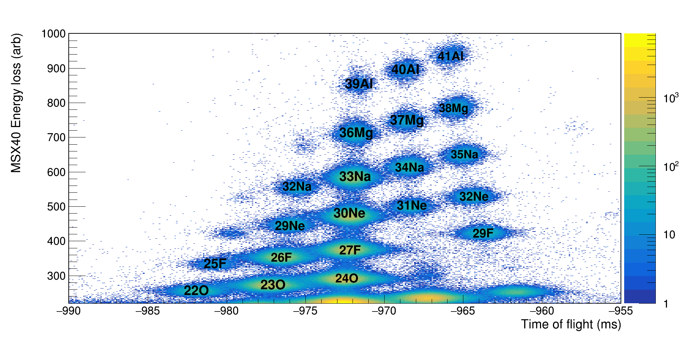
3: Automated Processing Pipeline: In Production
Particle identification plot generated in near real time from data processed at NERSC (courtesy of R. Lubna)
Experiment ran 140 hours 28 Feb. – 4 Mar. 2024
80% reduction in data size
One hour of recorded data is fully processed in ~10 minutes¹
Simultaneous utilization of 3800 CPU cores in realtime queue with startup latency ~few seconds
Total of 718 compute hours used
¹Assuming code optimized for parallel processing

Slide 16
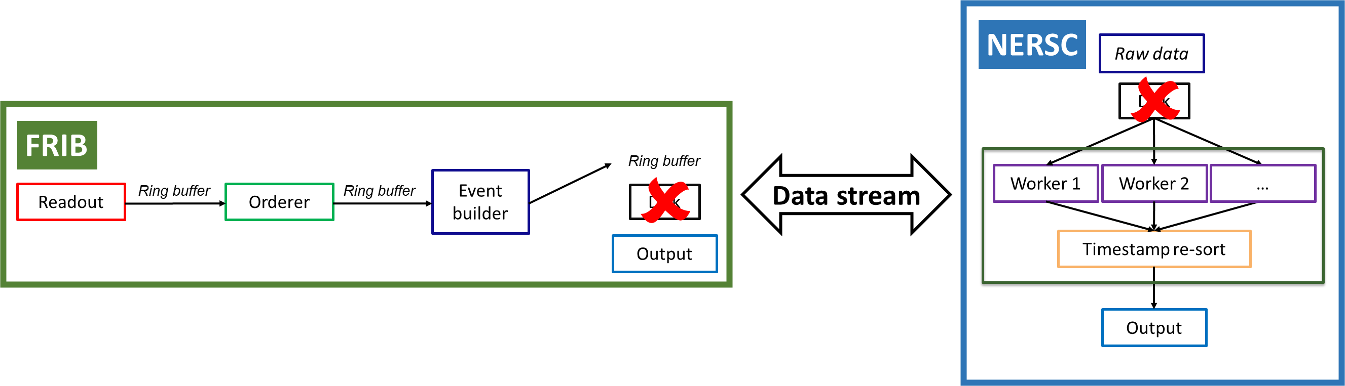
Conclusions
Nearline analysis is possible using FRIBDAQ parallel analysis framework
High-speed data transfer between local storage and HPC facility realized using ESnet
Successfully automated the processing pipeline using Globus Flows
Globus Compute FaaS platform was used to run FRIBDAQ code remotely at NERSC
Important take-home message: improvements to DAQ and data processing software driven by user’s needs!
Future work:
  Streaming readout to HPC facilities
    Talks by M. Goodrich, M. Battaglieri
  Improvements to supported software
    Modeling detector response
    Machine learning classification
    Alternative parallel analysis frameworks
    …

Slide 17




Acknowledgements
Giordano Cerizza, Genie Jhang, Ron Fox, Simon Giraud, Sean Liddick, Rebeka Lubna, Paul Reece, Tom Rockwell, Bashir Sadeghi, Jerry Vasquez
Heather Crawford, Mario Cromaz
Eli Dart, Jason Zurawski
Debbie Bard, Nicholas Tyler, NERSC support
This material is based upon work supported by the DOE Office of Science, Office of Nuclear Physics and used resources of the FRIB Operations, which is a DOE Office of Science User Facility under Award Number DE-SC0023633.

