Slide 1
An Intermediate Level Supernova Pointing Trigger for DUNE Using In-storage AI
Michael Wang (Fermilab) for the DUNE collaboration
24th IEEE Real Time Conference - ICISE, Quy Nhon, Vietnam
April 22-26, 2024

Slide 2
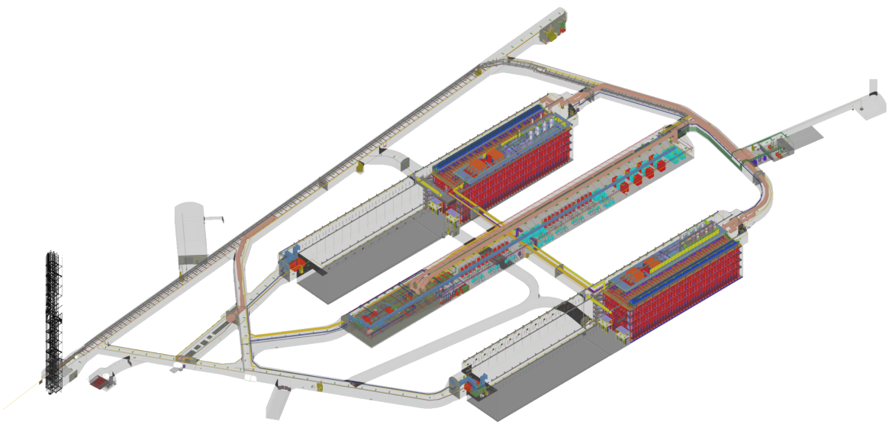
Deep Underground Neutrino Experiment
SURF
Lead, SD
FNAL
Batavia, IL
1,300 km/800 m
4 17-kton LArTPC
modules
1.5 km to surface

Slide 3
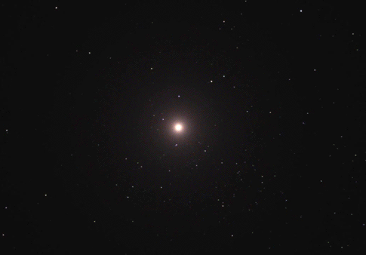
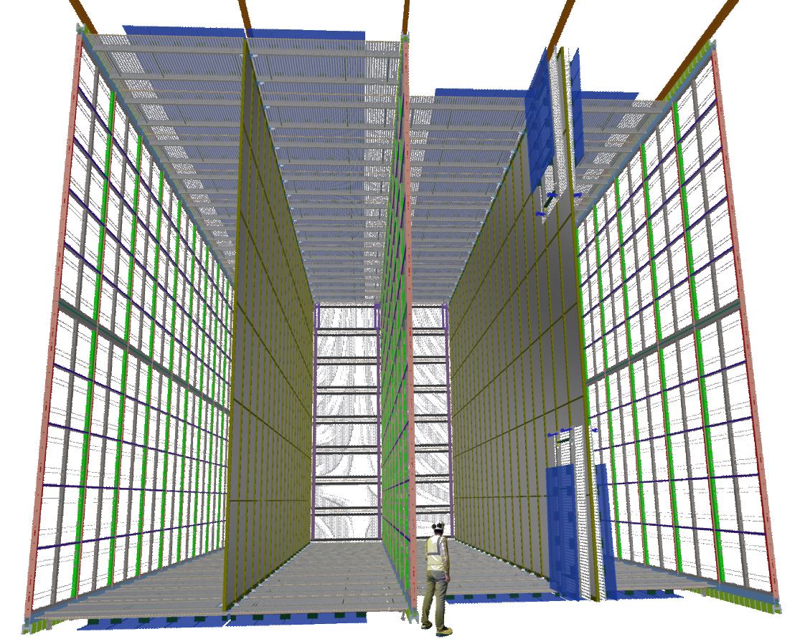
Deep Underground Neutrino Experiment
SURF
Lead, SD
FNAL
Batavia, IL
1,300 km/800 m
4 17-kton LArTPC
modules
1 module
150 Anode Plane Assemblies
2560 wires/APA
384,000 channels total
14-bit ADC @2MHz
> 1TB/sec !
1.5 km to surface

Slide 4
DUNE DAQ and Trigger System

Slide 5
DUNE DAQ and Trigger System
Raw data from detector
NIC
NIC
CPU
CPU
NIC
To DS computer
& event builders
RAM
SSD
DAQ Front End Computer (FEC)

Slide 6

DUNE SNB Trigger
#interactons
Raw data from detector
NIC
NIC
60
CPU
SNB trigger
CPU
NIC
To DS computer
& event builders
10 sec
To DS computer
& event builders
RAM
gate
0
10
secs
10 s circular buffer
SSD
100 sec
SNB data
DAQ Front End Computer (FEC)

Slide 7
DUNE SNB Trigger – baseline requirements
Raw data from detector
Baseline trigger provides no pointing information, which is needed for optical follow-ups
Idea is to send data back to FNAL for more processing
100 Gbps links from underground caverns to surface & back to FNAL
Best case scenario: 120 TB/module would take ~3 hrs to transfer
Could be worse: DUNE requirement is to copy data back within 24 h
NIC
NIC
CPU
CPU
NIC
RAM
SSD
DAQ Front End Computer (FEC)

Slide 8
SURFing the cosmic wave
shockwave
shock breakout
(SBO)
Fe core ~1.4 M.

Slide 9
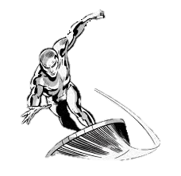
SURFing the cosmic wave
shockwave
shock breakout
(SBO)

Slide 10
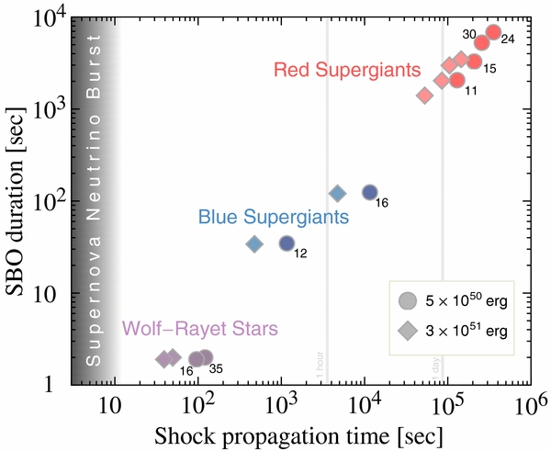
Shock propagation time
Matthew D. Kistler et al 2013 ApJ 778 81
Delay between arrival of neutrinos and optical light: ~shock propagation time
Range: ~1 min to several days
Unless progenitor is red supergiant, network transfer time back to FNAL alone already exceeds available window of opportunity
SN 1987A ~3 hrs

Slide 11
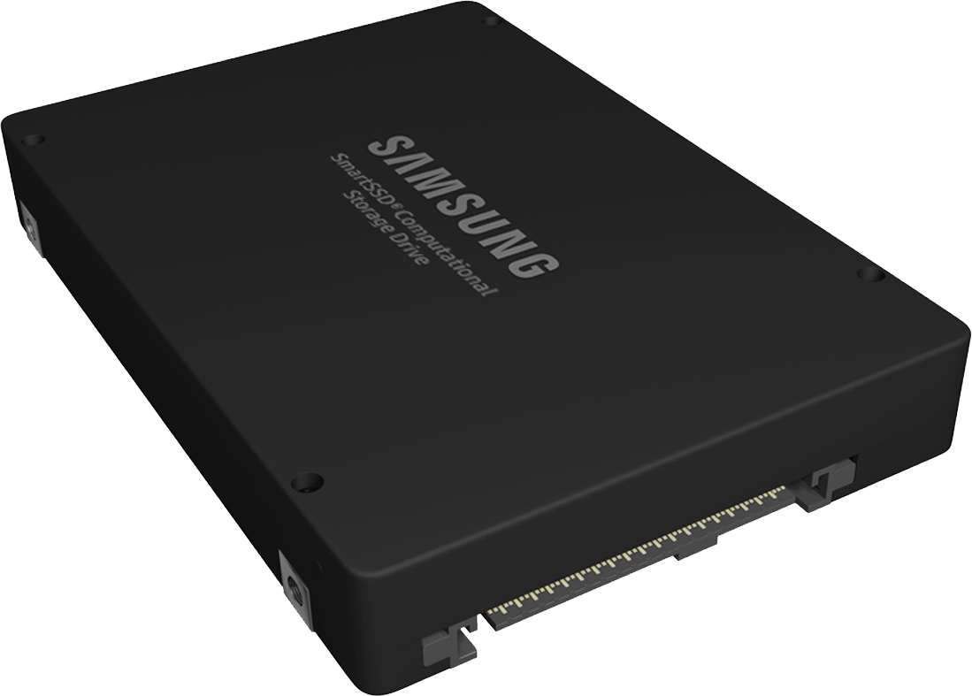
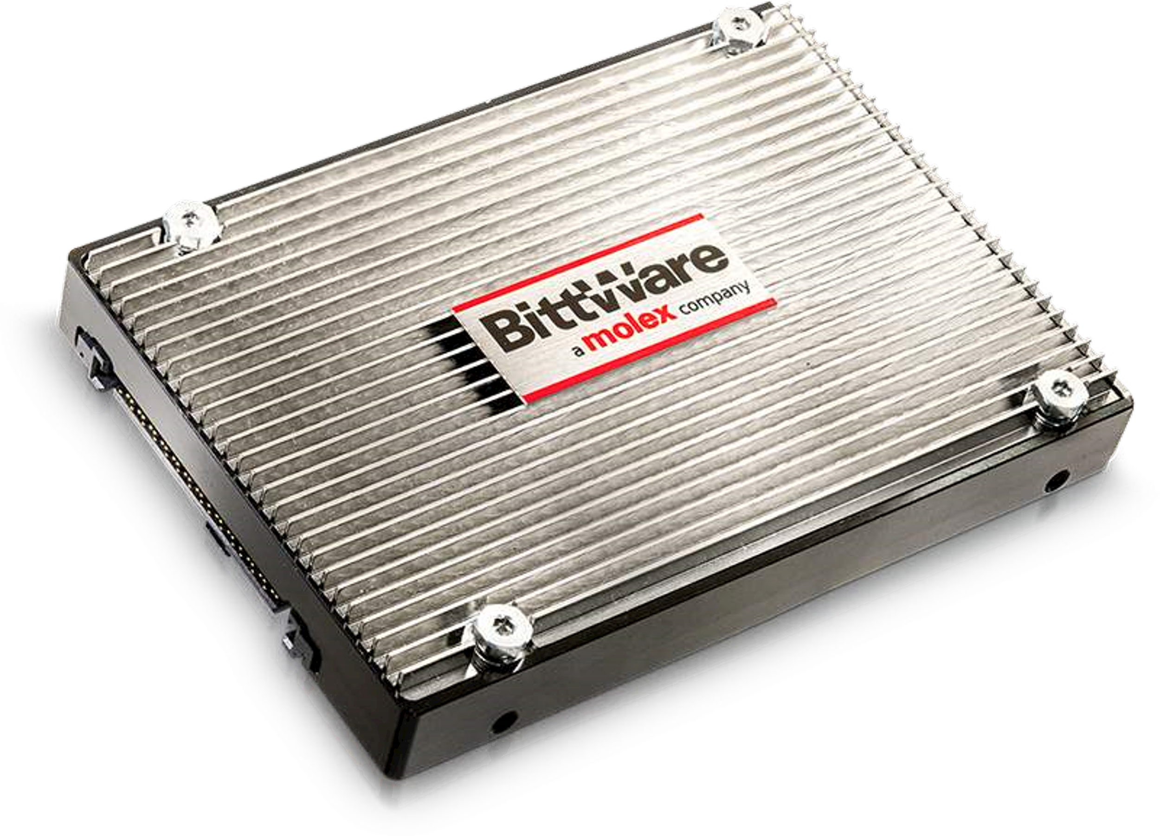
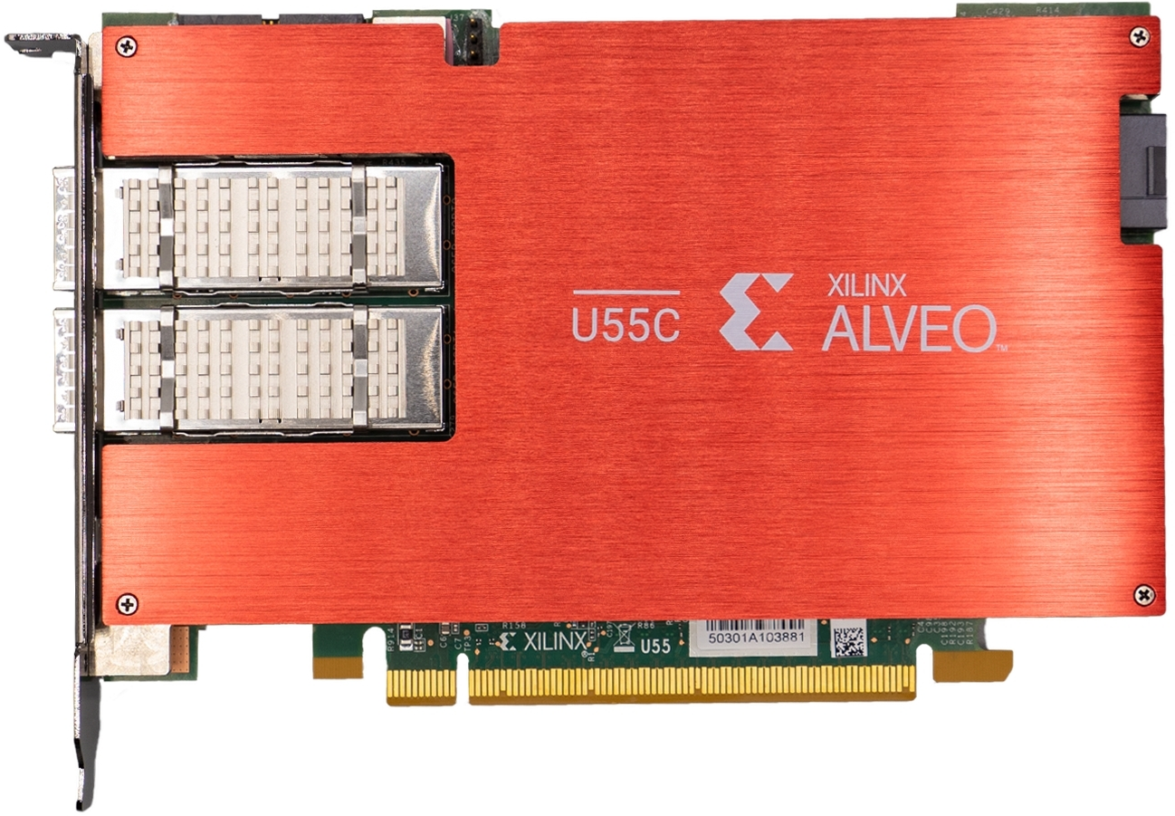
Computing paradigm shift
A solution: Near-data computing
  Instead of moving data to processors, move processing to the data
One example is Computational Storage Technology
  COTS products available now
Raw data from detector
NIC
NIC
CPU
Samsung SmartSSD CSD
CPU
NIC
RAM
Standard 2.5”
form factor
BittWare 250-U2 CSP
Computational
Storage
SSD
DAQ Front End Computer (FEC)
Xilinx Alveo card

Slide 12
Strategy for fast pointing determination
Two step approach:
  Data reduction: perform in situ on data, using FPGAs or GPUs to reduce buffered SNB data to a point where it can be transported quickly over conventional network to destination server
  Pointing determination: execute optimized “offline-like” pointing analysis on the reduced data set on the server
Use AI/ML methods for the in situ data reduction step:
  Run ML models on accelerators like FPGAs, GPUs, etc.
  Fast inference times for low latencies
  Apply ML methods on both:
    Raw 2D LArTPC wire plane images
    Raw 1D LArTPC wire waveforms

Slide 13
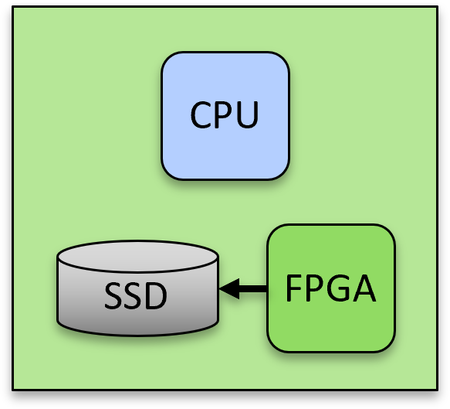
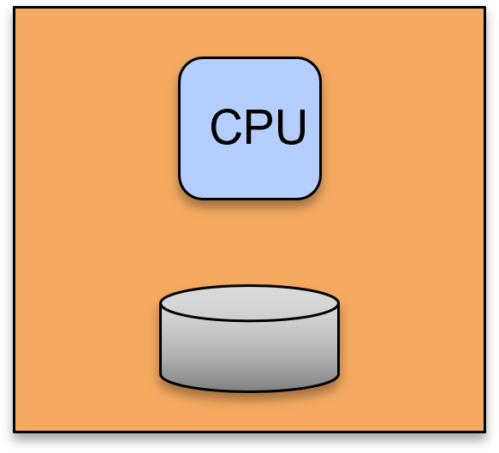
Strategy for fast pointing determination: hardware
~75 DAQ front end computers
performing near-data computing
to reduce buffered SNB data
10Gbps
Network switch
100Gbps
Perform pointing analysis
on reduced data

Slide 14
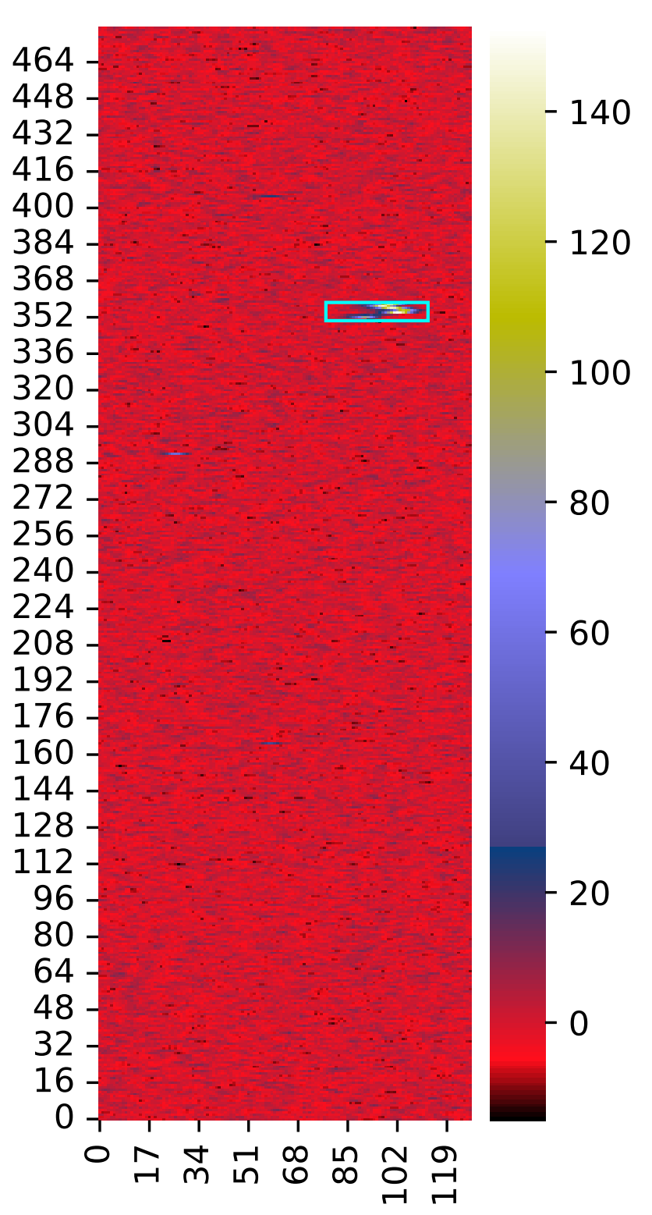
Strategy for fast pointing determination: algorithms
ML-based in situ data reduction
Radiological Bkg rejection with 2DCNN
Raw waveform ROI finding with 1DCNN
Denoising raw waveforms in ROIs with
1D AutoEncoder
Raw wire plane
data
network
Dataprep
(sig-proc)
Gaushit
SP Solver
DisAmbig
TrajCluster
PmTrack
PointTreeRes
Likelihood fit
for direction
“Offline-like” reconstruction and pointing analysis

Slide 15
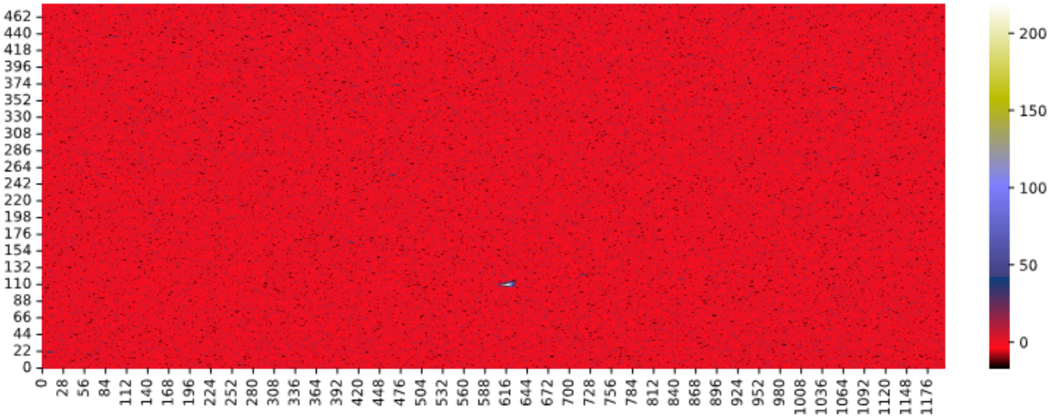
Radiological background rejection with 2D-CNN
Wire number
(512 ns / tick)
Time tick

Slide 16
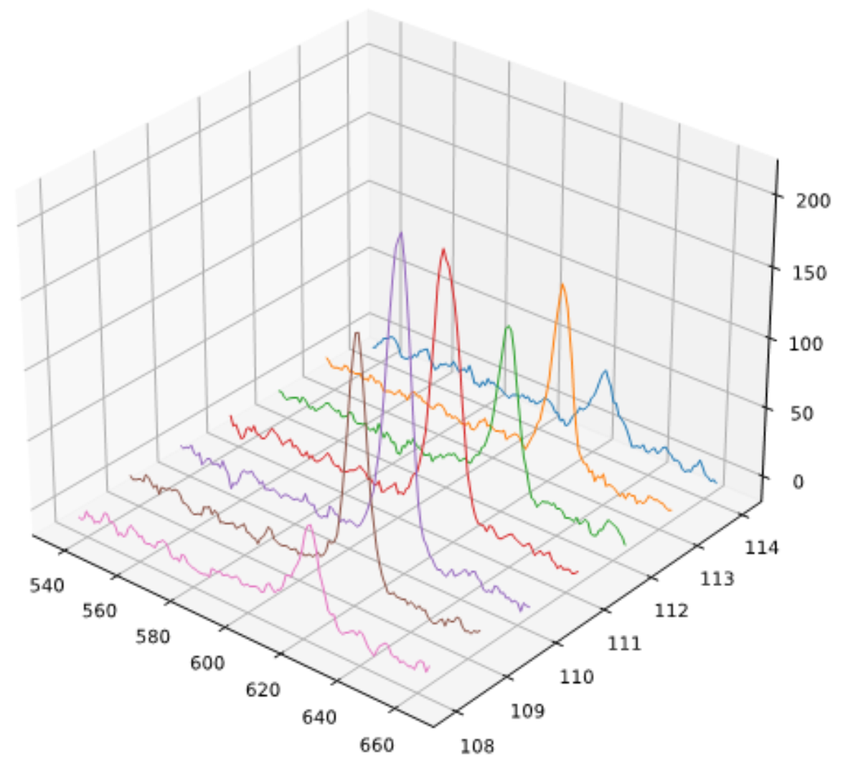
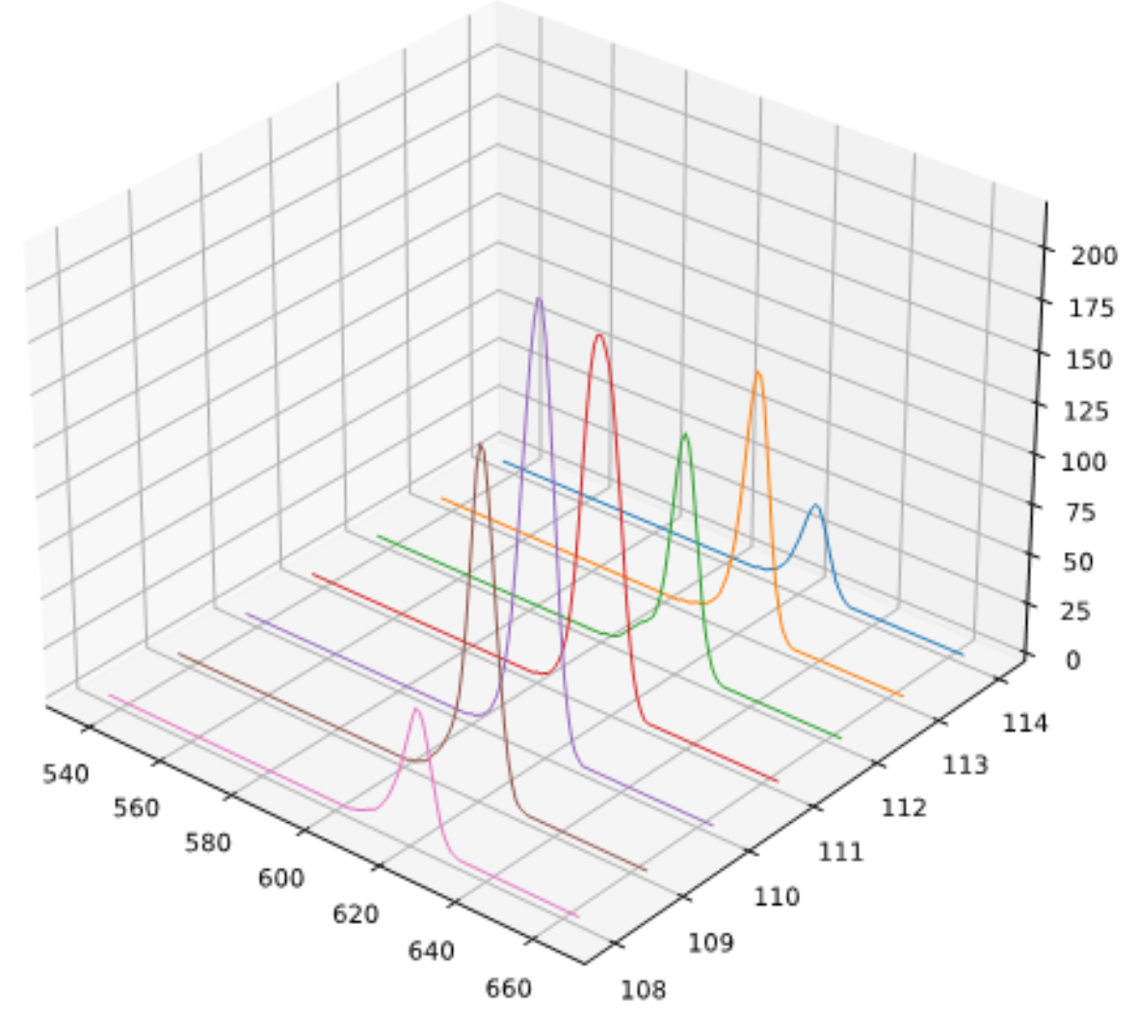
ROI finding with 1D-CNN and denoising with 1D-AE
Wire number
Time tick
Wire number
Time tick
Wire number
Time tick

Slide 17
ML-based data size reduction estimates
Data rate from 1 far detector module (horizontal drift):
  150 APAs×2560 ch/APA×14 bits/sample×2 Msamples/sec ~ 1.2 TB/s
Buffered supernova data per detector module:
  100 seconds: 120 TB
  For pointing determination, focus on first 10 seconds: 12 TB
Estimated size of data per SN neutrino candidate from ML-based reduction pipeline:
  CC: 47,306 bytes
  ES: 29,680 bytes
Assuming 2DCNN rejects 100% radiologicals, assume we retain all CC + ES neutrinos interactions:
  3,300 CC×47,306 bytes + 326 ES×29,680 bytes ~ 158 MB for all 4 modules
  48 TB → 0.000151 TB ~ over 5 orders of magnitude reduction !

Slide 18
Execution time for track reconstruction on reduced sample
Track reconstruction pipeline:
Use of 1D denoising AutoEncoder to clean up electronics noise of raw waveforms in ROIs from 1DCNN allows us to use “legacy” 1D FFT deconvolution in the “Dataprep” stage to speed up things.
Assume we reject all radiologicals with 2DCNN and retain all CC+ES events:
  3300×.061 + 326×.026 ~ 210 seconds = 3.5 min
  for full DUNE detector executed using one CPU core !
Dataprep
Gaushit
SP Solver
DisAmbig
TrajCluster
PmTrack
Interaction | Reco time (sec/event)
CC | 0.061
ES | 0.026

Slide 19
Compare with no reduction case
How long would it take to process the SN data using the reco pipeline in the previous slide on a full 10 second raw dataset
It takes ~9.5 seconds to process 1 APA worth of data in a 6000 time tick
(500 ns/tick) readout window using one CPU core:
  Assuming we dedicated one CPU core to 1 APA on each DAQ readout computer:
    100 seconds of SN data would take 88 hrs to complete
    1st 10 seconds of SN data would take ~9 hrs to complete
For simplicity assume all 4 detector modules identical to first horizontal drift module, i.e. 150 APAs per module:
  9 hrs using 4×150 = 600 CPU cores versus 3.5 min using 1 CPU core !

Slide 20
Execution time for ML-based data reduction pipeline
ML-based data reduction algorithm is meant to run on FPGAs that access buffered SN data on SSDs directly. FPGA’s main advantage over GPU is lower power consumption – important because of limited power budget in SURF underground caverns.
However, since we were not able to get results in time, we benchmarked the algorithm on a typical GPU to get an idea of what is achievable
Using half of an Nvidia A100 GPU*:
  Since each front end DAQ computer serves 2 APAs
  15 minutes to perform the ML-based data reduction for 1 APA
  * A100 is a datacenter GPU and not the ideal for this application due to power consumption. Only used here to get an idea of inference times possible. There are other GPUs targeted at low latency inference combined with low power consumption
Total of ~20 minutes to do ML-based data reduction + track reconstruction
  Still considerably less time than it takes just to transfer the SN data back to Fermilab:
    10 seconds of SN data for all 4 modules: 48 TB takes ~1 hr to transfer over 100 Gbps ethernet

Slide 21
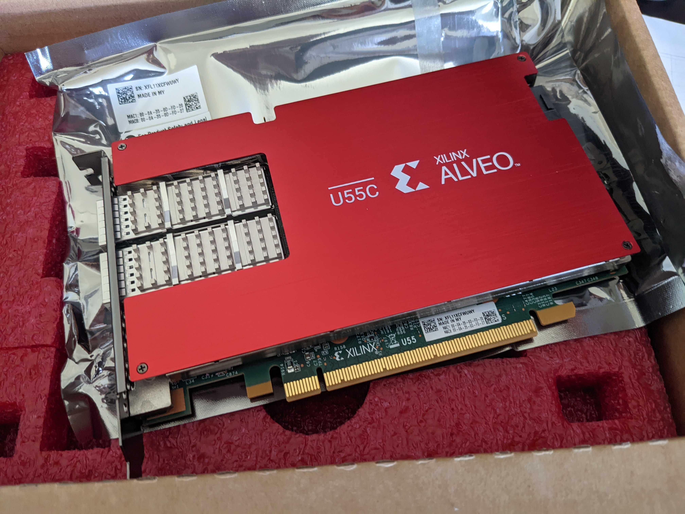
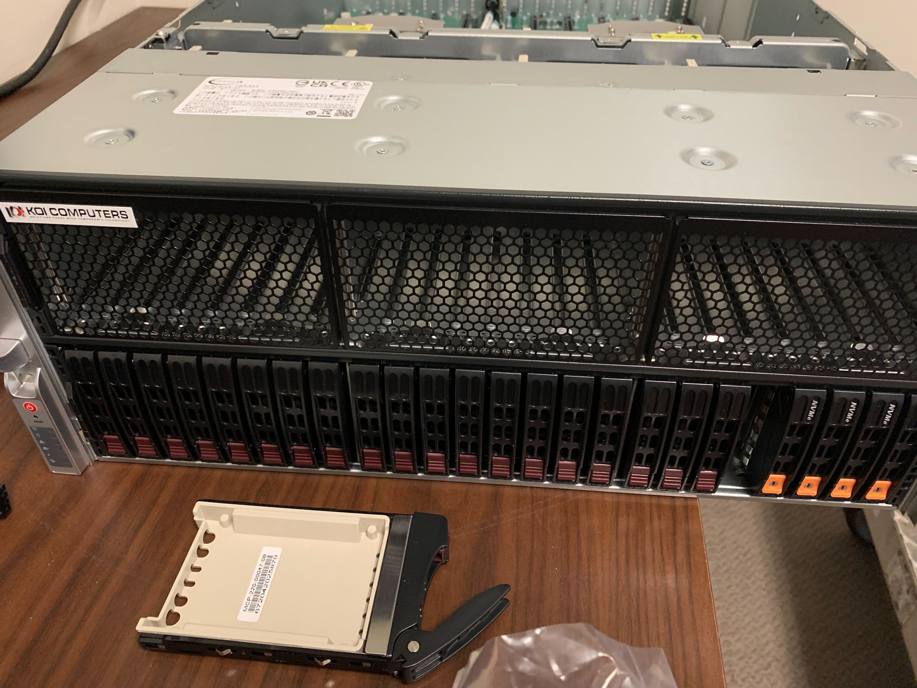
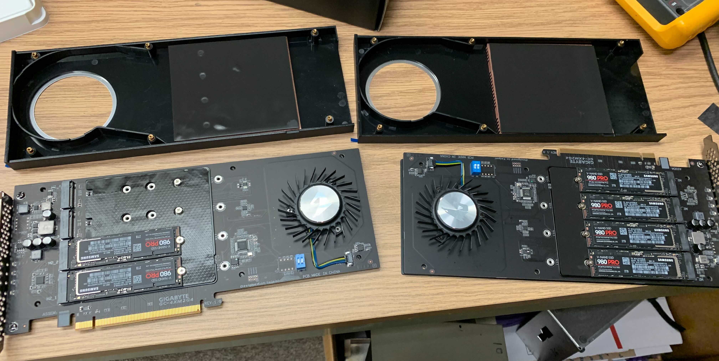
In-storage ML-based data reduction
RAM
Host
CPU
Prototype DUNE DAQ
front end computer
Xilinx FPGA card
PCIe
Supernova readout buffer:
PCIe Gen4 NVMe SSD
modules on PCIe carrier
PCIe peer-to-peer
FPGA
NVMe
SSD
mem

Slide 22
Hardware implementation 1
Perform inference
AvgPool 8
AvgPool 16
Flatten
AvgPool 16
AvgPool 8
Reorganize raw data & generate input frames
Subtract pedestal
Output
To
1dcnn
2dConv 8
Dense
2dConv 16
Dropout
Dropout
Full-size frames sent to
2dcnn for inference
2dConv 16
Dropout
2dConv 8
2DCNN
Plane | Input frame size
induction | 200 x 1,148(9)
collection | 200 x 480
Inference time/frame ~3.2 ms
Compared with ~0.5 ms for the GPU

Slide 23
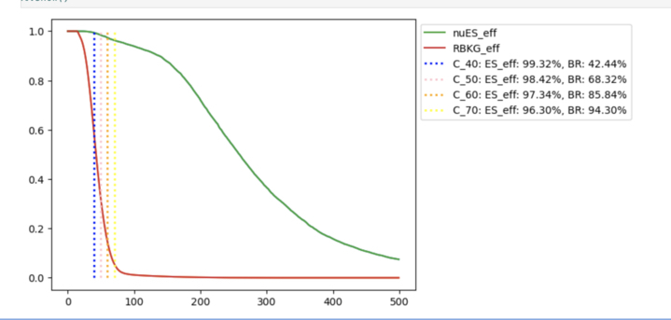
Hardware implementation 2
Downsample
Perform inference
Filter input frames
SumPool
MaxPool 8
Flatten
Different “skip”
thresholds
MaxPool 16
Reorganize raw data & generate input frames
Subtract pedestal
Is MaxADC >
some threshold ?
Output
Yes
To
1dcnn
efficiency
Dense
No
2dConv 16
2dConv 8
2DCNN
Skip
J. Clair, G. Karagiorgi, G. Ge, A. Malige
(DUNE-doc-27333-v1)
- Looks promising, achieving inference times of O(10) us with input frame widths of 64
- More compact: more instances can be implemented for parallel execution
- Requires more testing with wider input frames and inclusion of all pre-processing steps
Skip threshold (in ADC counts)

Slide 24
Signal efficiencies when using ML-based data reduction
Fast execution times are useless unless we retain a significant amount of the SN neutrino interactions. Here we compare signal efficiencies after the GausHit finder stage between a standard full dataset reconstruction and our ML-based reduced dataset reconstruction:
Able to achieve same signal efficiencies but with tremendous reduction in execution time !
Reconstruction chain | Sig eff for primary trk hits |  |  | Sig eff for daughter trk hits
 | U | V | Z | U | V | Z
ML-reduced (1D deconvolution) | 0.69 | 0.71 | 0.66 | 0.16 | 0.18 | 0.073
Standard full dataset (2D deconvolution) | 0.68 | 0.67 | 0.62 | 0.14 | 0.17 | 0.062
GausHit finder hit efficiencies for fully simulated nuES events

Slide 25
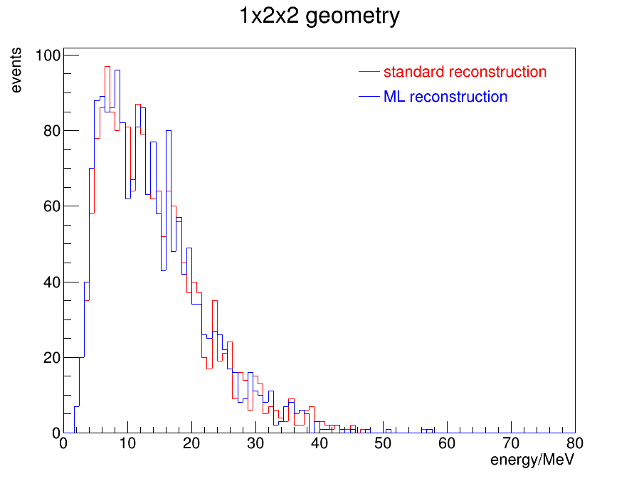
Energy distributions
Here we compare the reconstructed energy of the scattered electron in the SN ES interactions between the standard full-dataset reconstruction and the ML-based reduced dataset reconstruction:
Basically, the ML-based reconstruction pipeline produces identical results as a standard offline reconstruction

Slide 26
More info on DUNE SN pointing capability & ML models used
For more details on DUNE’s supernova pointing capabilities, please refer to:
  Abi, B., Acciarri, R., Acero, M.A. et al. Supernova neutrino burst detection with the Deep Underground Neutrino Experiment. Eur. Phys. J. C 81, 423 (2021).
  Updated version to be published:
  Abed Abud, A., Abi, B., Acciarri, R. et al. Supernova pointing capabilities of DUNE.
  (DUNE-doc-27538-v13, primary authors: Shen, J., Roeth, A. J., Hakenmueller, J., Queen, J., Pershey, D., Scholberg, K. )
For more details on ML models used in this work:
  Clair, J. Real-Time Detection of Low-Energy Events for the DUNE Data Selection System. DUNE-doc-27333-v1. (2DCNN)
  Uboldi, L., Ruth, D., Andrews M., Wang, M.H.L.S. et al. Extracting low energy signals from raw LArTPC waveforms using deep learning techniques — A proof of concept. Nucl. Instrum. Methods Phys. Res. A 1028 166371 (2022). (1DCNN)
  Mitrevski, J. Low Energy LArTPC Signal Detection using Anomaly Detection. Fast Machine Learning for Science, Imperial College London, 25-28 Sept 2023. (1D denoising autoencoder)

Slide 27
Conclusions
Common assumption: DUNE SN processing requires significant computing resources: processing, network, and storage
  SN data needs to be transferred back to FNAL for more processing to determine direction
  HPC sites were also being considered for this purpose
What we have demonstrated: applying ML-based data reduction as early as possible can reduce data to such a degree that makes it possible to perform offline-like analysis on-site with minimal computing resources – i.e. on a single server:
  total processing times less than network transfer time back to FNAL appear achievable
  no loss in quality of results wrt full reconstruction/analysis
This has positive implications for previous assumptions about DUNE’s computing requirements, perhaps warranting a re-examination of these assumptions

Slide 28
Conclusions (continued)
While results look promising, this is a work in progress, and more work needs to be done:
  Single largest contribution to the total processing time is the 2DCNN-based radiological background rejection:
    Focusing on reducing 2DCNN inference time will reap the largest benefits
  Continue exploring hardware accelerator options:
    Continue with FPGA implementation and optimization
    Benchmark GPUs geared towards low-latency inference applications & low power
    Explore dedicated AI inference chips
  Include algorithms for discriminating ES vs CC and optimize these algorithms
  Implement end-to-end demonstrator within dune-daq framework

Slide 29
People directly involved in this effort
Fermilab
  Maira Khan, Jovan Mitrevski, Ben Hawks,
  Tom Junk, Tingjun Yang, Jennifer Ngadiuba, Mike Wang,
  Pengfei Ding (now at LBNL)
Duke University
  Kate Scholberg, Janina Hakenmueller, Van Tha Bik Lian
Columbia University
  Georgia Karagiorgi, Judicael Claire, Guanqun Ge, Akshay Malige
York University
  Tejin Cai (now at Synopsys Inc.)
Iowa State University
  Amanda Weinstein, Avik Ghosh

Slide 30
Thank you!

Slide 31
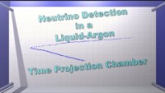
How a LArTPC works

