Slide 1
HEP detectors overview and example
Christian Bohm
Stockholm University
Outline
Physics Background
LHC and its detectors
ATLAS and its subdetectors
Trigger and Data Acqusition
Syncronization
Future

Slide 2


Introduction
We study new physics by colliding high energy particles
New particles can be produced in these collisions if the energy is sufficiently high.
If we collide protons the probability (cross section) for this is small.
You need many collisions to increase the probability – need high luminosity and many repetitions
The protons contains three quarks
Not only must the protons collide head-on but also their constituents.
After doing this for some time, we look for unusual interesting events.
And not only one, we want many to believe the results
Thus,
We must collide a large number of protons each time – use high luminosity proton beams
We must repeat collisions many times – use high collision rates

Slide 3
Why we need to record many events
To determine if our N new observed events constitute a discovery we must determine if the same data could be produced by combinations of well-known events. The probability for is the background B.
For N to be a discovery N must be significantly larger than B
For example if N is 80 and B is 64 then σ(B) is 8 (assume Poisson distribution σ²=N)
N is 2σ above i.e. 2% probability that N is just random noise
If we measure twice as long N will be 320, B is 256 and σ(B) is 16 i.e. about 4σ above (0.004% that it is random noise). Much smaller probability that N is due to random noise but not enough.
5σ (0.00002% it is random noise) is required for discovery.
The significance of N can grow after more measurements, but the significance could also decrease or even disappear.
There are many 3σ that have disappeared, but a 5σ must have been a 3σ at some point.
Normal distribution
Almost the same
as Poisson if N>50
68.3
95.5
99.7
μ−σ
μ
μ+σ

Slide 4
Beyond the Standard Model
We have a theory, the Standard Model, to explain much of the particle physics we have observed, but not all.
The task is to explore Beyond Standard Model (BSM) physics
One way is to find new observational results that cannot be explained by the Standard Model
Better precision (higher luminosity and longer time) increases the probability for deviations
Another way is to propose theories that agrees with existing experimental results but also predicts new results that can be tested with experiments
Some potential BSM theories predict super symmetric partners to all normal particles – none of which have been seen so far
To progress we need to know where the Standard Model fails
We need more data and/or higher energies

Slide 5
Detectable Standard Model particles
The Standard Model, explains most of the particle physics we have observed (but not all).
The most basic constituents are:
Leptons, quarks and bosons
These can be created in collisions in high energy physics experiments at accelerators, but the short lived particles decay before they reach the detector. They can only be deduced by their decay products.
We can detect electrons, (positive) muons and their anti particles (positrons and negative muons)
The only boson we can detect is the photon.
We can detect composite particles (charged and uncharged) formed by quarks, called hadrons but have problems identifying them.
The hadrons can be mesons and baryons such as protons and neutrons

Slide 6
Jets
In the standard model there are 6 types of quarks and 6 types of antiquarks.
Free quarks are never seen. You only see combinations of them, hadrons.
They can combine into baryons (3 quarks) or mesons (a quark-antiquark pair).
One way to illustrate the quark behavior is to see them as string ends.
A mesons will then be modelled as: and a baryon (e.g. a proton) as: or
If you stretch a meson, i.e. trying to move the quark and antiquark away from each other, the string breaks.
Forming two strings with two new string ends, a new quark-antiquark par, and thus two mesons
*

Slide 7
Jets
If the quarks in a meson separate with a high kinetic energy there will be multiple string ruptures a jet of hadrons
Whenever a quark tries to escape a jet is formed
Jet
1 meson
2 mesons
4 mesons
Jet fragmentation

Slide 8
Short lived particles
You have to infer the existence of short lived (< 10⁻¹⁰ sec) particles by recording the disintegration products
But this opens for mistakes:
If A → B, C and you record B and C it is not certain they came from the same A. They might have come from different processes
Need to know the direction with high precision
Then you can identify if it is a secondary vertex
Secondary vertex
Primary vertex
Primary vertex

Slide 9
Missing Transverse Momenta (Energy)
The center of gravity of all particles created in an explosion stay at the collision center
The vectorial sum of all momenta in the COG system is 0
Same thing applies to the transverse projection
If one particle is not detected there will be a missing transverse momenta
3D Transverse projection
Missing transverse momenta can be due to:
Particles that cannot be detected (e.g. neutrinos) or failing detector elements
The detector should be hermetic

Slide 10
Colliders
One solution to get high luminosity and high repetition rate is to circulate the particles (e.g. protons) in two ring accelerators that cross in regions where the particles can collide
Most protons will pass through and continue to recirculate, but some would collide (along with collisions with rest gas)
Eventually all protons will be lost, but before that they will pass each other many times
A better solutions is to group the protons in bunches and let the bunches collide

Slide 11
Detector and Subdetectors
All short-lived particles decay before entering the detector itself
Remaining particles: e-, e+, γ, hadrons (p, n..., jets), μ+, μ-, ν, ?
Onion-like with multiple subdetector and magnet shells:
Inner detector (tracker) with Pixel, SCT and TRT
to find charged particle tracks
Solenoid magnets to deduce charge and momentum
Electromagnetic calorimeter to measure e/m tracks and energy
Hadron calorimeter to measure hadron and jet tracks and energy
Muon detector to detect muon tracks and momentum

Slide 12
Identifying the collision event
An electron (e⁻) leaves a track in the inner detector with negative (here counter clockwise) curvature and showers and is absorbed in the electromagnetic calorimeter
ν
p⁺
An higher energy positron (e⁺) leaves a positive smaller curvature
μ⁺
n
A photon (γ) leaves no track in the inner detector
A positive muon (μ⁺) leaves a positive curvature track in the inner detector, a weak track in the hadron calorimeter and a signal in the muon spectrometer
γ
e⁺
e⁻
A proton (p) leaves a positive curvature track in the inner detector, a track in the e/m calorimeter and a track in the hadron calorimeter
Dashed lines
are not recorded
by the detector
A neutron (n) leaves no track in the inner detector, a track in the e/m calorimeter and a track in the hadron calorimeter
A neutrino (ν) does not leave any tracks at all

Slide 13
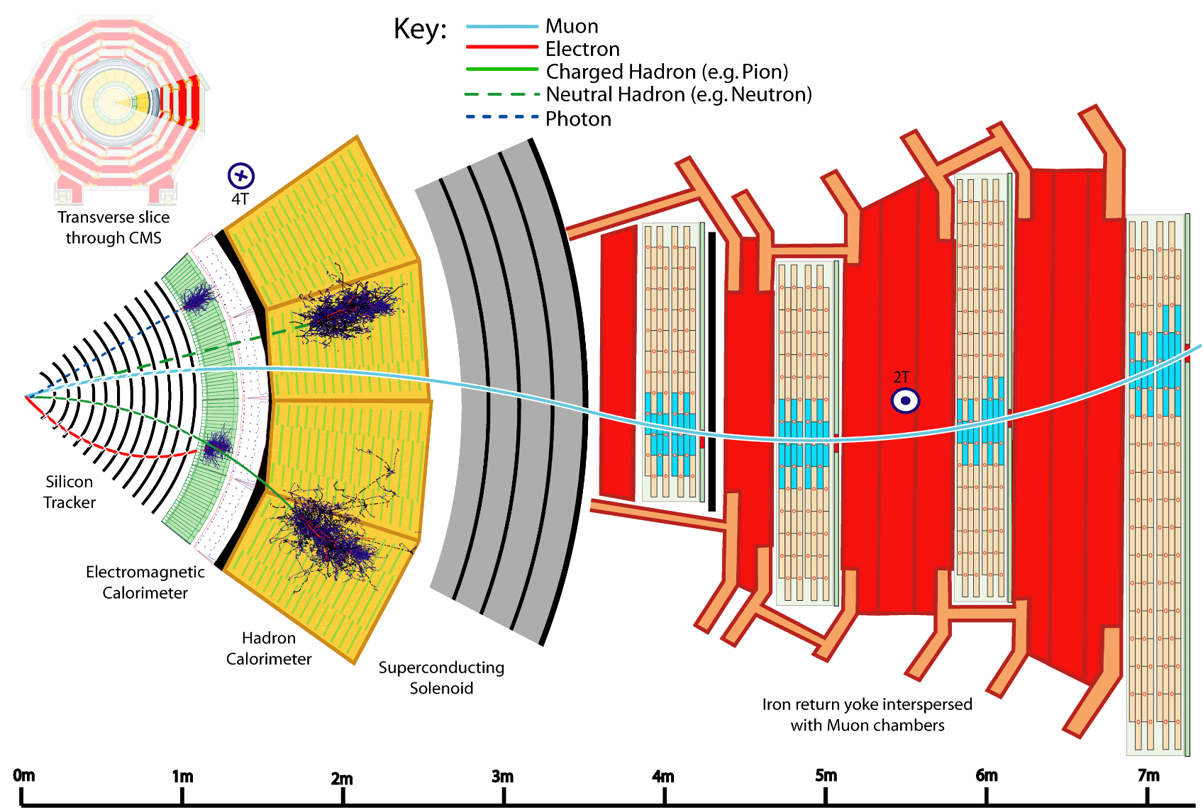
Identifying the collision event
Group particles from the same interaction point – could be outside beam pipe
Deduce source particle:
e⁺+e⁻ ->Z
μ⁺+μ⁻ ->Z
2Z-> H
Transverse vectorial momentum sum should be 0
If not, something is missing – a neutrino, or something more exiting
Broken parts must be
corrected for
Missing momentum

Slide 14
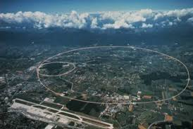
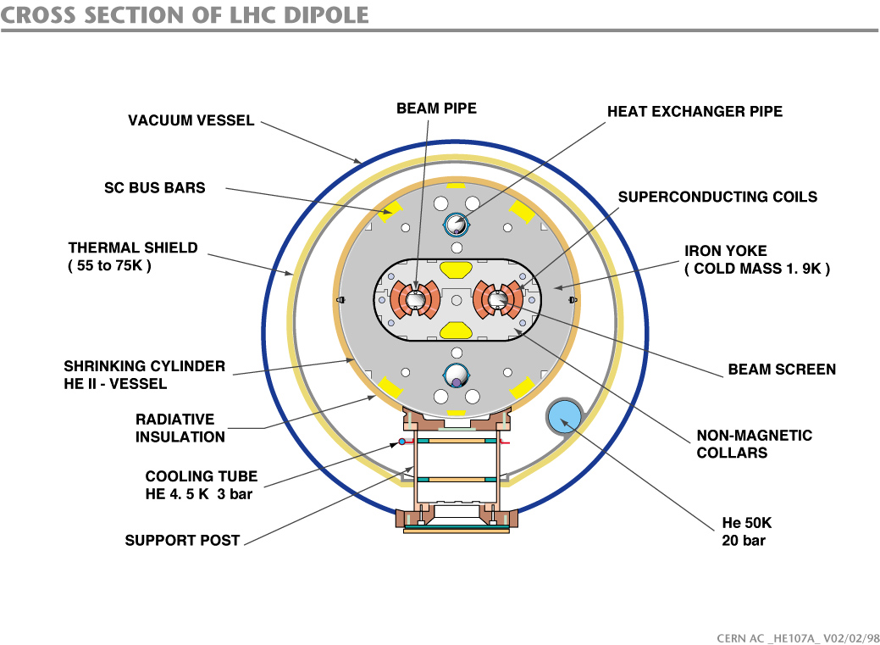
The Large Hadron Collider
27km circumference double ring collider
13 TeV (6.5+6.5) – 0.999999991 times c, i.e. 3m/s less than c
4 interaction points with detectors – ATLAS, CMS, LHC-B and ALICE
1.5.10³⁴ protons/cm²/sec focused into 16 μ beams that collide
1600 superconducting magnets (up to 9T) to bend and focus the beams
Bunches with about 10¹¹ protons collide every 25 ns
The total beam energy is 562 MJ – melts 2 ton cupper
Start of operations 2010 (2008)

Slide 15
Separate data from different Bunch crossings

Slide 16
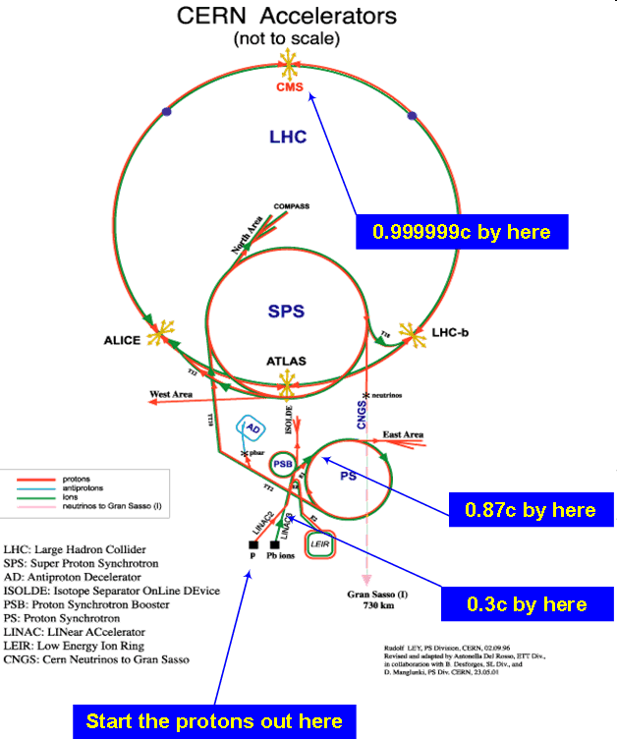
The CERN Accelerator Systems
A hierarchical system of accelerators
Lineac 2 → PS Boster → PS → SPS → LHC
50 MeV I.4 GeV 25GeV 450GeV 6.5TeV
One or two injections into LHC per day
450 GeV injected protons accelerate to 6.5 TeV in 20 minutes
Aim for 7 TeV 2021

Slide 17
Desirable detector properties
High precision inner detector position information to identify secondary vertices, but amplitude information is not needed – many layers and many channels
It should be a light construction that does not compromise calorimeter resolution
Good energy information in calorimeters and muon detector to determine missing momentum accurately
All detectable particles should be detected – hermeticity
Detector signals are often long, many bunch crossings, but must be associated with correct bunch crossing, if not, false missing momentum – pile-up problem at high count rates
E/M calorimeter should be deep enough to contain electrons and γ
Hadron calorimeter should be deep enough to contain hadrons
Radiation levels determine choice of detectors and electronics
Design compromises necessary for economical reasons
Pile-up

Slide 18
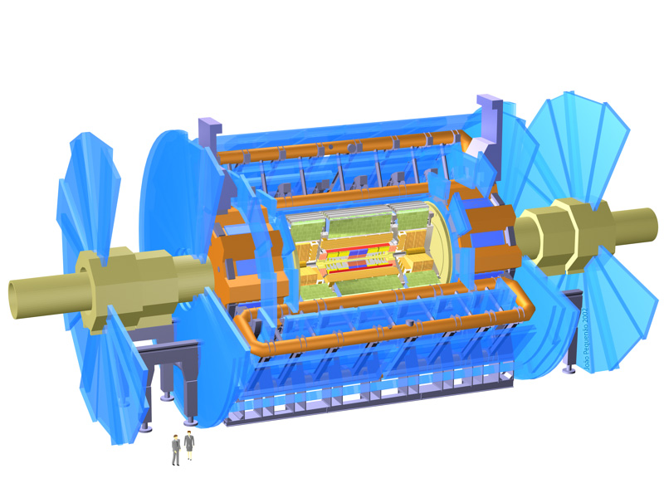
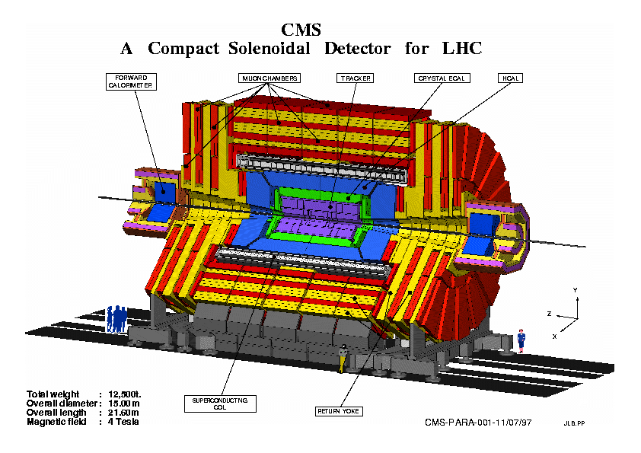
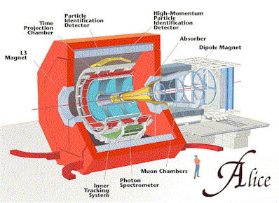
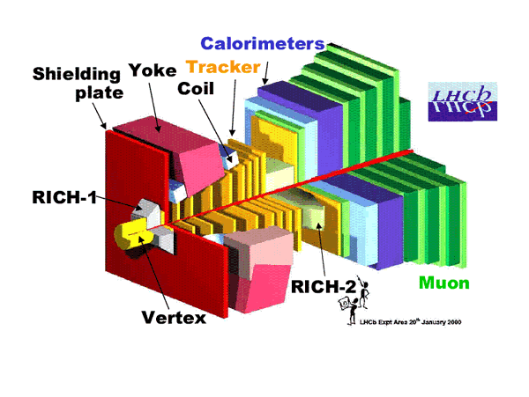
LHC Detectors
ATLAS
Heavy ion experiments about 2 weeks/year
ATLAS -CMS
Similar but different – magnet system,
detector solutions, TDAQ system
Competition – Collaboration
Heavy ion experiments,
Pb – Pb or Au – Au
B physics at lower luminosities

Slide 19
LHC results and cost
RESULTS so far
Higgs particle discovered 2012 July 4th (Nobel prize 2013)
No strong indications for BSM physics (Beyond Standard Model) yet
No SUSY (SuperSymmetry) yet
COSTS
LHC material costs ~3.1 G€
ATLAS material costs ~.3 G€

Slide 20
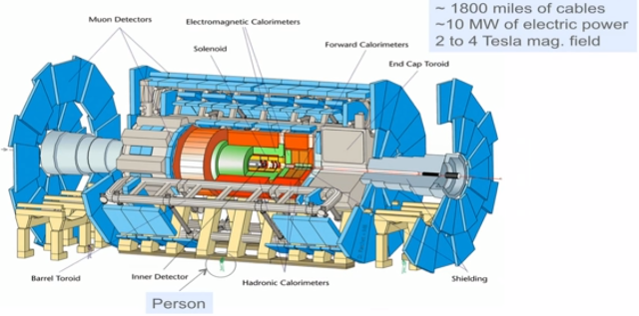
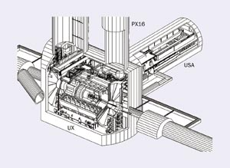
A ToroidaL ApparatuS - ATLAS
46 meters
25 meters
USA = Underground Storage Area 100m below surface
Access shafts 12 – 22 m diam.
Inner detector 1 bit? - ~86 Mch
E/M calorimeter 16 bit - ~300 kch
Hadron calorimeter 16 bit ~10kch
Muon detector x bit ~100 kch
Weight 7000 tons
3000 physicists + x engineers
181 institutes from
38 countries

Slide 21
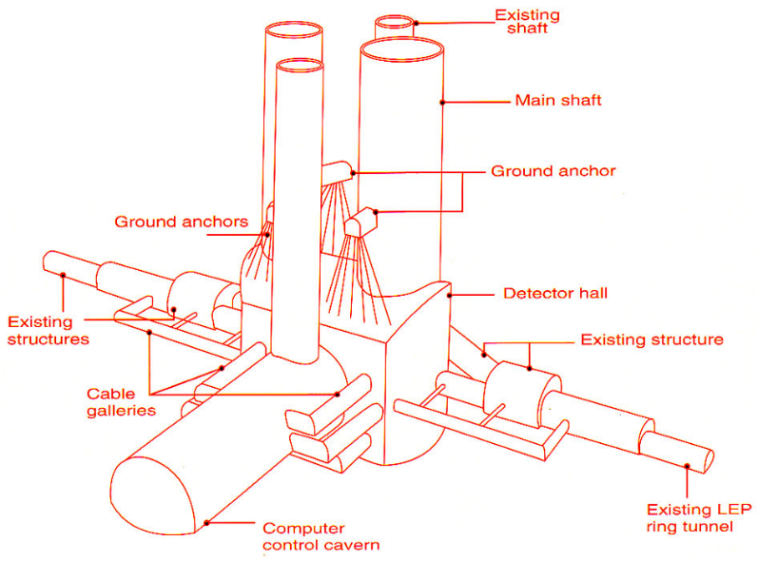
A ToroidaL ApparatuS - ATLAS
A ToroidaL ApparatuS - ATLAS
46 meters
25 meters
USA = Underground Storage Area 100m below surface
Access shafts 12 – 22 m diam.
Inner detector 1 bit? - ~86 Mch
E/M calorimeter 16 bit - ~300 kch
Hadron calorimeter 16 bit ~10kch
Muon detector x bit ~100 kch
Weight 7000 tons
3000 physicists + x engineers
174 institutes from
38 countries

Slide 22
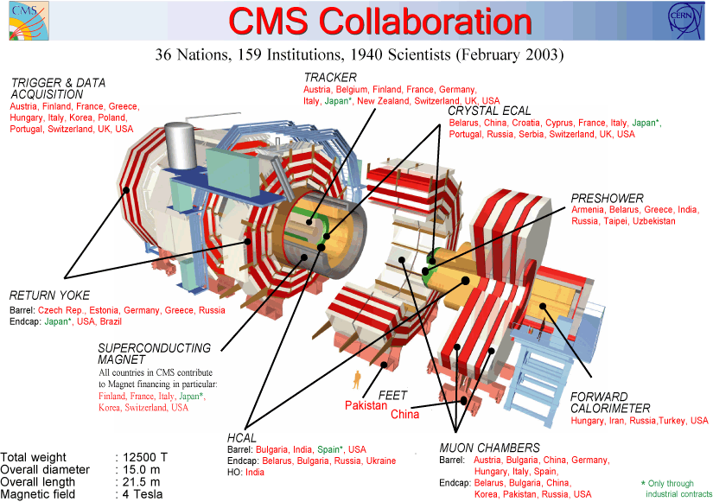
CMS – Compact Muon Solenoid

Slide 23
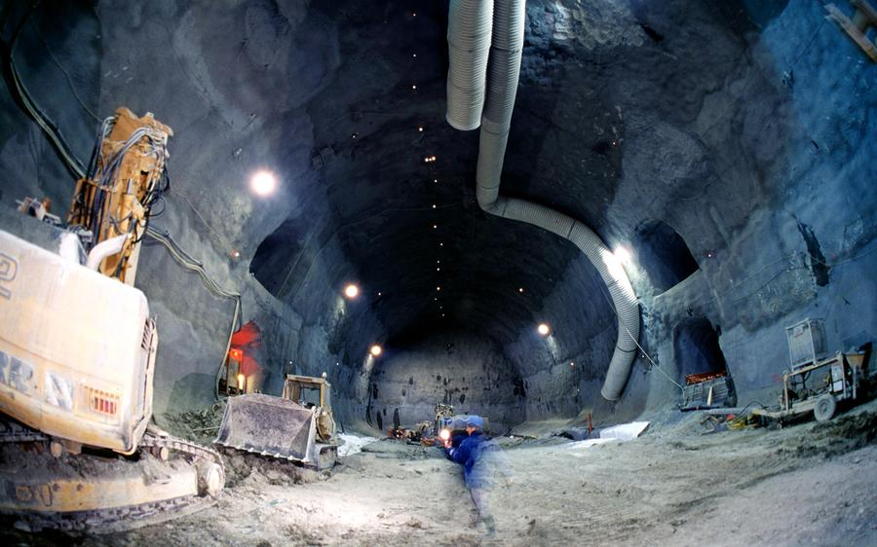
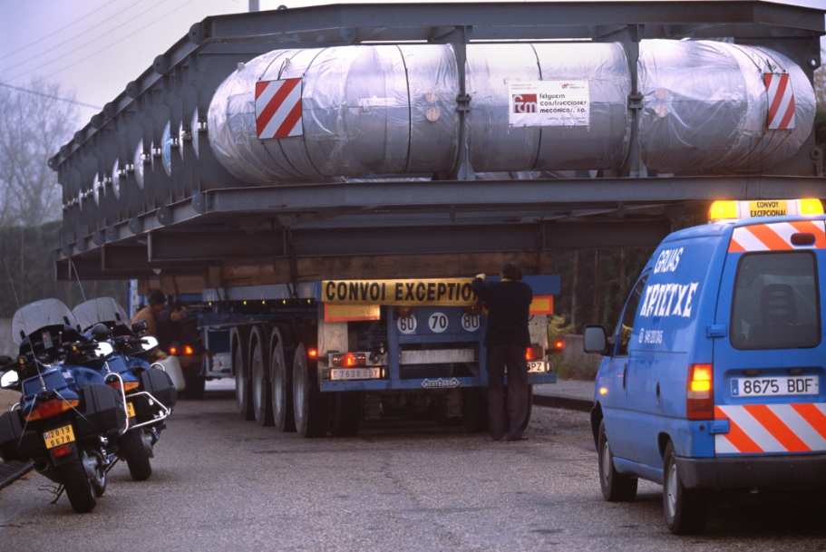
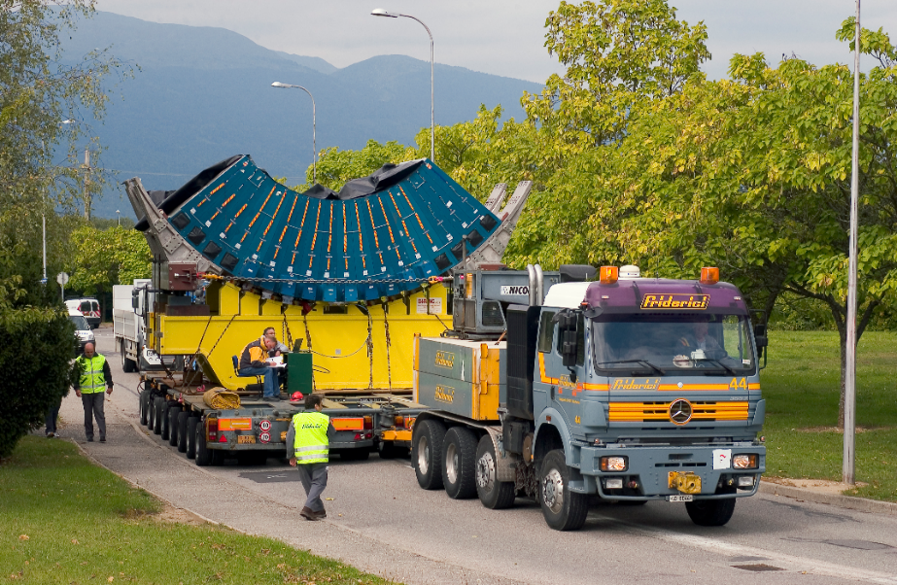
ATLAS installation

Slide 24
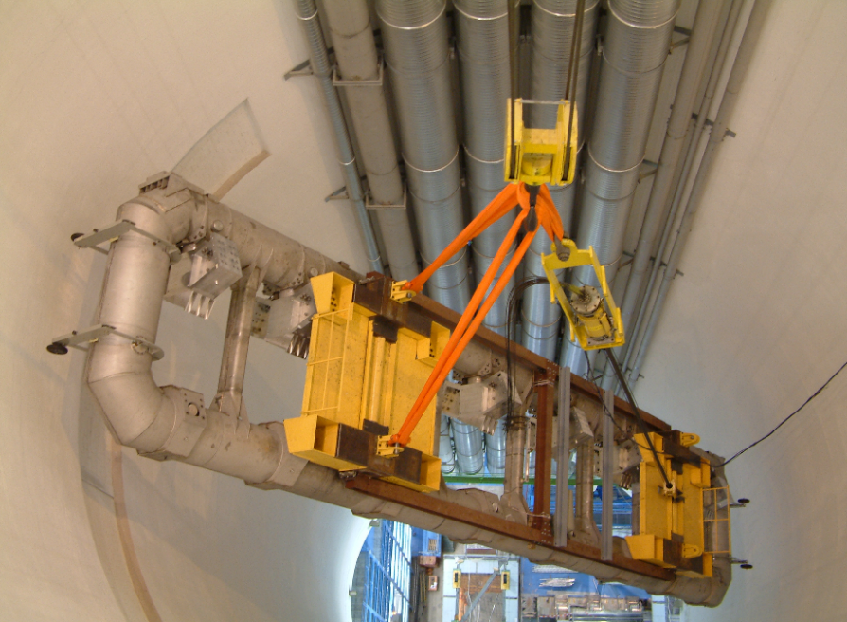
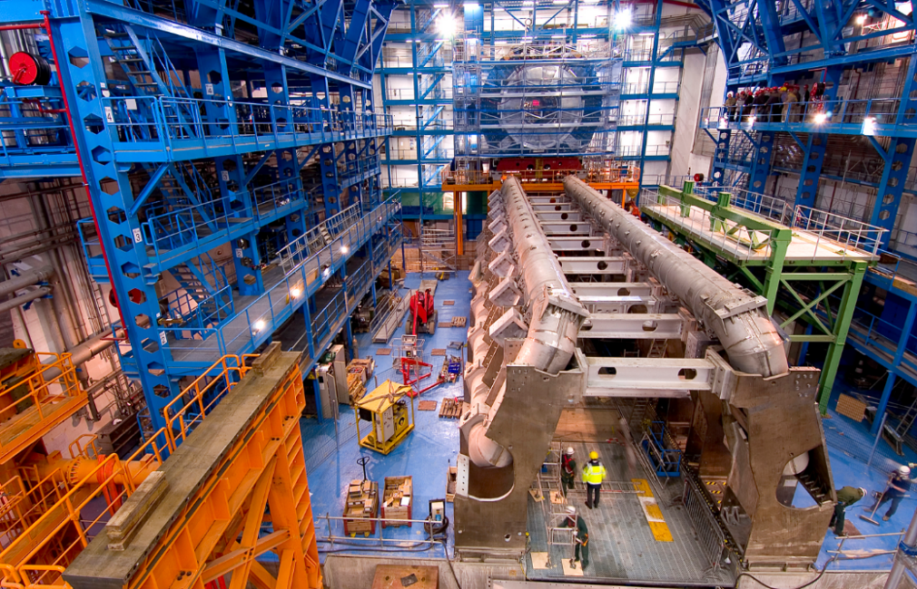
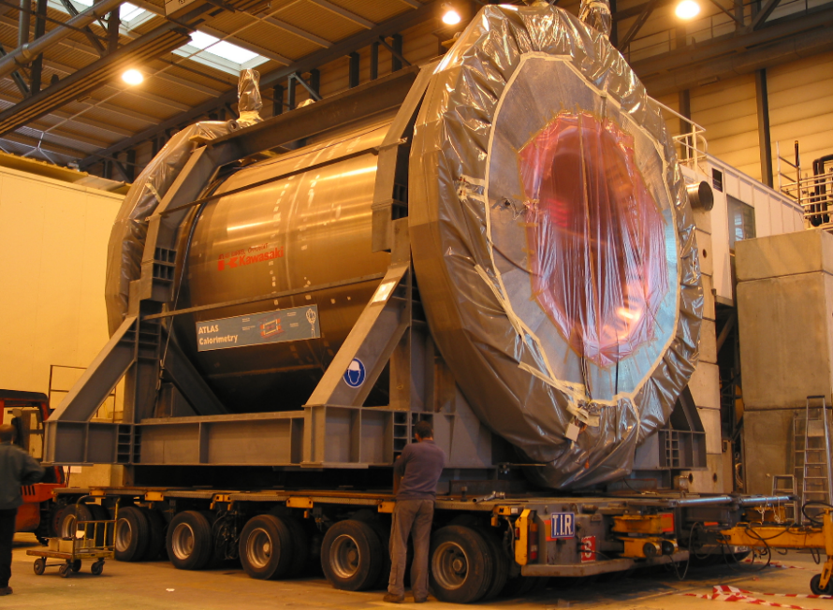
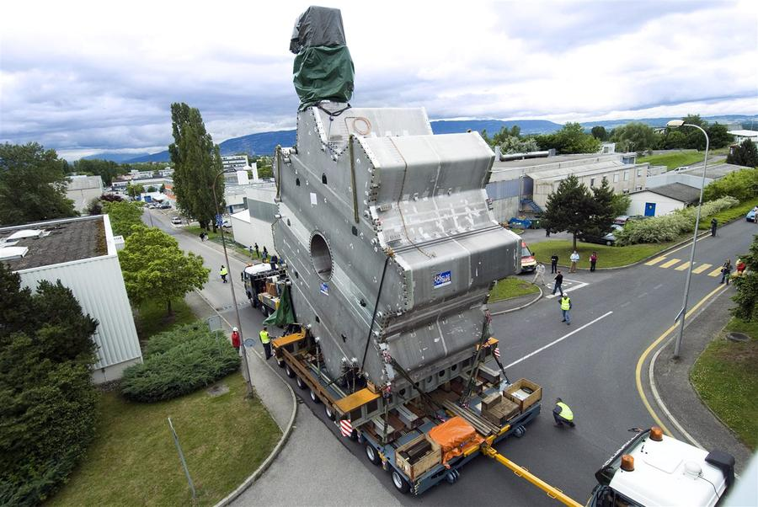
ATLAS installation

Slide 25
Radiation Detectors
A large class of radiation detectors are based on scintillation where the ionizing radiation excites an inorganic or organic scintillator When the scintillator de-excites it emits light of characteristic wavelengths
The light can be collected by photo multipliers or silicon light sensors.
In another class of radiation detectors the radiation ionizes the media and an electric field separates the electrons and the ions. The media can be gaseous or liquid. Different media gives different performance.
In semiconductor detectors the radiation creates electron-hole pairs that are separated by the field over a p-n junction

Slide 26
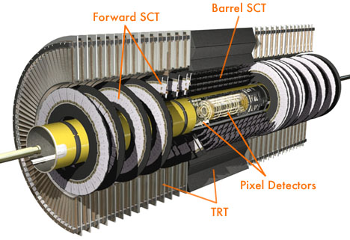
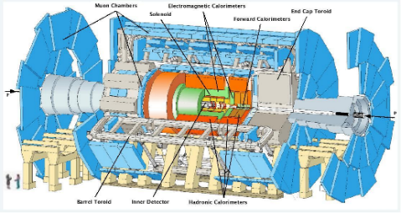
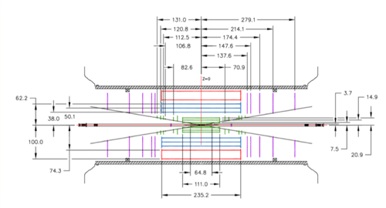
ATLAS inner detector
Magnetic field 2T
3 different detector types
Pixel detector 80 Mch
Silicon pad detector 2D resolution 12 μx110μ
Semiconducor Tracker (SCT) 6 Mch
Silicon strip detector (1D)
Double layers Resolution 23 μ x800μ
Transition Radiation Tracker (TRT) 300kch
Gas detector – straw tubes
Electron identification

Slide 27
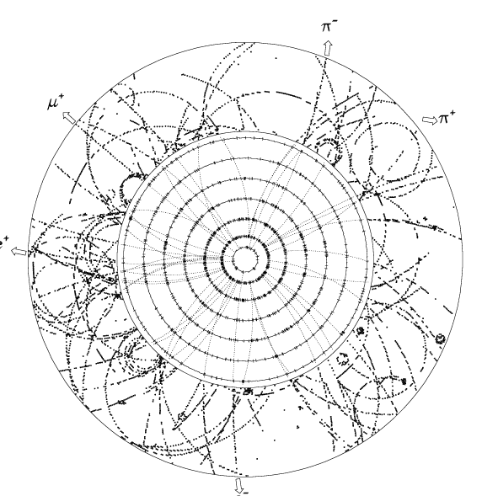
ATLAS inner detector
Magnetic field 2T
3 different detector types
Pixel detector 80 Mch
Silicon pad detector 2D resolution 12 μx110μ
Semiconducor Tracker (SCT) 6 Mch
Silicon strip detector (1D)
Double layers Resolution 23 μ x800μ
Transition Radiation Tracker (TRT) 300kch
Gas detector – straw tubes
Electron identification
Pixel detector 3 sample points
Strip detector 4 sample points
TRT 36 sample points
About 1000 particles

Slide 28
ATLAS inner detector
Magnetic field 2T
3 different detector types
Pixel detector 80 Mch
Silicon pad detector 2D resolution 12 μx110μ
Semiconducor Tracker (SCT) 6 Mch
Silicon strip detector (1D)
Double layers Resolution 23 μ x800μ
Transition Radiation Tracker (TRT) 300kch
Gas detector – straw tubes
Electron identification
Pixel detector
TRT
SemiConductor Tracker

Slide 29
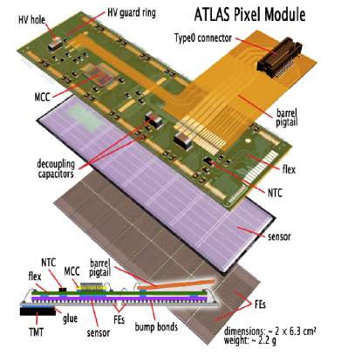
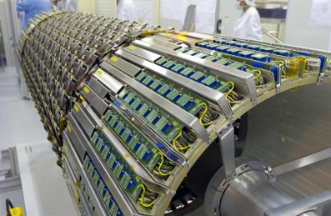
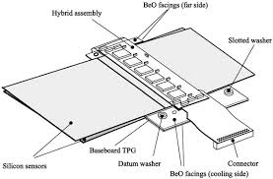
ATLAS inner detector
Radiation tolerance, power and cooling problematic

Slide 30
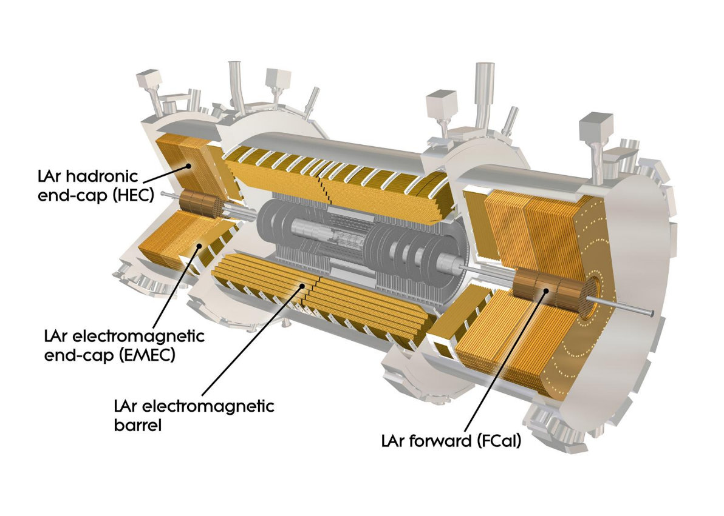
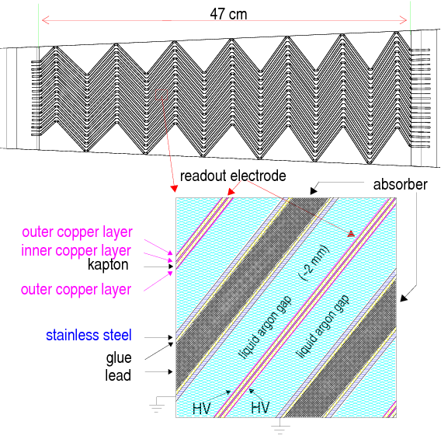
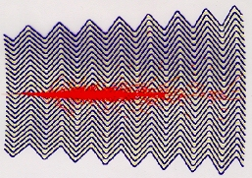
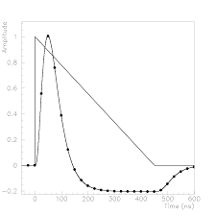
Liquid Argon e-m calorimeter
Liquid Argon-Lead/stainless steel calorimeter (87ºK)
16-bit dynamic range
Cooled preamplifiers
4 layers + presampler

Slide 31
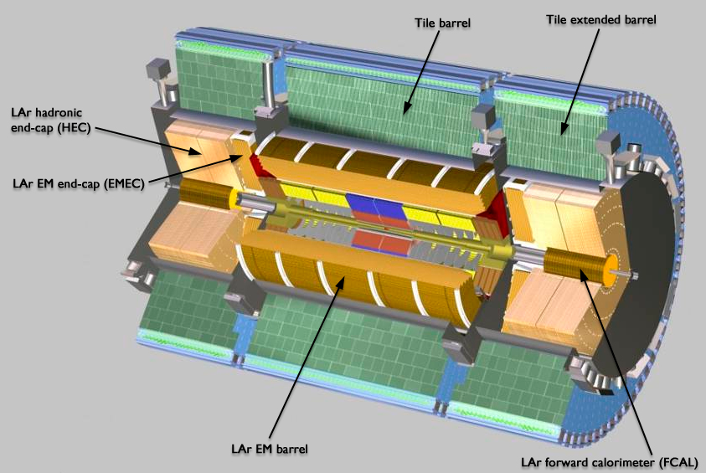
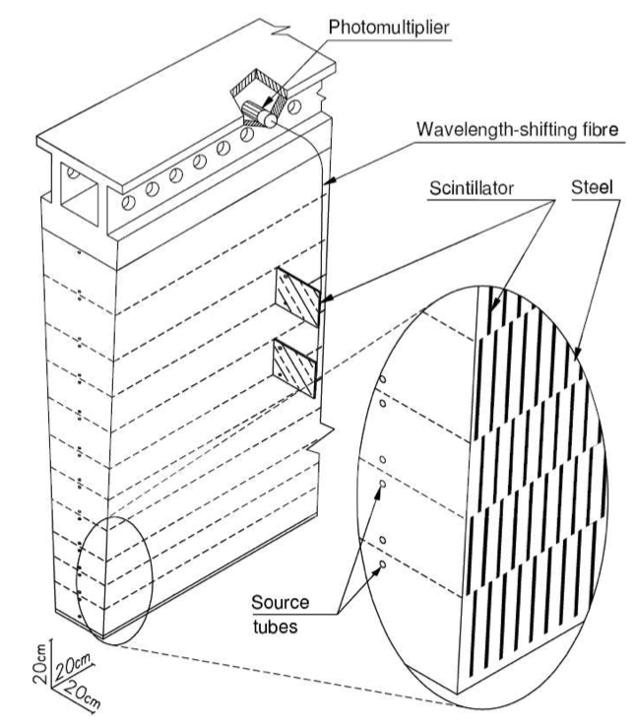
TileCal hadron calorimeter
Interleaved steel and scintillator tiles
256 modules, each weighing 10 tons
4 depth layers
Coarse spatial but good amplitude resolution
Wave Length Shifting fiber – good light transfer
Clear fiber – bad light transfer

Slide 32
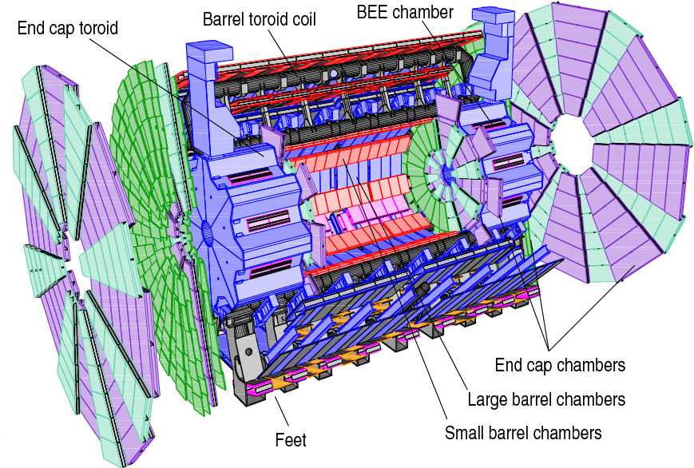
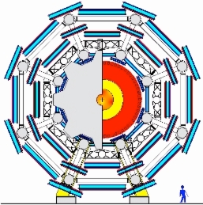
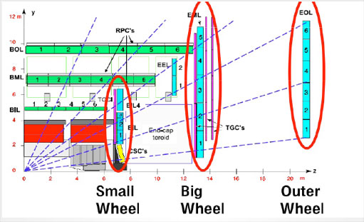
The Muon Spectrometerr
Geometrical alignment precision 30 μm
Alignment can change due to temperature change or deformations when the magnet field is changed
Cost → Use gas detectors, different types for precision and trigger and different types for normal and high intensity regions, close to beam pipe
MDT(Monitored Drift Tubes) and CSC (Cathod Strip Chambers) for high precision. CSC for high intensity forward regions
RPC (Resistive Plate Chambers) and TGC (Thin Gap Chambers) for trigger. TGC for high intensity regions.
32

Slide 33
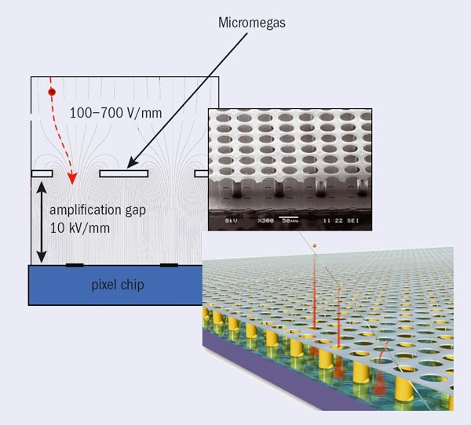
The Muon Spectrometer
RPC – Resistive Plate Chamber
MDT – Monitored Drift Tubes
Micromegas for muon detector upgrade

Slide 34
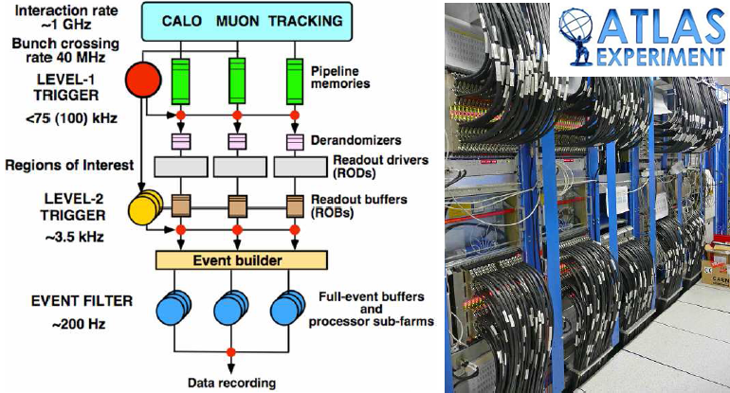
Trigger and Data Acquistion (TDAQ)
Reading out all data, every bunch crossing, completely impossible 2008 - data transfer limitations
Solution -> use multilevel trigger – data storage limitations, radiation tolerance
CMS

Slide 35
Trigger and Data Acquistion (TDAQ)
First level trigger – pipe-lined processing (in FPGAs) of merged calorimeter and muon data with reduced spatial and amplitude information - delivers Regions Of Interest
Second level trigger – PC based software processing full resolution data from all subdetectors but only from RIOs
Third level trigger – Event Builder – PC farm to on-line analyze all data at highest precision
A first selection criteria is to require large transverse energy components to guarantee a head-on collision
CMS

Slide 36
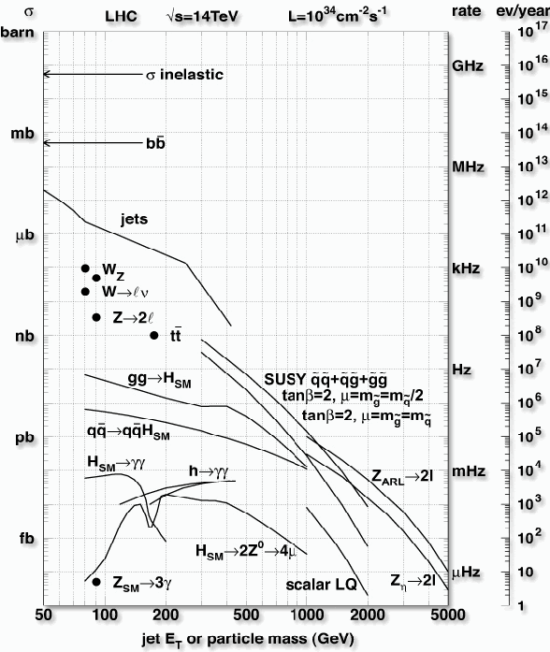
Trigger and Data Acquistion (TDAQ)

Slide 37
First level trigger
Calo TP
CTP
Muon TP
The Calorimeter trigger processor and the Muon trigger processor reports to the Central Trigger Processor (CTP)
CTP looks for characteristic signatures in the data that indicates that the data contains an interesting event e.g.
    4 isolated electrons or
    4 muons or
    2 high energy electrons over a certain threshold and 2 jets
    etc.
The search criteria are defined in the Trigger Menu data base
The current Trigger Menu selection is defined at the start of a run

Slide 38
First level trigger
Calo TP
CTP
Muon TP
All data can be stored on the detector for maximum 2.5 μs – the latency of the first level trigger
Before this, a decision must made on saving or not saving that data
The specified data latency allows for sending the data from the detector to the trigger processor in USA-15 (Underground Storage Area), process it and send the result back to the detector for possible transmission of the entire data set.

Slide 39
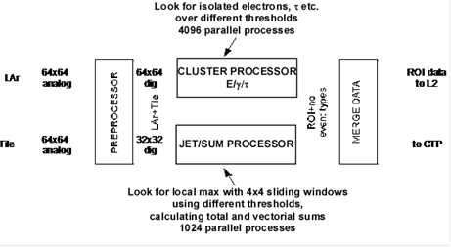
First level trigger
Each bunch crossing, i.e. each 25ns
4096 trigger data values arrive from LAr and Tile
64 cell rows around the calorimeter cylinder and 64 cells in each row along the detector
For each corresponding trigger cell one must study if it contained an interesting event
4096 parallel processes start every 25ns and should be completed within 1 μs
FPGAs widely used together with pipelined processing

Slide 40
Pipelined Processing

Slide 41
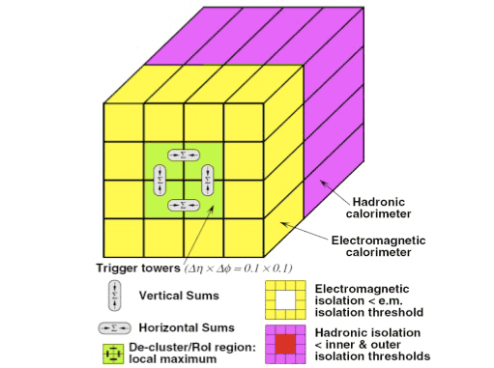
First level trigger
CLUSTER FINDING e/γ ALGORITHM
For each cell anf each set of thresh.
Vert. SUM or Hor. SUM > thresh.
Em isolation SUM< thresh.
Had isolation SUM < thresh.
JET MAX ALGORITHM
41

Slide 42
Synchronization
The Timing, Trigger and Control (TTC) system is responsible for synchronization
The accelerator clock 40.08 MHz distributed to all Front-End units with local phase control
L1A distributed to all FE-boards with programmable delay to maintain sync.
Addressed commands to configure local FE-boards
Maintains Bunch Crossing Identifier BCID to label events

Slide 43
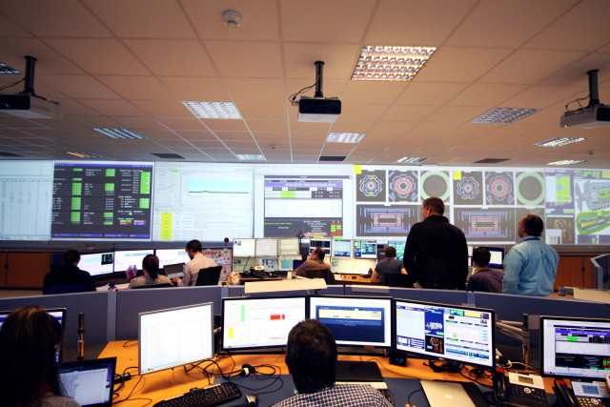
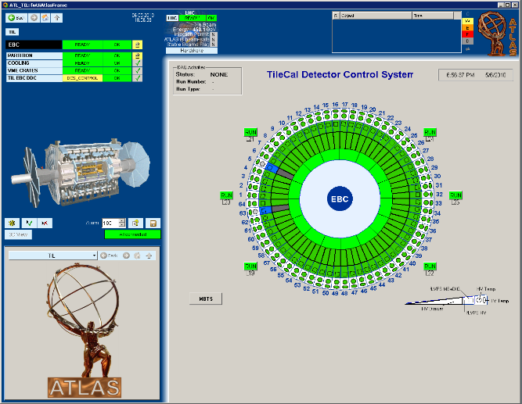
Detector Control - DCS
The Detector Control System or Slow Control, as it was called before, is responsible for initializing and monitoring of all system components including configuring programmable logic (FPGAs).
It will monitor parameters like temperatures, fan operation, pressures, voltages, currents, humilities, error conditions etc..
It is also responsible for safety functions and alarms
It records error conditions and archives monitored parameters
When supervising DCS it is important to have efficient and intuitive GUIs
ATLAS control room
Click
to see
Drawer
Click
to see
fLVPS

Slide 44
Front-End example - TileCal
4x64 modules (with electronics in ”drawers”) with 46 or 32 PMTs each read out by 2 10 bit ADCs (high and low gain)
Each module 8 contains Digitizer boards with 2 ASICs each containing digital pipeline and de-randomizer
Analog trigger signals – digitized in USA-15
44

Slide 45
Calibration - problem for TileCal
Scintillators and fibers age due to radiation
PMTs age when exposed to light
Tree calibration methods:
Cesium calibration – with circulating sources
Laser calibration – with clear fibers
Charge injection – in FEB

Slide 46
ATLAS upgrades
LHC have regular stops for longer maintenance and upgrade
End of operation 2037?
Upgrade phase 0 (LS1)
Prepared for almost full energy 13 TeV
Insertable B-layer – replaced the inner pixel layer

Slide 47
ATLAS upgrades
LHC have regular stops for longer maintenance and upgrade
End of operation 2037?
Upgrade phase 1 (LS 2) – 2019-2020
3 times higher luminosity, need better algorithms
Full energy 14 TeV
New Small Wheel? (at least one)
Topological trigger – not only count event but also consider their geometrical relationship
LAr fully digital trigger
New trigger architecture

Slide 48
ATLAS upgrades
LHC have regular stops for longer maintenance and upgrade
End of operation 2037?
Upgrade phase 2 (LS 3) – 2025-27
Prepare for HL-LHC (High Luminosity LHC)
5 times higher instantaneous luminosity, need still better algorithms
10 times total luminosity – luminosity leveling
New Trigger system – level 0 (L0a: 1MHz, Latency: 6μs) (level1 (L1a:<400kHz,Latency: <30μs))?
New inner detector – no TRT, track trigger (introducing track data into Level 1)?
New TileCal electronics – read out all data to USA-15 – fully digital trigger
New trigger architecture L0/L1?, higher rates, longer latencies
Track trigger?

Slide 49
Phase 2 (LS3) upgraded TileCal electronics
More luminosity → upto 200 event/bunch crossing →more complex trigger processes → require more data → read out all data directly to off detector trigger
Many (4000) 9.6 Gbs links and large FPGAs
New TileCal electronics
Better redundancy, smaller units (failure less costly)
New Low Voltage Power Supplies (partly from South Africa)

Slide 50
Different electronic design strategies
When designing the first (present) version of the ATLAS electronics then:
Special rad hard (tolerant) electronics was available (close to end of cold war)
High speed data transmission (optical or electrical) expensive→
Send trigger data to external trigger processor. Keep data on detector until accepted by L1 trigger – reduced data flow
Now:
standard electronics reasonably radiation tolerant – SEE problem
High speed transmission available →
Remove all data from detector as soon as possible
Then:
FPGAs unsafe
Now:
SEE mitigation techniques exist making on-detector FPGAs feasible

Slide 51
Mistakes
We learn from mistakes but some times we forget what we learned’
Connector problems
Power supply problems
Radiation sensitivity problems
Problems with new untested techniques

Slide 52
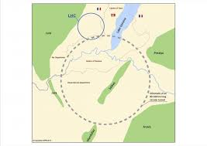
Future
General trends
Higher energies
Higher luminosity
Higher granularity in all detector sub-systems
More complicated events to process early in the triggers
More on-detector FPGAs – new FPGAs more radiation tolerant to hard but not soft
errors – develop correction strategies for soft errors
More high speed data transmission – 40 Gb/s or more
Early digitization – less analog, more digital
After 2037? ILC? CLIC? FCC?
BUT THIS IS FOR YOU!
Future Circular Collider
FCC
50+50TeV p – p
100 km circumference
Assumes new magnet technologies
(20 TeV magnets)

Slide 53
TileCal hadron calorimeter
The End
Thanks for your attention

