Slide 1
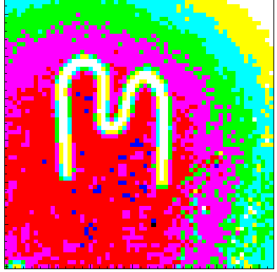

Application of semiconductor pixel detectors for high resolution X-ray and neutron imaging, particle tracking and in space
Stanislav Pospíšil
on behalf of former and present Medipix/Timepix team
of the Institute of Experimental and Applied Physics
Czech Technical University in Prague

Slide 2
Main goals of the lecture
● To describe shortly family of Medipix2, Timepix and Timepix3 semiconductor pixel detectors including corresponding R/O electronics.
● To document ability of Timepix pixel detector to visualize individual particle tracks in solid state similarly to nuclear emulsions, cloud chambers, bubble chamber, Micro-Pattern Gaseous Detectors etc.
● To demonstrate capability of the devices for high resolution (micrometric and nearly nanometric) radiography, nondestructive testing and 3D imaging by means of X-rays and neutrons.
● To present results of investigation of neutron interactions in silicon sensors in a broad energy range (500 keV up to GeV region) by means of Time-of-Flight (ToF) technique.
● To show examples of broad applications of the Timepix detectors for measurements of composition and spectral characteristics of mixed radiation fields around physics experiments, in medicine and in space research.

Slide 3
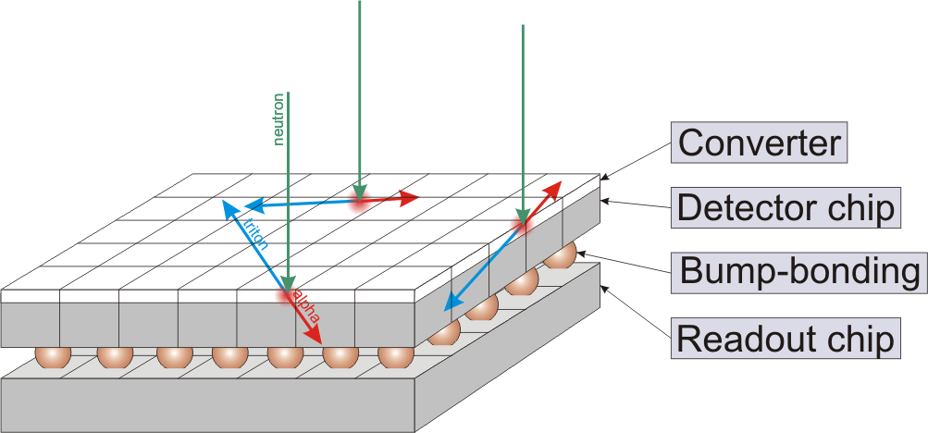
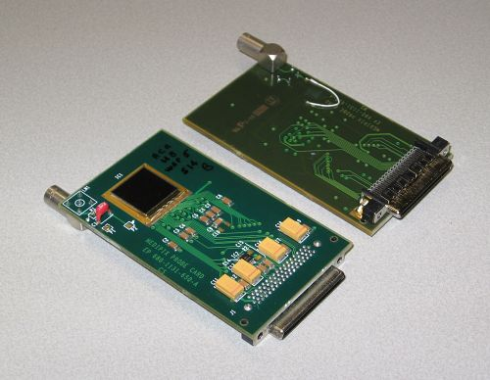
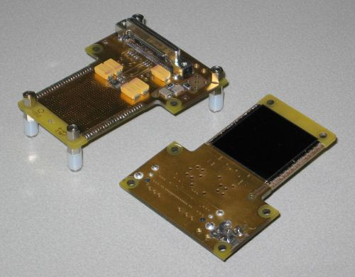
Medipix/Timepix hybrid pixel detector device
www.cern.ch/medipix
Planar pixellated detector (Si, GaAs, CdTe, thickness: 300/700/1000μm)
Bump-bonded to Medipix readout chip containing in each pixel cell:
- amplifier,
- double discriminator
- and counter
● Converter materials to detect
- thermal neutrons: 6Li(n,α)T, Q=4.78MeV
10B(n,α)7Li, Q=2.78MeV
- fast neutrons: recoiled protons from PE-foil
α, β, γ, ...
Detector chip
Medipix chip
Bump-bonding
Medipix2/Timepix
Pixels: 256 x 256
Pixel size: 55 x 55 μm²
Area: 1.5 x 1.5 cm²
Medipix2/Timepix
Quad
Pixels: 512 x 512
Pixel size: 55 x 55 μm²
Area: 3 x 3 cm²
Notes:
3

Slide 4
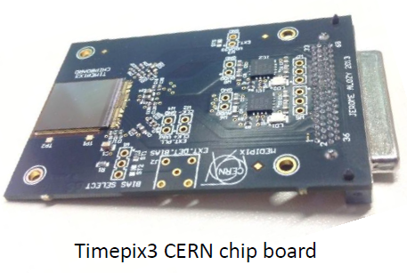
TIMEPIX3
The pixel device permitting simultaneous measurement of Time over Threshold (ToT - collected charge) and Time of Arrival
(ToA) of the signal in every pixel with resolution 1.6 ns.
It can be effectively used for simultaneous measurement
of Time-of-Flight of detected particle,
Energy of this particle deposited in the sensor and
a drift time of charge in the sensor
Thickness: 300µm
Bias: 90 V
Triggered
Data driven mode
T0 synch when trigger signal was received

Slide 5
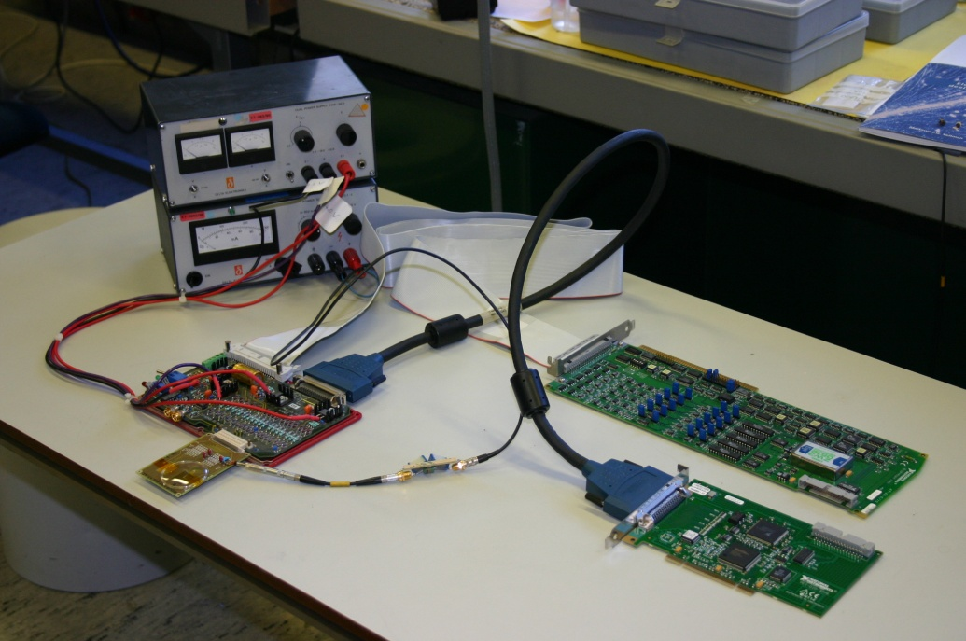
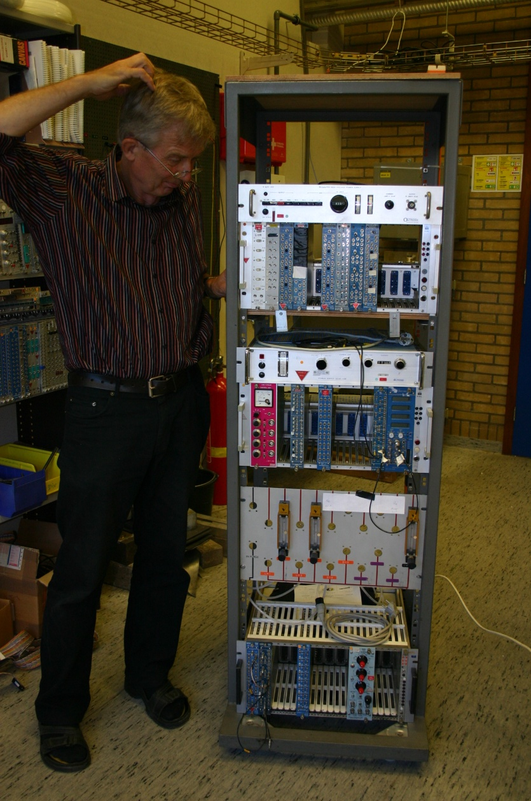
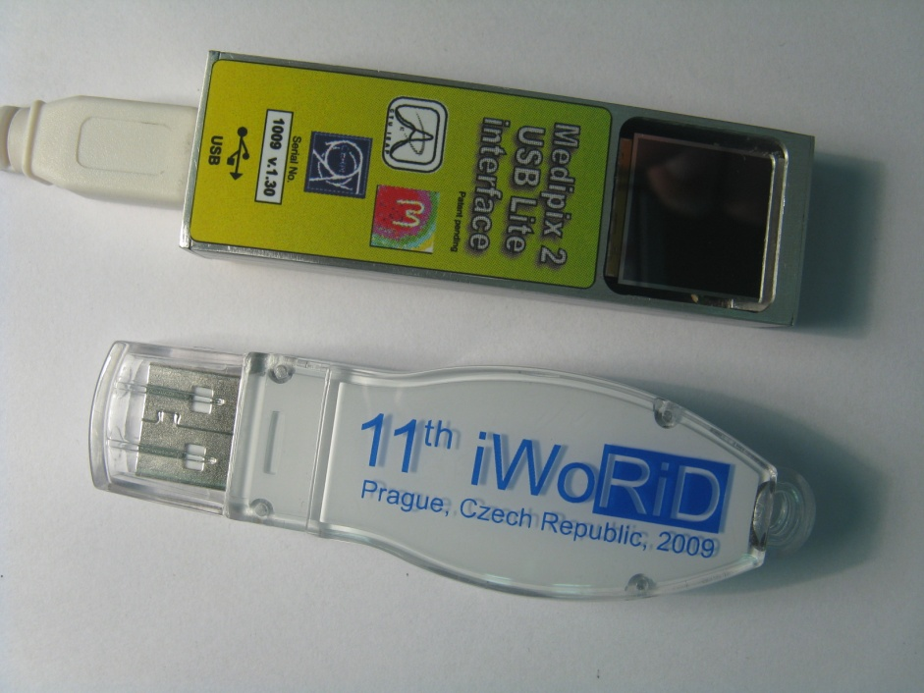
About development of R/O interfaces for
Medipix/Timepix devices
MUROS 1
HISTORY
1995-2011:
MAMOGRAPHY
- CAMAC/VME
- MUROS (NIKHEF)
- USB1 (IEAP)
- USB Lite (IEAP)
- RUIN (IEAP)
- MARS (NZ)
- USB2 (IEAP)
- TPX Lite (IEAP)
USB Lite
CAMAC
Notes:
5

Slide 6
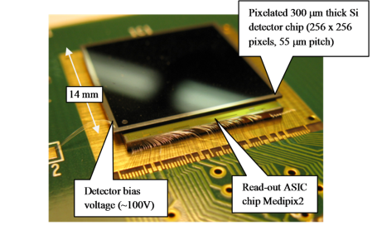
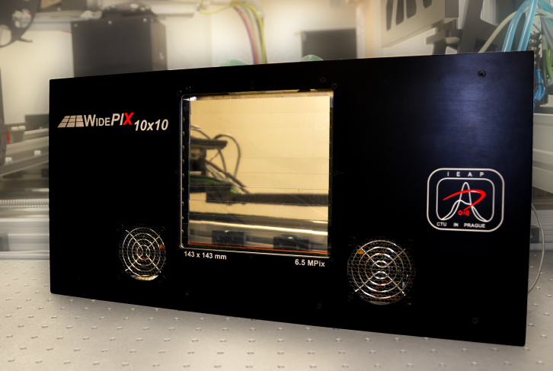
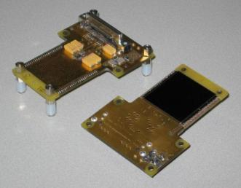
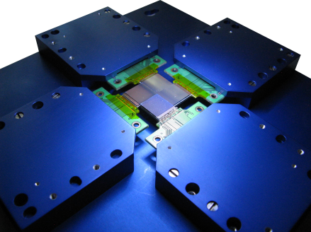
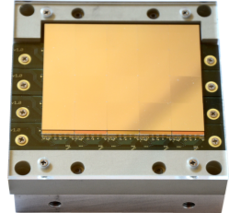
Timepix pixel device operating as single particle counting pixel detector
www.cern.ch/medipix
Planar pixelated detector (Si, GaAs, CdTe, thickness: 150/300/700/1000mm ...)
Bump-bonded to readout chip containing in each pixel cell: amplifier, discriminator, Counter or ADC or Timer
Multichip assemblies with common sensor: Quad (30 x 30 mm), Hexa (45 x 30 mm)
Multichip detectors with edgeless sensors: WidePIX_{10x10} (143x143 mm)
α, β, γ
Detector chip
Medipix chip
Bump-bonding
Timepix Quad
Pixels: 512 x 512
Pixel size: 55 x 55 μm²
Area: 3 x 3 cm²
Notes:
6

Slide 7
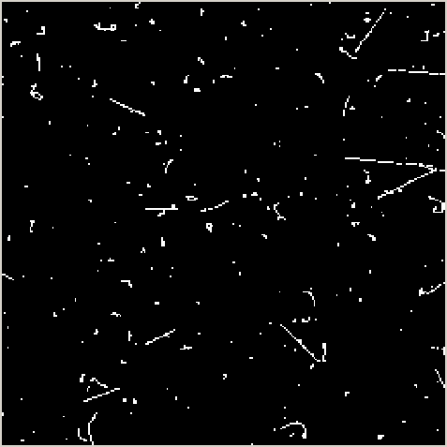
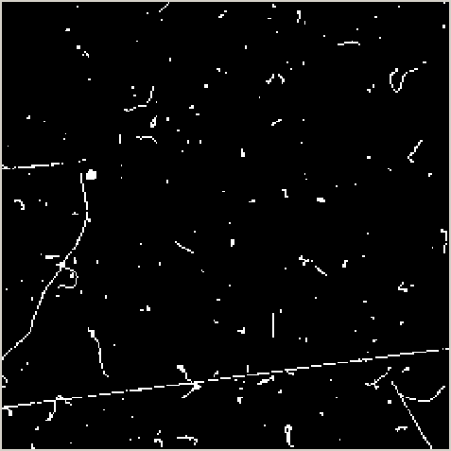
Response of Medipix2 device to natural background radiation
Clearly recognizable tracks and traces of X-rays, electrons generated mostly by gamma rays, alpha particles, muon, … . Muon tracks can be recognized by submicrometric precision.

Slide 8
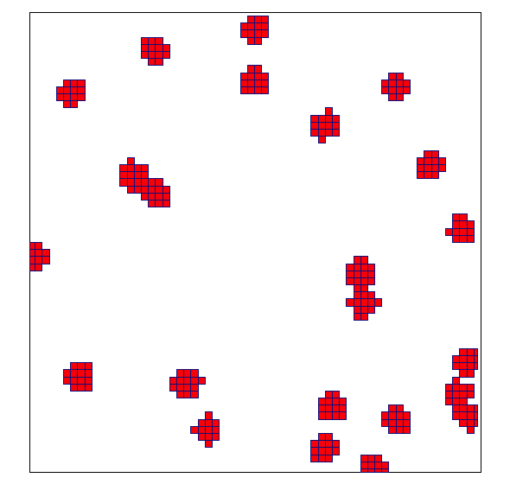



Noiseless particle detection
Tracking mode of pixel detector operation
(on-line imaging of tracks and traces of single radiation quanta)
²⁴¹Am alpha source gives clusters of ~5x5 pixels measured with the MEDIPIX-USB device and a 300 μm thick silicon sensor. The clusters are shown in detail in the inlet. The cluster sizes depend on particle energy and threshold setting.
Signature of X-rays from a ⁵⁵Fe X-ray source. Photons yield single pixel hits or hits on 2 adjacent pixels due to charge sharing.
A ⁹⁰Sr beta source produces curved tracks in the silicon detector.
A pixel counter is used just to say “YES” if individual quantum of radiation generates in the pixel a charge above the pre-selected treshold.

Slide 9
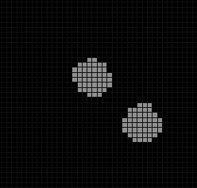
Charge sharing effect - clusters
Ionizing particle creates a charge in the sensor.
The charge is collected by external electric field => the process takes some time
Due to charge diffusion the charge cloud expands
The charge cloud can overlap several adjacent pixels => CLUSTER
Pixels in a cluster will detect the charge if it is higher than certain threshold
The Cluster size depends on:
Particle energy and range
Depth of interaction
Detector Bias Voltage
Local CCE (e.g. due to a material inhomogeneities and radiation damage)
Ionizing particle can creates huge charge signal in several adjacent pixels forming cluster.
Cluster volume depends on particle energy.
Ionizing particle
2 detected clusters
Pixel cells
Cluster size can be >100
TimePix can measure charge in each pixel
Energy threshold

Slide 10
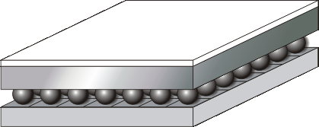
Dependence of cluster size on applied bias (on electric field in semiconductor)
Particle
BIAS
100 V –
-
-
-
-
-
7 V –
Cluster size

Slide 11
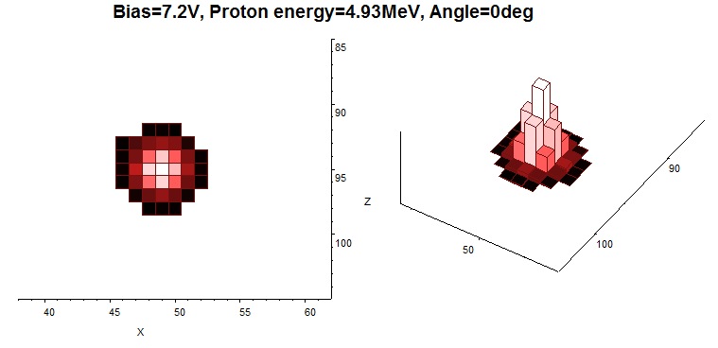
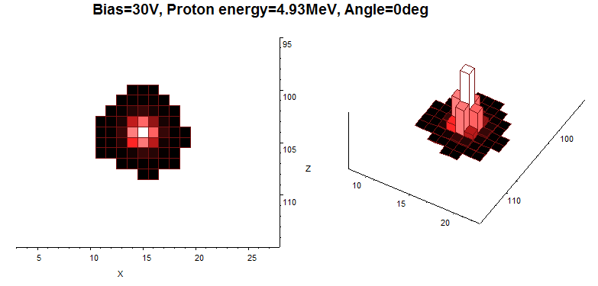
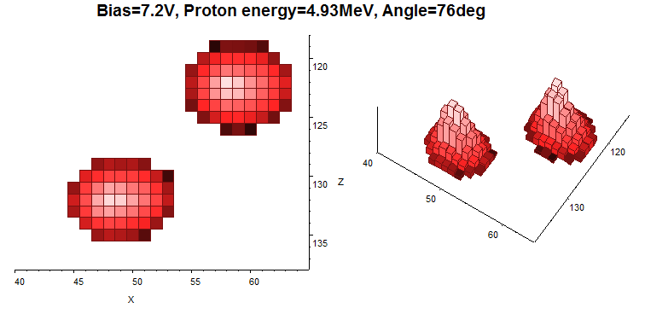
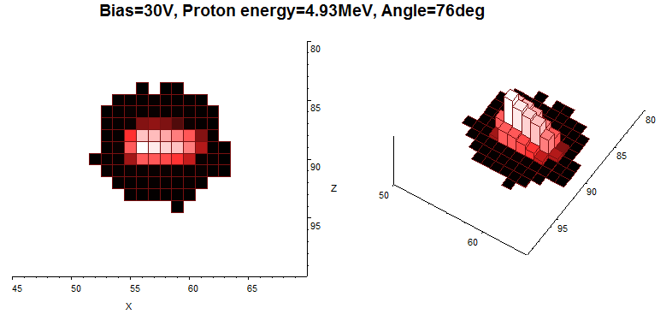
3D-visualization of proton tracks in Timepix silicon pixel detector. Illumination under different angles and different applied biases
What is the spatial resolution? X- and Y-coordinates are determined with a precision of about 500nm. Determination of angle is with a precision of about 1º. It needs additional experiments.

Slide 12
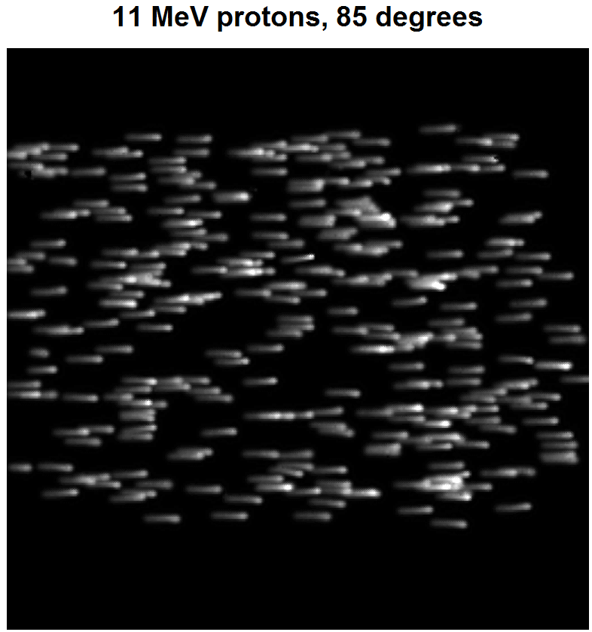
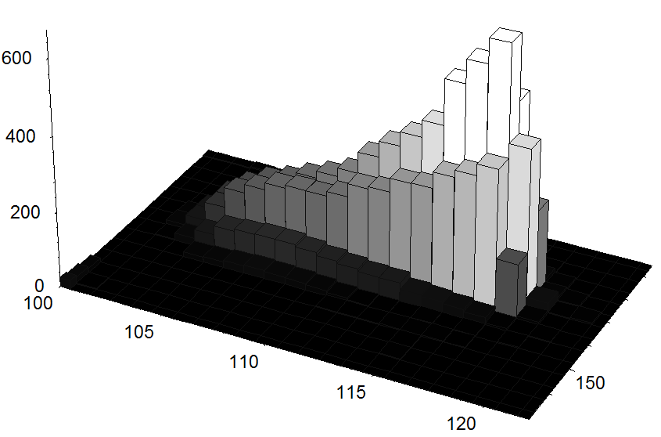
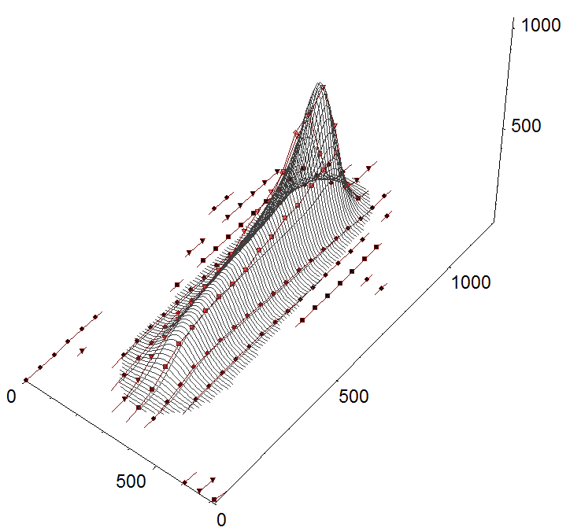
Flock of 11 MeV protons entering the silicon sensor under 85º
ΔE/Δx Bragg profile nicely pronounced, proton range about 960 μm
Fit by model

Slide 13
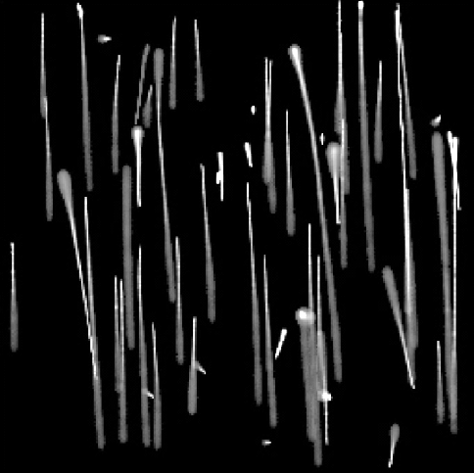
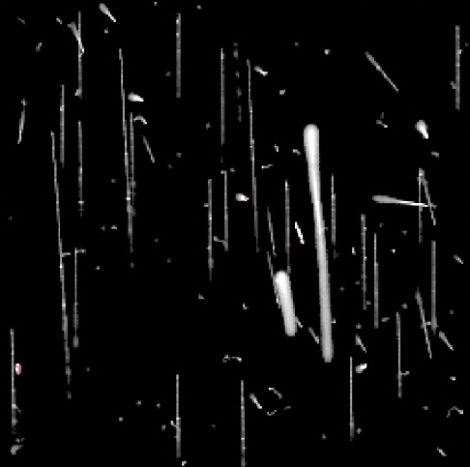
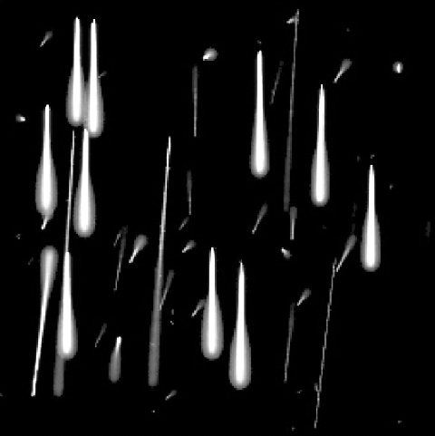
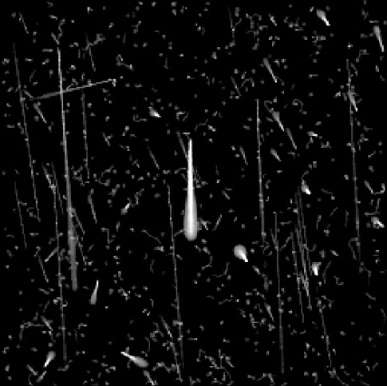
Typical observed tracks of particles used for hadron therapy beam
Protons 48 MeV
Protons 221 MeV
Carbons 89 MeV/u
Carbons 430 MeV/u
Only protons and their scattering, no secondaries.
Many secondaries, (delta electrons fragments).
Carbons and protons and their scattering, no secondaries.
Carbons and many secondaries.

Slide 14
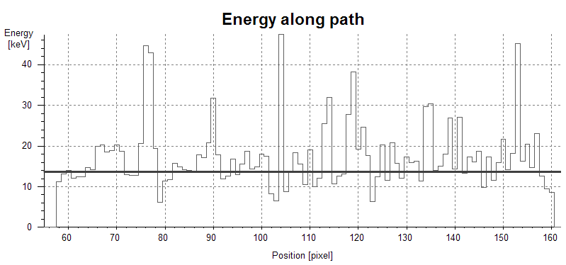
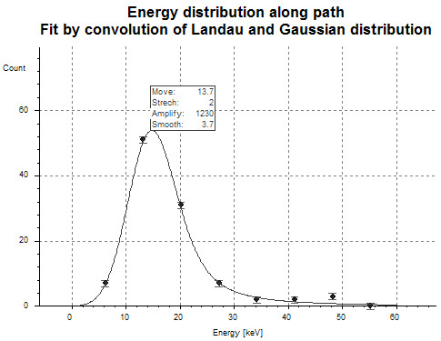
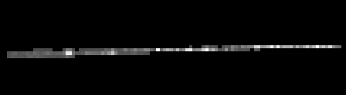
Track of MIP particle – cosmic muon
Charge sharing effect helps to determine all three track coordinates with quite high resolution (deeply submicrometric in case of x and y)
Energy distribution fit by convolution of Landau and Gauss distribution
Track recorded by TimePix device

Slide 15





Review of the characteristic patterns
Event by event processing
1) Dot
2) Small blob
3) Curly track
4) Heavy blob
5) Heavy track
6) Straight track
Photons and electrons (10keV)
Photons and electrons
Electrons (MeV range)
Heavy ionizing particles with low range (alpha particles,…)
Heavy ionizing particles (protons,…)
Energetic light charged particles (MIP, Muons,…)

Slide 16
X-ray imaging

Slide 17
High resolution X-ray radiography Experimental setup
Requirements:
Microfocus X-ray source to enable geometrical magnification
Adjustable object holder (three translations + rotation)
Sample stabilization (temperature, humidity)
Equipment for automatic calibration of pixel responses
Detector holder and detector stabilization (temperature, condensing point)
Geometric magnification
Enlarged projection
X-ray tube
Object
Notes:
In this picture there is shown our Experimental setup. On the left side we can see the Hamammatsu x ray tube and the translation stages with a sample. On the opposite side there are the detector Medipix and carroousel.

Slide 18
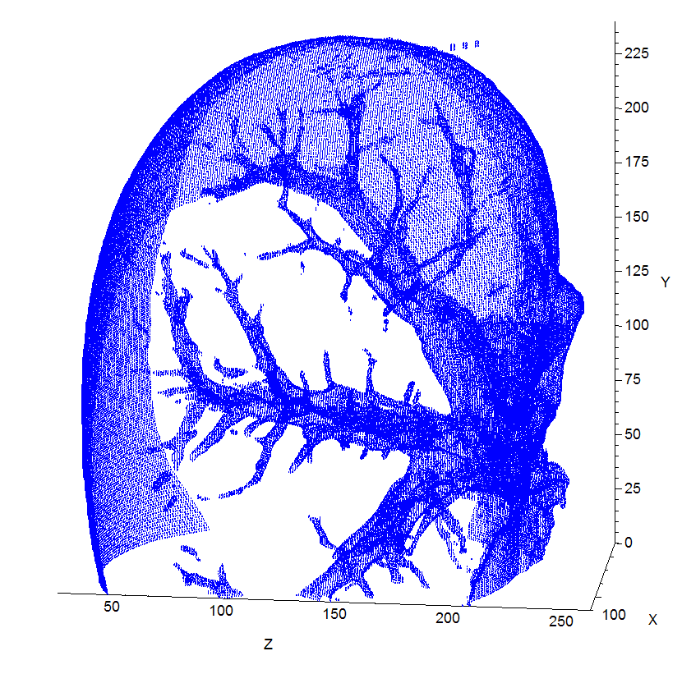
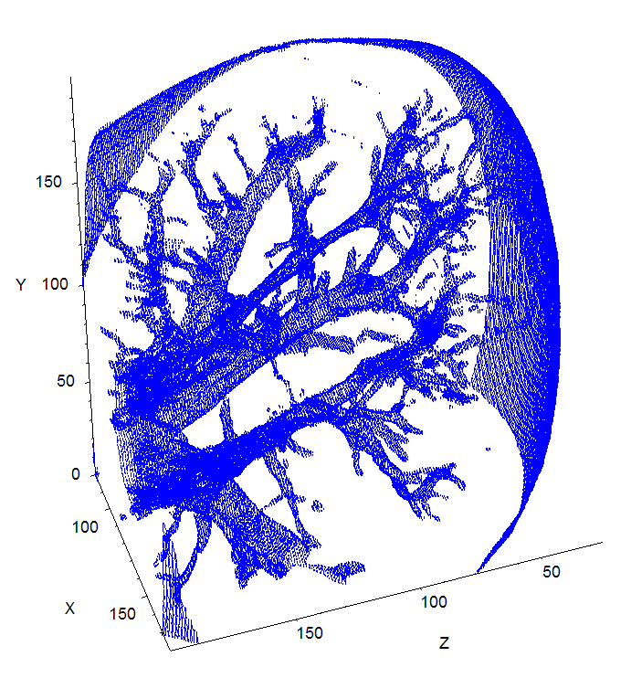
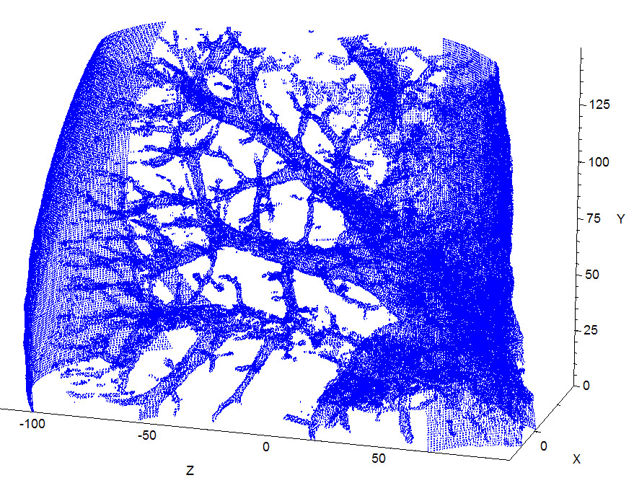
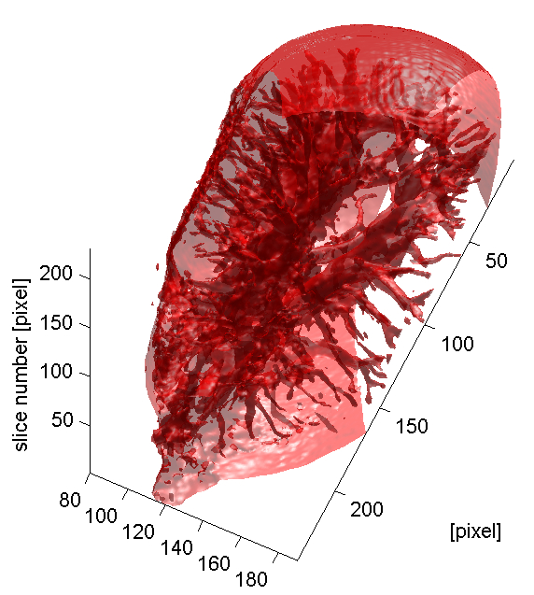
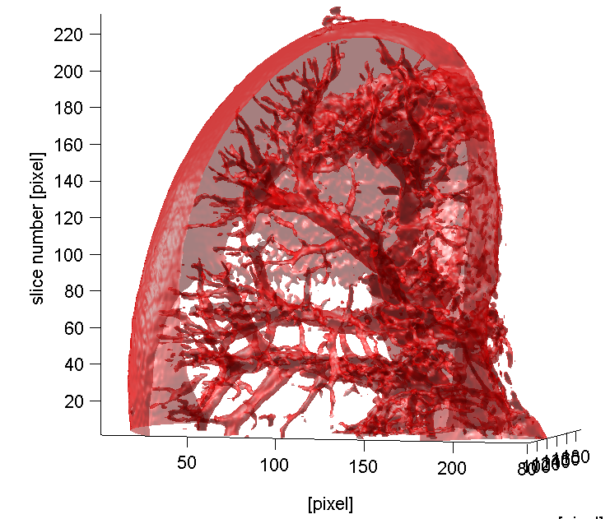
Mouse Kidney Tomography
Soft tissue X-ray imaging
Missing angles => Iterative algorithm instead of Filtered back projection (3 iterations in OSEM 5)
Notes:
Next, tomography was followed by reconstruction of every slice. For calculation of missing angles we use interactive algorithm instead (insted) of filtered back projection.
OSEM = Oredered Subset Expectancy Maximization (size of subset = 5)

Slide 19
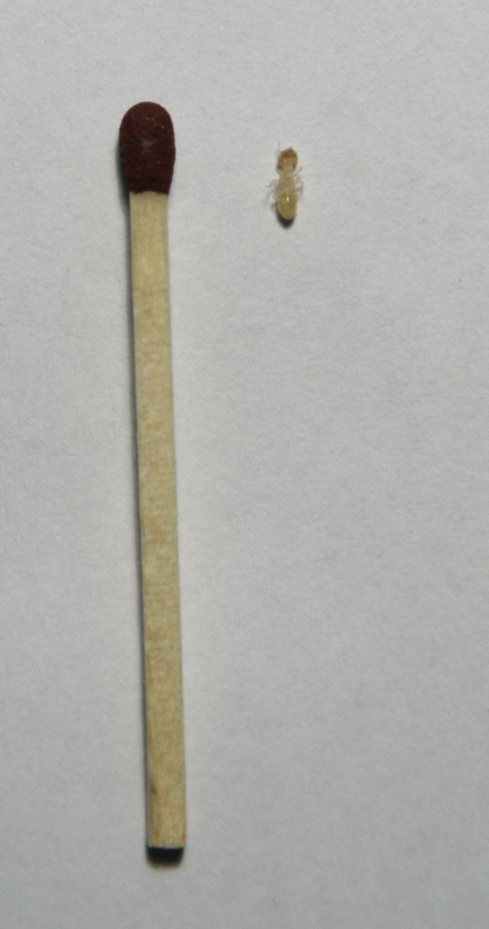
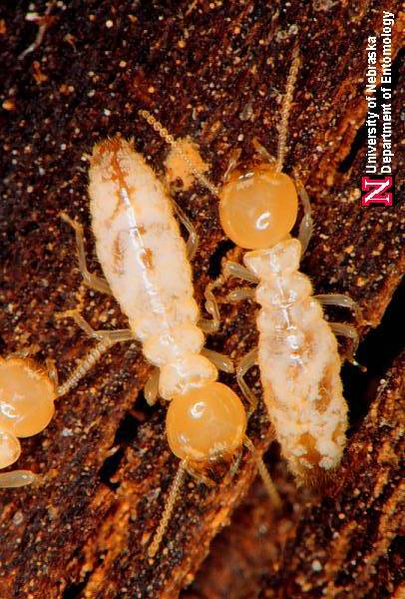
High resolution X-ray radiography:
Imaging of Termites
The imaging of termites as a model soft tissue organism is particularly difficult due to their poorly sclerotized cuticle making difficult to observe the anatomic structures with an optimal contrast.
Moreover, they are vulnerable to damage when they are manipulated or treated during sample preparation.
Thus, the termites represent an ideal model to optimize the accuracy and sensitivity of the developed method.

Slide 20
High resolution X-ray radiography:
Imaging of Termites
X-ray transmission image of termite worker body (left) and detail of its head (bottom). Even fine internal structure of the antennae is recognized.
(Magnified 15x, time=30s, tube at 40kV and 70μA)

Slide 21
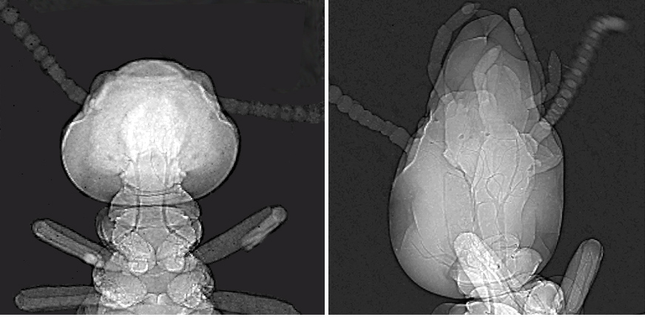
High resolution X-ray radiography:
Imaging of Living Termites
Images of a termite worker before (left) and after (right) its metamorphosis toward the soldier caste (5s exposure ~ 0.7mGy dose)

Slide 22
About neutrons

Slide 23
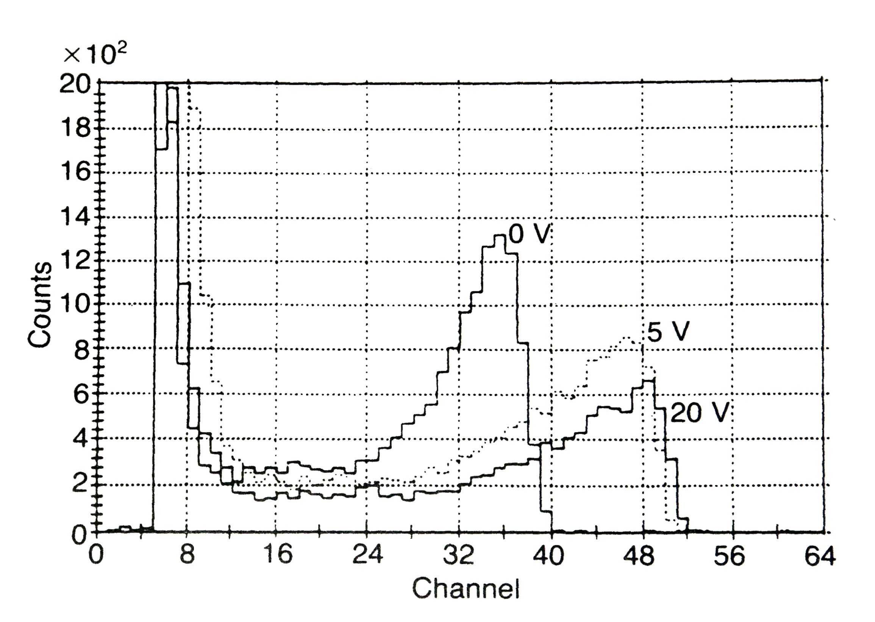
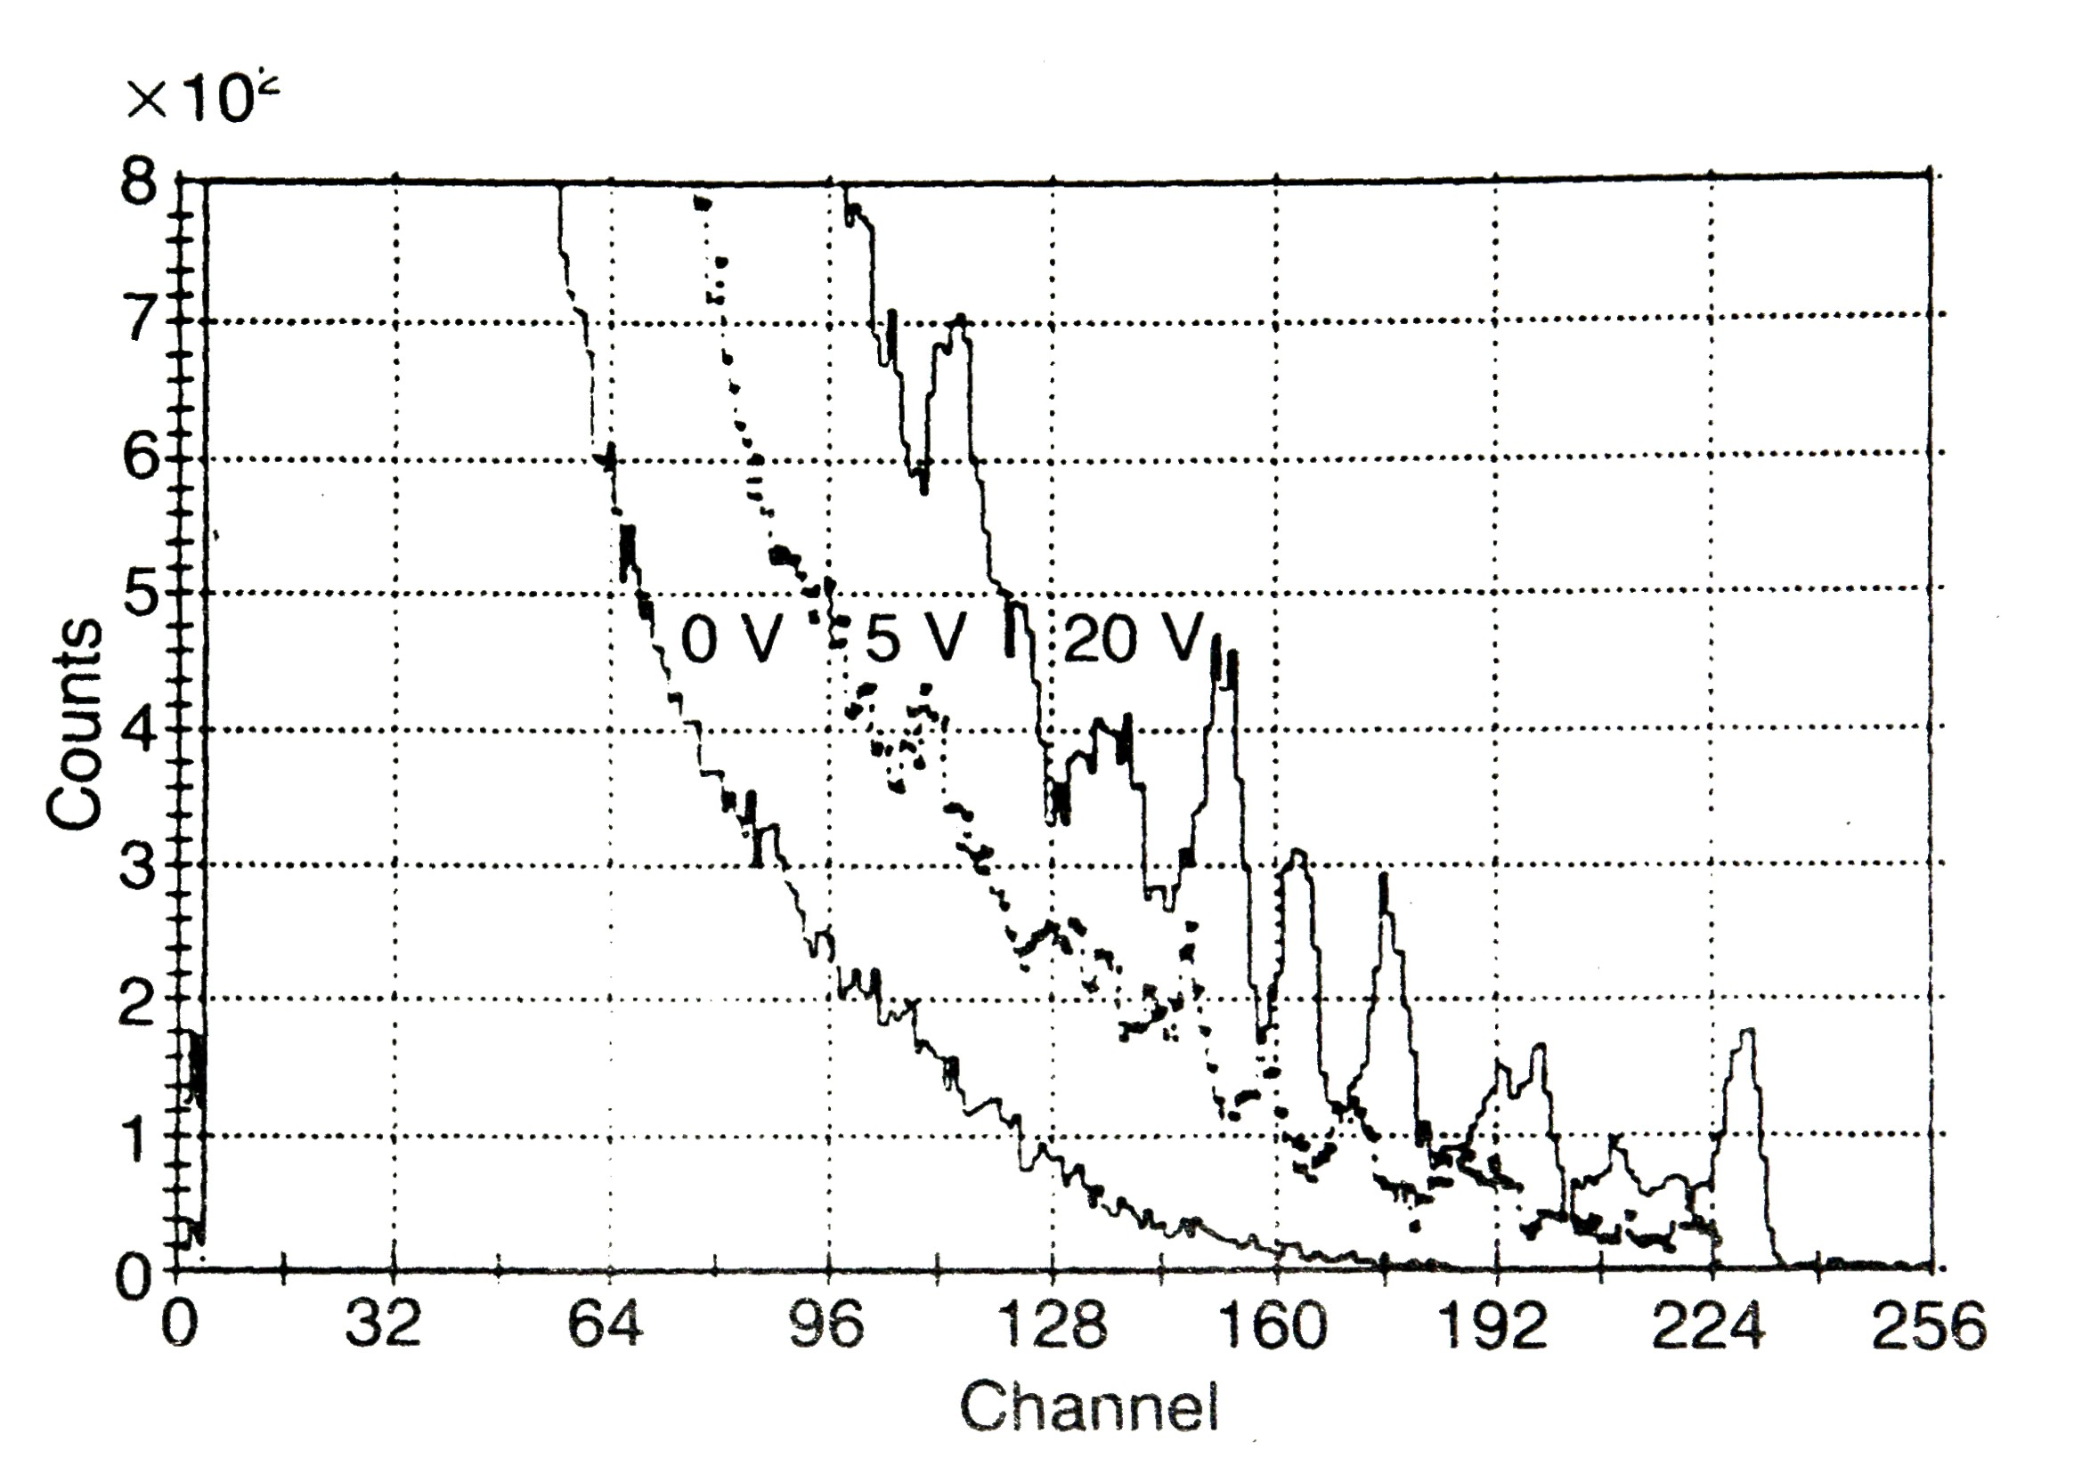
Responses of silicon detetcors to neutrons
Silicon diode + ⁶LiF converter
Illuminated by thermal neutrons
Silicon diode illuminated
by fast neutrons
Pulse height distributions of neutron detector on thermal neutrons at different bias (0, 5, 20 V). Detector operates well in the self-biased regime.
Pulse height distributions of neutron detector when illuminated by fast neutrons (14.8 MeV) at different bias (0, 5, 20 V). Peaks from interaction of fast neutrons with ²⁸Si are clearly seen

Slide 24
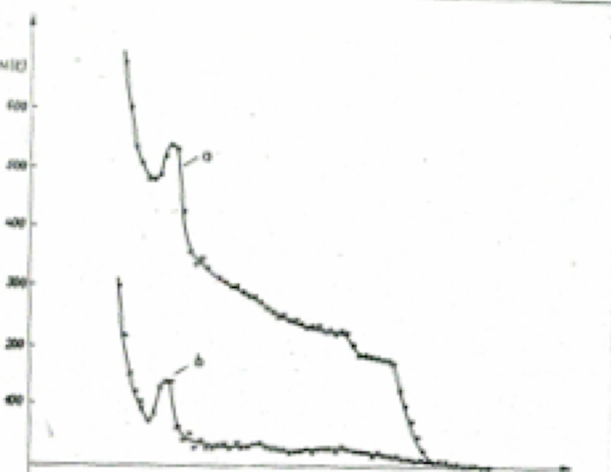
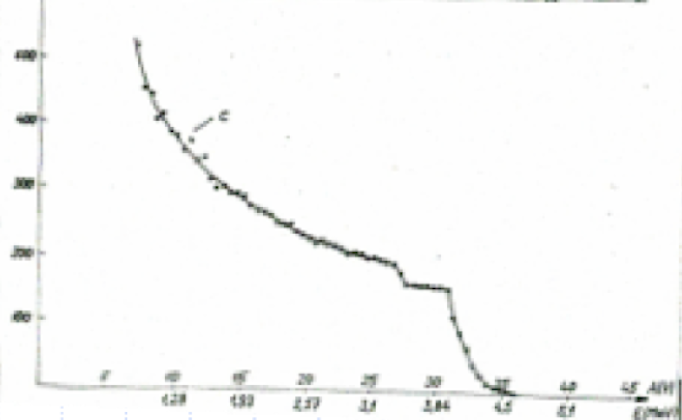
Response of silicon diode with CH2 converter
to protons recoiled
by 3.8 and 4.2 MeV neutrons
a) PH spectrum measured by the diode with CH2 converter (up)
b) PH spectrum measured by the diode without CH2 representing background caused by ²⁸Si(n,α)²⁵Mg (down)
c) Pure spectrum of recoiled protons
(background subtracted

Slide 25
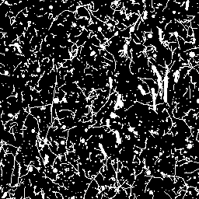
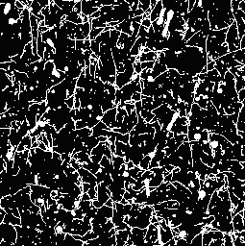
Response of MEDIPIX-USB device with polyethylene converter (on the right hand side ) to fast monochromatic neutrons (17MeV)
The direction of the neutrons with respect to the image was upstream (from bottom to top). The huge background is due to gamma rays which accompany neutrons. Half of the sensor (the right-hand side) was covered with a CH2 foil about 1.3 mm thickness.
One can clearly recognize long and rather thick tracks of recoiled protons (up to 2 mm, vertically oriented) and big tracks and clusters generated via 28Si(n,α)25Mg, 28Si(n,p)28Al nuclear reactions in the body of the silicon detector. These events are displayed on the dense background caused by tracks and traces of electrons from interactions of gamma rays. One can even recognize that proton tracks shapes follows a Bragg law.

Slide 26
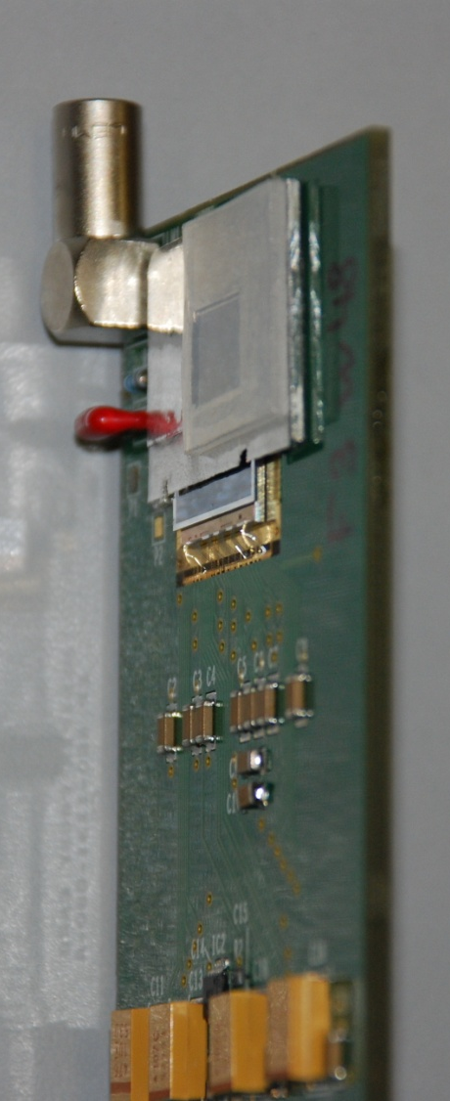
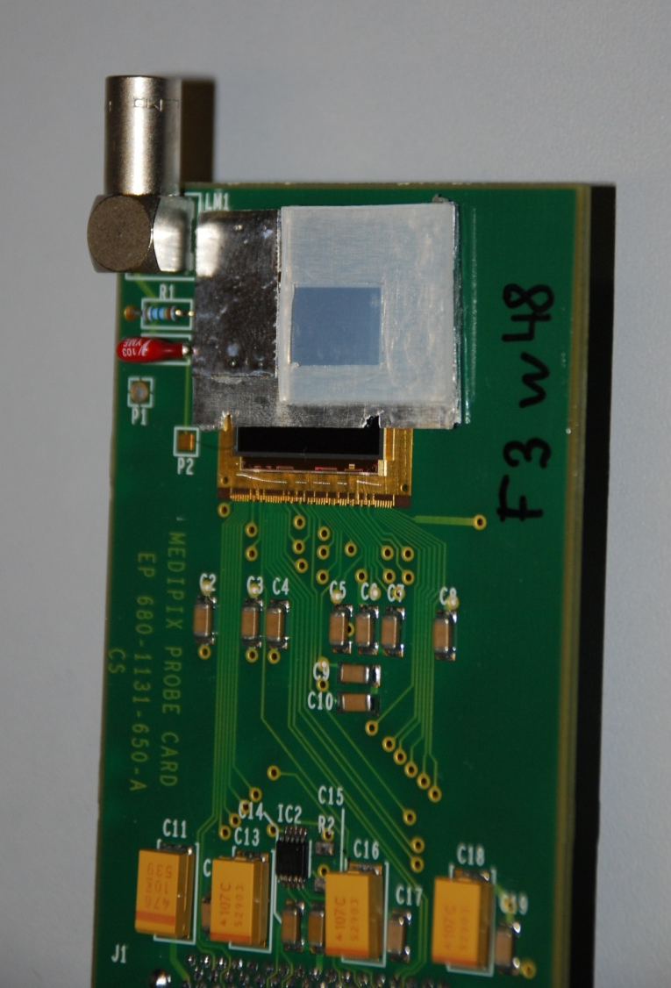
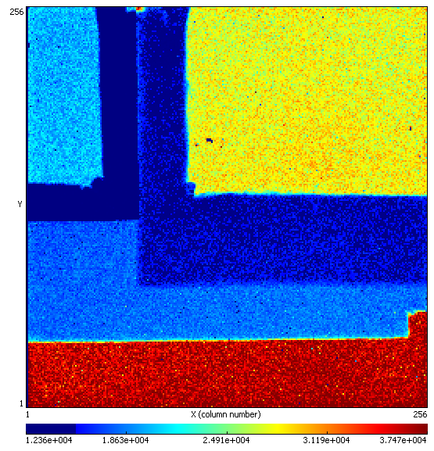
Detail view on conversion layers added for a neutron detection in mixed radiation fields
Several different regions:
LiF+50µm Al foil area
100µm Al foil area
PE area
PE+50µm Al foil area
50µm Al foil area
Uncovered area
PE
LiF
PE + Al
Al
Uncovered
Notes:
26
26

Slide 27
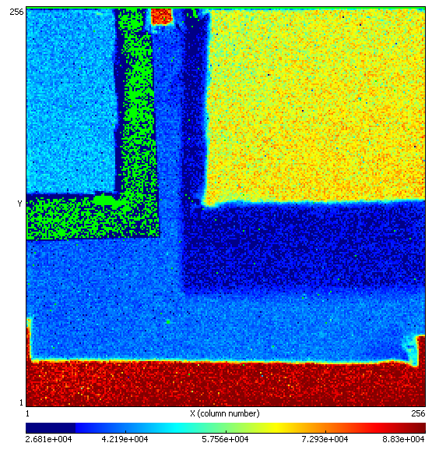


²⁵²Cf neutrons measured in counting mode of operation at different thresholds
⁶LiF
PE
PE+Al
Al
PE
PE + Al
252Cf, high threshold (300 keV)
252Cf, low threshold (8 keV)
Al

Slide 28



Responses to neutrons of different energies measured at high threshold in counting mode
Thermal neutrons – 500s
Identification of spectral composition of incoming neutron radiation can be done by comparing responses of different sensitive regions.
LiF
PE
PE + Al
Al
Uncovered
252Cf – 2000s
AmBe – 2000s
17 MeV neutrons at 0º

Slide 29
Neutron imaging

Slide 30


Motivation – neutron radiography
While X-rays are attenuated more effectively by heavier materials like metals, neutrons allow to image some light materials such as hydrogenous substances with high contrast.
Neutron radiography can serve as complementary technique to X-ray radiography
X-rays
Neutrons
In the X-ray image, the metal parts of the photo camera are seen clearly, while the neutron radiogram shows details of the plastic parts (Courtesy of E. Lehmann, PSI)
3.7.2014

Slide 31



The Neutronography based on
⁶Li(n,α)T, Q=4.78MeV and¹⁰B(n,α)⁷Li, Q=2.78MeV
(energetic charged products define interaction with deeply subpixel resolution)
Parallel beam of thermal neutrons
Specimen attenuating the beam
Shadow on detector
plane
Neutronogram

Slide 32


Flower behind Al plate
Look through metal with thermal neutron beam at NPI Rez
Seeds

Slide 33


Glued Al pieces
(measured at NPI Rez)
Glue raised through capillary attraction
Notes:
33

Slide 34



Neutron radiography with Medipix coated by ⁶LiF: Blank cartridge. Look through metals!
Photography
Roentgenogram
Neutronogram
Blank shell
(cartridge)
Explosive filling

Slide 35

3D neutron tomography

Slide 36



Neutron transmission radiography (counting mode)
Test of Spatial Resolution
(Medipix2 Quad system and cold neutrons)
50μm
100μm
=>Resolution about 65μm!
Prague 12th July 2007
Prague 12th July 2007
37

Slide 37




Cold neutron radiography performed at PSI
Wrist watch
38
Notes:
37

Slide 38

Bellflower
39

Slide 39
About detection efficiency and position resolution
Monte-Carlo simulations and experiments
Simulations performed using MCNP, SRIM and Matlab
Aim: To estimate detection efficiency and spatial resolution
⁶LiF
Silicon
Expected UCNs velocity: 500 cm/s. For such neutrons the cross section of ⁶Li increases to 0.34 Mbarn. The cross section of ¹⁰B reaches 1.67 Mbarn.
50% of such UCNs are fully absorbed in ⁶LiF layer of 85 ug/cm² (~ 320 nm thickness). For ¹⁰B it is layer of 7 ug/cm² (~ 30 nm thickness).
Used ⁶LiF density of 2.65 g/cm³ and ¹⁰B density of 2.35 g/cm³.
FWHM
Bragg
curve
³Η⁻
UCN
PSF
α
Insensitive Si layer
Range of α
Range of ³H⁻
Absorption
Geometry used in simulations
40

Slide 40
Detail view on individual clusters resulting from (n,α) reaction in ¹⁰B converter
(tracking mode applicable for neutron imaging)
Pixel detector response to every charged article (alpha and 7Li) in a form of 3D-cluster with a shape corresponding to convolution of Gaussian and individual pixel responses
Corresponding amplitude spectrum measured by integration of cluster volumes. ¹⁰B converter thickness 1.8 ug/cm² (~ 36 nm)
41

Slide 41

Alpha clusters centroiding only, resolution ~ 3 um

Slide 42
Alpha radiography

Slide 43
Application:
Radiography with highly ionizing particles
Sample
Monoenergetic beam of heavy charged particles
Energy sensitive imaging detector
Intensity
Energy
Heavy charged particles (protons, deuterons, tritons, alphas, ions) can be used (impossible with photons, difficult with electrons due to huge change of direction).
Instead of transmitted beam intensity the energy losses of individual particles are measured.
Just single particle is needed to measure material “density”.
With common sources of heavy charged particles (isotopes, ion beams) it is feasible to inspect just small (thin) objects (thin layer, foils, cellular structures)
Precision of thickness measurement can be in nanometer scale.
Notes:
43

Slide 44


Radiography with heavy charged particles with Medipix2
By cluster analysis it can be determined:
Centroid to increase spatial resolution (subpixel resolution)
Size as a measure of particle energy
Wing of fly
(less than 20 particles per pixel)
Photo
Intensity
Energy

Slide 45

Single ⁸He ion decay sequence recorded by Timepix operating in ToA mode
β⁻
β ⁻
⁸Be
⁸He
⁸Li
α+α
⁸He ion hits the Timepix sensor where undergoes
β-decay
Subsequent decays of the daughter nuclei by emission of one beta and two alpha particles follows
Time = 0
+ 119 ms
+ 840 ms
Notes:
45

Slide 46
About use of Timepix pixel detectors
for measurement
of composition and spectral characteristics
of complex radiation fields
Calibration of detector responses to all
available particles is required!

Slide 47







Protons with different energies: 90 degree
48 MeV/u
75 MeV/u
100 MeV/u
Notes:
Straggling of protons = scattering!

Slide 48




Carbon ions with different energies: 90 degrees
89 MeV/u
200 MeV/u
300 MeV/u
430 MeV/u
Halo of pixel with low energy deposition around track - less pronounced for higher energies.
Number of delta rays increases with increasing energy.
Notes:
Halo ASIC effect? Houston group?

Slide 49






Oxygen ions with different energies: 90 degrees
104 MeV/u
250 MeV/u
430 MeV/u

Slide 50





Alphas with different energies: 90 degrees
80 MeV/u
50 MeV/u
115 MeV/u
221 MeV/u
185 MeV/u

Slide 51


Tracks of Pb ions as measured on SPS beam at CERN
(rear-side glancing angular incidence about 4.1 degree)
scale 100
scale 3000
Imaged with low threshold on the left and with high threshold on the right

Slide 52




Online miniaturized
Timepix Quantum Dosimeter
Single particle visualization & tracking
Cluster analysis algorithm is successfully working in ATLAS-MPX network
Frame containing 400 MeV 56Fe, 85º, measured at HIMAC, Japan
Daniel Turecek, 6th July 2011
13th IWORID Zürich IEAP, CTU n Prague

Slide 53


Fast neutron ToF measurement with TIMEPIX
LANSCE neutron sources and nuclear science flight paths
(combined ToA and ToT modes)
The layout of the LANSCE neutron sources and Nuclear Science flight paths
Time structure of the proton beam for typical Target-4 operation

Slide 54



Fluences below different conversion layers
In the lower energy region responses below LiF, PE, PE+Al seem to be a good indicator for neutron energies
- Threshold for PE+Al at ~ 3.4 MeV
- Enhanced signal below LiF up to 4 MeV
- Recoiled protons visible above 1.2 MeV
1.2 MeV
3.4 MeV
5 MeV

Slide 55


Response of Timepix:
Energy region 0.4 – 1.2 MeV
Mainly dots, curly tracks are found in this energy region
Heavy blobs below LiF indicate presence of slow/thermal neutrons
Also PE region shows slightly enhanced count rate
All types of clusters in this energy region integral picture (1000 events were considered)
Heavy tracks and heavy blobs in this energy region (139 events were found)

Slide 56


Response of Timepix:
Energy region 1.2 – 3.4 MeV
Heavy blobs below LiF indicate presence of slow/thermal neutrons
Clear signal of High Energy Transfer Particles (HETP) below PE
uncovered area shows also a few events
All types of clusters in this energy region integral picture (1000 events were considered)
Heavy tracks and heavy blobs in this energy region (full statistics - 10259 events were found)

Slide 57


Response of Timepix:
Energy region 3.4 – 5.0 MeV
Clear signal of HETP below PE
Also in PE+Al region HETP are becoming visible
All types of clusters in this energy region integral picture (1000 events were considered)
Heavy tracks and heavy blobs in this energy region (full statistics – 13406 events were found)

Slide 58


Response of Timepix:
Energy region 100 – 300 MeV
HETP nearly equally distributed below all regions
HETP Cluster shapes
  Are getting bigger and more and more asymmetric
  Round clusters with outgoing tracks are seen
All types of clusters in this energy region integral picture (1000 events were considered)
Heavy tracks and heavy blobs in this energy region (full statistics - 64755 events were found)

Slide 59


Examples of heavy ionizing events induced by neutrons of different energies selected according their cluster sizes
Different colors and black numbers assigned to individual clusters indicate the energy of incoming neutrons as measured by means of the TOF technique

Slide 60


Cluster shapes
Timepix detector responses as a function of neutron kinetic energy
The ToF technique*⁾ was used to assign the detector responses to the corresponding neutron energies (track by track).
Heavy events due to nuclear interactions appear
Peaks of resonance neutron elastic scattering
Gammas from the 1st excited level of silicon (1.78 MeV)
*) see: B Bergmann et al 2014 JINST 9 C05048
Notes:
For me: Check, if there is a correlation between the appearance of curly tracks and the inelastic scattering to the first excited level of silicon – Ethreshold = 1.85 MeV –compton electrons!!!
+ compare measured peaks with the cross section for it
Number of different cluster types as a function of kinetic neutron energy!

Slide 61


Medical application:
Hadron therapy - Experimental setup
Beam exit window
80 µm thick PA foil
Water tank
Timepix stack
Visualization of secondary particles produced by the beam

Slide 62

Particle beam vizualization in air and in the phantom
Reconstructed image (all coincident events)
Water tank
Shielded by tank
Tank
impact
Foil
Exit Window
Beam
Interactions in air

Slide 63





The TPX devices in the MoEDAL network
5 Timepix detectors of different thicknesses (300 µm and 1000 µm, 1 of them equipped with neutron converters) placed in chipboards with radiation tolerant electronics installed in the MoEDAL at LHC
60 mm
95 mm
30 mm
Timepix devices in the MoEDAL experiment

Slide 64


Selected tracks observed with MOEDAL TPX03
12/09/2015
High Energy Transfer Events
(Min Clstr Height: 300 keV)
Long Tracks
(Min Clstr Height: 300 keV)

Slide 65


Selected tracks observed with MOEDAL TPX04
12/09/2015
High Energy Transfer Events
(Min Clstr Height: 300 keV)
Long Tracks
(Min Clstr Height: 300 keV)

Slide 66



Timepix3 in ATLAS synchronized with LHC clock
Detail view on bunch-bunch collisions recorded by TPX3

Slide 67



Clusters corresponding to particles generated in the LHC bunch-bunch collisions and recorded according their ToF
Peak area
Background area

Slide 68






3D-visualisation of particle tracks in CZT detector measured at SPS
(z-coordinate determined from the drift time of charge carriers)
Muon
Pion + delta electron
Fragmentation
Electron
Heavy track
Pion + delta electron

Slide 69
Space applications

Slide 70

Timepix detector in the highly miniaturized LITE architecture (a) customized for the ISS (b) as deployed with an on-board laptop via USB port (c) in a NASA Module at the ISS (d). Work done in cooperation with NASA and the University of Houston.

Slide 71

The IEAP CTU Timepix based device used by NASA astronauts on ISS (courtesy of L.Pinsky, UoH)

Slide 72







Dosimetry in space on ISS
- Timepix for the first time in the space on the altitude ~400km
- 5 detectors deployed on ISS fromOctober 2012

Slide 73




Dosimetry in space:
SATRAM – ESA Proba-V satellite
Characterization of mixed radiation field on low orbit of PROBA-V satellite
Altitude ~ 800 km
Timepix for the first time outside in the space
Launched in May 2013

Slide 74


ESA Vega-2 rocket
SATRAM payload (arrow) onboard ESA Proba-V satellite.
ESA Vega-2 launcher rocket upper stage

Slide 75


Slide 76




Timepix/ESA Proba-V:
LEO space radiation @ 820 km
Energetic heavy charged particles (ions)

Slide 77

Timepix/ESA Proba-V:
LEO space radiation @ 820 km
HETPs: Highly energetic heavy charged particles (ions) → HZE’s

Slide 78

Timepix/ESA Proba-V:
LEO space radiation @ 820 km
HETPs: Highly energetic heavy charged particles (ions) → HZE’s

Slide 79

Timepix/ESA Proba-V:
LEO space radiation @ 820 km
LETPs: Energetic light charged particles (I) + nuclear interactions

Slide 80

Measured radiation map by Satram device in orbit around the Earth at an altitude of 820 km from the earth's surface obtained within 36 days from January 1, 2014 to February 7, 2014 logarithmic scale in μG/hr.

Slide 81



RISESAT
(Rapid International Experimental Satellite)
Timepix particle µ-tracker particle telescope – launched on Feb 2019
Particle micro-tracker of a stack of Timepix detector chipboards with common motherboard and single integrated R/O interface (left). Illustration of particle telescope on two pixelated sensors determining the direction of partcle flight (middle) providing spatial visualization of particle trajectories (right).
Timepix µ-tracker for the RISESAT satellite consisting of two separate devices with synchronized operation. Spacewire interface (a), payload engineering model (b) and its position in the 50 Kg micro-satellite (c).

Slide 82



Timepix3 for coincidence gamma ray spectroscopy PET – with TPX3 CdTe detectors
D. Tureček et.al.: NIMA 895 (2018) 84-89

Slide 83




Timepix3 for coincidence gamma ray spectroscopy
Compton camera with CdTe and Si detectors
D. Tureček et.al.: 2018 JINST 13 C11022

Slide 84
Acknowledgement
The presented results have been achieved within research activities cultivated at IEAP CTU in Prague. They result from extensive partnerships in frame of the Medipix2@3 collaboration with significant contributions of the following colleagues:
R. Ballabriga², B. Bergmann¹, P. Burian^{1,12}, I. Caicedo¹, M. Campbell², J. Dammer¹, C. DaVia⁸, J. Dudák¹, C. Froejdh⁹, E. Froejdh², V. Georgiev¹², C. Granja¹, E. Heijne^{1,2}, M. Holík^{1,12}, R. Hall-Wilton¹⁰, M. Holík¹², T. Holý¹, J. Jakůbek¹, M. Jakůbek¹, J. Kirstead⁷, V. Kraus^{1,12}, F. Krejčí¹, E. Lehmann¹¹, C. Leroy⁴, X. Llopart², J. M. O‘Donnel³, R. Nelson³, M. Nessi², A. Owens⁵, L. Pinsky⁶, S. Petersson⁹, S. Pospíšil¹, M. Platkevič¹, K. Smith¹³, T. Slavíček¹, P. Soukup¹, M. Suk¹, J. Šolc¹, H. Takai⁷, G. Thungstroem⁹, D. Tureček¹, J. Uher¹, D.Vavřík¹, Z.Vykydal¹, S. Wender^{7,} J. Žemlička¹
¹ Institute of Experimental and Applied Physics, CTU in Prague, Czech Republic
² CERN, Switzerland
³ LANSCE, LANL, USA
⁴ Université de Montréal, Canada
⁵ ESA
⁶ NASA/University Houston, USA
⁷ BNL, USA
⁸ Manchester University, UK
⁹ MidSweden University, Sundsvall, Sweden
¹⁰ ESS, Sweden
¹¹ PSI, Switzerland
¹² WBU Pilsen, Czech Republic
¹³ Glasgow University

Slide 85
Thank you for your attention!

