Slide 1
Review of Coincidence Detection for Positron Emission Tomography
Marc-André Tétrault
IEEE NPSS International School for Real Time Systems
November 10-15th 2019

Slide 2
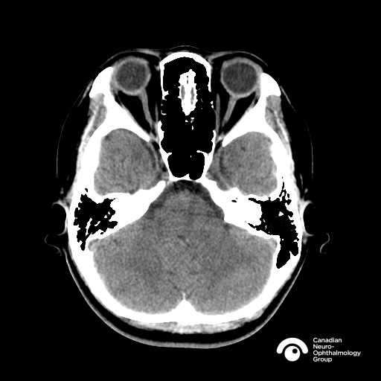
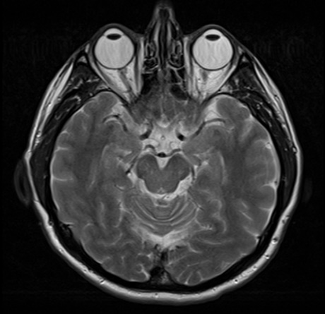
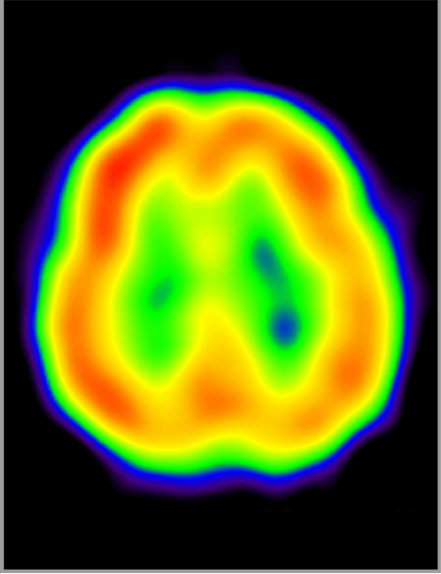
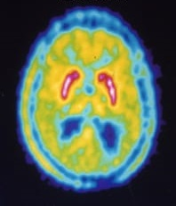
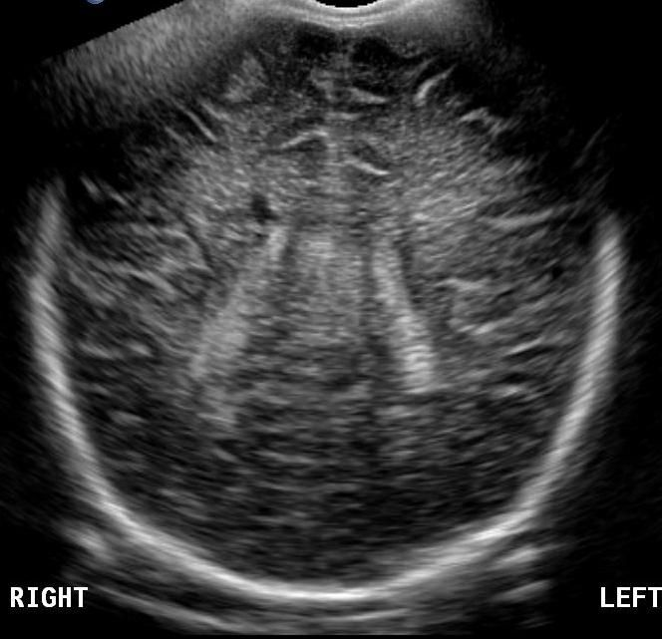
Families of medical imaging
Structural Imaging
Molecular Imaging (see metabolism)
MRI
CT
SPECT
PET
Ultrasound

Slide 3
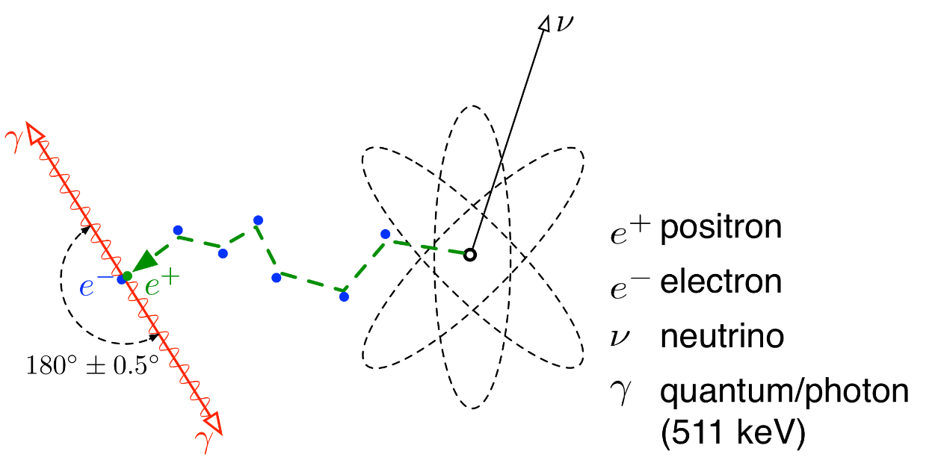
Positron Emission Tomography

Slide 4
Positron Emission Tomography
Molecular Imaging Modality
  Tracer distribution (positron emitter)
    Hot spot on the left side
  Positron Annihilation
  Collinear 511 keV particles
  Line of response

Slide 5
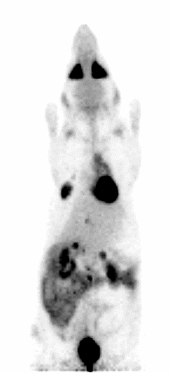
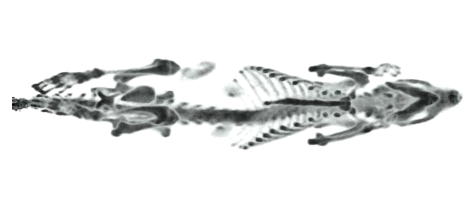
Examples of PET images
FDG (Glucose) tracer
Bone Tracer

Slide 6
But how does a PET scanner work?

Slide 7
Goal of PET Scanner
Get image to help doctors and scientists do their work
To build an image, scanner needs to collect as many lines of response (LOR) as possible
  How do we find them?

Slide 8
Unique properties of PET radiation
The gamma energy is known (511 keV)
They always come in pairs
  Found at the same time
  On opposite sides of the scanner

Slide 9
Unique properties of PET radiation
We need to find events with the correct
  Energy
  Timing
  Position (in the ring)

Slide 10
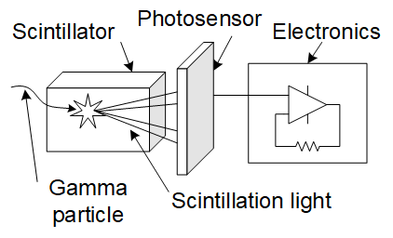
The PET detector

Slide 11
Unique properties of PET radiation
We need to find events with the correct
  Energy
  Timing
  Position (in the ring)

Slide 12
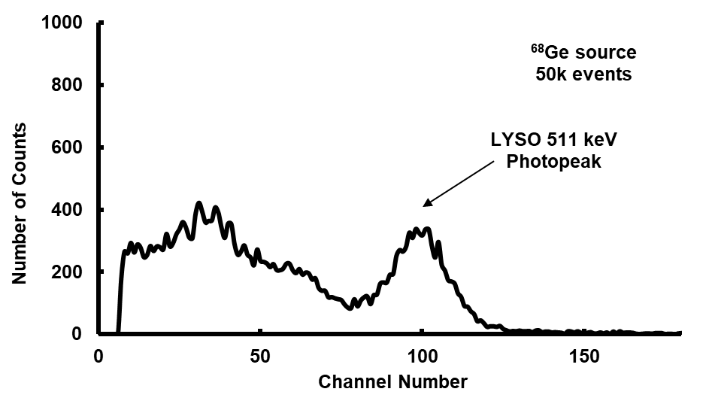
How to find 511 keV events?
Energy ≡ Number of Scint. Photons
  Like photon counting exercise
  Usually charge measurement
How to determine energy?
  Collect many events with known source
  Build histogram
  Find peak
  Scale axis
  Compare new events to scale

Slide 13
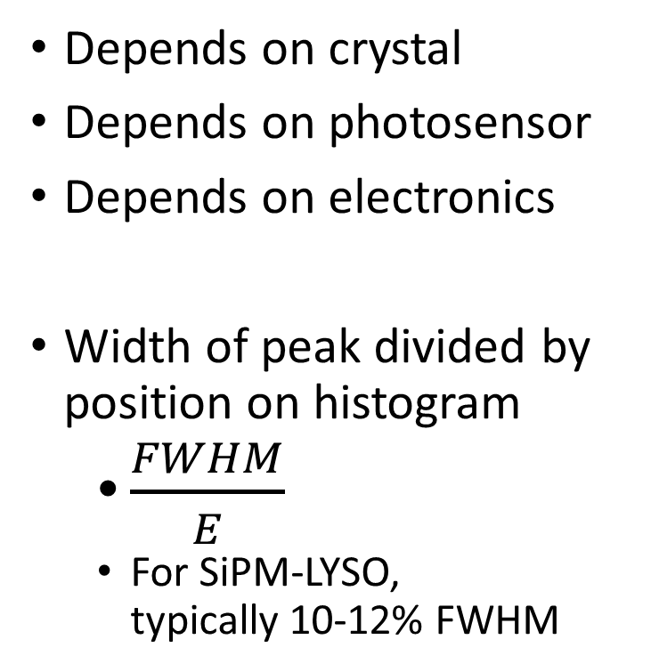
How good is an energy measurement?
Depends on crystal
Depends on photosensor
Depends on electronics
Width of peak divided by position on histogram
  $\frac{FWHM}{E}$
  For SiPM-LYSO,
  typically 10-12% FWHM

Slide 14
What’s that before the peak?
Events with less than 511?
Compton Scatter
  Partial energy transfer

Slide 15
How does this affect the image?
True Scatter Scatter Random Random

Slide 16
Unique properties of PET radiation
We need to find events with the correct
  Energy
  Timing
  Position (in the ring)

Slide 17
Time and Position Electronic Collimation
Pulse is generated when gamma is found
  But save data only when found in pair

Slide 18
Time and Position Electronic Collimation
Pulsed systems (before 2004)
Digital sampling systems (2003- )
Triggered systems (many variations)
event 1: Time, Position, Energy
event 2: Time, Position, Energy
…

Slide 19
Building the timing histogram
Number of detections
Time difference

Slide 20
Actual timing spectrum
Number of detections
Time difference

Slide 21
Types of coincidence
True Scatter Scatter Random Random

Slide 22
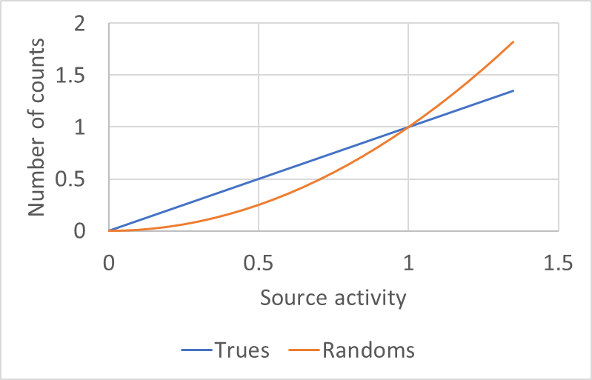
Coincidences vs Relative Activity

Slide 23
The coincidence timing spectrum
Prompt Coincidences
Coincidence time window
(Count rate)²

Slide 24
Solution 1: Estimate Random Coincidences

Slide 25
Solution 2: better timing measurement

Slide 26
Review
Find lines of response (LOR) using
  Energy
  Timing
  Position
Use image reconstruction program
Goal: Support doctors and scientists in
medicine and biology
How to make better? (Today’s research)

Slide 27
Another way to use very good timing

Slide 28
Time of Flight PET
How fast do we need to be?
  Say 1.5 mm
Other advantage
  If < 10 ps,
  no need for image reconstruction
10 picoseconds (!!!) or better
10 *10⁻¹² seconds

Slide 29
Time of Flight PET Today
 | PET Systems | Laboratory setups
PMT | 473 ps FWHM (1) | 234±20 ps rms (5)
APD | 6.6 ns FWHM (2) | 1.9 ns FWHM (6)
Analog SiPM | 385 ps FWHM (3) | 58±3 ps FWHM (7)
Digital SiPM Frach et al, 2009 | 266 ps FWHM (4) | 177 ps FWHM, (8)
 |  | 120 ps FWHM, (9)
1- Wong et al, TNS 2015 5- Peng et al, TNS 2013
2- Bergeron et al, TNS 2009 6- Leroux et al, TNS 2009
3- Levin et al, TMI 2016 7- Gundacker et al, PMB 2019
4- Degenhardt et al, NSS-MIC 2012 8- Somlai-Schweiger et al, J. Inst. 2015
9- van Dam et al, PMB 2013

Slide 30
Challenges to reach 10 ps
Need better scintillators
Need better photosensors
Need better electronics

Slide 31
PET Relationship with Exercises
EasyPET
Image Reconstruction
Photon Counting
  Energy measurement
Pulse Shape Discriminator
  Signal analysis of crystal response
Time of Flight
  Improve image contrast
TimePix
  Fast timing for single photons

Slide 32
Thanks! Questions?

Slide 33
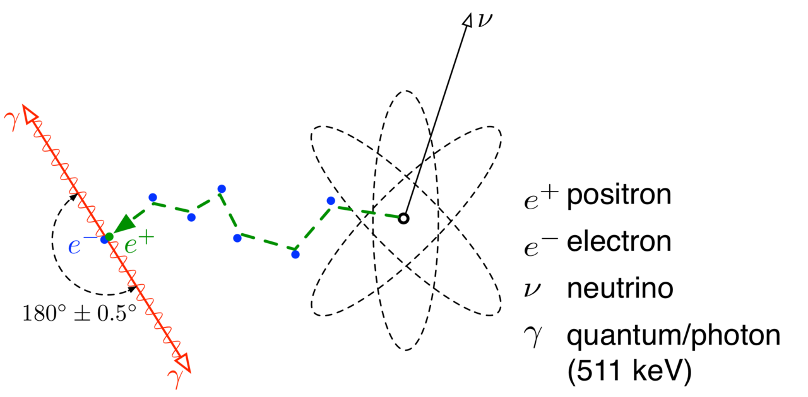
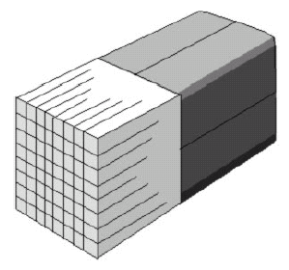
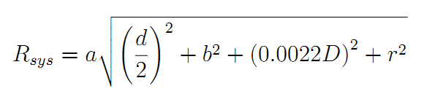
Spatial Resolution Limit
By Jens Maus (http://jens-maus.de/) - own work - part of PhD thesishttp://nbn-resolving.de/urn:nbn:de:bsz:14-qucosa-23509, Public Domain, https://commons.wikimedia.org/w/index.php?curid=379922

