Slide 1
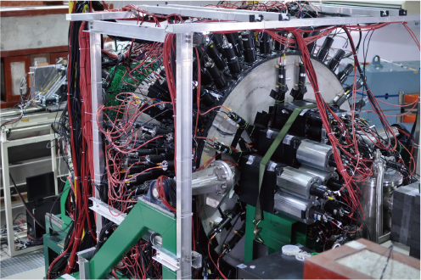
EM calorimeter for detecting high-energy photons
Ac
Takatsugu Ishikawa
Research Center for Electron Photon Science (ELPH),
Tohoku University, Japan
ishikawa@lns.tohoku.ac.jp
IEEE NPSS International School for Real Time Systems in Particle Physics 2019

Slide 2
Unit of the energy
electron volt (eV)
amount of kinetic energy gained by an electron accelerating from rest through an electric potential difference of 1 V in vacuum
eV ~ energy of a visible photon
keV=1000 eV
MeV=1000 keV ~ minimum energy loss in a certain
thickness g/cm²
GeV=1000 MeV ~ energy corresponding to the rest
mass of a proton (neutron)

Slide 3
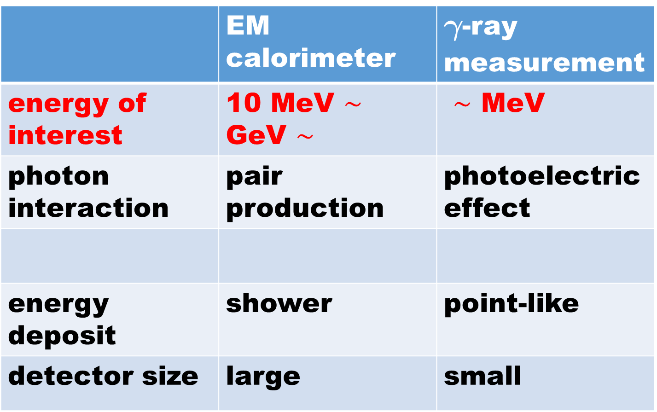
What is different
 | EM calorimeter | g-ray measurement
energy of interest | 10 MeV $∼$ GeV $∼$ | $∼$ MeV
photon interaction | pair production | photoelectric effect
energy deposit | shower | point-like
detector size | large | small

Slide 4
Outline ~ 1st lesson
introduction ~ hadron physics
getting started ~ calorimetry & EM shower
physics processes in EM showers
EM shower profile
light source
light detection
energy response of a calorimeter
FOREST detector
summary

Slide 5
Introduction
hadron physics
dibaryon (B=2 hadron object)

Slide 6
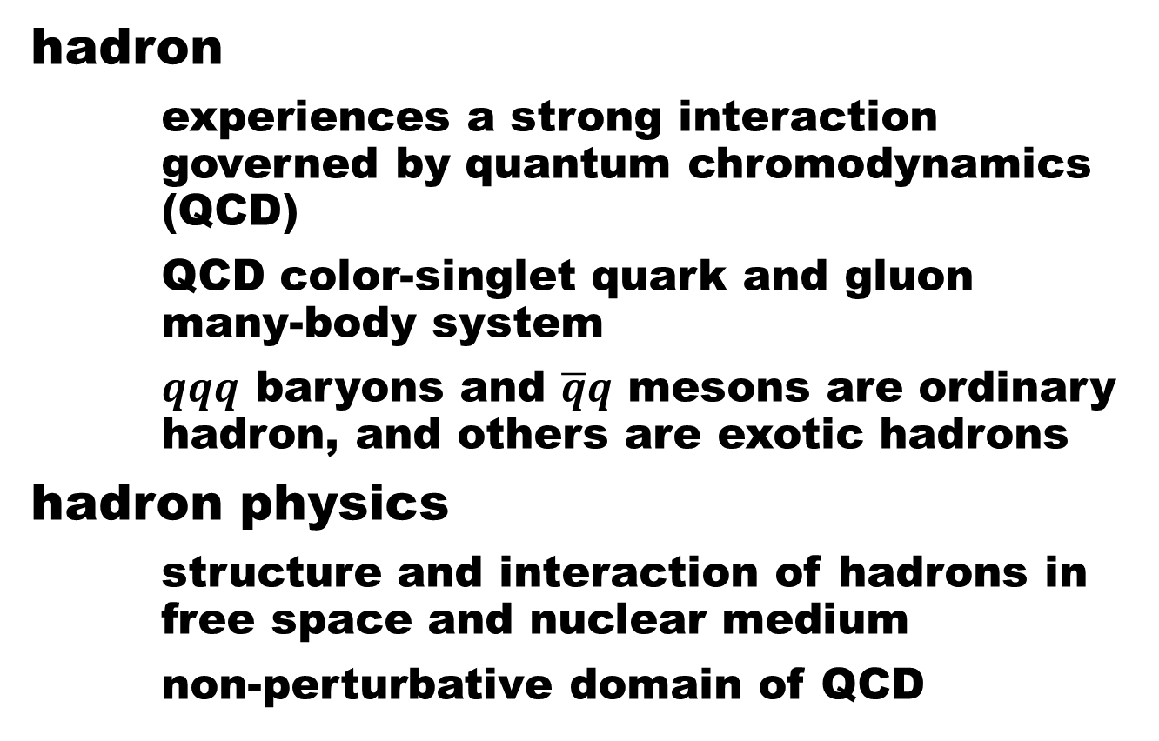
Hadron physics
hadron
experiences a strong interaction governed by quantum chromodynamics (QCD)
QCD color-singlet quark and gluon many-body system
$qqq$ baryons and $\overline{q}q$ mesons are ordinary hadron, and others are exotic hadrons
hadron physics
structure and interaction of hadrons in free space and nuclear medium
non-perturbative domain of QCD

Slide 7
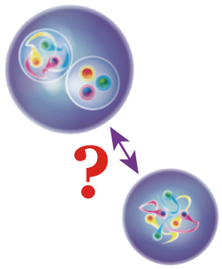
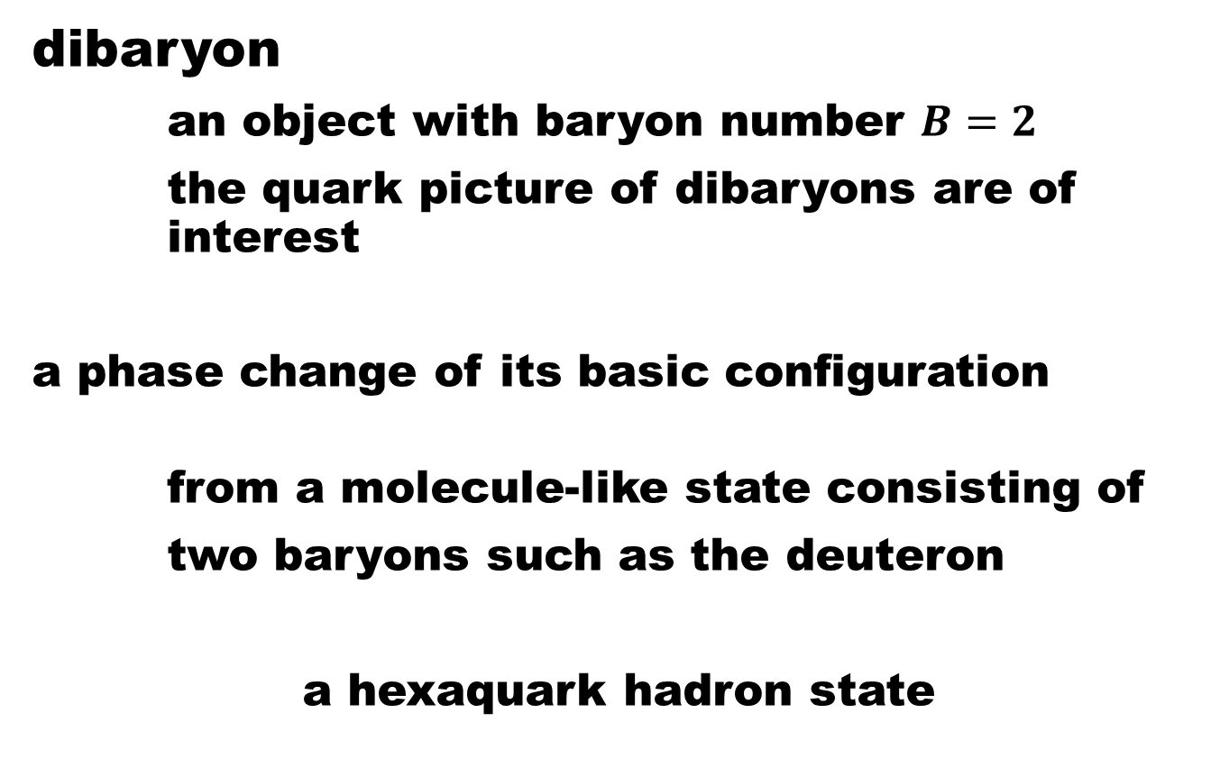
Dibaryon
dibaryon
an object with baryon number $B=2$
the quark picture of dibaryons are of interest
a phase change of its basic configuration
from a molecule-like state consisting of
two baryons such as the deuteron
a hexaquark hadron state

Slide 8
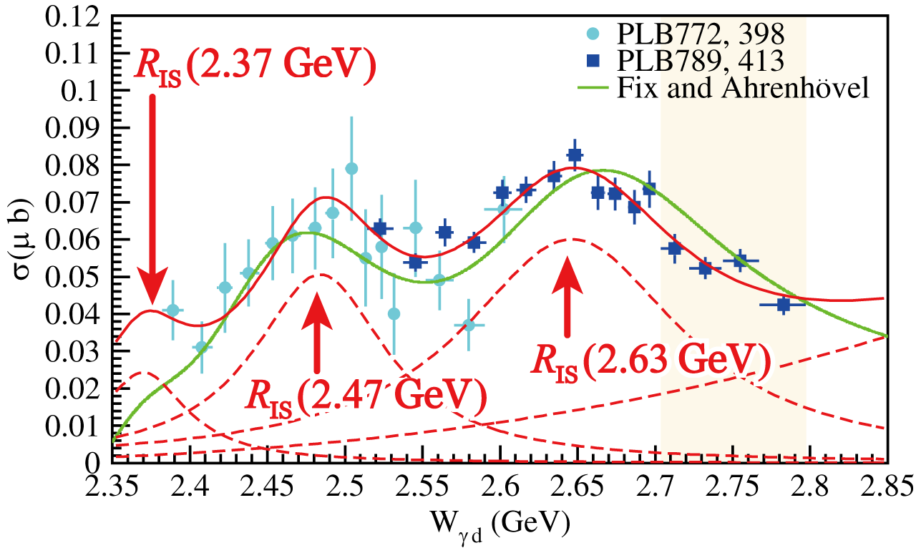
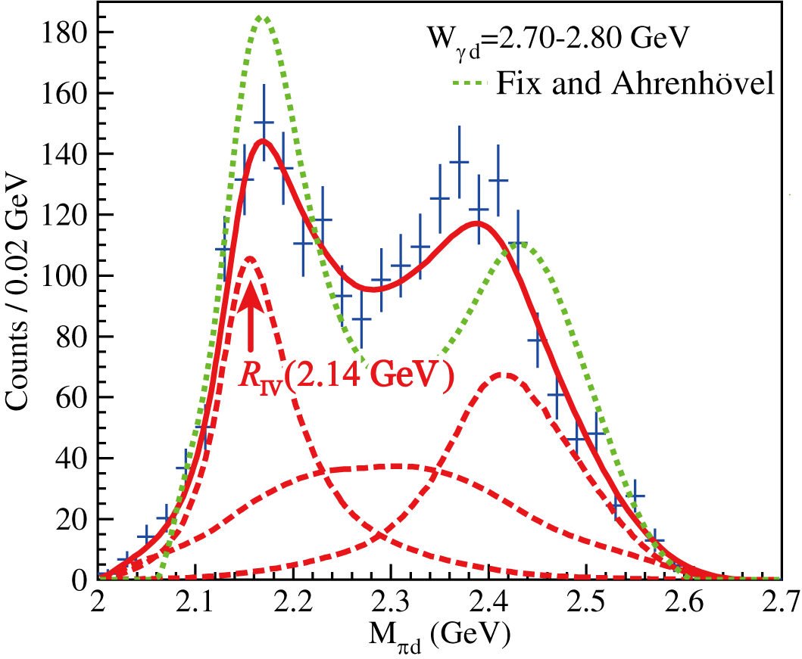



Dibaryon
our measurement of cross sections for the $γd→π^{0}π^{0}d$ reaction, suggesting
the $γd→R_{IS}→π^{0}{R_{IV}→π}^{0}π^{0}d \text{sequential} \text{process} \text{is} \text{dominant}$
T. Ishikawa et al., Phys. Lett. B 789, 413 (2019).
$$π^{0}d system$$
$$π^{0}π^{0}d system$$

Slide 9
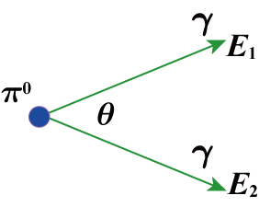
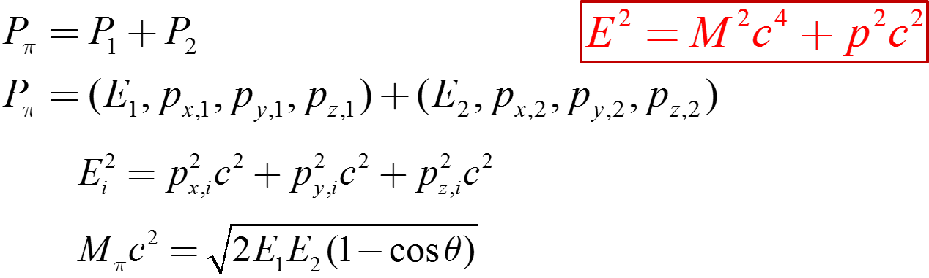

Dibaryon
neutral mesons decay into several photons
$π^{0}→γγ$
Four-momentum of a meson is given by a sum of that for the daughter photons
high-energy photon detection is important!
a photon is massless

Slide 10
Getting started
calorimetry
electromagnetic shower

Slide 11
Calorimetry
in thermodynamics
measuring the heat transfer
in nuclear physics
measuring the energy of a particle
through total absorption in a block of
matter (the energy of the particle is
eventually converted into heat)
the calorimeter must have a destructive
feature

Slide 12
Electromagnetic shower
shower
a cascade of secondary particles
produced as the result of a high-energy
particle interaction with dense matter
electromagnetic (EM) shower
produced by a photon, electron, or
positron
hadronic shower
produced by a hadron

Slide 13
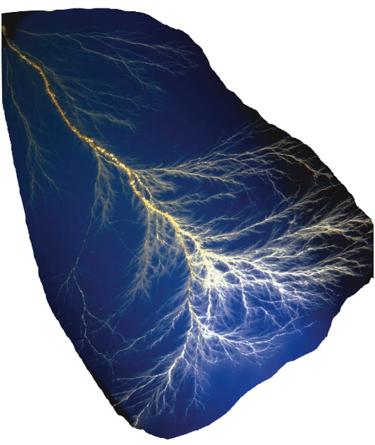
Electromagnetic shower
shower
a cascade of secondary particles
produced as the result of a high-energy
particle interaction with dense matter
electromagnetic (EM) shower
produced by a photon, electron, or
positron
hadronic shower
produced by a hadron
R. Wigmans, beam tree created by EM showers frozen into a piece of plastic

Slide 14
Electromagnetic shower
EM shower
cascade of the following two processes
pair production
a high-energy photon is converted into
an electron and positron pair
bremsstrahlung
a high-energy electron (positron) emits
a photon

Slide 15
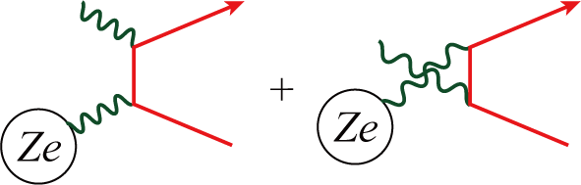
Electromagnetic shower
EM shower
cascade of the following two processes
pair production
a high-energy photon is converted into
an electron and positron pair
bremsstrahlung
a high-energy electron (positron) emits
a photon

Slide 16
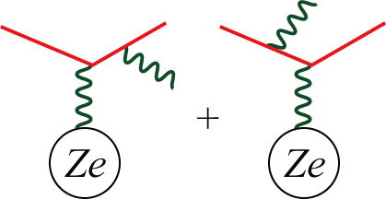
Electromagnetic shower
EM shower
cascade of the following two processes
pair production
a high-energy photon is converted into
an electron and positron pair
bremsstrahlung
a high-energy electron (positron) emits
a photon

Slide 17
Physics processes in EM showers
energy loss of a charged particle
critical energy
Photon interaction

Slide 18
Energy loss of a charged particle
EM interaction
ionizing the medium
energy transfer is sufficient to release a bound electron
principle on which many detectors are based
exciting atoms or molecules
de-excitation from these metastable states may yield
scintillation light
emitting Cherenkov light
producing energetic knock-on electrons (d ray)
producing bremsstrahlung
nuclear reaction

Slide 19
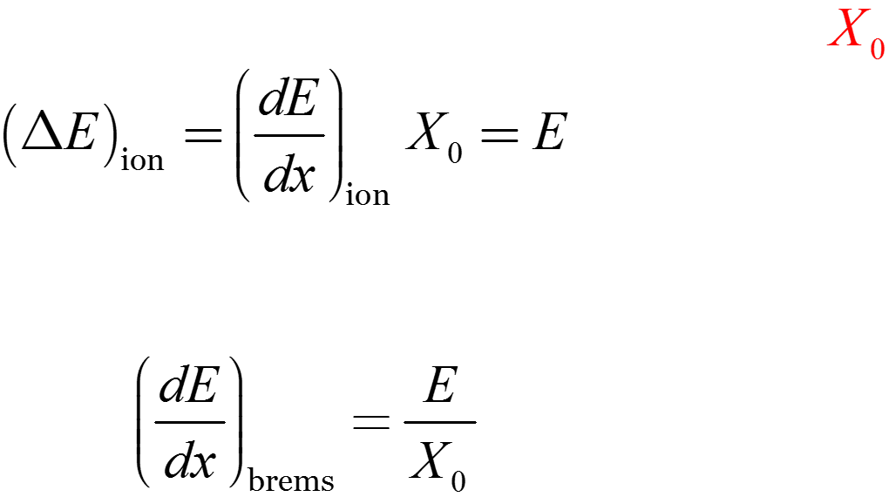
Critical energy
traditional definition
energy loss of the radiation process
= energy loss of the ionization
Rossi definition using the radiation length
this definition is equivalent when
(high energy limit)

Slide 20

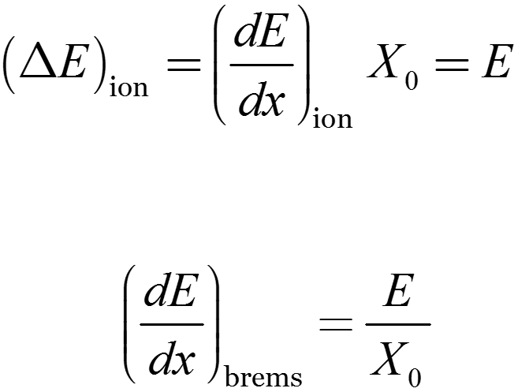
Critical energy
traditional definition
energy loss of the radiation process
= energy loss of the ionization
Rossi definition using the radiation length
this definition is equivalent when
(high energy limit)
PDG

Slide 21
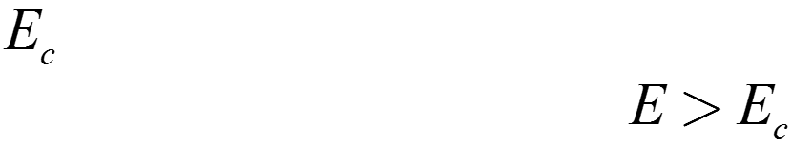
Critical energy
Rossi definition
radiation is more likely to occur for
gas
solid or liquid
PDG

Slide 22
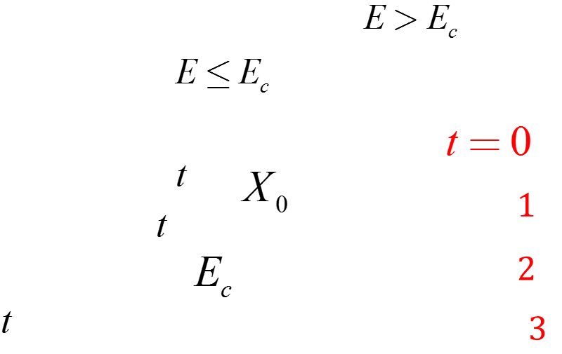
Exercise 1
Obtain the shower maximum (depth giving the maximum energy deposit) in the following simple shower model.
bremsstrahlung / pair production at each step (=depth)
energy sharing is symmetric after each process
no energy loss by ionization (excitation) for
full energy loss by ionization for
number of particles after depth
energy per particle after depth
number of shower particles with
shower maximum in

Slide 23
Photon interactions
PDG
photoelectric effect
Rayleigh scattering
Compton scattering
pair production
photonuclear reaction

Slide 24
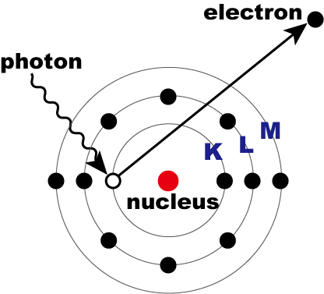
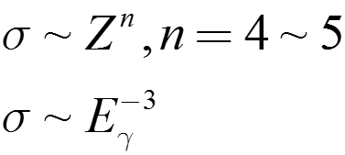
Photon interactions
photoelectric effect
most likely to occur at low energies
a bound electron is kicked out
photon is absorbed
complicated
Rayleigh scattering
Compton scattering
pair production
Photonuclear reaction

Slide 25
Photon interactions
photoelectric effect
most likely to occur at low energies
a bound electron is kicked out
complicated
Rayleigh scattering
Compton scattering
pair production
M
L
K
PDG

Slide 26
Photon interactions
photoelectric effect
Rayleigh scattering [coherent]
important at low energies
photon is deflected by atomic electrons
without losing its energy
only affects the spatial distribution of the energy deposit
Compton scattering [incoherent]
pair production
photonuclear reaction

Slide 27
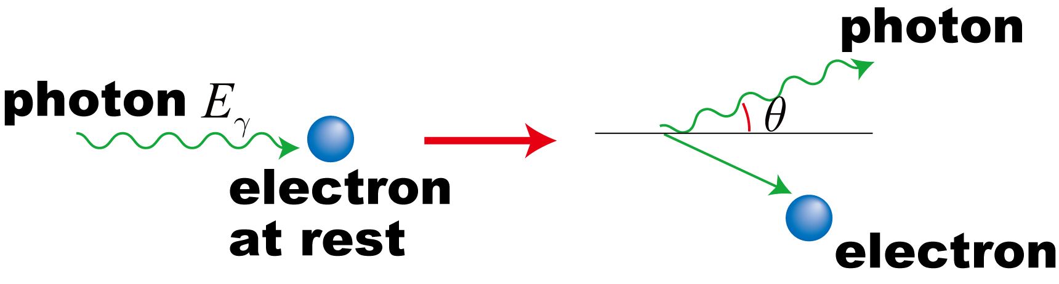
Photon interactions
photoelectric effect
Rayleigh scattering [coherent]
Compton scattering [incoherent]
a bound electron is kicked out
photon is not absorbed
pair production
photonuclear reaction

Slide 28
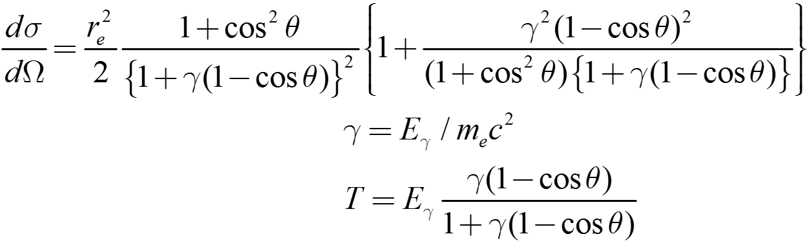
Photon interactions
photoelectric effect
Rayleigh scattering [coherent]
Compton scattering [incoherent]
a bound electron is kicked out
photon is not absorbed
  energy transfer
pair production
photonuclear reaction

Slide 29
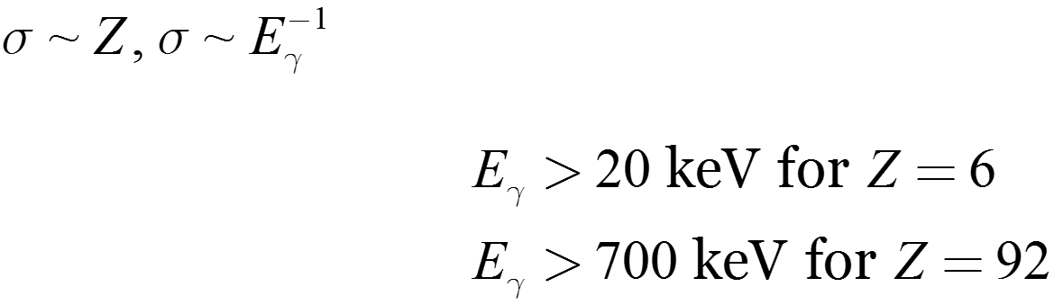
Photon interactions
photoelectric effect
Rayleigh scattering [coherent]
Compton scattering [incoherent]
many MeV photon are absorbed finally
in a sequence of Compton scattering
angular distribution disappears quickly
in this sequence
more likely to occur than photoelectric effect at energies
pair production
photonuclear reaction

Slide 30
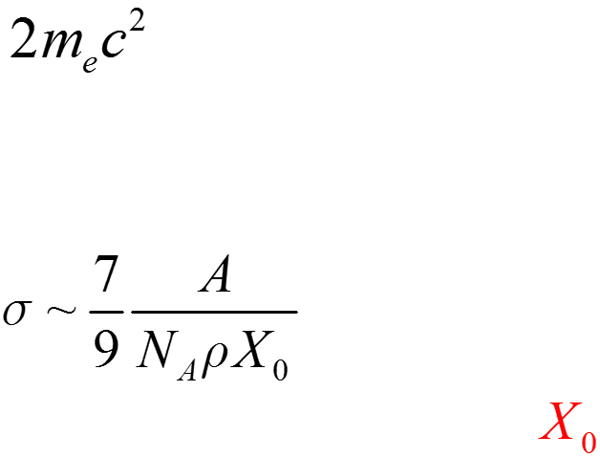
Photon interactions
photoelectric effect
Rayleigh scattering
Compton scattering
pair production
threshold
increasing with energy
reaching an asymptotic value at high energies
related to the radiation length
photonuclear reaction

Slide 31
Photon interactions
photoelectric effect
Rayleigh scattering
Compton scattering
pair production
photonuclear reaction
at energies 5~20 MeV
giant dipole resonance (GDR)
less than 1% of the total

Slide 32
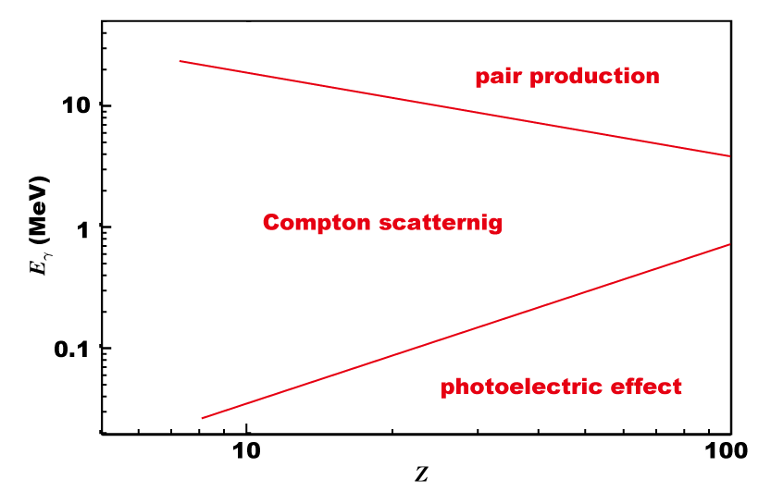
Photon interactions
photoelectric effect
Rayleigh scattering
Compton scattering
pair production
photonuclear reaction
R. Wigmans
Energy domain in which each process
is most likely to occur

Slide 33
Exercise 2
What is the main process in the total energy deposit (more than 2/3) ?

Slide 34
Outline ~ 2nd lesson
introduction ~ hadron physics
getting started ~ calorimetry & EM shower
physics processes in EM showers
EM shower profile
light source
light detection
energy response of a calorimeter
FOREST detector
summary

Slide 35
EM shower profile
scaling variables
radiation length
Molière radius
shower development
longitudinal
transverse

Slide 36
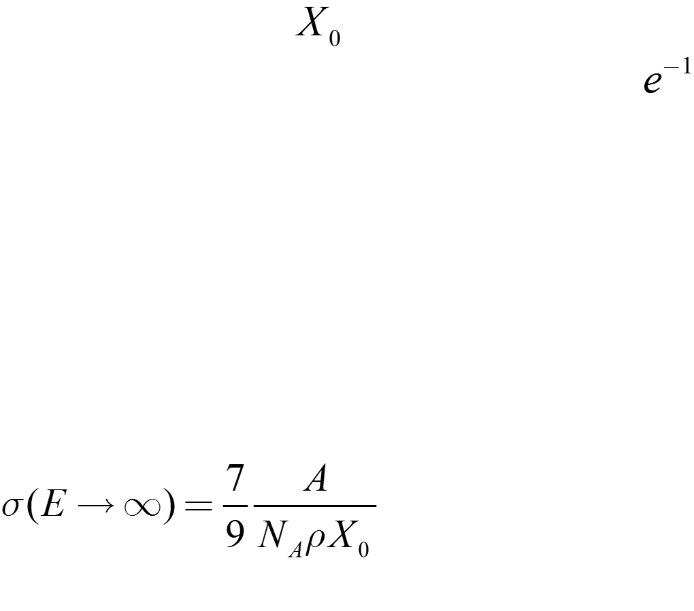

Radiation length
mean distance over which a high-energy
electron or positron loses all but of its
energy
high-energy electrons lose the same fraction
of their energy in the same number in
material-dependent effects are eliminated
for photon interactions (pair production)

Slide 37
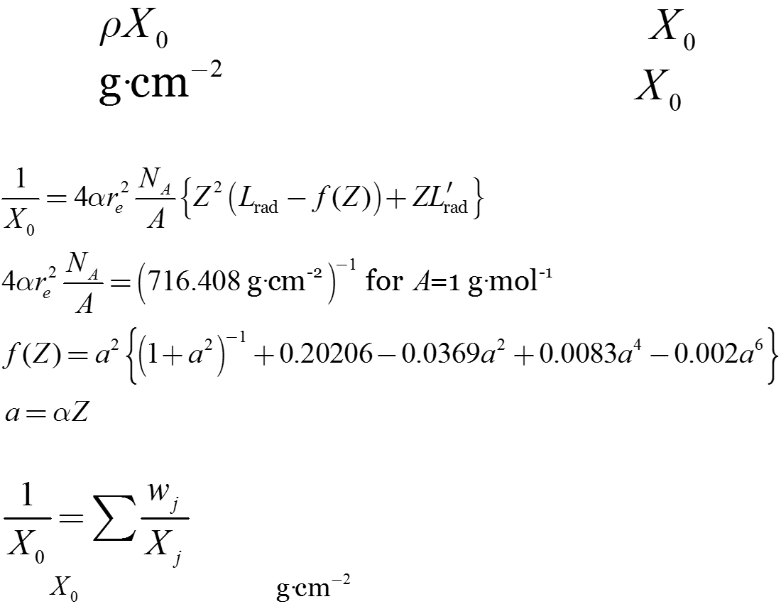
Radiation length
usually is expressed simply by
namely is used as a unit for
calculation by Tsai
mixture or compound
fraction by weight
is measured in
PDG

Slide 38
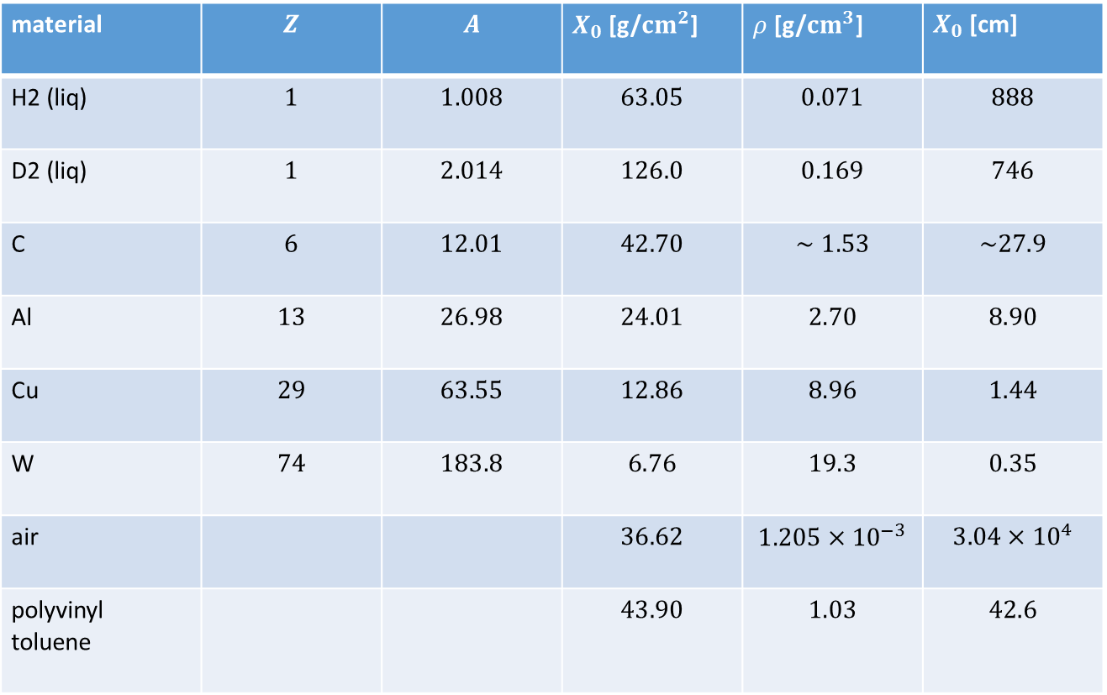
Radiation length
typical values
material | $$Z$$ | $$A$$ | $X_{0}$ [g/${cm}^{2}$] | $ρ$ [g/${cm}^{3}$] | $X_{0}$ [cm]
H2 (liq) | $$1$$ | $$1.008$$ | $$63.05$$ | $$0.071$$ | $$888$$
D2 (liq) | $$1$$ | $$2.014$$ | $$126.0$$ | $$0.169$$ | $$746$$
C | $$6$$ | $$12.01$$ | $$42.70$$ | $$∼1.53$$ | $$\sim 27.9$$
Al | $$13$$ | $$26.98$$ | $$24.01$$ | $$2.70$$ | $$8.90$$
Cu | $$29$$ | $$63.55$$ | $$12.86$$ | $$8.96$$ | $$1.44$$
W | $$74$$ | $$183.8$$ | $$6.76$$ | $$19.3$$ | $$0.35$$
air |  |  | $$36.62$$ | $$1.205×{10}^{−3}$$ | $$3.04×{10}^{4}$$
polyvinyl toluene |  |  | $$43.90$$ | $$1.03$$ | $$42.6$$

Slide 39
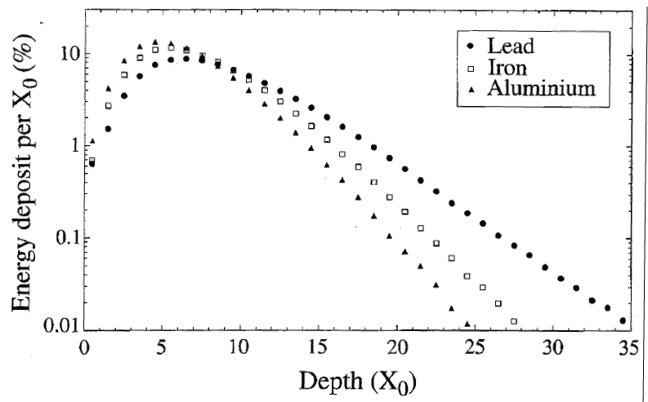
Longitudinal development
energy deposit as a function of depth
expressed by the radiation length
almost material-independent
R. Wigmans

Slide 40

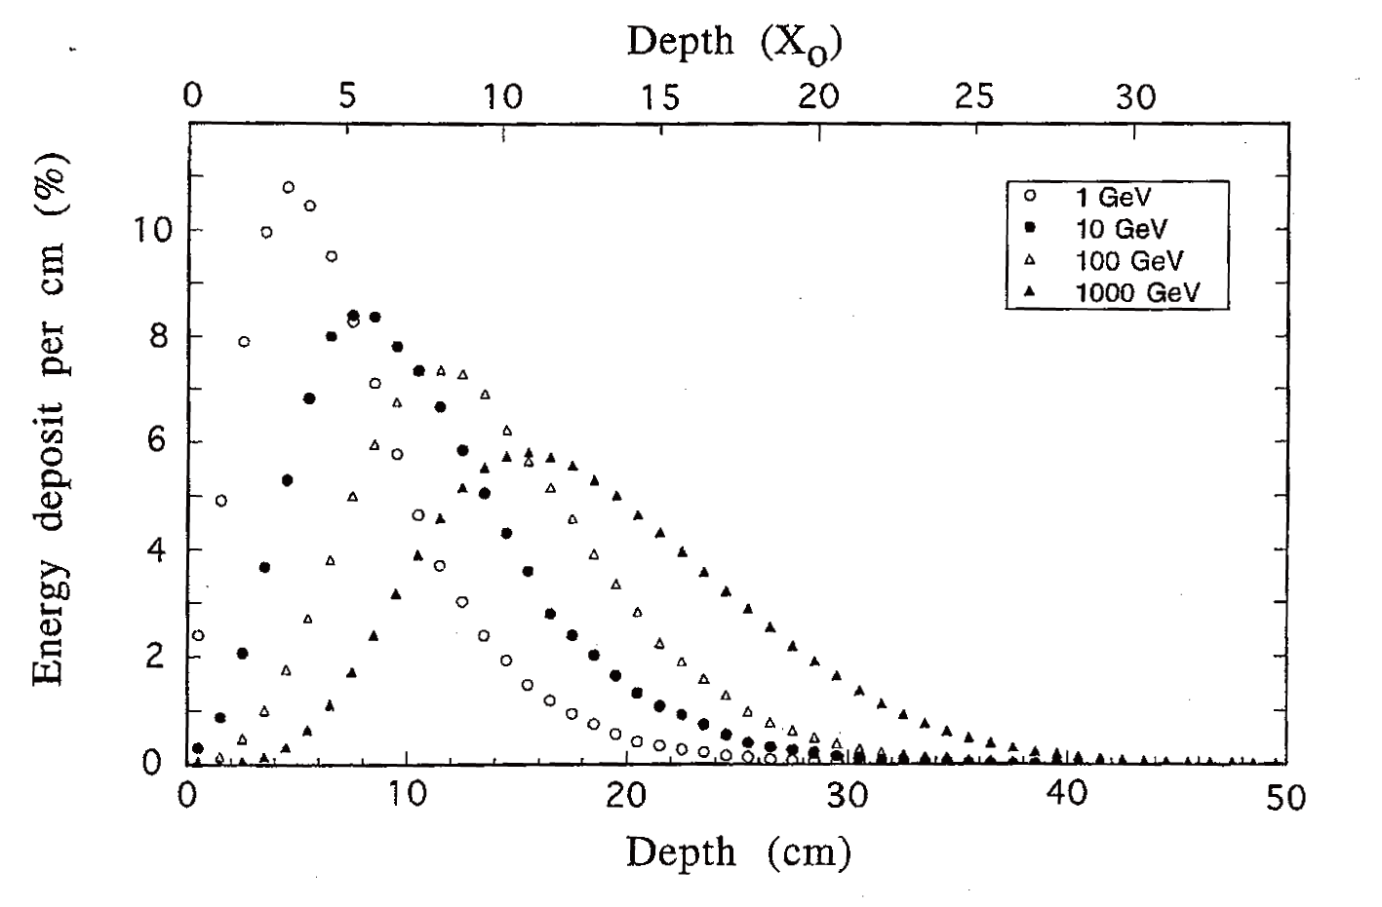
Longitudinal development
shower maximum
depth giving the maximum energy deposit
Cu
R. Wigmans

Slide 41
Longitudinal development
average energy fraction contained in a block of matter with infinite transverse dimensions
R. Wigmans

Slide 42
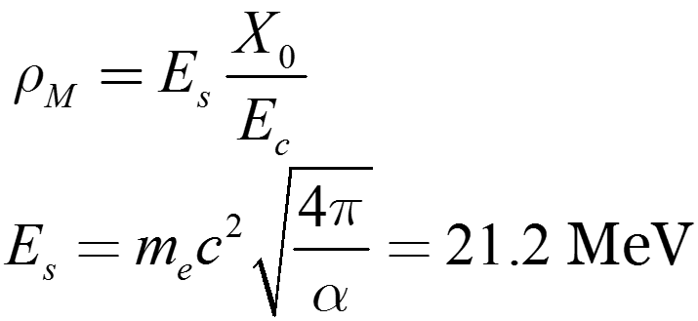

Molière radius
transverse development of EM showers
80% of the shower energy is deposited in a cylinder with a radius of against the momentum direction of the primary high-energy particle

Slide 43
Transverse development
radial distribution of energy deposits for some depths
10 GeV electron

Slide 44
Transverse development
radial distribution of energy deposits for some materials
material-independent
10 GeV electron

Slide 45
Transverse development
average energy fraction contained in an infinitely long cylinder
10 GeV electron

Slide 46
Exercise 3
Consider the minimum length of the calorimeter module for 1, 10 GeV, 100 GeV photons? Here, 99% of the total energy deposit is assumed to be measured, and the module has a infinite
transverse dimension.
R. Wigmans

Slide 47
Light source
Cherenkov light
scintillation light

Slide 48
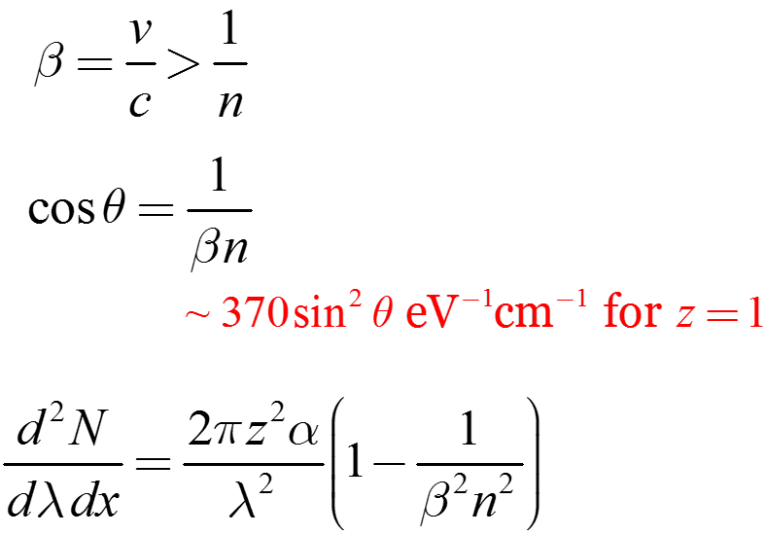
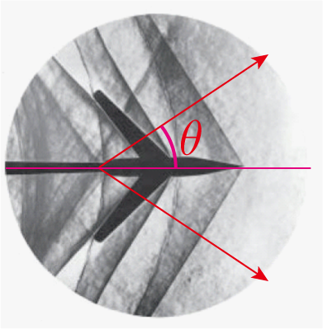
Cherenkov light
emitted when a charged particle travels through the medium faster than the speed of light
threshold
angle
number
prompt emission, polarized
shock wave phenomenon
n: refractive index
low #photons, mainly UV
Wikipedia

Slide 49
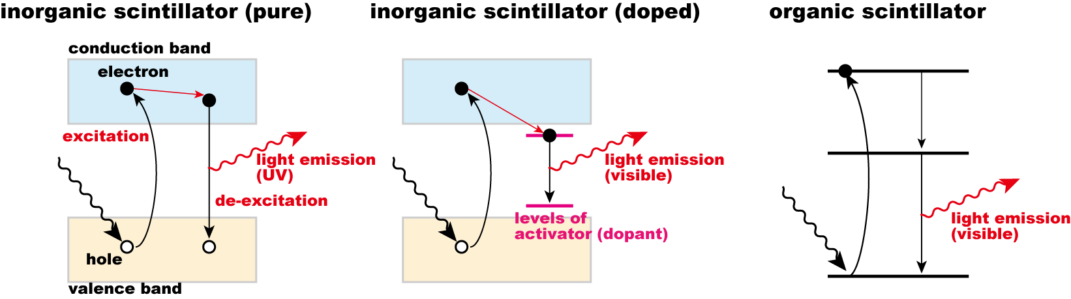
Scintillation light
different light emission mechanisms
inorganic scintillator is often used for calorimeters
short radiation length
long decay time

Slide 50
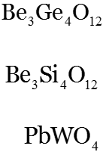
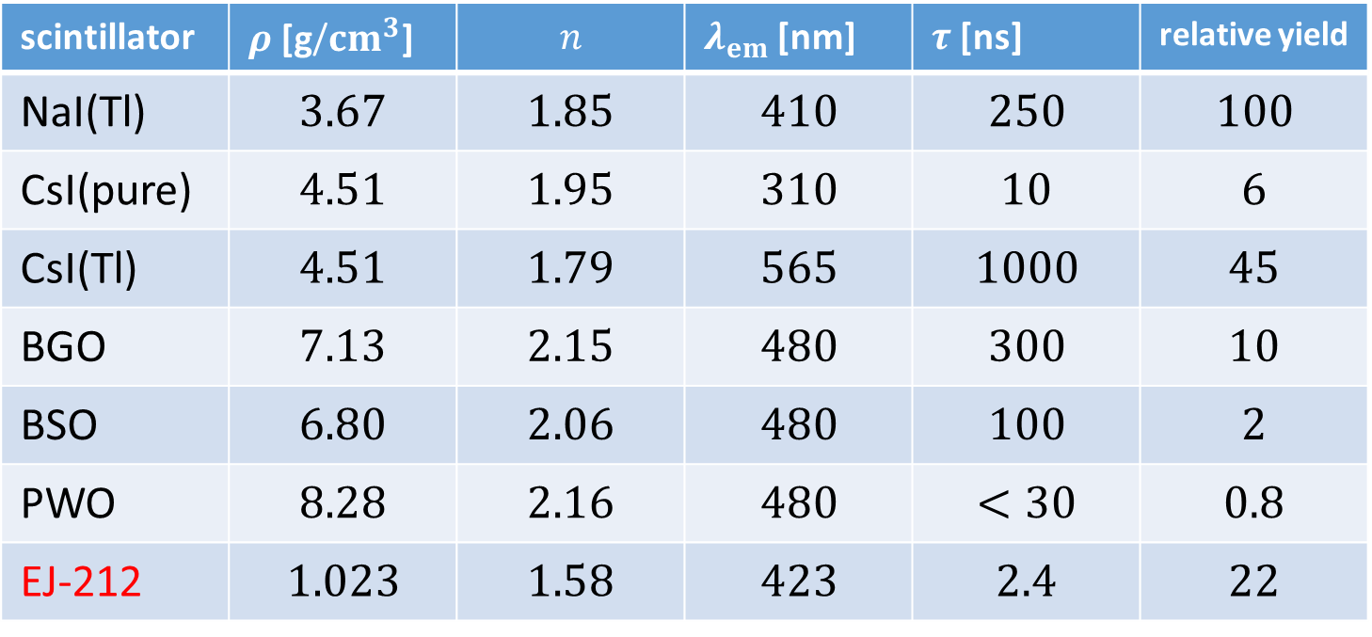
Scintillation light
NaI(Tl): 45000 photons /MeV
scintillator | $ρ$ [g/${cm}^{3}$] | $$n$$ | $λ_{em}$ [nm] | $τ$ [ns] | relative yield
NaI(Tl) | $$3.67$$ | $$1.85$$ | $$410$$ | $$250$$ | $$100$$
CsI(pure) | $$4.51$$ | $$1.95$$ | $$310$$ | $$10$$ | $$6$$
CsI(Tl) | $$4.51$$ | $$1.79$$ | $$565$$ | $$1000$$ | $$45$$
BGO | $$7.13$$ | $$2.15$$ | $$480$$ | $$300$$ | $$10$$
BSO | $$6.80$$ | $$2.06$$ | $$480$$ | $$100$$ | $$2$$
PWO | $$8.28$$ | $$2.16$$ | $$480$$ | $$<30$$ | $$0.8$$
EJ-212 | $$1.023$$ | $$1.58$$ | $$423$$ | $$2.4$$ | $$22$$
plastic scintillator
green-light emission materials are often used
decay time: organic scintillator is shorter
time resolution: number of photons at the leading edge

Slide 51
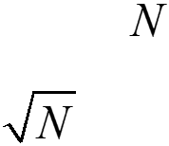
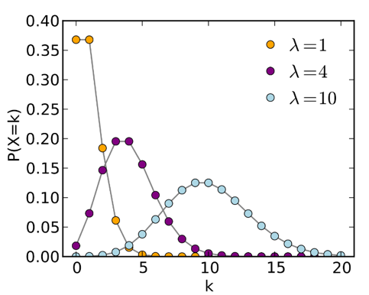
Exercise 4
What is the width of the photoelectric peak in response to the ¹³⁷Cs radioactive source for NaI(Tl), BGO, and PWO? Here, all the emitted scintillation light is assumed to be converted into a electric signal.
¹³⁷Cs: 0.662 MeV
counting number having a fluctuation (standard
deviation) of
(Poisson distribution)

Slide 52
Light detection
photo-sensitive material
photo-multiplier tube
Photo-diode

Slide 53
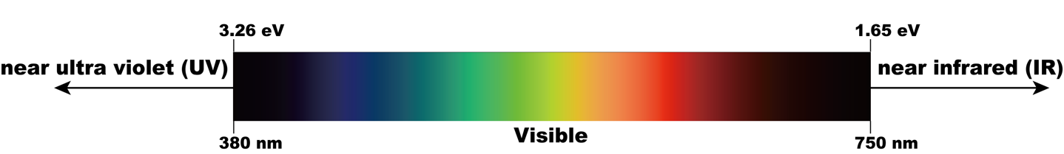
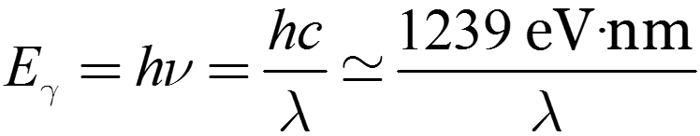
Photo-sensitive material
photo-detectors sensitive to visible or near visible light
photon energy:
Wikipedia

Slide 54
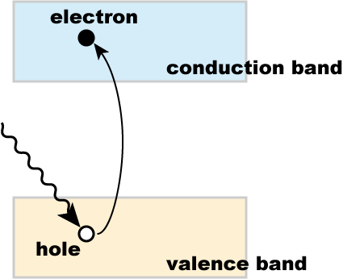
Photo-sensitive material
energy transfer of a photon to a free electron: forbidden
low sensitivity of metals to photons
photoconductive effect
electrons in the material are
lifted to the conduction band
from the valence band
electrons and holes
produce a photo-current
→ photodiode

Slide 55
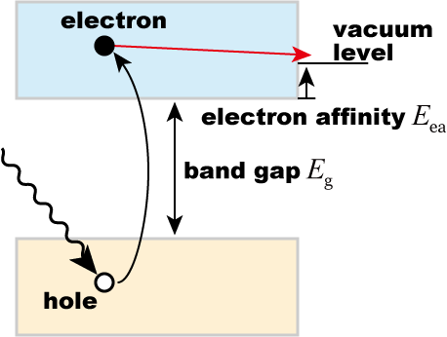

Photo-sensitive material
photoelectric effect
energized electrons diffuse through the material
0.05 eV loss for each electron-phonon scattering
(mean free path: a few nm)
electron arriving at the
surface with a sufficient
excess energy can escape
from the material
the work function: fermi level and vacuum level

Slide 56
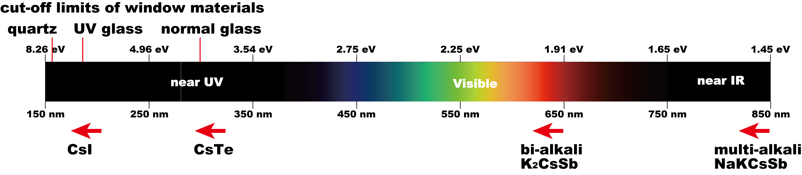
Photo-sensitive material
almost all the photo-sensitive materials are reactive (made up of alkali metals)
operation must be in vacuum
window materials are required
transparent to the light of interest
less than 1100 nm for Si

Slide 57
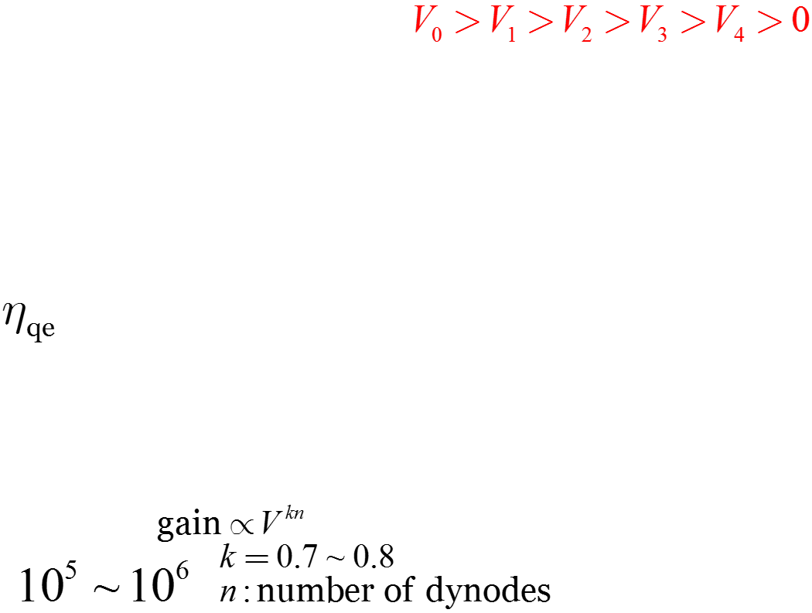
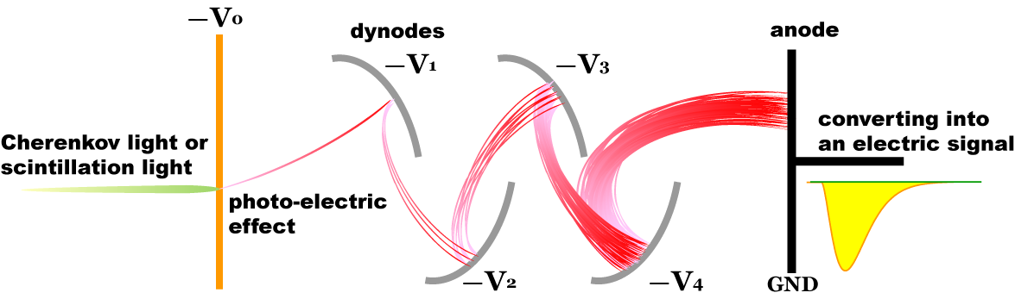
Photo-multiplier tube
almost all the photo-sensitive materials are reactive (made up of alkali metals)
electrons are accelerated in each step
several secondary electrons are emitted at each dynode
quantum
efficiency
electron avalanche

Slide 58
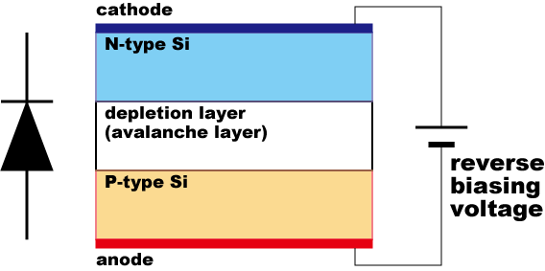
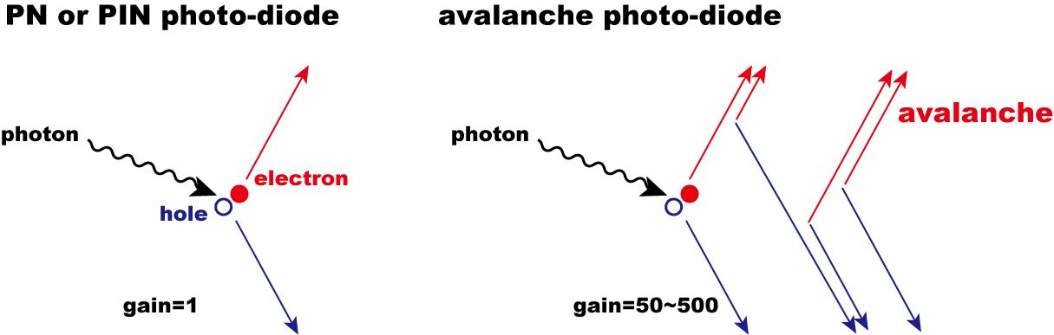
Photo-diode
electron-hole pair is produced by a photon
electrons moves to the anode
semiconductor
N-type … donors (electrons)
I-type
P-type … acceptors (holes)
avalanche layer
low-density acceptors

Slide 59
Photo-diode
lower gain as compared with PMT
additional amplifier is needed
operation is also available in high magnetic fields
K. Miyabayashi
Belle at KEK
used in a solenoidal magnetic field

Slide 60
Energy response of a calorimeter
types
homogeneous
sampling
performance
energy resolution
non-linearity

Slide 61
Homogeneous calorimeters
Entire kinetic energy of shower particles gives a signal
energy response is intrinsically linear
large number of photoelectrons
non-linearity
saturation effects in PMTs
saturation effects in scintillator
shower leakage
light attenuation
non uniformity of scintillator
non uniformity of PMT
inorganic scintillator is the best

Slide 62
Sampling calorimeters
inactive part [lead]
develop the EM shower
active part [plastic scintillator]
convert the kinetic energies of shower particles into a photon
sampling fraction
small number of photoelectrons
energy response is different between
electron, positron, photon, [linear] and
the others [non-linear]
energy resolution
is not so high

Slide 63
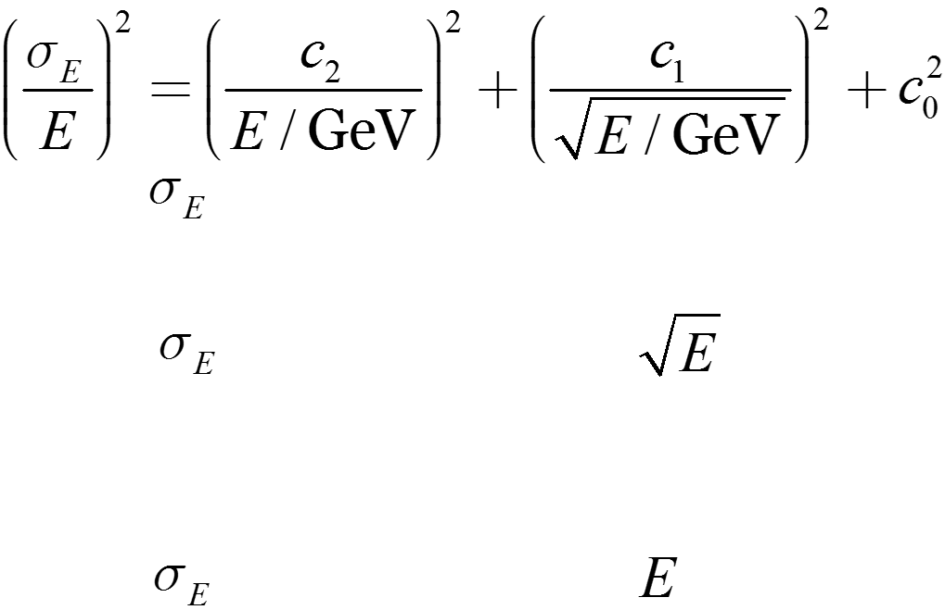
Energy resolution
empirical formula
1st term ( : independent of the energy) [noise]
electric noise
2nd term ( : proportional to ) [statistics]
photo-electron statistics
photon yield & conversion
3rd term ( : proportional to ) [constant]

Slide 64
Energy resolution
constant term
shower leakage from the back, side, front
calibration errors for modules
non-uniformities
non-uniformity in scintillator
(emission, and light collection)
non-uniformity in PMTs
albedo

Slide 65
Exercise 5
Consider the best geometry of a calorimeter for the photon beam energy measurement? Here, all the photons are assumed to come on the z axis.

Slide 66
FOREST detector
EM calorimeters
forward calorimeter
central calorimeter
backward calorimeter
plastic scintillator hodoscopes

Slide 67
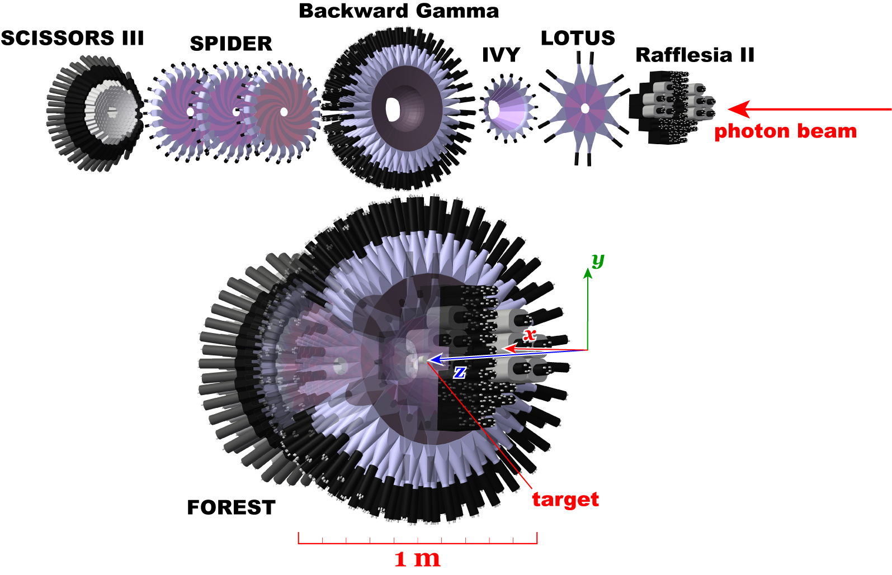
FOREST detector
62 lead glasses
5% @ 1 GeV
192 pure CsI crystals
3% @ 1 GeV
252 lead/scintillating fiber modules
7% @ 1 GeV

Slide 68
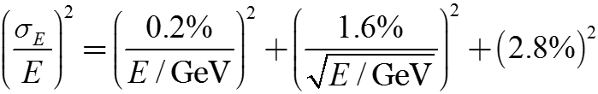


Forward calorimeter
inorganic scintillator
high Z and high density
active material only
high energy resolution
expensive

Slide 69



Central calorimeter
sampling calorimeter
heavy material (lead) & active scintillator (scintillating fiber)
poor energy resolution
cheaper

Slide 70



Backward calorimeter
Cherenkov calorimeter
heavy transparent material
poor energy resolution
cheaper

Slide 71

Plastic scintillator hodoscopes
placed in front of each calorimeter
to identify charged particles
forward hodoscope can determine the position of impact

Slide 72

FOREST detector
EM calorimeters in FOREST
energy resolution is not so high, yet
solid angle is large (88% in total)
giving an opportunity for hadron
physics studies
new calorimeter
BGOegg at SPring-8

Slide 73



FOREST detector
new calorimeter BGOegg at SPring-8
1320 BGO crystals
1.38% @ 1 GeV

Slide 74

Exercise 6
What is the mean number of photo-electrons for 1 MeV energy deposit for BGOegg calorimeter?
Suppose quantum efficiency is 20%, what is the light collection efficiency in a BGO crystal?
NaI(Tl): 45000 photons /MeV
relative photon yield of BGO
with respect to Na(Tl): 10%

Slide 75

Summary
omitted items
clustering
energy reconstruction
position reconstruction
energy calibration
most important
$π^{0}$ peak in the $γγ$ invariant mass
is used in the FOREST experiments

Slide 76

Summary
references
M. Tanabashi et al. (Particle Data Group), Review of Particle Physics, Phys. Rev. D 98, 030001 (2018). [PDG]
G. Gratta, H. Newman, and R.Y. Zhu,
Crystal Calorimeters in Particle Physics,
Ann. Rev. Nucl. Part. Sci. 14, 453 (1994).
R. Wigmans, Calorimetry
Energy Measurements in Particle Physics,
Oxford Univ. Press (2000).

Slide 77
Summary
our papers describing EM calorimeters
T. Ishikawa et al.,
Testing a prototype BGO calorimeter with 100-800 MeV positron beams,
Nucl. Instrum. Meth. A 837, 109 (2016).
T. Ishikawa et al.,
The FOREST detector for meson photoproduction experiments at ELPH,
Nucl. Instrum. Meth. A 832, 108 (2016).
T. Ishikawa et al.,
A detailed test of a BSO calorimeter with 100-800 MeV positrons,
Nucl. Instrum. Meth. A 694, 348 (2012).

