Slide 1
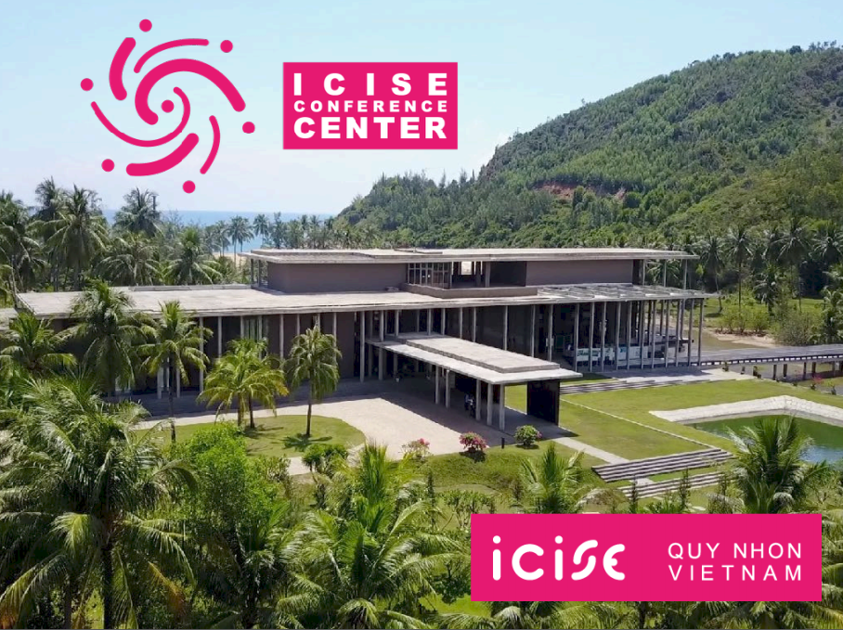
23rd Real Time Conference 2022
Quy Nhon city, Vietnam
ORGANIZING PLAN
The International Centre for Interdisciplinary Science and Education (ICISE)

Slide 2
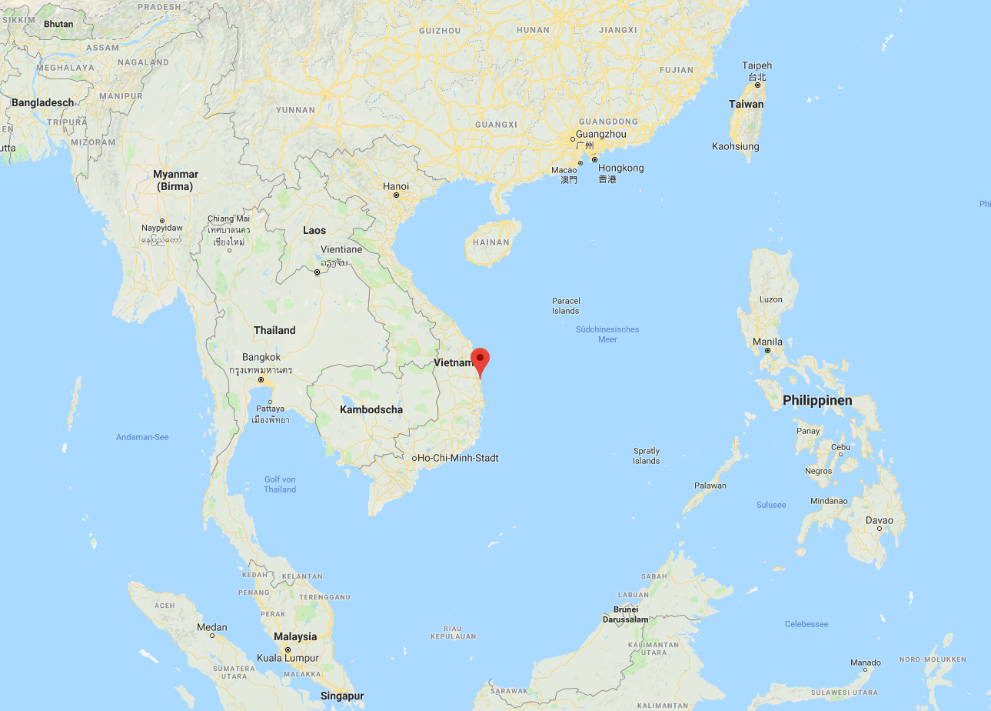
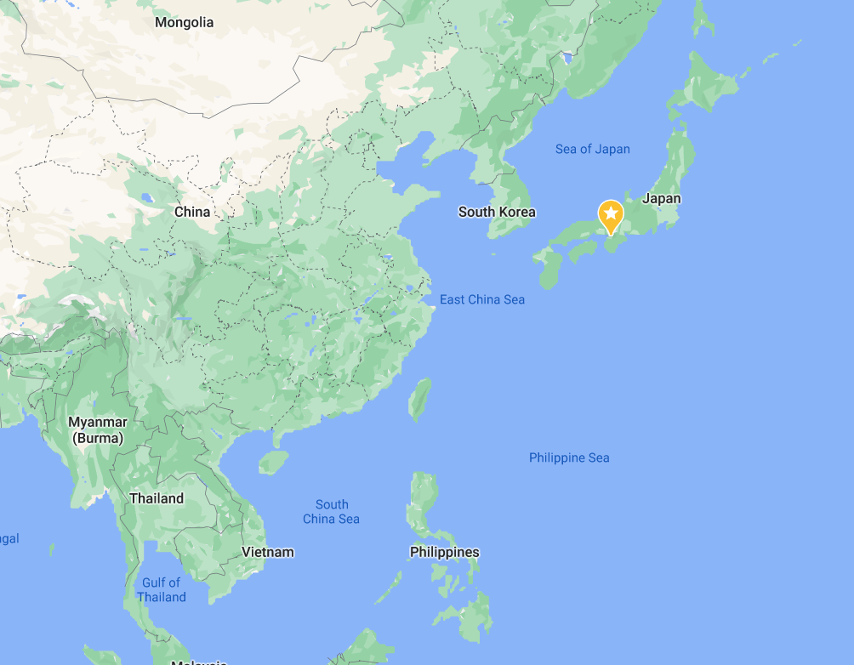
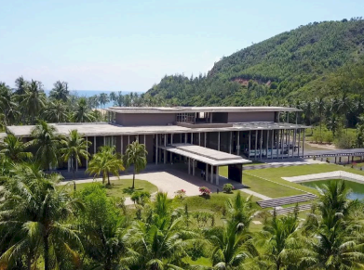
China
Japan
S. Korea
Hanoi capital
Vietnam
1h: 45min. flight
Quy Nhon City
ICISE conference center
45 min. flight
Ho Chi Minh city
The International Centre for Interdisciplinary Science and Education (ICISE), Quy Nhon City.

Slide 3
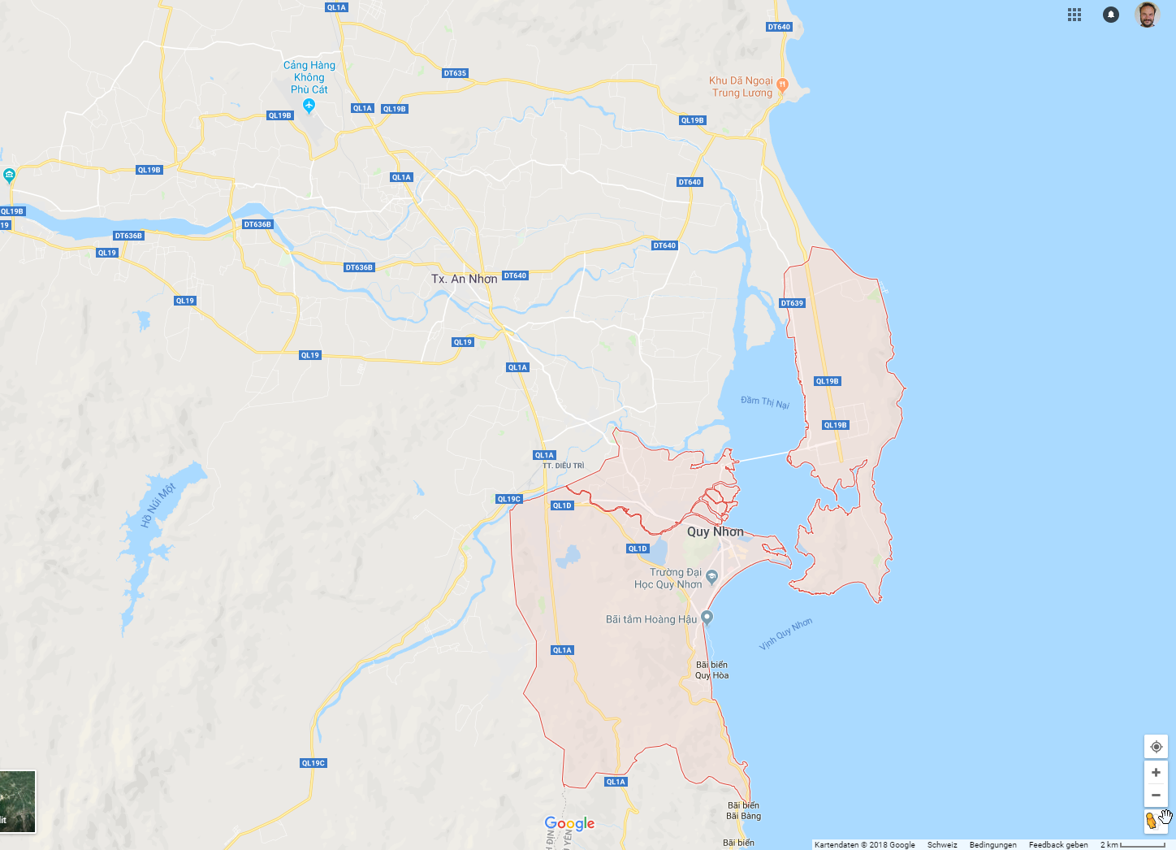
Phu Cat Airport
35 min. by taxi or bus
Quy Nhon downtown
~7 km
ICISE

Slide 4
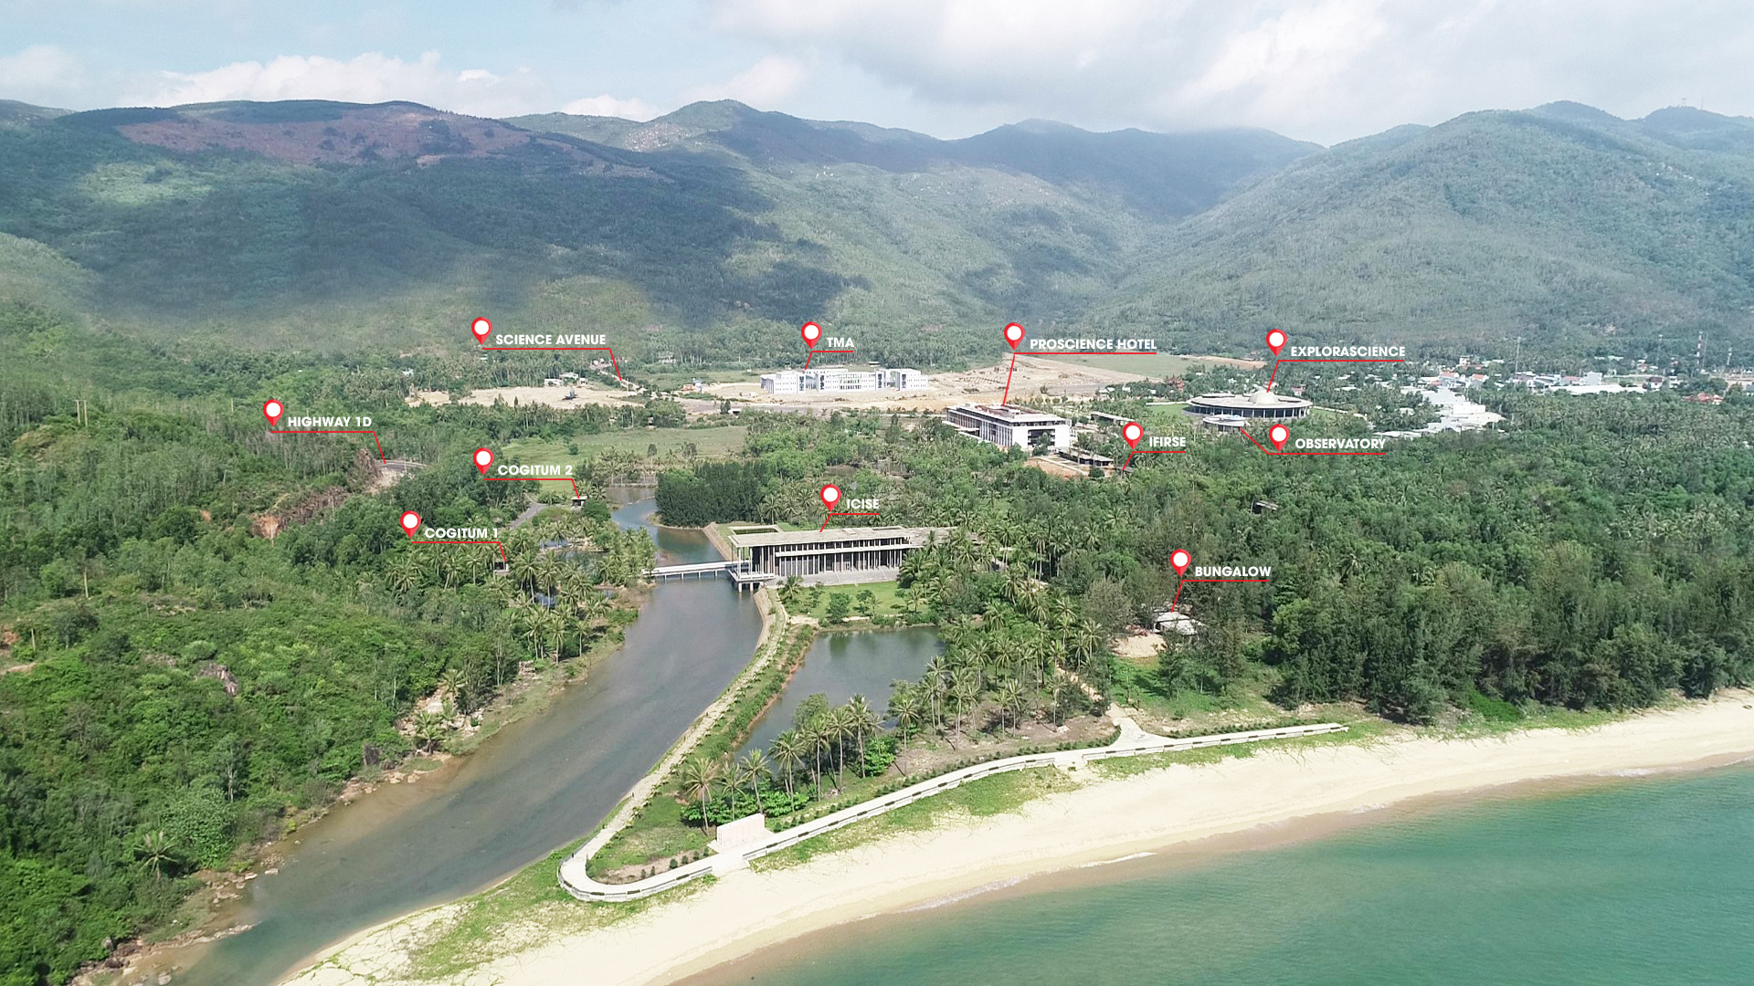
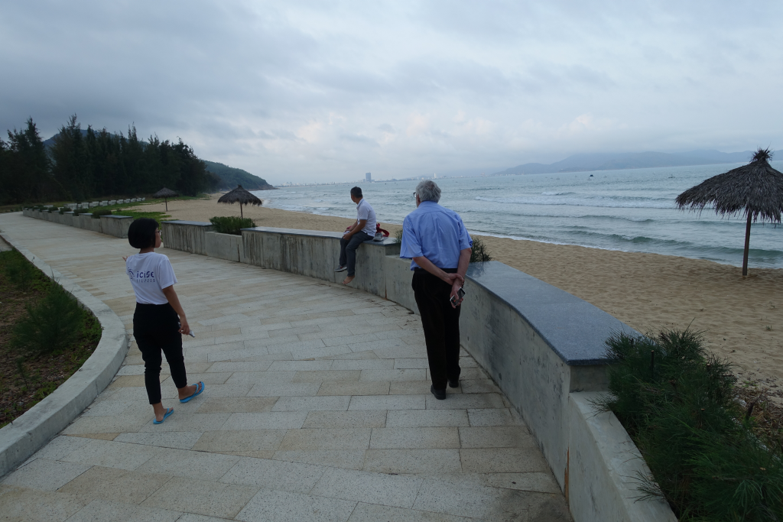
A new panorama view of the ICISE area.
ICISE

Slide 5
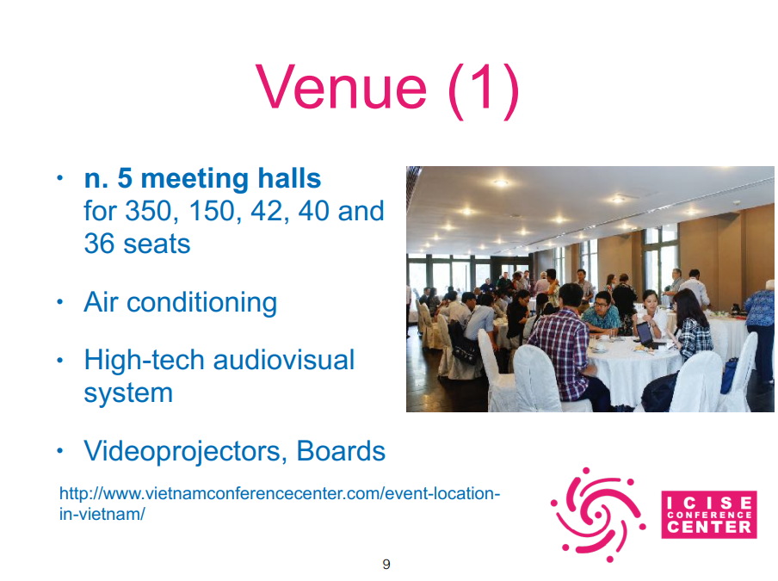
Venue
6 meeting halls: 350, 150, 80, 40, 36 and 32 seats

Slide 6
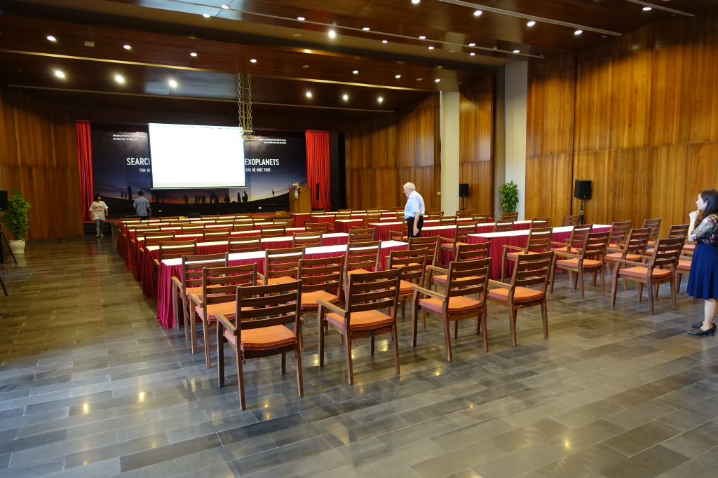
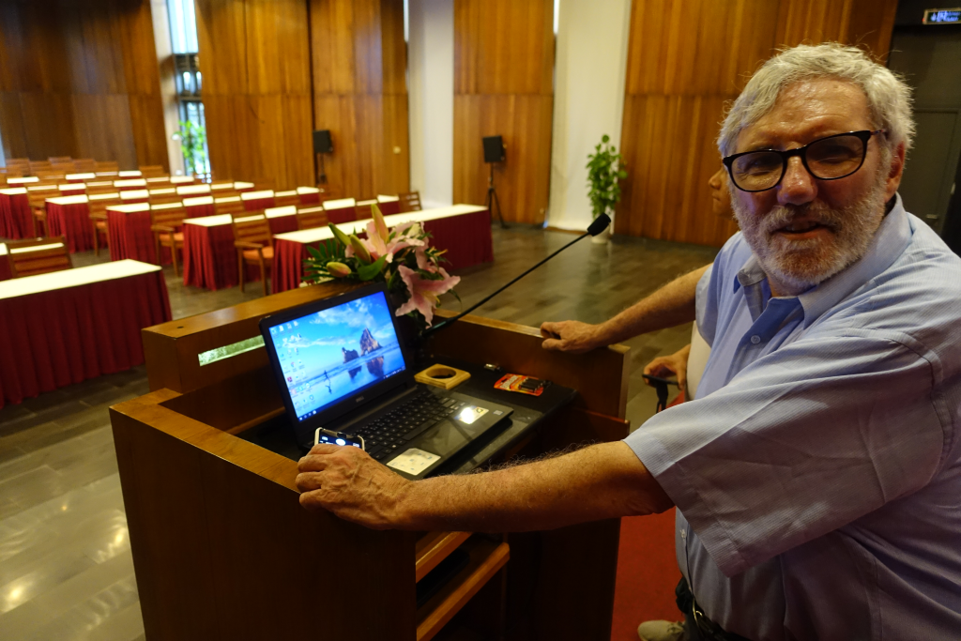
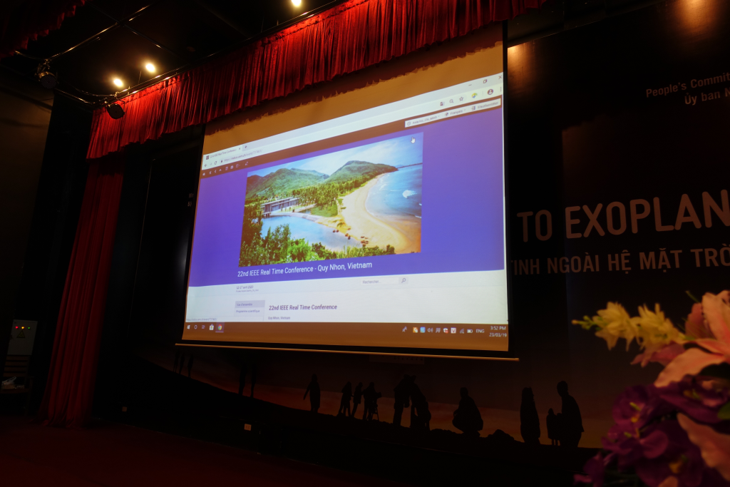
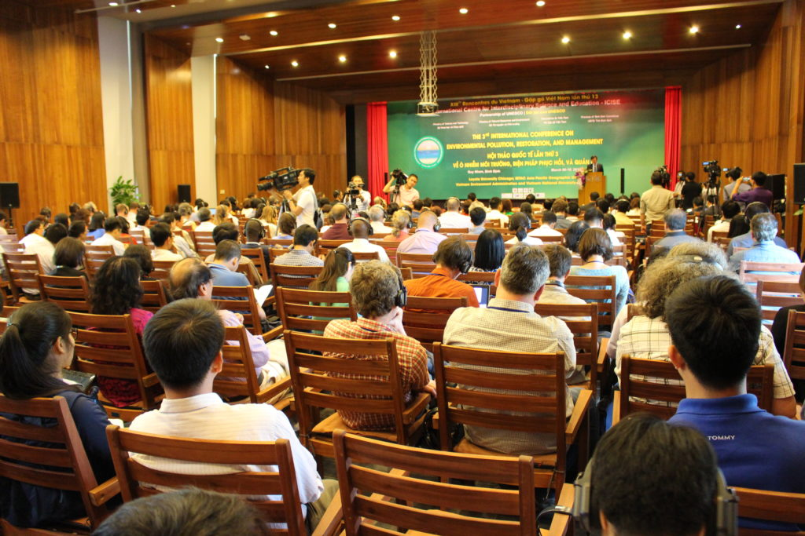
Venue
Main auditorium for up to 350 persons -> plenary session

Slide 7
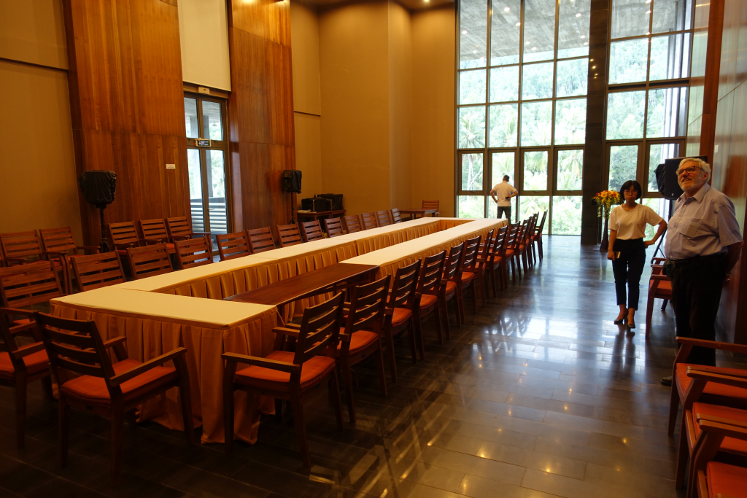
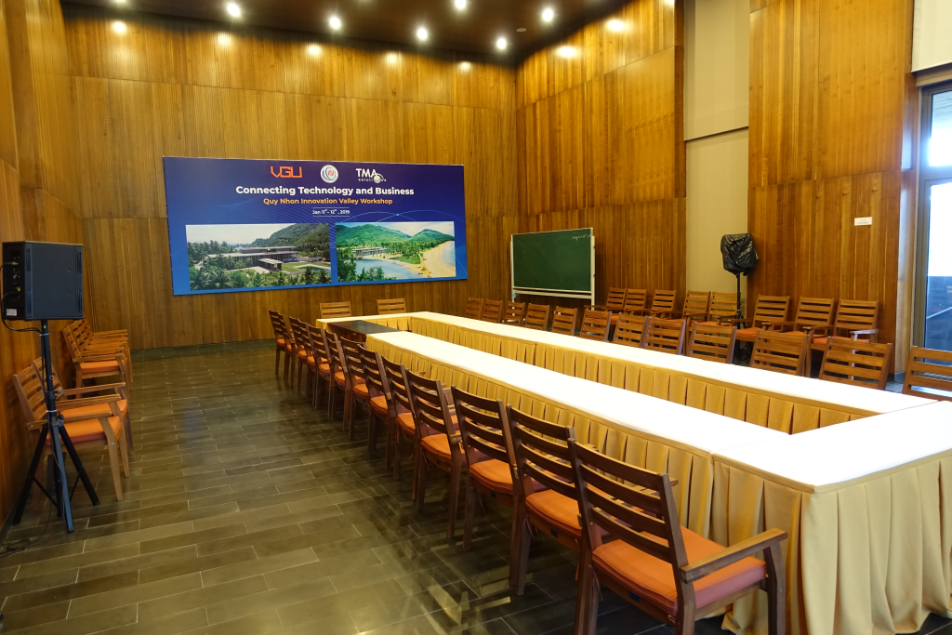
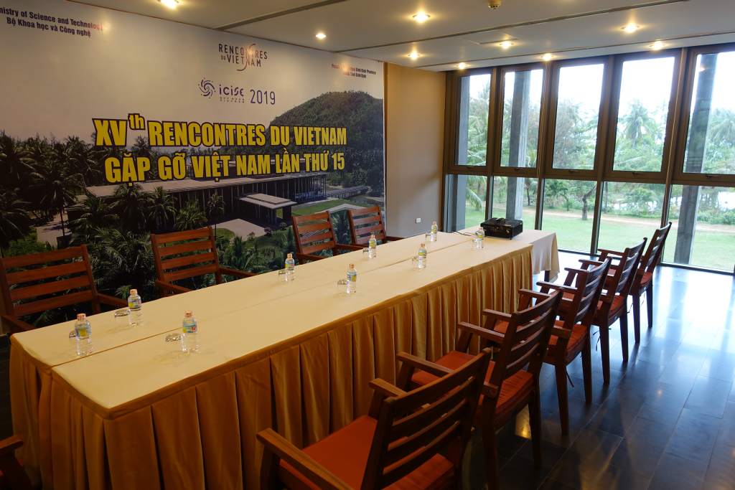
Venue
5 smaller meeting rooms: tutorial/workshop, computer room, committee etc.

Slide 8
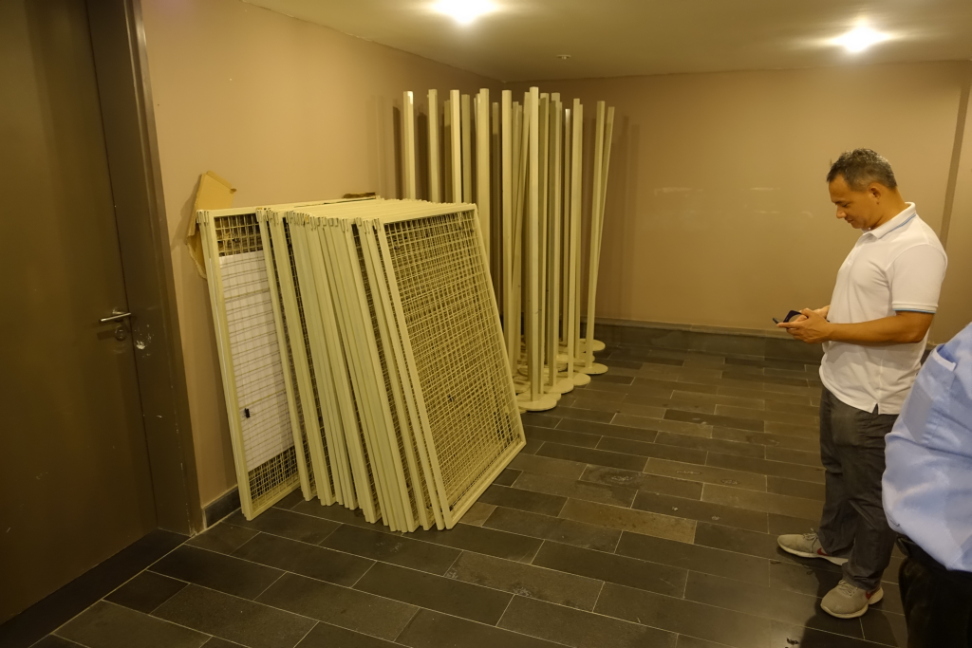
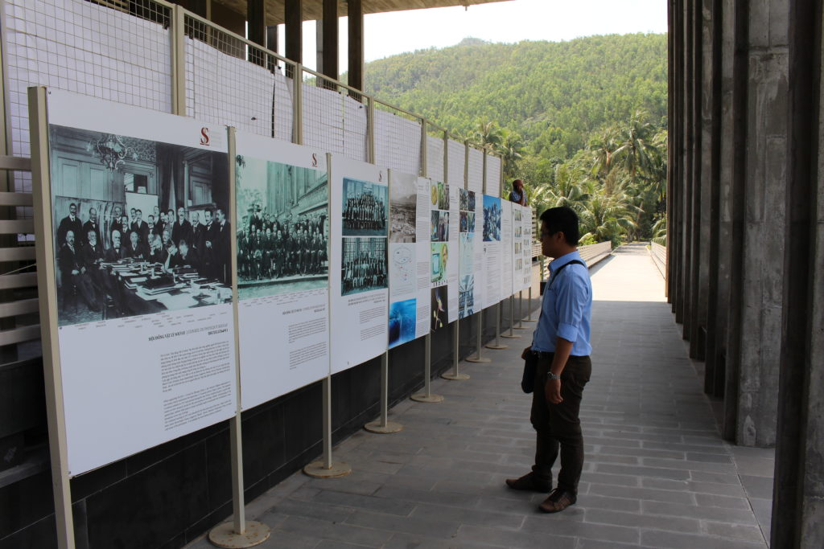
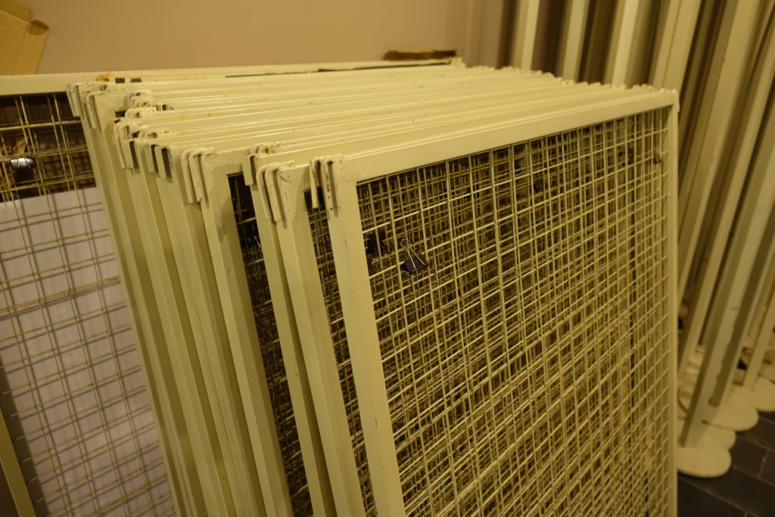
Venue
Prepared for poster session (outside!)

Slide 9
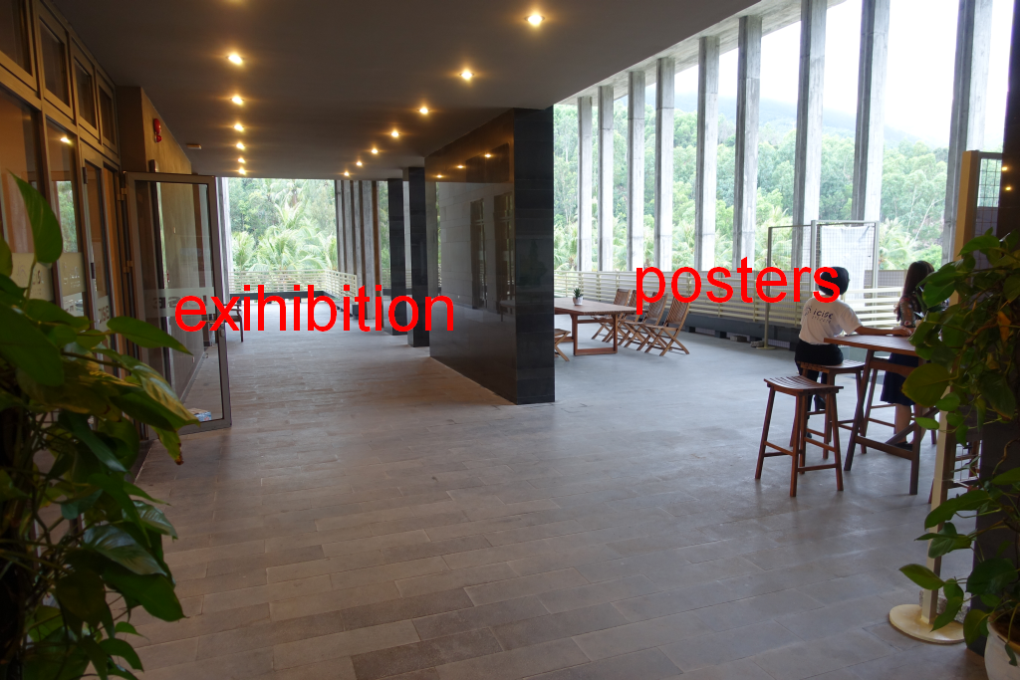
Venue
Space for vendor exhibition

Slide 10
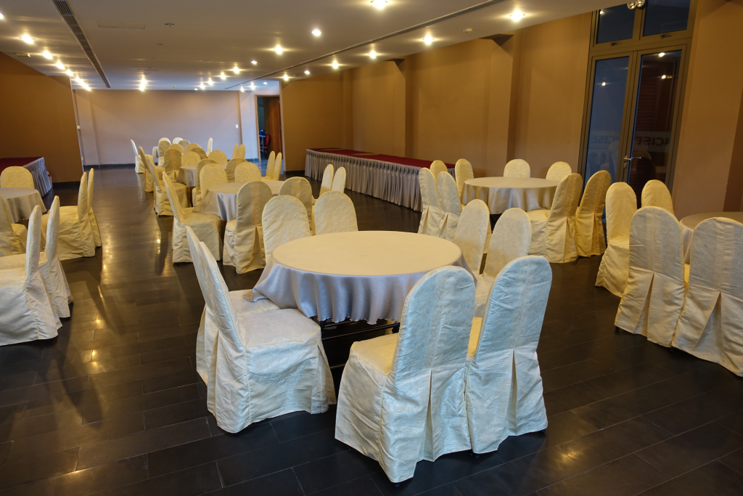
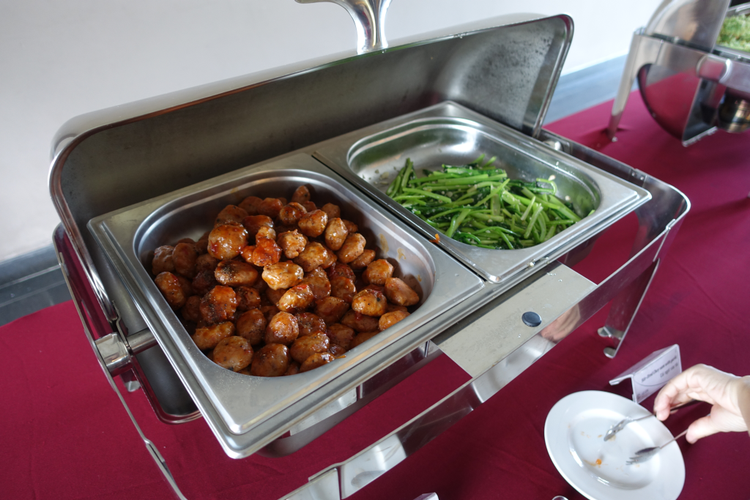
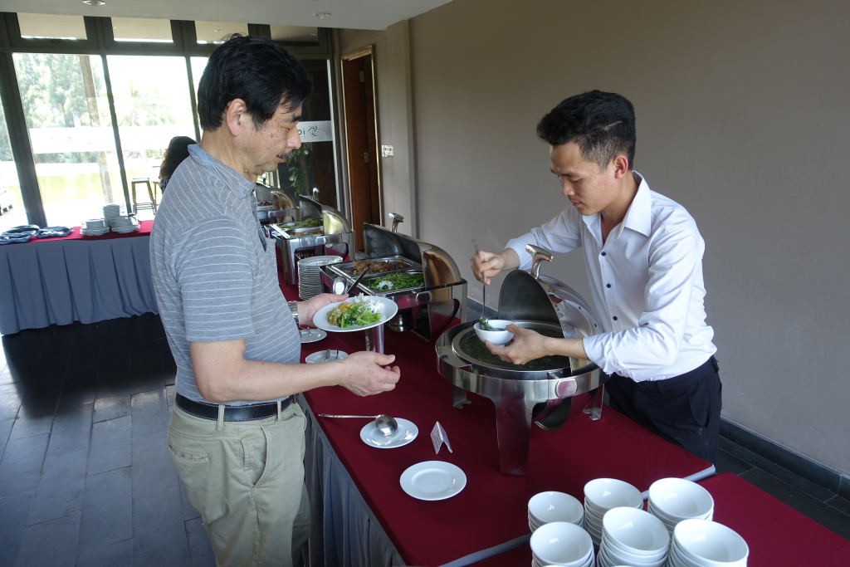
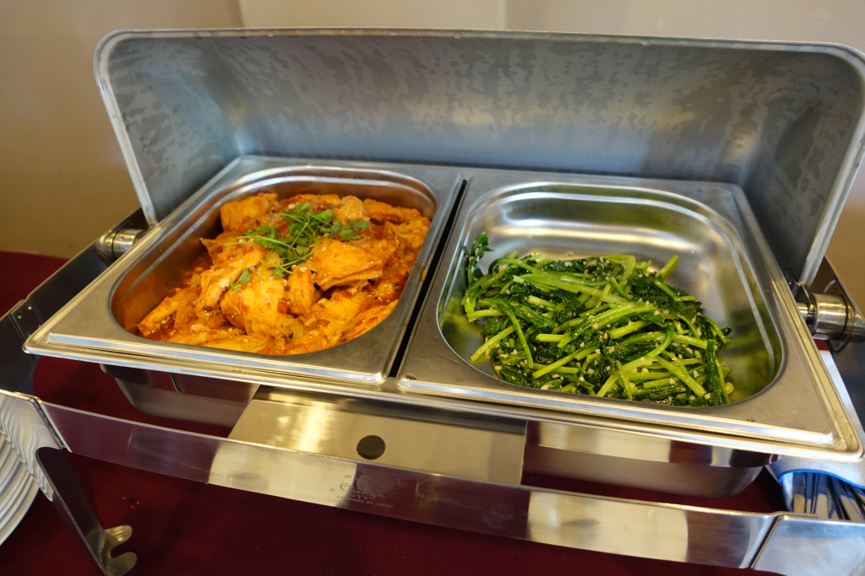
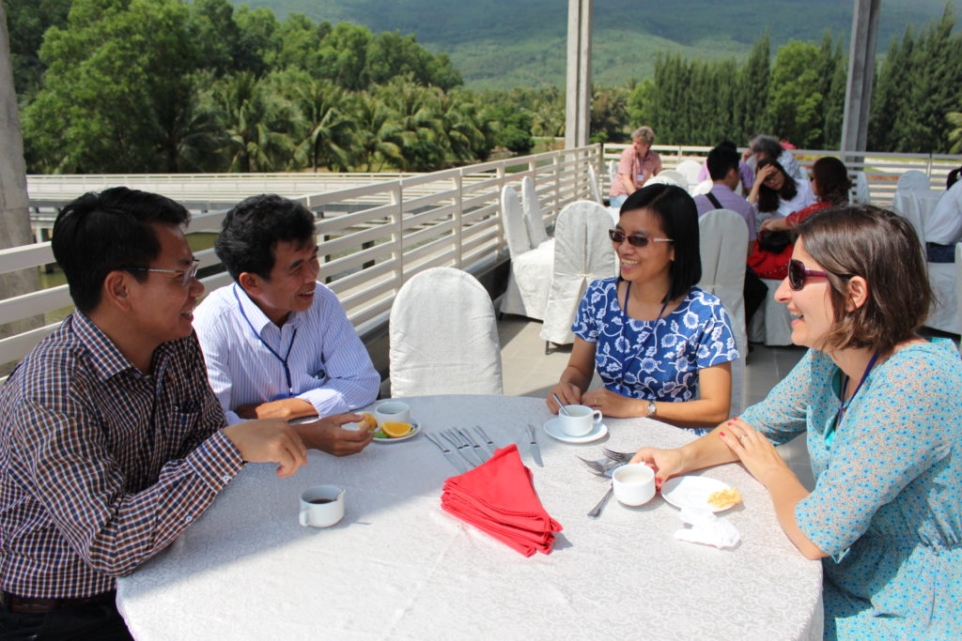
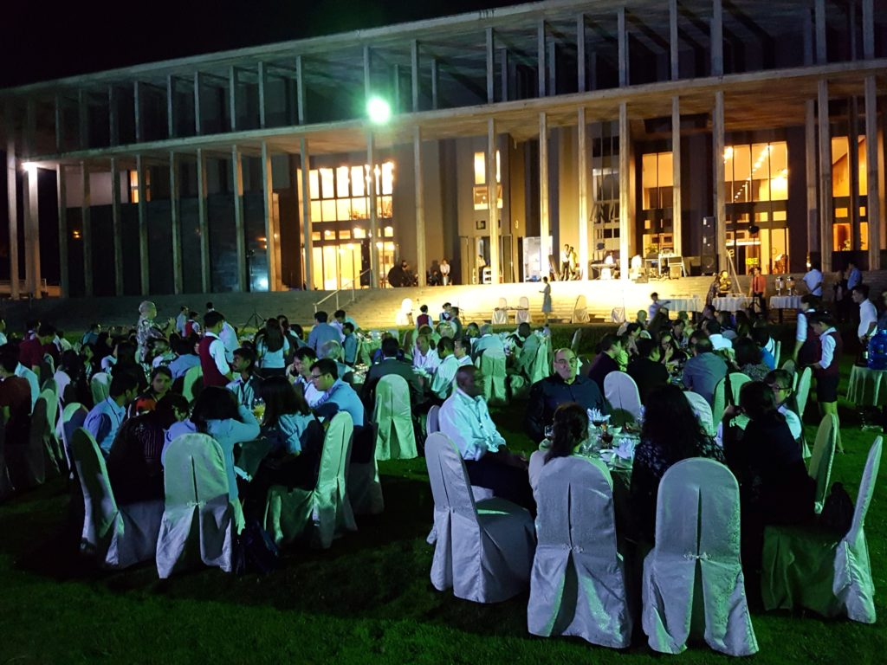
Venue
Coffee break – lunches - Dinners by local catering partner

Slide 11
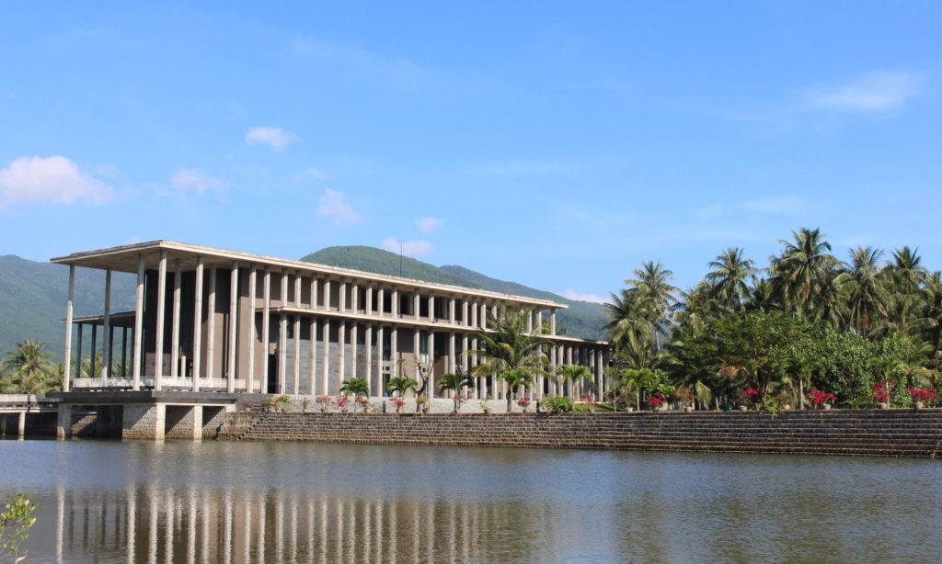
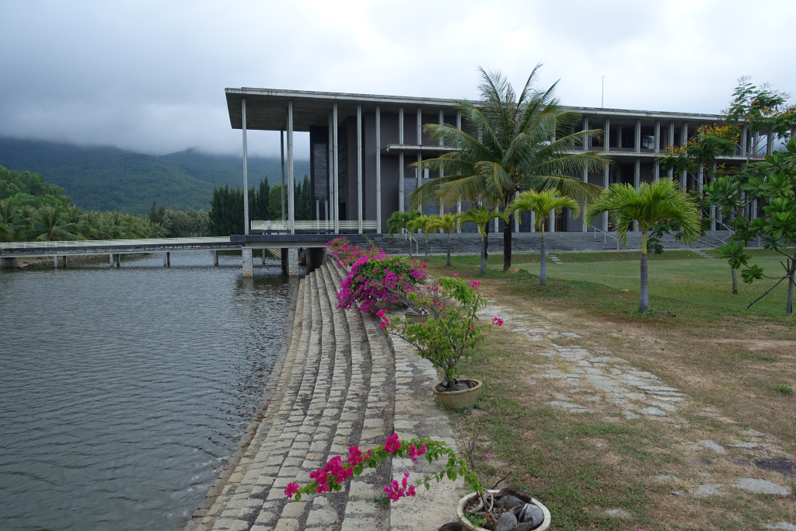
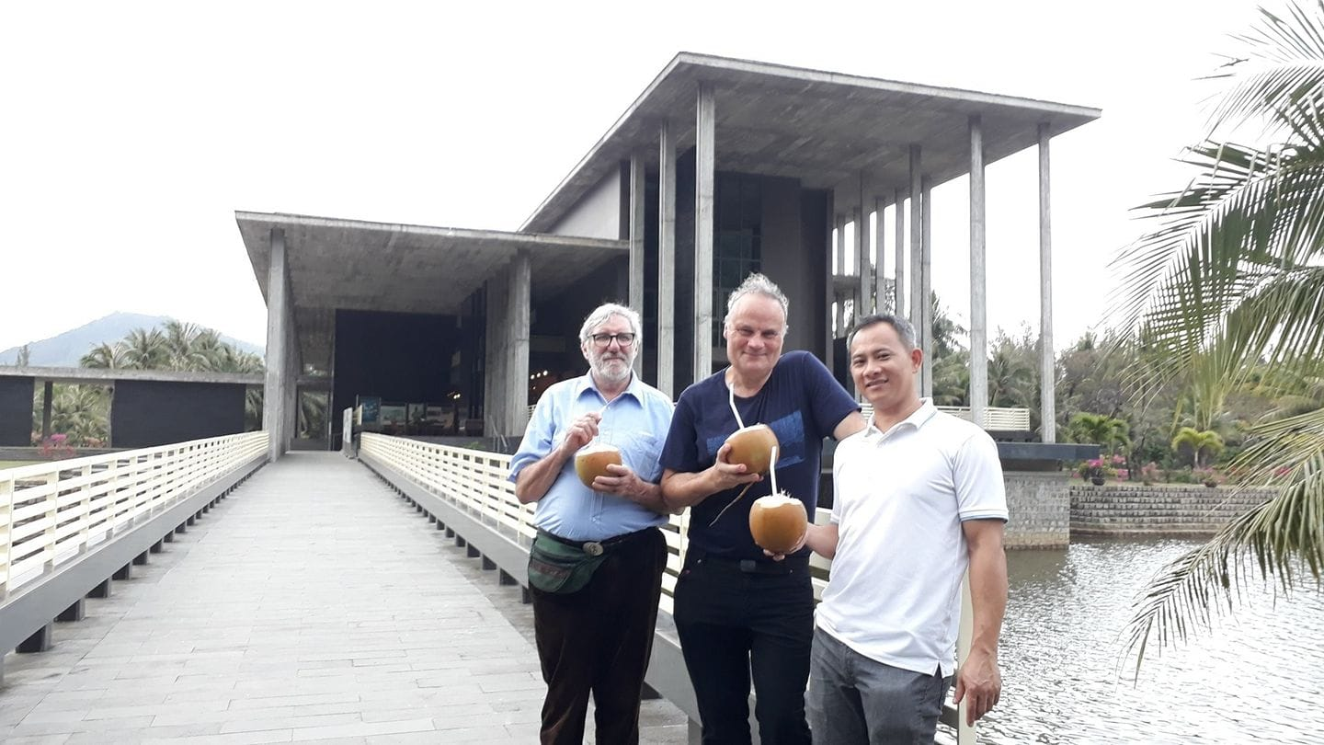
Surroundings (on site)

Slide 12
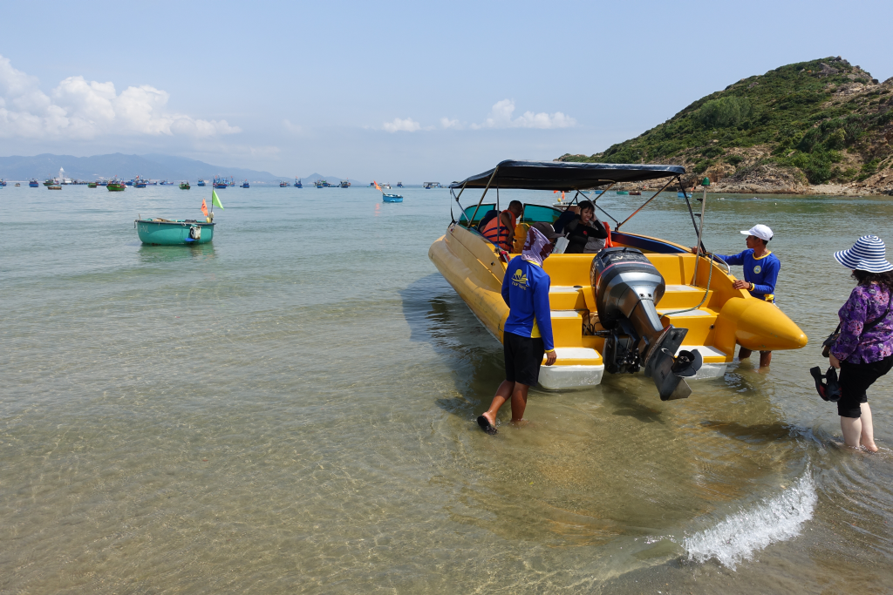
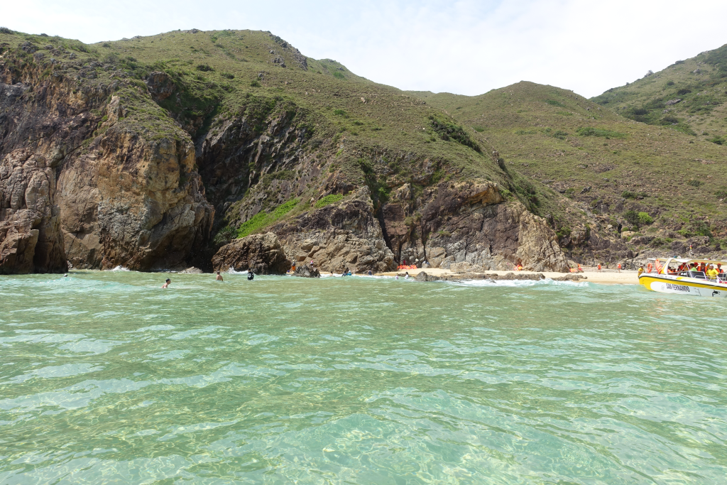
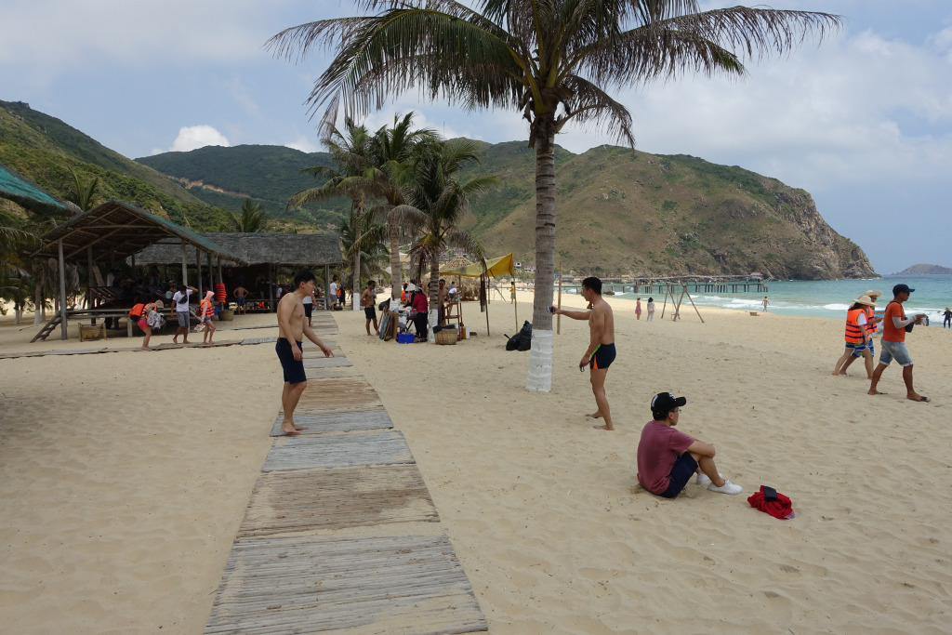
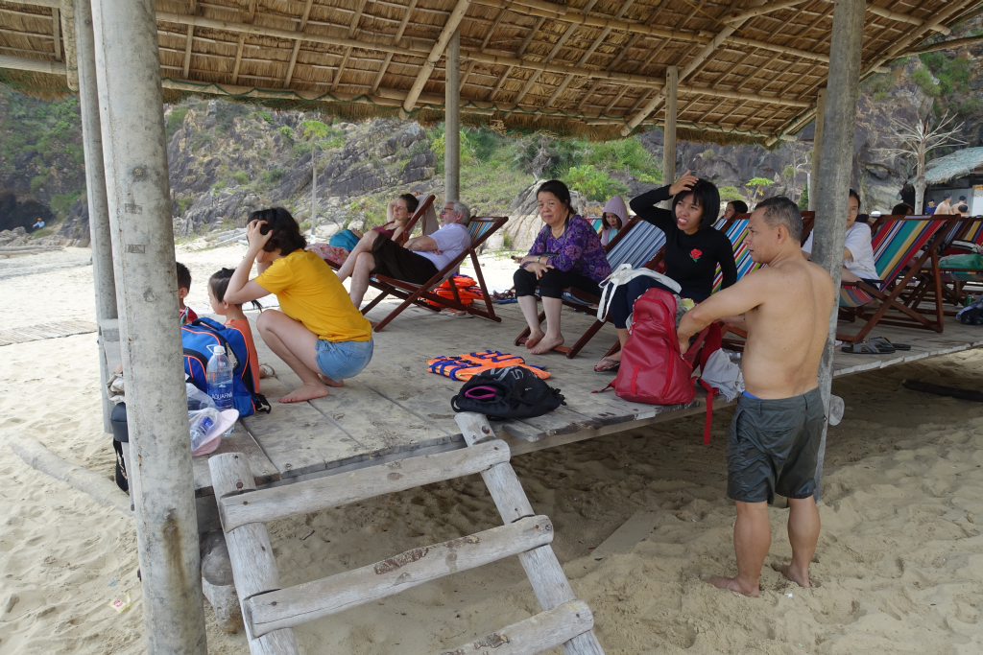

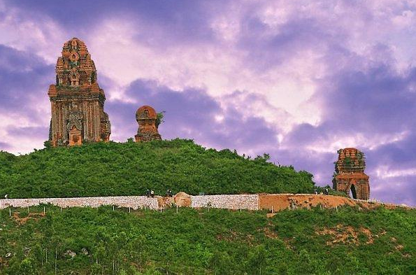
Excursion
Excursion to Ky Co beach
Banh It Towers (20 km from Quy Nhon)

Slide 13
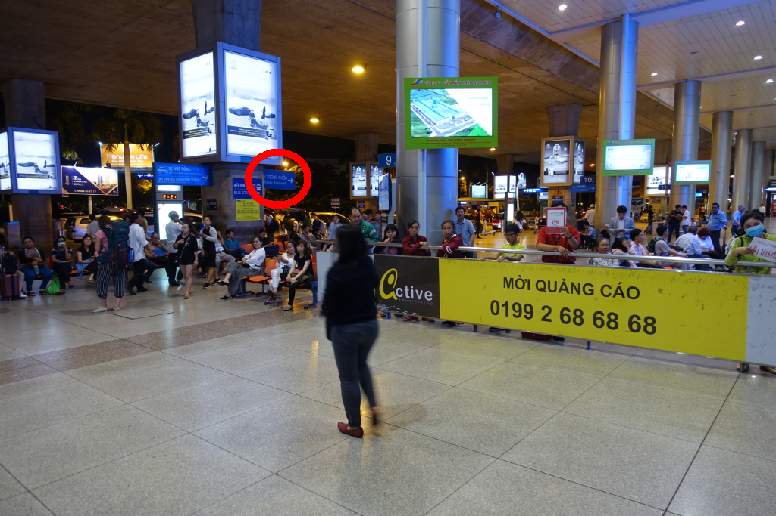
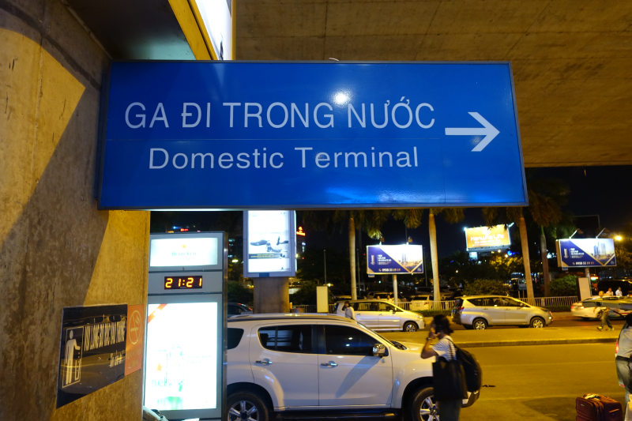
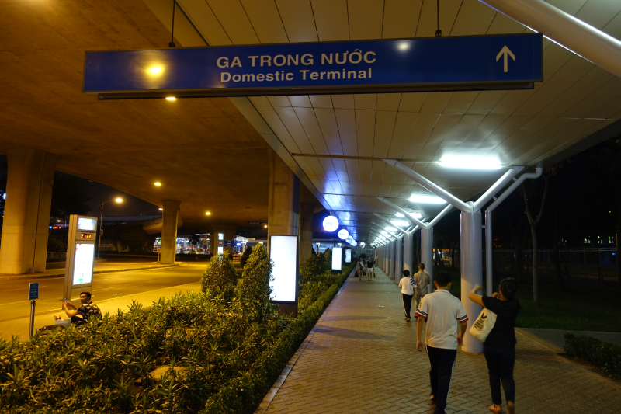
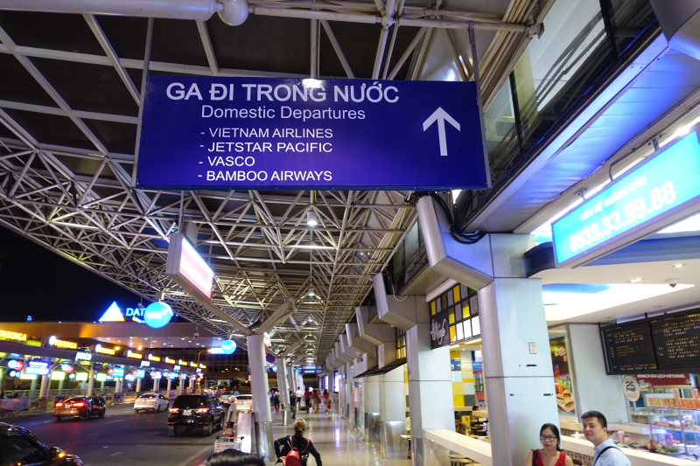
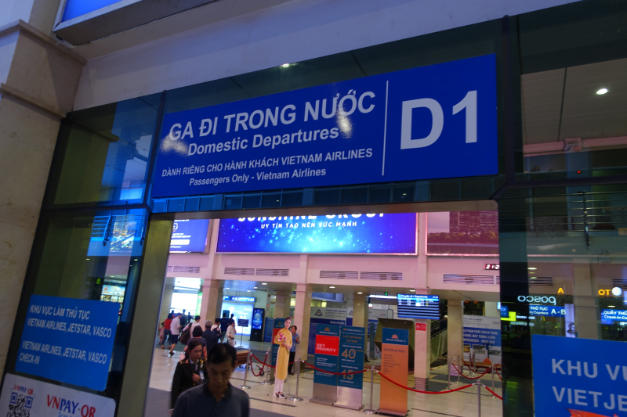
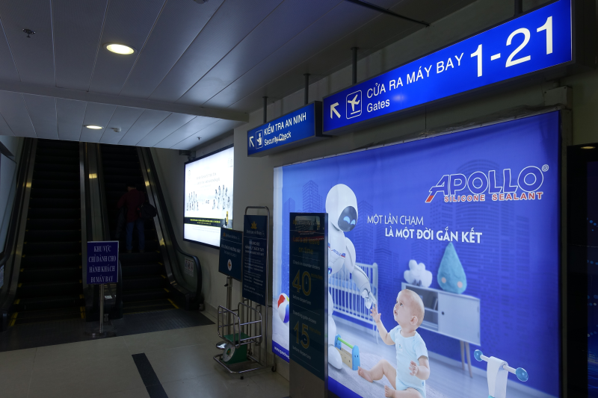
Travel through Ho Chi Minh City airport to Phu Cat

Slide 14
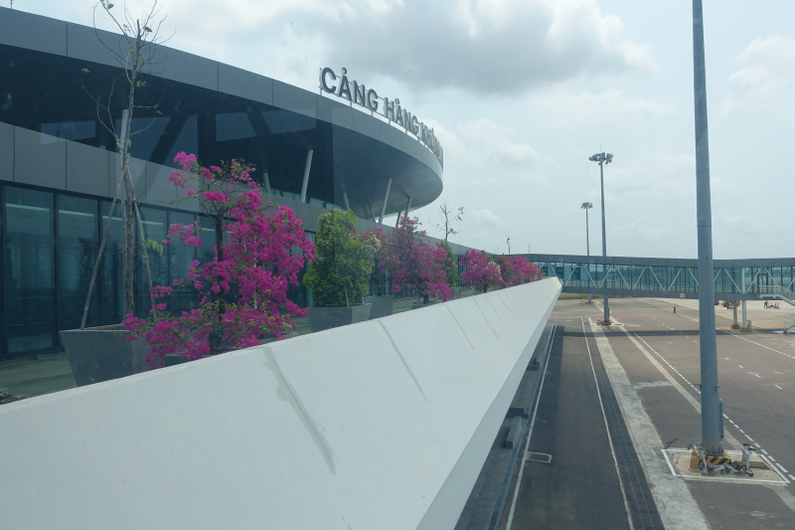
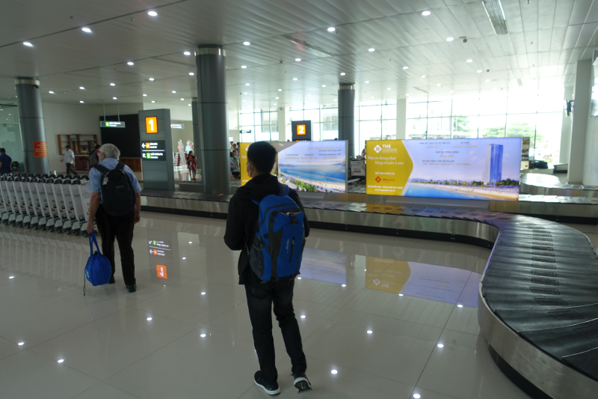
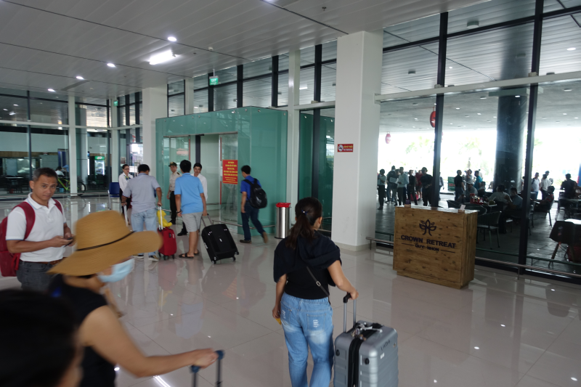
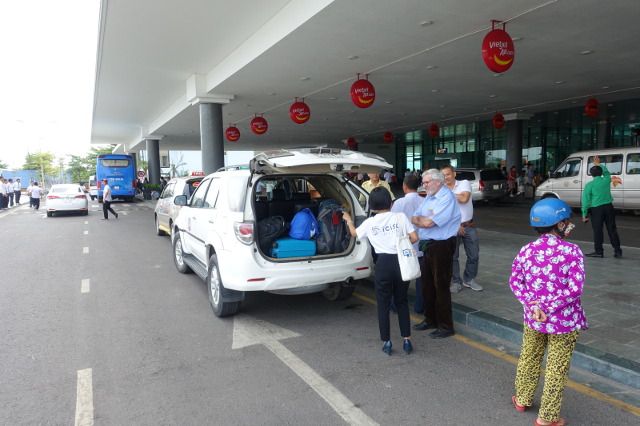
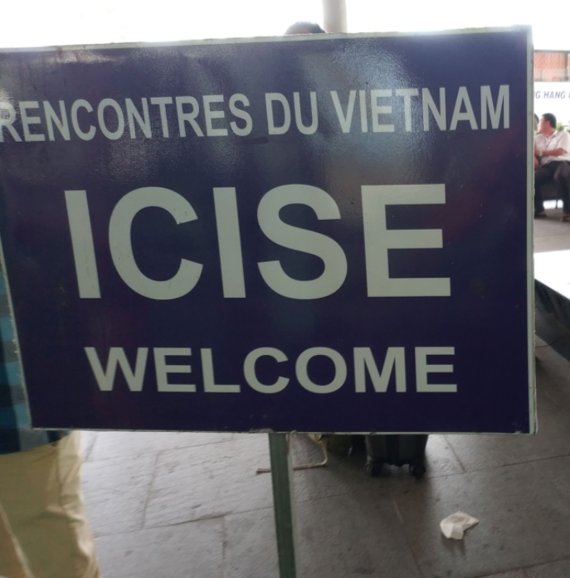
Phu Cat airport: small and modern. Shuttle to pick up participants.

Slide 15
Accomodation
Hotel (ProScience hotel) being built at the conference center.
Many hotels in downtown Quy Nhon
  Capacity more than enough for RT (1000 4*/5*, 500 3*)
  Good quality for reasonable price
  Simpler hotels for participants on tight budget
    Option to book hotel including dinner
  ICISE has partner hotels
  Shuttle service Quy Nhon <-> ICISE will be provided

Slide 16
Warmly welcome you all to Vietnam
for the 23rd Realtime Conference 2022

