Slide 1
High-Level Software Tools for LLRF System Dedicated to Elliptical Cavities Management of European Spallation Source Facility
Kacper Kłys
22nd Virtual IEEE Real Time Conference – October 2020
1/13
Notes:
1

Slide 2
Agenda
European Spallation Source
LLRF control system
EPICS and E3
Piezo Driver management and monitoring software
LO Distribution Tool
IPMI Manager supporting software
2/13
22nd Virtual IEEE Real Time Conference – October 2020
Notes:
2

Slide 3
European Spallation Source
Fig. 1 Block diagram ot the ESS accelerator
ESS is an accelerator-driven neutron spallation source.
It generates protons from the ion source.
They are accelerated to suitable energy and driven to target.
Protons are accelerated with energy from Radio Frequency system.
High Beta and Medium Beta sections are composed of 84 and 36 elliptical cavities.
3/13
22nd Virtual IEEE Real Time Conference – October 2020
Notes:
3

Slide 4
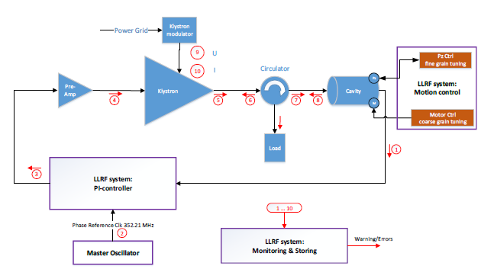
Low Level Radio Frequency Control System
Fig. 2 Schematic of the LLRF section
Control of electrical field’s parameters in the superconductive cavities (phase and amplitude).
Compares current value against a group of desired data.
Uses PI controller.
4/13
22nd Virtual IEEE Real Time Conference – October 2020
Notes:
4

Slide 5
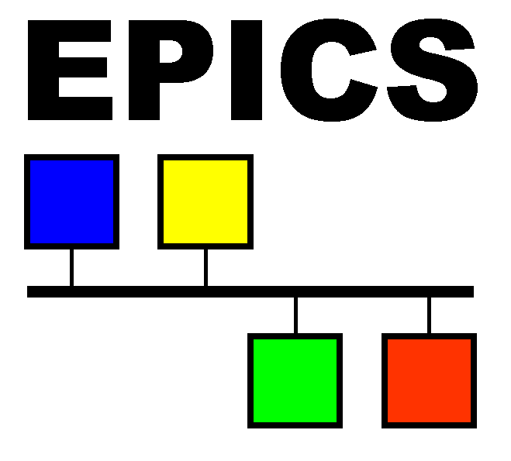
EPICS and E3
E3
Fig. 3 Logos of EPICS and E3
Experimental Physics and Industrial Control System (EPICS) – software toolkit for distributed control system.
Bases on client/server idea.
Data stored and accessed in Process Variables (PVs).
ESS EPICS Environment (E3) – environment where EPICS applications are compiled and launched.
Helps to keep consistency, easier long term maintenance.
Focuses on device integration.
5/13
22nd Virtual IEEE Real Time Conference – October 2020
Notes:
5

Slide 6
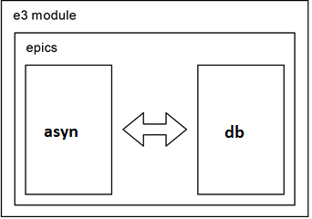
IOCs Architecture and E3
Fig. 4 Standard IOC structure
EPICS structure is encapsulated into E3 module.
IOC uses C++ asyn class to communicate with device.
Asyn reads/loads data from/to PVs in database.
PVs are used by users to set device parameters.
6/13
22nd Virtual IEEE Real Time Conference – October 2020
Notes:
6

Slide 7
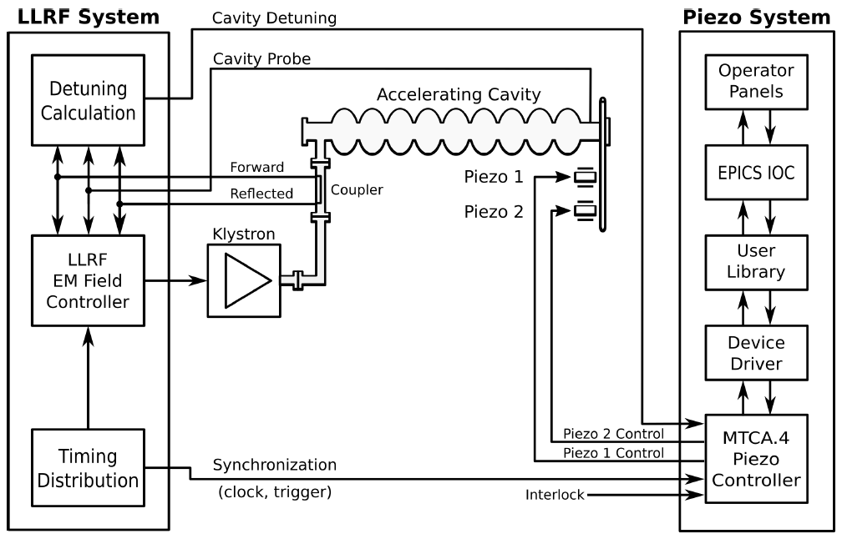
Piezo Driver - Overview
Piezo elements are used for fast compensation of detuning.
Detuning can be caused by the Lorentz force, microphonics.
Designed as Rear Transition Module (RTM), MicroTCA.4 standard
Bases on FPGA board.
Fig. 5 Piezo control system of the ESS accelerator
7/13
22nd Virtual IEEE Real Time Conference – October 2020
Notes:
7

Slide 8
Piezo Driver – IOC structure
e3-PiezoDriver
(e3-iocStats, e3-autosave, e3-recsync)
SensorConfiguration.db
AcutatorsConfiguration.db
DebugConfiguration.db
asyn driver
ics-pcd-lib
ics-xdriver-core
ics-xdriver-lib
8/13
Fig. 6 Piezo Driver IOC block diagram structure
22nd Virtual IEEE Real Time Conference – October 2020
Notes:
8

Slide 9
LO Distribution Tool – Overview
LLRF control system needs to master phase reference clock and propagate system clock.
Local Oscillator (LO) RTM device is responsible for the generation of the local oscillator signal.
It is used for RF down-conversion.
The device was implemented as RTM module in MTCA.4 standard.
Uses same drivers as Piezo Driver.
9/13
22nd Virtual IEEE Real Time Conference – October 2020
Notes:
9

Slide 10
LO Distribution Tool – IOC structure
e3-LOdistribution
(e3-iocStats, e3-autosave, e3-recsync)
LOdistribution.db
asyn driver
ics-lo-lib
ics-xdriver-core
ics-xdriver-lib
Fig. 7 LO IOC block diagram structure
10/13
22nd Virtual IEEE Real Time Conference – October 2020
Notes:
10

Slide 11
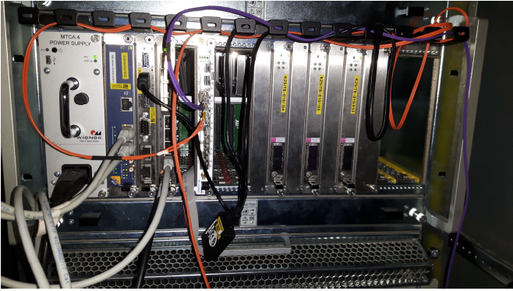
IPMI Manager – Overview
Major part of the LLRF system is based on MTCA.4 architecture.
Its control layer bases on IPMI (Intelligent Platform Management Interface) protocol.
It can be used to monitor the whole system and attached modules.
IPMI Manager is a scalable software.
Dynamical detection of available modules and generation of PVs.
Uses OpenIPMI library.
Fig. 8 MTCA.4 crate
11/13
22nd Virtual IEEE Real Time Conference – October 2020
Notes:
11

Slide 12
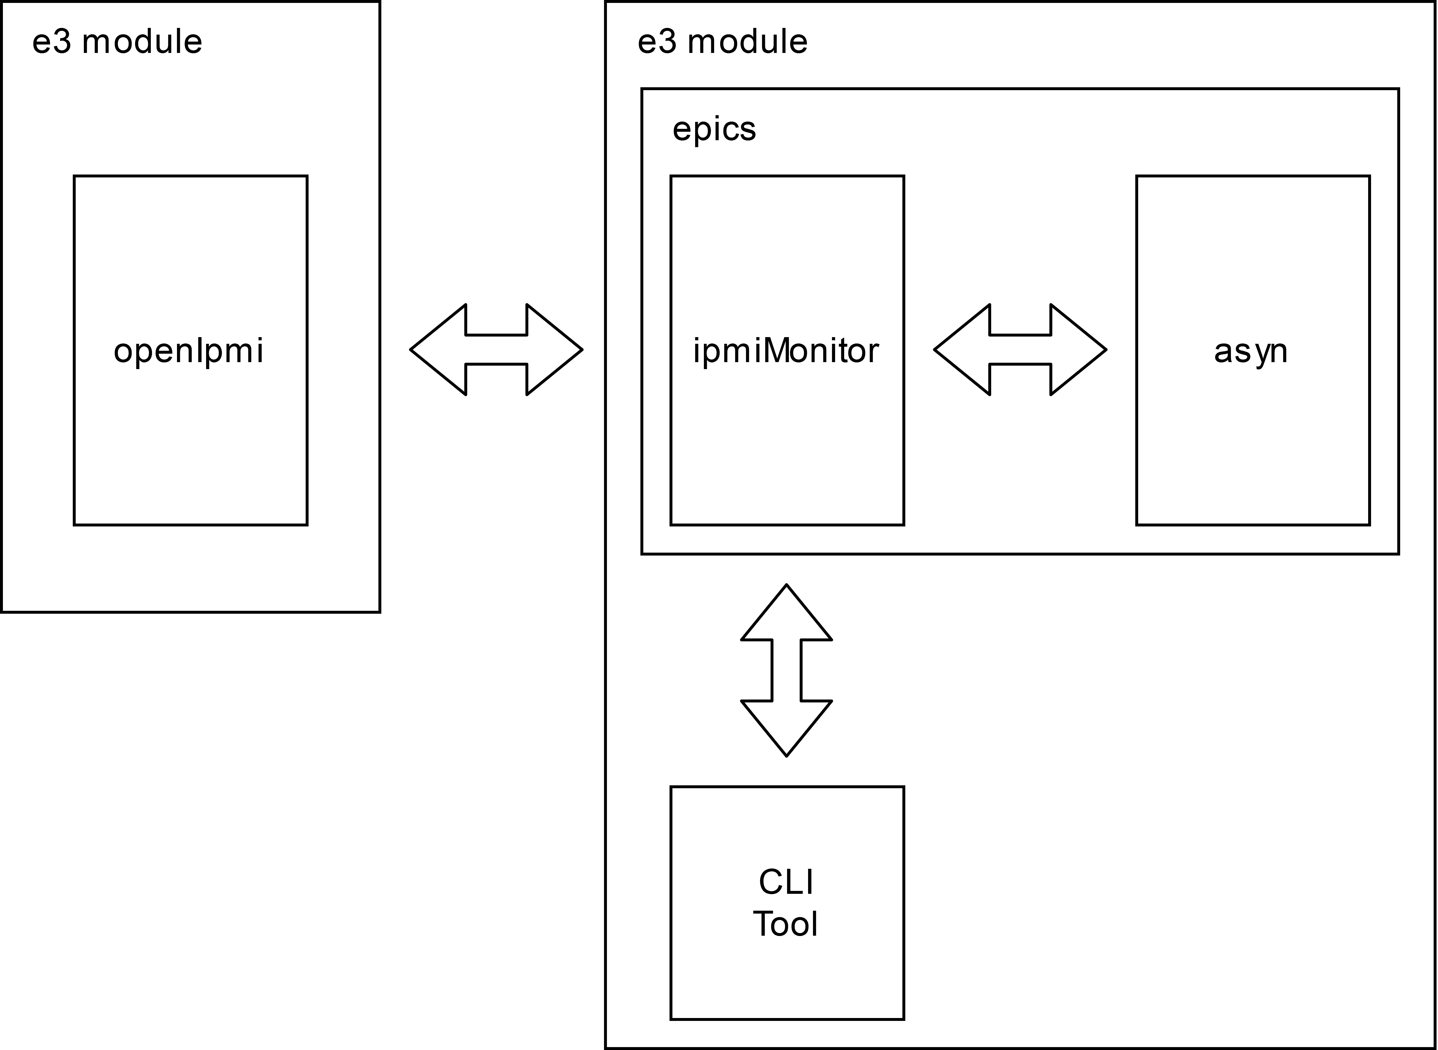
IPMI Manager – IOC structure
Fig. 9 IPMI IOC structure
12/13
22nd Virtual IEEE Real Time Conference – October 2020
Notes:
12

Slide 13
Summary
All the tools are still being developed (looking for bugs, making them more user-friendly).
They have been tested with real devices.
Those measurements and their results were recorded as videos.
13/13
22nd Virtual IEEE Real Time Conference – October 2020
Notes:
13

