Slide 1


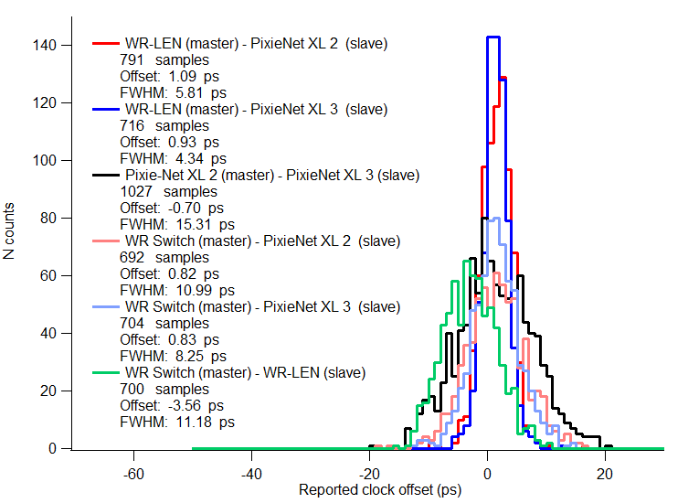
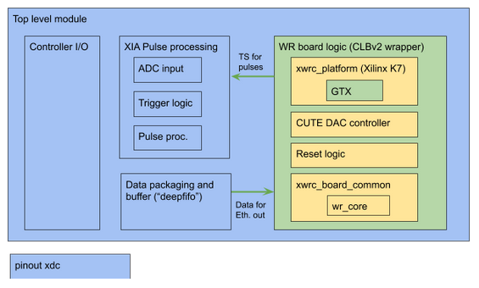
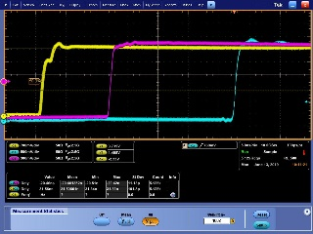

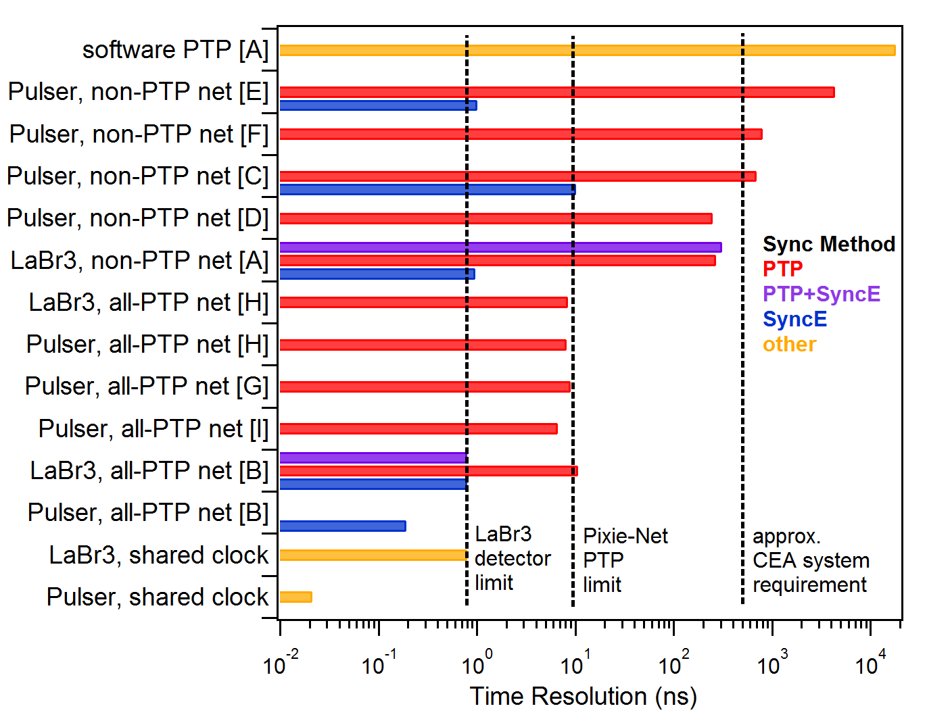
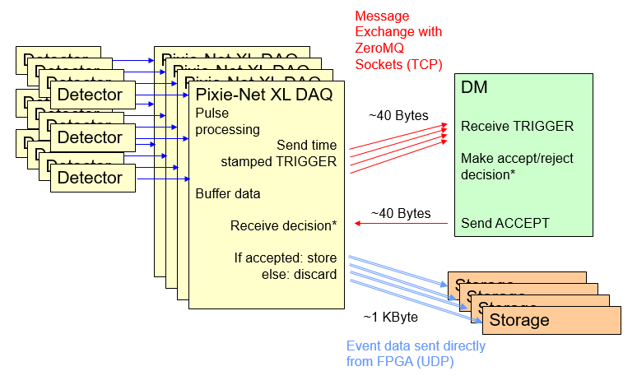
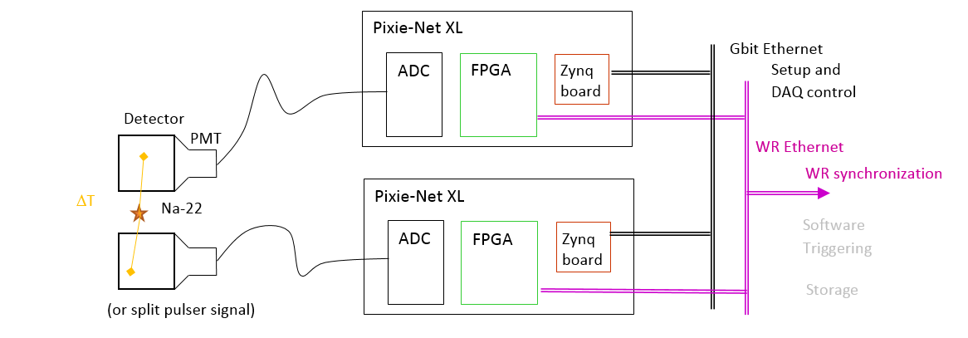
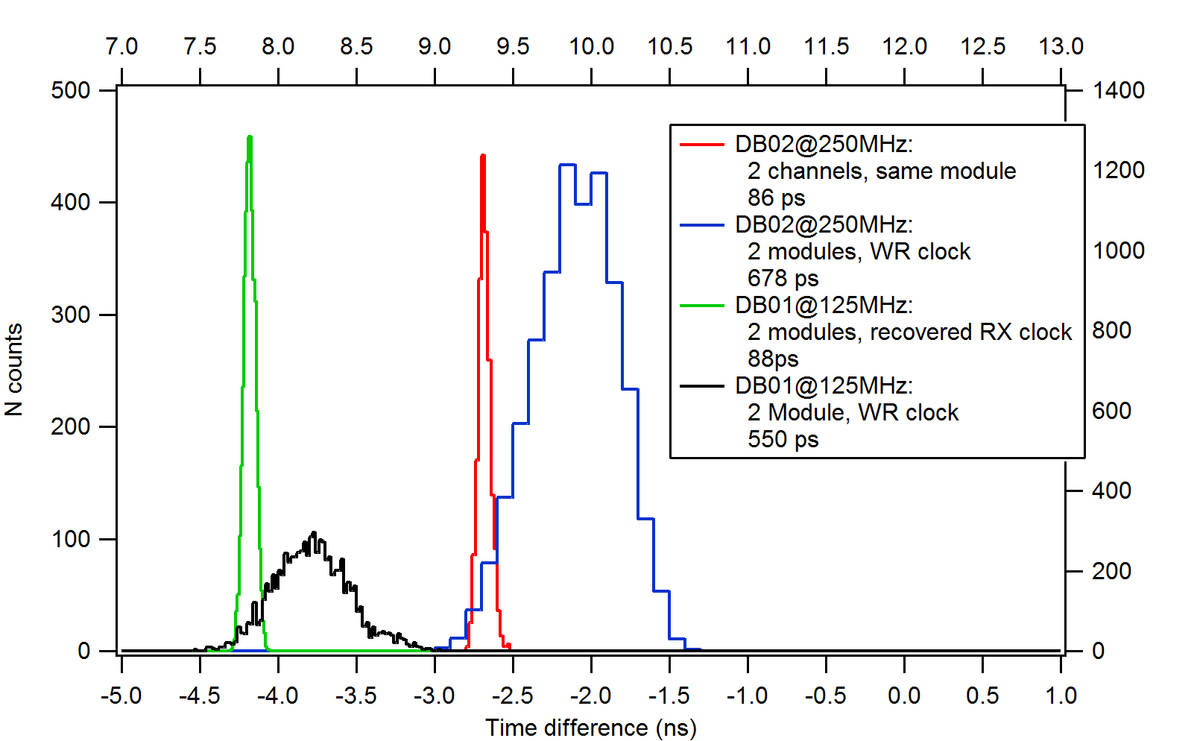
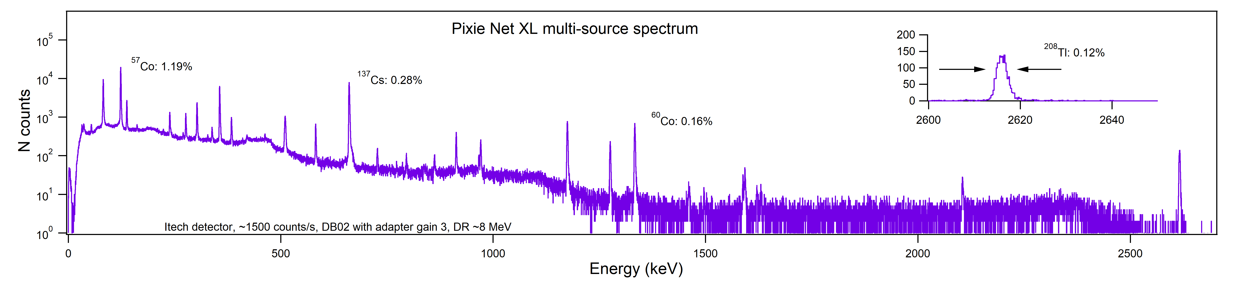
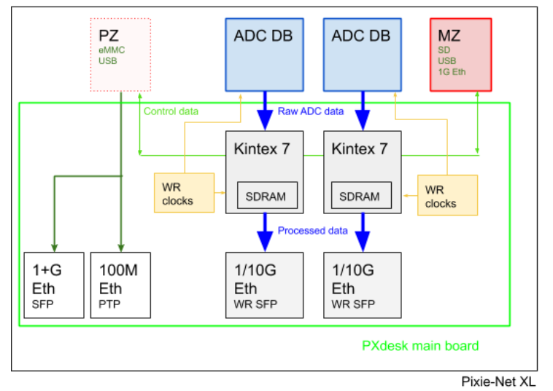
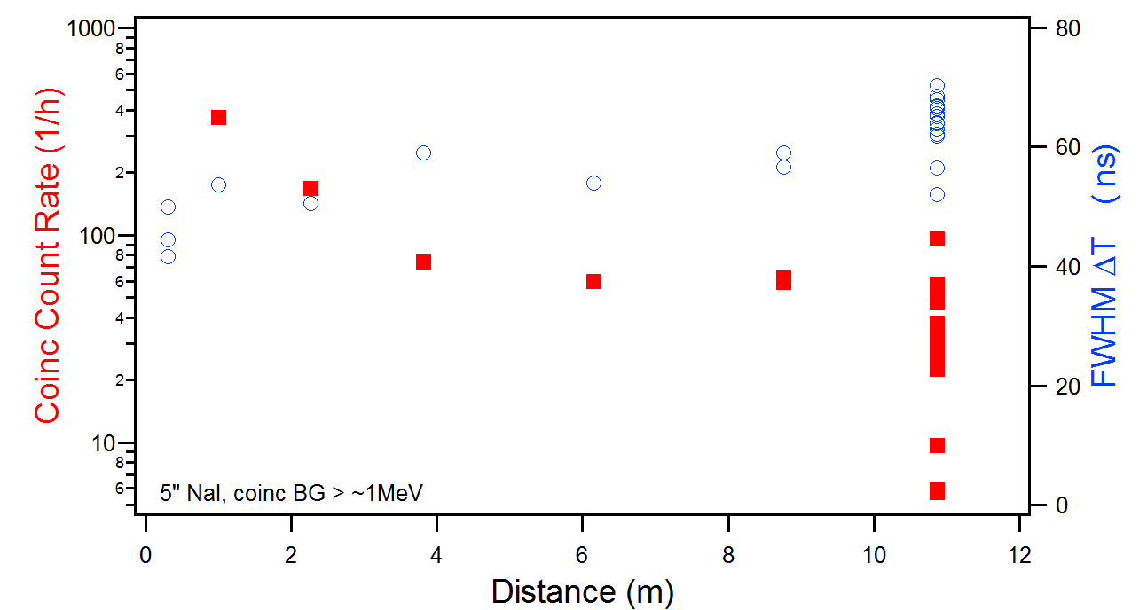
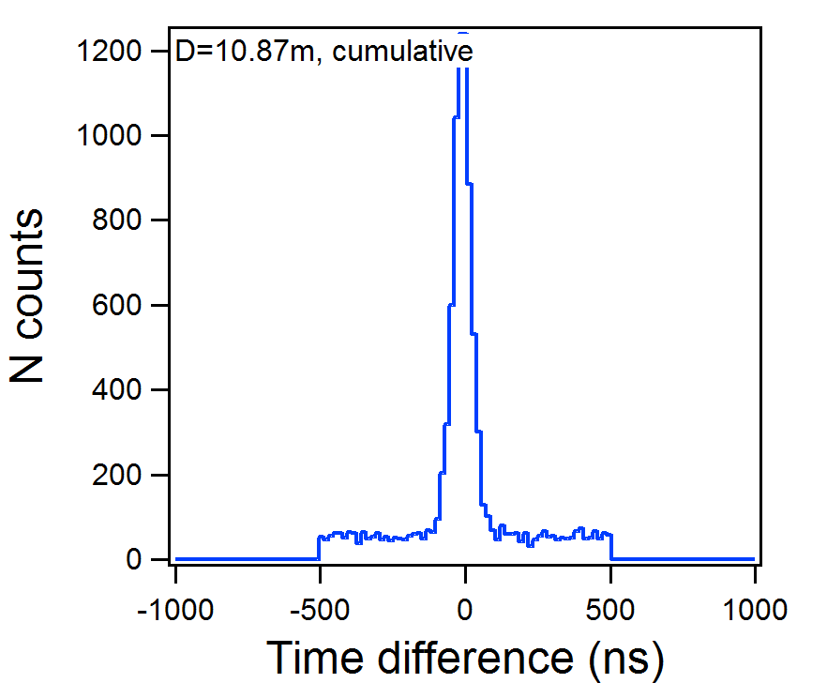
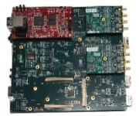
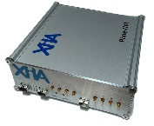


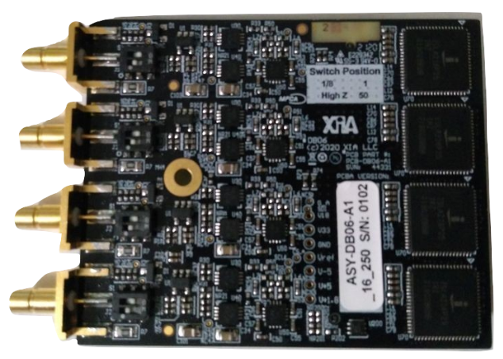
White Rabbit Time Synchronization for Radiation Detector Readout Electronics
W. Hennig, S. Hoover • XIA LLC, 31057 Genstar Rd, Hayward, CA 94544, USA • whennig@xia.com
PLEASE SCROLL DOWN OR FOLLOW THE HYPERLINKS FOR DETAILED VIEW
www.xia.com
Background
Radiation detector systems in nuclear physics applications are often large arrays of individual detectors and can be physically separated in different rooms or buildings. In such systems, the time synchronization of the data collected from different detectors is essential to reconstruct multi-detector events such as scattering and coincidences. Traditionally, this is accomplished by distributing clocks and triggers via dedicated connections, but newer methods such as the IEEE 1588 Precision Time Protocol (PTP) and White Rabbit (WR) allow clock synchronization through the exchange of timing messages over Ethernet. Consequently, we report here the use of White Rabbit in a new detector readout electronics module, the Pixie-Net XL.
Previous work [1] studied the use of PTP and Synchronous Ethernet (SyncE) for synchronization of detector data from multiple Pixie-Net modules, an earlier and smaller version of the digitizing and pulse processing electronics described here. The time resolution for coincident events reached ~10ns FWHM with PTP synchronization and 200-800ps FWHM with SyncE synchronization, compared to 20-50ps FWHM with a dedicated clock connection. Thus we concluded that PTP and SyncE are good alternatives for a number of applications (e.g. coincidence background suppression), but not sufficient for the most demanding applications (e.g. time of flight measurements requiring <100ps timing). Preliminary tests with a commercial WR demo kit obtained better time resolution than SyncE (~150ps FWHM) and thus in the current stage of the project we integrated the WR firmware and hardware into the new electronics.
Timing Characterization Measurements
Pixie-Net XL Firmware design
SW/FW reports
Timing resolutions
4.3-15.3 ps FWHM
No significant difference
between commercial WR
modules and Pixie-Net XL
But is a SW report a good measure for actual performance ??
The firmware of each Kintex FPGA is
divided into 4 major sections:
Detector pulse processing derived
from previous Pixie pulse
processors [4] and option to latch
White Rabbit time stamps
Controller I/O with Zynq board
to write processing parameters
and read out data in slow debug
mode, using [5].
Output data is buffered in a 256 MB
SDRAM, assembled as UDP
packages, and fed into the White
Rabbit “fabric interface”
White Rabbit core [2] with customized Verilog wrapper and
GTX pinout matching Pixie-Net XL pinout.
The WR “SoftPLL” core reports performance values, e.g. the clock offset of WR slave to WR master.
Measured for a variety of commercial WR modules and the Pixie-Net XL
Histogramm offsets, apply Gauss fit
XIA pulse processing adapted to Kintex board
WR open source unchanged
WR open source adapted
Clock jitter tests
Figure 3. Pixie-Net XL firmware block diagram
Probing actual clock or PPS signals on Pixie-Net XL vs PPS reference pulse from WR master (commercial WR switch)
Oscilloscope reports std.dev. of delay from edge to edge
(= “jitter”)
Pixie-Net XL jitter is ~100ps, but commercial WR module reaches 10-15ps
Further probing shows tuned WR clock on Pixie-Net XL is unusually jittery, and clock fanout for ADCs adds even
more jitter (~300ps)
But fortunately the Recovered RX Ethernet clock is low jitter (17ps) and can be routed from FPGA to ADC as a workaround
[A] Dell PowerConnect 2216
non-PTP
[B] back to back, PTP
[C] Netgear ProSAFE GS108
non-PTP
[D] Toplink TK 1005G, non-PTP
[E] Linksys EZXS55W,
non-PTP
[F] Moxa EDS-405A-PTP,
non-PTP (disabled)
[G] Moxa EDS-405A-PTP, PTP
[H] Oregano syn1588, PTP
[I] Artel Quarra 2800, PTP
Software Triggering
Blue: WR Master PPS (commercial WR switch)
Red: WR Slave PPS (commercial WR-LEN
Yellow: WR Slave PPS (Pixie-Net XL)
To further reduce cabling complexity, we are developing “software triggering”, where decisions to record data are made through the exchange of data packets over the network by software instead of hardwired connections. Each Pixie-Net XL in a multi-module system will send out minimal data packages (metadata) which are used by a central Decision Maker (DM) to make accept/reject decisions, which are then communicated back to all Pixie-Net XL modules. The Pixie‑Net XL then independently move their full data to long term storage or discard.
Figure 1. Summary of FWHM time resolution for various signal sources and PTP/SyncE network configurations with Pixie-Net electronics (pictured left)
Time of Flight (Pulser)
Two detector signals (or split pulser) connected to two Pixie-Net XL synchronized via WR
Capture waveforms and timestamps, compute sub-sample time of arrival by interpolation on rising edge [6]
Histogram the difference of time of arrival ΔT in both modules, apply Gauss fit
This is the measure of performance closest to “real world” applications
Below 100ps resolution, performance depends strongly on pulse shape, interpolation method, etc
Figure 4. Concept of software triggering, for example to apply coincidence decision during the data acquisition without the need of hardwire logic.
Pixie-Net XL Hardware design
The electronics hardware design centers on two Kintex 7 FPGAs on the “PXdesk” main board. Each FPGA is connected with high speed LVDS lines, gigabit transceiver lines, and slower CMOS control lines to a high density connector for ADC daughter cards that implement multiple channels detector signal digitization. Moving the ADC circuitry to a daughter card allows customization of the inputs for different applications. Each FPGA is further connected to a dedicated 4Gb SDRAM memory for buffering of output data, an SFP card cage for 1G Ethernet for the WR connection (capable of 10G with upgrades), and a variety of general purpose I/O connections and other peripherals. Both FPGAs are further connected to a daughterboard implementing the DAC controlled oscillators from WR reference designs [2], which also clock the ADCs (with buffers).
Detector Readout Performance
ADC DB: ADC daughtercards for detector readout (flexibility in ADC channels, rate, precision, or non-ADC functions)
MZ: Zynq controller board (MicroZed [3]) reused from Pixie-Net (optionally PicoZed, PZ)
High speed data flow from ADC to FPGA to WR Ethernet output
WR, PTP, SyncE can be used as source for ADC and FPGA clocking
Targets:
<100ps timing resolution
10G Ethernet
processing ~1M pulses/s
The Pixie-Net XL is designed to read out scintillators at high rate and precision detectors (HPGe) with high energy resolution. Preliminary performance results indicate performance similar to XIA’s established pulse processor modules.
Figure 5. Multi-source HPGe spectrum with DB02 (12bit, 250 MSPS).
Cosmic coincidences
Use cosmic showers as source for coincident radiation separated by large distance.
Using large (slow) detectors for efficiency.
Goal is to demonstrate synchronization over long time and large distance
(not high precision)
Only use WR time stamps, not waveform interpolation
Summary
We implemented the White Rabbit time synchronization in a new detector readout electronics module, the Pixie-Net XL. Time resolutions in preliminary measurements are 5-15ps per software output, ~100ps per clock jitter measurements and ~500ps per digitized coincident pulser signal; overall well below 1ns. The method has been proven suitable for distances of more than 10m. A software triggering scheme has been demonstrated and performance with
radiation detectors is being characterized
Prototypes built so far
4-channel, 75-125 MHz,
14bit ADC daughtercard
8-channel, 250 MHz,
12bit ADC daughtercard
Differential inputs via HDMI cable
Background rate ~500 counts/s each detector, recording ~8.5 million records (>1 MeV) per day.
Coincidence rate decreases with distance. Hundreds of coincidence events per day at ~11m distance.
Timing resolution ~70 ns FWHM
If modules could share trigger information besides clock synchronization, we would not have to record the 99.984% waste data => use Software Triggering
Fully
assembled box
4-channel,
16bit, 250 MHz or 14bit, 500 MHz ADC daughtercard
PXdesk main board with ADC daughtercards and Zynq controller
Figure 2. Pixie-Net XL block diagram and pictures
About XIA LLC
XIA LLC invents, develops and markets advanced digital data acquisition and processing systems for x-ray, gamma-ray, and other radiation detector applications in university research, national laboratories and industry. Having pioneered digital detector readout electronics for over 20 years, our most recent new products integrate PTP and/or White Rabbit
References and Acknowledgments
[1] W. Hennig, et al, IEEE Trans. Nucl. Sci. 66 (2019), p1182
[2] https://ohwr.org/project/white-rabbit
[3] http://zedboard.org/product/microzed
[4] https://www.xia.com/dgf_products.html
[5] http://xillybus.com/xillybus-lite
[6] equivalent to A. Fallu-Labruyere et al, NIM A 579 (2007), p247.
[7] M. Lipinski, et al, 2011 IEEE Intl. Symposium on Precision Clock Synchronization for Measurement, Control and Communication
This material is based upon work supported by the U.S. Department of Energy, Office of Science, Office of Nuclear Physics under Award Number DE-SC0017223.
Disclaimer: "This report was prepared as an account of work sponsored by an agency of the United States Government. Neither the United States Government nor any agency thereof, nor any of their employees, makes any warranty, express or implied, or assumes any legal liability or responsibility for the accuracy, completeness, or usefulness of any information, apparatus, product, or process disclosed, or represents that its use would not infringe privately owned rights. Reference herein to any specific commercial product, process, or service by trade name, trademark, manufacturer, or otherwise does not necessarily constitute or imply its endorsement, recommendation, or favoring by the United States Government or any agency thereof. The views and opinions of authors expressed herein do not necessarily state or reflect those of the United States Government or any agency thereof."
2020 RTC

Slide 2
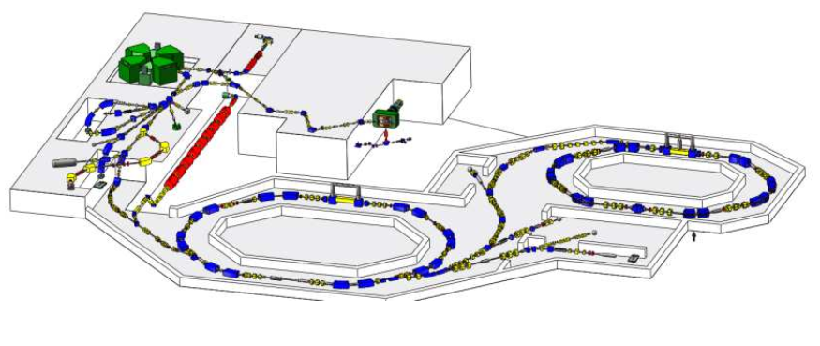


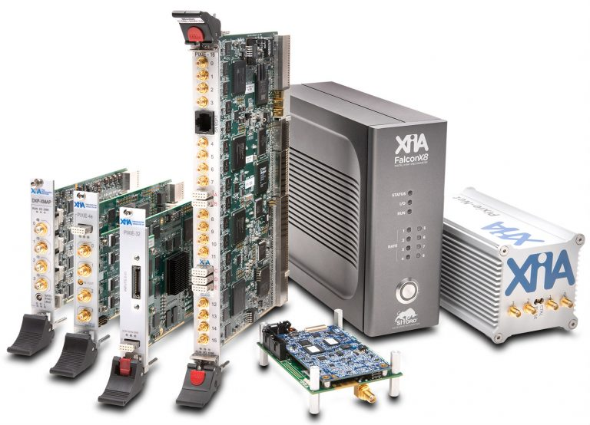

White Rabbit Time Synchronization for Radiation Detector Readout Electronics
W. Hennig, S. Hoover • XIA LLC, 31057 Genstar Rd, Hayward, CA 94544, USA • whennig@xia.com
Motivation
www.xia.com
New
DAQ electronics with White Rabbit / PTP synchronization
Modern technologies allow time synchronization through data network
Large nuclear physics experiments often use physically separated radiation detectors
Electronics to read out detectors must be synchronized to 100ns-100ps,
ideally <10ps
Traditionally use clock/trigger cables for synchronization ☹
XIA has been developing digital data acquisition electronics for radiation detector applications for over 20 years
Notes:
1min summary: 1st four slides: motivation slide – HW slide –results – full poster
Hello, and thank you for your interest in my poster. The work I’m presenting here is developing readout electronics for radiation detectors that integrate the White Rabbit network time synchronization.
As nuclear physics experiments are getting larger and cabling for clocks and triggers gets more and more complicated, methods like IEEE 1588 and White Rabbit that allow time synchronization with very high precision over the data network look like better approach than conventional cabling solutions
At this point, we have a hardware prototype with various digitizing options; integrated our pulse processing with the White Rabbit FPGA IP core, and of course have new software to run it.
We achieved timing precisions in the tens of picoseconds, decent resolution with germanium detectors, and processing throughputs in the hundreds of thousands of pulses per second.
If you like to hear more, I’m happy to guide you through my poster. Don’t worry, I have prepared slides large enough to see the details.

Slide 3
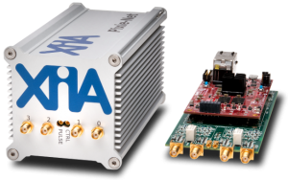
White Rabbit Time Synchronization for Radiation Detector Readout Electronics
W. Hennig, S. Hoover • XIA LLC, 31057 Genstar Rd, Hayward, CA 94544, USA • whennig@xia.com
www.xia.com
Background
Radiation detector systems in nuclear physics applications are often large arrays of individual detectors and can be physically separated in different rooms or buildings. In such systems, the time synchronization of the data collected from different detectors is essential to reconstruct multi-detector events such as scattering and coincidences. Traditionally, this is accomplished by distributing clocks and triggers via dedicated connections, but newer methods such as the IEEE 1588 Precision Time Protocol (PTP) and White Rabbit (WR) allow clock synchronization through the exchange of timing messages over Ethernet. Consequently, we report here the use of White Rabbit in a new detector readout electronics module, the Pixie-Net XL.
Previous work [1] studied the use of PTP and Synchronous Ethernet (SyncE) for synchronization of detector data from multiple Pixie-Net modules, an earlier and smaller version of the digitizing and pulse processing electronics described here. The time resolution for coincident events reached ~10ns FWHM with PTP synchronization and 200-800ps FWHM with SyncE synchronization, compared to 20-50ps FWHM with a dedicated clock connection. Thus we concluded that PTP and SyncE are good alternatives for a number of applications (e.g. coincidence background suppression), but not sufficient for the most demanding applications (e.g. time of flight measurements requiring <100ps timing). Preliminary tests with a commercial WR demo kit obtained better time resolution than SyncE (~150ps FWHM) and thus in the current stage of the project we integrated the WR firmware and hardware into the new electronics.
[A] Dell PowerConnect 2216
non-PTP
[B] back to back, PTP
[C] Netgear ProSAFE GS108
non-PTP
[D] Toplink TK 1005G, non-PTP
[E] Linksys EZXS55W,
non-PTP
[F] Moxa EDS-405A-PTP,
non-PTP (disabled)
[G] Moxa EDS-405A-PTP, PTP
[H] Oregano syn1588, PTP
[I] Artel Quarra 2800, PTP
Figure 1. Summary of FWHM time resolution for various signal sources and PTP/SyncE network configurations with Pixie-Net electronics (pictured above)

Slide 4


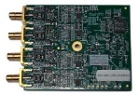
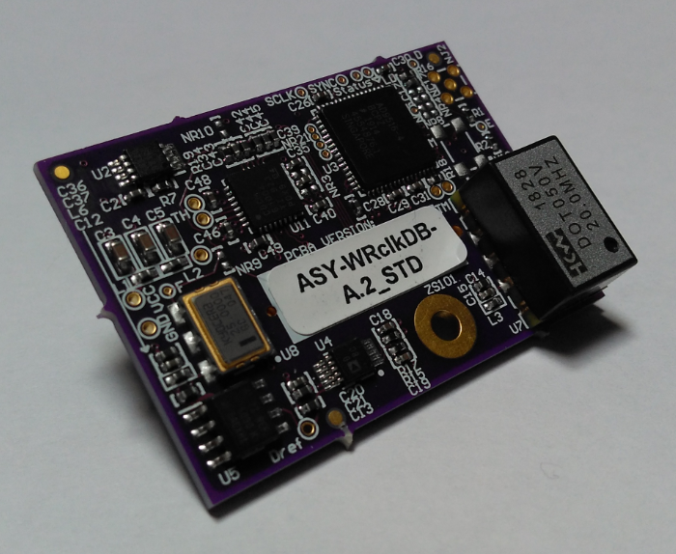
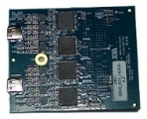
White Rabbit Time Synchronization for Radiation Detector Readout Electronics
W. Hennig, S. Hoover • XIA LLC, 31057 Genstar Rd, Hayward, CA 94544, USA • whennig@xia.com
www.xia.com
Pixie-Net XL Hardware design
The electronics hardware design centers on two Kintex 7 FPGAs. Each FPGA is connected with high speed LVDS lines, gigabit transceiver lines, and slower CMOS control lines to a high density connector for ADC daughter cards that implement multiple channels detector signal digitization. Moving the ADC circuitry to a daughter card allows customization of the inputs for different applications. Each FPGA is further connected to a dedicated 4Gb SDRAM memory for buffering of output data, an SFP card cage for 1G Ethernet for the WR connection (capable of 10G with upgrades), and a variety of general purpose I/O connections and other peripherals. Both FPGAs are further connected to a daughterboard implementing the DAC controlled oscillators from WR reference designs [2], which also clock the ADCs (with buffers).
ADC DB: ADC daughtercards for detector readout (flexibility in ADC channels, rate, precision, or non-ADC functions)
MZ: Zynq controller board (MicroZed [3]) reused from Pixie-Net (optionally PicoZed, PZ)
High speed data flow from ADC to FPGA to WR Ethernet output
WR, PTP, SyncE can be used as source for ADC and FPGA clocking
Targets:
<100ps timing resolution
10G Ethernet
processing ~1M pulses/s
Prototypes built so far
4-channel, 75-125 MHz,
14bit ADC daughtercard
8-channel, 250 MHz,
12bit ADC daughtercard
Differential inputs via HDMI cable
4-channel,
16bit, 250 MHz or 14bit, 500 MHz
ADC daughtercard
Fully
assembled box
White Rabbit Clock Daughterboard
Pxdesk main board with ADC daughtercards and Zynq controller
Figure 2. Pixie-Net XL block diagram and pictures

Slide 5
White Rabbit Time Synchronization for Radiation Detector Readout Electronics
W. Hennig, S. Hoover • XIA LLC, 31057 Genstar Rd, Hayward, CA 94544, USA • whennig@xia.com
www.xia.com
SW/FW reports
Timing resolutions
4.3-15.3 ps FWHM
No significant difference
between commercial WR
modules and Pixie-Net XL
But is a SW report a good measure for actual performance ??
The WR “SoftPLL” core reports performance values, e.g. the clock offset of WR slave to WR master.
Measured for a variety of commercial WR modules and the Pixie-Net XL
Histogramm offsets, apply Gauss fit
Clock jitter tests
Blue: WR Master PPS (commercial WR switch)
Red: WR Slave PPS (commercial WR-LEN
Yellow: WR Slave PPS (Pixie-Net XL)
Probing actual clock or PPS signals on Pixie-Net XL vs PPS reference pulse from WR master (commercial WR switch)
Oscilloscope reports std.dev. of delay from edge to edge
(= “jitter”)

Slide 6
White Rabbit Time Synchronization for Radiation Detector Readout Electronics
W. Hennig, S. Hoover • XIA LLC, 31057 Genstar Rd, Hayward, CA 94544, USA • whennig@xia.com
www.xia.com
Time of Flight (Pulser)
Two detector signals (or split pulser) connected to two Pixie-Net XL synchronized via WR
Capture waveforms and timestamps, compute sub-sample time of arrival by interpolation on rising edge [6]
Histogram the difference of time of arrival ΔT in both modules, apply Gauss fit
This is the measure of performance closest to “real world” applications
Below 100ps resolution, performance depends strongly on pulse shape, interpolation method, etc

Slide 7
White Rabbit Time Synchronization for Radiation Detector Readout Electronics
W. Hennig, S. Hoover • XIA LLC, 31057 Genstar Rd, Hayward, CA 94544, USA • whennig@xia.com
www.xia.com
Cosmic coincidences
Use cosmic showers as source for coincident radiation separated by large distance.
Using large (slow) detectors for efficiency.
Goal is to demonstrate synchronization over long time and large distance
(not high precision)
Only use WR time stamps, not waveform interpolation
Background rate ~500 counts/s each detector, recording ~8.5 million records (>1 MeV) per day.
Coincidence rate decreases with distance. Hundreds of coincidence events per day at ~11m distance.
Timing resolution ~70 ns FWHM
If modules could share trigger information besides clock synchronization, we would not have to record the 99.984% waste data => use Software Triggering

Slide 8
White Rabbit Time Synchronization for Radiation Detector Readout Electronics
W. Hennig, S. Hoover • XIA LLC, 31057 Genstar Rd, Hayward, CA 94544, USA • whennig@xia.com
www.xia.com
Pixie-Net XL Firmware design
The firmware of each Kintex FPGA is
divided into 4 major sections:
Detector pulse processing derived
from previous Pixie pulse
processors [4] and option to latch
White Rabbit time stamps
Controller I/O with Zynq board
to write processing parameters
and read out data in slow debug
mode, using [5].
Output data is buffered in a 256 MB
SDRAM, assembled as UDP
packages, and fed into the White
Rabbit “fabric interface”
White Rabbit core [2] with customized
Verilog wrapper and
GTX pinout matching Pixie-Net XL pinout.
XIA pulse processing adapted to Kintex board
WR open source unchanged
WR open source adapted
Figure 3. Pixie-Net XL firmware block diagram

Slide 9
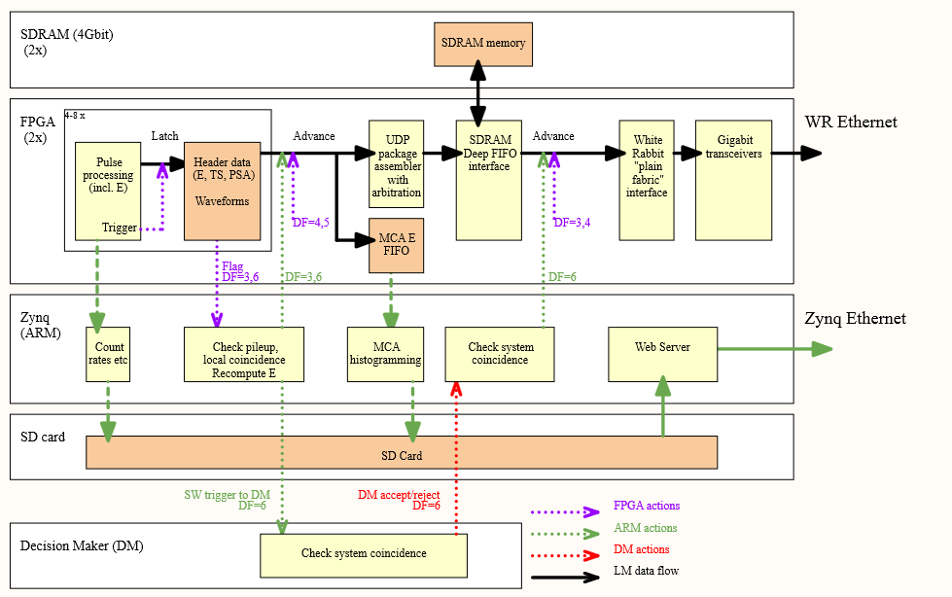
White Rabbit Time Synchronization for Radiation Detector Readout Electronics
W. Hennig, S. Hoover • XIA LLC, 31057 Genstar Rd, Hayward, CA 94544, USA • whennig@xia.com
www.xia.com
Software Triggering
To further reduce cabling complexity, we are developing “software triggering”, where decisions to record data are made through the exchange of data packets over the network by software instead of hardwired connections. Each Pixie-Net XL in a multi-module system sends out minimal data packages (metadata) which are used by a central Decision Maker (DM) to make accept/reject decisions, which are then communicated back to all Pixie-Net XL modules. The Pixie‑Net XL then independently move their full data to long term storage or discard.
Figure 4a. Concept of software triggering, for example to apply coincidence decision during the data acquisition without the need of hardwire logic.
* = coded decision making, based on WR time stamp, hit pattern, history, …
Figure 4b. Data flow in FPGA

Slide 10
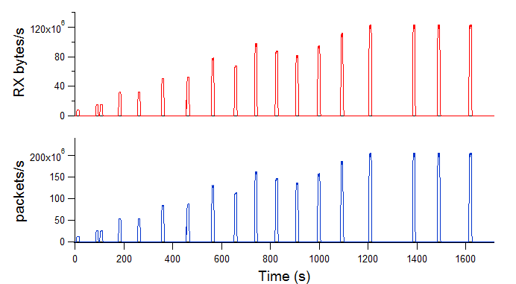
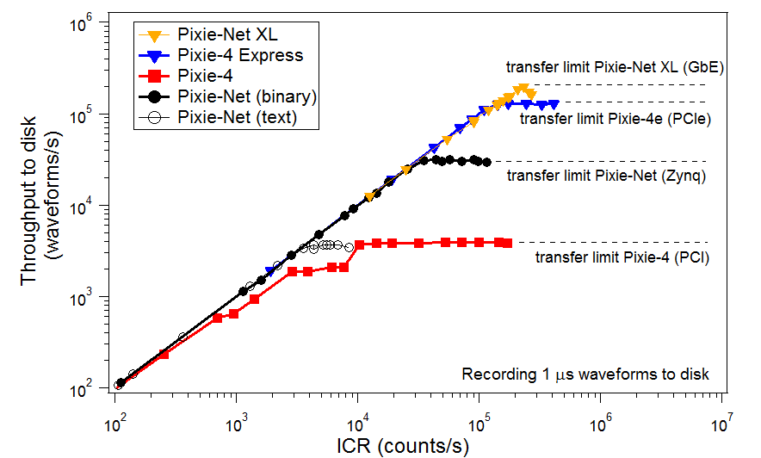
White Rabbit Time Synchronization for Radiation Detector Readout Electronics
W. Hennig, S. Hoover • XIA LLC, 31057 Genstar Rd, Hayward, CA 94544, USA • whennig@xia.com
www.xia.com
Detector Readout Performance
The Pixie-Net Xl is designed to
read out scintillators at high
rate and precision detectors
(HPGe) with high energy
resolution. Preliminary
performance results indicate
performance similar to
XIA’s established pulse
processor modules.
Preliminary tests of the list mode data output throughput, in comparison to previous Pixie DAQ modules are summarized in the plot to the right. Using the “bmon” utility on the receiving PC, we measured RX rates from the Pixie Net-XL of ~122 MB/s or ~200,000 packets/s (above), with each packet containing a list mode record with header and 1us waveform.
Data rate,
Figure 5. Multi-source HPGe spectrum with DB02 (12bit, 250 MSPS).

Slide 11
White Rabbit Time Synchronization for Radiation Detector Readout Electronics
W. Hennig, S. Hoover • XIA LLC, 31057 Genstar Rd, Hayward, CA 94544, USA • whennig@xia.com
www.xia.com
Summary
We implemented the White Rabbit time synchronization in a new detector readout electronics module, the Pixie-Net XL. Time resolutions in preliminary measurements are 5-15ps per software output, ~100ps per clock jitter measurements and ~500ps per digitized coincident pulser signal; overall well below 1ns. The method has been proven suitable for distances of more than 10m. A software triggering scheme has been demonstrated and performance with radiation detectors is being characterized
Key results:
White Rabbit IP core integrated into detector readout pulse processing logic
HW design with multiple ADC daughtercard options
Software triggering scheme
Sub-nanosecond timing resolution in time-of-flight type measurements
1Gbps Ethernet data output with White Rabbit synchronization, demonstrated 10Gbps data capability of hardware
Outlook
To bring this project to completion, we plan to
Revise and finalize the clock circuitry for minimal jitter
Explore the Dolosse data management scheme in the data readout
Fully characterize timing and detector performance

Slide 12
White Rabbit Time Synchronization for Radiation Detector Readout Electronics
W. Hennig, S. Hoover • XIA LLC, 31057 Genstar Rd, Hayward, CA 94544, USA • whennig@xia.com
www.xia.com
About XIA LLC
XIA LLC invents, develops and markets advanced digital data acquisition and processing systems for x-ray, gamma-ray, and other radiation detector applications in university research, national laboratories and industry.
Having pioneered digital detector readout electronics for over 20 years, our most recent new products integrate PTP and/or White Rabbit
Contact:
www.xia.com
whennig@xia.com
References and Acknowledgments
[1] W. Hennig, et al, IEEE Trans. Nucl. Sci. 66 (2019), p1182
[2] https://ohwr.org/project/white-rabbit
[3] http://zedboard.org/product/microzed
[4] https://www.xia.com/dgf_products.html
[5] http://xillybus.com/xillybus-lite
[6] equivalent to A. Fallu-Labruyere et al, NIM A 579 (2007), p247.
[7] M. Lipinski, et al, 2011 IEEE Intl. Symposium on Precision Clock Synchronization for Measurement, Control and Communication
This material is based upon work supported by the U.S. Department of Energy, Office of Science, Office of Nuclear Physics under Award Number DE-SC0017223.
Disclaimer: "This report was prepared as an account of work sponsored by an agency of the United States Government. Neither the United States Government nor any agency thereof, nor any of their employees, makes any warranty, express or implied, or assumes any legal liability or responsibility for the accuracy, completeness, or usefulness of any information, apparatus, product, or process disclosed, or represents that its use would not infringe privately owned rights. Reference herein to any specific commercial product, process, or service by trade name, trademark, manufacturer, or otherwise does not necessarily constitute or imply its endorsement, recommendation, or favoring by the United States Government or any agency thereof. The views and opinions of authors expressed herein do not necessarily state or reflect those of the United States Government or any agency thereof."

