Slide 1
FPGA network cards developments for the supernovae trigger of the DUNE Dual-Phase (DP) 10 kton detector module
Quentin DAVID, 14/10/20

Slide 2
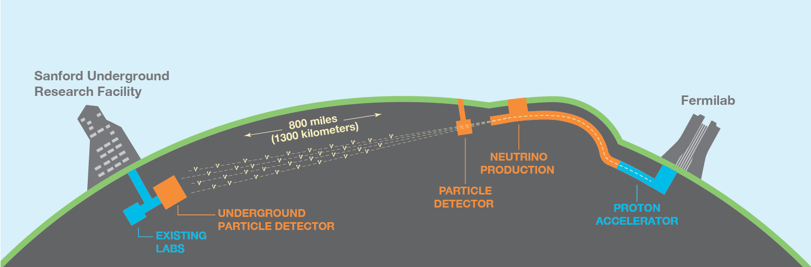
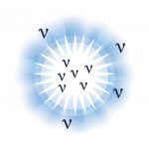
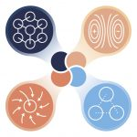
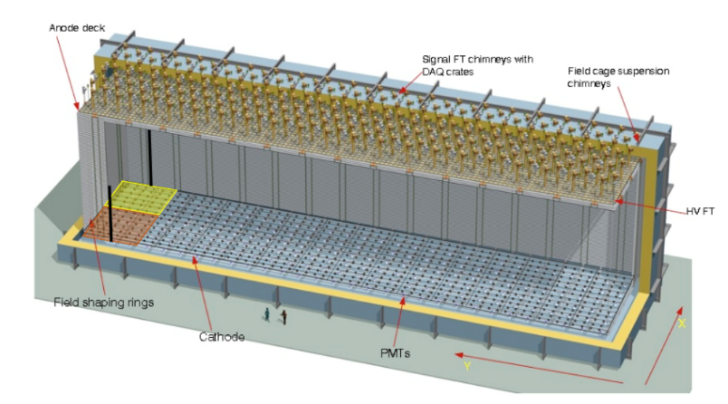

What is DUNE ?
DUNE: Deep Underground Neutrino Experiment
International project on neutrino physics
Aiming for groundbreaking discoveries
  Search of CP violation, origin of matter/antimatter asymmetry
  Unification of Forces
  Supernovae collapses and black hole formation

Slide 3
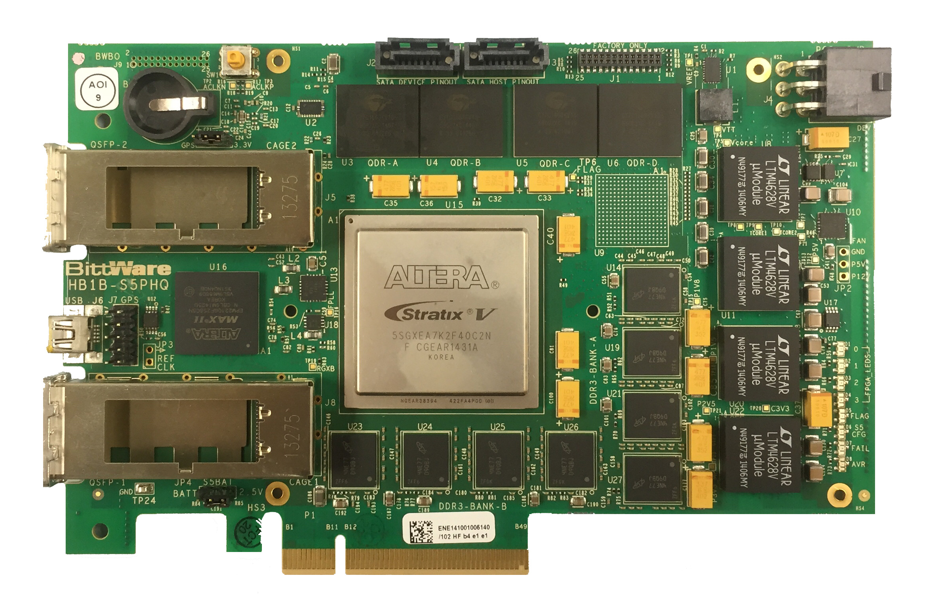
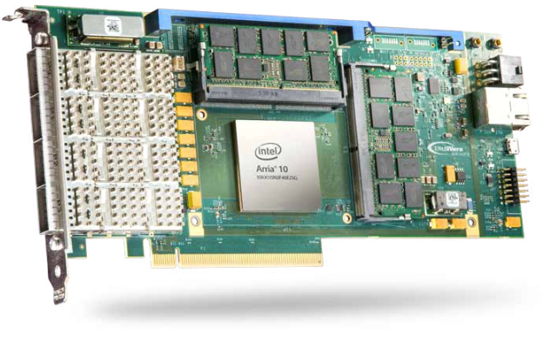
What are the needs and what do we need to study ?
Evolution from protoDUNE DP DAQ to DUNE DAQ Fully continuous readout (see C. Girerd’s talk)
Implies big dataflow (~ 4,2 Tb/s) generated by the detector
Important requirements to process the data:
  Large network infrastructure to move the data from the Front-End electronics to the storage disks
  Event trigger defined by the DAQ back-end system by looking at the presence of hits (trigger primitives) in the detector in a sliding time window
  A lot of memory (for SNa time window buffering before trigger decision)
Goals of the studies: Evaluation of means to process all these data efficiently
  Decompression from lossless compression
  Hit finding in real time
Tests performed so far on FPGA network boards interfacing FE and BE

Slide 4
DUNE DP baseline DAQ architecture
Common SP/DP
DAQ system with the same functional elements
Storage
Persistent data flow to storage
BE
DAQ units:
Receiving data from network links
Trigger Primitives Generation
Time window buffer for SNa
DAQ units:
Receiving data from network links
Trigger Primitives Generation
Time window buffer for SNa
DAQ units:
Receiving data from network links
Trigger Primitives Generation
Time window buffer for SNa
DAQ units:
Receiving data from network links
Trigger Primitives Generation
Time window buffer for SNa
Trigger units
Trigger primitives and trigger decision flow
x245 10 Gbe links
→ continuous data streaming of all digitized samples without
zero-skipping
x240 FE units
Charge Readout
FE unit 640 channels
(uTCA crate)
FE unit 640 channels
(uTCA crate)
x5 FE units
Light Readout
FE unit 144 ch.
(uTCA crate)
FE unit 144 ch.
(uTCA crate)
FE
Analog cabling
Analog cabling
Analog FE
Cryogenic FE
640 channels per Chimney
Cryogenic FE
640 channels per Chimney
PMTs (144)
PMTs (144)
DP Electronics
DP-PD System

Slide 5
Readout architecture overview and constraints with hardware decompression. (DUNE DP TDR Baseline)
FE Unit
DAQ Unit
X10 per µTCA Crate
x2 buffer of 20 GB
For compressed data
10 sec to analyze primitives
Take data decision with others ROI results
64 ADC
Readout board
Compression
64 ADC
Readout board
MCH
10Gbe switch
~20 GB
Of memory
For 10 sec
64 ADC
Readout board
ROI
64 ADC
Readout board
~40 GB
Of memory
For 10 sec
x10
~2 Gb/s
primitives
ROI
x8
~2 GB/s
Ethernet FPGA board
x2 links
Huffman Decompression
Primitives search
Ethernet FPGA board
x2 links
Huffman Decompression
Primitives search
Ethernet FPGA board
x2 links
Huffman Decompression
Primitives search
Ethernet FPGA board
x2 links
Huffman Decompression
Trigger primitives search
X10 per µTCA Crate
64 ADC
Readout board
Compression
~2 Gb/s
64 ADC
Readout board
MCH
10Gbe switch
64 ADC
Readout board
64 ADC
Readout board
x10

Slide 6
Readout architecture overview and constraints without compression
FE Unit
DAQ Unit
X10 per µTCA Crate
x2 buffers of 200 GB
64 ADC
Readout board
~200 GB
Of memory
For 10 sec
64 ADC
Readout board
MCH
40Gbe switch
64 ADC
Readout board
ROI
64 ADC
Readout board
~40 GB
Of memory
For 10 sec
Primitive
searching
(Multicore processing, GPU..)
x10
~20 Gb/s
ROI
x8
~20 GB/s (PCIe 4.0)
Ethernet Board
x8
10 sec to search trigger primitives in 5120 channels of 40 MB
Take data decision with others ROI results
X10 per µTCA Crate
~20 Gb/s
64 ADC
Readout board
64 ADC
Readout board
MCH
40Gbe switch
64 ADC
Readout board
64 ADC
Readout board
x10

Slide 7
Evaluation of treatments on DAQ Units - Decompression
In DUNE Baseline, data are compressed on the 64 ADC Readout boards
Data link of 10 Gb/s on each crate
Need to decompress the data before doing online analysis like trigger primitives finding
Implementation of decompression on 640 channels
  First step, 640 decompressors

Slide 8
DP Huffman Decompression Implementation on Arria 10 FPGA
Slow control packets
NIOS 2
Controller
Board Discovering
Configuration
QSFP
10 Gbe
PHY
10 Gbe
MAC
FIFO
TX
JTAG
FIFO
RX
RX PACKET
FILTER
Packet identification
Packet redirection
IP/UDP header removing
Slow control packets from
AMCs
Compressed data (avalon streaming)
CSR avalon MM
CSR avalon MM
Pedestals
Sample counters
Decompression Duration
64 bits @ 156.2 MHz
4x10x16= 640 channels
x10
4x10
Extract Channel
Number LSB
Extract Channel
Number LSB
Huffman
Decompressor
Pedestals
Counters
Extract Channel
Number LSB
Extract Channel
Number LSB
Extract
Board
number
Extract Channel
Number LSB
Extract Channel
Number LSB
Extract Channel
Number MSB
Extract Channel
Number LSB
1:10
1:4
Extract Channel
Number LSB
x10
x10
1:4
Extract Channel
Number LSB
x10
1:4
Extract Channel
Number LSB
1:4
Extract Channel
Number LSB
Huffman
Decompressor
Pedestals
Counters
1:4
1:16
x16
x16
Huffman
Decompressor
Pedestals
Counters

Slide 9
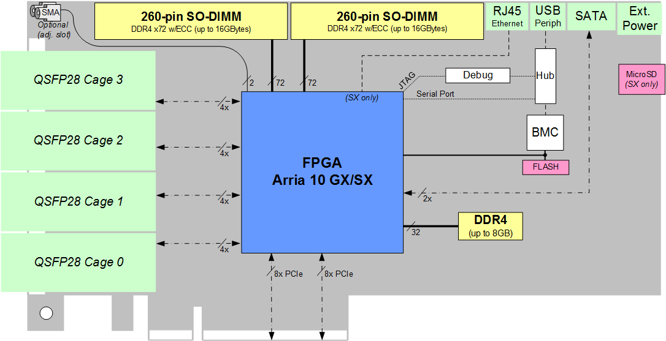
Full crate decompression implementation on Arria 10 FPGA
nios2-terminal: connected to hardware target using JTAG UART on cable
nios2-terminal: "A10P3S [USB-1]", device 1, instance 0
nios2-terminal: (Use the IDE stop button or Ctrl-C to terminate)
Waiting for ARP: ..... OK
Waiting for board initialization: OK 9 boards replied
***** Complete Drift received => Huffman results ******
Board[0],Channel[0] => Count=10000 Flags=28 SeqSize=274 Pedestal=74 Time=187152
Board[0],Channel[1] => Count=10000 Flags=28 SeqSize=96 Pedestal=54 Time=81152
Board[0],Channel[2] => Count=10000 Flags=28 SeqSize=212 Pedestal=60 Time=150764
Board[0],Channel[3] => Count=10000 Flags=28 SeqSize=122 Pedestal=71 Time=96804
Board[0],Channel[4] => Count=10000 Flags=28 SeqSize=352 Pedestal=39 Time=234132
Board[0],Channel[5] => Count=10000 Flags=28 SeqSize=306 Pedestal=85 Time=206700
Board[0],Channel[6] => Count=10000 Flags=28 SeqSize=352 Pedestal=48 Time=234496
Board[0],Channel[7] => Count=10000 Flags=28 SeqSize=364 Pedestal=36 Time=242006
Board[0],Channel[8] => Count=10000 Flags=28 SeqSize=152 Pedestal=30 Time=113864
10Gbe MCH
ADC 64 AMC
ADC 64 AMC
ADC 64 AMC
ADC 64 AMC
ADC 64 AMC
ADC 64 AMC
ADC 64 AMC
ADC 64 AMC
ADC 64 AMC
ADC 64 AMC
WR MCH
WR link
10 Gbe link
JTAG
Log
The firmware in ARIA 10 includes:
640 decompressor Units
Automatically configure and control the AMC boards
Decompressed samples are not stored.
Compute pedestals on decompressed samples.
The number of decompressed sample is displayed (should be 10000)

Slide 10
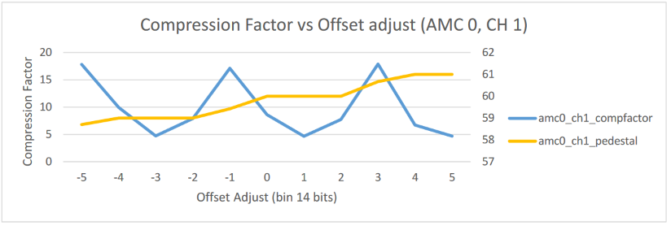
Some Huffman decompression results
The maximum decompression duration for a 10000 samples sequence is 1.8 ms (no detector)
Functional verification by comparing pedestals after decompression with a direct measurement.

Slide 11
Compilation report for 640 Huffman decompressors and packet multiplexing
Flow Status Flow Failed - Fri Oct 18 17:47:48 2019
Quartus Prime Version 17.1.1 Internal Build 593 12/11/2017 SJ Standard Edition
Revision Name 10GbaseR
Top-level Entity Name HOE_DEMUX_TOP
Family Arria 10
Device 10AX115N3F40E2SG
Timing Models Final
Logic utilization (in ALMs) 254,931 / 427,200 ( 60 % )
Total registers 351380
Total pins 8 / 826 ( < 1 % )
Total virtual pins 0
Total block memory bits 42,948,388 / 55,562,240 ( 77 % )
Total DSP Blocks 3 / 1,518 ( < 1 % )
Total HSSI RX channels 1 / 48 ( 2 % )
Total HSSI TX channels 1 / 48 ( 2 % )
Total PLLs 3 / 112 ( 3 % )

Slide 12
Next Huffman decompression implementation
Slow control packets
NIOS 2
Controller
Board Discovering
Configuration
QSFP
10 Gbe
PHY
10 Gbe
MAC
FIFO
TX
JTAG
FIFO
RX
RX PACKET
FILTER
Packet identification
Packet redirection
IP/UDP header removing
Slow control packets from
AMCs
CSR avalon MM
Pedestals
Sample counters
Decompression Duration
Compressed data (avalon streaming)
CSR avalon MM
64 bits @ 156.2 MHz
10 x 16 decompressors
x10
Extract Channel
Number LSB
Huffman
Decompressor
Pedestals
Counters
Extract
Board
number
Extract Channel
Number LSB
Extract Channel
Number LSB
Extract Channel
Number LSB
x10
Extract Channel
Number LSB
x10
1:10
Extract Channel
Number LSB
Extract Channel
Number LSB
Huffman
Decompressor
Pedestals
Counters
Extract Channel
Number LSB
1:16
x16
x16
Huffman
Decompressor
Pedestals
Counters

Slide 13
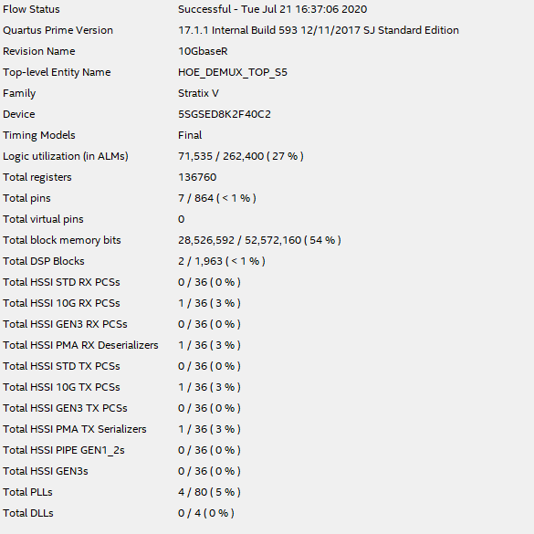
Compilation report for 160 Huffman decompressors and packet multiplexing

Slide 14
Evaluation of treatments on DAQ Units – Trigger primitives finding
Simple streaming algorithm
Pedestal finding by computing an estimated median on consecutive input samples
Fixed threshold relative to the median to detect a hit
Retrieving information on the primitive like when it starts, when it ends and its integrated value

Slide 15
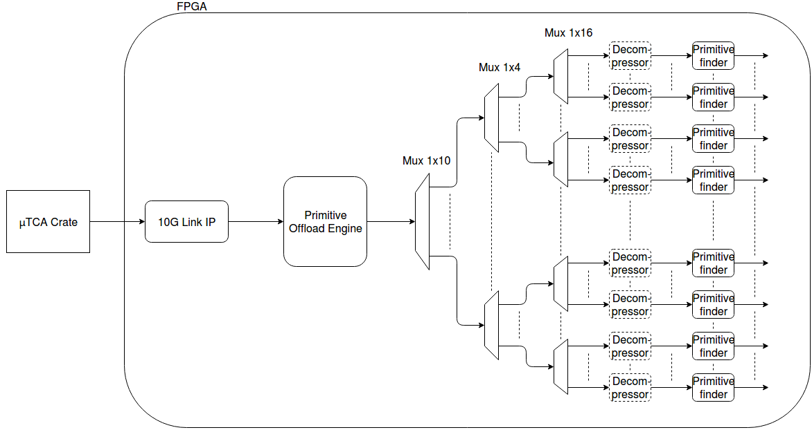
Trigger primitive search hardware implementation
Complete system schematic to work on real time on an entire crate (640 channels) at 10Gb/s
Architecture inspired by the use of the decompressed data at channel level
POE: redirects valid data packets, remove IP header, reformatting data packet with channel and board number
640 channels

Slide 16
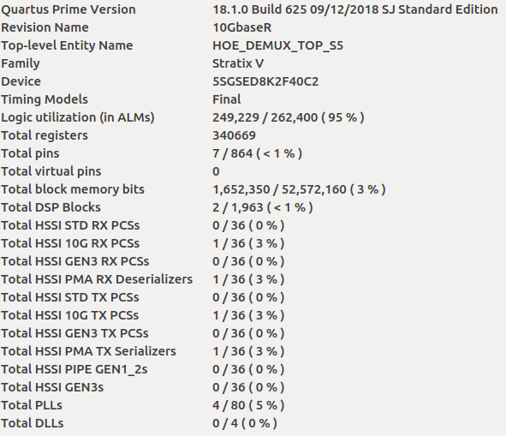
Results
Quartus compilation report on resources usage
95% of logic elements used
3% of the internal memory
640 channels treated in parallel

Slide 17
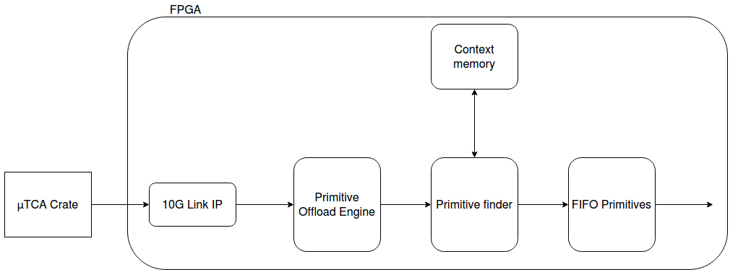
Improved version of trigger primitive search
Architecture optimized for one crate:
  With the previous version, the primitive finder modules are working only one at a time
  Need only one primitive finder module for one crate, which might make the duplication of the architecture on the FPGA Board possible
Context memory – State of the channel to retrieve:
  Estimated median
  Primitive start time
  Current sum value

Slide 18
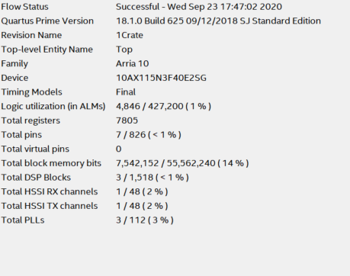
Results
Quartus compilation report on resources usage
1% of logic elements used
14% of the internal memory
640 channels treated in streaming

Slide 19
Conclusions
The decompression turns out to be space consuming on FPGA cards interfacing the backend, even optimized we could only concentrate maybe 2 crates in one FPGA card
The primitive search standalone can be implemented with current FPGA cards resources and should be able to concentrate several crates in one FPGA card
Other Options based on possible 40 Gbe connectivity
Option 1 :
  FE transmits non-compressed data
  Compression performed on FPGA at backend level for data storage (easier to implement than decompression)
  This would allow to search directly for the trigger primitive at backend (no need to decompress the data)
Option 2 :
  Similar to Option 1:
  Trigger primitives search performed directly on FE AMC digitization boards
  Compression performed on FPGA at backend level for data storage (easier to implement than decompression)

Slide 20
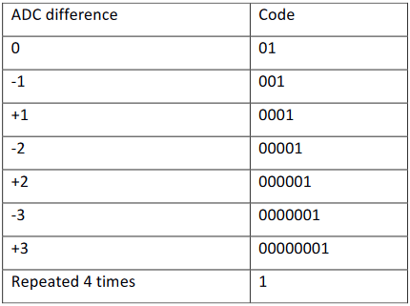
Backup: Huffman Compression
Custom Huffman compression
Here are the codes of the differences
If the differences are outside this table, the 12 bit ADC value is written entirely with a flag

Slide 21
Backup: Scheduling
Sequence length is 8000 samples
A packet of 1200 bytes / channel needed with a compression ratio of 10
Time to transfer the packet about 1µs
We must decompress the 640 channels in 3,2 ms (drift time of 8000 samples)
A packet will be sent every 50 us from each board. (3,2 ms / 64)
The decompression take about 600 us for a 8000 sample and a ratio of 10
If we use 12 decompressor by board we can reuse the same decompressor for different channel (120 decompressor)
50 µs
12 decompressors for each board
Decompressor Num
0
1
2
3
4
5
10
11
0
1
2
3
4
5
10
11
0
Packet Board N
ch0
ch1
ch2
ch3
ch4
ch5
ch10
ch11
ch13
ch14
ch15
ch16
ch17
ch18
ch22
ch23
ch24
600 µs (decompressor 0 is free)
600 µs (decompressor 1 is free)
3,2 ms for 64 channels x 50 µs for each board (Sequence of 8000 samples)

