Slide 1
A New Scheme of Redundant Timing Crosschecking for Frontend Systems
Jingjing Xu, Jinyuan Wu, Ted Liu, Jamieson T Olsen and Quan Sun
Fermilab
Oct. 2020

Slide 2
Introduction
Establishing Common Timing Reference Across Entire System
No Delay-Match Cables Required
Cross Checking
Redundant

Slide 3
Timing Distribution to Front-end Digitizers
FE1
FE2
FE3
FEN
Assume fibers are used to distribute clock to the front-end digitizers, with return path to compensate temperature variation.
Clock skews between front-end modules may not be fully compensated due to temperature difference of silicon devices.
It would be good to have some redundant cross checking between modules.
CLK
FAN
OUT

Slide 4
The Scheme Reported 2019

Slide 5
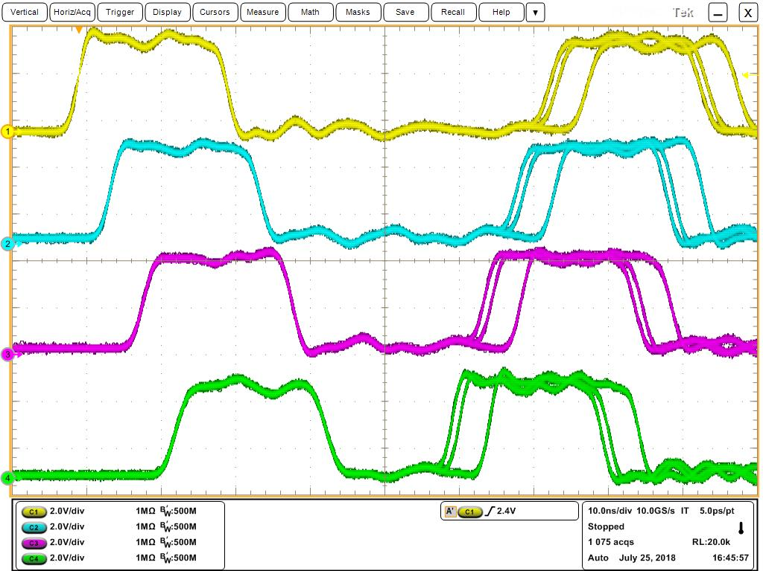
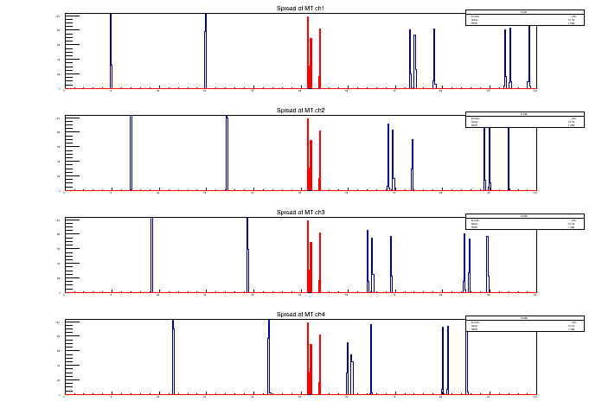
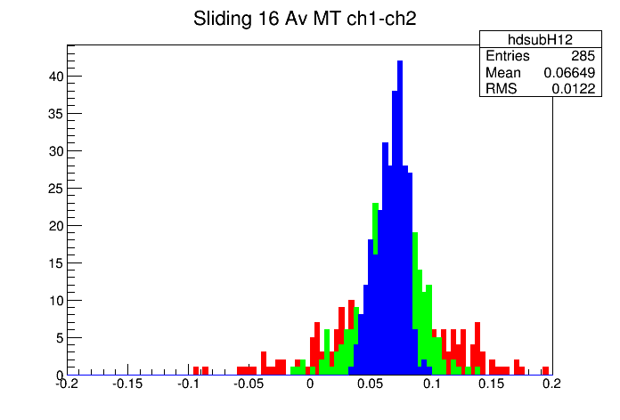
Sending Pulses from Cable Ends
PULSE
GEN
A
TA_{i}
TA_{j}
B
TB_{i}
ΔT_{ij}
TB_{j}
TDC
FE1
TDC
FEi
TDC
FEj
TDC
FEN
TA_{j} =TA_{i} +ΔT_{ij}
TB_{i} =TB_{j} +ΔT_{ij}
(TA_{i} + TB_{i} )/2=(TA_{i} + TB_{j}+ΔT_{ij})/2
(TA_{j} + TB_{j} )/2=(TA_{i} + TB_{j}+ΔT_{ij})/2
CLK
FAN
OUT
Temperature variations of the cable delays are canceled mathematically
  The values of the mean times may change with cable delays.
  But mean times remain identical.

Slide 6
The New Scheme

Slide 7
Pulsing at the FE Modules
Signals are sent from FE modules alternately synchronized with the system clock at each FE module.
Using averages of the arrival times at TDC A and B, one can find the initial times of the pulses at different FE modules.
Temperature variations of the cable delays are canceled mathematically.
In this scheme, only two TDC channels are required at the Timing Cross-checking Module, not in FE modules.
TDC A
TDC B
Timing
Cross-
checking
Module
FE1
FE2
FE3
FE4
CLK
FAN
OUT

Slide 8
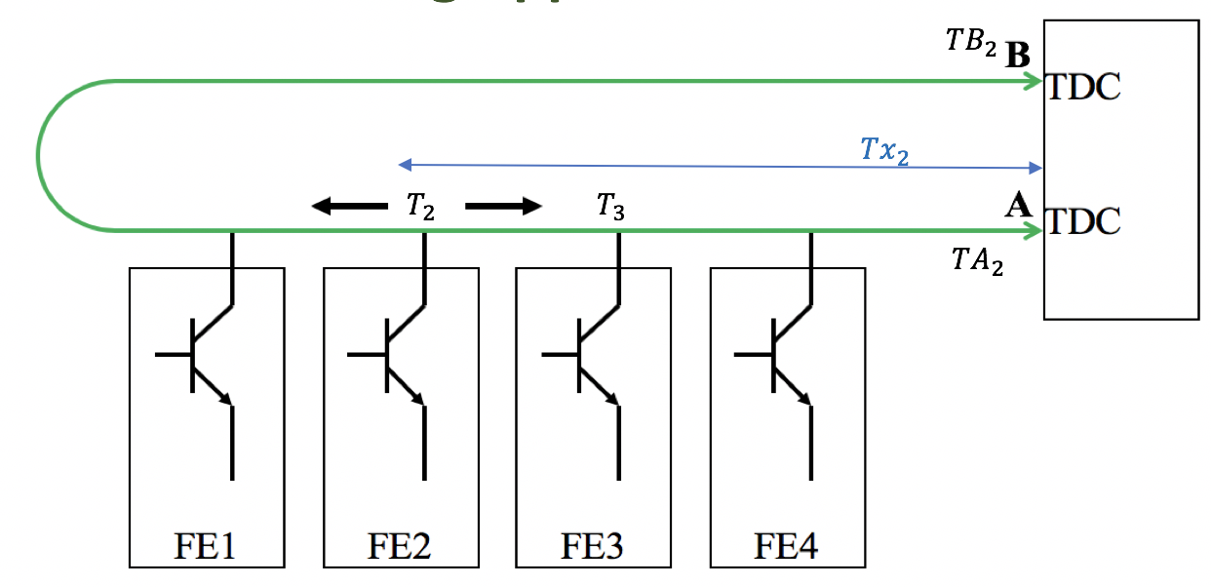
Time Differences of FE Output Signals
Temperature variations of the cable delays are canceled mathematically.
The only requirement is that the signal travels both directions with the same speed in the cable.

Slide 9
Validation Tests

Slide 10
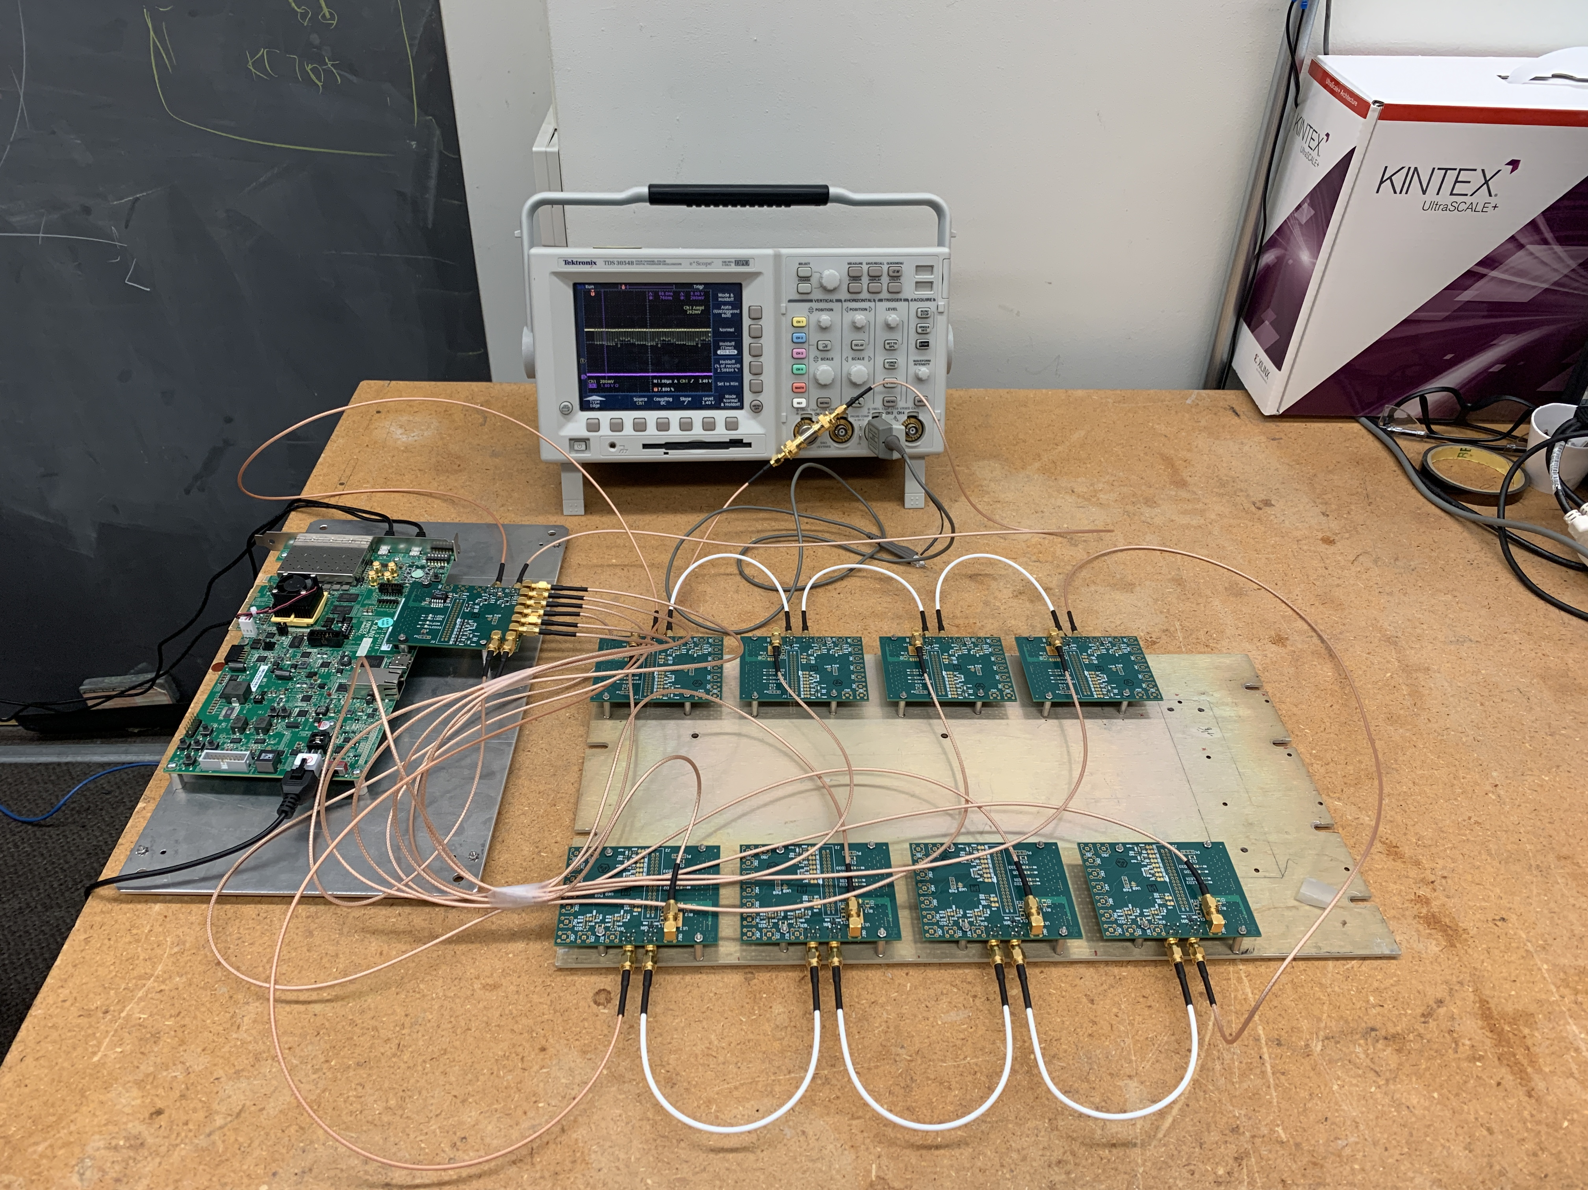
Cable Driven by Front End Modules
B
TDC
TDC
_{Kintex Ultra Scale+}
_{Evaluation Module}
A
FE1
FE2
FE3
FE4
_{Dummy}
_{FE Modules}
The FE modules drive the cable alternately.
The arrival times are measured by the TDC in the monitoring module.

Slide 11
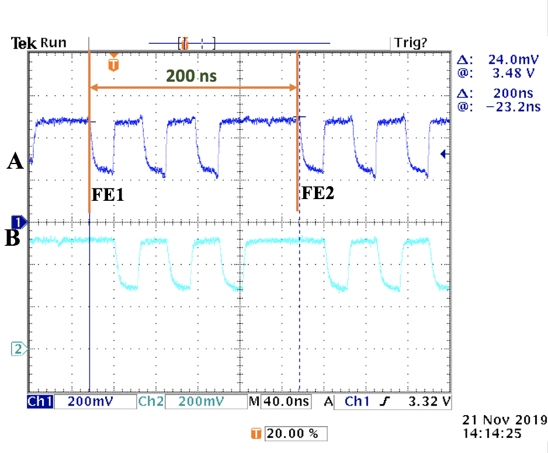
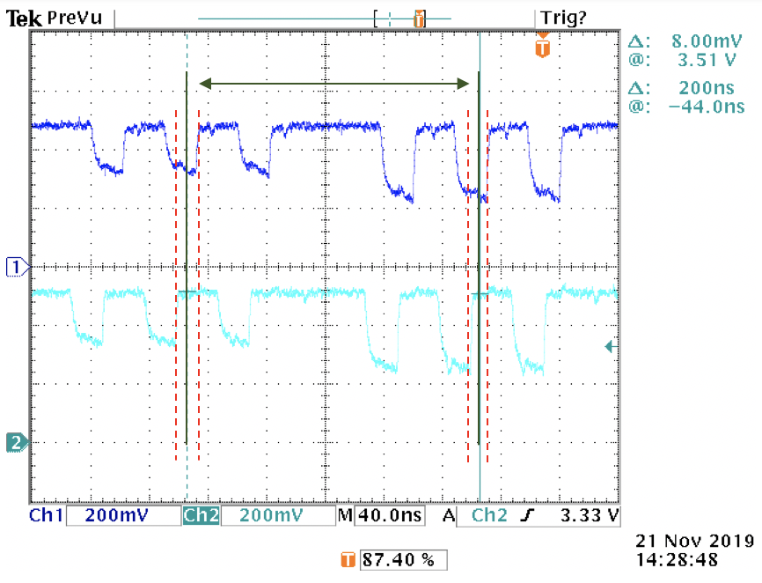
Common Timing Bursts
Each module sends out a burst with three pulses.
All edges of the bursts are used to improve measurement precision.

Slide 12
Time Differences Between Modules
<10 ps
The histogram shows the difference of the common burst times between two modules five segments apart.
Timing precision can be further improved by averaging multiple measurements.

Slide 13
Clock Drift Monitoring
Artificial clock drift at an FE module is emulated by adding connector unions.
The connector union delay is 130-140 ps each.
The clock drift can be monitored with good precision.

Slide 14
Comments
This scheme provides a redundant checking/monitoring of the system clock on the front-end modules
Each FE module only needs to send out pulses synchronized to its system clock.
Clocks at the front-end module can be monitored with precision good to 10 ps.

Slide 15
The Analog Schemes
(Previous Works)

Slide 16
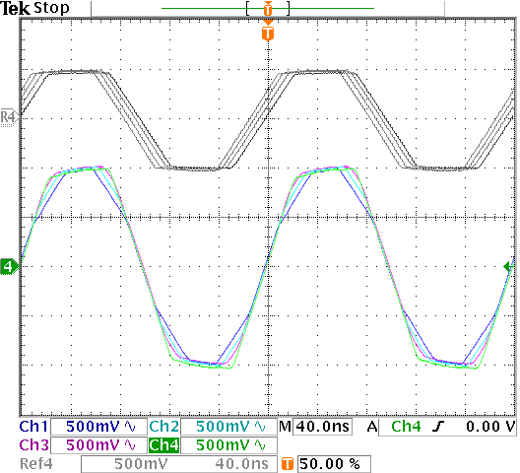
Analog Approach of Clock/Timing Distribution: Trapezoid Clocking
Trapezoid
Wave
GEN
B
A
FE1
FE2
FE3
FE4
Trapezoid waveforms are sent from both ends of the cable. (Or send from one end and let it to reflect from the open end)
Summed voltage crosses zero simultaneously at all taps.

Slide 17
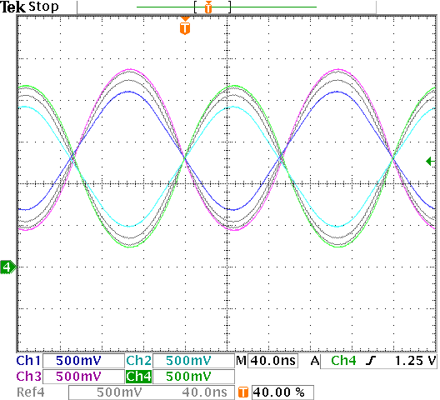
Analog Approach of Clock/Timing Distribution: Sine Wave Clocking
Sine
Wave
GEN
B
A
FE1
FE2
FE3
FE4
Sine waveforms are sent from both ends of the cable. (Or send from one end and let it to reflect from the open end)
Summed voltage crosses zero simultaneously at all taps.

Slide 18
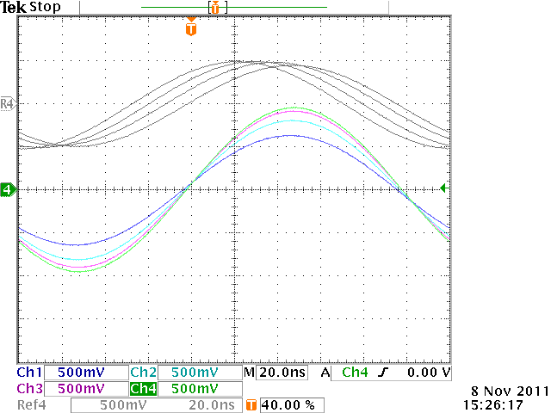
A Possible Simple Clock Distribution Scheme
Sine
CLK
When a sine signal is distributed in opposite directions in a cable, all high impedance taps on the cable pick up signals with same zero-crossing time.
The signals can be used for redundant checking or as system clock to drive PLL directly.
No delay-matched cables are needed.
This is suitable for small systems such as TOF PET cameras.

Slide 19
Summary
The mean timing approach allows users to distribute to check common timing references at the FE modules connected to a cable without delay-matched cables.
Digitals schemes:
  TDC at FE modules (and pulsing from cable ends). (Reported 2019)
  TDC at cable ends (and pulsing from FE modules). (This work)
Analog schemes:
  Trapezoid clocking 1: (using trapezoid signal)
  Trapezoid clocking 2: (using sine signal)

Slide 20
The End
Thanks

Slide 21
Redundant Cross Checking
PULSE
GEN
A
B
TDC
FE1
TDC
FEi
TDC
FEj
TDC
FEN
CLK
FAN
OUT

Slide 22
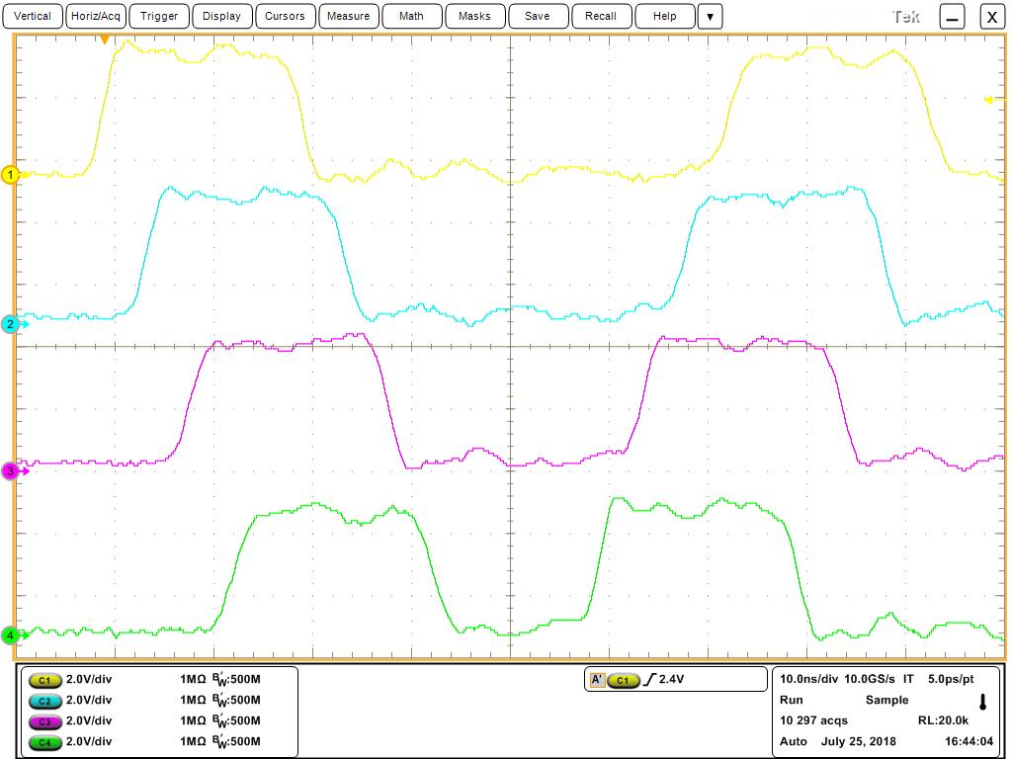
Validation Tests
PULSE
GEN
A
TA_{i}
TA_{j}
B
TB_{i}
ΔT_{ij}
TB_{j}
Oscilloscope
CH1
CH2
CH3
CH4
The common bursts are captured by a digital oscilloscope.
The 4 input channels in high impedance are daisy chained using BNC TEE connectors.
The output results are stored in ASCII files.
The samples at 10 Gs/s are used to emulate TDC channels with 100 ps bin width.

Slide 23
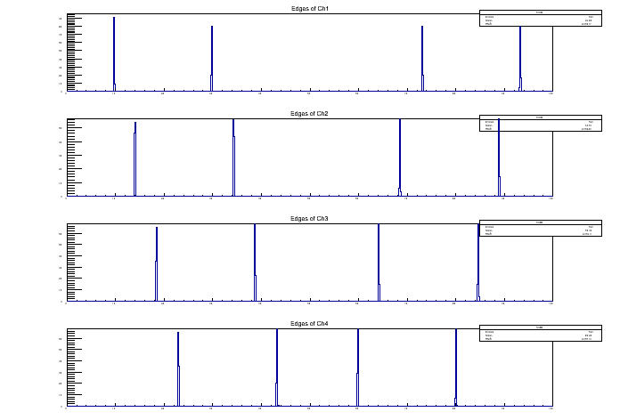
Arrival Times
Both rising and falling edges of the pulses are used.
Times calculated with 100 ps granularity to emulate TDC (without analog information).
With both edges, base line shift can be partially cancelled.

Slide 24
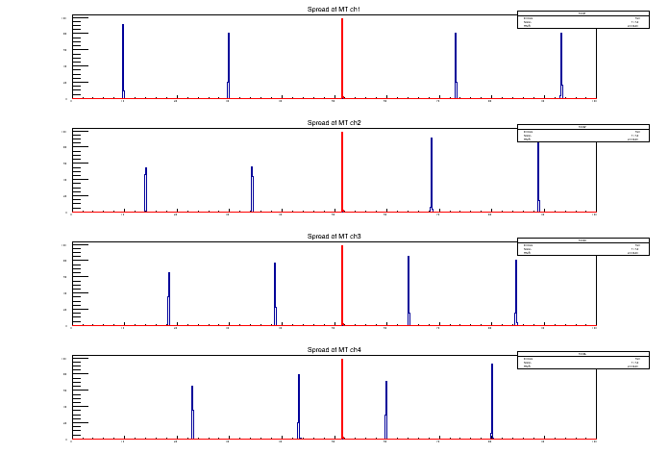
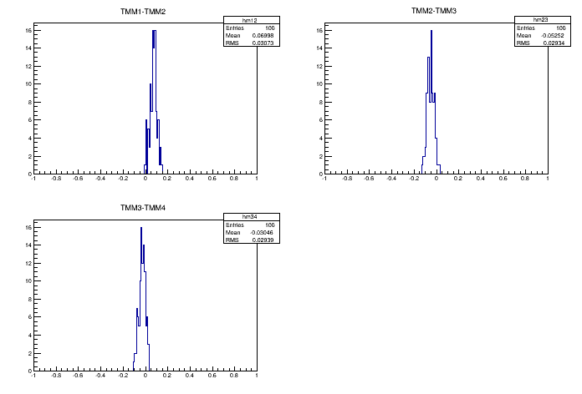
The Mean Times
Mean times using arrival times of 4 edges are calculated.
The arrival times are different in different channels but the mean times are identical.

Slide 25
The Differences of Mean Times in Different channels
30 ps typ.
The measurement precisions for single common burst of different channels are around 30 ps.

Slide 26
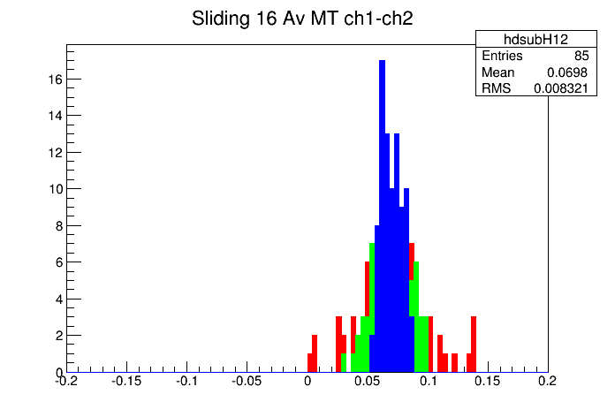
The Average of Multiple Measurements
<10 ps
The single and sliding averages of 4 and16 mean times are plotted above.
With repeating measurements, the monitoring precisions better than 10 ps can be achieved.

Slide 27
Cable Delay Effects
Artificial delays are added in the signal generator pulses to emulate cable delay variations.
Arrival times are changed accordingly.
Mean times are also changed, but all channels have same amount of change.

Slide 28
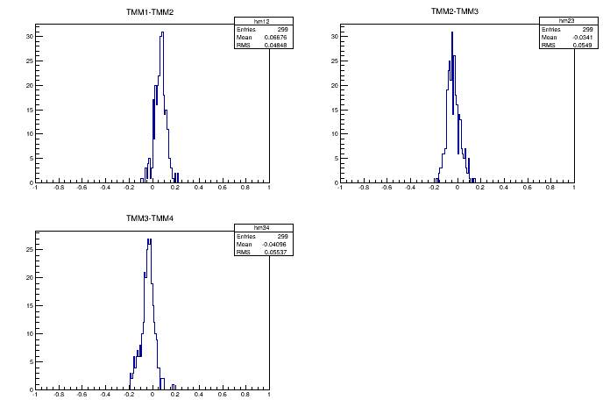
Differences of Mean Times in Different Channels
12 ps
The mean times are still identical in different channels within good precisions.

