Slide 1
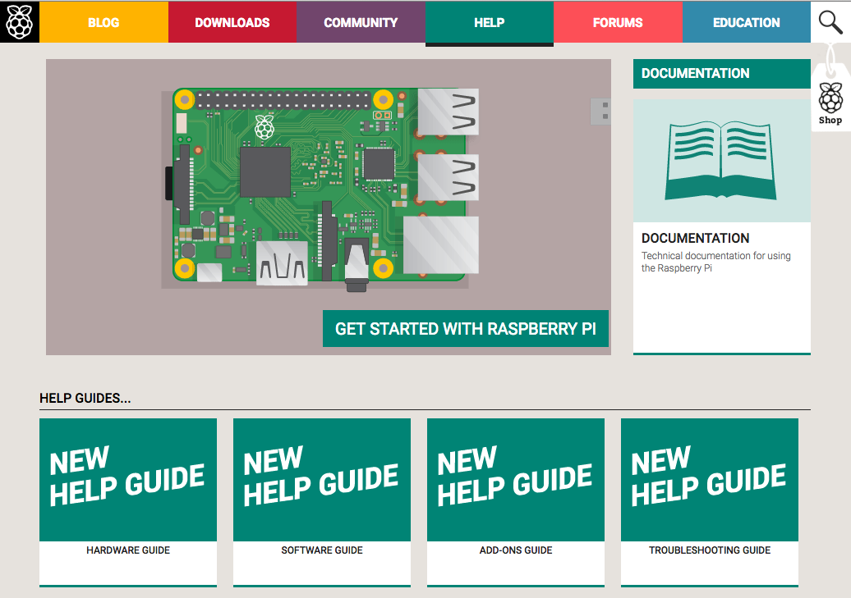
http://raspberrypi.org

Slide 2
http://elinux.org/RPi_Expansion_Boards

Slide 3
PSI-made ADC/DAC IO board

Slide 4
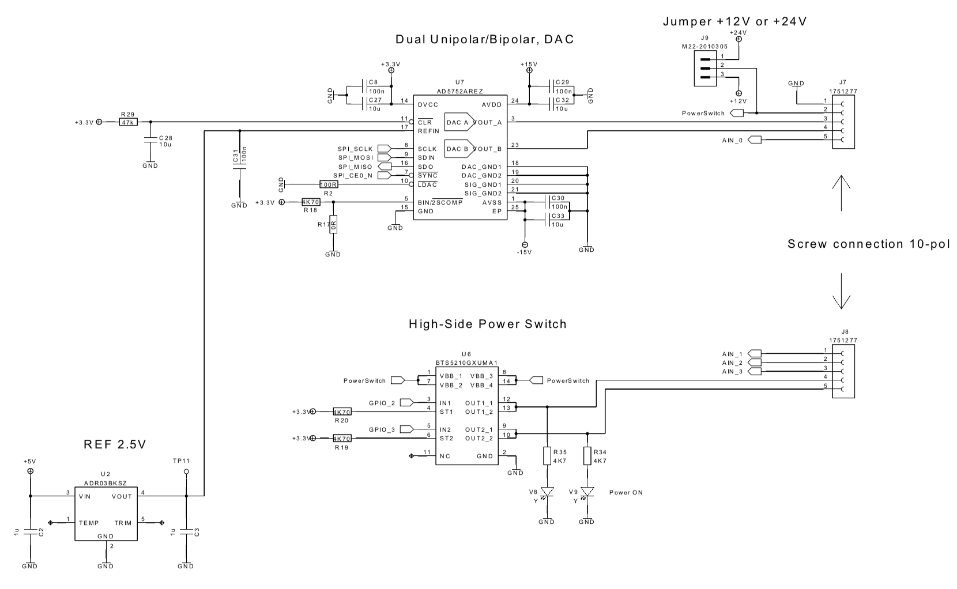

Slide 5
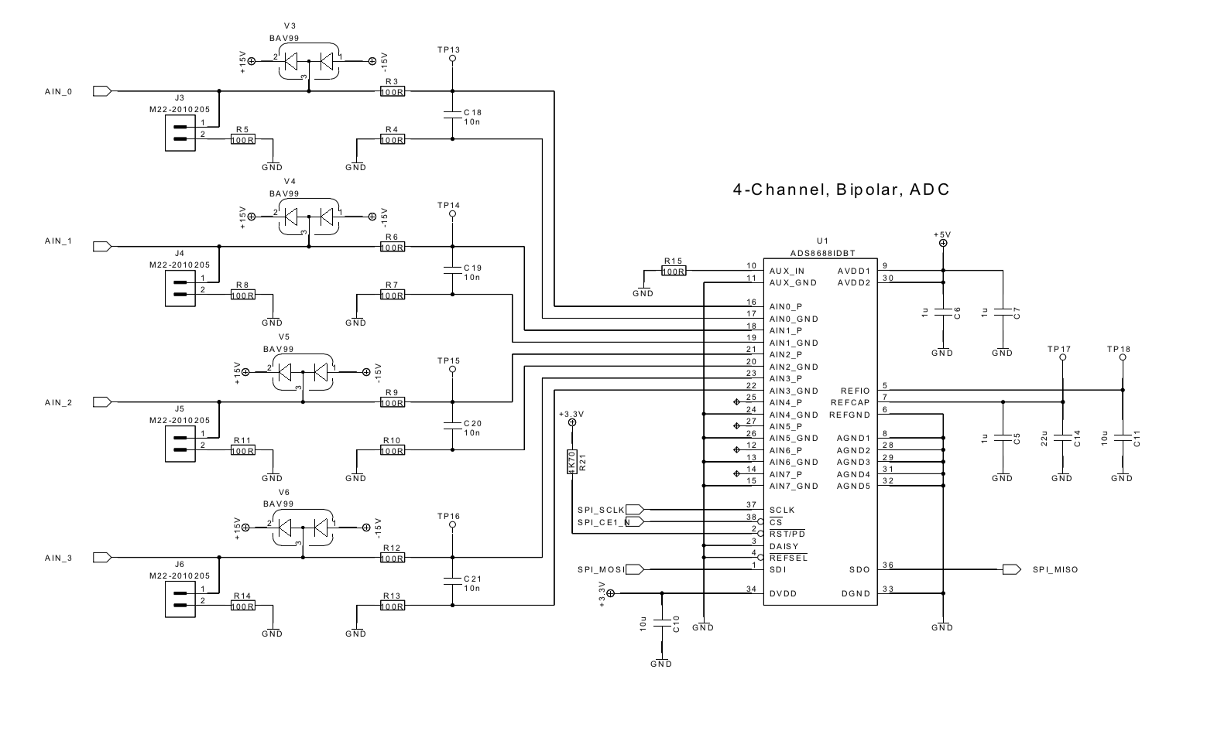

Slide 6
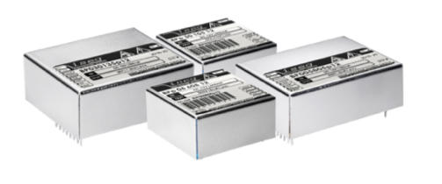
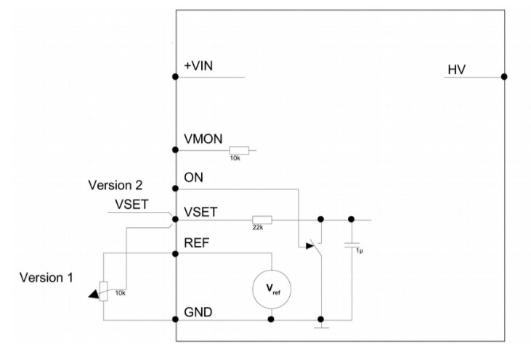
ISED BPS series DC-DC Converter

Slide 7
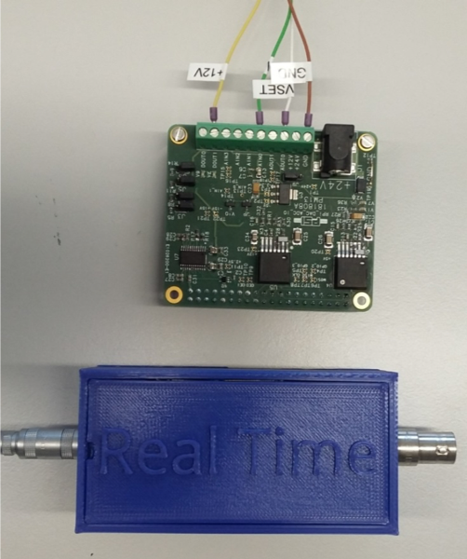
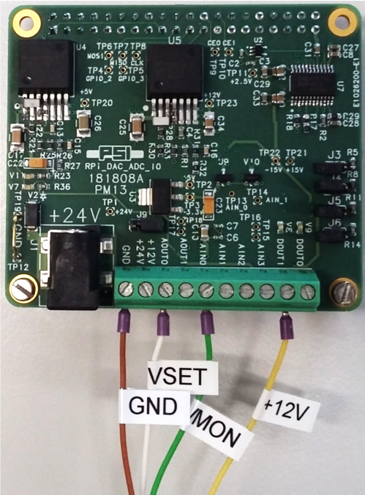
HV Supply 0…-2000V / 1.5 mA

Slide 8
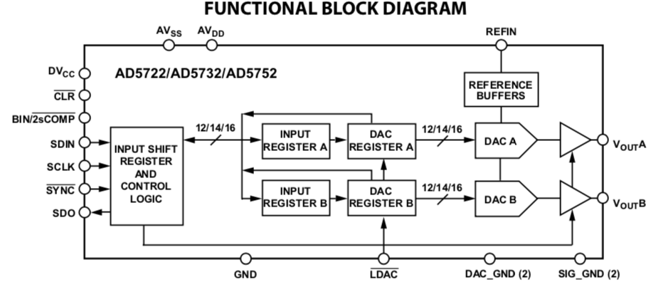
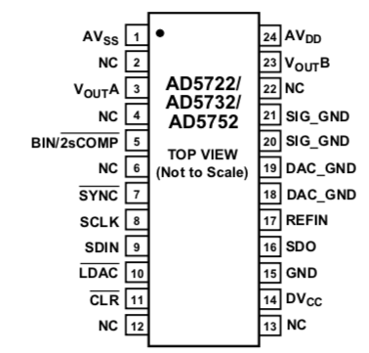
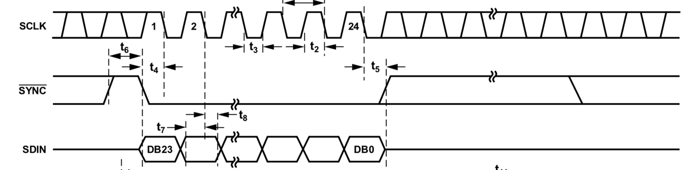
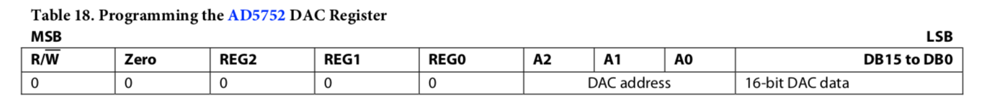
DAC programming via SPI
(https://en.wikipedia.org/wiki/Serial_Peripheral_Interface)

Slide 9
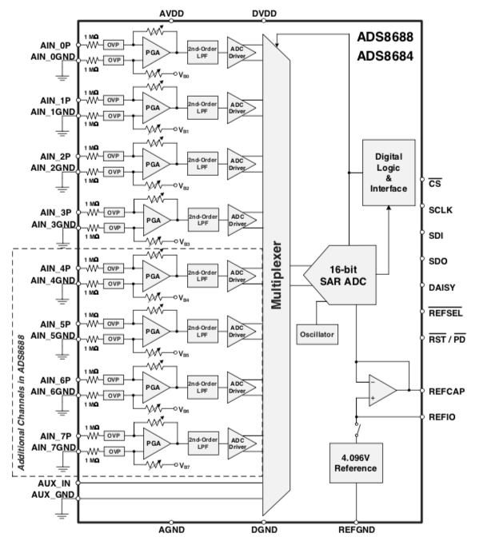
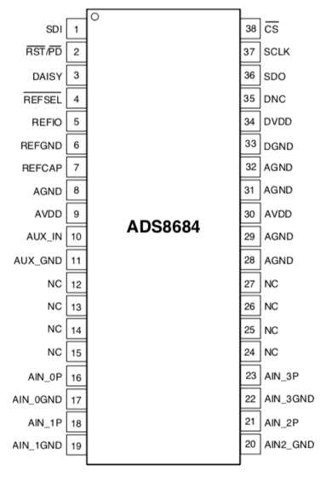
ADC programming via SPI

Slide 10
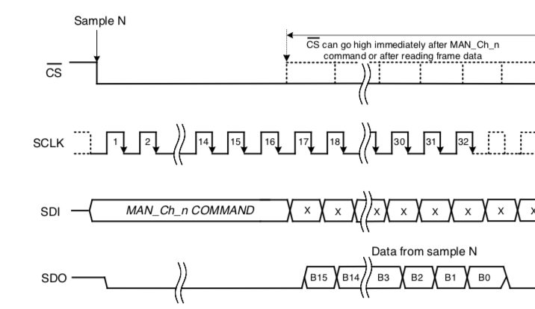
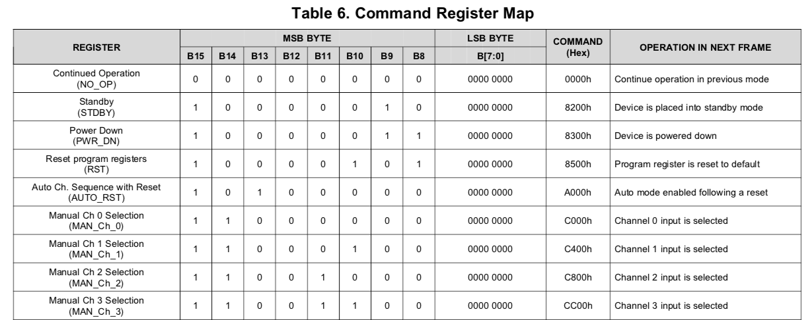
ADC programming via SPI

Slide 11
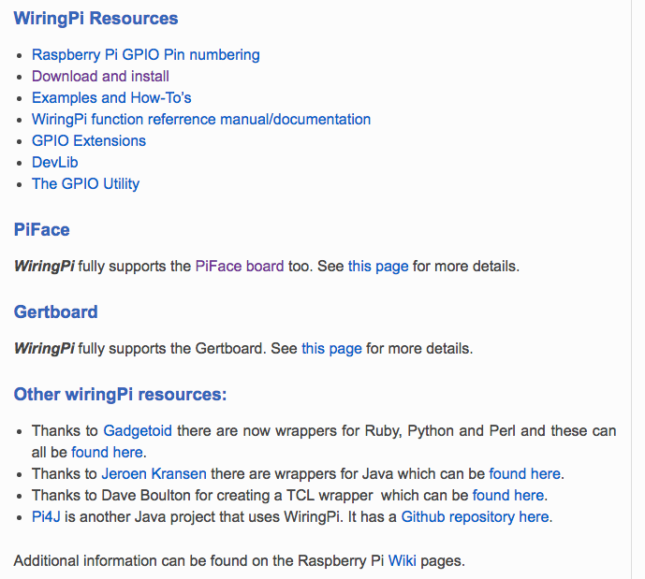
http://wiringpi.com

Slide 12
Minimal HV control program
#include <stdio.h>
#include <stdlib.h>
#include <wiringPi.h>
#include <wiringPiSPI.h>
int main(int argc, char *argv[])
{
int spi_fd0, spi_fd1;
unsigned char spi_buf[3];
double hv;
// setup IO
wiringPiSetup();
pinMode(8, OUTPUT); // pin #3
spi_fd0 = wiringPiSPISetup(0, 10000000);// DAC 10 MHz
spi_fd1 = wiringPiSPISetup(1, 10000000);// ADC 10 MHz
// turn on HV
digitalWrite(9, HIGH);
hv = 1000;
// calculate 16-bit value
d = (unsigned int) (hv / 2000 * 65535);
// program DAC range
spi_buf[0] = 0x08;
spi_buf[1] = 0x00;
spi_buf[2] = 0x00;
// Range = 0...+10V
wiringPiSPIDataRW(spi_fd0, spi_buf, 3);
// program DAC power register
spi_buf[0] = 0x10; // REG=2, A=0 PUA = PUB = 1
spi_buf[1] = 0x00;
spi_buf[2] = 0x05; // PUA = PUB = 1
wiringPiSPIDataRW(spi_fd0, spi_buf, 3);
// set DAC output
spi_buf[0] = 0x00;
spi_buf[1] = d >> 8; // MSB
spi_buf[2] = d & 0xFF; // LSB
wiringPiSPIDataRW(spi_fd0, spi_buf, 3);
/*---------------------------*/
// Read monitor output through ADC
spi_buf[0] = 0xC0;
spi_buf[1] = 0x00;
spi_buf[2] = 0x00;
spi_buf[3] = 0x00; // Manual Ch 0 Conversion
wiringPiSPIDataRW(spi_fd1, spi_buf, 4);
// convert to Volts
hv = ((spi_buf[2] << 8) | spi_buf[3])/65535.0 *
20.48 - 10.24;
// round to one digit
hv = (int)(hv*1000+0.5)/1000.0;
// convert to HV
hv = hv * 400;
printf("%1.1lf\n", hv);
}

Slide 13
HV command line program
…
int main(int argc, char *argv[])
{
if (argc < 2) {
readvoltage();
return 0;
}
if (argc == 2 && isdigit(argv[1][0])) {
double hv = atof(argv[1]);
sethv(hv);
return 0;
} else {
printf("usage: hvcl [voltage]\n\n");
return 1;
}
return 0;
}

Slide 14
Raspberry Pi groups
Group 1 (front table): pi01, pi02
Group 2 (middle table): pi03, pi04
Group 3 (back table): pi05, pi05
Log in with Cygwin schell, usual password

Slide 15
Install HV software
~ $ wget elog.psi.ch/rts/hv.tar
~ $ tar -xvf hv.tar
~ $ cd hv
~/hv $ make
gcc server-hv.c mongoose.c -o server-hv -g -lwiringPi
gcc hvcl.c -o hvcl -g -lwiringPi
~/hv $ ./server-hv
Starting server on port 8080

Slide 16
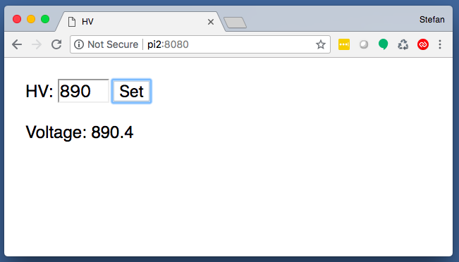
Control HV
Max voltage: 1600 V !!!

Slide 17
Connect HV Supply

