Slide 1
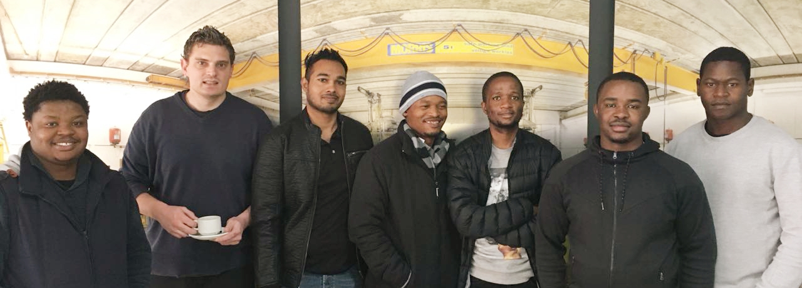
Seeing the invisible – The Timepix way
By
Group 4
Starring: Mabena Chemist; Karl A. Van Niekerk; Elisha Indarjit ; Obakeng Maphane; Lehumo Mashishi; Fortune Mhlanga; Humphry Tlou.

Slide 2
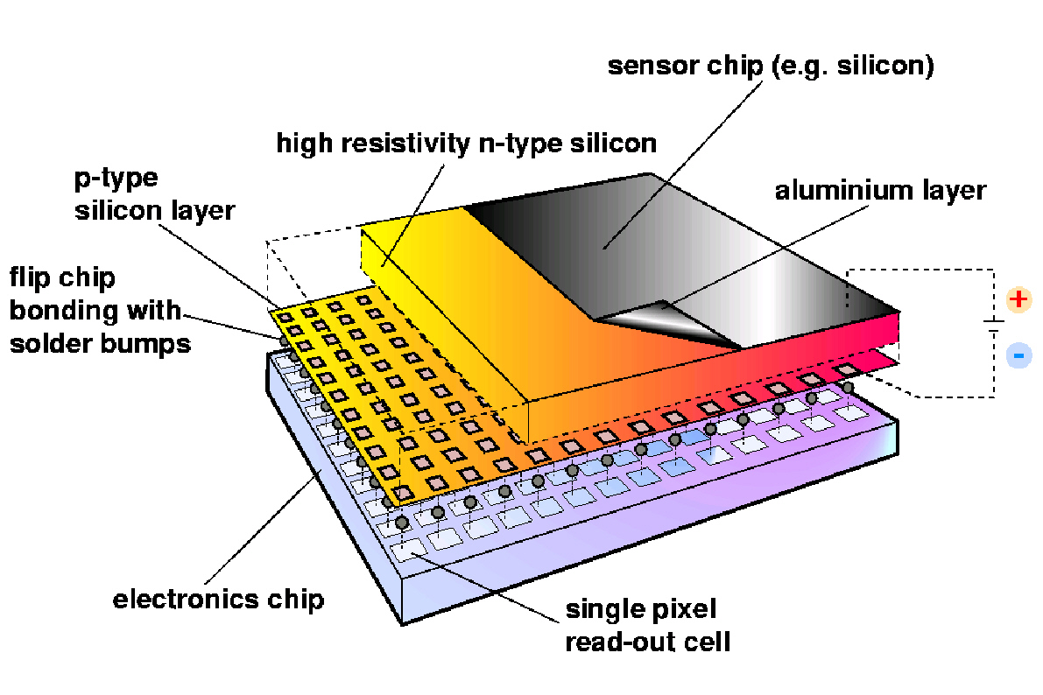
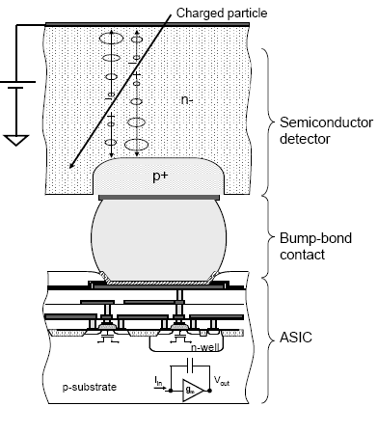
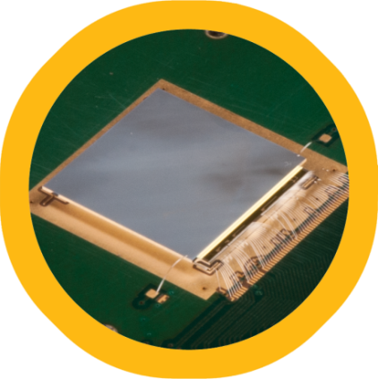
The star of the show…
14 x 14 mm detector dimensions
256 x 256 = 65 536 pixels
55 x 55 μm single pixel pitch
300 μm sensor thickness

Slide 3
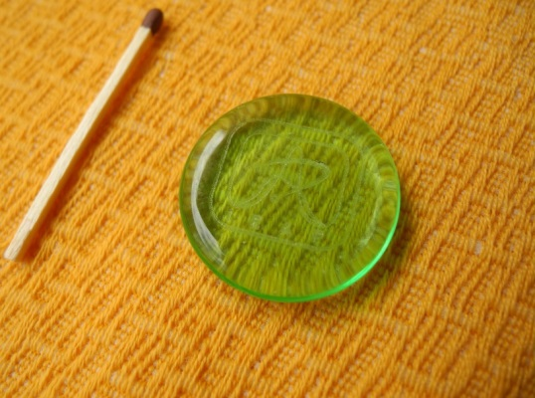
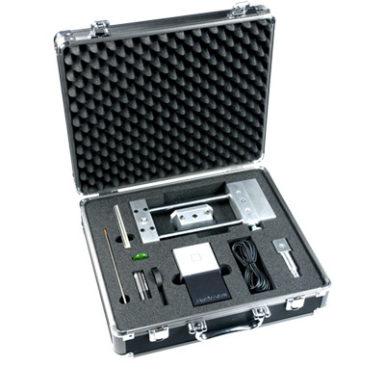
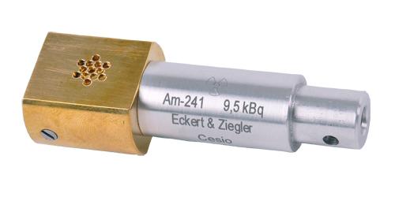
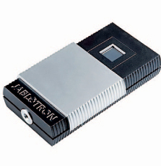
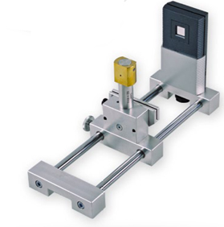
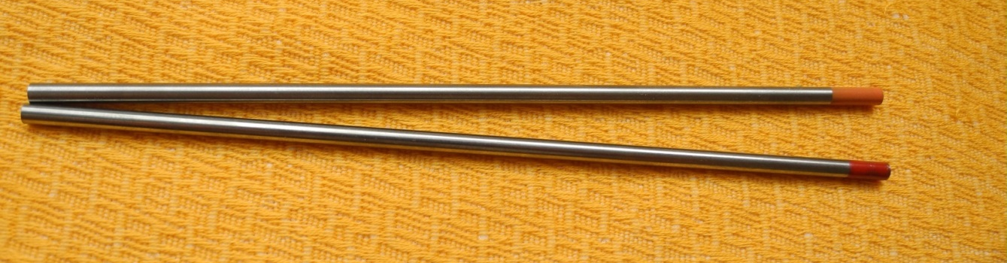
The kit …

Slide 4
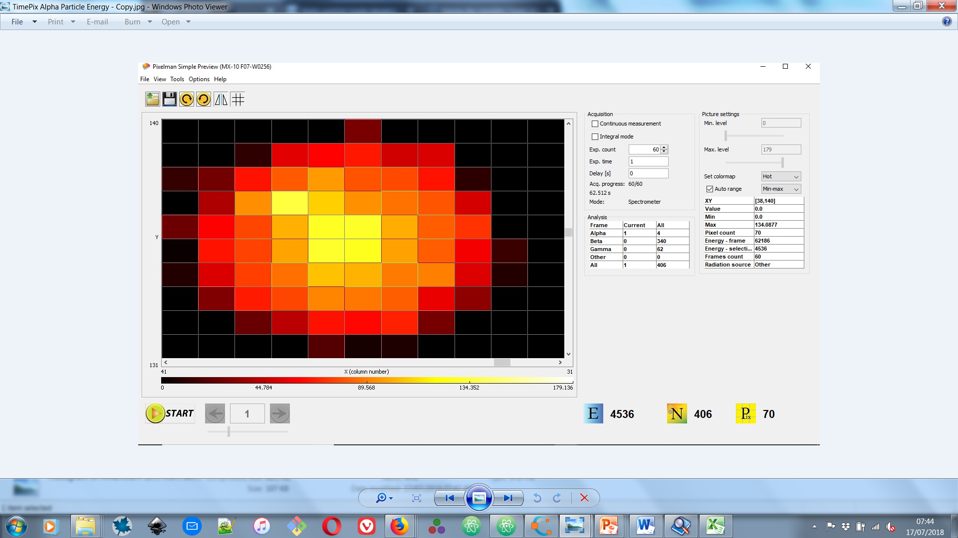
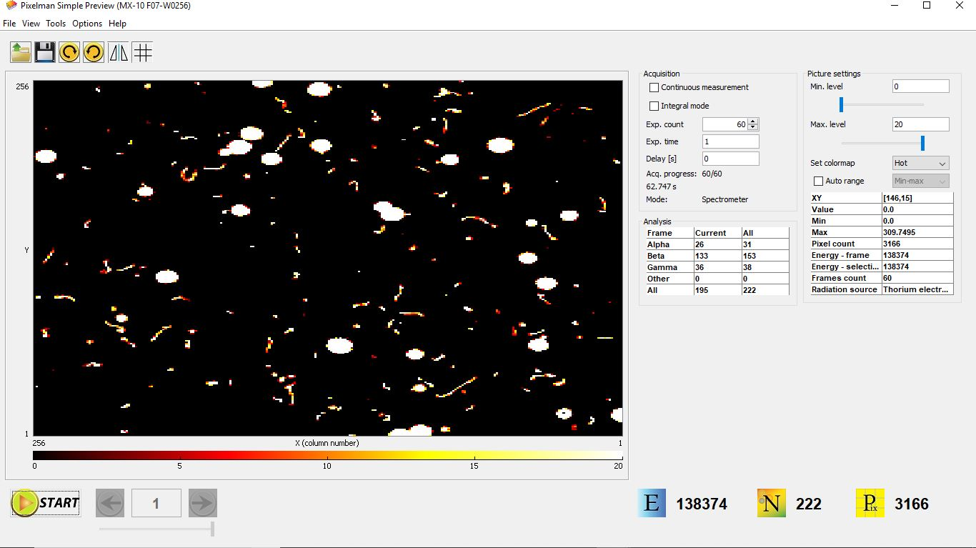
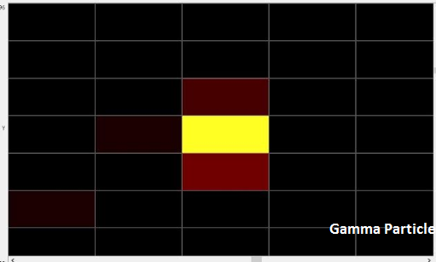
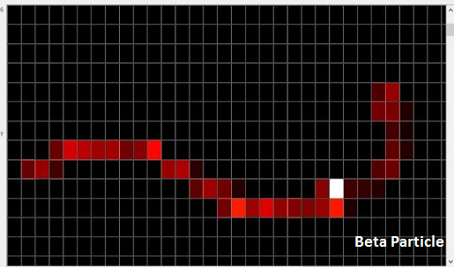
Particle these tracks…

Slide 5
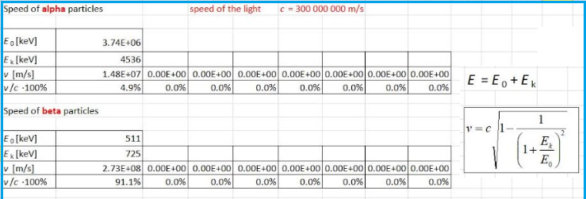
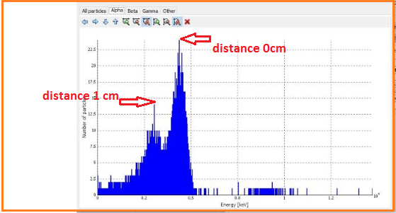
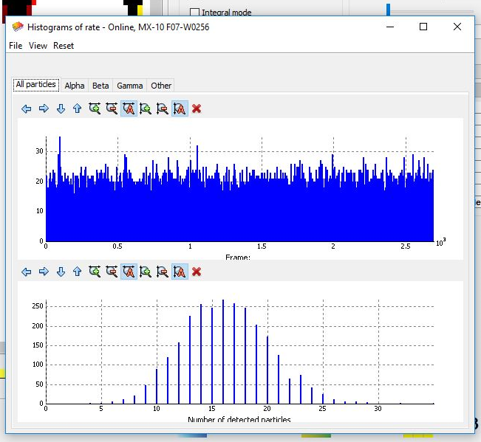
Peaks and numbers…

Slide 6
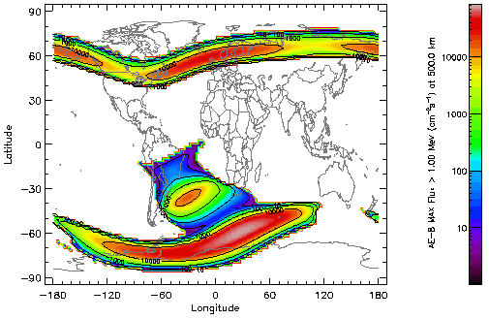
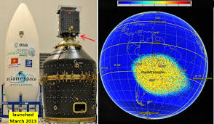
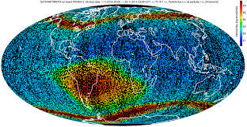
TimePix
Applications
Medical Imaging
Characterization of Ions, Radiation Therapy, Particle Tracking
(Medipix)
Exposure Limits
Hazardous Materials, High Radiation Environments, Shielding and Protection
Environmental Monitoring
Contamination, Water Quality, Food Quality, Soil Quality, Background Radiation, Fallout, Spills, Leakage
Nuclear Safety
Accidents, Exposure, Fallout, Shielding, Mineside Dust, Ore & Nuclear Materials Processing, Fuel Production, Nuclear Waste Disposal
Materials Testing
Composites & Materials Properties, Performance and Processing (Ceramics, Metals, Polymers)
Education
Classroom Demostrations (Secondary and Tertiary Level), Nuclear Industry Training, Nuclear Safety and Security, Research & Development

Slide 7
Recommendations and Conclusion

