Slide 1
Introduction to EasyPET Exercise
Martin Grossmann :: Center for Proton Therapy :: Paul Scherrer Institute

Slide 2
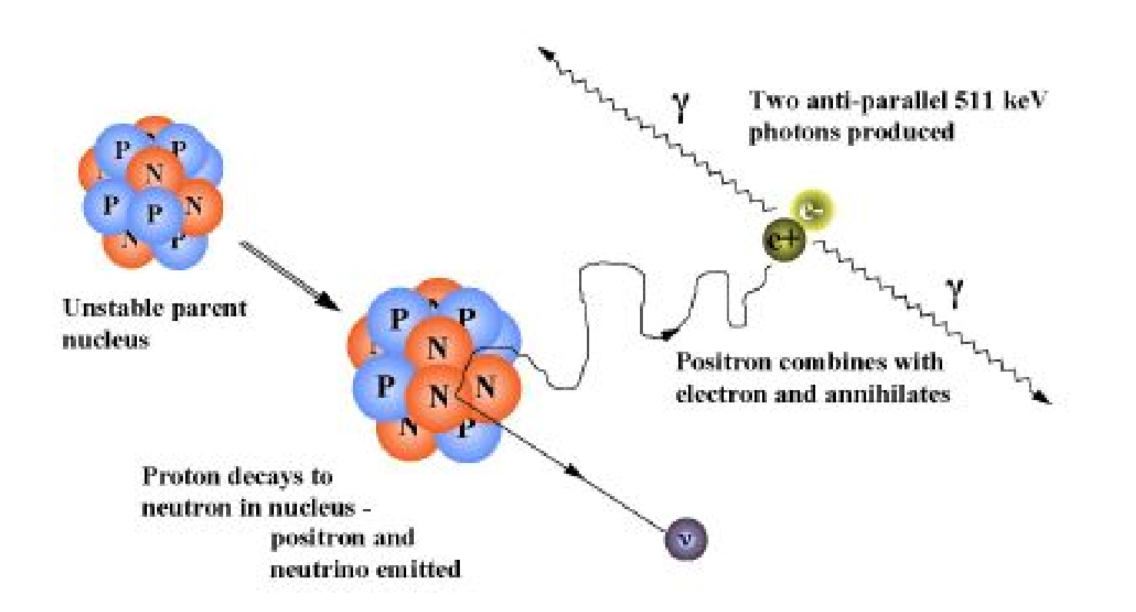
What is PET

Slide 3
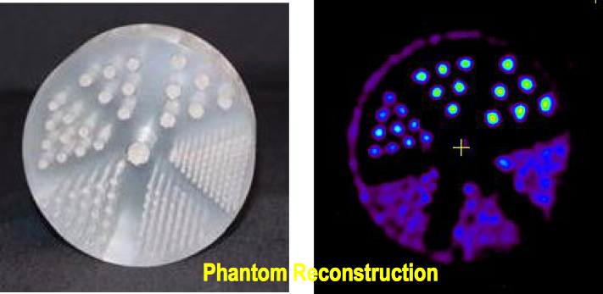
PET – Positron Emission Tomography
From Martin Purschke!
Ring of Photon
Detectors
Radionuclide decays, emitting β^{+.}
β⁺ annihilates with e– from tissue, forming back-to-back 511 keV photon pair.
511 keV photon pairs detected via time coincidence.
Positron lies on line defined by detector pair (known as a line of response or a LOR).
Back-to-back 511KeV photons are detected

Slide 4
Why PET is so cool
From Martin Purschke!
PET can be tailored to show metabolic processes in tissue
Remember, the chemical properties of a radioactive isotope are the same as the stable isotope – it will be used by the body indiscriminately
So you take a molecule that is used in your body for some process – sugar, dopamine, what have you, swap out an atom for a radioactive one
You get “hot spots” where lots of said molecules are used by the body
For example, a tumor that grows uses a lot of energy (sugar), so radioactively tagged sugar will accumulate a lot of activity there
Or tag molecules that the brain burns when it “thinks” – active areas show up as hot spots
Frequently used radiotracers are ¹¹C and ¹⁸F (all beta+ = positrons)

Slide 5
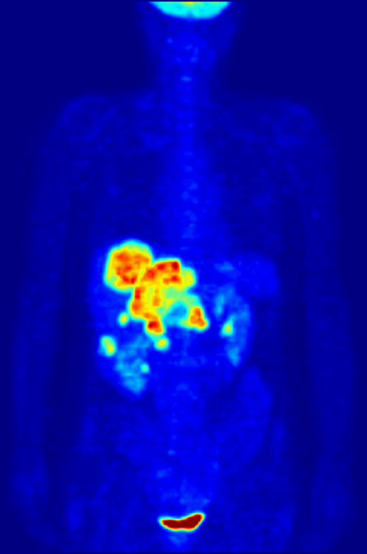
From Martin Purschke!
An Example - ¹⁸F
¹⁸F-FDG - Fludeoxyglucose is one of the commonly used radiotracers
It is a sugar, so it accumulates where the body burns a lot of energy (“uptake”)
Unusual “hot spots” can point to cancer
Whole-body PET scan using 18F-FDG to show liver metastases of a colorectal tumor

Slide 6
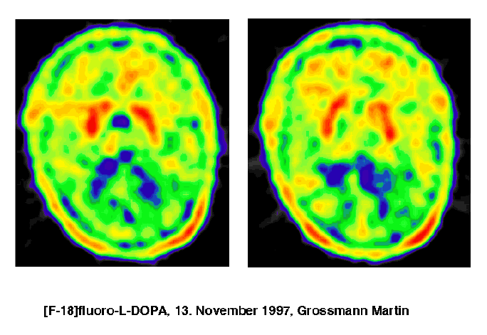
PET image of the brain
Dopamine = chemical messenger in our body
Parkinson’s disease: dopamine production in the central brain not properly working
PET image using dopamine with F¹⁸ isotope

Slide 7
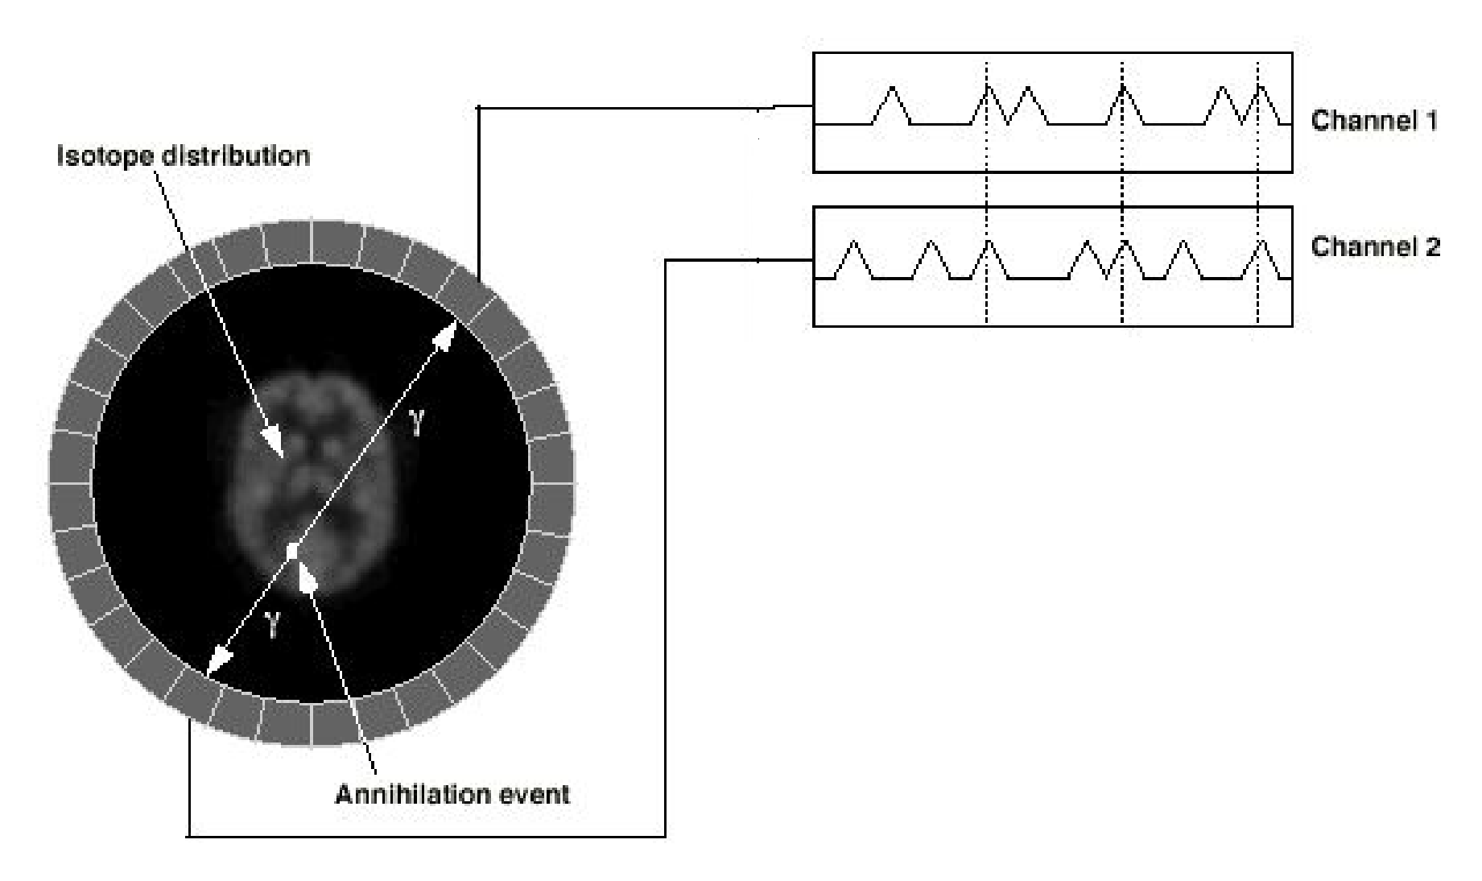
Coincidence detection

Slide 8
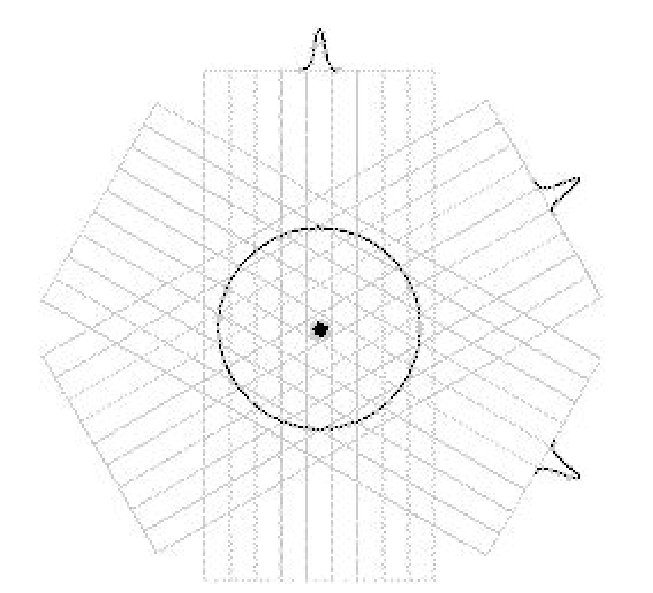
2D PET image
LOR (lines of response) arranged into sets of 1-dimensional parallel projections

Slide 9

2D PET image
Back-Projection allows to reconstruct original source distribution

Slide 10
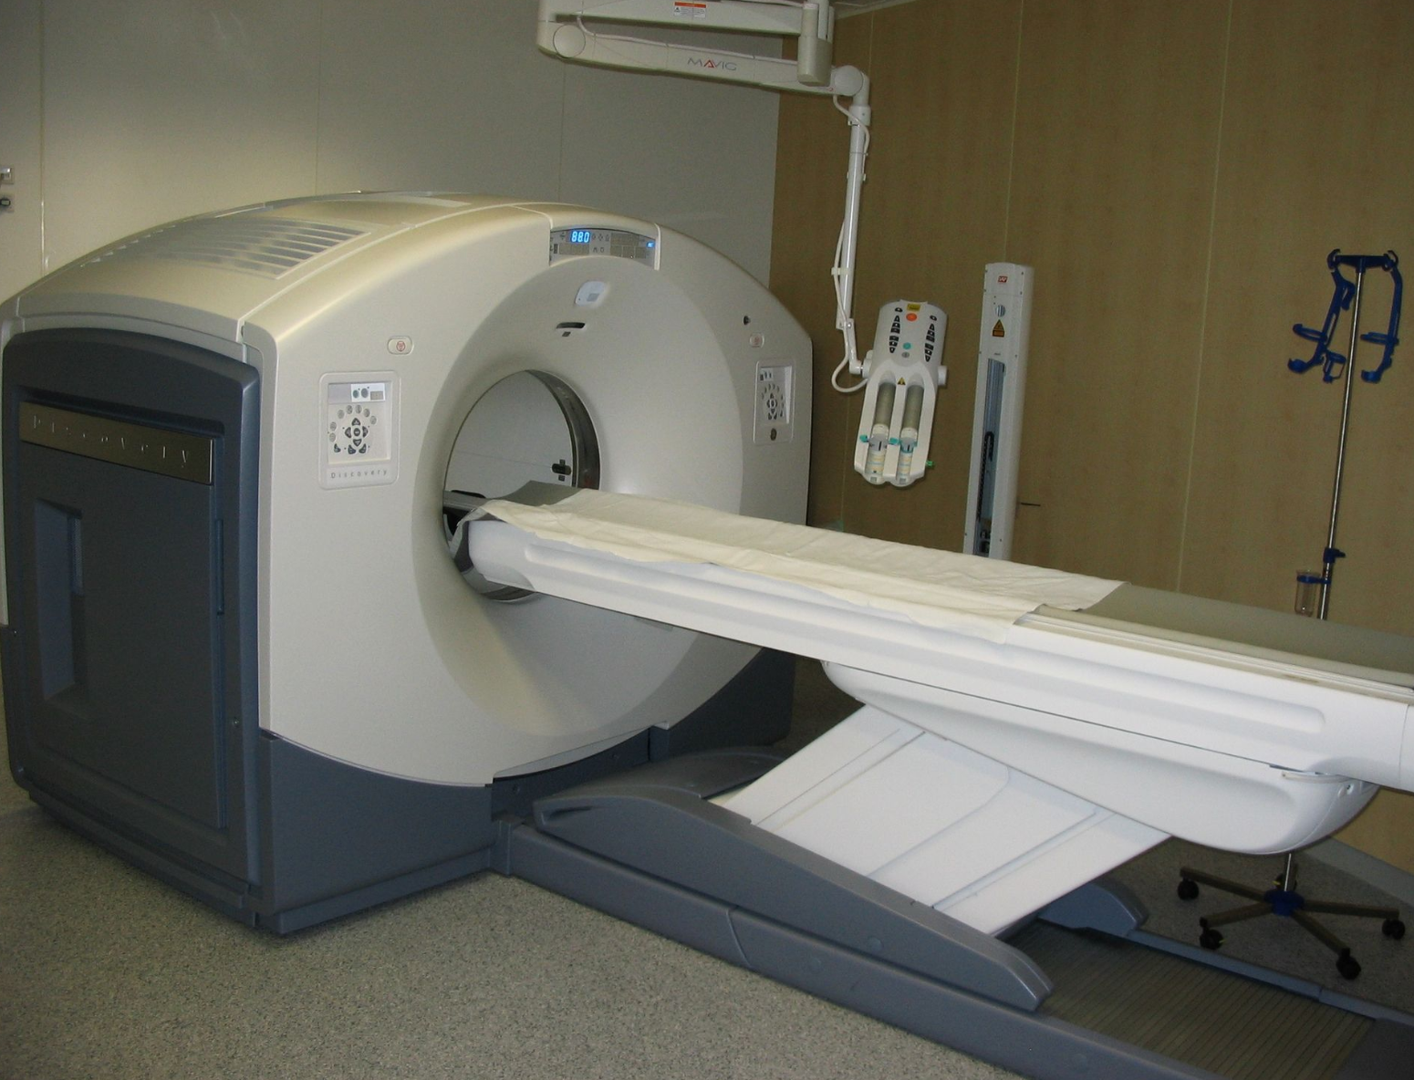
Commercial PET scanner

Slide 11
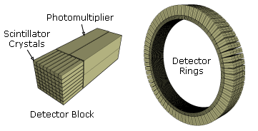
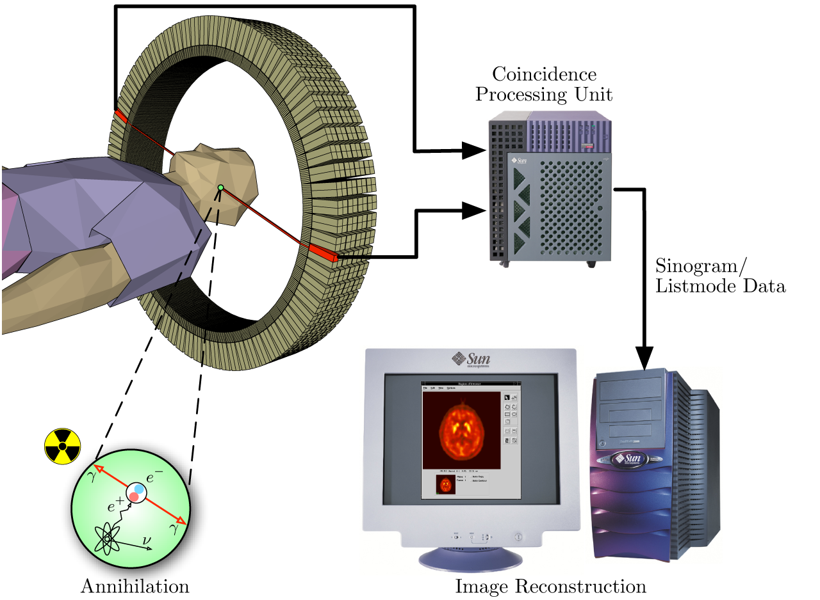
Commercial PET scanner

Slide 12
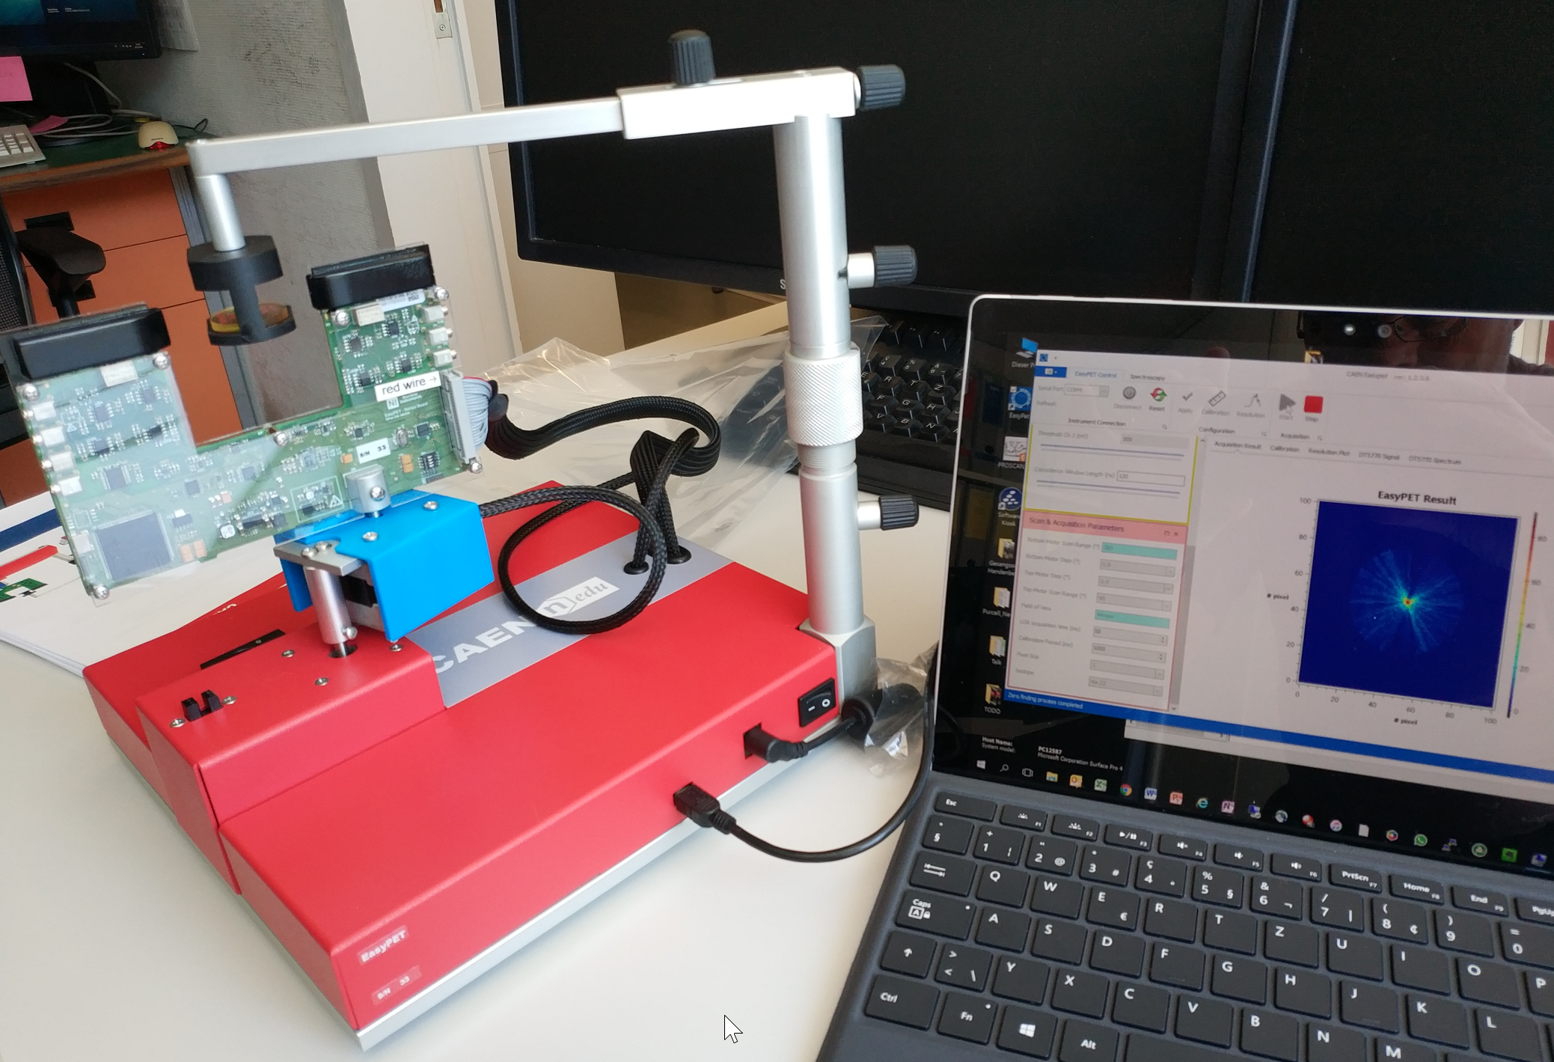
EasyPET
2 detectors moving around the target

Slide 13
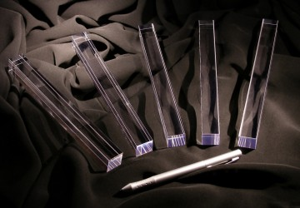
LySO Crystals
Lutetium-yttrium oxyorthosilicate
Lu2(1-x)Y2xSiO5
Scintillator crystal

Slide 14
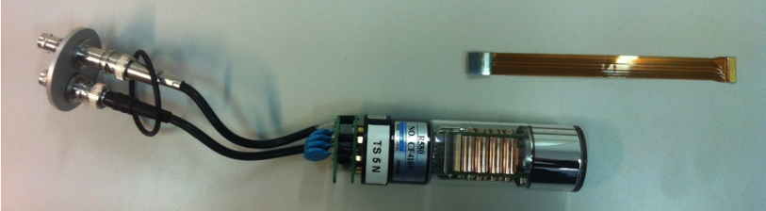
Silicon Photo Multiplier - SiPM
Solid state photon detectors
High gain, low voltage («bias»)
Very compact
Compatible with magnetic resonance imaging MRI

Slide 15
Silicon Photo Multiplier - SiPM
Many institutes/companies are involved in SiPM production
  CPTA, Russia
  Amplification Technologies , USA
  Novel Device Laboratory (NDL), China
  Excelitas tech. (formerly Perkin-Elmer)
  National Nano Fab Center, Korea
  MePhi/Pulsar Enterprise, Russia
  Zecotek, Canada
  Hamamatsu HPK,, Japan
  FBK-AdvanSiD, Italy
  ST Microelectronics, Italy
  MPI-HLL, Germany
  Philips, Germany
  KETEK, Germany
  SensL, Ireland
  RMD, USA
Papers on Google Scholar about «SiPM»

Slide 16
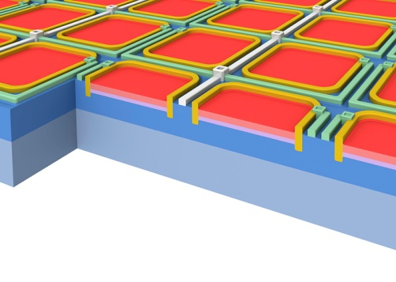
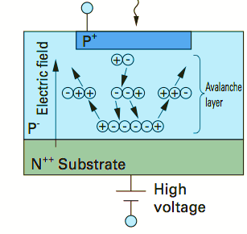
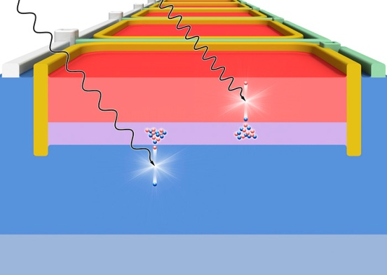
Silicon Photo Multiplier - SiPM
SiPM is a High density (up to 104/mm2 ) matrix of diodes with a common output, working in Geiger-Müller regime
Common bias is applied to all cells (few % over breakdown voltage)
Each cell has its own quenching resistor (from 100kΩto several MΩ)
When a cell is fired an avalanche starts with a multiplicative factor of about 10⁵-10⁶
The output is a fast signal (trise~ ns; tfall ~ 50 ns) sum of signals produced by individual cells
SiPM works as an analog photon detector

Slide 17
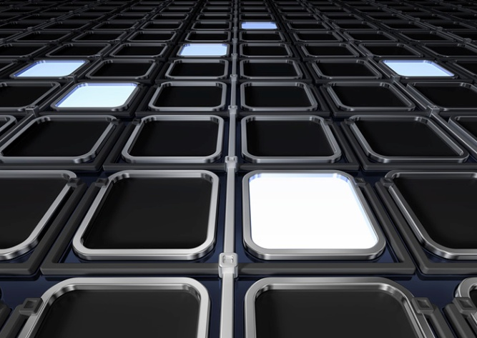
Silicon Photo Multiplier - SiPM
SiPM can be seen as a collection of binary cells, fired when a photon is absorbed
Counting cells provides information about the intensity of the incoming light
Dark Count Rate (DCR)
  Avalanche induced by thermal effects
  Depends on
    Temperature
    Sensor technology
    Bias voltage
Detector counts even without
radioactive source

Slide 18
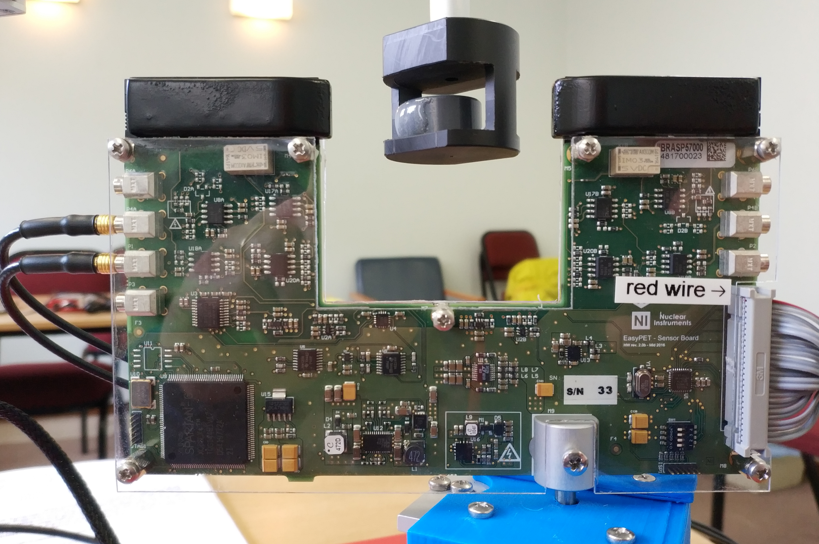
EasyPET PCB
Channel 1
Channel 2
Analog output
Comparator signal
Coincidence signal

Slide 19
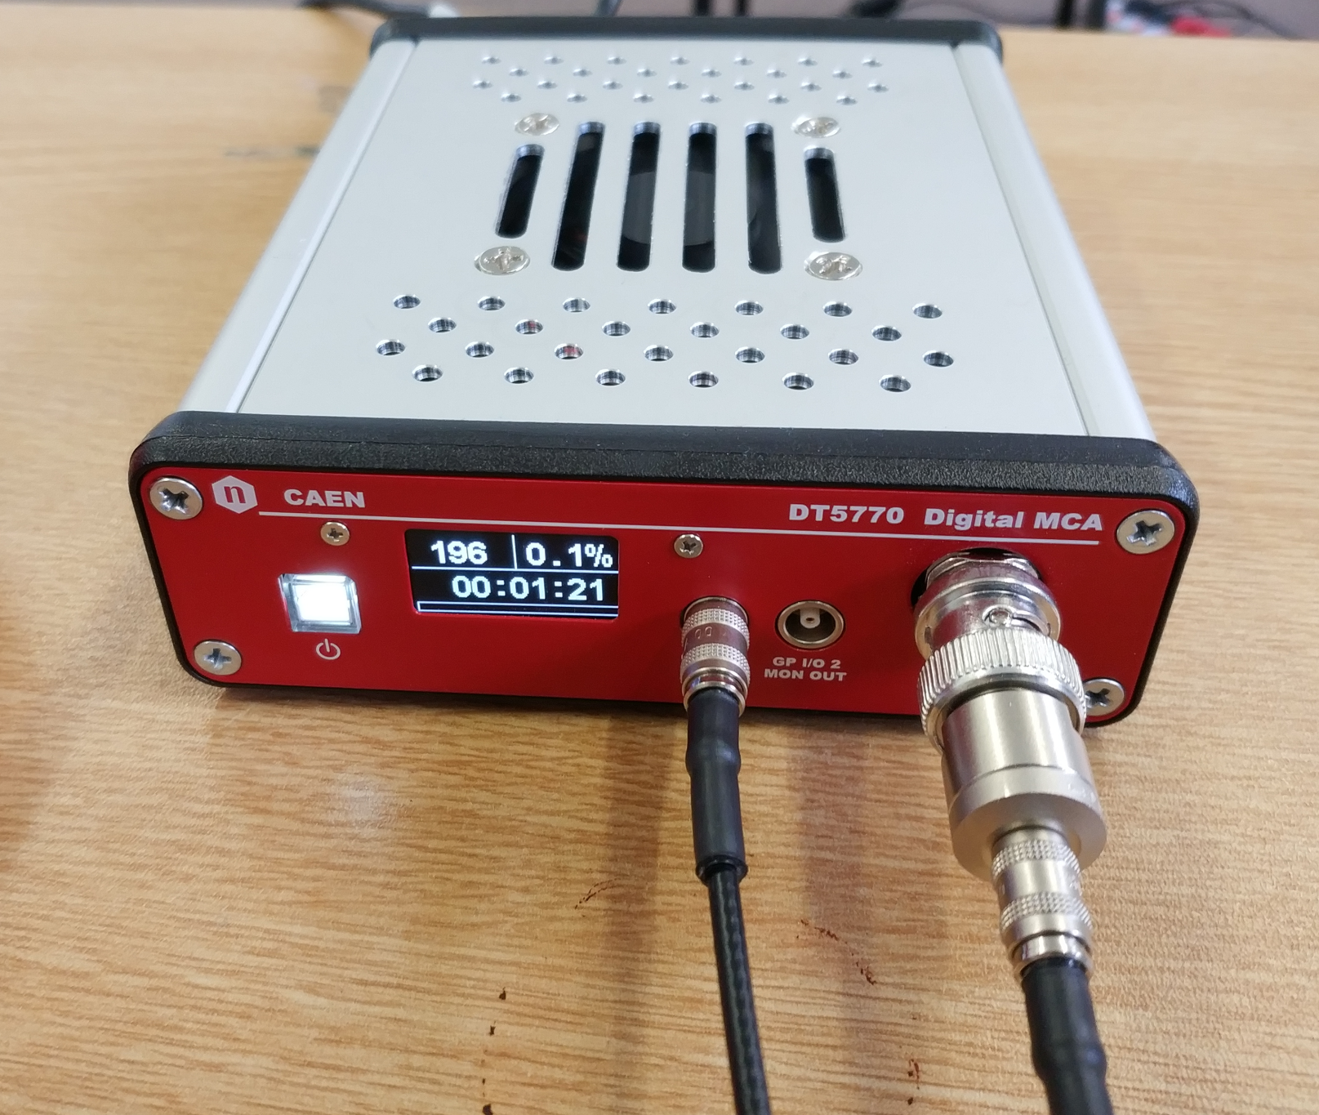
DT5770 Multi Channel Analyzer (MCA)
Analyze pulses
Accept signal and trigger input
Readout with PC

Slide 20
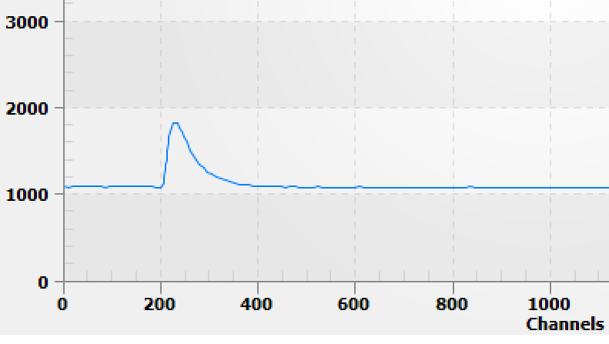
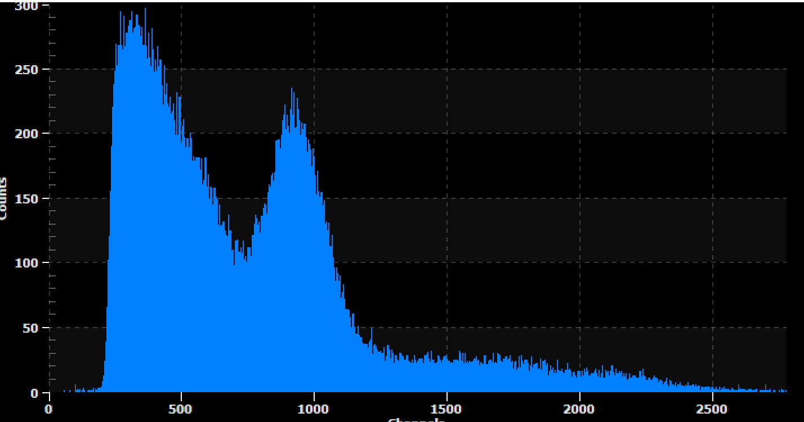
Multi Channel Analyzer (MCA)
Look at individual pulses
Acquire spectrum

Slide 21
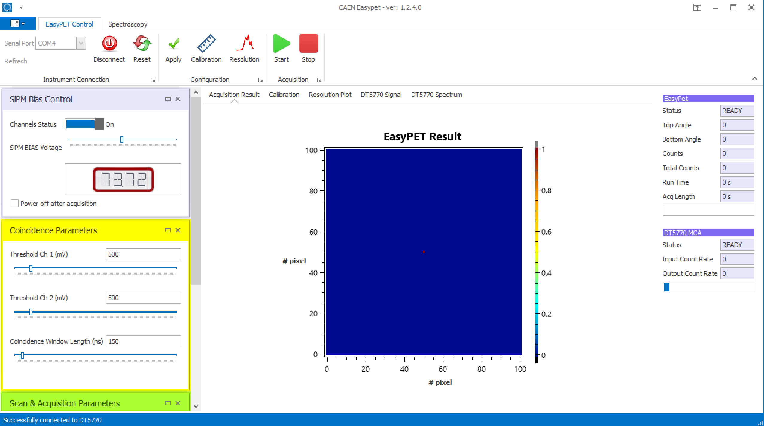
EasyPET GUI

Slide 22
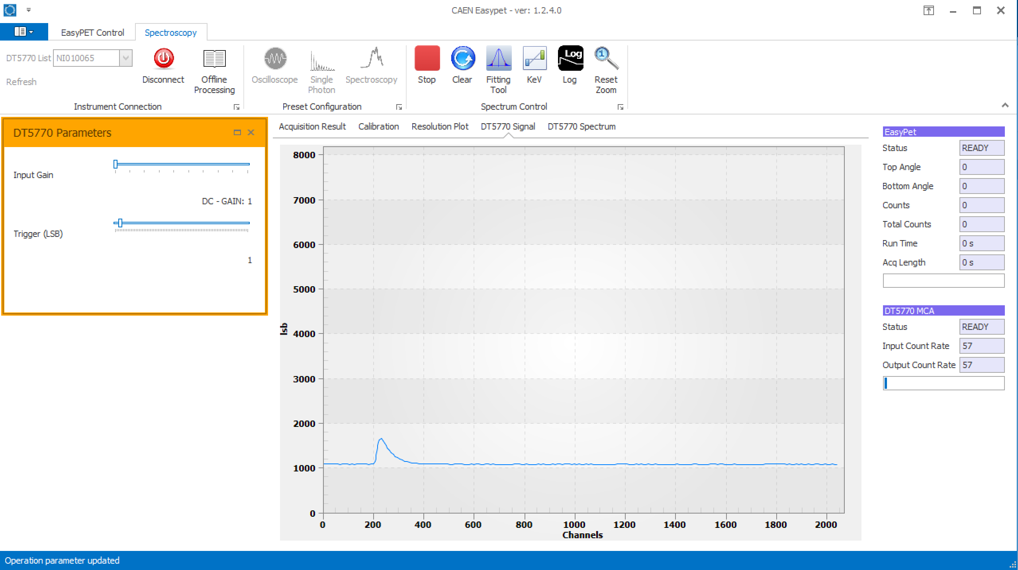
EasyPET GUI

Slide 23
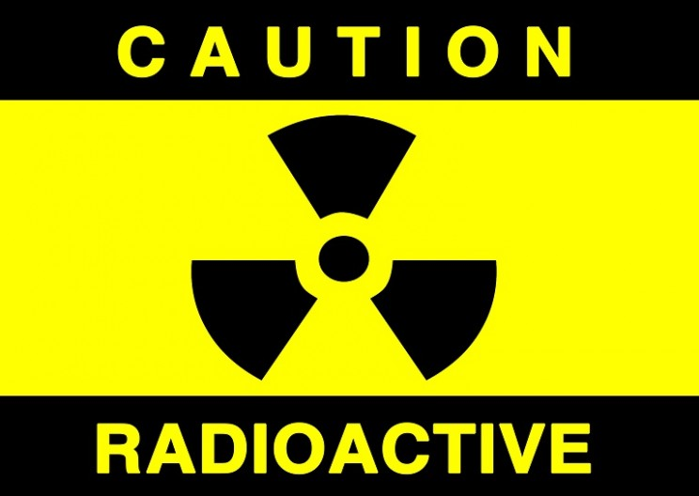
Handling radioactive sources

Slide 24
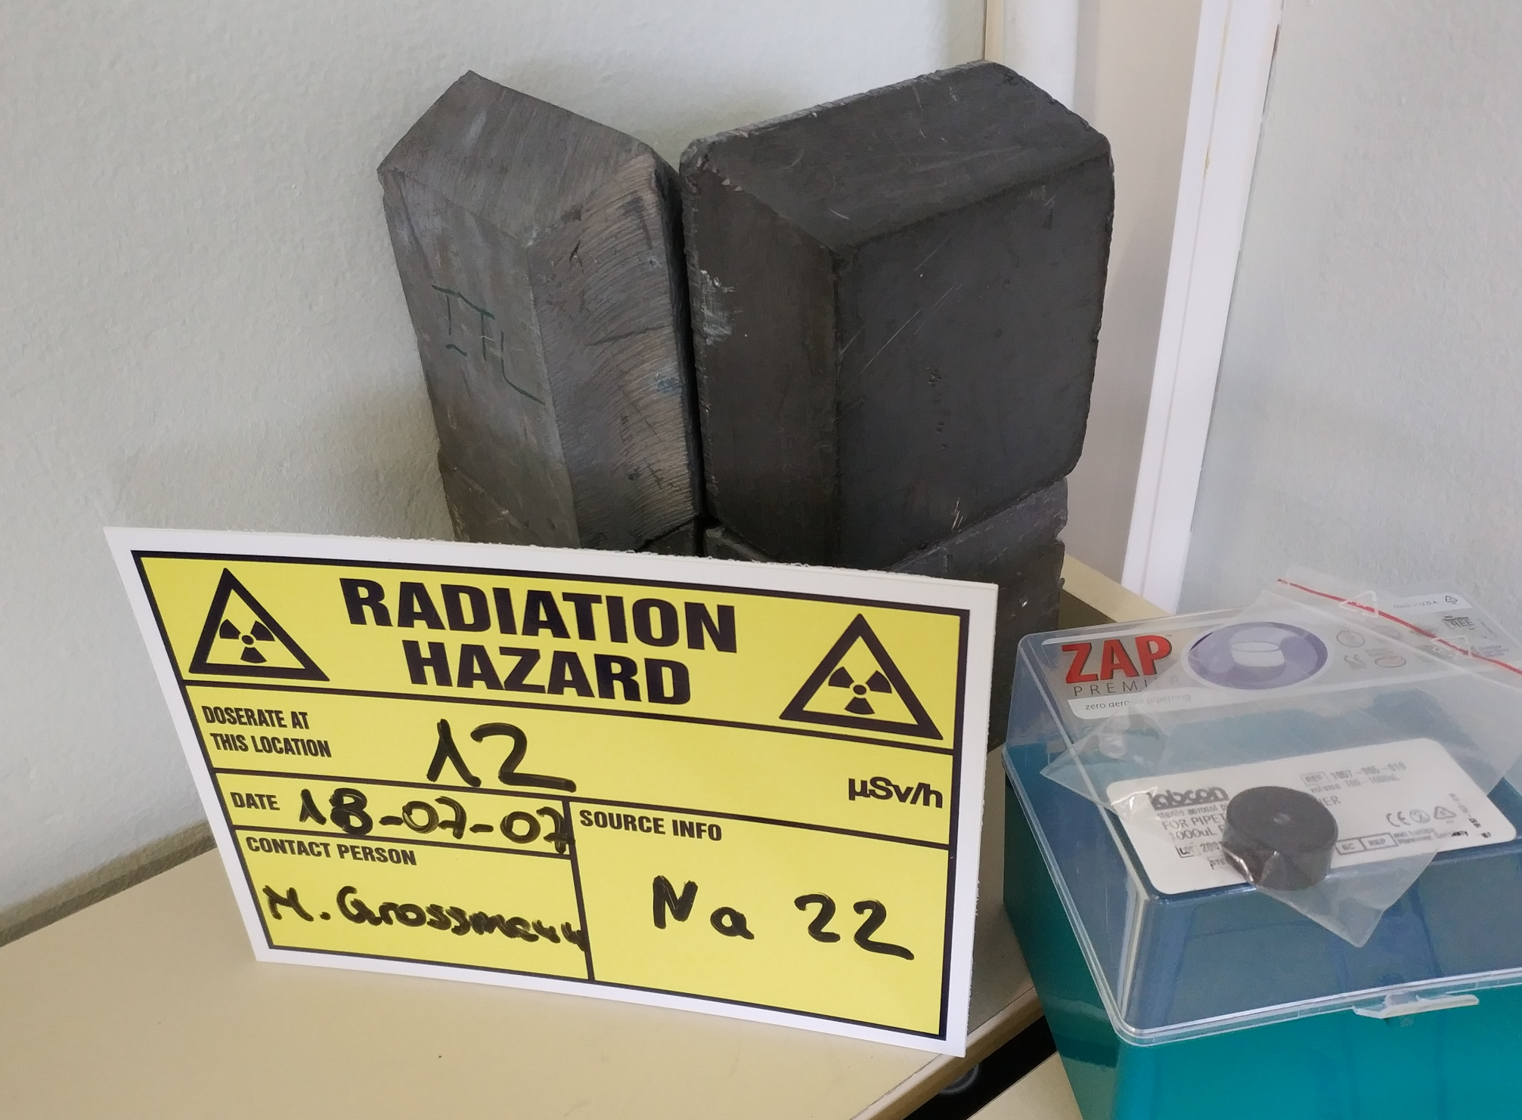
Handling radioactive sources

Slide 25
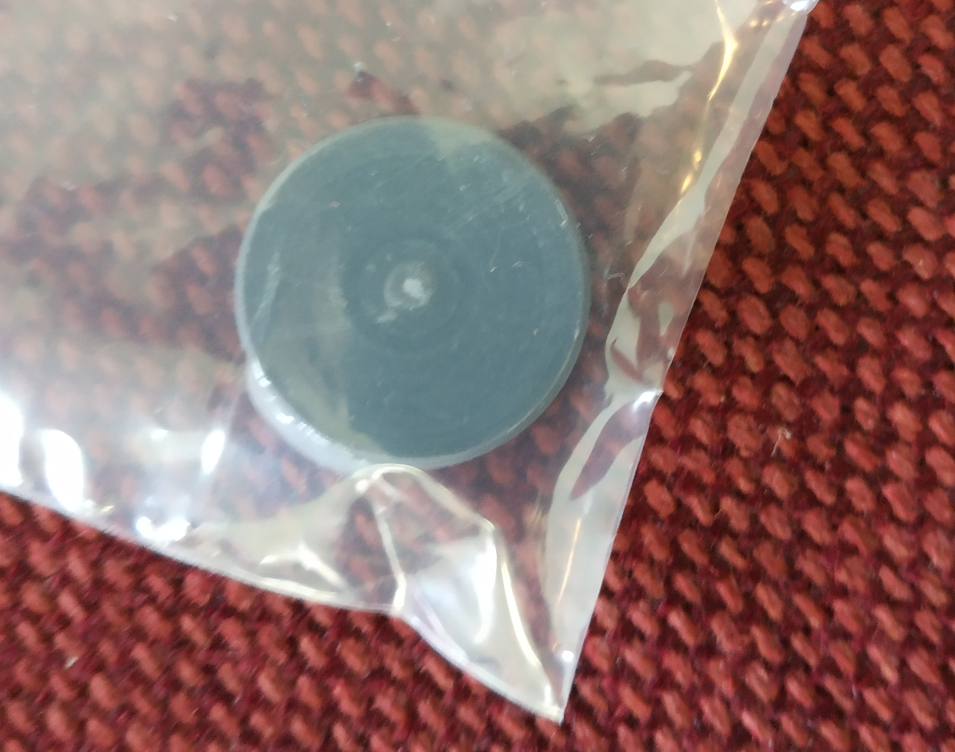
Handling radioactive sources

Slide 26
Handling radioactive sources
Let your instructor do most of the source handling!
Minimize the time you are handling the sources directly
Maximize your distance from the sources during the experiment
When not needed store the sources in the lead castle (small desk in the corner)

Slide 27
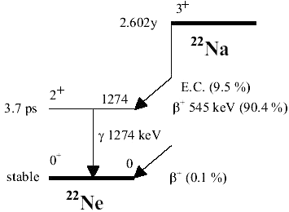
Na²²
Sealed sources of Na²²
β⁺ emitter
12 µCi activity
Emission of 511 keV from positron annihilation
Emission of 1274 keV from Ne²² in excited state

Slide 28
EXERCISE

Slide 29
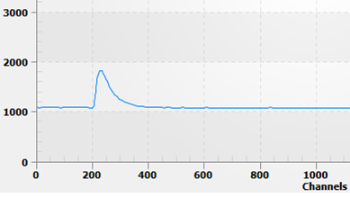
Single Pulses

Slide 30
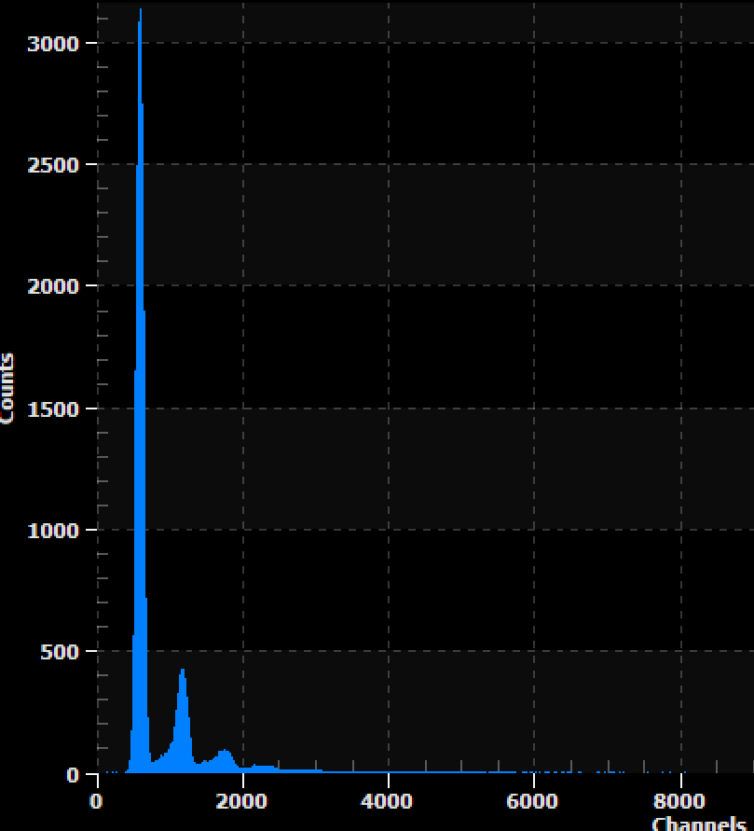
Multi Photon Spectrum

Slide 31
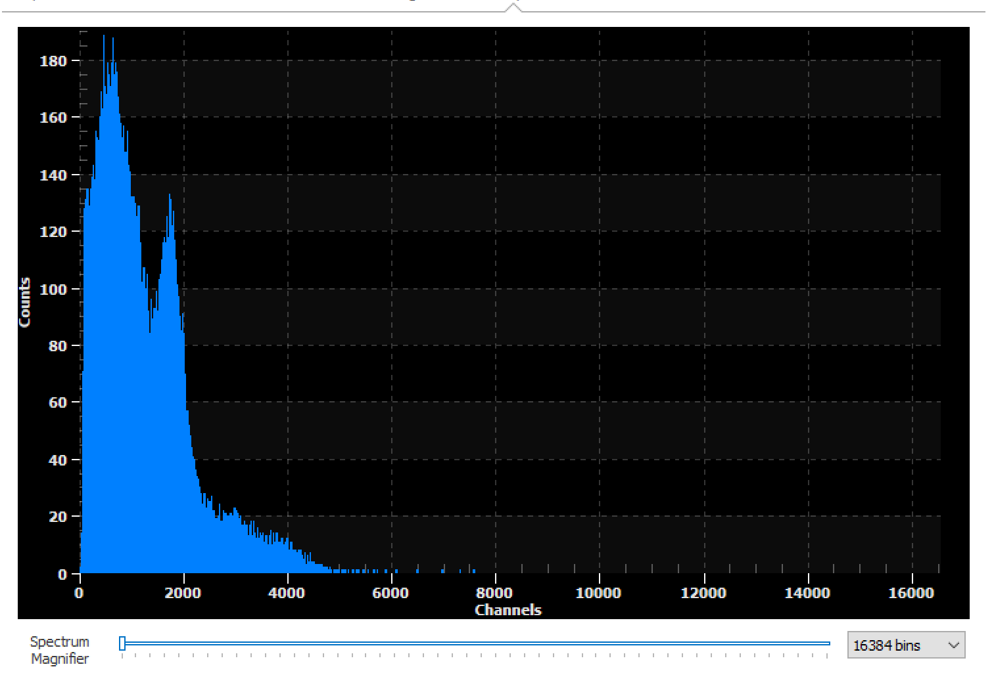
Gamma Spectrum

Slide 32
PET image

Slide 33
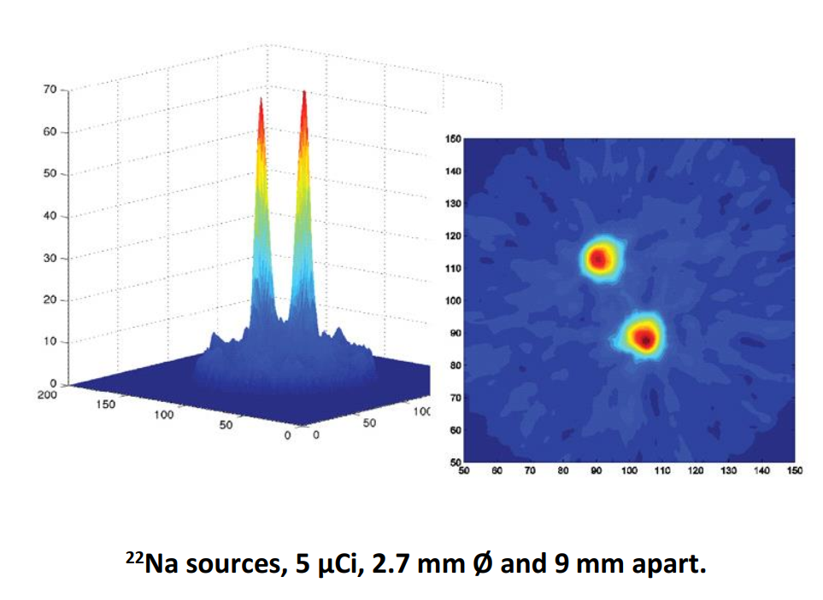
Two sources resolution

Slide 34
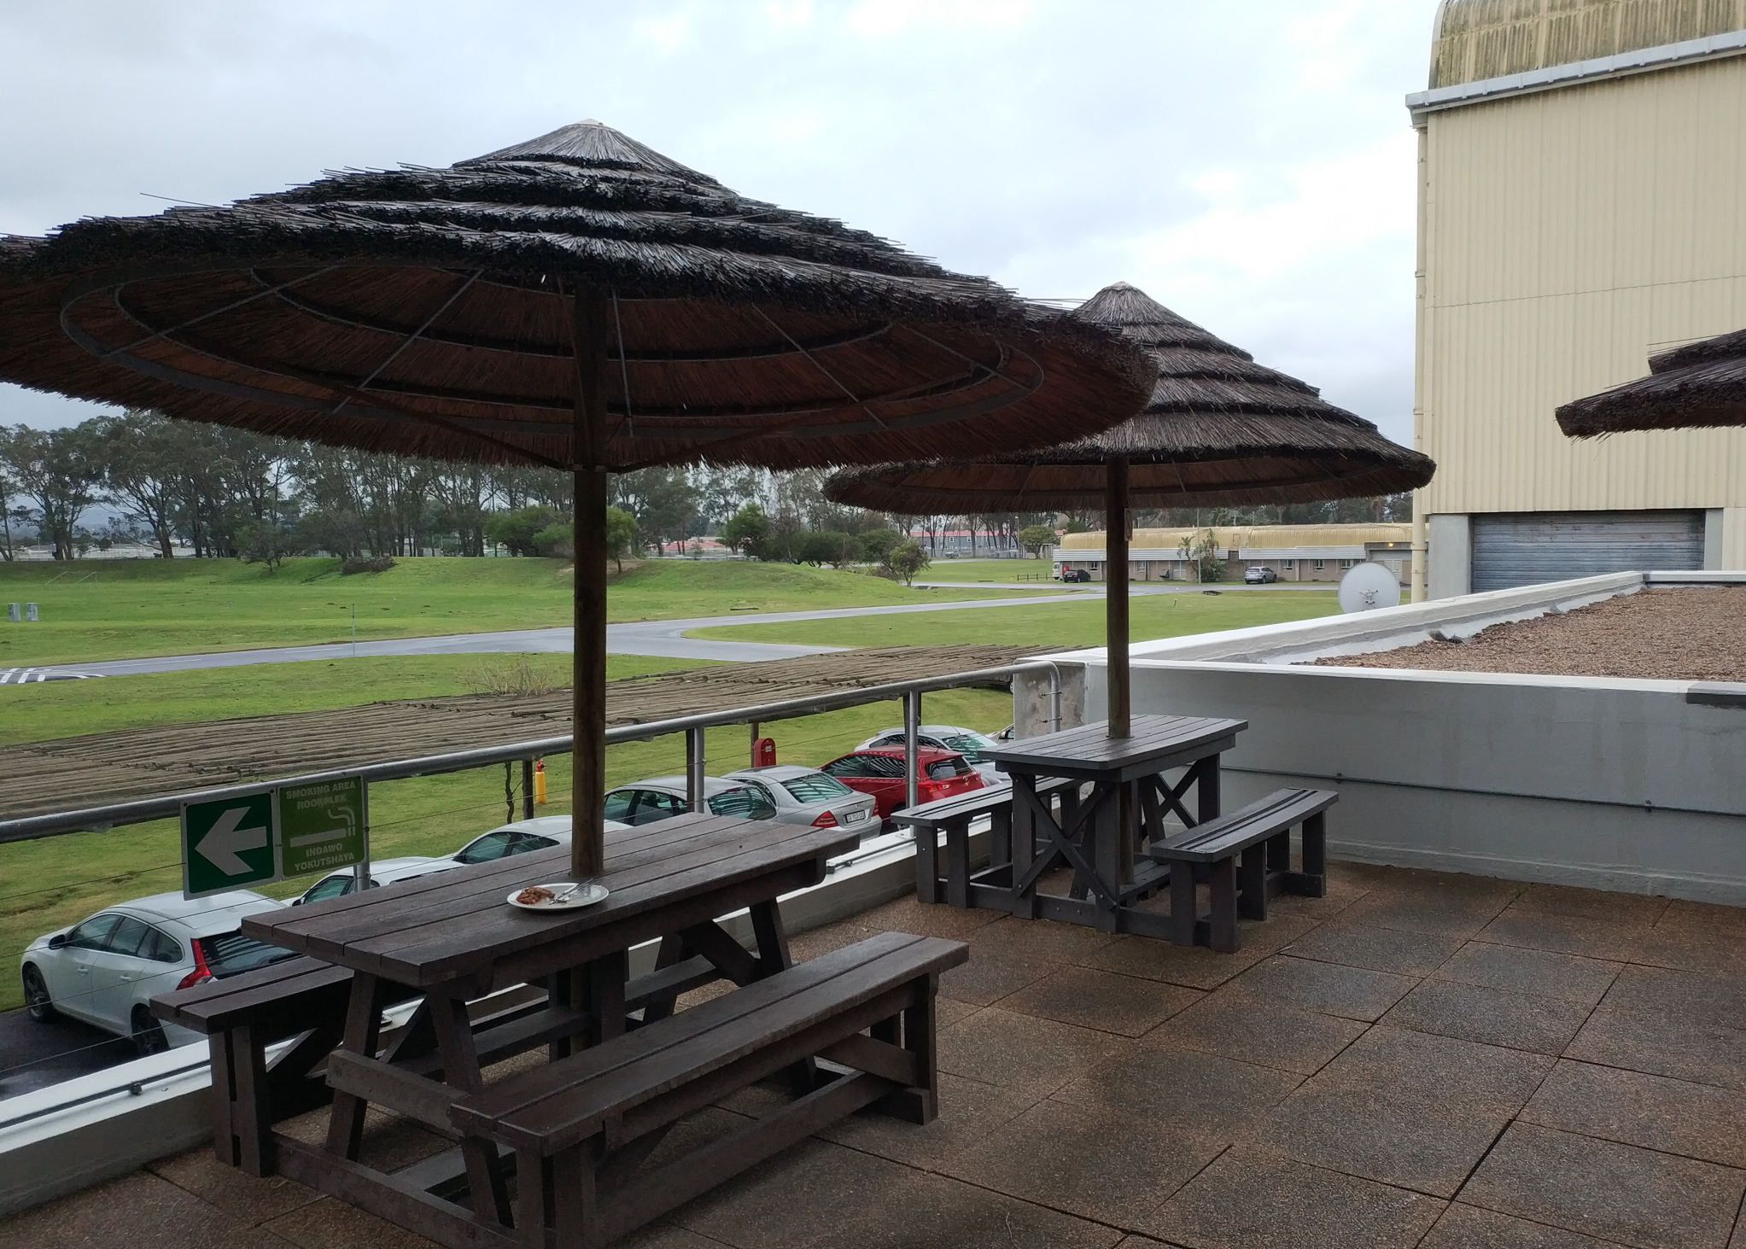
Seminar Room PG 57

Slide 35
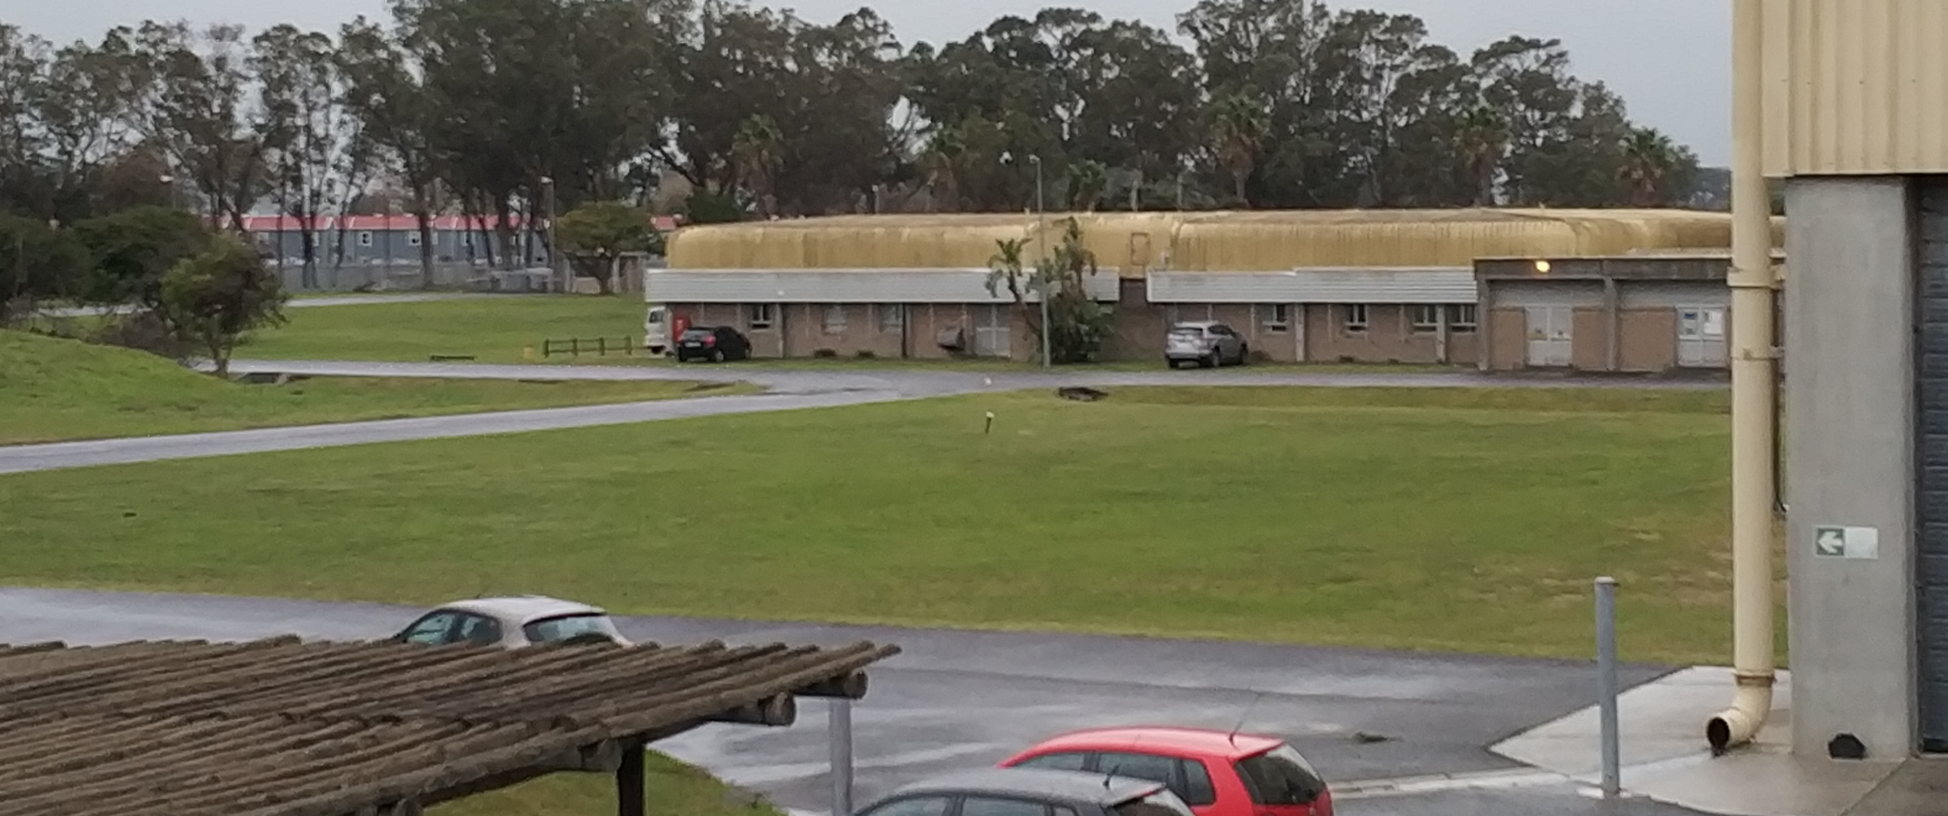

Slide 36
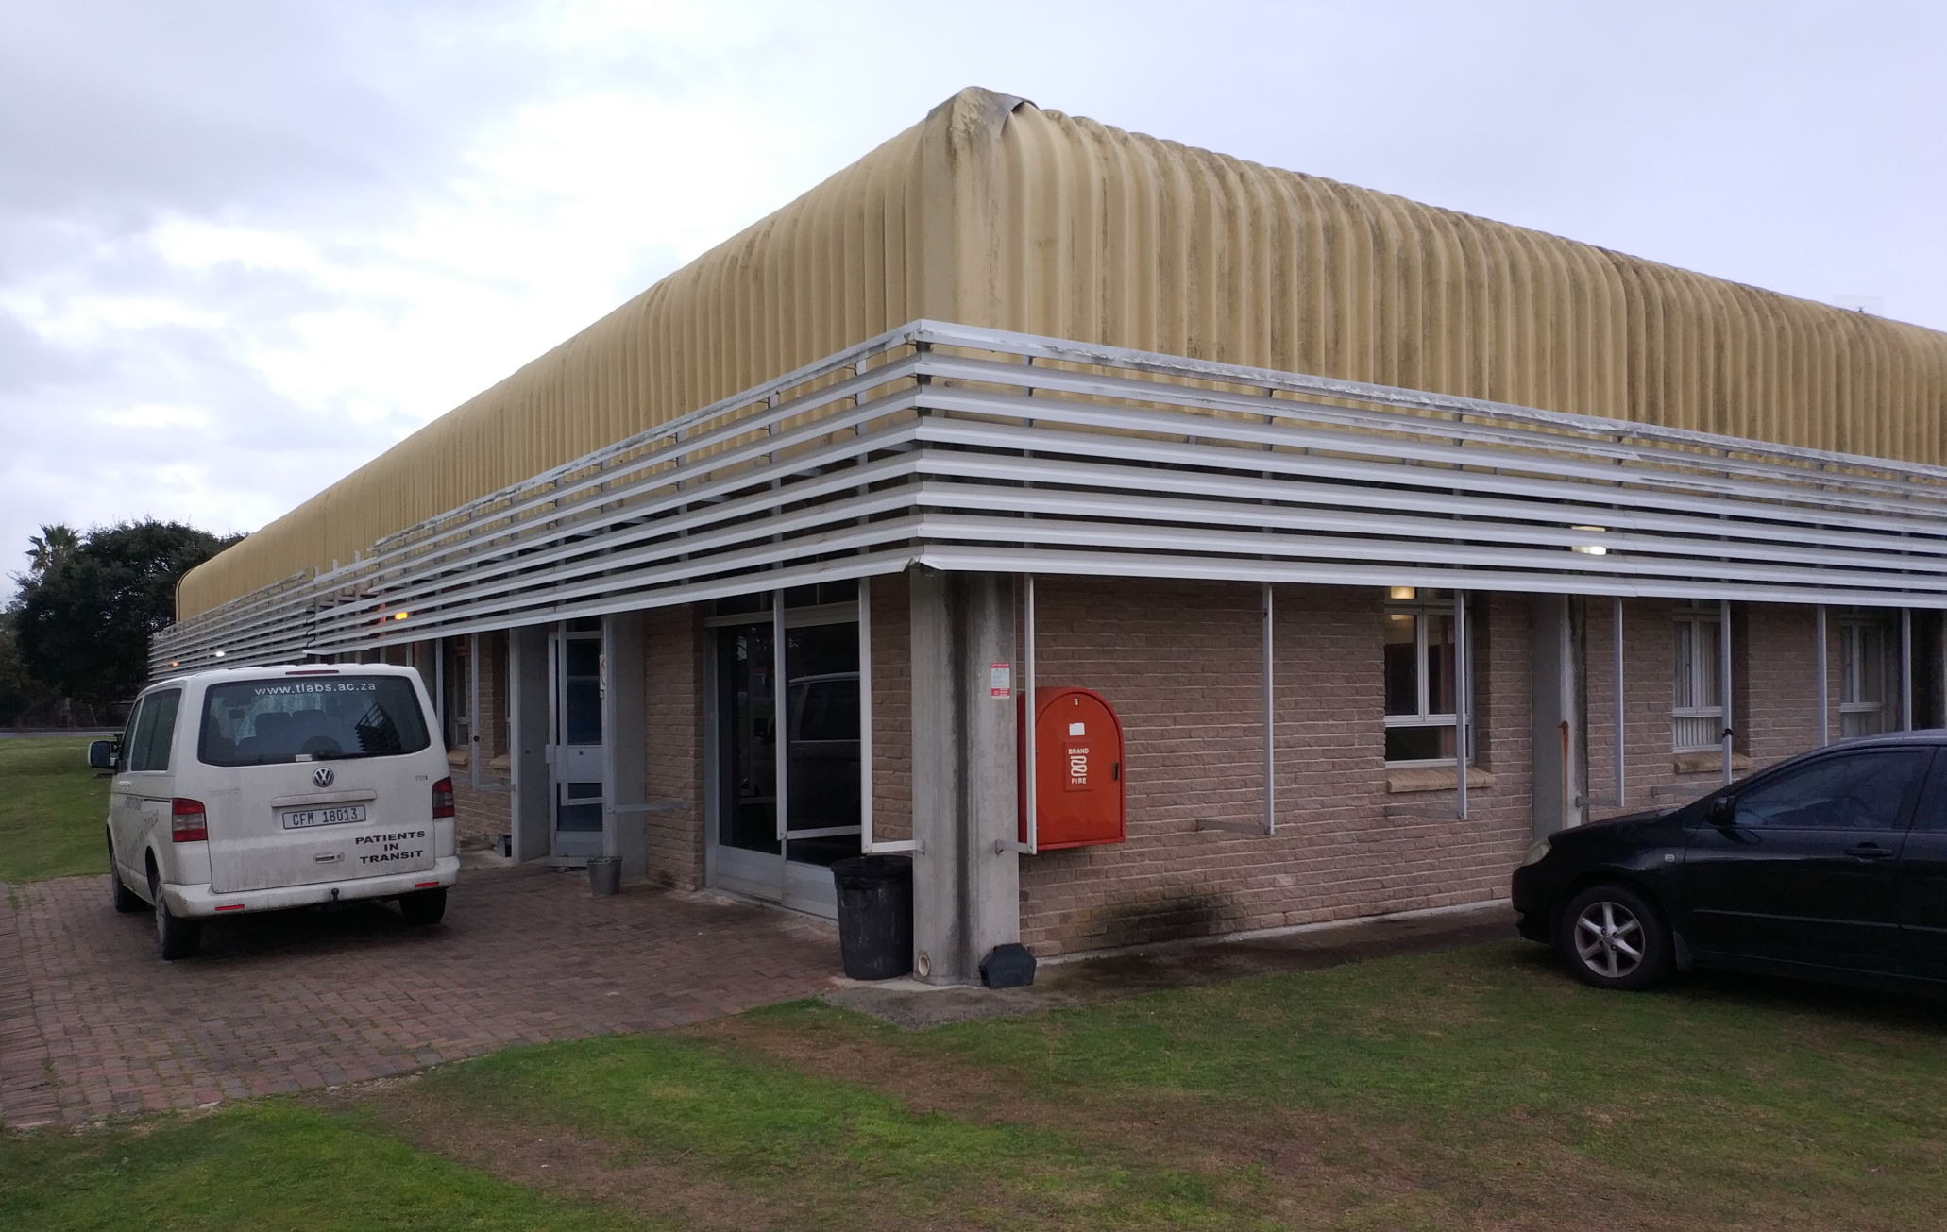

Slide 37
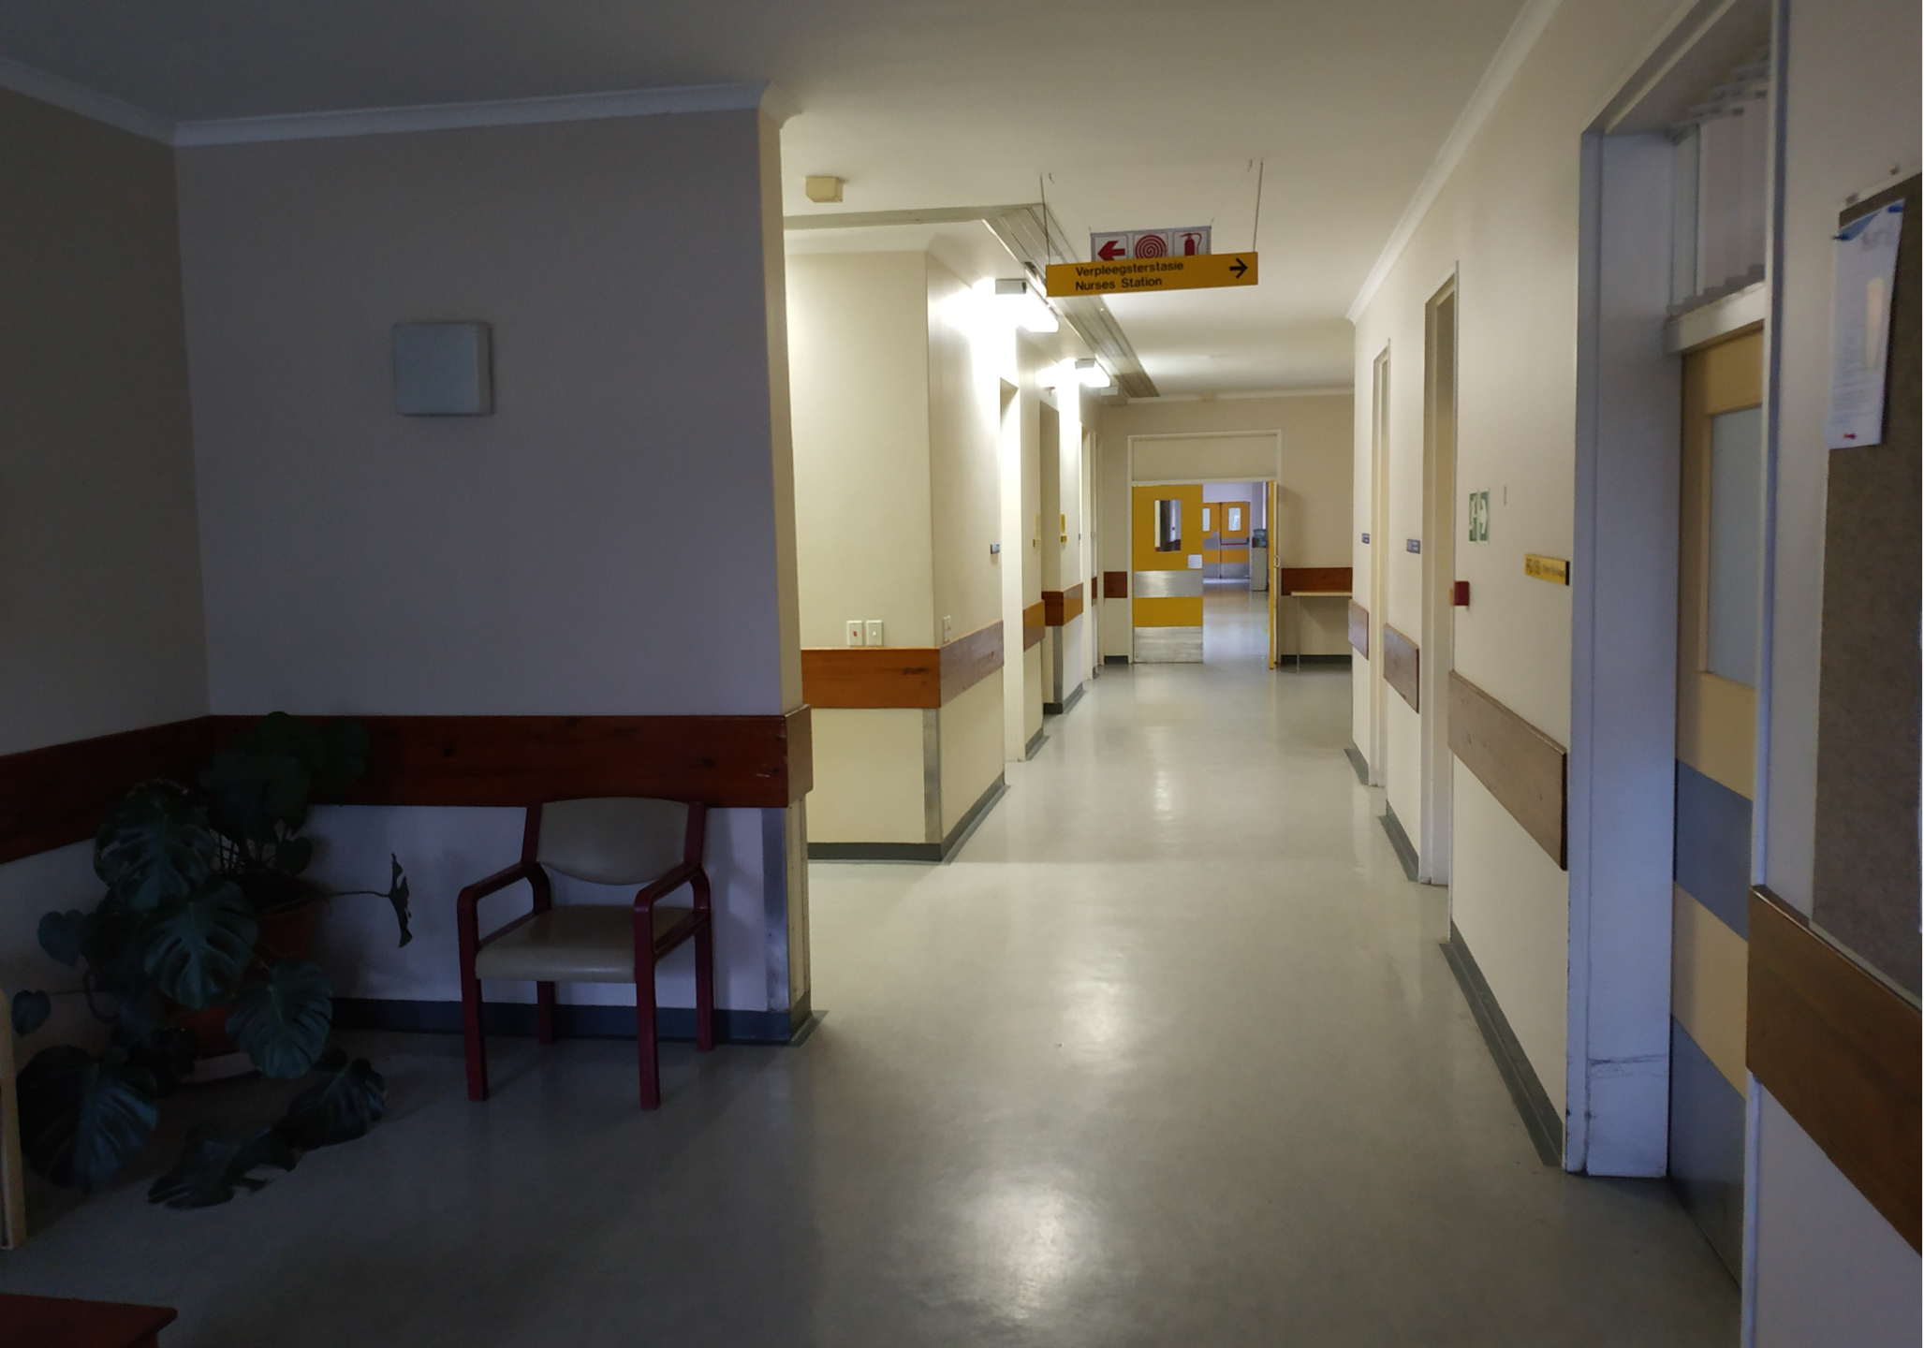

Slide 38
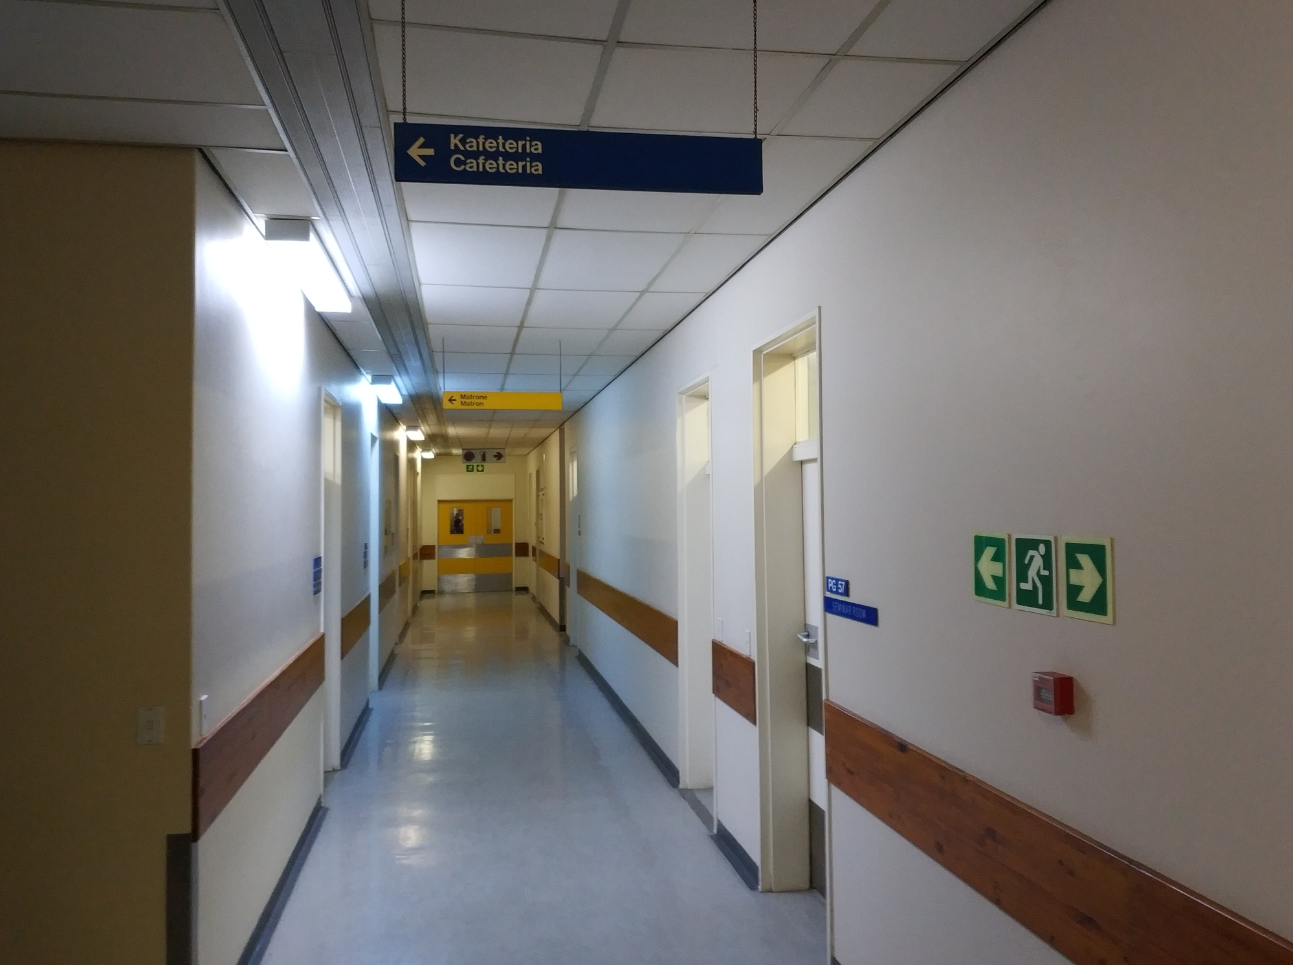

Slide 39
