Slide 1
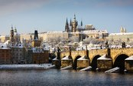

Application of pixel detectors
Ivan Štekl
Institute of Experimental and Applied Physics, Czech Technical University in Prague
Main scientific programs in IEAP CTU:
- research infrastructure
- accelerator particle physics
- neutrino physics
- astroparticle physics
- applied nuclear spectroscopy
- R&D of detectors techniques
- applications of semiconductor pixel detectors

Slide 2
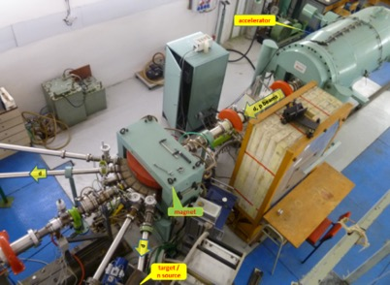
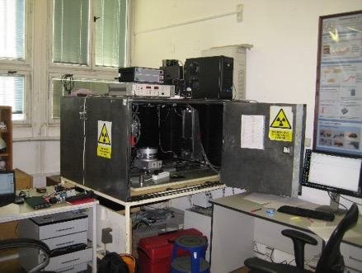
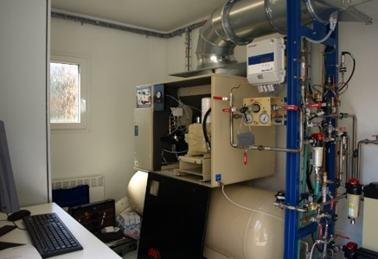
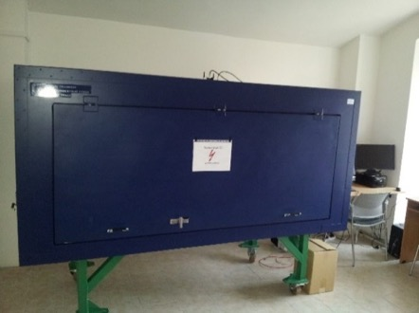
Research infrastructure of IEAP
Van de Graaff accelerator
Underground laboratory LSM in Modane, France
Small underground laboratory in Prague in a nuclear shelter
2 electron microscopes
Laboratory for high-resolution X-ray radiography, 3D X-ray tomography and neutronography in IEAP,
Specialized laboratory for experimental imaging – common laboratory of IEAP and 3rd faculty of medicine of CU
Radon laboratory (ultrasensitive measurement, radon-free chambers) – common laboratory of IEAP and the National Radiation Protection Institute;
Tunable electron source and equipment for scintillators measurements – common laboratory of IEAP and the Nuvia company.

Slide 3
Research subjects:
LHC at CERN – experiments ATLAS (shielding, ATLAS TPX – radiation field measurement, luminosity monitoring, theory, data processing), MoEDAL
Neutrino physics – 2νEC/EC decay of ¹⁰⁶Cd (experiment TGV), detection of 0ν and 2νββ decay of ⁸²Se (experiment SuperNEMO), experiment LEGEND (USA/Germany – 0νββ decay of ⁷⁶Ge); detection of atmospheric neutrinos in experiment Baikal Gigaton Volume Detector (Baikal-GVD); detection of reactor antineutrinos in the nuclear power plant in Kalinin
Detection of dark matter – experiment PICO in SNOLAB (Canada), detection of neutralino
Detection of high-energy cosmic rays – detection of radiation from universe (6 Timepix detectors on ISS, NASA; Timepix detector on satellite Proba-V; future mission of RISESAT satellite; small unit VZLUSat), experiment GROND (γ ray burst, cooperation with MPI Germany, in Chile), experiment CZELTA (secondary cosmic rays, outreach, cooperation with secondary schools)
Structure of atomic nuclei and nuclear reactions – fission, radioactive nuclei decay, super heavy nuclei, astrophysical reactions
Applications – pixel and strip detectors, imaging (X-rays and neutrons), biomedicine, hadron therapy, study of material…..

Slide 4
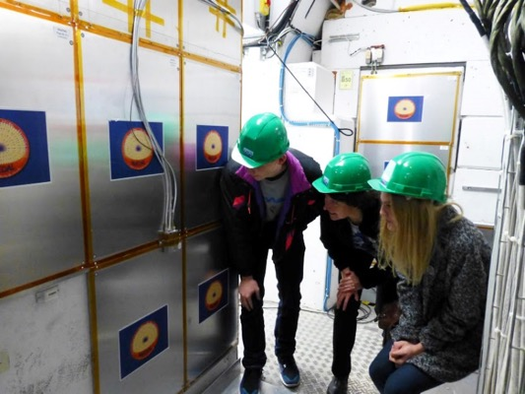
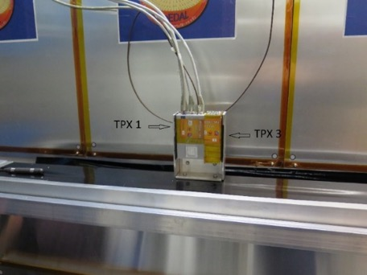
Experiment MoEDAL
Detection of magnetic monopoles and other highly ionizing (pseudo-)stable massive particles.
Consists of:
  Passive nuclear track-etch detectors (CR 39 foils)
  Trapping detectors (aluminium volumes)
  MoEDAL-TPX array
    Radiation monitor, capable of determining background of highly ionizing particles (alphas, protons,…).
    Five TPX detectors, located at distances 1 m – 2 m around the IP
We need new detection technique based on hi-tech electronics (quick electronics, complex information about signals) => we need you

Slide 5
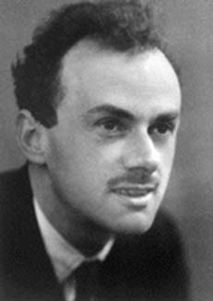
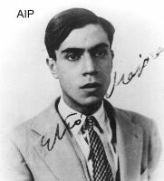
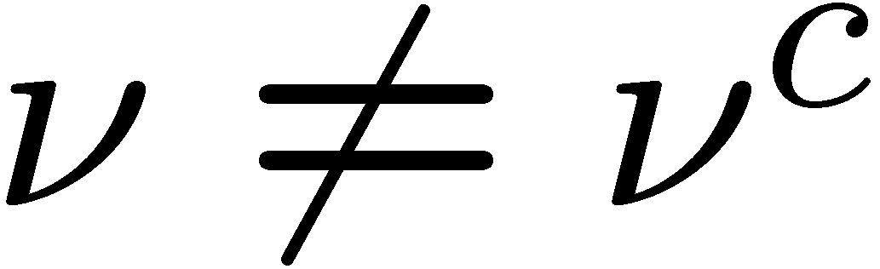

The most important question: nature of neutrinos? Mass?
We are here because there is slight preference in our Universe of matter over
anti-matter: No explanation in Standard Model, we need NEW PHYSICS
This “disbalance” is likely to be linked to the two processes:
Proton decay (“disappearance” of nucleons)
Neutrinoless double beta decay (“creation” of electrons)
Maria Goeppert-Mayer: two-neutrinos double beta decay (1935)
(Z-2,A) (Z,A)+2e⁻+2ν_{e} (2νβ⁻β⁻)
Furry: neutrinoless double beta decay
(Z-2,A) (Z,A)+2e⁻ (0νβ⁻β⁻)
Paul Dirac
Ettore Majorana
Long term study which need young people => we need you.
It is task for future Nobel price winners

Slide 6
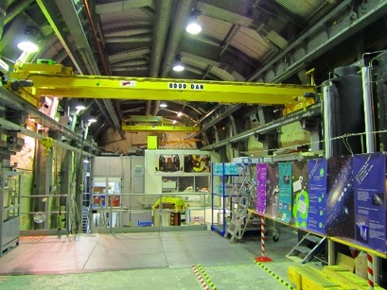
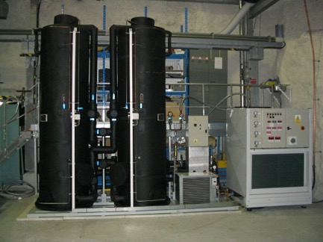
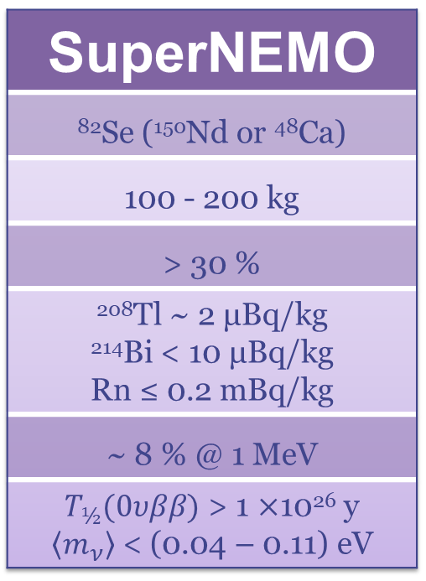
Neutrino physics in underground experiments
Experiments for the measurement of double beta decay in the LSM underground laboratory in Modane, France – shielding 4 800 m w.e.
low background technologies (Rn suppression ~1 mBq/m³)
Muon flux: 4 x 10⁻⁵ μ.m⁻².s⁻¹
Neutron flux: 4 x 10⁻² n.m⁻².s⁻¹(fast);
1.6 x 10⁻² n.m⁻².s⁻¹ (thermal)
Radon: 15 Bq.m⁻³
SuperNEMO
⁸²Se (¹⁵⁰Nd or ⁴⁸Ca)
100 - 200 kg
> 30 %
²⁰⁸Tl ~ 2 μBq/kg ²¹⁴Bi < 10 μBq/kg Rn ≤ 0.2 mBq/kg
~ 8 % @ 1 MeV
$T_{½}(0υββ)$ > 1 ×10²⁶ y $\left\langle m_{ν}\right\rangle$ < (0.04 – 0.11) eV
We are approaching to 1 ton experiments with
many detectors; we need new detection technique
based on hi-tech electronics => we need you

Slide 7

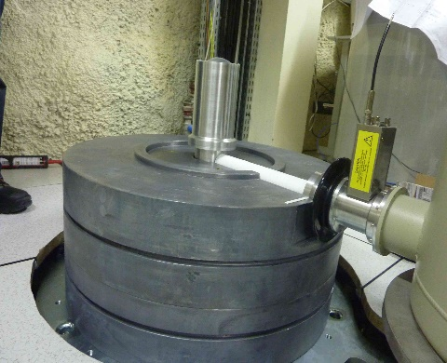
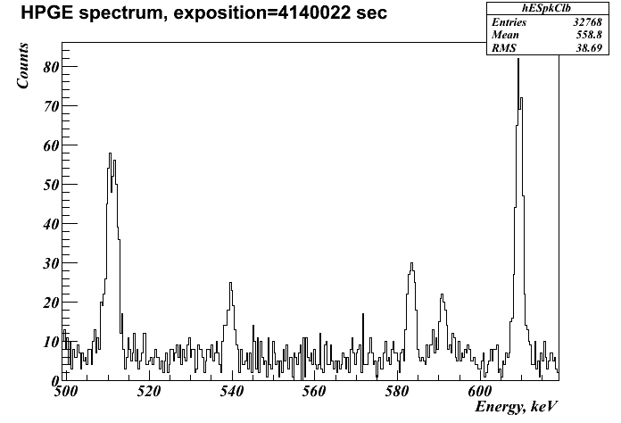
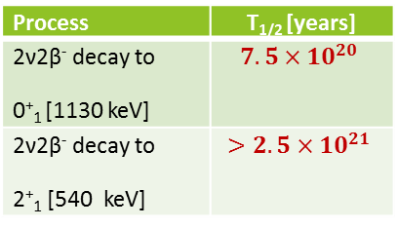
Detector “Obelix” (JINR/IEAP CTU/LSM)
P type coaxial HPGe detector (U-type ultra low background cryostat
located at LSM (4800 m w.e.)
Sensitive volume 600 cm³ Efficiency 162%
Energy resolution ~1.2 keV at 122 keV (⁵⁷Co), ~2 keV at 1332 keV (⁶⁰Co)
12 cm of arch. Pb, 20 cm of low active Pb, Radon free air
Process | T_{1/2} [years]
2ν2β⁻ decay to 0⁺₁ [1130 keV]
2ν2β⁻ decay to 2⁺₁ [540 keV]
Mass of ¹⁰⁰Mo – 2517,15 g
Total measurement time – 2288 h
¹⁰⁰Mo
¹⁰⁰Mo
The price of such detector is
250 kEUROs => you need
international cooperation

Slide 8

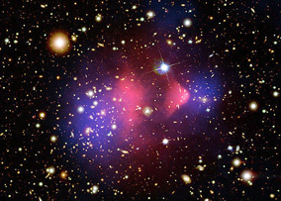
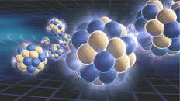

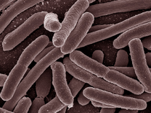
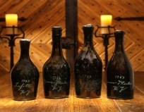
Scientific activities at LSM
15 milliards
d’années
isotope mass
3 minutes
1 seconde
Neutrino physics
SuperNEMO, TGV,CUPID, R2D2
Search of dark matter
EDELWEISS, SEDINE, NEWS-G, MIMAC
Nuclear physics
TGV, OBELIX, SHIN
Environmental sciences
Nano-electronics
Biology
Applications
climatology, oceanography, effects of human activity on the environment, glaciology, archaeology,....
Today`s science is multidisciplinary => you can find application of your knowledge in different fields

Slide 9
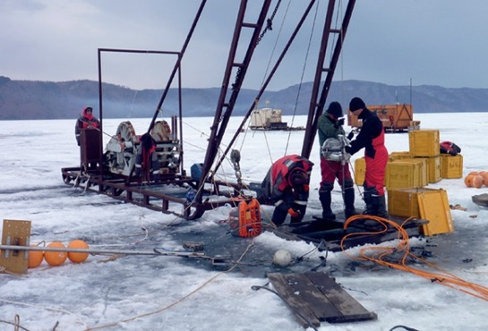
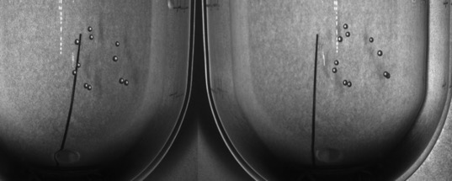
Other neutrino and astroparticle experiments
S3 - detector of reactor (anti)neutrinos
  Collaboration with JINR Dubna (South Africa is associated member)
  Detection of sterile neutrinos in low-distance oscillations.
  Compact detector made from plastic scintillators.
BAIKAL-GVD experiment (Baikal Gigaton Volume Detector)
  1.5 km³ of water in the Baikal lake as a neutrino detector.
PICASSO, PICO experiment
  SNOLAB underground laboratory.
  Detection of neutralinos as dark matter candidates using a bubble detector.
If you like real winter, tell me and you can go to Bajkal lake during Russian winter (2 meters of snow, 1 meter of ice and -30 degrees) => sometimes science is difficult

Slide 10
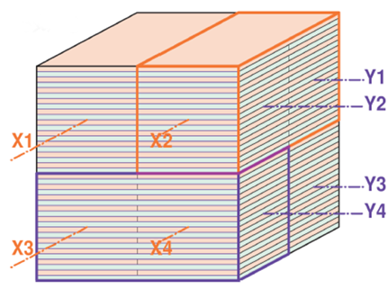
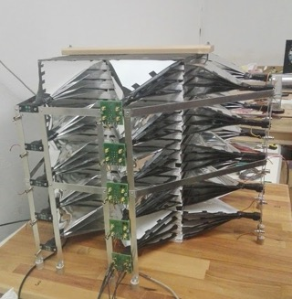

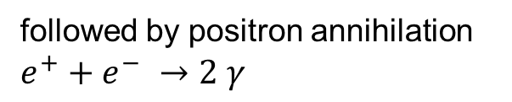
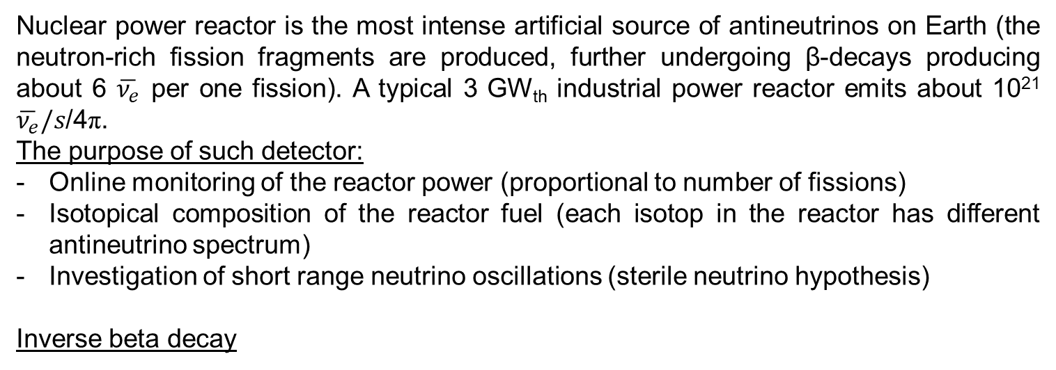
Detector of reactor antineutrinos (S³)
Nuclear power reactor is the most intense artificial source of antineutrinos on Earth (the neutron-rich fission fragments are produced, further undergoing β-decays producing about 6 $\overline{ν_{e}}$ per one fission). A typical 3 GW_{th} industrial power reactor emits about 10²¹ $\overline{ν_{e}}/s$/4π.
The purpose of such detector:
Online monitoring of the reactor power (proportional to number of fissions)
Isotopical composition of the reactor fuel (each isotop in the reactor has different antineutrino spectrum)
Investigation of short range neutrino oscillations (sterile neutrino hypothesis)
Inverse beta decay
followed by positron annihilation
$$e^{+}+e^{−} →2 γ$$
and by neutron capture:
¹⁵⁷Gd(n,γ) ΣE_{γ}=8 MeV σ=255 000 b
$\tilde{ν_{e }}$+ p$→e^{+}+n$
You need to be familiar with different detection techniques, you need to know physics (you know how it works, but physics tells you why it works (or not).
Correction of the floor slope
Pb-shield transport

Slide 11
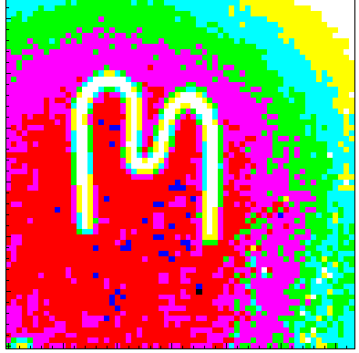

Acknowledgement
The presented results have been achieved within research activities cultivated at IEAP CTU in Prague. They result from extensive partnerships in frame of the Medipix2@3 collaboration with significant contributions of the following colleagues:
R. Ballabriga², B. Bergmann¹, P. Burian^{1,12}, I. Caicedo¹, M. Campbell², J. Dammer¹, C. DaVia⁸, J. Dudák¹, C. Froejdh⁹, E. Froejdh², V. Georgiev¹², C. Granja¹, E. Heijne^{1,2}, M. Holík^{1,12}, R. Hall-Wilton¹⁰, M. Holík¹², T. Holý¹, J. Jakůbek¹, M. Jakůbek¹, J. Kirstead⁷, V. Kraus^{1,12}, F. Krejčí¹, E. Lehmann¹¹, C. Leroy⁴, X. Llopart², J. M. O‘Donnel³, R. Nelson³, M. Nessi², A. Owens⁵, L. Pinsky⁶, S. Petersson⁹, S. Pospíšil¹, M. Platkevič¹, K. Smith¹³, T. Slavíček¹, P. Soukup¹, M. Suk¹, J. Šolc¹, H. Takai⁷, G. Thungstroem⁹, D. Tureček¹, J. Uher¹, D.Vavřík¹, Z.Vykydal¹, S. Wender^{7,} J. Žemlička¹
¹ Institute of Experimental and Applied Physics, CTU in Prague, Czech Republic
² CERN, Switzerland
³ LANSCE, LANL, USA
⁴ Université de Montréal, Canada
⁵ ESA
⁶ NASA/University Houston, USA
⁷ BNL, USA
⁸ Manchester University, UK
⁹ MidSweden University, Sundsvall, Sweden
¹⁰ ESS, Sweden
¹¹ PSI, Switzerland
¹² WBU Pilsen, Czech Republic
¹³ Glasgow University

Slide 12
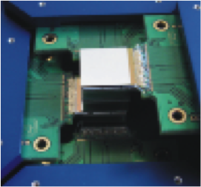
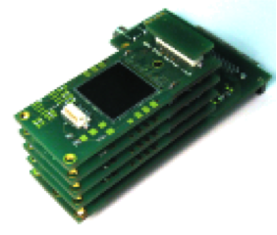
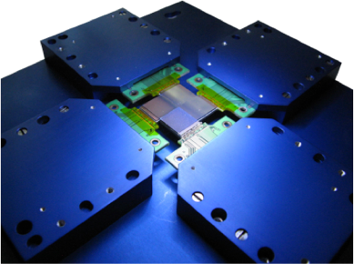
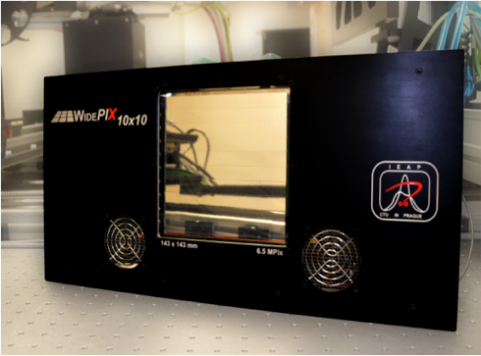

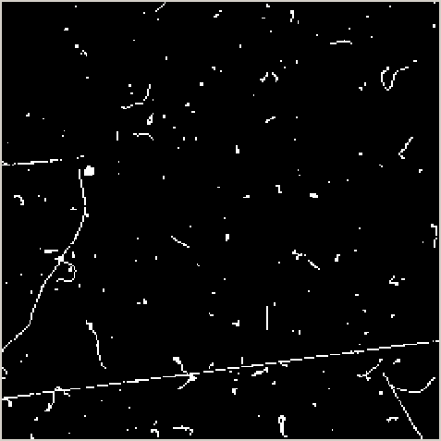
Timepix based devices developed and tested in IEAP CTU
Typical response of Medipix2/Timepix device to natural background radiation
Clearly recognizable tracks
and traces of
- X-rays
- electrons generated mostly
by gamma rays
- alpha particles
- muon
- electron-positron pair, … .

Slide 13
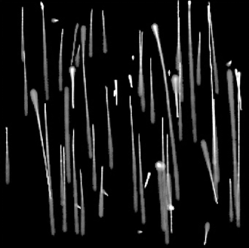
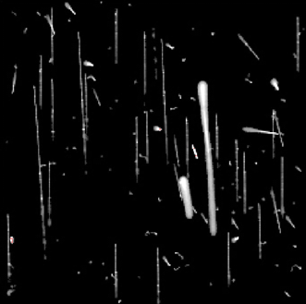
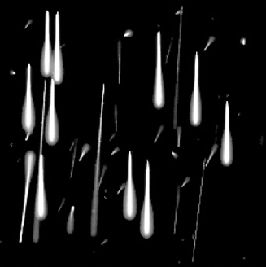
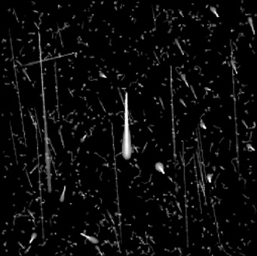
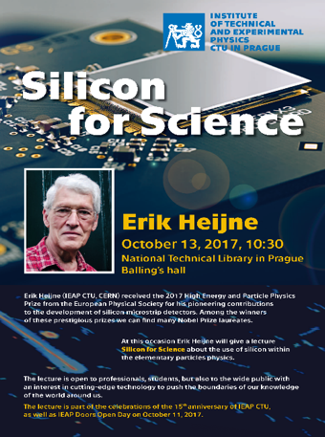
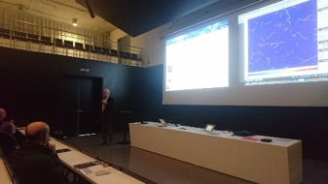
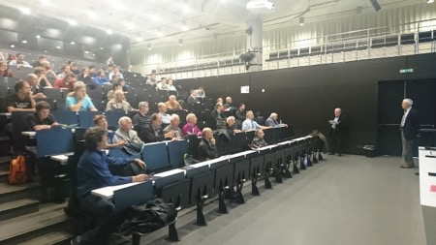
Typical observed tracks of particles used for hadron therapy beam
Protons 48 MeV
Protons 221 MeV
Carbons 89 MeV/u
Carbons 430 MeV/u
Only protons and their scattering, no secondaries.
Many secondaries, (delta electrons fragments).
Carbons and protons and their scattering, no secondaries.
Carbons and many secondaries.
Erik Heijne received the 2017 High Energy and Particle Physics Prize from the European Physical Society for his pioneering contributions to the development of silicon microstrip detectors. At this occasion (and as a part of the celebrations of the 15th anniversary of IEAP CTU) he gave a lecture for wide public about the use of silicon within the elementary particles physics.

Slide 14
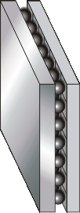
Single ⁸He ion decay sequence recorded by Timepix operating in ToA mode
β⁻
β ⁻
⁸Be
⁸He
⁸Li
α+α
⁸He ion hits the Timepix sensor where undergoes
β-decay
Subsequent decays of the daughter nuclei by emission of one beta and two alpha particles follow
Time = 0
+ 119 ms
+ 840 ms
Notes:
14

Slide 15
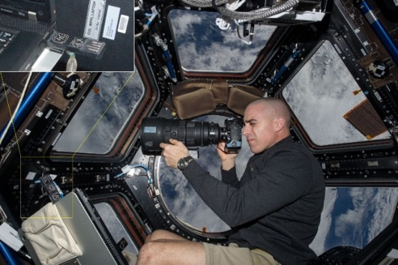
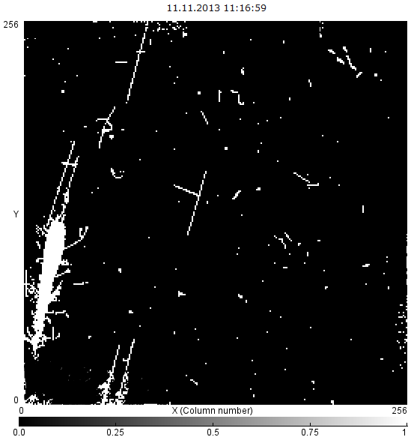
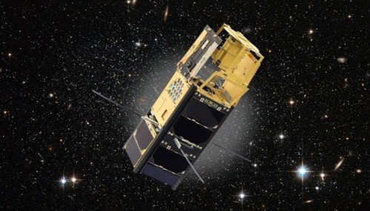
Astroparticle physics in space
Measurement of cosmic rays in space
  Equipments based on the Medipix/Timepix semiconductor pixel detectors
  Dosimeters in Interantional Space Station (NASA)
  Equipment for the measurement of cosmic rays in outer space in Proba-V satellite (ESA)
  In preparation: RISESAT (Japan Space Agency)
Pixel detectors in X-ray telescopes
  VZLUSAT-1 nanosatellite with the novel concept of X-ray telescope (wide-field optical system “Lobster Eye”) – launched in June 2017
  X-ray telescope test with ballistic missile (NASA)

Slide 16
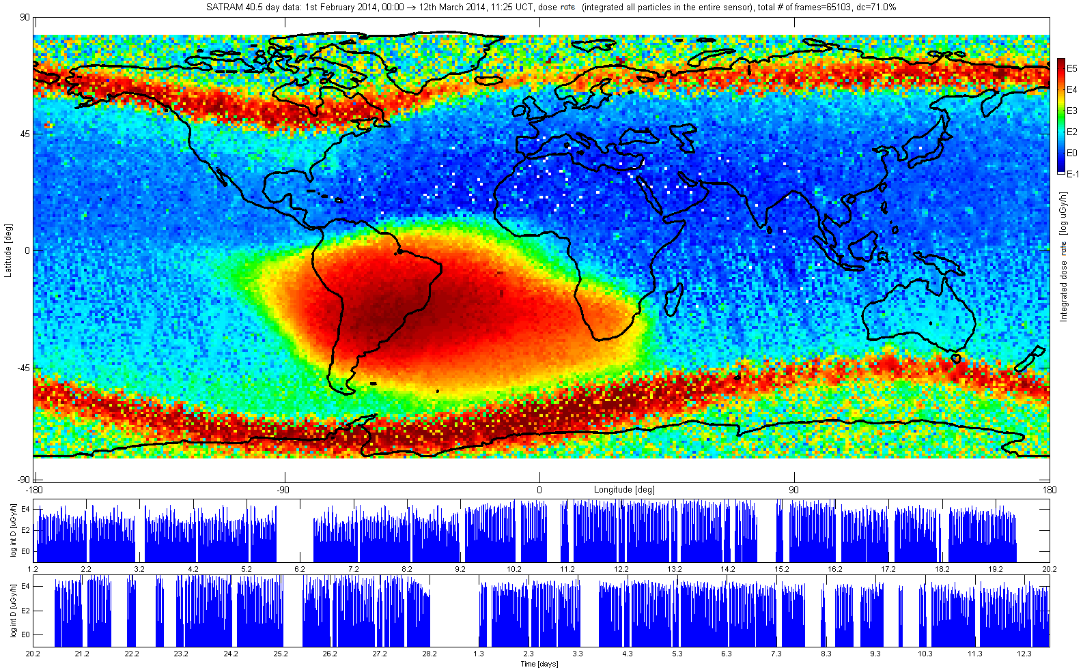
Measured radiation map by Satram device in orbit around the Earth at an altitude of 820 km from the earth's surface obtained within 36 days from January 1, 2014 to February 7, 2014 logarithmic scale in μG/hr.

Slide 17
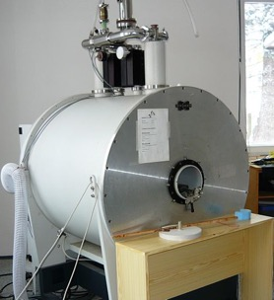
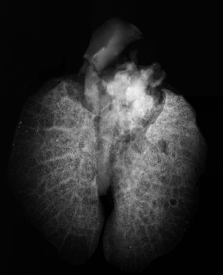
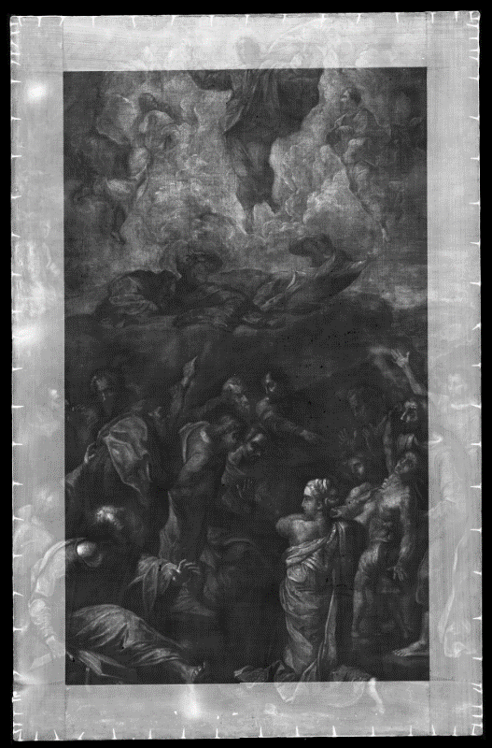
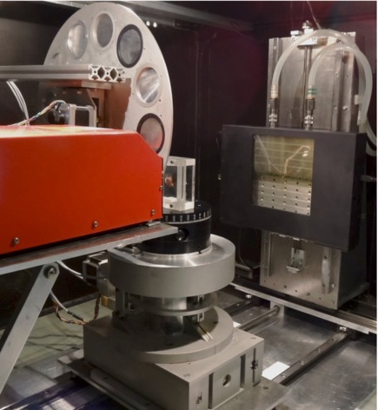
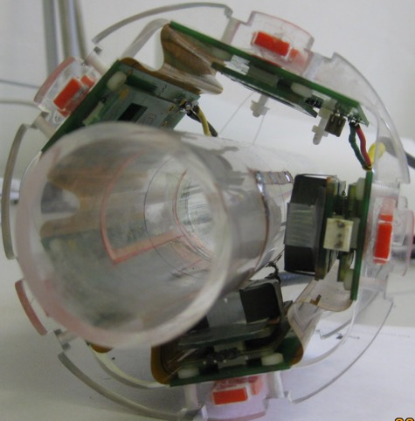
Applications of pixel detectors in imaging
X-ray radiography and tomography
  Imaging of different samples (materials, biology, medicine….)
  Applications in art
Neutron radiography
MRI-SPECT

Slide 18
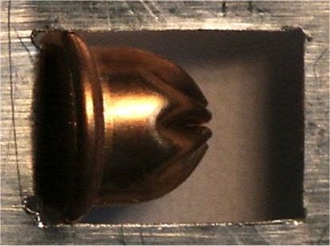



Medipix with neutron converter: Visualization of explosive encapsulated in a copper cartridge
Photography
Roentgenogram
Neutronogram
Blank shell
(cartridge)
Explosive filling
Neutron radiography of a lighter with a steel body; prepared in PSI, Switzerland.

Slide 19



Imaging of biological samples
High contrast, high resolution
Energetically-sensitive detector response
Timepix detector - 55 µm pixel, 300 µm Si sensor
CCD camera – 9 µm pixel, 22 µm Gadox scintillator

Slide 20




RTG imaging of soft tissues fixed by alcohol
5 mm
lung
5 mm
kidney
brain
5 mm
5 mm
liver
A set of CT projections of a mouse kidney, resolution 4.5 µm, prepared with the detector WidePIX_{10x5}
2D projections ex-vivo organs of a mouse.

Slide 21


RTG imaging with sub-micron resolution
Foraminifera – one-cell sea organism
Notes:
This slide should demonstrate how small and fine objects cane be visualized in great detail using high resolution X-ray radiography

Slide 22





Radiography of works of art
Transformation of Christ on the hill
Size 90 x 60 cm, 18400 x 12000 pixels (220 megapixels)
Date of work
Analysis of painting techniques
Revealing previous restoration interventions
Authorization Confirmation
5 mm
Notes:
Acquisition parameters of both samples: Acquisition parameters: Tube voltage 60 kV, tube current 90 µA, acquisition time 10 seconds per projection
Used detector: Timepix Quad

Slide 23

Radiography of works of art
Malba Svaté rodiny

Slide 24
Conclusion:
- we need your expertise in hardware and software (huge amount of detectors of different types, huge amount of data, importance of data processing)
- a lot of questions in fundamental and applied science (nature of neutrino, DM, astrophysics, medicine, biology, art, electronics…)
- international cooperation, but develop your infrastructure in South Africa
I wish you success in your activities

Slide 25
Thanks a lot for your attention

