Slide 1
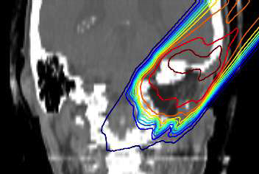
Particle therapy
Critical issues and Challenges
P. Le Dû
patrickledu@me.com

Slide 2
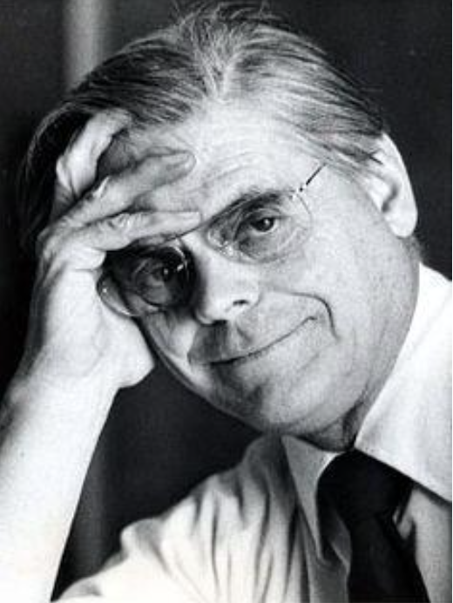
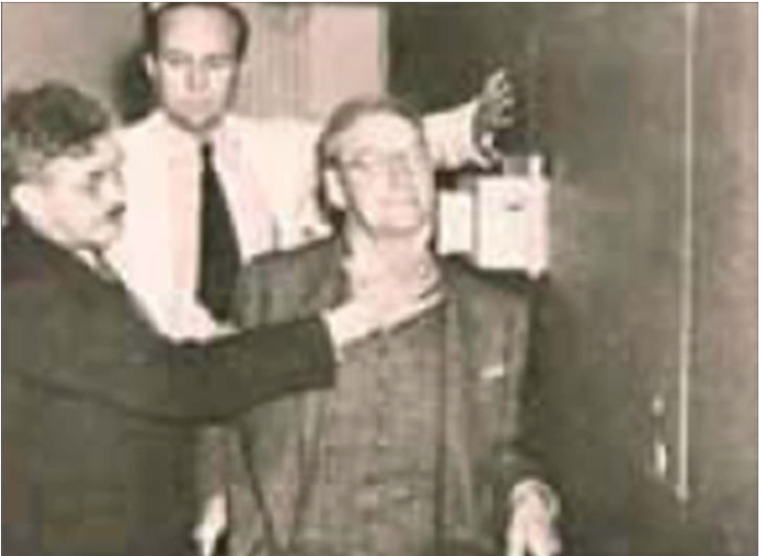
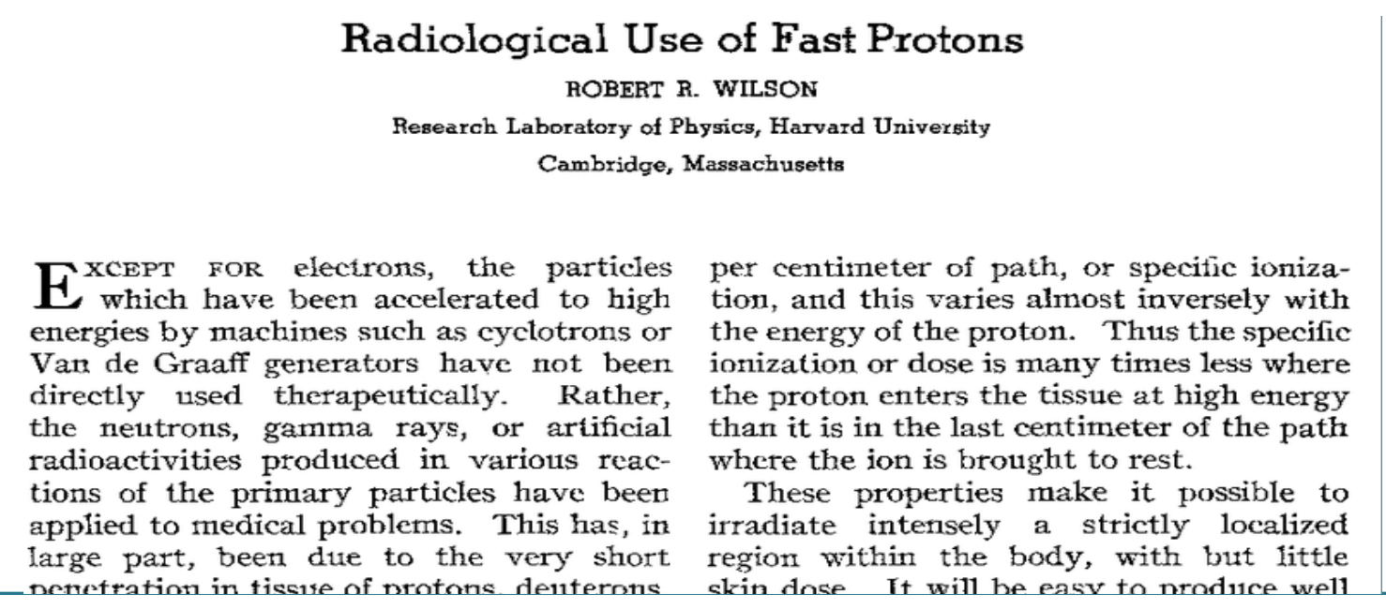
History of Hadrontherapy
1946: R. Wilson first proposed a possible therapeutic application of proton and ion beams
1954: first patient treated with deuteron and helium beams at Lawrence Berkeley Laboratory (LBL)
Wilson,
R. Radiologial use of fast protons,
Radiology 47, 487-491, 1946

Slide 3
Treating Cancer
Radiotherapy X
  Local irradiation → 100 Gy = 90 % of sterilization
  Frequent treatment (2/3 of cases).
  Allow good quality of life and tolerance
  non invasive, itinerant and without important physical effects.
  Cheap (< 10%) of the cancer budget (France)
  Essentially X rays (Linear accelerators) & photons (curietherapy)
  Efficient treatment but ….

Slide 4
Particle therapy: The Context
Why Radiotherapy X is NOT 100 % efficient?
  Complication < 5 %
  Tolerance of saine tissue is the limiting factor
    Close to Organ at Risk
  Failures due to radioresistant tumors!
  Second cancer 30 years after Radio Therapy (from recent statistics)
    Adult : 1.1
    Chidren : 6
Particle therapy
around 15%of the cases

Slide 5
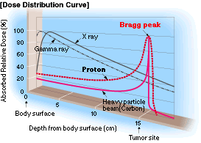
Why use Hadrons for Therapy?
Most dose is deposited in the sharp "Bragg Peak", with no dose beyond
Escalate the dose in the tumor
Reduction of dose in surrounding normal tissue

Slide 6

The advantage of Protons
Extra Dose avoided with protons
Dose
protons
proton Bragg Peak
proton SOBP
SOBP →
Spread Out
Bragg Peak
Depth in Tissue
Tumor extension

Slide 7
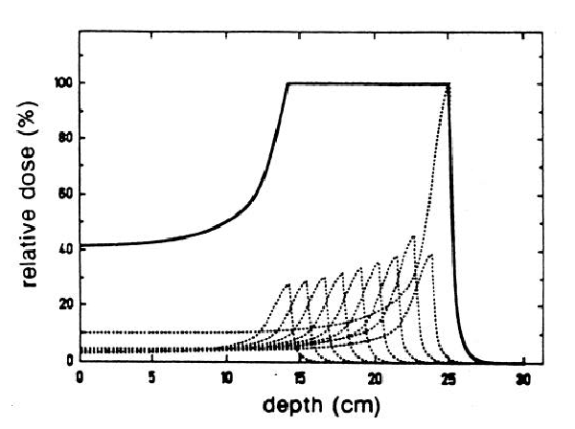
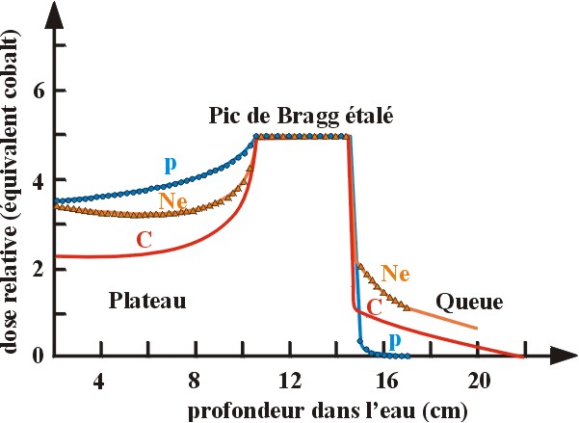
How to irradiate the tumor ?
Spread Bragg peak
Treatment in depth → combine
  Energy modulation → Scan the energy to make a Spread Out Bragg Peak (SOBP) that spans the tumor
  Intensity modulation

Slide 8
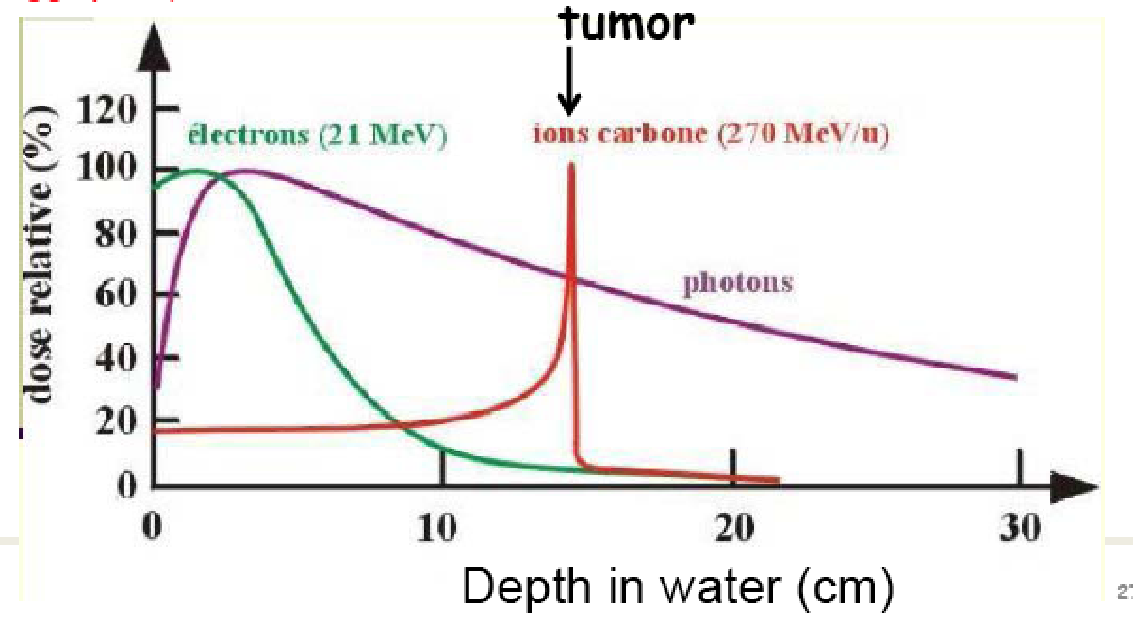
Hadrontherapy principle ( C ion)
Absorbed
dose
Electron : most of the energy released in first cm
Photon : Large energy loss all over the path (X rays therapy)
C ions : heavy charged particle : most of the energy lost at the end of path
(Braggs peak)

Slide 9
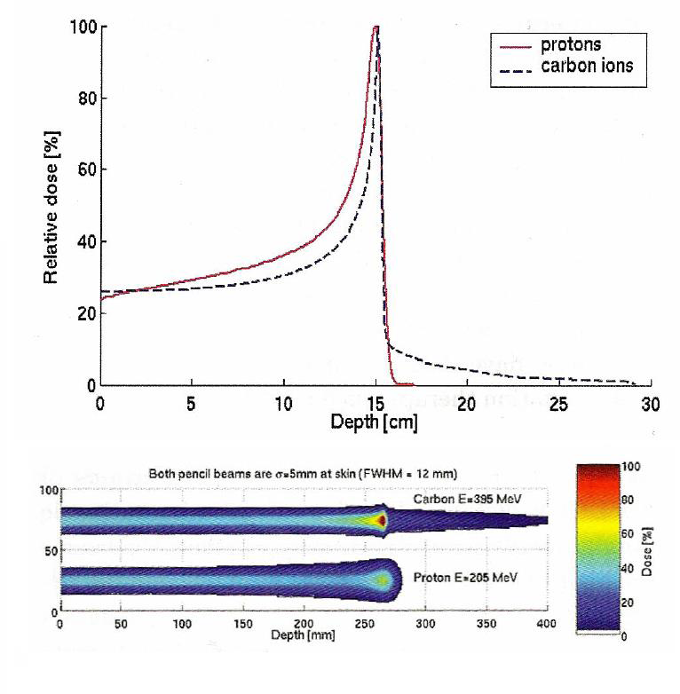
Protons and Carbon in Comparison
Compared to the lighter protons,carbon ions produce pencil beams with a sharper peak and less penumbra
Carbons have, however, a dose tail due to fragmentation

Slide 10
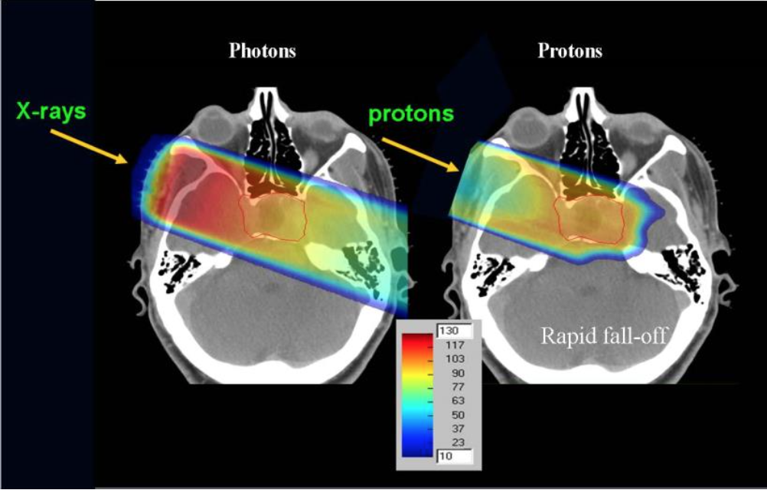
Summary :BIOLOGICAL BASICS
Protons vs photons
Clinical advantages :
✓ treatment of deep-seated, irregular shaped and radioresistant tumors;
✓ small probability of side effects in normal tissue (critical structrure);
✓ proton therapy suitable for pediatric diseases (reduced toxicity).
TC image: dose distribution calculated
for proton beams and X-rays.

Slide 11
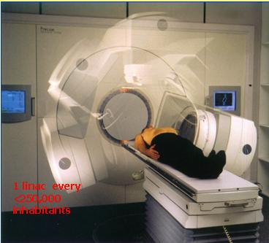
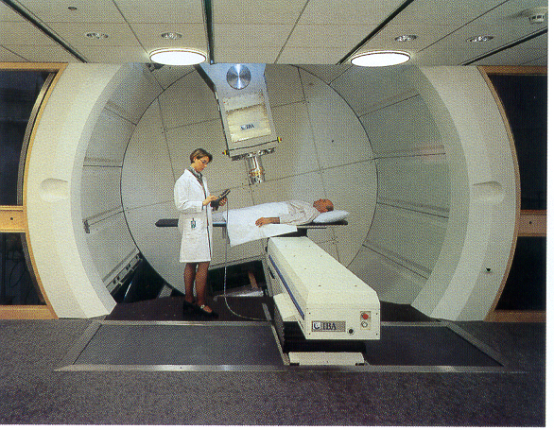
Comparison IMRT-Protons
Courtesy of IBA

Slide 12
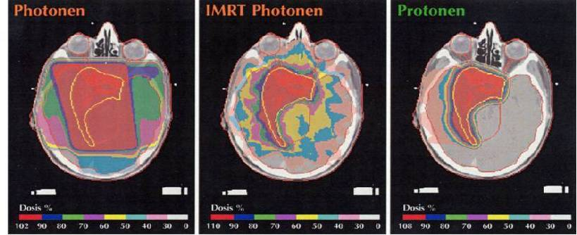
Comparing Proton and conventional RT
Photon
IMRT Photon
Proton
Conventional Radiotherapy:
Important dose outside
the tumor
Scattering technique :
Low dose outside
IMRT = Intensity
Modulated
Radio Therapy:
still non negligable dose
outside the tumor

Slide 13
Estimated absolute yearly rate (%) of 2nd cancer after radiotherapy
Tumor site X-rays IMXT Protons
Oesoph. & stomach 0.15 0.11 0.00
Colon 0.15 0.07 0.00
Breast 0.00 0.00 0.00
Lung 0.07 0.07 0.01
Thyroid 0.18 0.06 0.00
Bone & soft tissue 0.03 0.02 0.01
Leukemia 0.07 0.05 0.03
All 0.75 0.43 0.05
Compared to X-rays 1 0.6 0.07

Slide 14
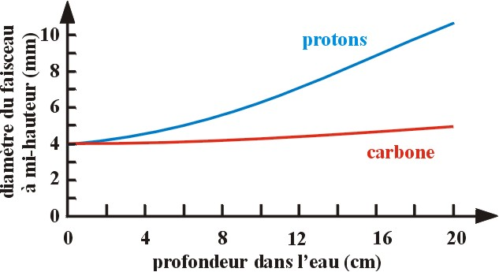
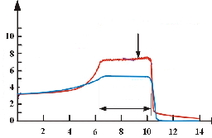
Proton vs light ion
Biological effect ( RBE) : carbone
tumor
Protons
Multiple scattering
Depth in water (cm)
Biologic →High Biological Effectiveness (RBE)
- Oxygen effect = OER = 1
- EBR relative 1 to 2
Physics → Lower lateral diffusion
C12 > P 4 mm at the entrance
after 16 cm 4,5 mm vs 8 mm
  Good depth dose distribution
Carbon looks
the best
but ? ..

Slide 15
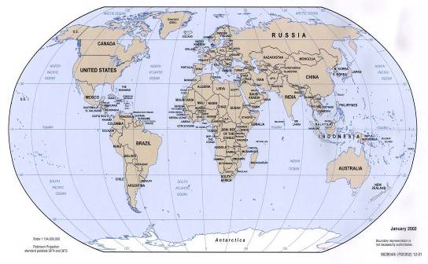
Proton Therapy is growing rapidly!
PT center under operation
Courtesy Janet Sisterson & PTCOG

Slide 16
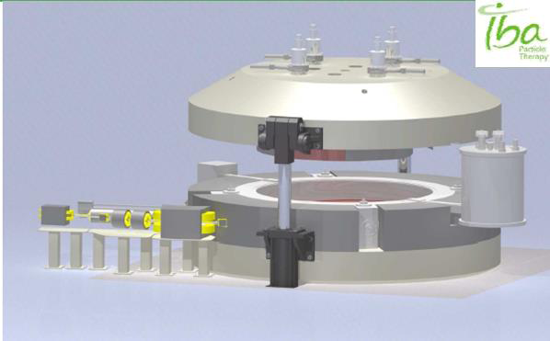
Iontherapy around the world
Need a bigger Accelerator → : Synchrotron (70-300 Mev/nucleon) → more complex and expensive ( x5?)
    Initiator: Berkeley (1954-1993) - 2500 patients
    Experimental : GSI (Germany- 120 patients
    Routine : Chiba (Japan) → 1000 patients/year
    New facilities: HIT (Heidelberg), Pavia (TERA)
    Vienna (MED- AUSTRON), Caen-Ganil (F)
The IBA C400 Medical Ion Cyclotron
Prototype for ARCADE (Caen, France)

Slide 17
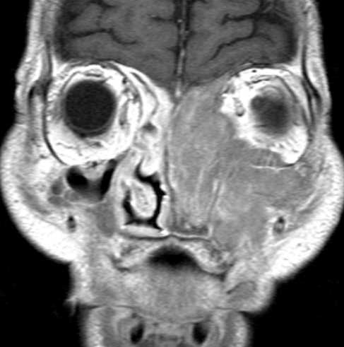
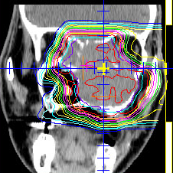
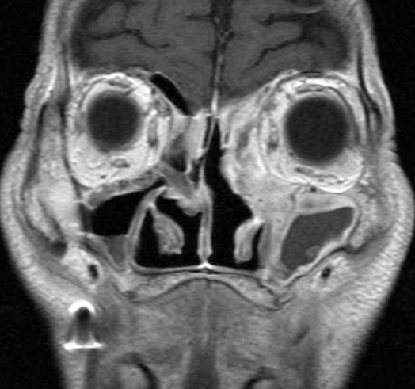
Efficacity of ion therapy
73M Lt. Nasal Cavity Malignant Melanoma T4N0M0 57.6GyE/16fr/4w
Before 2 months after RT
GSI- W. Enghardt courtesy

Slide 18
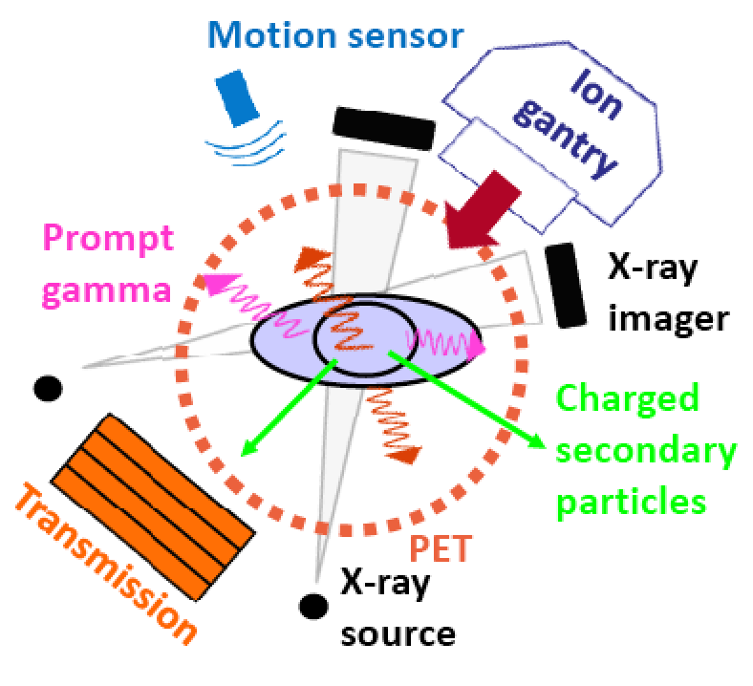
Particle therapy environment
Machine
Beam delivery
Photon detectors
CT imaging
Motion sensor
Courtesy
Katia Parodi

Slide 19
Treatment

Slide 20
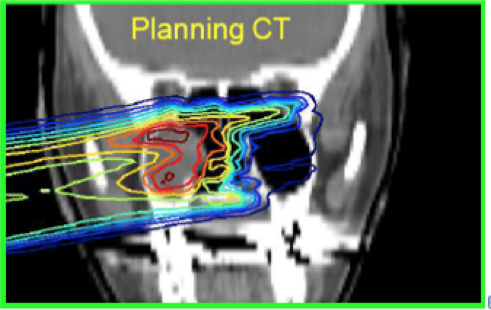
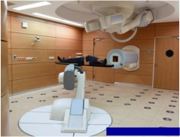
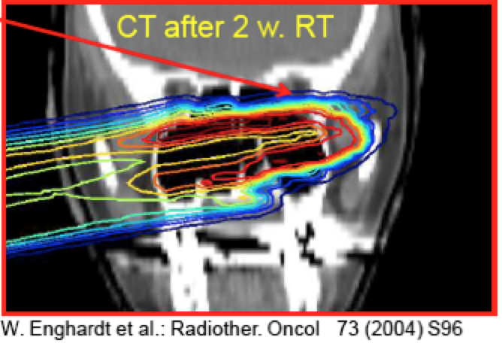
Particle therapy workflow
Step 1 → Treatment planning after CT scan
  Dose to be distributed
  MC simulation
  Give information to the machine
Step 2 → Treatment
  10-20 fractions (tumour irradiation)
Step 3 → verification using CT scan
Overdosage in normal tissue

Slide 21
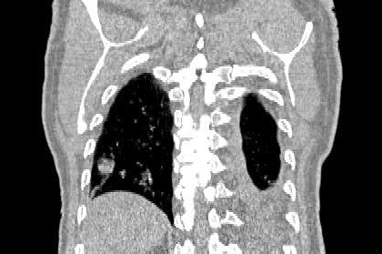
What are the critical issues & challenges?
This is NOT a ‘simple target’ but a human body
  Treatment and quality assurance techniques of conventional radiotherapy not adequat for particle therapy
    A complex procedure for the ‘treatment planning’
How to be sure that the dose is delivered at the right place (tumour) ?
  Particle beam are error sensitive
    Displaced organ & overdose
    Moving organ in some case
What is the dose deposited ?
How to verify the treatment?

Slide 22
The two ‘simultaneous’ challenges
Reducing error means → Real Time imaging
  3D in vivo dosimetry and tomography
    Use fragments of beam projectile reactions in the biological matter emerging from the tumor target volume
Verification using Computed Tomography/Radiography:
  CT imaging in charged Particle therapy is needed for:
    Target volume definition (anatomical boundaries with additional information from multimodality imaging (CT/MRI/PET studies)
    Dose and range calculation
    Patient alignment verification
But today these process are made at different moment and place

Slide 23
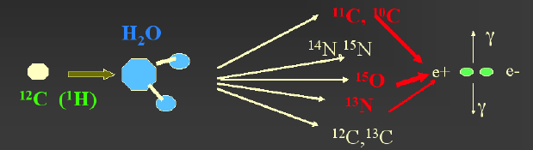
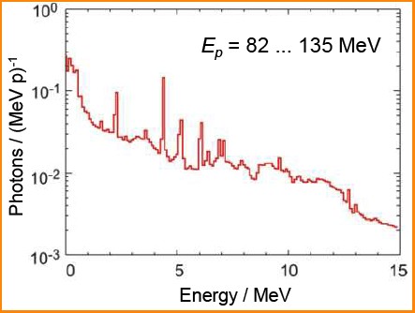
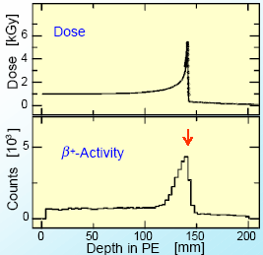
In-beam nuclear method principle for ‘in vivo’ dosimetry
Target
Nucleons
& projectile/target fragments
Projectile
10⁻²¹ 10⁻¹⁸ 10⁻¹⁵ 10⁻¹² 10⁻⁹ 10⁻⁶ 10⁻³ 10⁰ 10³
Time (s)
after collision
Particles
β⁺ - emitter decay
Prompt γ-rays
Balance of promptly emitted
particles outside the target:
Incident protons: 1.0 (~10¹⁰)
γ-rays: 0.3 (3·10⁹)
Neutrons: 0.09 (9·10⁸)
Protons: 0.001 (1·10⁷)
a-particles: 2 · 10⁻⁵ (2·10⁵)
However the photon energy different from standard medical (Anger) SPECT camera
Relation between dose and β+ activities

Slide 24
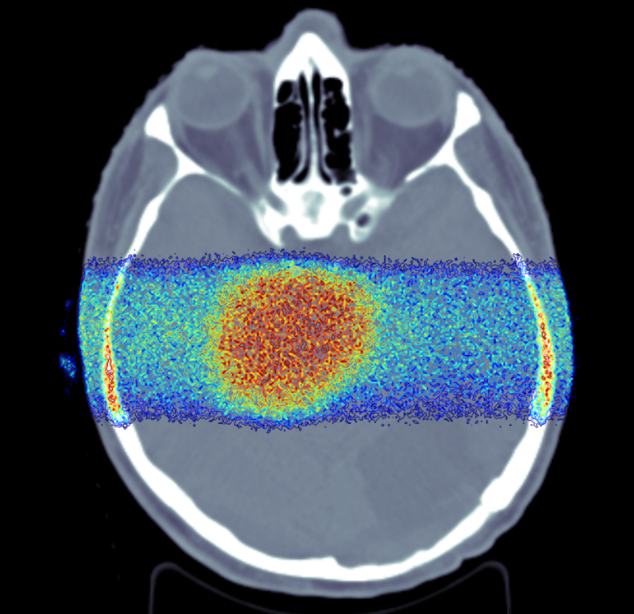
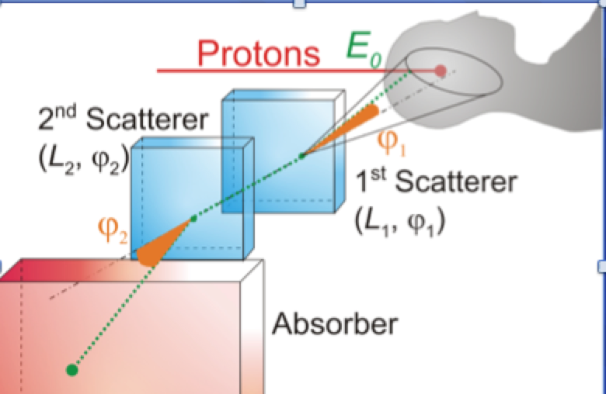
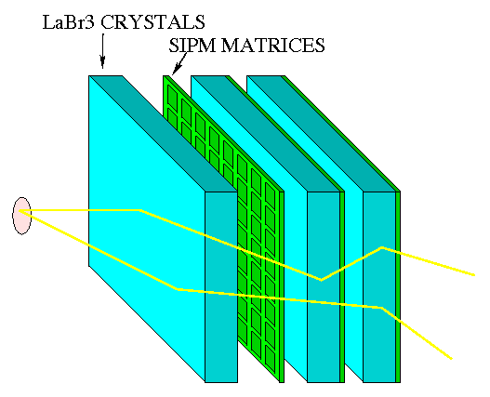
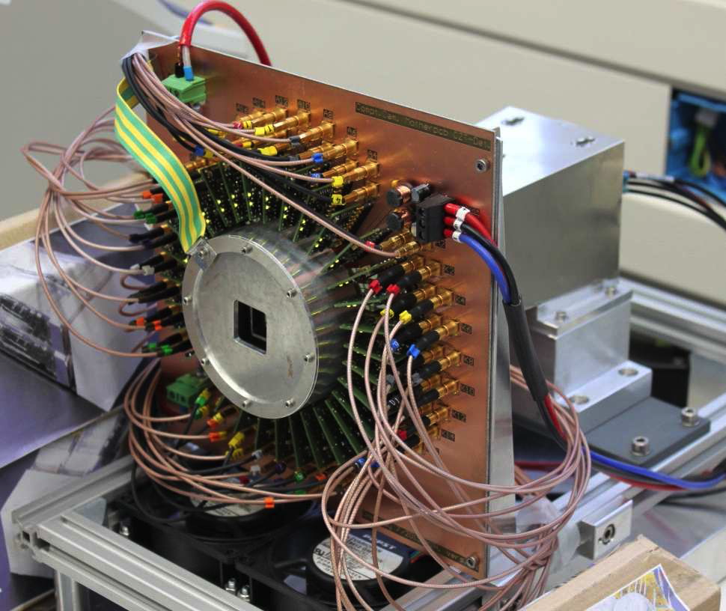
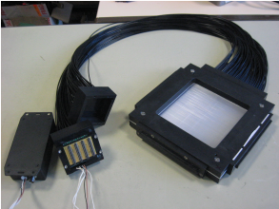
Single photon: in vivo Compton Camera
γ-rays MC simulationn
Required devices:
  Hodoscope (x,y,t)
  Scatterer (x,y,E)
  Absorber (x,y,z,E,t)
(A.Muller,TU Dresden)
Scintillating-fibre Hodoscope + MA PMT
Ray et al. IPN Lyon
CZT-strip+LYSO-block Detector
C.Llosa, IFIC
F.Fiedler et al. Dresden

Slide 25
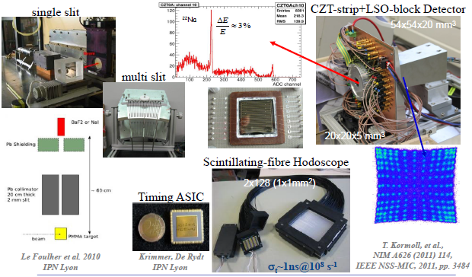
Exemple of Single photon: in vivo SPECT

Slide 26
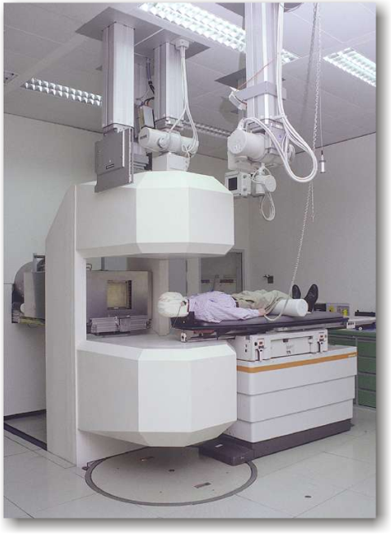
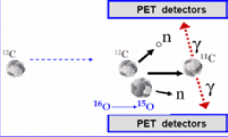
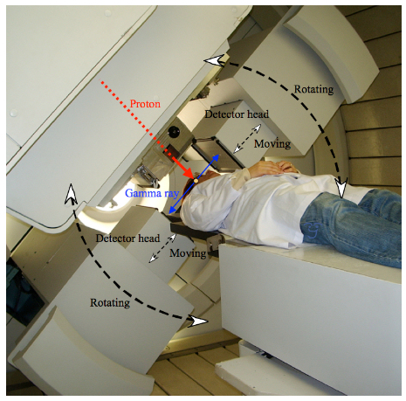
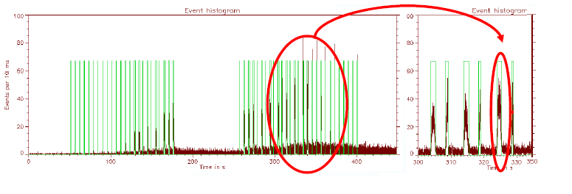
Present examples: in beam PET
Extraction
A₂
B₂
P
¹H-therapy at the National Cancer Center, Kashiwa, Japan
In-beam PET scanner at
¹²C-therapy unit at GSI
Large beam background
No Real time capability
Low signal to noise ratio

Slide 27
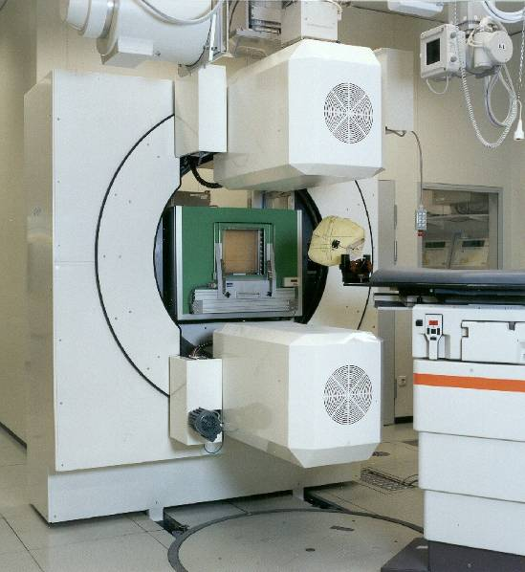
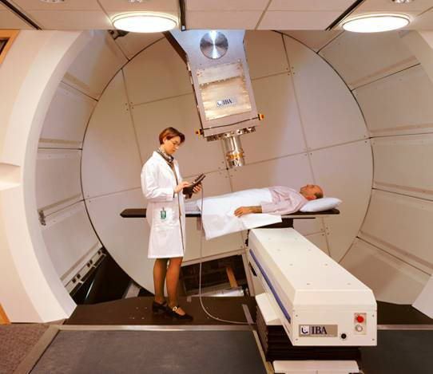
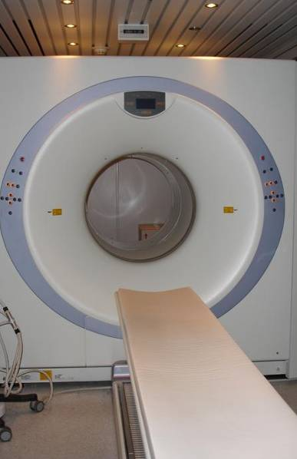
Positron Emission Tomograph …some Hardware
In-beam: GSI Darmstadt
Off-line: MGH Boston, HIT Heidelberg
more…
• HIMAC, Chiba
• NCC, Kashiwa
• HIBMC, Hyogo
• MDACC, Houston
• Univ. of Florida
In-vivo range measurements
In-vivo dosimetry & real-time image guidance
Ongoing developments (TOF-PET, PET+CT) reduce unfavorable in-beam random coincidences/background (by 20-30%)
Mature technology
Courtesy W. Enghardt / OncoRay
Notes:
in case of ¹²C in-beam randoms totally prevent of using this data slot
Tagging the events with an in-beam detector (TOF-PET)

Slide 28
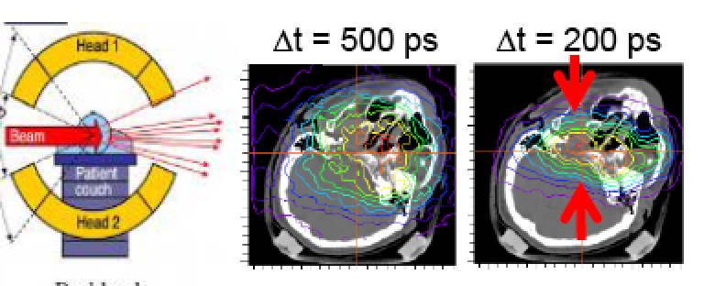
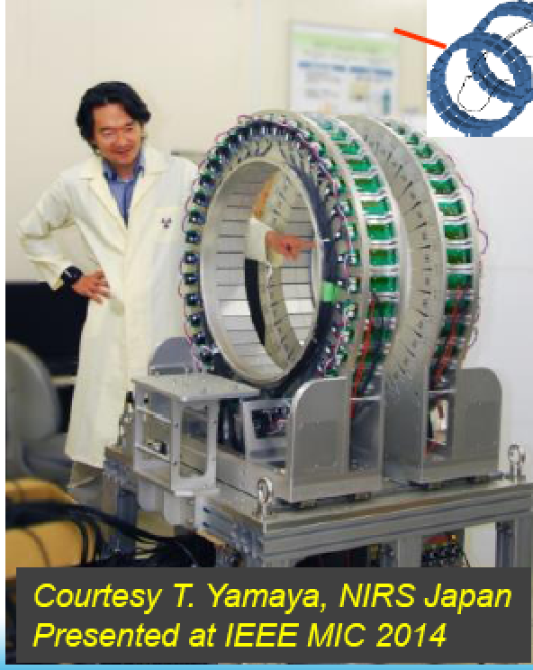
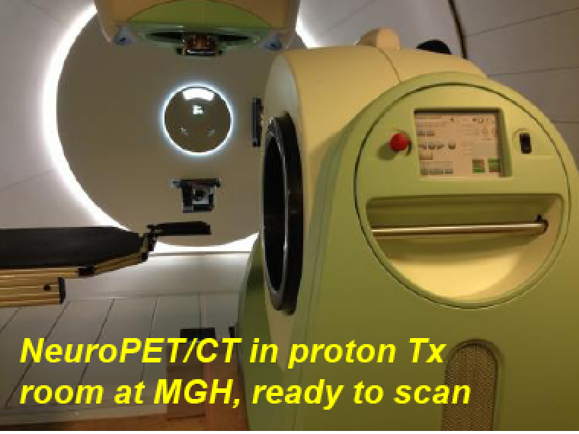
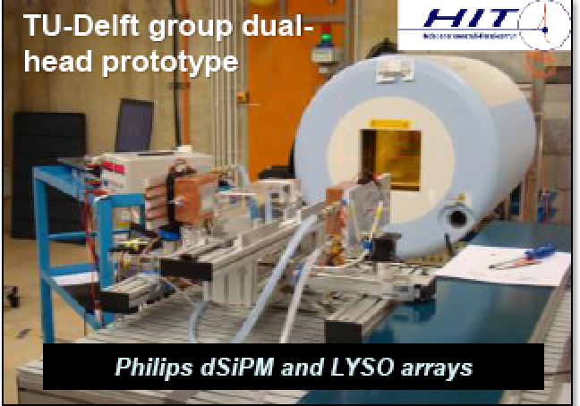
In vivo PET recent developments
MGH

Slide 29
A long termdream
The Proton CT

Slide 30
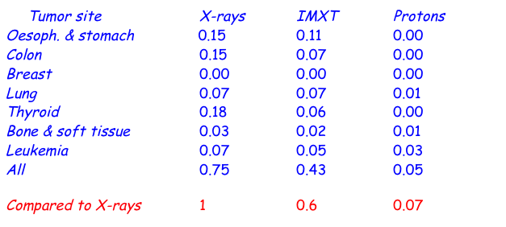
X ray & CT after each fraction ?
X ray is agressive --> see table below about estimated absolute rate of (%) of 2nd cancer
  30-50 mGy/scan
  30 fraction daily --> Total : 0,6 -3 Gy

Slide 31
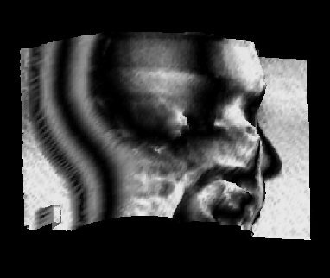
Basics of particle imaging
The particle (proton/ion) go through the patient at high energy
Advantages:
  Decrease the uncertainties → better dose accuracy
  Reduce the dose delivered to the patient
Challenge → the data reconstruction
  correctly reconstruct the path of the proton
Proton CT:
1) replaces X-ray absorption with proton energy loss
2) reconstruct mass density distribution instead of electron distribution
Radiograph of a phantom
Uwe Schneider PhD thesis (1978,PSI)
A tribute to G.Charpak

Slide 32
The Basics Ingredients
Beam
  Measurement (position and direction ) particle per particle
Photon detectors
  In beam selection of
    single photon → compton camera (SPECT)
    two photons → in Beam TOF-PET
Proton (ion) CT
  Measure the energy (position, energy and time) of the diffracted particle in an imaging calorimeter
The Global aspect!
  Event by event selection particle like in a nuclear & HEP physics experiment.
  Deatimeless electronics
  Real time acquisition and reconstruction
Need all HEP modern instrumentation tools & technique

Slide 33
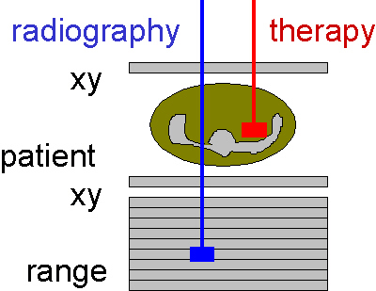
Schematic block diagram of an integrated concept of radiography / therapy system
In beam SPECT-PET
Sampling calorimeter
Beam hodoscope
Photon detector
CT
Tumour
Plastic
scintillator
Tracking
detector
Tracking
detector
Photon detector
CT
Treatment
CT
Identify tracks and energy deposition of individual protons
Scintillators for trigger to read-out detectors
Tracking detectors for 3D tracks
Sampling Calorimeter for energy determination
High rate integrated DAQ

Slide 34
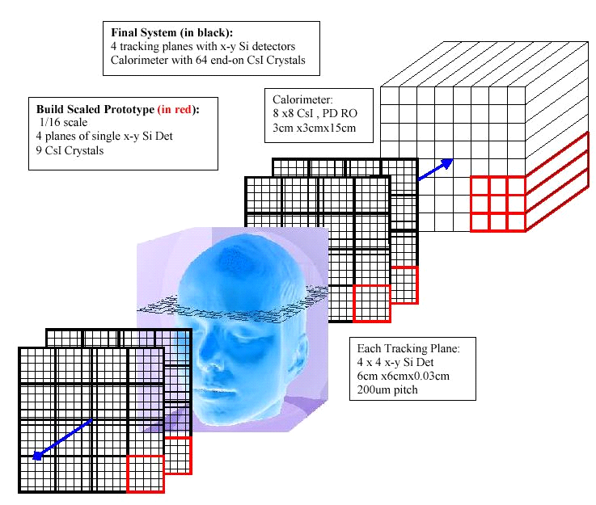
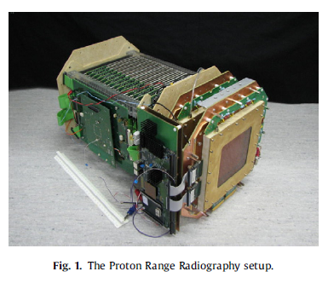


Present examples : PCT
Different prototypes are proposed based on the same “philosophy” (Reinhard Schulte et Al.)
    BNL, Santa Cruz, Loma Linda, Stony Brook layout (2003)
AQUA-CNAO
Scint/MPPC/GEM
Si Strips + CSI crystals
+ GPU’s
NIU/FNAL
Scint/WLS+SiPM GPU farm
Ion Transmission Imaging
  → See talk from B.Voss

Slide 35

Primary-Ion Radiography / Tomography
¹²C ions Radiography X-rays
1x1mm²
3x0.6mm²
61x ICs & PMMA slabs (300x300x3)mm³
Water equivalent thickness
Tomography
Rinaldi et al 2012
(www.ptcusa.com)
Electrometer
Water equivalent path length
Transmission ion imaging prior to or in-between RT is feasible

Slide 36
Conclusion from a pioner
Prof. W. Enghardt Oncoray, Dresden
Strongly
Approve
Particle thearapy units should be equipped with the most advanced imaging and motion tracking devices available
And Not with the technology of the last century

Slide 37
Final Conclusions
There is a lot to do
Particularly
for students
References
Proceedings
of NSS-MIC
conferences
Transaction on Nuclear Sciences (TNS)
http://www.nss-mic.org/2016/NSSMain.asp

Slide 38
Thanks to
W. Enghardt (Dresden)
U.Amaldi (Tera)
H.Hoffman (CERN)
K.Parodi (Munich TU)
T.Yamaya (Chiba,JP)
Pr. J.P. Gerard (Nice)
Etoile Collaboration Lyon)
R. Schulte (Loma Linda)
… and many others
Thank you
for your attention

Slide 39
Why particle CT ?
The role of CT imaging in charged Particle therapy is needed for:
  Target volume definition (anatomical boundaries with additional information from fused MRI and PET studies
  Dose and range calculation
  Patient alignment verification
The protons go through the patient
Higher energy, small dose

