Slide 1
Raspberry Pi
We will play a bit with the GPIO pins of the Pi to make cool things
We will show how to light up LEDs and measure temperatures
I’d like you to get to “tinker” – you are engineers and scientists after all…

Slide 2
Controlling hardware is hard
Have you ever tried to control some actual piece of hardware with your laptop?
It can do all kind of useful things, such as showing this PowerPoint presentation, but it doesn’t have any “pins” to, say, turn some light on
Old, 1995-vintage PCs sometimes still had a parallel port that could somehow do that, with some effort
Throw in the Raspberry Pi with lots of “General Purpose I/O” (”GPIO”) pins

Slide 3
Hardware control is back…
For the first time in a long while, we have a cheap (<R500 or <R200) linux-running single-board computer with lots of physical I/O capabilities
You can use this for all kinds of really interesting projects
We will concentrate here on the RPi, but let me point out another device for applications where even a RPi seems overkill:

Slide 4
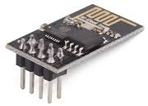
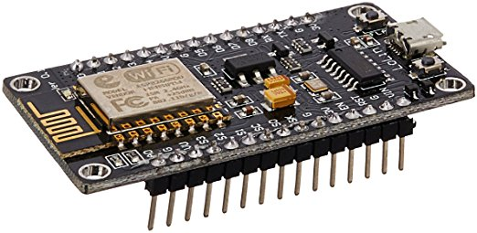
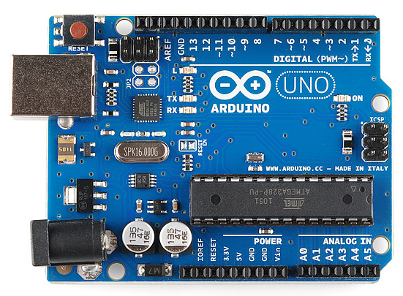
The ESP8266
This chip was made to retrofit a Arduino board with wireless capabilities
Turns out it can be used as an Arduino in its own right – same pins, same processor, etc
For R25 ($1.50), you can have a wireless-capable single-purpose unit to control stuff
The larger -12E version adds USB support and more pins (~R80)
Back to Raspberry Pis…
ESP8266
ESP8266-12E
Arduino

Slide 5
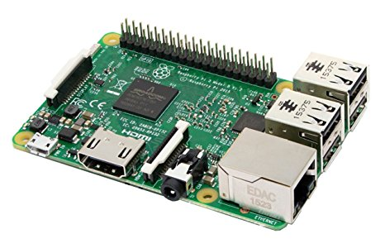
The Raspberry Pi
Conceived by a non-profit “Raspberry Pi
Foundation” to bring “tinkering” back to us
(this goes against the trend set by Apple,
MicroSoft, and also Google to make
everything “sealed” and tinker-proof )
Here have a totally open Linux environment that can be used to learn how computers work on the inside
It is cheap – with a case and (cell-phone style) power supply it costs less than R500
And it has full networking, USB, sound output, HDMI video, a camera port, and lots of GPIO pins that you can use in many different ways
Standard RPi Linux distros come with built-in support for many sensor protocols out of the box (one-wire, infrared, etc etc)

Slide 6
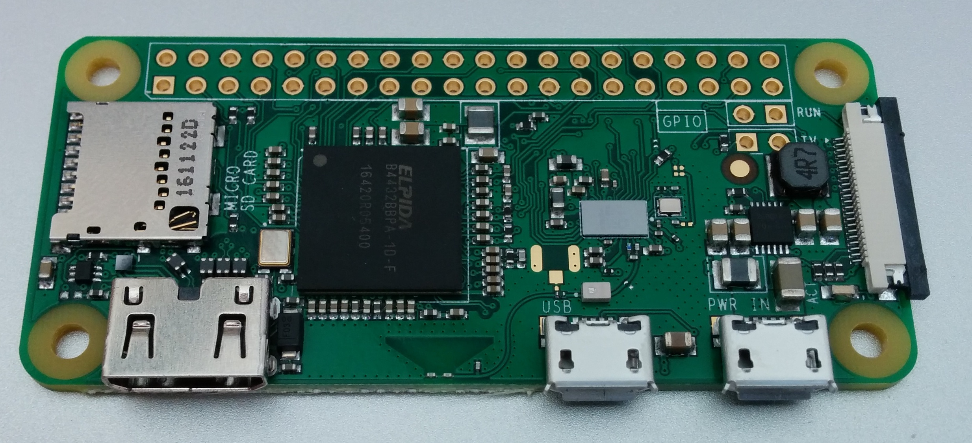
And the little brother….
Raspberry Pi Zero W
½ size
½ power
But with wireless and Bluetooth on board
Even cheaper - ~ R200

Slide 7
My house is run by RPis
Long ago I decided to make my house (especially the heating system) computer-controlled
It has “3-zone heat” – meaning 3 circulation pumps that pump hot water upstairs, ground floor, basement when the thermostats say “heat, please!”
A dumb thermostat is a really bad solution – even if it claims to be “programmable”
I disconnected the 3 original thermostats and replaced them with at least one temperature sensor in each room
More “sensory input” means better control
Master controller is aware if someone is actually at home
Daily schedule infinitely programmable

Slide 8
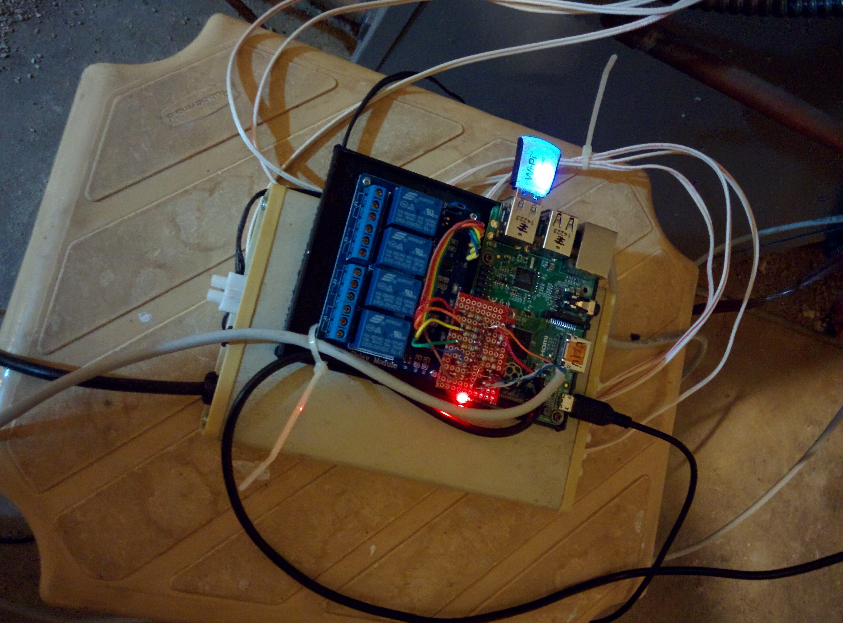
Furnace Control
This is the “master module” that controls the circulation pumps
3 lines going to the pumps
(picture was taken before I switched to the new RPi unit)
Has been at work now for almost a year w/o glitch
Relais where the pump wires are now connected
Controlled by the Rpi GPIO pins

Slide 9
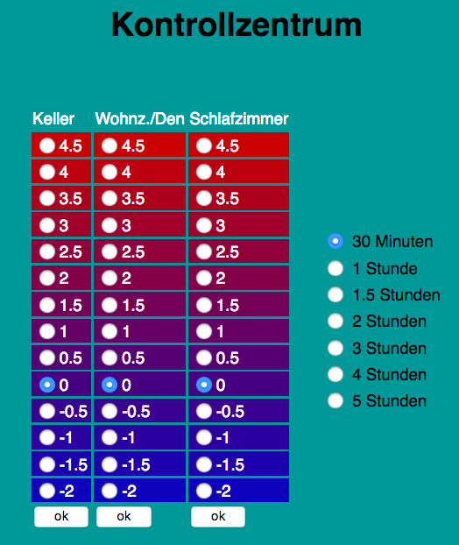
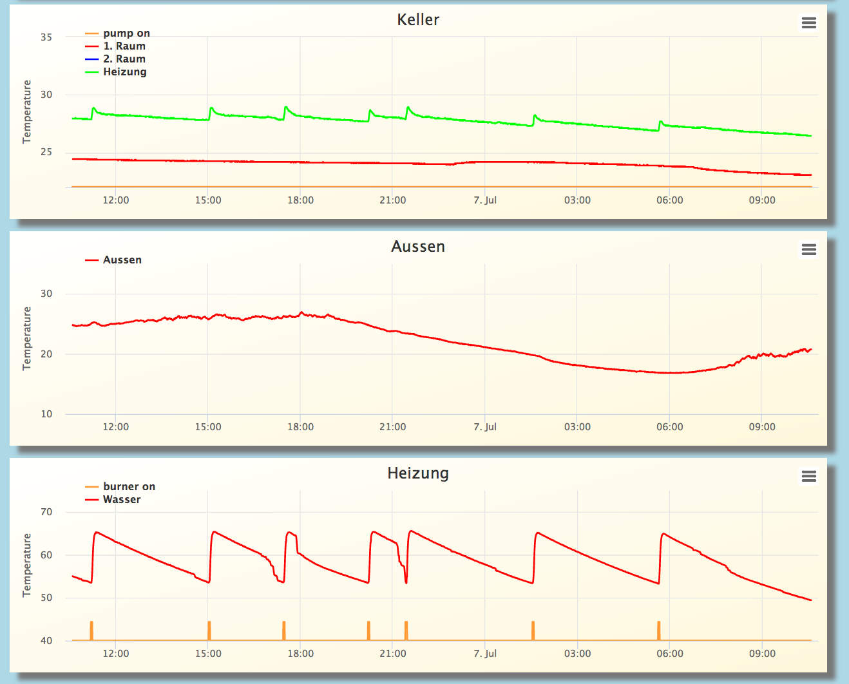
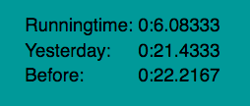
Web Controls
The system is aware when the burner is actually firing –
I can calculate my heating costs every day
Compared to the “dumb” system I save about 18% in heating costs
(measured by ½ winter of running the system in “observer mode” only)

Slide 10
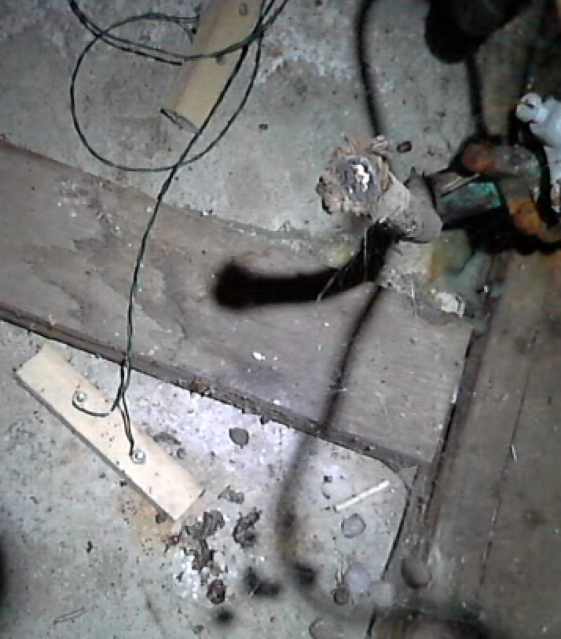
Other Controls & Sensors @Home
System also controls the lights
They turn off when no one is at home
No more lights left on unless I want them to
Also runs a water alarm for the basement
Water sensor alarm sending a text to my phone
Turns a light on and takes a 30s video of the floor so I can recognize false alarms
Saved the day (and a costly repair) already once!
“This is a drill”
System test every
Saturday night

Slide 11
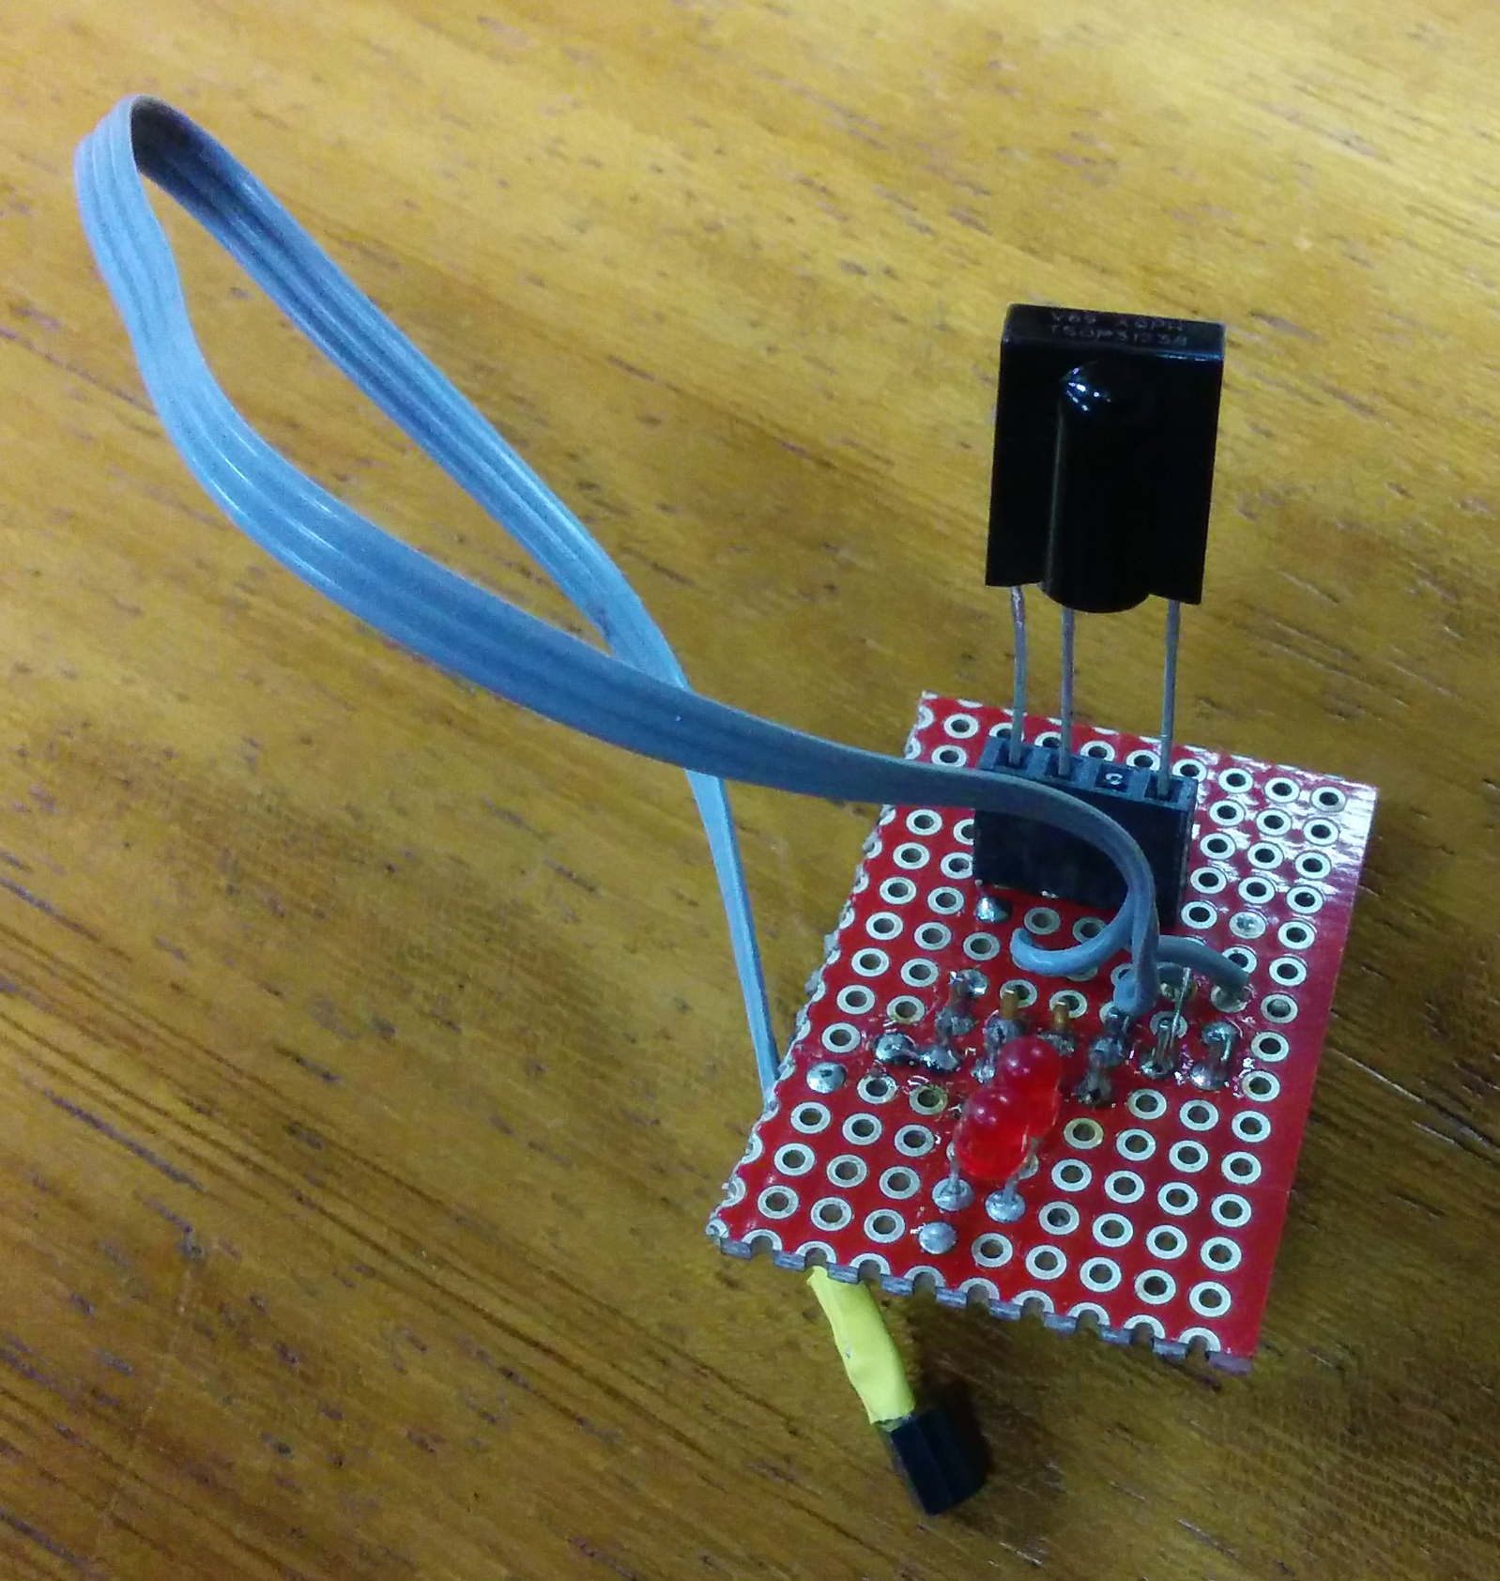
Raspberry Pi “Sensor” package
This is a small 20x30mm² hand-made board (I made it myself in an hour)
It has a header for an infrared receiver
that allows to control things
with a remote
It has two LEDs that can be turned on
and off through GPIO pins
it has a temperature readout

Slide 12
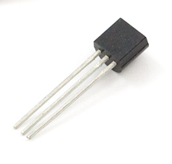
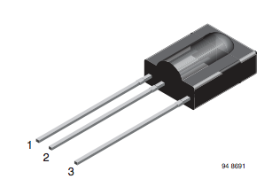
Sensor Input
The Pi has software out of the box to read out one-wire “Dallas” protocol sensors
We use it to read DS18B20 digital thermometers (by default on GPIO pin 4)
We read a TSOP 312 infrared receiver (on GPIO pin 17 – default input)
There two LEDs using GPIO pins 23
and 24
DS18B20
TSOP 312
Please distinguish between GPIO pin numbers (on the chip -> function) and the pin number on the header. E.g. GPIO pin 4 is pin 7 on the header.

Slide 13
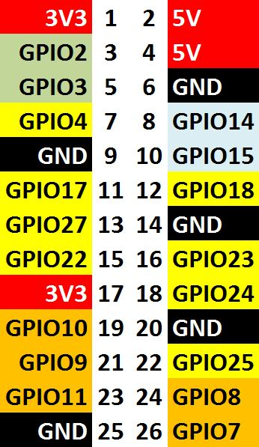
Connections
One-wire input (temperature)
Infrared input
LED 1 Output
LED 2 Output

Slide 14

Infrared Circuit
Ground Pin 9
GPIO pin 17 / Pin 11
3.3V Pin 17

Slide 15

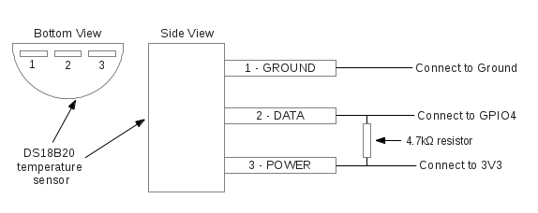
Temperature Circuit
3.3K Resistor between 3.3V and output
DS18B20
Ground Pin 9
3.3V Pin 17
GPIO pin 4 / Pin 7
3.3K

Slide 16

LED 1 and 2
3.3V Pin 17
echo 23 > /sys/class/gpio/export
echo out > /sys/class/gpio/gpio23/direction
echo 1 > /sys/class/gpio/gpio23/value #turn on
echo 0 > /sys/class/gpio/gpio23/value # turn 0ff
GPIO pin 23
/ Pin 16
GPIO pin 24
/ Pin 18

Slide 17
Enabling one-wire protocol
This enables our temperature reading with the DS18B20, which talks one-wire protocol
Edit /boot/config.txt and add
dtoverlay=w1-gpio
Then reboot

Slide 18
Software (DS18B20)
Each DS18B20 sensor has a unique and unchangeable 64bit serial number assigned by the manufacturer.
It shows up as
/sys/devices/w1_bus_master1/28-xxxxxxxxxxxxxx/
where 28- is the device type and xxxxxxxxxx is the serial number
# cat /sys/devices/w1_bus_master1/28-0000065e5516/w1_slave
31 01 4b 46 7f ff 0f 10 1f : crc=1f YES
31 01 4b 46 7f ff 0f 10 1f t=19062
This is the temperature in “milli-Centigrade”
( e.g. 19062 deg. C = 66.31 F)
# grep t= /sys/devices/w1_bus_master1/28-0000065e5516/w1_slave | awk -F= '{print $NF}’
19062

Slide 19
One more shell command
# cat /sys/devices/w1_bus_master1/28-0000065e5516/w1_slave
31 01 4b 46 7f ff 0f 10 1f : crc=1f YES
31 01 4b 46 7f ff 0f 10 1f t=19062
grep t= /sys/devices/w1_bus_master1/28-0000065e5516/w1_slave | awk -F= '{print $NF}’

Slide 20
Enabling Infrared
Edit /boot/config.txt and add
dtoverlay=lirc-rpi,gpio_in_pin=17,gpio_in_pull=high,gpio_out_pin=18
Then reboot

Slide 21
Software (Infrared)
apt-get install lirc (Linux Infrared Controller)
Edit /etc/lirc/hardware.conf to read
#Try to load appropriate kernel modules
LOAD_MODULES=false
# Run "lircd --driver=help" for a list of supported drivers.
DRIVER=""
# usually /dev/lirc0 is the correct setting for systems using udev
DEVICE="/dev/lirc0"
“mode2” refers to the infrared protocol which is virtually always used
mode2 –d /dev/lirc0
Will show you raw pulses from the transmitter
The “Lirc Daemon” lircd interprets the pulses and can issue commands and trigger actions

Slide 22
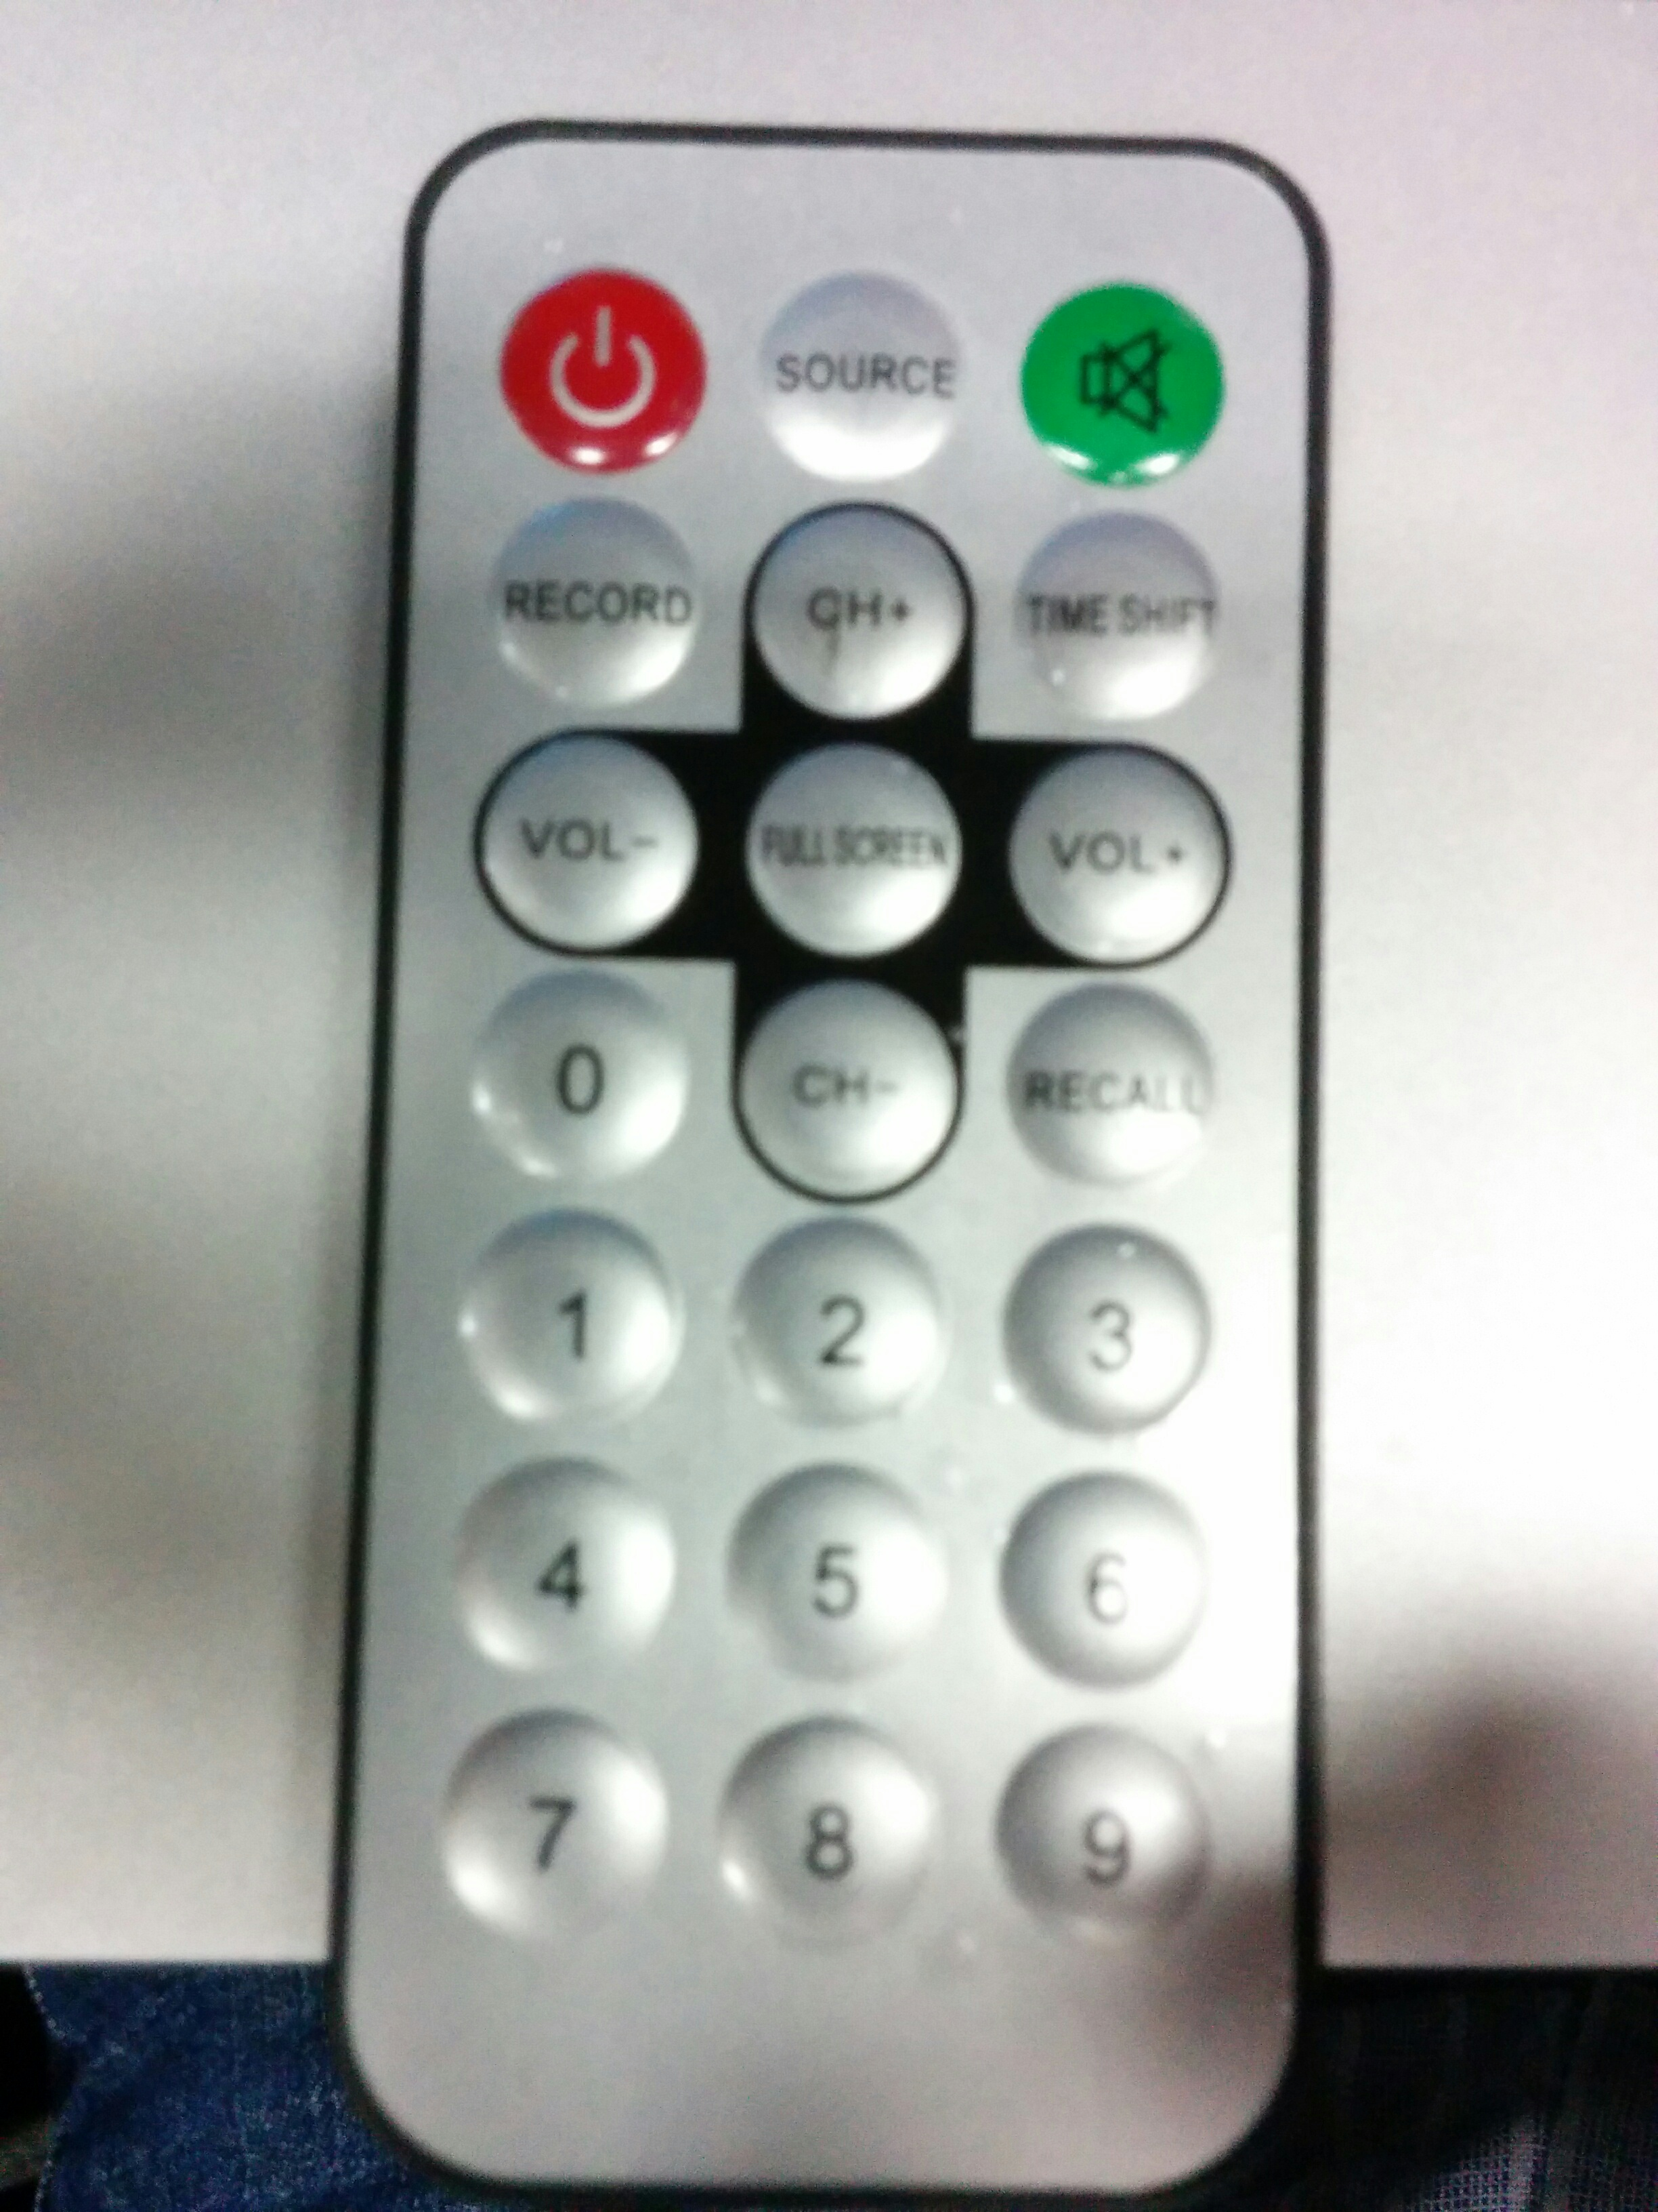
Remote-controlling cool stuff
I use a “leftover” remote control to do some interesting things
At home I control various lights with a n Infrared Remote that once belonged to a VCR (long gone)
I really don’t know wat this one belonged to
But pretty much any Remote will do
You can hook up arbitrary commands to any button
I made it so that Button “1” is switching on and off the one, and “2” the other LED…

Slide 23
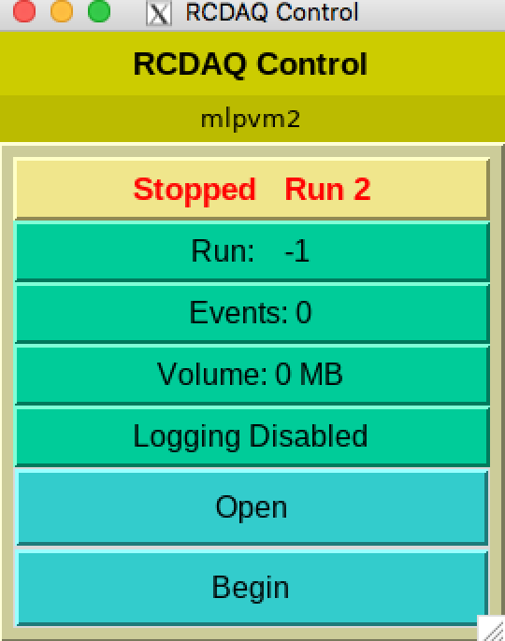
But I can take it further…
Did I mention that the rcdaq control commands work through the network? ( I know I did ☺ )
I make it so that the Rpi’s rcdaq commands operate on my Mac (rcdaq is running in a virtual machine there)
I hooked the “End run” to the “power off” button
And the “Begin” command to the “Record” button
Daq_open and close to CH+ and CH-…

Slide 24
It’s really easy…
And this deals with the LEDs…
begin
prog = irexec
remote = sradio
button = KEY_RECORD
repeat = 2
config = /root/rcdaq.sh daq_begin
end
begin
prog = irexec
remote = sradio
button = KEY_POWER
repeat = 2
config = /root/rcdaq.sh daq_end
end
This is part of the rcdaq setup
begin
prog = irexec
remote = sradio
button = KEY_1
repeat = 2
config = /root/toggle.sh 0
end
begin
prog = irexec
remote = sradio
button = KEY_2
repeat = 2
config = /root/toggle.sh 1
end

Slide 25
Controlling stuff is cool
You are engineers, scientists…
Please – tinker! If you are only learning from books, and only do exercises prescribed by your professor, you are missing things
Think of a musician who has never learned and played anything that wasn’t part of the curriculum – probably not someone you want in your orchestra!
I hope I have made you curious
There are plenty of commercial, cheap sensor boards out there
I have built all of mine myself - more fun.

