Slide 1
Paul Scherrer Institute, Switzerland
Stefan Ritt
Front-end Electronics, Waveform Digitizing and Signal Processing

Slide 2
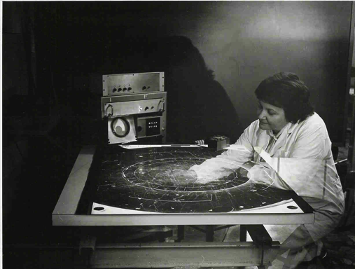
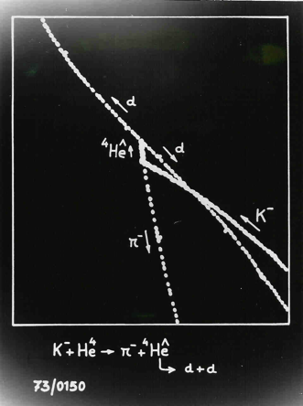


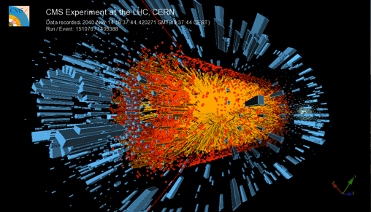

“Manual” DAQ
1000 tracks per 25 ns
A4 paper @ 5 g
Truck load @ 40 t
How much paper
per second?
200’000 t
5000 Trucks !!!

Slide 3

Electronic Signal Acquisition
Electronic Signal
Waveform Digitizing and Signal Processing
Particle
ADC & TDC technologies
Signal shaping
Ultra-fast digitizing (>1 GSPS)
Digital pulse processing
Applications

Slide 4
Signals in particle physics
Scintillators
(Plastic, Crystals,
Noble Liquids, …)
Photomultiplier (PMT)
Scintillator
Particle
HV
10 – 100 ns
Wire chambers
Straw tubes
HV
Silicon
Germanium
1 – 10 μs

Slide 5
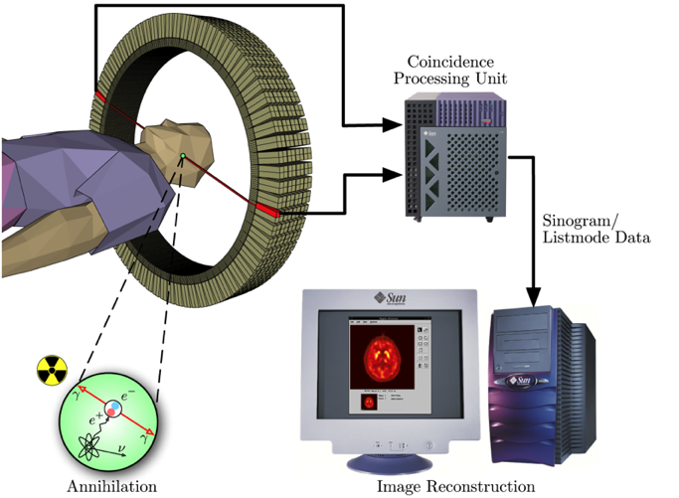
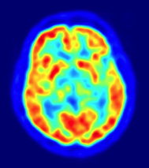
Measure precise timing: ToF-PET
Positron Emission Tomography
Time-of-Flight PET
d
Δt
d ~ c/2 * Δt
e.g.
d=1 cm → Δt = 67 ps

Slide 6
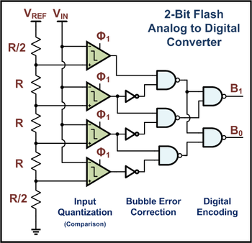
1-bit & 2-bit ADC
V_{REF}
1-Bit Flash
Analog to Digital
Converter
R
V_{IN}
B
Threshold
R

Slide 7
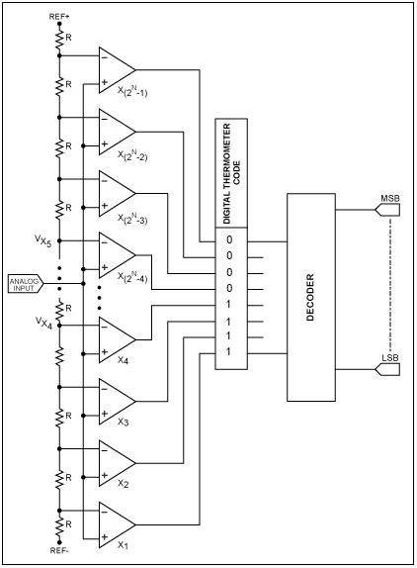
n-bit ADC
Flash ADC very fast for small number of bits
Requires 2^{n} comparators

Slide 8
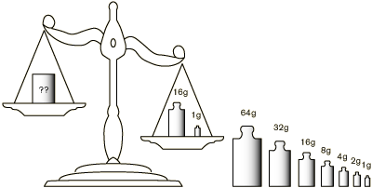
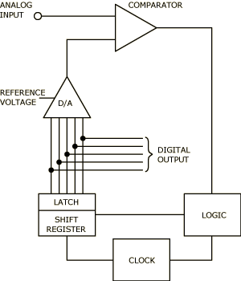
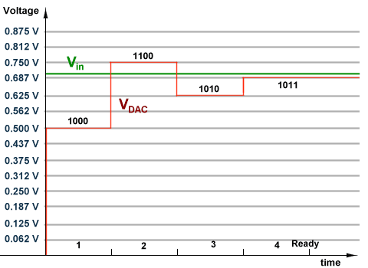
Successive approximation ADC

Slide 9
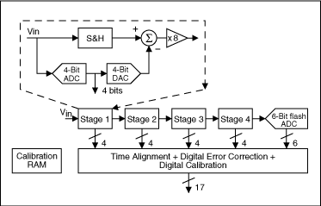
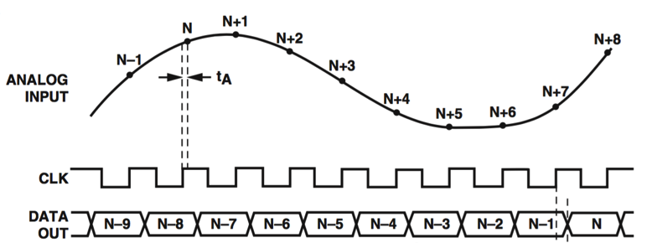
Pipeline ADC
Combine 4-Bit flash ADC with successive approximation logic
Only requires 4-Bit flash ADC
Can convert one sample in each clock cycle
Has a latency depending on the number of pipeline stages
Most common technology for fast ADCs (> 10 MHz)

Slide 10
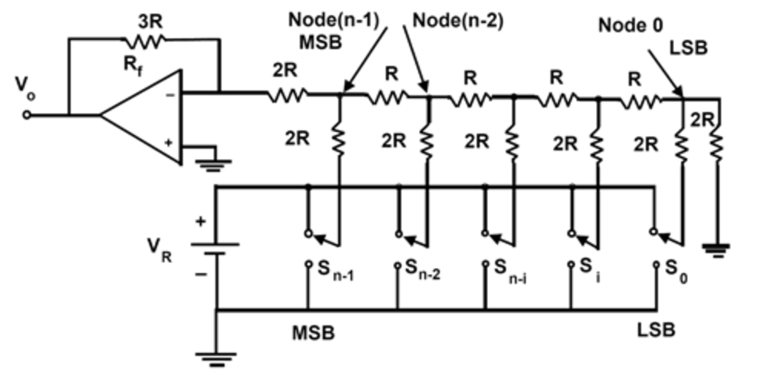
Digital-to-analog converter (DAC)
R-2R Ladder: 0/V_{R} at S₀...S_{n-1} give binary weighted output V_{o} = S * V_{R}/32
S_{n-1}-S₀ | V_{O} [V]
00000 | 0
00001 | 0.16
00010 | 0.31
00011 | 0.47
00100 | 0.63
00101 | 0.78
... | ...
11100 | 4.38
11101 | 4.53
11110 | 4.69
11111 | 4.84
5 V

Slide 11
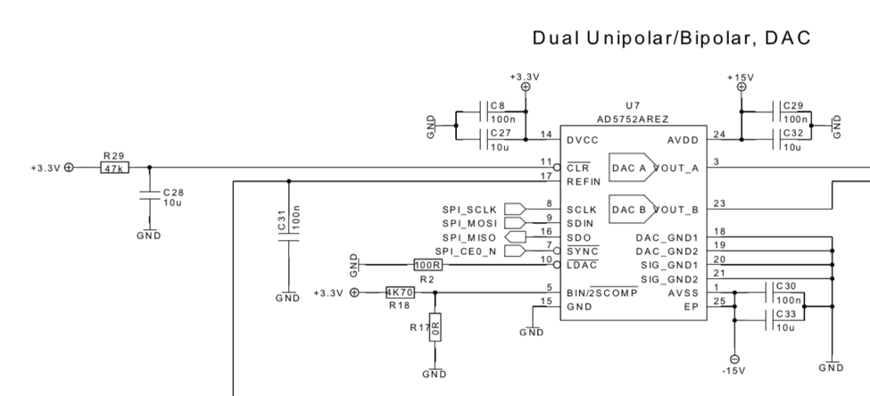
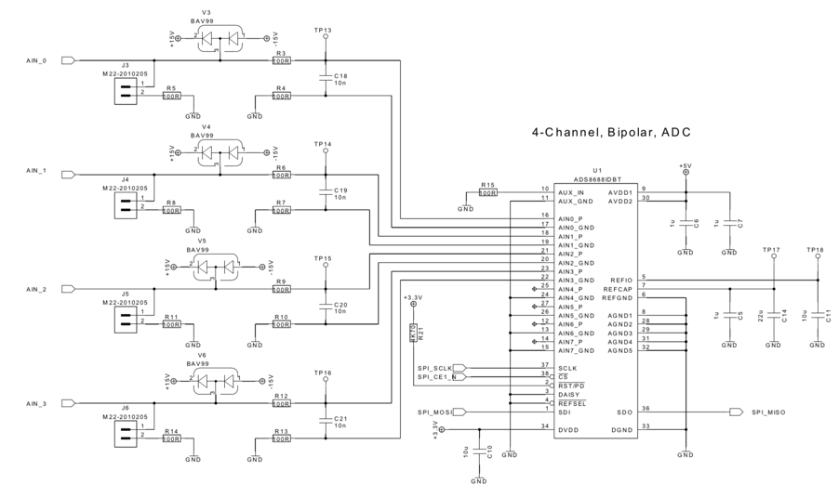
Raspberry Pi ADC – DAC Board
DAC
ADC

Slide 12
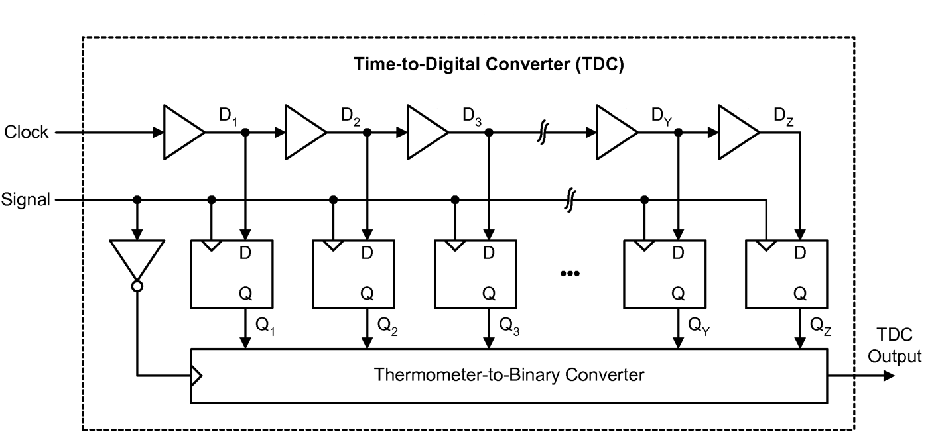
Time-to-Digital Converter
Coarse Counter
Stop
Clock
TDC
Coarse
Output
1
1
0
0
0
Δt
TDC
Fine
Output

Slide 13
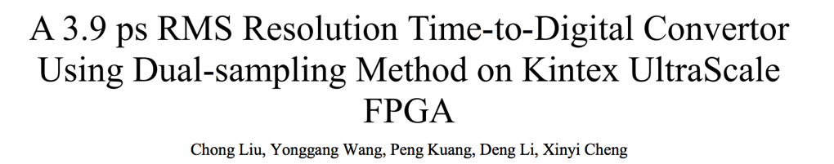
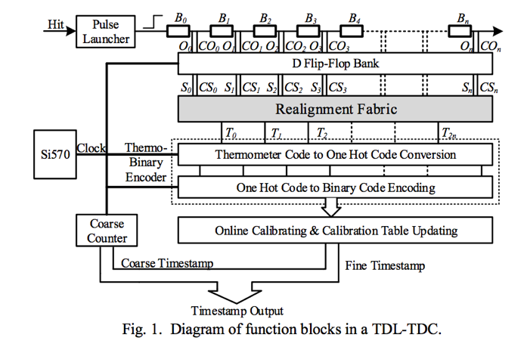
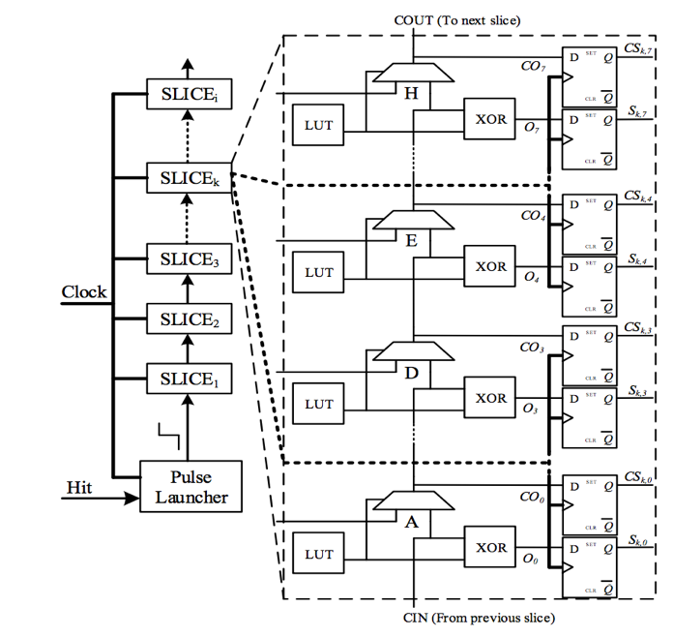
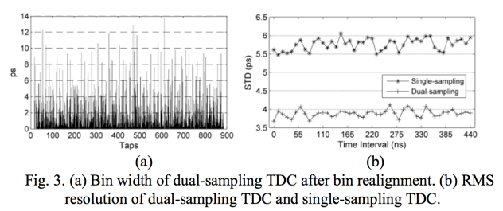
TDC in FPGA
Real Time 2016 Conference, Padova

Slide 14
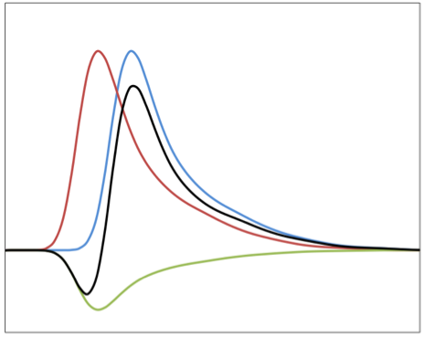
Signal discrimination
Single Threshold
Multiple Thresholds
Constant Fraction (CFD)
Inverter & Attenuator
T1
Threshold
Σ
T2
0
Adder
T3
Delay
“Time-Walk”
T1
T2
T3

Slide 15
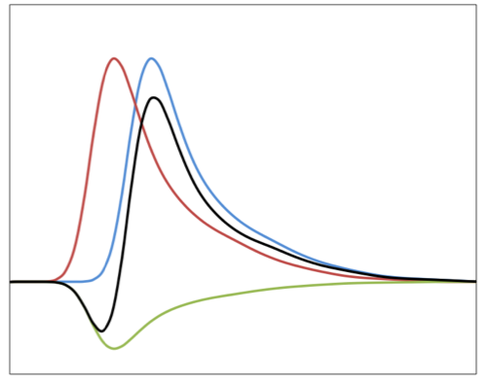
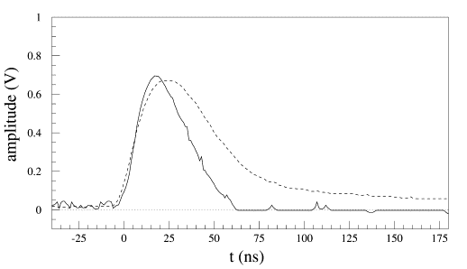

Influence of noise
Voltage noise causes
timing jitter !
Signal
Low pass filter
Noise
Fourier Spectrum
Low pass filter (shaper) reduces noise while maintaining most of the signal

Slide 16
Noise limited time accuracy
All values in this talk are σ (RMS) !
FHWM = 2.35 x σ
U [mV] | ΔU [mV] | t_{r} | Δt
100 | 1 | 1 ns | 10 ps
10 | 1 | 3 ns | 300 ps
Most today’s TDCs have ~20 ps LSB
How can we do better ?

Slide 17
Noise limited time accuracy

Slide 18
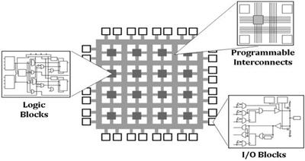
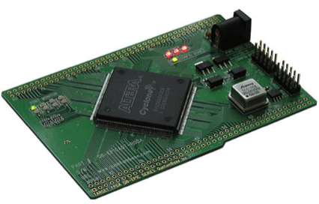

Example: CFG in FPGA
FPGA
Σ
Adder
0
Delay
* (-0.3)
Adder
Look-up Table
(LUT)
8-bit address
8-bit data
+
>0
Latch
AND
≤ 0
Clock
Delay

Slide 19
Nyquist-Shannon Sampling Theorem
f_{signal} < f_{sampling} /2
f_{signal} > f_{sampling} /2

Slide 20
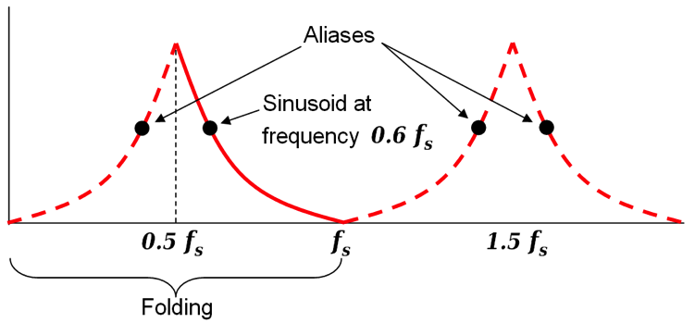
Limits of waveform digitizing
Aliasing Occurs if f_{signal} > 0.5 * f_{sampling}
Features of the signal can be lost (“pile-up”)
Measurement of time becomes hard
ADC resolution limits energy measurement
Need very fast high resolution ADC

Slide 21
Charge ADCs (QADC)
Threshold
ADC
~MHz
+
-
TDC
(Clock)
Threshold

Slide 22
Peak sensing ADC
Threshold
Sample
ADC
~MHz
+
-
Delay
Threshold

Slide 23
Double buffering
Store an event in an analog cell
Start converting cell
If second event arrived before conversion is ready – store event in second cell
Decrease dead time significantly
ADC conversion time
+
-
ADC
~MHz
+
-

Slide 24
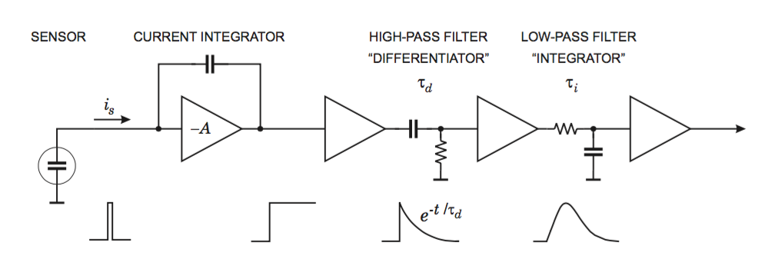
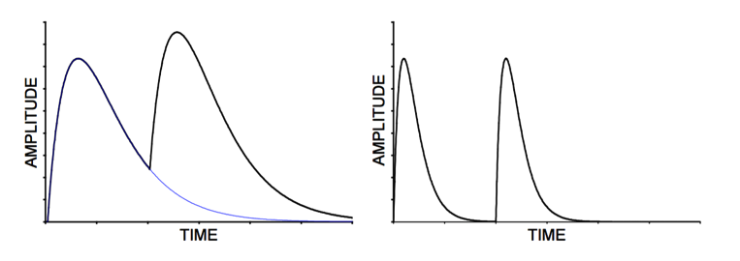
Analog readout chain
Optimal parameters can greatly improve the signal-to-noise ratio
“pile-up”
Effect of slow shaping time:

Slide 25
Baseline noise
Baseline with ~50 Hz noise
Charge integration error due to signal “sitting” on fluctuating baseline
(e.g. 50 Hz ground loop or artifact of shaper)
Can be fixed by sampling baseline prior to signal (requires signal delay)
Sample signal after peak for pile-up recognition

Slide 26
Conventional DAQ chain
Detector world
Energy, Time
Analog world
Charges, Voltages
Digital world
Bits and Bytes
Particle
Detector
Cable
Signal
Conditioning
Analog-to-Digital
Converter
Processing
Scintillator
Solid state detector
Gas detector
Amplifier
Shaper
Discriminator
Digital filter
Charge integrator
Waveform fitting
High-level triggering
Data storage

Slide 27
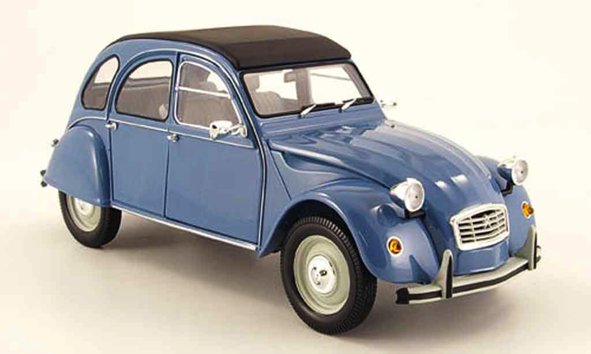
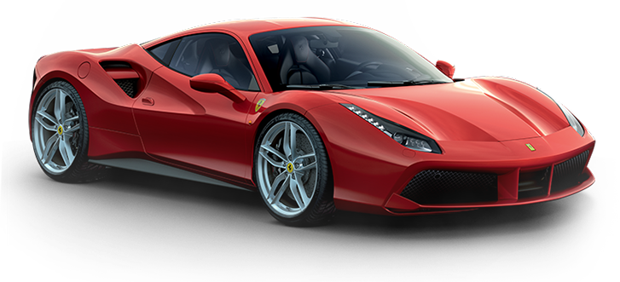
Let’s go a bit faster…

Slide 28
Ultimate sampling
Fast ADC
Direct fast sampling without shaping
  No shaping artifacts
  Less electronics
  All information if captured if
  f_{sampling} > 2*f_{signal} and LSB < V_{noise}
  Any shaping circuitry can only remove information

Slide 29
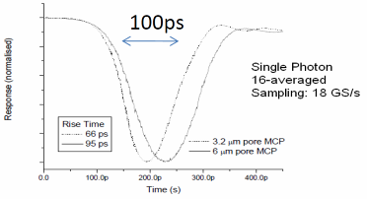
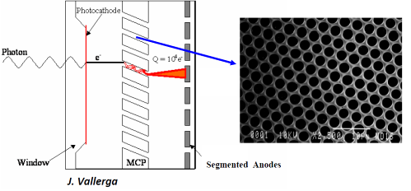
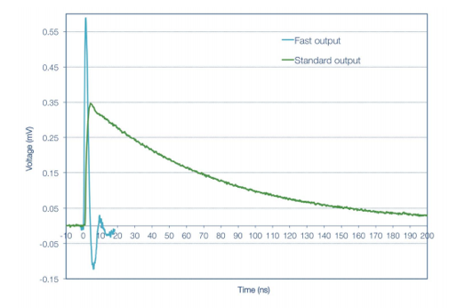
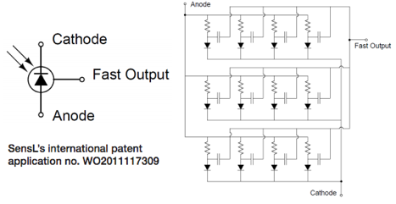
What are the fastest detectors?
Micro-Channel-Plates (MCP)
      Photomultipliers with thousands of tiny channels (3-10 μm)
      Typical gain of 10,000 per plate
      Very fast rise time down to 70 ps
70 ps rise time → 4-5 GHz BW → 10 GSPS
SiPMs (Silicon PMTs) are also getting < 100 ps
J. Milnes, J. Howoth, Photek
http://sensl.com

Slide 30
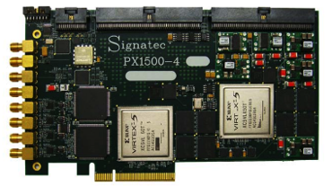
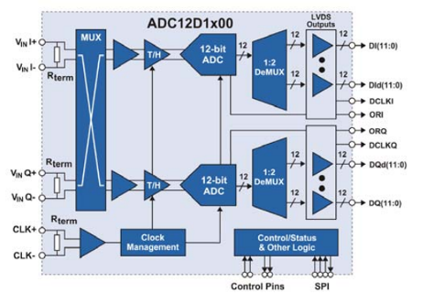
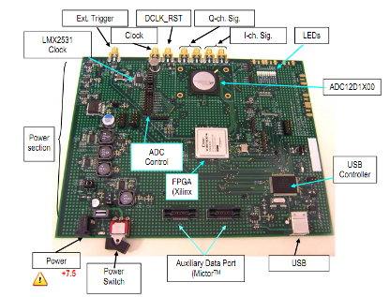

Can it be done with FADCs?
8 bits – 3 GS/s – 1.9 W → 24 Gbits/s
10 bits – 3 GS/s – 3.6 W → 30 Gbits/s
12 bits – 3.6 GS/s – 3.9 W → 43.2 Gbits/s
14 bits – 0.4 GS/s – 2.5 W → 5.6 Gbits/s
PX1500-4:
2 Channel
3 GS/s
8 bits
24x1.8 Gbits/s
1.8 GHz!
1-10 k$ / channel
What about 1000+ Channels?
Requires high-end FPGA
Complex board design
High FPGA power
ADC12D1X00RB:
1 Channel
1.8 GS/s
12 bits
V1761: 2 Channels, 4 GS/s, 10 bits

Slide 31
Switched Capacitor Array (Analog Memory)
0.2-2 ns
10-100 mW
Inverter “Domino” ring chain
IN
Waveform
stored
Out
FADC
33 MHz
Clock
Shift Register
“Time stretcher” GHz → MHz

Slide 32
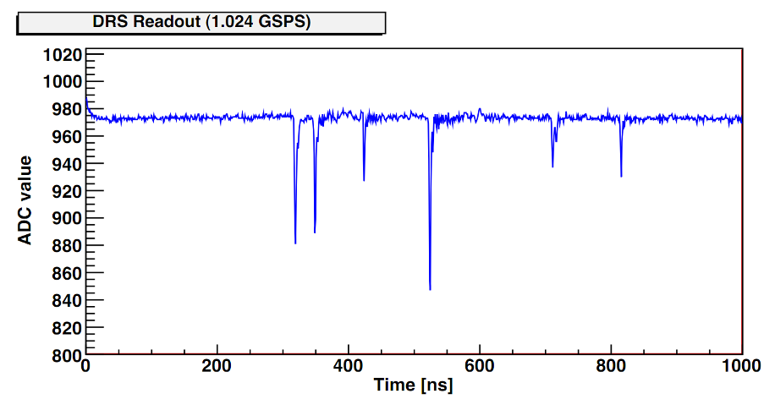
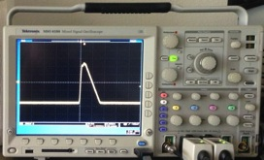
Triggered Operation
sampling
digitization
sampling
digitization
Sampling Windows * TSR
lost events
Dead time =
Conversion Time * Samples
(e.g. 30 ns ∙ 100 = 3 μs)
Chips usually cannot sample during readout ⇒ “Dead Time”
Technique only works for “events” and “triggers”

Slide 33
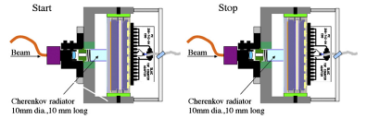
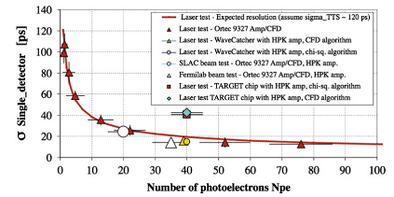
How to measure best timing?
Simulation of MCP with realistic noise and different discriminators
Beam measurement at SLAC & Fermilab
J.-F. Genat et al., arXiv:0810.5590 (2008)
D. Breton et al., NIM A629, 123 (2011)

Slide 34
How is timing resolution affected?
voltage noise Δu
signal height U
timing uncertainty Δt
rise time t_{r}
number of samples on slope
Simplified estimation!

Slide 35
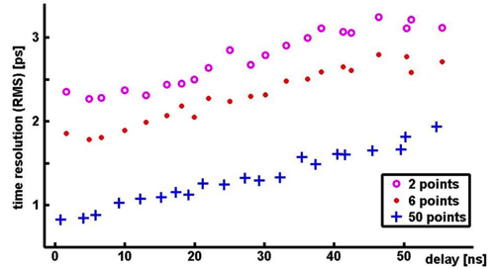
How is timing resolution affected?
Assumes ideal
sampling
U | Δu | f_{s} | f_{3db} | Δt
100 mV | 1 mV | 2 GSPS | 300 MHz | ∼10 ps
1 V | 1 mV | 2 GSPS | 300 MHz | 1 ps
1 V | 1 mV | 10 GSPS | 3 GHz | 0.1 ps
today:
optimized SNR:
next generation:
“Novel Calibration Method for Switched Capacitor Arrays Enables Time Measurements width Sub-Picosecond Resolution”,
D.A. Stricker-Shaver, S. Ritt, B.J. Pichler, IEEE TNS 61 (2014), 3607

Slide 36
Readout of Straw Tubes
HV
d ~ c/2 * Δt
Readout of straw tubes or drift chambers usually with “charge sharing”: 1-2 cm resolution
Readout with fast timing: 10 ps / √10 = 3 ps → 0.5 mm
Currently ongoing research project at PSI

Slide 37
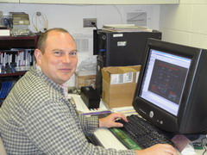
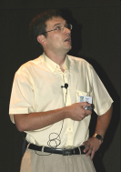

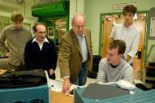






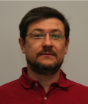

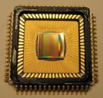
Switched Capacitor Arrays for Particle Physics
E. Delagnes
D. Breton
CEA Saclay
G. Varner, Univ. of Hawaii
H. Frisch et al., Univ. Chicago
STRAW3
LABRADOR3
TARGET
AFTER
SAM
NECTAR0
PSEC1 - PSEC4
0.13 μm IBM
Large Area Picosecond Photo-Detectors Project (LAPPD)
0.25 μm TSMC
Many chips for different projects
(Belle, Anita, IceCube …)
0.35 μm AMS
T2K TPC, Antares, Hess2, CTA
www.phys.hawaii.edu/~idlab/
matacq.free.fr
psec.uchicago.edu
DRS1
DRS2
DRS3
DRS4
0.25 μm UMC
Universal chip for many applications
MEG experiment, MAGIC, Veritas,
TOF-PET
SR
R. Dinapoli
PSI, Switzerland
2002
2004
2007
2008
Poster 15, 106
drs.web.psi.ch

Slide 38
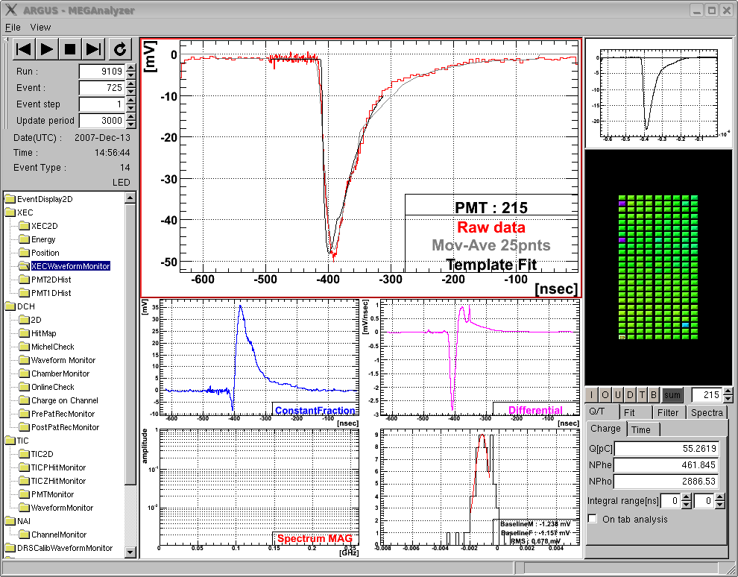
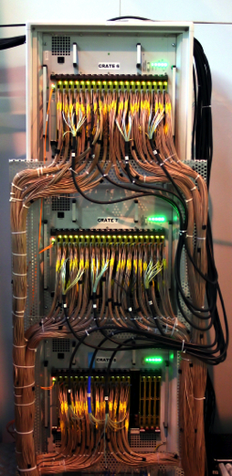
MEG On-line waveform display
“virtual oscilloscope”
γ
Σ848
PMTs
Liq. Xe
μ
template
fit
PMT
1.5m
μ⁺→e⁺γ
At 10⁻¹³ level
3000 Channels
Digitized with
DRS4 chips at
1.6 GSPS
750 Oscilloscopes!
Drawback: 400 TB data/year

Slide 39
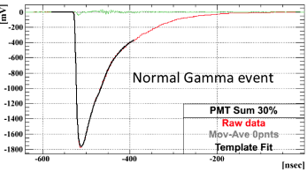


Pulse shape discrimination
μ
γ
γ
α
α
μ
Events found and correctly processed 2 years (!) after the were acquired

Slide 40



MAGIC Telescope
http://ihp-lx.ethz.ch/Stamet/magic/magicIntro.html
La Palma, Canary Islands, Spain, 2200 m above sea level
https://wwwmagic.mpp.mpg.de/

Slide 41



Template Fit
πβ Experiment
500 MHz sampling
14 bit
60 MHz
www.southerninnovation.com
Determine “standard” PMT pulse by
averaging over many events → “Template”
  Find hit in waveform
  Shift (“TDC”) and scale (“ADC”)
  template to hit
  Minimize χ²
  Compare fit with waveform
  Repeat if above threshold
Store ADC & TDC values

Slide 42


High speed USB oscilloscope
4 channels
5 GSPS
1 GHz BW
8 bit (6-7)
15 k€
4 channels
5 GSPS
1 GHz BW
11.5 bits
1170 €
USB Power

Slide 43

New chips
CEA/Saclay
SAMPIC Waveform TDC
Record short (64 bins) waveforms
Digitize on-chip
Data-driven read out
DRS5 (PSI, planned)
Self-trigger writing of 128 short 32-bin segments (4096 bins total)
Storage of 128 events
  Accommodate long trigger latencies
  Quasi dead time-free up to a few MHz,
  Possibility to skip segments
  → second level trigger

Slide 44
Summary
Digitization is a key element of all particle physics experiments
General trend to faster digitization and waveform analysis in digital domain
(embedded CPUs, FPGAs)
This talk can only give you a glimpse
Further information
  H. Spieler, “Semiconductor Detector Systems”, Oxford Univ. Press, 2005
  G. Knoll, “Radiation Detection and Measurement”, Wiley, 2010
  Conferences (with short courses):
  IEEE NSS-MIC (Sydney, Australia, Nov. 2018)
  IEEE Realtime (Ho Chi Minh City, Vietnam, June 2020)
  Become IEEE NPSS member

