Slide 1
Data Acquisitions, Trigger, Controls
What you always wanted to know about...
( … but never dared to ask. )‏
Martin L. Purschke, Brookhaven National Laboratory
Data Acquisitions, Trigger, Controls

Slide 2
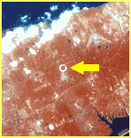
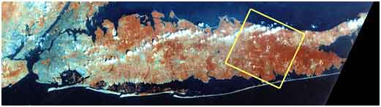
About Martin
Studied nuclear physics at the University of Muenster, Germany
WA80 - WA93 – WA98 Experiments at CERN
Graduated in 1990
Spent 11 years at CERN with the SPS Heavy-Ion Program until it ended in 1996
Then I moved “with the program” to Brookhaven National Laboratory
BNL has the Relativistic Heavy Ion Collider called “RHIC”
New York City
Manhattan
RHIC from space
Long Island, NY

Slide 3
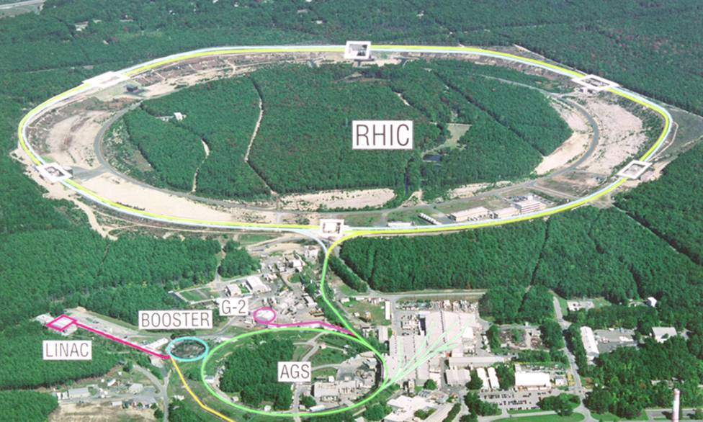
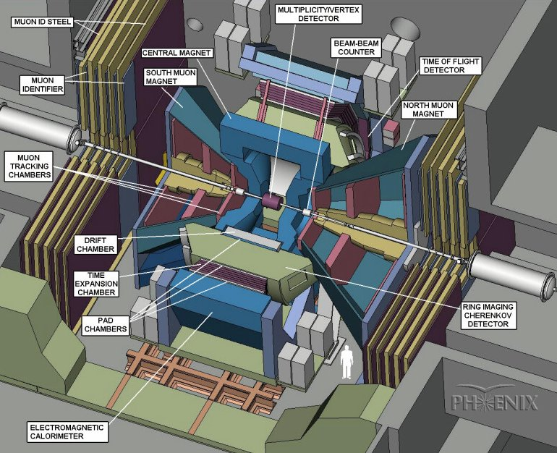

RHIC/PHENIX at a glance
PHENIX:
4 spectrometer arms
12 Detector subsystems
2500,000 detector channels
Lots of readout electronics
Data rate ~7KHz (AuAu) , 9KHz (pp)
Data Logging rate ~900-1200 MB/s 1600MB/s max
RHIC:
2 independent rings, one beam clockwise, the other counterclockwise
sqrt(S_{NN})= 500GeV * Z/A
~200 GeV for Heavy Ions
~500 GeV for proton-proton (polarized)

Slide 4
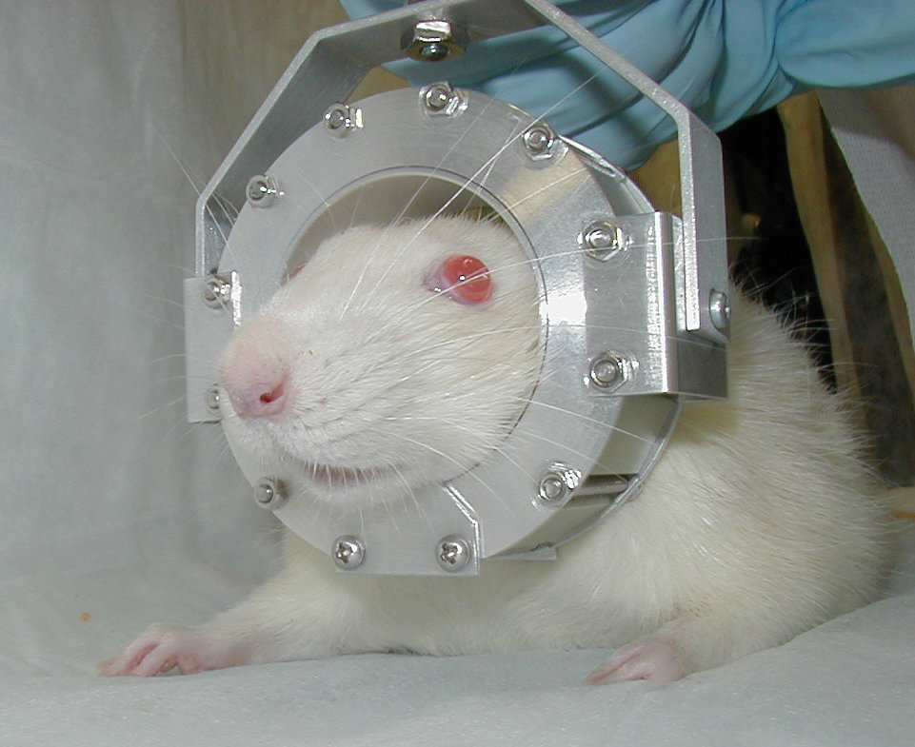
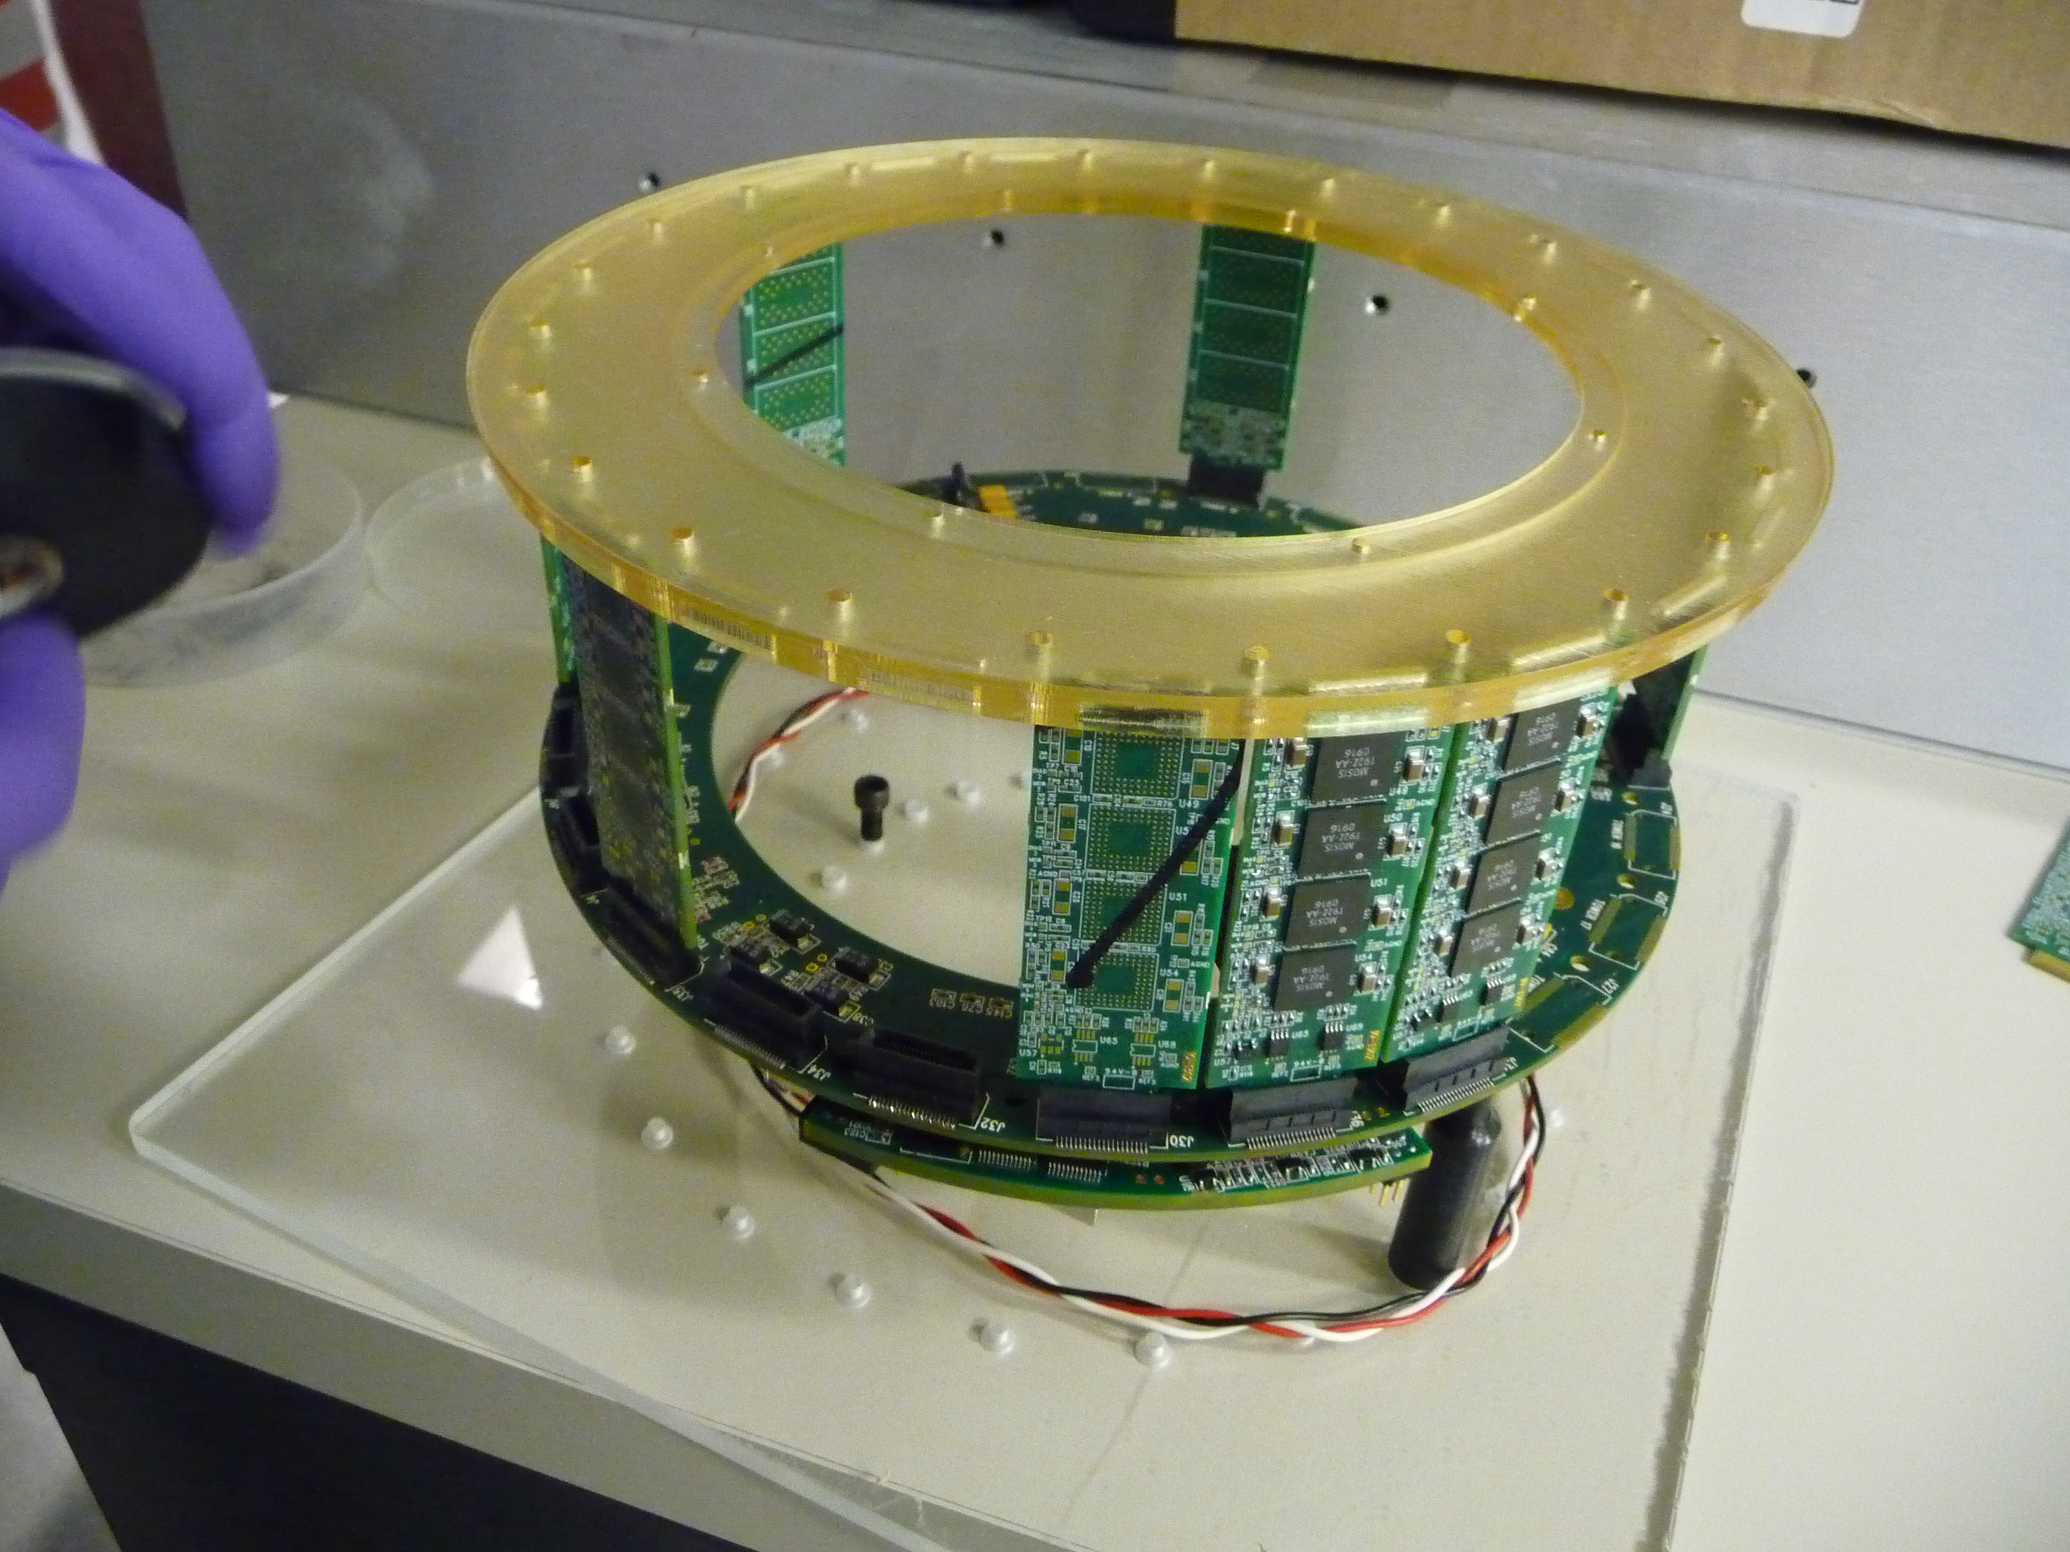
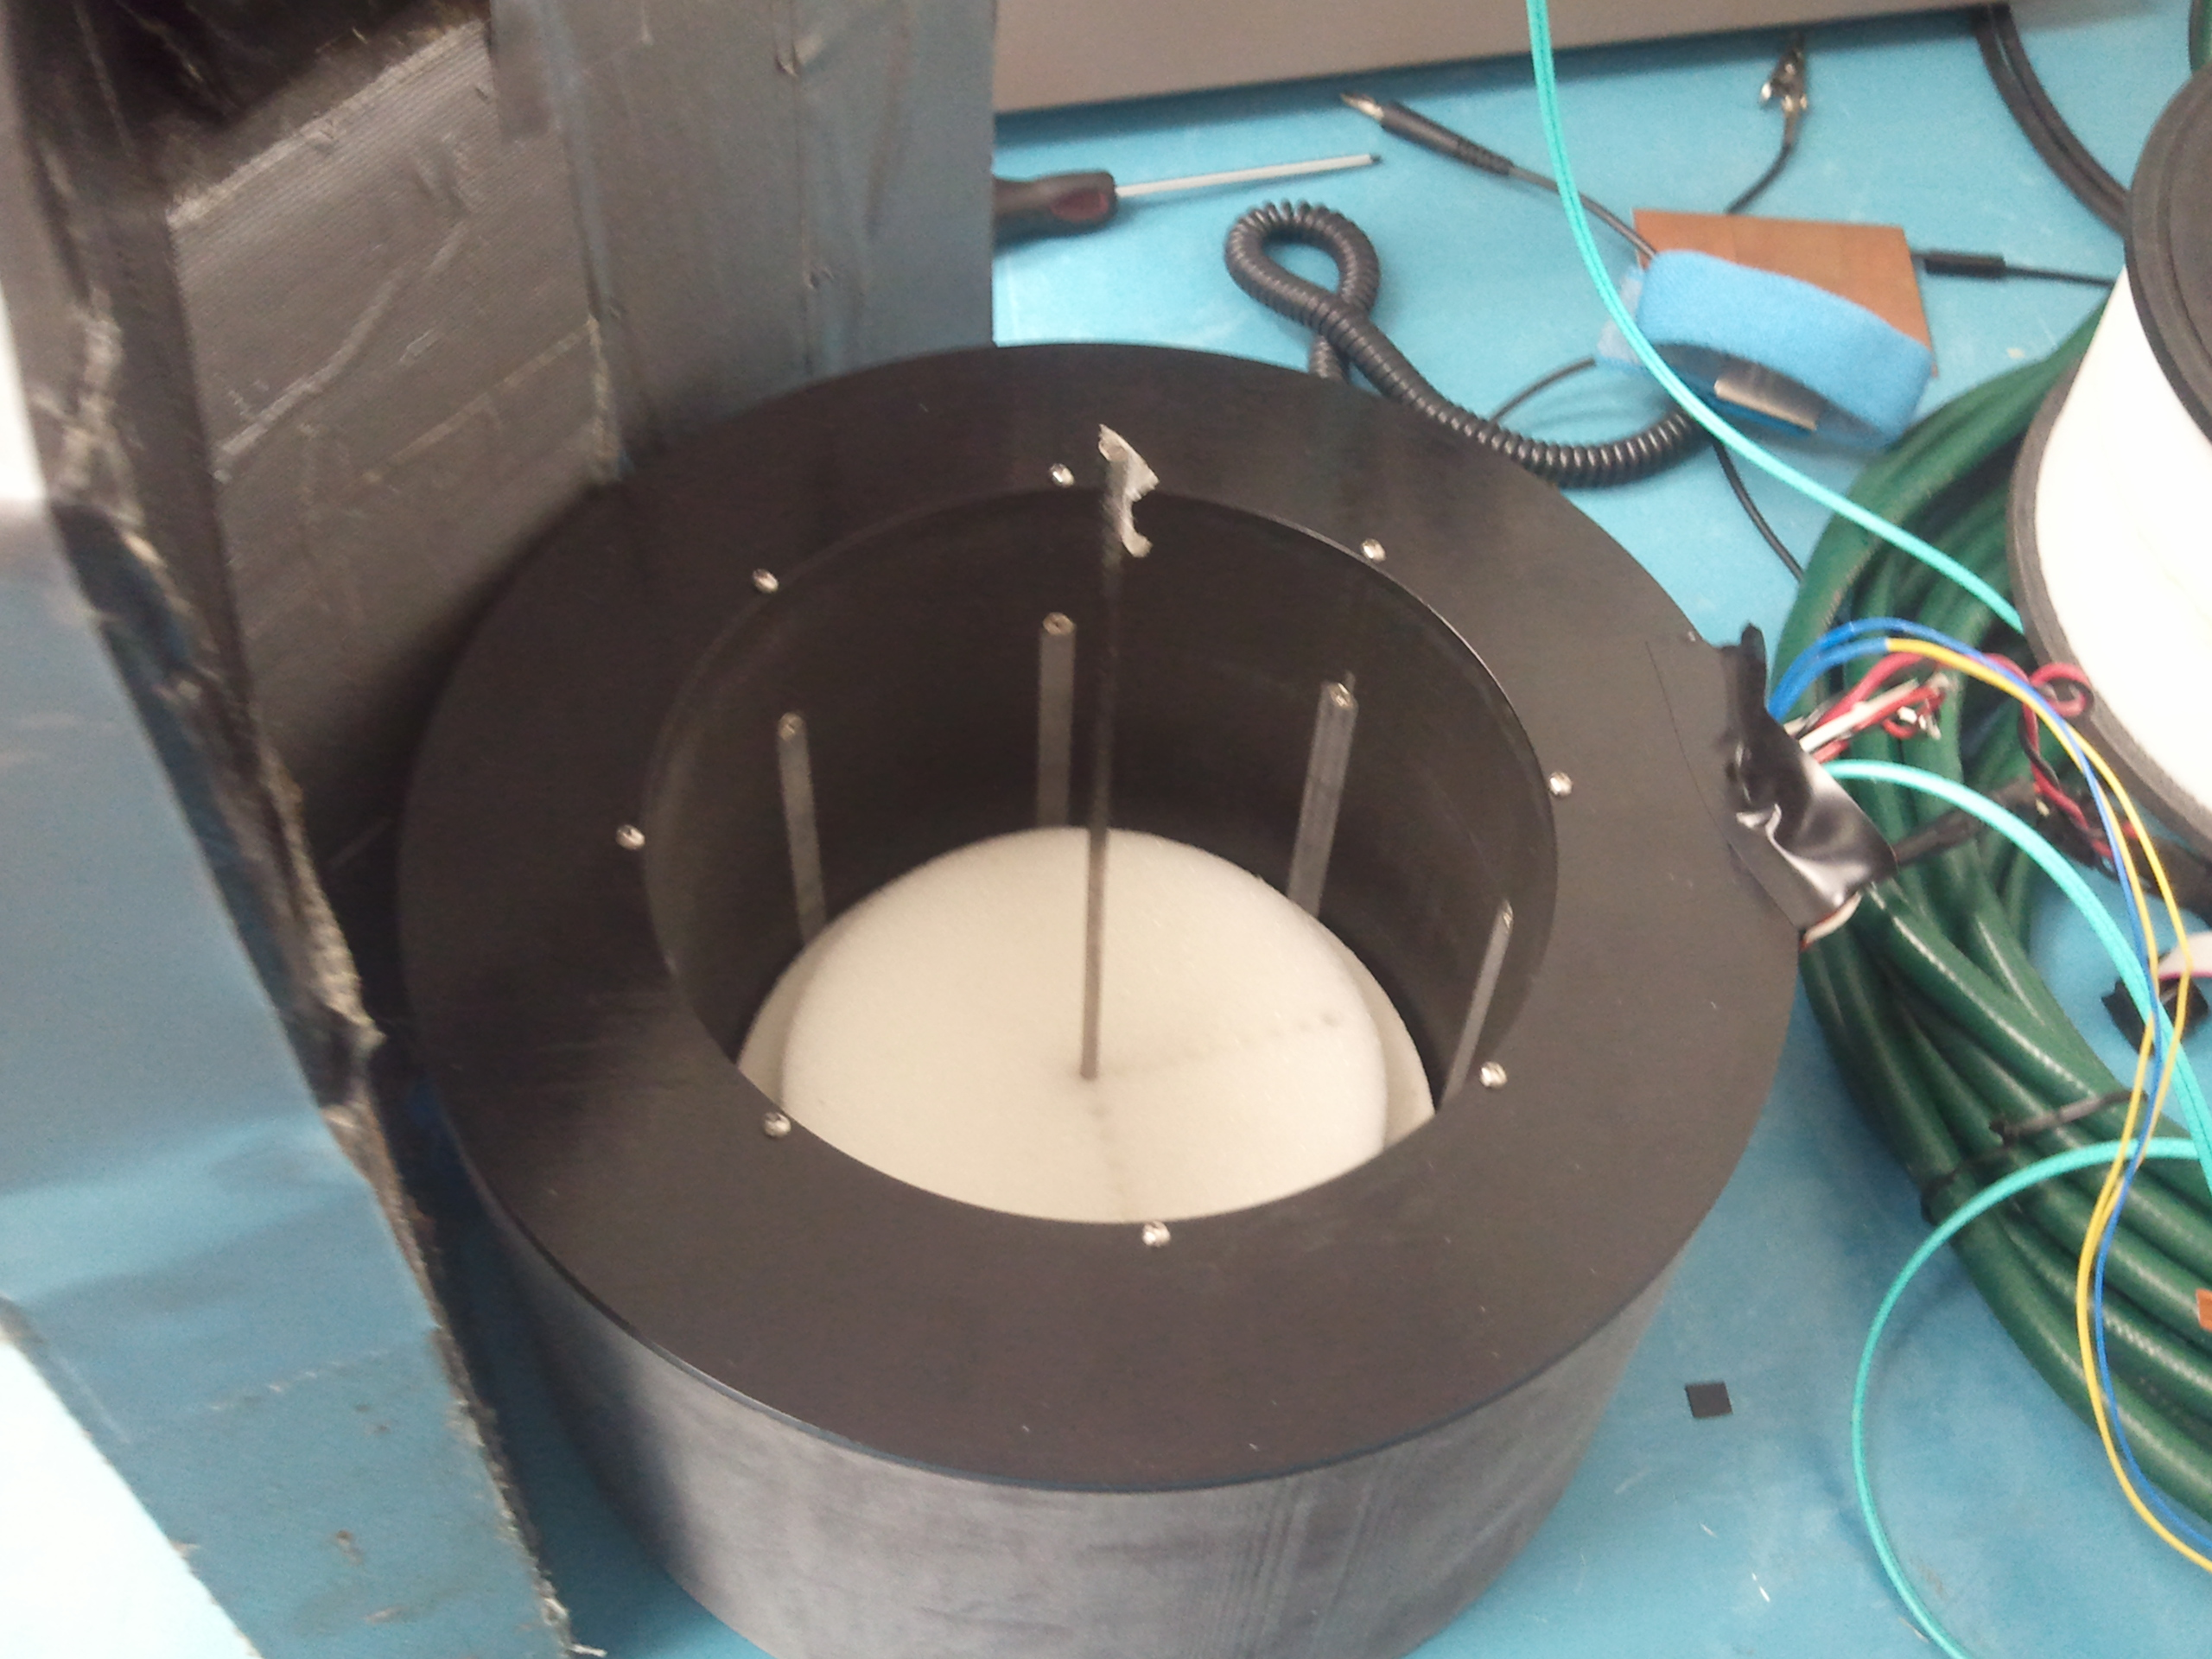
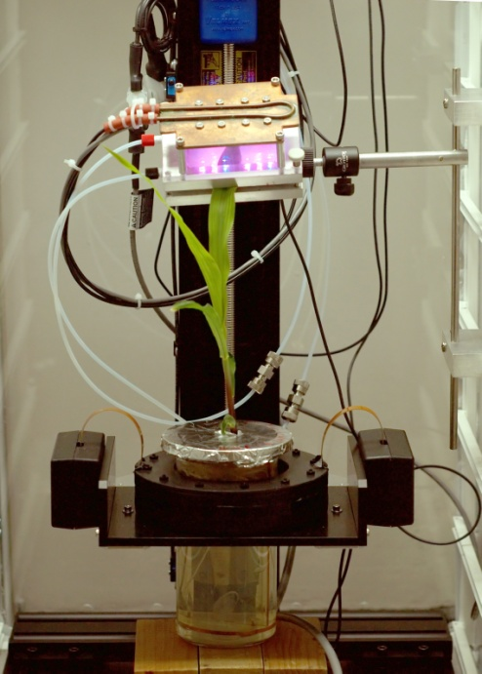
Medical Imaging / PET @BNL
Original Ratcap V1
Breast Scanner
UPenn Scanner 400MB/s DAQ application
Plant Scanner

Slide 5

PHENIX - an “early” high-rate experiment
My opening slide at the
Computing for High-Energy
Physics Conference in
Mumbai, India, 2006
I am the Data Acquisition Coordinator for PHENIX and our successor experiment “sPHENIX”
… and that's why I'm here today.

Slide 6
DAQ Timelines
1970
Minicomputers, PDP-11, Tracor
CAMAC and NIM electronics emerge as the de-facto standards for instrumentation
VME and Fastbus, VAX-VMS as standard OS, Digital Equipment dominates scientific computing and DAQ
data acquisition hardware from standard building blocks
VME Processors with CAMAC and Fastbus.
UNIX becomes the OS for DAQs
custom solutions for (by then-standards) high-bandwidth DAQ’s.
Single VME crates are no longer big enough
VME Crate Interconnect, VME Taxi
standard networks for interconnect
Trigger farms, commodity hardware for DAQ, GB/s data speeds
1980
1990
2000
2010

Slide 7
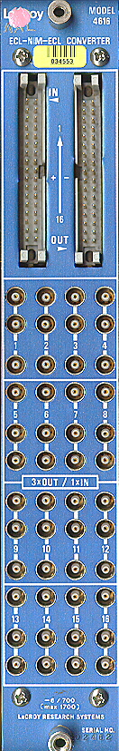
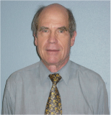
There is a name...
There are many manufacturers (CAEN, …), but this era of physics instrumentation is really associated with…
There are many manufacturers (CAEN, …), but this era of physics instrumentation is really associated with…
… Walter LeCroy
… Walter LeCroy
Even today, many modern detector elements and prototypes see their first test using LeCroy electronics
“I did it in Blue Logic”, referring to the LC blue color
Also, a prestigious series of “Electronics for Future Colliders” conferences held at LeCroy’s headquarters in the early 90’s
Even today, many modern detector elements and prototypes see their first test using LeCroy electronics
“I did it in Blue Logic”, referring to the LC blue color
Also, a prestigious series of “Electronics for Future Colliders” conferences held at LeCroy’s headquarters in the early 90’s

Slide 8
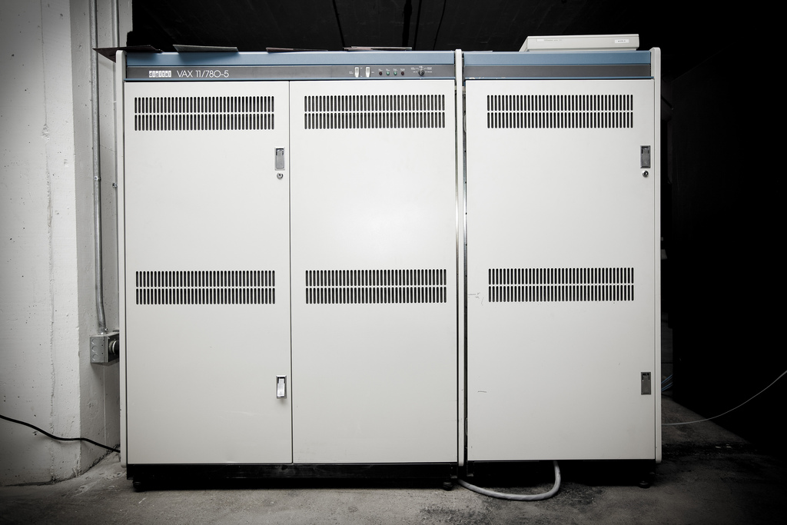
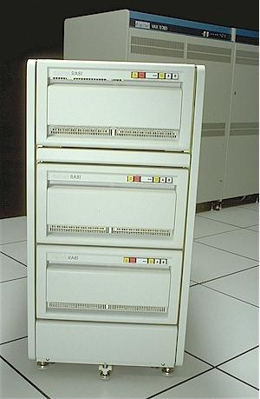
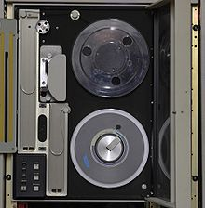
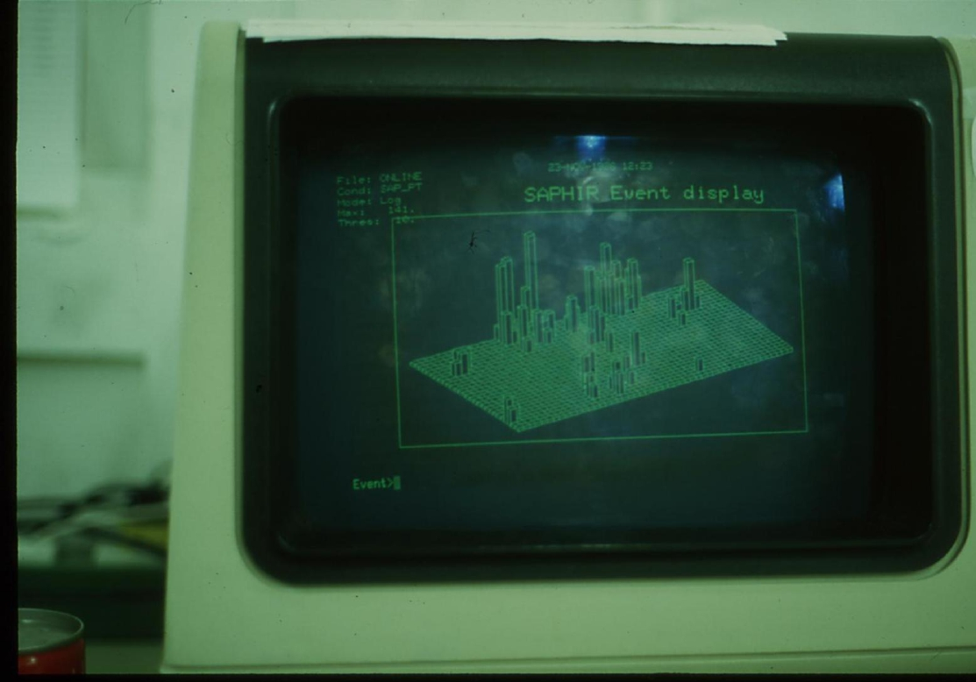
Computing ca. 1985
Our flagship mainframe computer, a Digital Equipment VAX 780
About 1/8 as much computing power as my Nexus 5 smartphone these days
Not as much memory though... 4MB
But a great OS, OpenVMS
This is a RA81 harddisk. 600MB, just enough to hold the contents of one data tape
And this is a DEC VT100 terminal, where most of the work took place in those days.

Slide 9
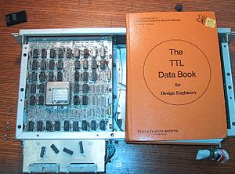
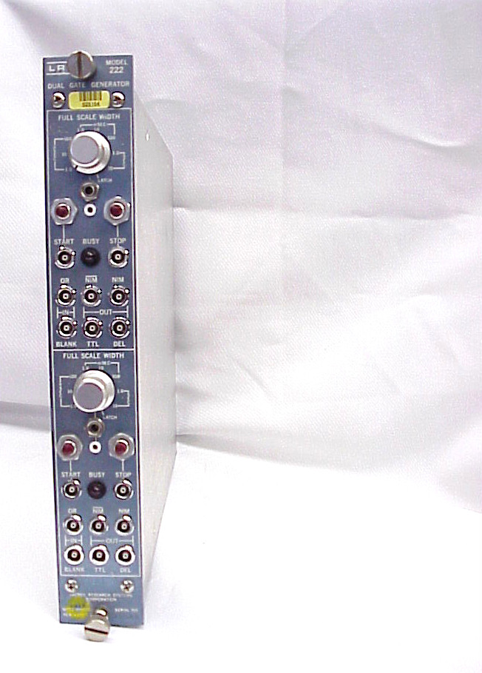
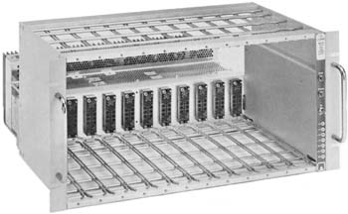
3 Fundamental Signal Standards
TTL – Transistor-Transistor Logic
0-5V digital signal range
Popular in circuit boards because of a wide range of IC (74LSxxxx)
Poor timing characteristics, high currents (= power) needed – largely obsolete
NIM – Nuclear Instrumentation Module ( AEC Standard)
Defines a crate standard, connectors, and power/voltage supply levels, as well as a signal standard
The signals are defined as currents (-16mA into 50 Ohm – makes about -800mV). Negative signals
Virtually every experiment has them. This what made standardization in instrumentation possible
Modules can be inserted and removed “hot”

Slide 10
Signal Standards - ECL
ECL – Emitter Coupled Logic
Part of the NIM standard
Excellent timing characteristics – constant current gets routed on way or another, no capacitance charging
High-Density (well, back some years) connectors with twisted-pair or short flat cables
A “bus” of ECL lines can connect to multiple inputs, last one gets terminated – convenient at times
Flat cables make it harder to make wiring mistakes
But mostly chosen for speed and density.
Constant current makes for high power consumption though

Slide 11
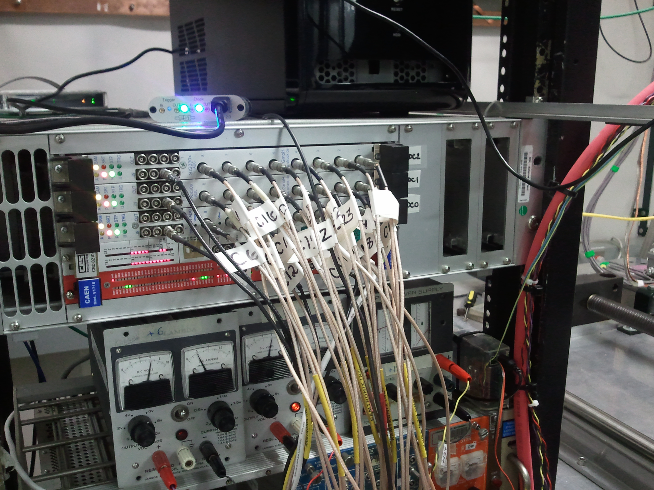
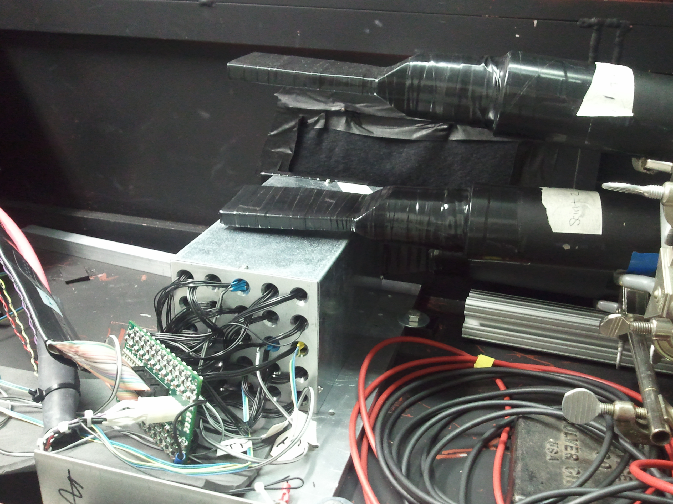
Why do we need to know the “classic” things?
Even in 2014, you are likely to use CAMAC / VME for the initial tests of the detector
Results obtained with “known” electronics drive the development of your final readout
That final readout is likely not available by the time you go to test beams
FermiLab test beam Sep. 2013
For the PHENIX-MPCEX detector
Struck SIS3300 Flash ADCs (VME)
(Also a DRS4 eval. Board...)

Slide 12
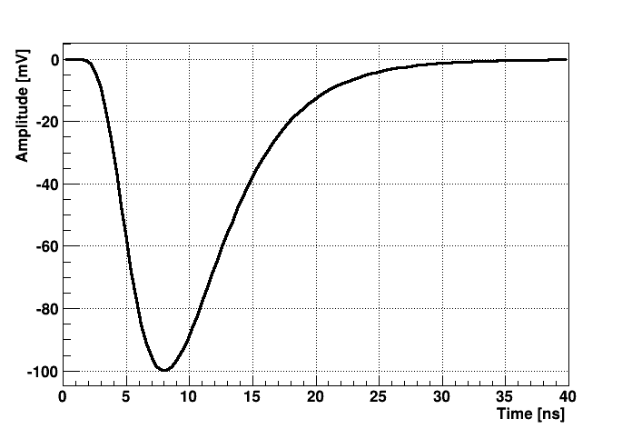
Signal Discriminators
This is a parameterized “typical” signal from a photomultiplier.
It usually has a fast rise and returns to the baseline more slowly.
We almost always deal with negative pulses, so we usually say “rise”, although it technically falls. In the same spirit, we always say “signal height”...

Slide 13
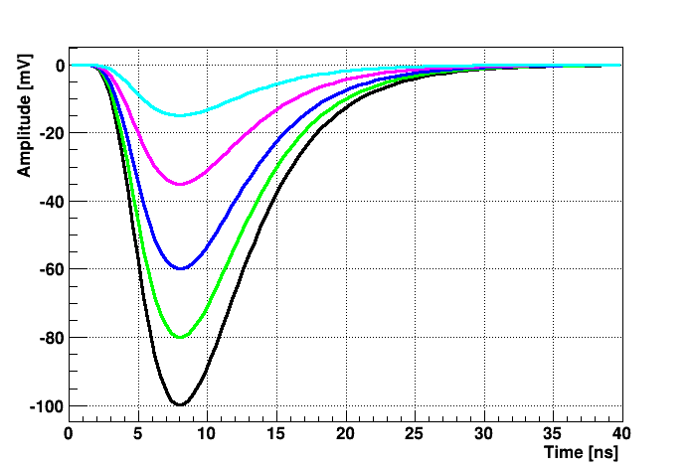
Signal Discriminators
Of course the signal heights vary from pulse to pulse
There is also noise – a myriad of tiny pulses which have nothing to do with a signal in your detector
You want to know whether or not a signal is higher than a certain threshold – this could translate into a minimum required energy deposited, for example
All signals on the left have the same form, just a different amplitude

Slide 14
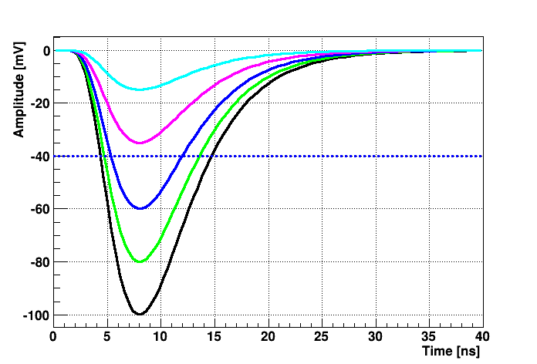
Signal Discriminators
In this example, we set a threshold of -40mV.
The black, green, and blue signals would make the cut here.
We would ignore the magenta and light blue signals here.
Threshold

Slide 15
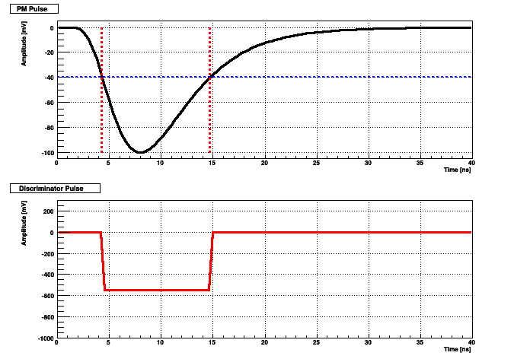
Signal Discriminators
This is what you might see on your scope.
Where the signal exceeds the threshold, you get the discriminator to fire.
Threshold
Most discriminators give a logic pulse with a fixed length, independent of the “above-threshold-time” of the signal. Has many advantages.
Fixed-length logical signal

Slide 16
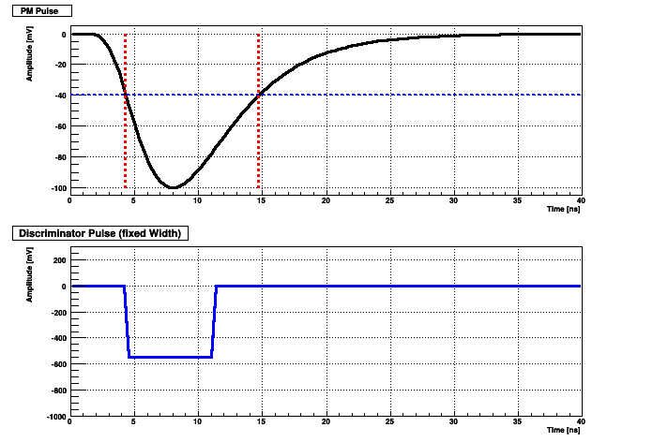
Signal Discriminators
This is what you might see on your scope.
Where the signal exceeds the threshold, you get the discriminator to fire.
Most discriminators give a
logic pulse with a fixed
length, independent of the
“above-threshold-time” of
the signal. Has many
advantages.
Fixed-length logical signal

Slide 17
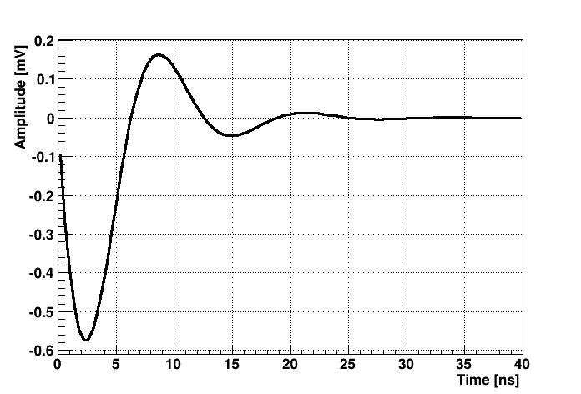
Zero-Crossing Discriminator
Just to mention this...
There are many ways to discriminate a signal – I just want to mention a zero-crossing discriminator.
Fires when a signal goes through zero.
Typically involves a shaper, which converts the pulse into a bipolar signal.
Why do we like a signal that is 0?
You can amplify the signal as much as you need
and get a more accurate measurement.
Distinguishing 200 from 201 mV is much harder than
distinguishing 0 from 1 mV

Slide 18
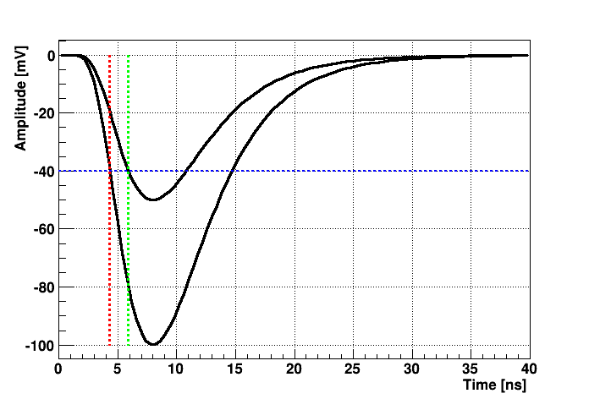
A big problem: Walk
A larger pulse will cross the threshold earlier than a smaller pulse which will ultimately be above the threshold.
So the timing when we cross the threshold “walks” around depending on signal height
By and large, physicists don't use threshold discriminators in their setups because of the significant walk problem.
Basically unusable for timing measurements.

Slide 19
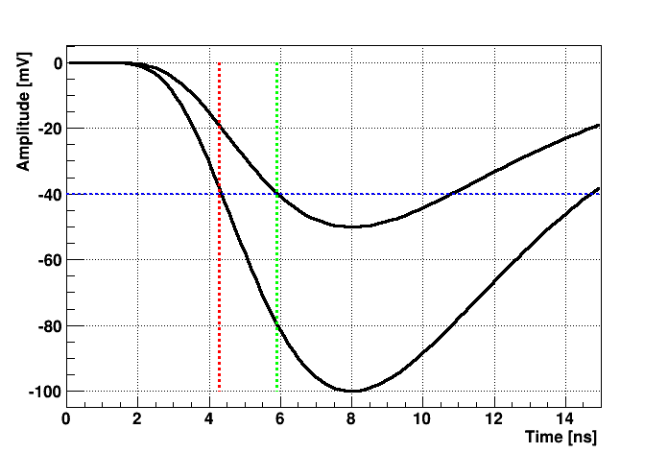
A big problem: Walk
A larger pulse will cross the threshold earlier than a smaller pulse which will ultimately be above the threshold.
So the timing when we cross the threshold “walks” around depending on signal height
By and large, physicists don't use threshold discriminators in their setups because of the significant walk problem.
Basically unusable for timing measurements.
walk

Slide 20
Constant Fraction Discriminators
Well, a Constant Fraction Discriminator sounds like the golden solution
instead of a fixed threshold, you “adjust” the threshold pulse by pulse so it fires at, say, 40% of the peak amplitude
No matter what the peak is, if the pulse shape is always the same, a signal reaches its 40% level at the same time. Walk eliminated.
Problem solved... well, not so fast.
How do you know the peak amplitude? How do you do that?
Luckily, someone figured that one out...

Slide 21
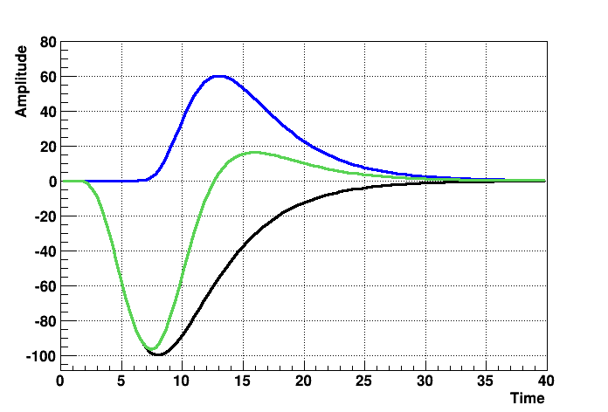
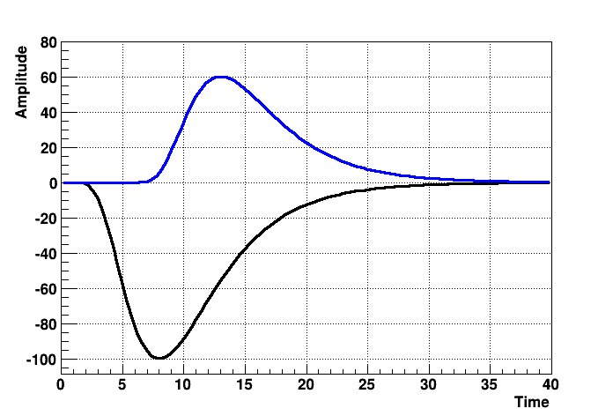
The Constant Fraction Discriminator (CFD)
You take the signal, and subtract a delayed and attenuated copy from it
(or: you add an inverted, delayed and attenuated copy to it)
Inverted, attenuated, delayed copy
Inverted, attenuated, delayed copy
And then you use a zero-crossing discriminator to find the spot
Resulting pulse
Original pulse
Original pulse

Slide 22
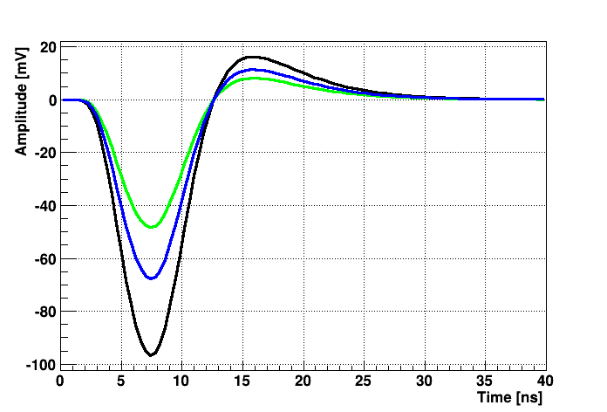
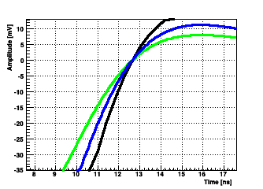
Look, no walk!
This shows the zero-crossing time of 3 different pulses
They all go through 0 at exactly the same time
If the signals are amplified copies (all the same shape), this is mathematically exact
Of course, we are dealing with real-life signals...

Slide 23
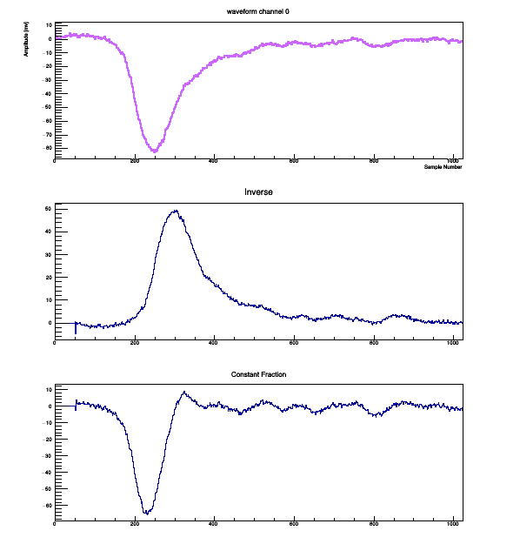
Data from our Time-of-Flight Setup
This are data taken by us here at the school with the TOF setup.
I picked a 0.6 fraction, 50 samples delay
That can still be improved...
Original Waveform
Delayed and inverted
Sum of the two

Slide 24
Slewing Correction
Real-life signals do usually not completely fulfill the “scaling rule”
They do not have the exact same shape (still good enough for many applications)
Example: Scintillator light does not simply “scale” - depending on energy the light profile varies, and so does the final pulse shape
For picosecond-level timing, one still needs to eliminate a residual timing dependence on the pulse height
Measure the pulse height and perform a amplitude-dependent correction -
“Slewing correction” - part of your offline analysis

Slide 25
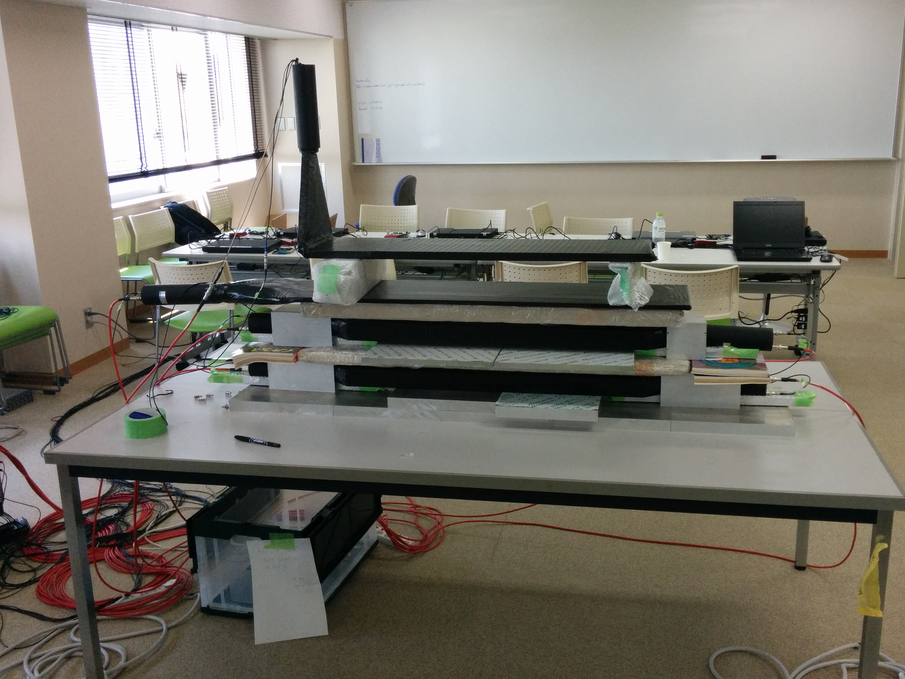
A Cosmic Ray Test Stand
Actual Detector(s)
you want to test
Cosmic rays

Slide 26
Let's Build a Cosmic Ray Teststand
Scintillator Paddle with PMT
Timing-defining CFD (short width)
CFD
Actual
Detector
you want
to test
Trigger for DAQ
Coincidence unit
DAQ
Signal(s) for DAQ
CFD
Cosmics

Slide 27
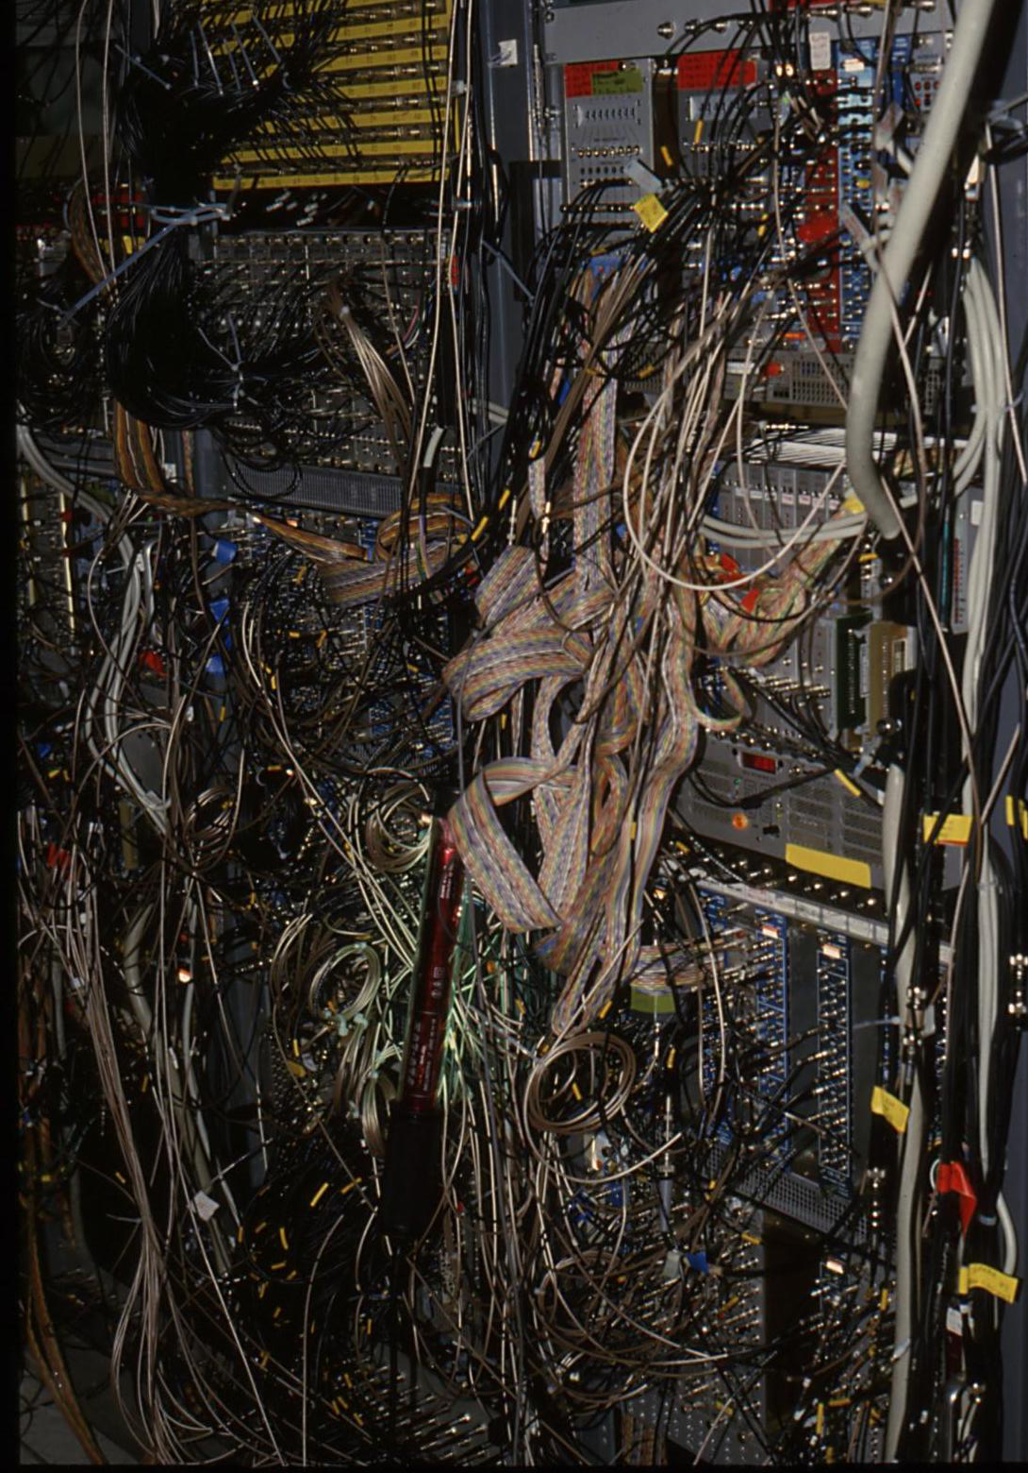
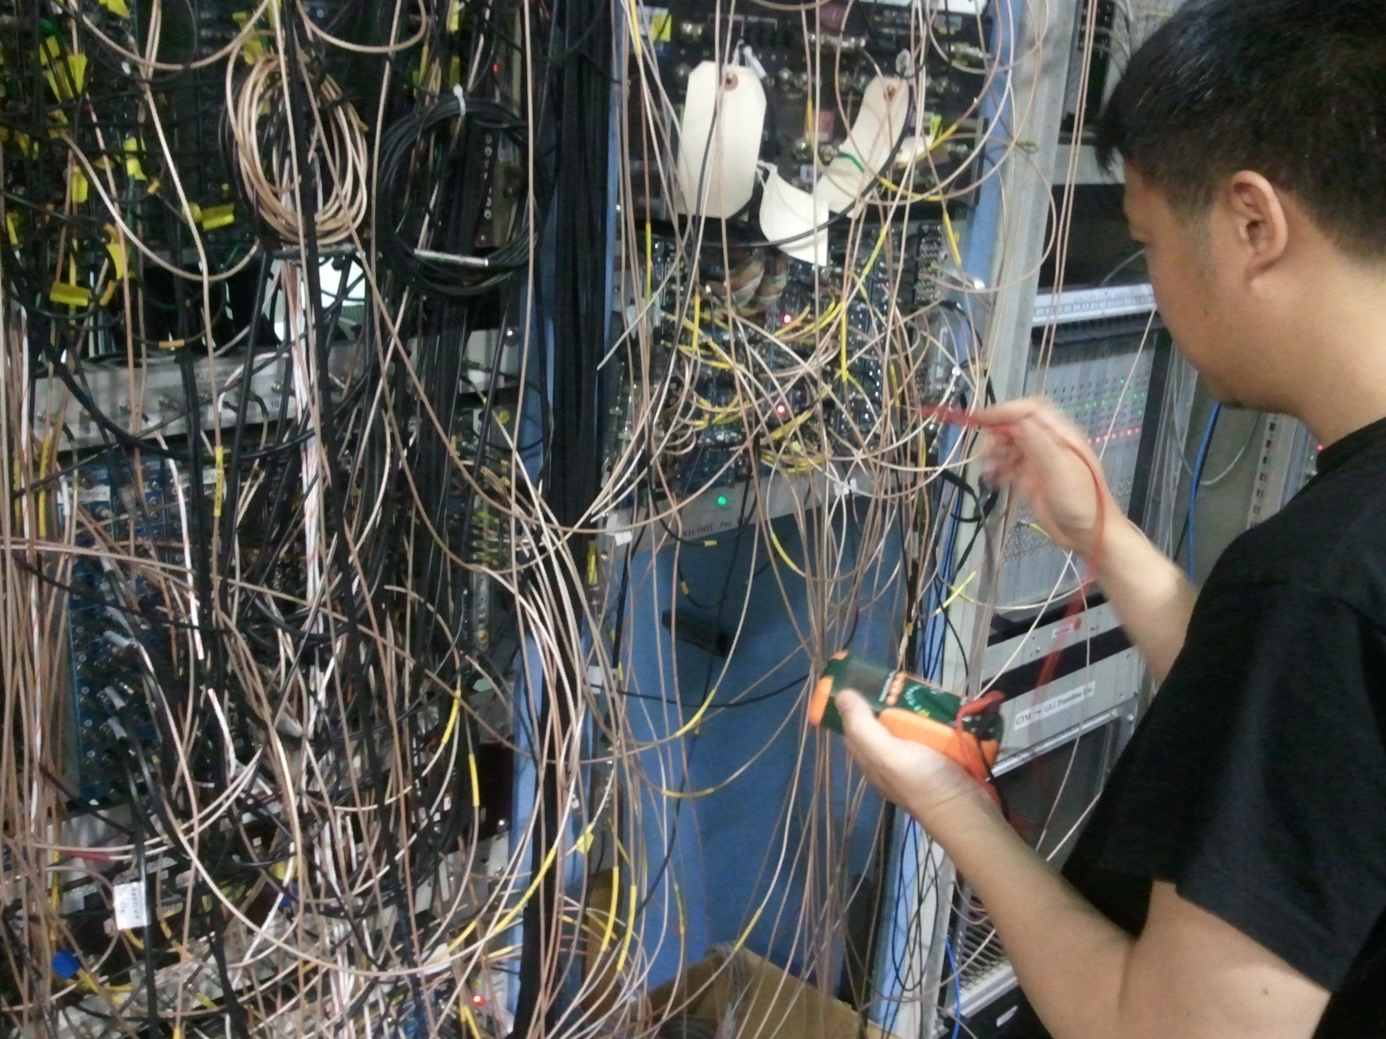
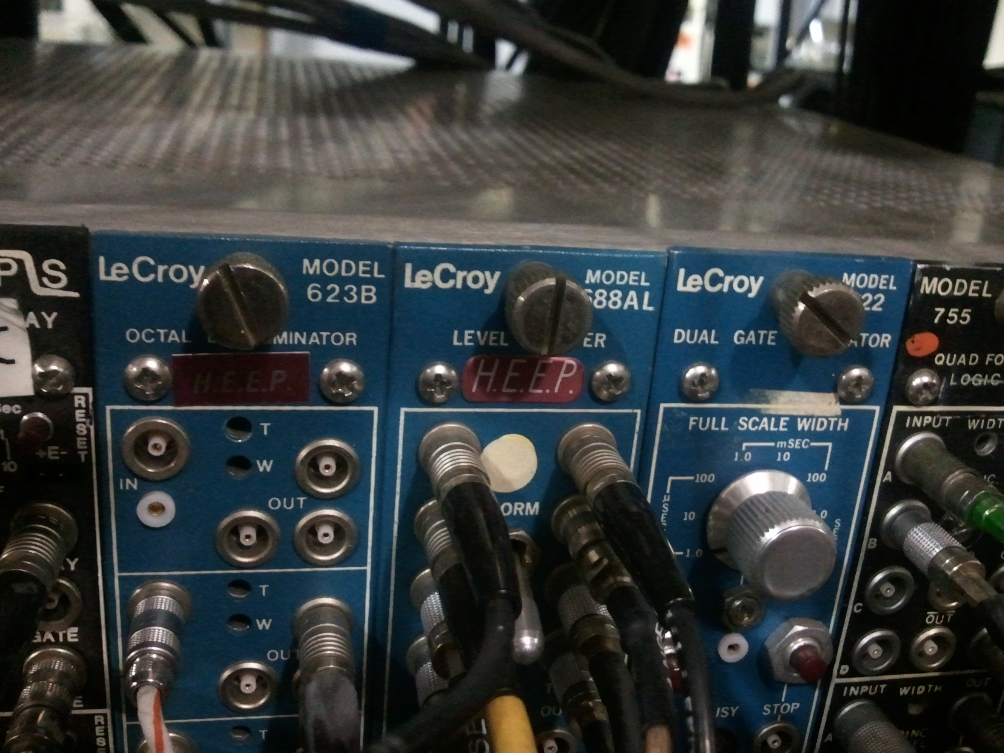
More BLTs...
The trigger of WA80 @ CERN

Slide 28
How to measure signals?
Two main devices:
An ADC – Analog to Digital Converter - converts a pulse height or integrated charge in to a number
A TDC – Time to Digital Converter - converts the time difference between a start and a stop signal into a number
You'll hear “10 bit” or “12 bit resolution” - how many bits that number has. This is one contributor to the real resolution – with 10bit you can get at most 0.1% (1/1024). Typically your detector's resolution is much worse than that.
ADC – “charge integrating” or “Peak Sensing” … PS is rare, charge-integrating is the most common ADC
signal
Charge integrating ADC are often the most precise ADCs (you can lose signal height, but you can't lose charge)
Gate
Integraton time
Even without an actual signal, an ADC does not measure 0 - noise, dark currents, etc make a “pedestal”. Needs to be measured and subtracted

Slide 29
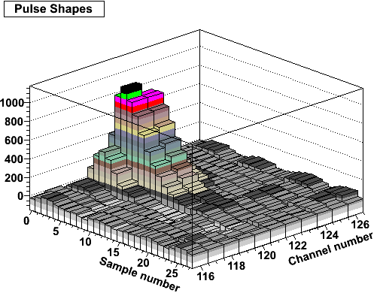
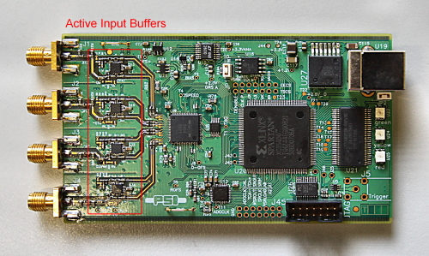
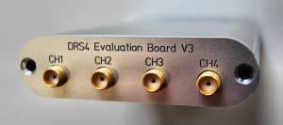
Flash ADCs
Rather than measuring one number, a Flash ADC samples the signal at a specific frequency (10, 100 MHz, 1, 2, 5 GHz)
FADC gives you a waveform just like a scope
You can measure pedestals signal-by-signal (select samples before the actual pulse)
Perform Waveform analysis
Much higher data volume though
FADCs are expensive
Switched-capacitor arrays can be a
cheaper alternative
we will use here the
DRS4 chip

Slide 30
More Standards
Now what? Can I buy one of those ADC's and read it out?
Depends. There are a few standards for such instrumentation so you can buy stuff off the shelf.
CAMAC
VME
FASTBUS
Custom-made (most of PHENIX)
uTCA (I'll get back to this later)

Slide 31
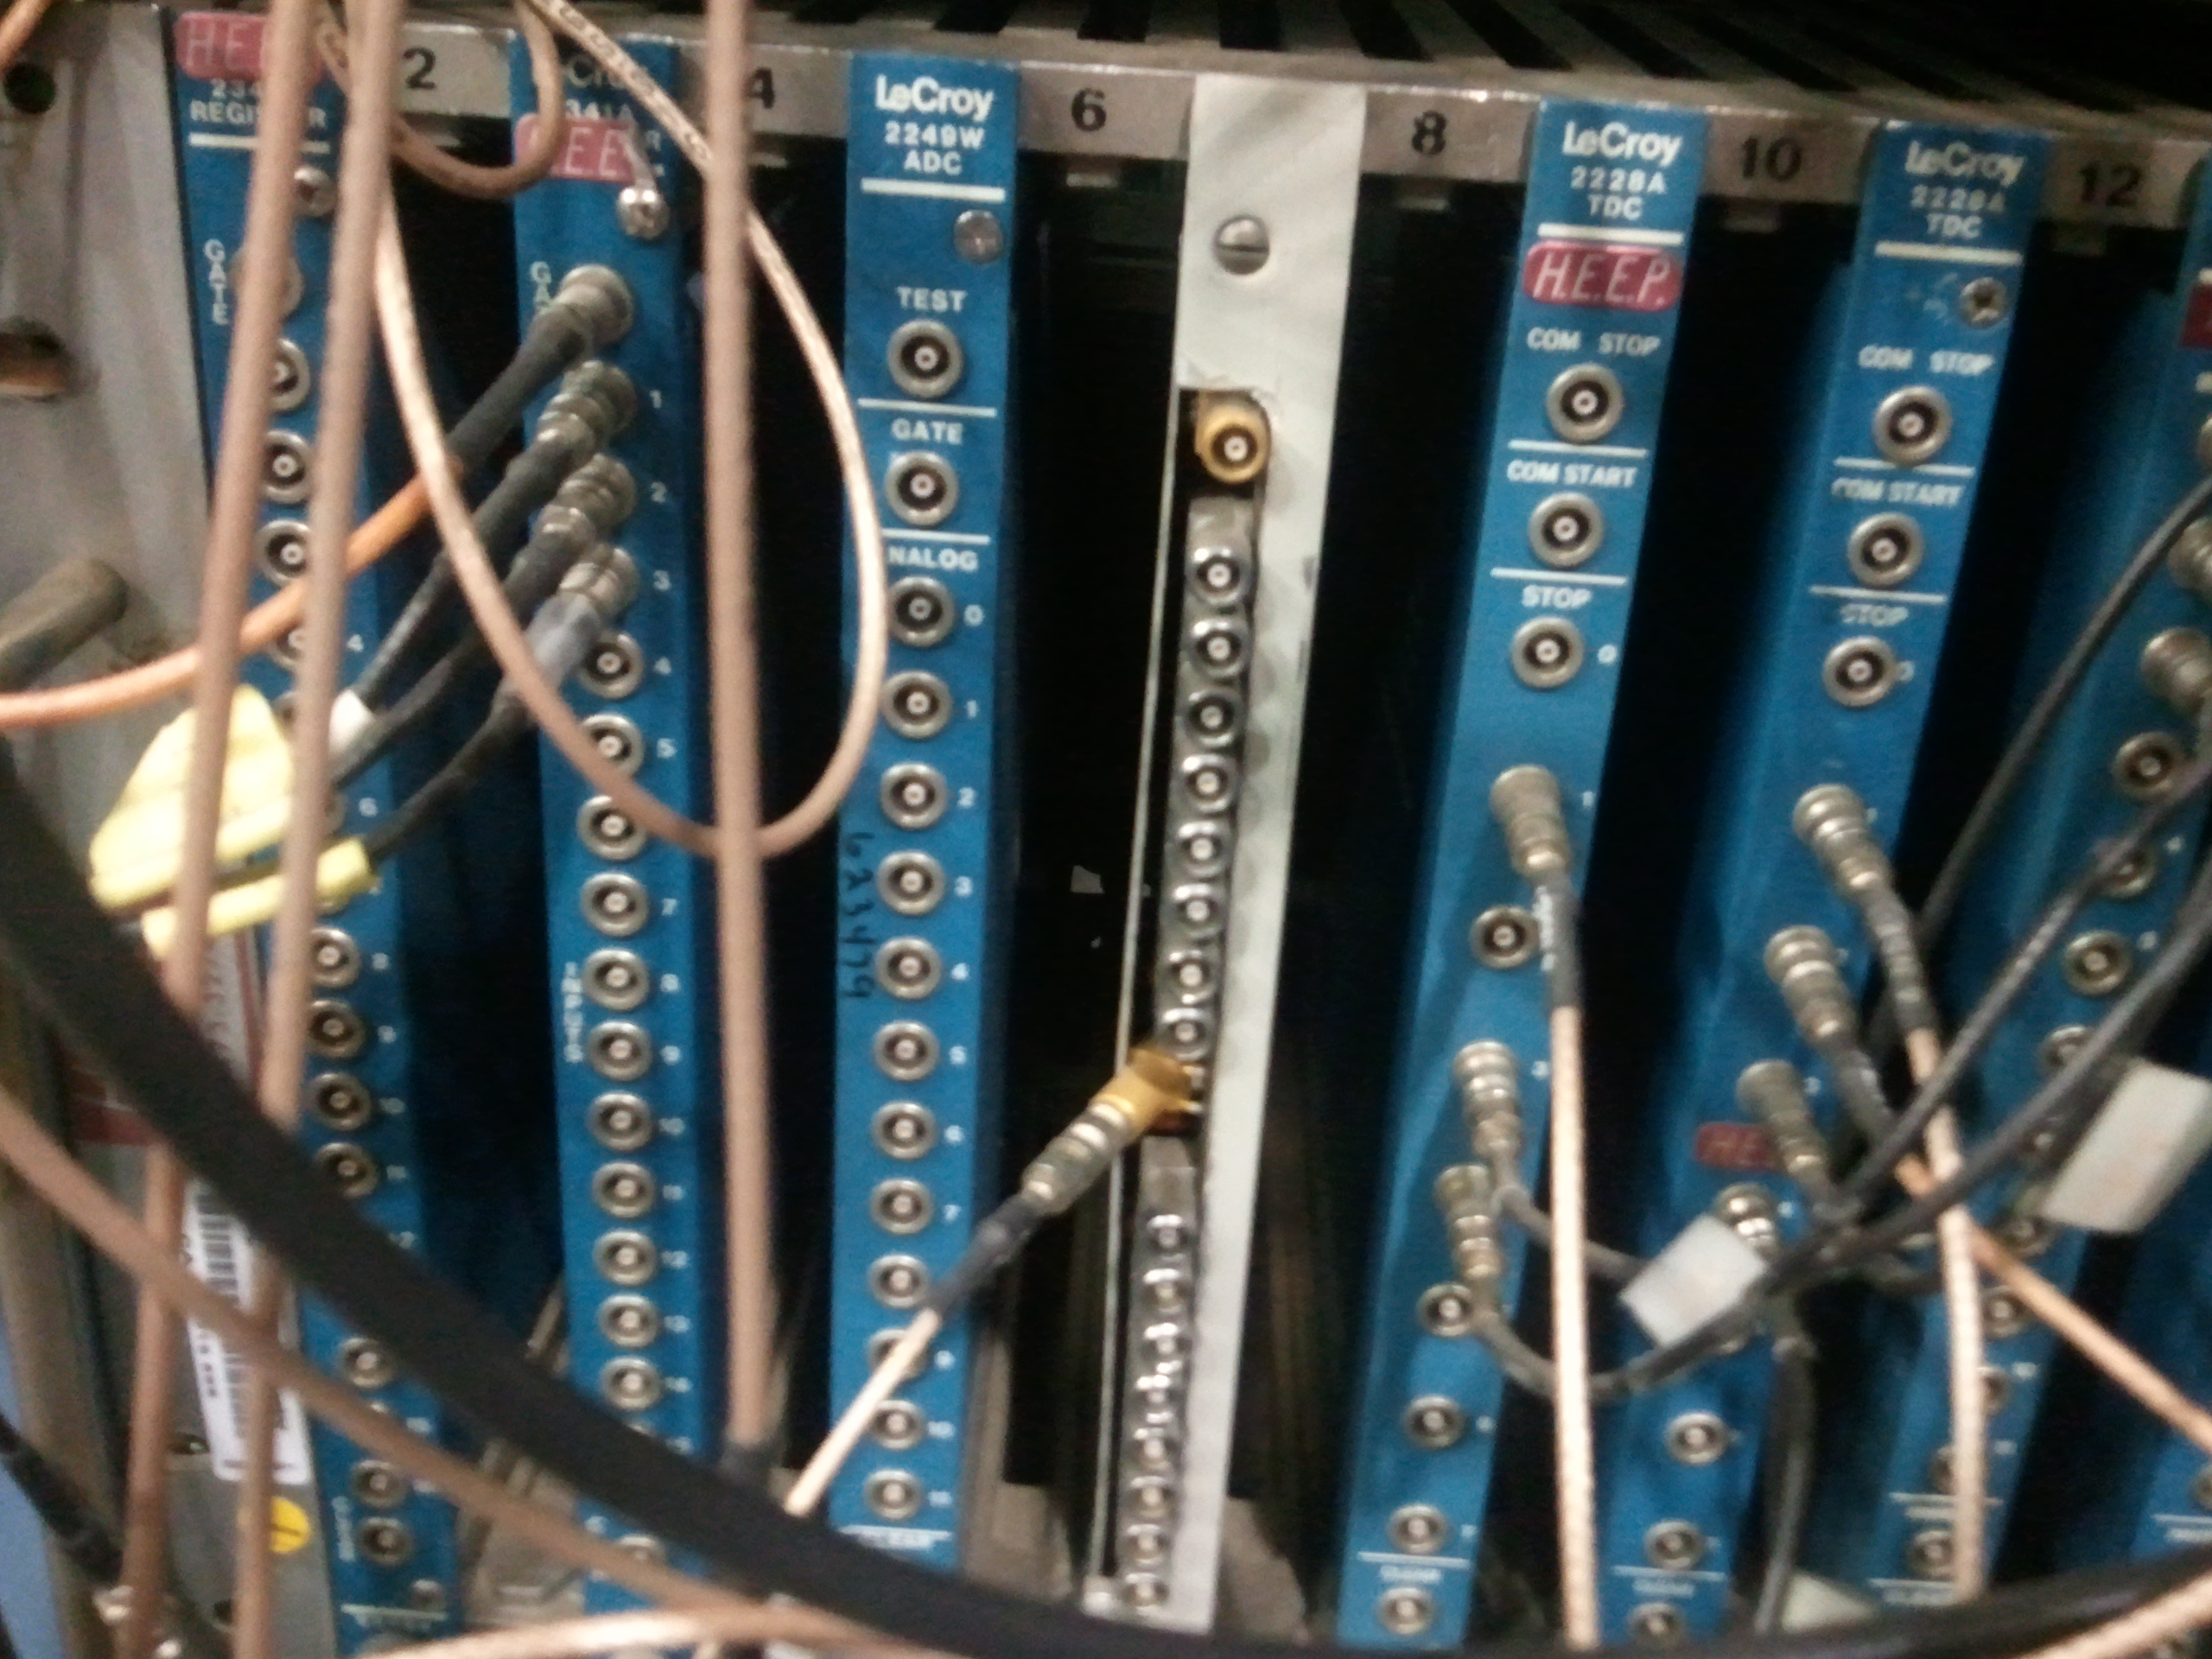
CAMAC
“Computer Automated Measurement and Control”
A standard crate with a bus-backplane
Up to 25 slots per crate, 2 typically taken by “Crate Controller”, 23 free
A standard communications interface, short-hand FCNA
Function (F), Crate (C), Station (N) (slot), Subaddress (A), with standard libraries on various platforms
To the extent that we are using CAMAC, it is typically through our VME crate controllers – not in the “real” PHENIX DAQ
But many R&D projects come to life initially using CAMAC modules
Most prominent: the LeCroy 2249W ADC and the LeCroy 2228A TDC
Virtually each Institute has a large inventory of CAMAC hardware, easy to get (“HEEP” at BNL)
Also many “control” modules, such as the delay module before, in CAMAC for all computer-controlled settings
At CERN we did what we do here by loading a LVL1 configuration by setting hundreds of CAMAC registers – CFDs in CAMAC, Logic modules (“8LM”), delays,... screwdriver-less operation

Slide 32
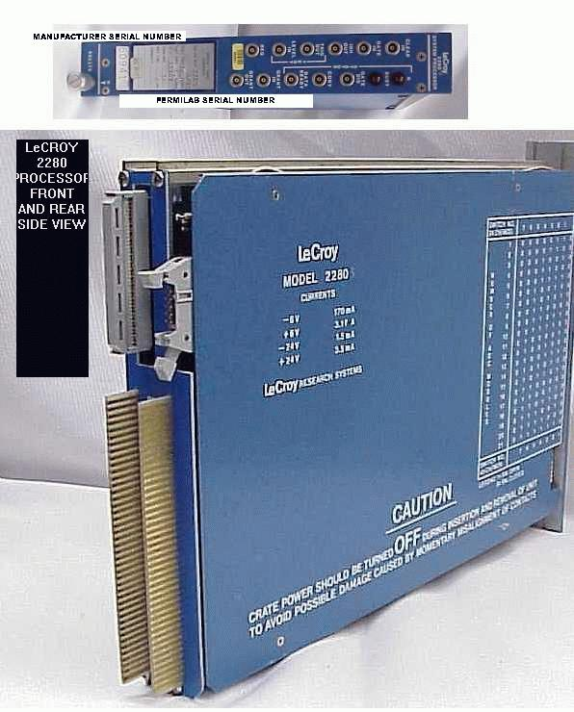
Example: 2280 ADC System
My workhorse ADC system back at CERN
To the best of my knowledge, the densest ADC system in CAMAC
Up to 960 ADC channels with a common gate in one crate
System processor subtracts pedestals, zero-suppresses, delivers data in a compact format
Used to read out what is today our Lead Glass Calorimeter (and other Calos at CERN)

Slide 33
FASTBUS
Attempt to overcome some of CAMAC's limitations
Larger crate, more space, hot-swappable modules...
I have not used FB that much, so I'm not the expert
The reason that I skipped FB, however, is the “wrong sex” of the backplane
The backplane is by far the most expensive item in a crate
In FB the backplane has the pins. What??? You bend or break one while inserting a module, and the backplane is shot
That said, JH's 787 experiment was all in FastBus... so it cannot be that bad

Slide 34
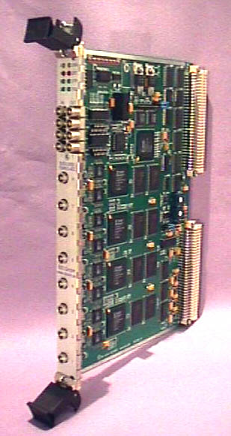
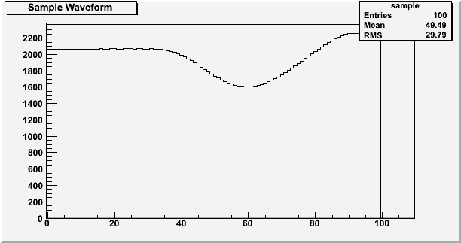
VME
“Virtual Memory Extender”, designed as a digital / computing device
Bus allows to memory-map modules and access them
Different modules can access each other's memory across the backplane
Many attempts to use VME for analog-type instrumentation (denser, faster, cheaper than CAMAC)
However, standard VME crates don't have the proper clean power for analog electronics
CERN's add-on standard “VIPA” guarantees certain limits, but makes VME crates really expensive
Still, a wealth of modules in VME
All of PHENIX's DCMs, DCM2s, Partitioners are in VME (e.g VME crate controllers, such as iocondev1a). All use of VME in the PHENIX DAQ is digital-only
I like(ed) VME a lot for its ease of use
Easy to understand
Struck SIS3300 8-channel Flash ADC

Slide 35
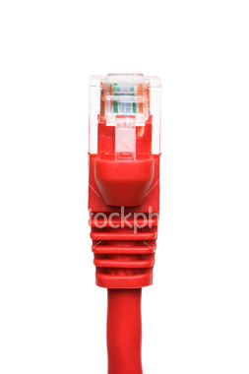

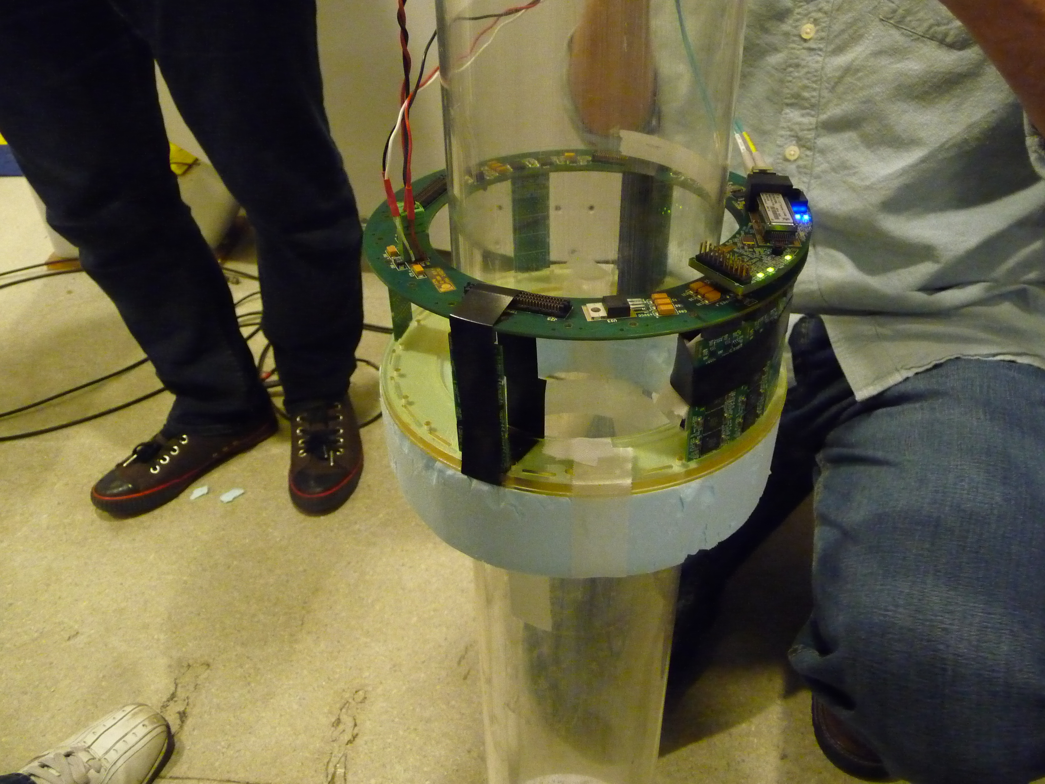
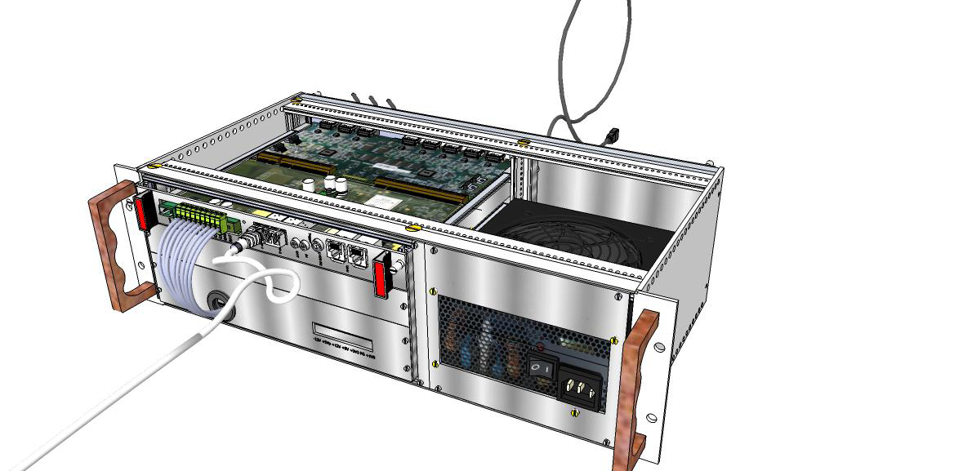
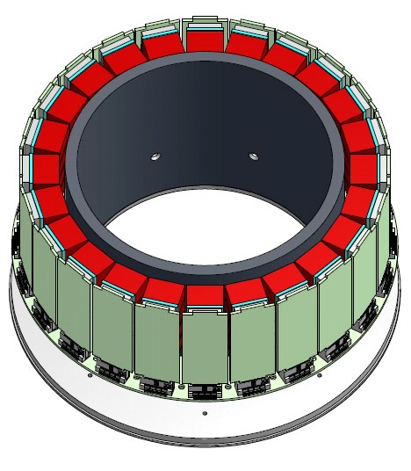
New(er) Developments
For various groups (medical imaging, GEM R&D, Stony Brook GEM Cherenkov, Yale...) I'm providing a modern DAQ system running on a PC.
The principal data streams into a PC are network, USB, and PCI/PCIe
Most folks planning some test beam will likely interact with it. SB@SLAC (now), MPC-EX...
RCDAQ
“TSPM”
Prototype
DRS4 Eval board
“USB Oscilloscope”
Nice for triggering, say, for cosmics
PET Scanner for Mammography / Rodents (3072 LYSO crystals)
The SRS System

Slide 36

Dead Time
Don't let Deadtime
ruin your data
Scientists
for less
Deadtime
Less
than
10%!
Scientists
for less
Deadtime
against
Less
than
10%!
Deadtime
More
Than
10%!
Deadtime is Evil!

Slide 37
Dead Time
It takes some time to actually read out your detectors. You have to transfer the data, package it, store it
Many “small” data acquisitions run in the neighborhood of 1 millisecond – so you can get an event rate of about 1KHz max.
During the time the DAQ is reading out, it cannot accept another signal - “dead ”.
An event / signal arriving during that time is lost.
We measure dead time (or live time) in percent – 10%, 20%, …
If your dead time is 50%, a given signal has a 50% chance to be accepted.
If your dead time is 10%, the chance is 90%.

Slide 38
Dead Time
If you have truly rare interesting events which you want to measure in your overall data stream, you cannot afford such a high dead time.
Example: PHENIX takes data at about 7KHz. We get about 300 J/Psi particles /day among all the millions of other events.
If we would be running at 50% dead, we would lose 150 out of the 300.
We are running about 88% live, so we are losing 36 of the 300.
Of course we would like to run 99% live.
But then we would not take not a lot of data, and the J/Psi is not the only thing we measure
→ Always a compromise.

Slide 39
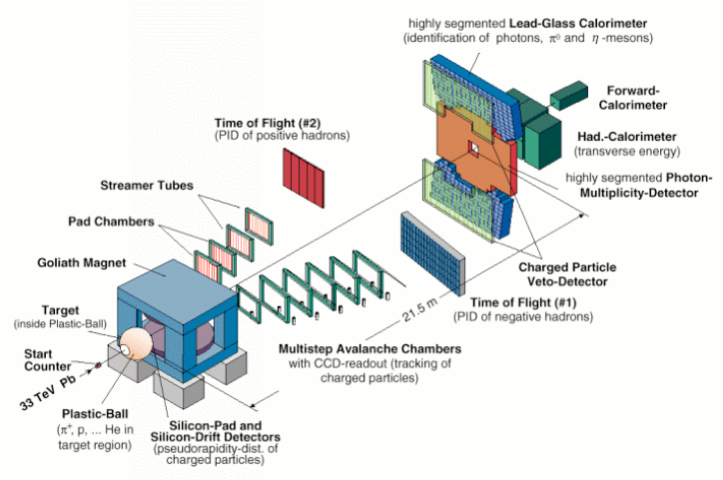
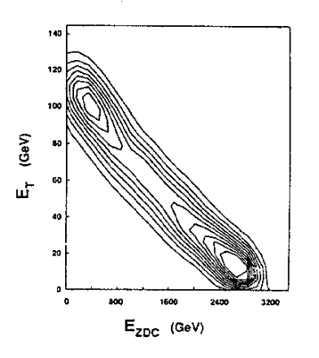
An example from my past
WA98 @ CERN
Heavy-Ion Experiment at the SPS – 158 GeV/A Pb
Zero-Degree Calorimeter (measures Energy going forward). No or “grazing” collision – lots of energy here
Mid-Rapidity calorimeter. No collision – no energy
More violent collision – more energy

Slide 40
Centrality Trigger
High Centrality → small impact parameter
Low Centrality → large impact parameter

Slide 41
Centrality Regions
High
Medium Centrality
Low

Slide 42
What is the problem?
For each high-centrality collision, you get
Such a central collision is
somewhat rare
If you can take 1000 event/s –
and your DAQ is 10% live –
You capture one of those events
every 4 hours and 40 minutes
You will never complete your
measurement!
You need to do something different...
1
10⁵
10⁸

Slide 43
How do we fix this?
The low-centrality collisions are abundant. There are plenty available, and
they look pretty much all the same.
You divide your trigger in the 3 regions, and scale down the trigger rate
for the low-C triggers
Now you play with the numbers until your DAQ
live time is right – for example, 90%
1 / 1 = 1
10⁵ / 1000 = 100
10⁸ / 100000 = 1000

Slide 44
Pitfalls of the Scaledown
You offer your DAQ fewer events of the “abundant” types by “scaling them down”
You offer the DAQ only each 5th, 100th, or 1000th event
VERY IMPORTANT: You can only count the events which arrived during the live time of your DAQ.
The Event could have been taken (we just decided not to).
Then (and ONLY then) such an event represents 5, 100, or 1000 others of the same kind (that's pretty much how a poll for politics works – you poll 5000 representative people)
When you analyze the data, you assign a weight of 5, 100, or 1000 (in this example) to it to account for the scaledown

Slide 45
End of Part 1.... I hope we made it here....

Slide 46
Let's go back here for a second
Scintillator Paddle with PMT
It takes time to form a trigger decision. Each
gate adds in the order of 20ns.
There is a very good chance that your trigger
decision is marginal at best
You need to gain some time for making the
trigger.
CFD
Actual
Detector
you want
to test
Coincidence unit
CFD
Cosmics

Slide 47
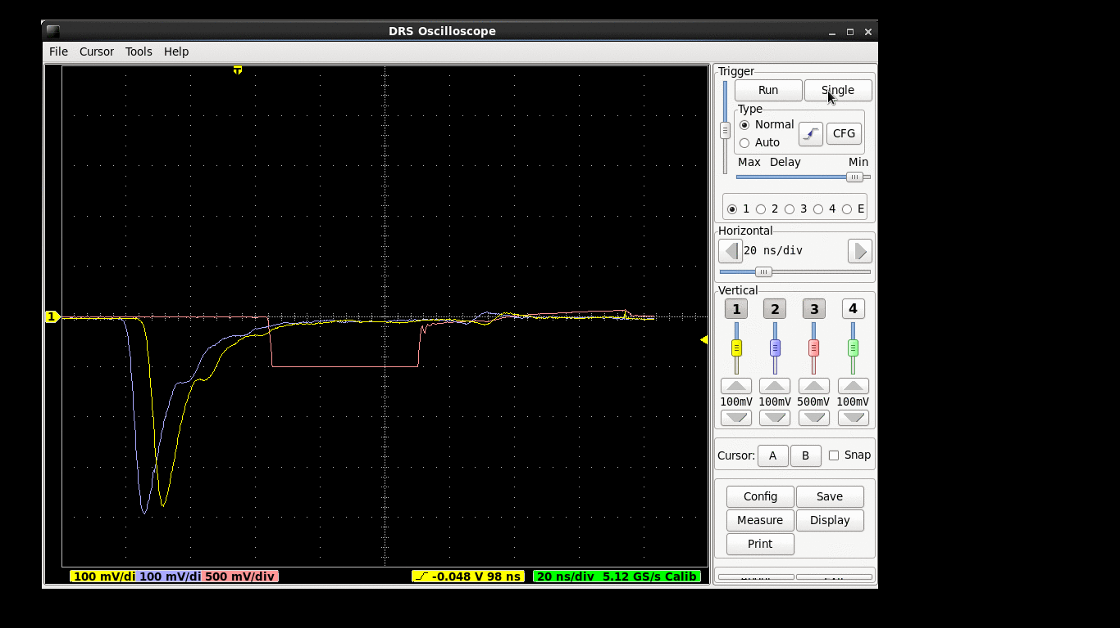
Too Late!
This is a screenshot where we see that
our gate would be too late for a “classic”
ADC

Slide 48

So what can you do?
Scintillator Paddle with PMT
CFD
Actual
Detector
you want
to test
Coincidence unit
In the 80's, we sent all signals through a long
cables (WA98 – 108 m) so the signals would
arrive only after the trigger decision has been
made
Expensive and ultimately limited – 600Km cables
To remember: RG58 and RG174 cables have
a speed of 5ns/m
108m → 540 ns trigger signals 30m,
subtract 150ns
CFD
Cosmics

Slide 49
Electronic delays instead
Here's what we concluded.
Move all analog electronics (ADCs, TDCs, etc) to the detector.
Those front-end modules (FEM) have some analog storage which allows to keep the data from a certain number of crossings (e.g.% 64)
When the trigger decision finally arrives, we go back a number of storage cells, digitize the signal in there, and transmit the number. Delay problem solved.
Crossing Nr -->
Storage cells
Trigger
decision is
ready
Signal
trigger latency
time
At each bunch crossing, store the signal in the next “memory” location. When the trigger decision is made, get the stored value that corresponds to that crossing

Slide 50

Pipelines
Volkswagen assembly line.
It takes about 18 hours for a given car to be assembled.
If VW would let just one car through at a given time, they would produce 1.3 cars /day
Of course they can put the next chassis on the line as soon as the first station clears
Each time a car is done at a station, the next car can move forward
So they assemble about 280 cars/day
→ Pipelined assembly

Slide 51
Types of Pipelines - CMS

Slide 52
Higher-Level Triggers
ATLAS
ATLAS: 3 physical levels
CMS: 2 physical levels
CMS
40MHz
Detectors
40MHz
Detectors
Lvl-1
Front end pipelines
Lvl-1
Front end pipelines
100KHz
Lvl-2
Readout buffers
100KHz
Readout buffers
1KHz
Switching network
Switching network
Lvl-3
Processor farms
HLT
Processor farms
100Hz
100Hz
Atlas has 3 levels with “Regions of Interest”
CMS has only 2 levels.
CMS’ Switching Network needs to perform at much higher throughput (1000 GB/s vs 1/100 of that for 3 levels)
But the processor farm has the full view of all L1 events

Slide 53
PHENIX DAQ Event builder
Event Builder
Buffer Box
FEM
DCM
SEB
10Gigabit
Crossbar
Switch
ATP
Buffer Box
FEM
Partition
Mod.
ATP
SEB
FEM
DCM
SEB
ATP
Buffer Box
FEM
SEB
ATP
FEM
DCM
SEB
ATP
Buffer Box
To
Tape
FEM
Partition
Mod.
SEB
ATP
FEM
DCM
SEB
ATP
Buffer Box
FEM
SEB
ATP
FEM
DCM
SEB
ATP
Buffer Box
FEM
SEB
ATP
Buffer Box
Front-End Module
Digitizes data
Partition Module and Sub-Event Buffer
Combines data from several DCMs
Assembly and Trigger Processor
Builds full events
Buffer Box
Buffers data O(40h) - steady data stream for the tape robot
Data Collection Module
Zero-Suppression, packaging

Slide 54





PHENIX DAQ
Event Builder
Buffer Box
FEM
DCM
SEB
10Gigabit
Crossbar
Switch
ATP
Buffer Box
FEM
Partition
Mod.
ATP
SEB
FEM
DCM
SEB
ATP
Buffer Box
FEM
SEB
ATP
FEM
DCM
SEB
ATP
Buffer Box
To
Tape
FEM
Partition
Mod.
SEB
ATP
FEM
DCM
SEB
ATP
Buffer Box
FEM
SEB
ATP
FEM
DCM
SEB
ATP
Buffer Box
FEM
SEB
ATP
Buffer Box

Slide 55

Multi-Event Buffering aka pipelining
Without MEB
PHENIX is a rare-event experiment, after all -- you don’t want to go down this path

Slide 56
MEB: trigger delays by analog Memory
trigger electronics needs to buy some time to make its decision
done by storing the signal charge in an analog memory (AMU)‏
Memory keeps the state of some 40us worth of bunch crossings
Trigger decision arrives. FEM goes back a given number of analog memory cells and digitizes the contents of that memory location
Multi-Event buffering means to start the AMU sampling again while the current sample is still being digitized.
Trigger busy released much earlier
deadtime greatly reduced
time

Slide 57



The Multi-Event Buffering Effect

Slide 58

FPGAs, FPGAs, and Networks
I believe that the typical physicist will be able to program FPGAs and know VHDL just like we all know C++ these days
We already see FPGAs enter the commodity HPC market (driven by $$$ or course)
That, and networks will drive most DAQs
We already see this in the (F)VTX readout – the entire front-end is FPGAs
A well-designed board can be used for an astonishing variety of things.
DCM2 + Partitioner 2

Slide 59
Controls
At some point, you need to add controls (usually called slow controls) to your setup.
Control the data taking
Control and configure the front-end
Set High Voltages, bias voltages, magnetic fields, etc
If you are a BIG experiment (think LHC), there's a comprehensive solution
If you rig up something smaller, you are typically on your own
Also think of the need to log all such data

Slide 60
Communication methods
If you work for an LHC experiment, this is all taken care of for you.
If not, well, some pointers.
These are some methods to communicate between processes on a machine
Shared
Memory
Named
Semaphores
Remote
Prodecure
Calls
CORBA
These work only on the same machine
(yes, there are add-ons to get around
that, but it's a bit of a kludge)
Few people use shared memory any more.
These work in a network-transparent fashion
If I want, I can control my DAQ at BNL from here

Slide 61
RPC
Remote Procedure Call
Widely established standard (RFC 1831) for remote execution of code controlled by a client
Makes it look like a local function call, but the function executes on a server
The ubiquitous NFS is based on RPC, it is available virtually everywhere
It is a network protocol, so client and server don't have to be on the same machine, can have DAQ and control machine in different rooms (or as far apart as you like as long as the connection traverses the firewalls)
Very robust and easy, and an open standard built into virtually any OS
Linux, Android, Windows, …. works on any Linux flavor, for example the Raspberry PI

Slide 62
CORBA
Attempt to take a C-style remote procedure call (like a function call) to calling methods on a remote object
Fundamentally a good idea, but in many cases overkill and really complicated to implement
Not very widespread availability
No good “vendor” (it's usually open source, but different implementations) interoperability (supposed to be, but not so)
I'm using RPCs unless there's a good reason not to.
My first choice.

Slide 63
Log. Log. And log some more
Everyone has used a paper logbook. In this day and age, this is not an adequate solution anymore.
I'm talking about “environmental” data logging here, the logging of “slow controls” data
I will use a DAQ of mine as an example, but this goes for all setups.

Slide 64
Logging data about the data
“reading out your detector” does not yet make a data acquisition
It lives and dies by its ability to capture... well, everything
What was the HV? Was the light on? What was the temperature?
In many cases, it's there only for forensics in case there's something wrong
Was the HV where it was supposed to be?
Often, you need to get parameters which in the old days you had to type in from a paper logbook
You could add a webcam picture so we have a visual confirmation of things (say, you want to move the detector with step motors)
When you log these things automatically, no one can forget to do it.

Slide 65
Metadata Example
“It appears that the distributions changes for Cherenkov counter 1 at 1,8,12,and 16 GeV compared to the other energies. It seems that the pressure is changed. […] Any help on understanding this would be appreciated.”
Martin: “Look at the info in the file!”
$ ddump -t 9 -p 910 beam_00002298-0000.prdf
S:MTNRG = -1 GeV
F:MT6SC1 = 5790 Cnts
F:MT6SC2 = 3533 Cnts
F:MT6SC3 = 1780 Cnts
F:MT6SC4 = 0 Cnts
F:MT6SC5 = 73316 Cnts
E:2CH = 1058 mm
E:2CV = 133.1 mm
E:2CMT6T = 73.84 F
E:2CMT6H = 32.86 %Hum
F:MT5CP2 = .4589 Psia
F:MT6CP2 = .6794 Psia
$ ddump -t 9 -p 910 beam_00002268-0000.prdf
S:MTNRG = -2 GeV
F:MT6SC1 = 11846 Cnts
F:MT6SC2 = 7069 Cnts
F:MT6SC3 = 3883 Cnts
F:MT6SC4 = 0 Cnts
F:MT6SC5 = 283048 Cnts
E:2CH = 1058 mm
E:2CV = 133 mm
E:2CMT6T = 74.13 F
E:2CMT6H = 37.26 %Hum
F:MT5CP2 = 12.95 Psia
F:MT6CP2 = 14.03 Psia

Slide 66


A picture tells more that 1000 words
Was XXXx's contraption in the beam in run 2743? There is a higher fraction of showering than before.”
Martin: “Look at the cam pictures we automatically captured for each run.”

Slide 67
Summary
The End

