Slide 1
Overview of school
Christian Bohm
University of Stockholm, Sweden

Slide 2
Overview of school
15 Instrumentation lectures

Slide 3
Overview of school
4 Lectures introducing the exercises

Slide 4
Overview of school
FPGA workshop
  Masaharu Nomachi
  Zhen-An Lui
Maximum ~20 persons
  A

Slide 5
Overview of school
Control using modern Web technologies
  Stefan Ritt
Raspberry Pi/RCDAQ
  Martin Purschke

Slide 6
Overview of school
Waveform capture
  Stefan Ritt
HV-control
  Masaharu Nomashi
  Martin Purschke
TimePix
  Michael Holik
  Vladimir Vicha
EasyPet
  Martin Grossmann

Slide 7
Overview of school
Women In Engineering
An event devoted discussions about mentoring, networking and professional development of women in Science, Technology, Engineering and Mathematics (STEM)

Slide 8
Overview of school
Two Parties:
Welcome Party
Main Party

Slide 9
Overview of school
Student presentations
8 groups
Agree on which of the 6 exercises to report on
Jointly develop the presentation
Elect one presenter

Slide 10
Overview of school
Distribution of certificates and rewards
Closing the school

Slide 11
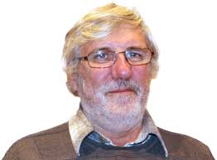
Overview of school
Lecturer:
Patrick Ledu,
IPN Lyon, France

Slide 12
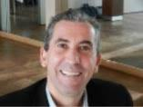
Overview of school
Lecturer:
Abdallah Lyoussi, CEA Cadarache, France

Slide 13
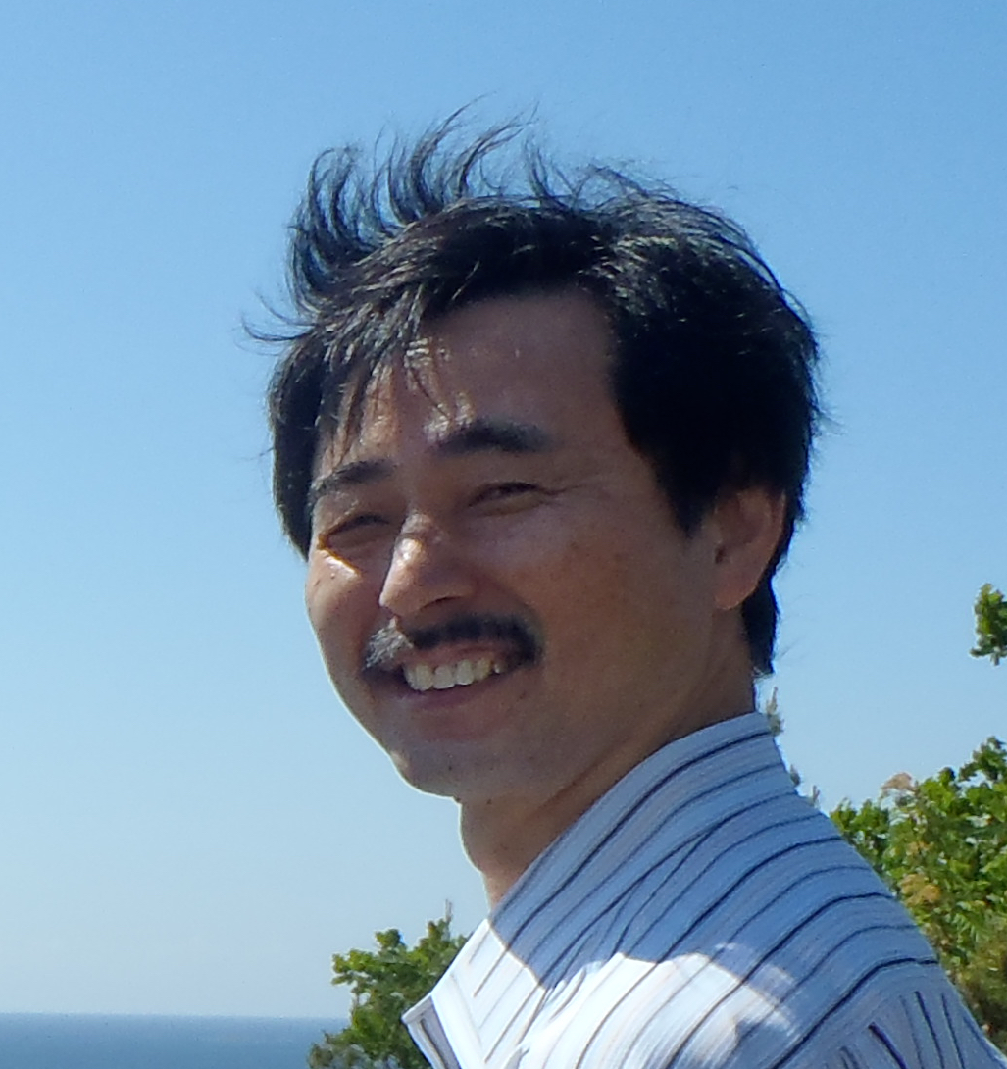
Overview of school
Lecturer:
Masaharu Nomachi, Osaka University, Japan
FPGA workshop
HV-control

Slide 14
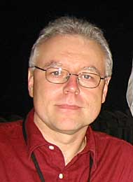
Overview of school
Lecturer:
Martin Purschke, BNL, USA
Raspberry Pi/RCDAQ
HV-control

Slide 15
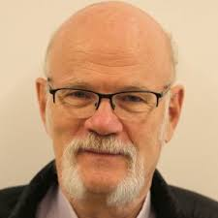
Overview of school
Lecturer:
Christian Bohm, Stockholm University, Sweden

Slide 16
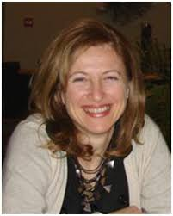
Overview of school
Lecturer:
Cinzia Da Via, Manchester University, UK
Women In Engineering

Slide 17
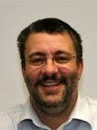
Overview of school
Lecturer:
Stefan Ritt, PSI, Switzerland
Control using modern Web technologies
Waveform capture

Slide 18
Overview of school
Lecturer:
Michael Holik, IEAP CTU, Czech Republic
and
Vladimir Vicha, IEAP CTU, Czech Republic
TimePix

Slide 19
Overview of school
Lecturer:
Zhen-An Liu, HEP, China
FPGA workshop

Slide 20
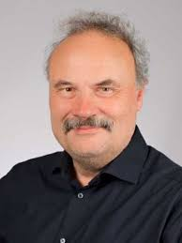
Overview of school
Lecturer:
Martin Grossmann, PSI, Switzerland
EasyPET

Slide 21
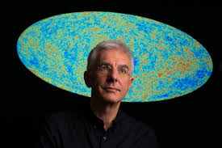
Overview of school
Lecturer:
Colafrancesco Sergio, Wits University, SA

