Slide 1
A warm welcome from IEEE Nuclear and Plasma Sciences Society (NPSS)
Stefan Ritt
Cape Town, July 2018

Slide 2
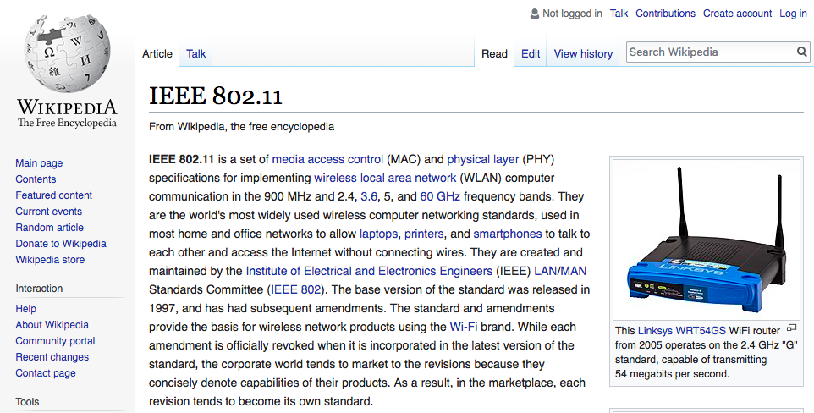

Slide 3
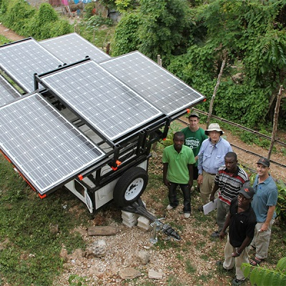
What is IEEE
Advancing Technology to the Benefit of Humanity
Non-profit organization
IEEE is the world’s largest technical professional organization (> 400’000 members, >120’000 student members) dedicated to advancing technology for the benefit of humanity.
Founded in US, now a global organization (more members outside the US than inside)
Responsible for 1’300+ standards (such as WiFi)
Host of 4M journal papers (https://ieeexplore.ieee.org/)
Sponsor of 1800+ conferences per year in 98 coutries
2000+ chapters, 3000+ student branches
Sponsor of humanitarian projects (IEEE Smart Village)
Sponsor of schools, Distinguished Lecturers Program, ...

Slide 4
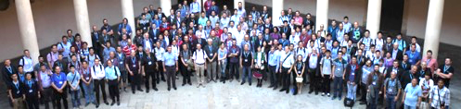

IEEE Organizational Governance
M E M B E R S
Board of Directors (BoD)
Assembly
MGA
TAB
PSPB
EAB
SA
IEEE-USA
ED
Member and Geographic Activities
Board
Technical Activities Board
Publication Services and Products Board
Educational Activities Board
Standards Association
IEEE USA
Executive Director
10 Regions
10 Divisions
We are here!
Staff &
Society Executive Directors/
Administrators
Sections & Geographic Councils
Societies & Technical Councils
Chapters
Chapters & Student branches are here!

Slide 5
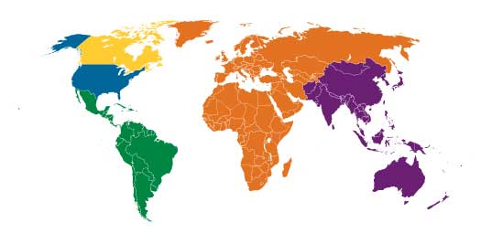
IEEE Membership By Region
436,000 members
as of 31 Dec. 2017
46 societies/councils
1600 conferences
R7
R9
R10
R1 to 6
R8
Membership by Region

Slide 6
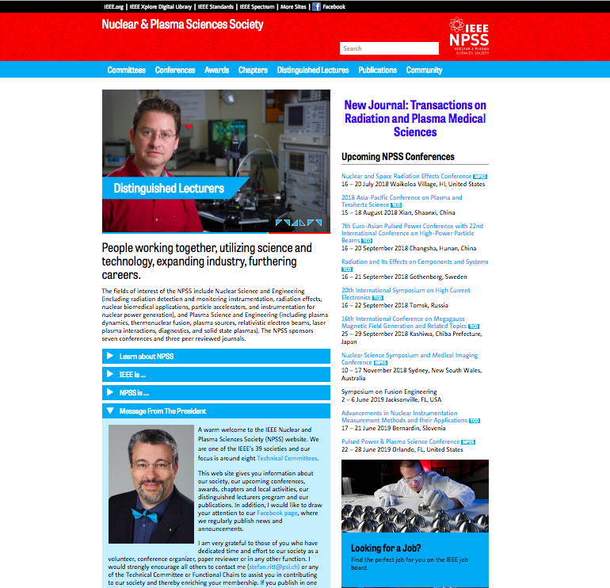
IEEE Nuclear and Plasma Society
Who are we?
One of 39 IEEE societies
Website: http://ieee-npss.org
Facebook: https://www.facebook.com/ieeenpss/
2500-3000 members in 19 countries
8 Technical communities

Slide 7
NPSS Technical Committees (TC)
The breadth of NPSS
Computer Applications in Nuclear and Plasma Sciences (CANPS)
Fusion Technology Committee (FTC)
Nuclear Medical Imaging Sciences Committee (NMISC)
Particle Accelerator Science and Technology (PAST)
Plasma Science and Applications Committee (PSAC)
Pulsed Power Science and Technology (PPST)
Radiation Effects Committee (REC)
Radiation Instrumentation Technical Committee (RITC)
NPSS Journals
IEEE Transactions on Nuclear Science
IEEE Transactions on Plasma Science
IEEE Transactions on Medical Imaging
IEEE Transactions on Radiation and Plasma Medical Sciences

Slide 8
NPSS benefits for members
IEEE NPSS Distinguished Lecture Program supports chapters and student branches
IEEE/NPSS Members receive (partial list):
    Significant discounts on registration rates for NPSS Conferences
    Electronic access to NPSS Journals and Conference Records via Xplore
    Reduced rates on print subscriptions to NPSS publications
    Subscriptions to the monthly magazine SPECTRUM and The Institute, a monthly news supplement
    Low rates on IEEE's many publications, discounted insurance rates …
    NPSS Newsletter published four times per year

Slide 9
Why become IEEE member?
Students: US$ 35 / year, full membership: US$ 163 / year
Full members from South Africa can obtain a 50% fee reduction (US$ 82 / year)
Networking is extremely helpful especially in the early stage of your career
  Job opening database
  Women in Engieering events
  Collabratec (Facebook for engineers)
  DataPort (Cloud storag for scientific data)
  Become a voluteer (help reviewing papers, help running conferences, ...)
Stay technical up-to-date (journals, conferences, online courses, …)
Need 12 members to form a chapter or 6 student members to form a student branch

Slide 10
