Slide 1
Raspberry Pi “Sensor” package
This is a small 20x30mm² hand-made board
it has a temperature readout
It has a header for an infrared receiver that allows to control things with a remote
It has two LEDs that can be turned on and off through GPIO pins

Slide 2
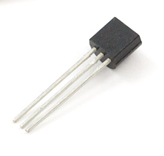
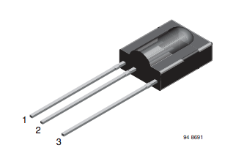
Sensor Input
The Pi has software out of the box to read out one-wire “Dallas” protocol sensors
We use it to read DS18B20 digital thermometers (by default on GPIO pin 4)
We read a TSOP 312 infrared receiver (on GPIO pin 17 – default input)
There two LEDs using GPIO pins 23
and 24
DS18B20
TSOP 312
Please distinguish between GPIO pin numbers (on the chip -> function) and the pin number on the header. E.g. GPIO pin 4 is pin 7 on the header.

Slide 3
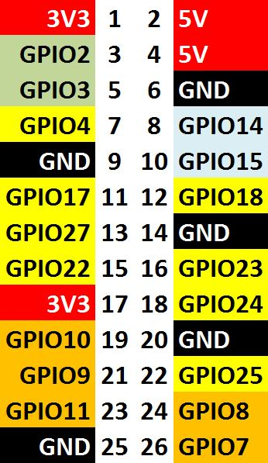
Connections
One-wire input (temperature)
Infrared input
LED 1 Output
LED 2 Output

Slide 4
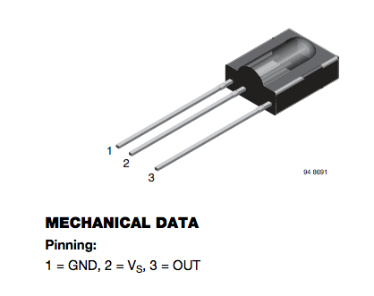
Infrared Circuit
Ground Pin 9
GPIO pin 17 / Pin 11
3.3V Pin 17

Slide 5

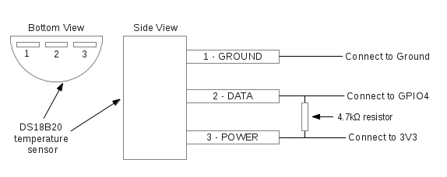
Temperature Circuit
3.3K Resistor between 3.3V and output
DS18B20
Ground Pin 9
3.3V Pin 17
GPIO pin 4 / Pin 7
3.3K

Slide 6

LED 1 and 2
3.3V Pin 17
echo 23 > /sys/class/gpio/export
echo out > /sys/class/gpio/gpio23/direction
echo 1 > /sys/class/gpio/gpio23/value #turn on
echo 0 > /sys/class/gpio/gpio23/value # turn 0ff
GPIO pin 23
/ Pin 16
GPIO pin 24
/ Pin 18

Slide 7
Software
Edit /boot/config.txt and add
dtoverlay=w1-gpio
dtoverlay=lirc-rpi,gpio_in_pin=17,gpio_in_pull=high,gpio_out_pin=18
Then reboot

Slide 8
Software (DS18B20)
Each DS18B20 sensor has a unique and unchangeable 64bit serial number assigned by the manufacturer.
It shows up as
/sys/devices/w1_bus_master1/28-xxxxxxxxxxxxxx/
where 28- is the device type and xxxxxxxxxx is the serial number
# cat /sys/devices/w1_bus_master1/28-0000065e5516/w1_slave
31 01 4b 46 7f ff 0f 10 1f : crc=1f YES
31 01 4b 46 7f ff 0f 10 1f t=19062
This is the temperature in “milli-Centigrade”
( e.g. 19062 deg. C = 66.31 F)
# grep t= /sys/devices/w1_bus_master1/28-0000065e5516/w1_slave | awk -F= '{print $NF}’
19062

Slide 9
One more shell command
# cat /sys/devices/w1_bus_master1/28-0000065e5516/w1_slave
31 01 4b 46 7f ff 0f 10 1f : crc=1f YES
31 01 4b 46 7f ff 0f 10 1f t=19062
grep t= /sys/devices/w1_bus_master1/28-0000065e5516/w1_slave | awk -F= '{print $NF}’

Slide 10
Software (Infrared)
apt-get install lirc (Linux Infrared Controller)
Edit /etc/lirc/hardware.conf to read
#Try to load appropriate kernel modules
LOAD_MODULES=false
# Run "lircd --driver=help" for a list of supported drivers.
DRIVER=""
# usually /dev/lirc0 is the correct setting for systems using udev
DEVICE="/dev/lirc0"
“mode2” refers to the infrared protocol which is virtually always used
mode2 –d /dev/lirc0
Will show you raw pulses from the transmitter
The “Lirc Daemon” lircd interprets the pulses and can issue commands and trigger actions

