Slide 1

A quick introduction to networks
Martin L. Purschke

Slide 2
What you should learn
Understand an IPv4 address
See how networks packets travel
Understand a netmask and a broadcast address
What a gateway is
What is a nameserver?
What is a time (ntp) server
What a protocol is, and the difference between “network” and “protocol”

Slide 3
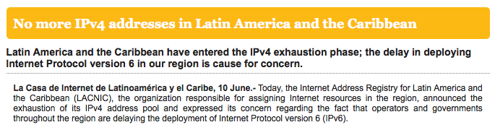
IPv4 and IPv6
IPv4 network was designed in the 1970’s
4 billion ( 4*1024*1024*1024) possible addresses
That seemed a ridiculously large number at the time (a computer cost millions of dollars)
(Other networks, e.g. DECNet, had only 65536 ( 256*256) addresses)
Today, where everyone uses multiple IP addresses (laptop, iPad, smartphone), we are running out of IPv4 addresses quickly
Also, the address space is very inefficiently used
For example my institution: has 65536 addresses 15500 in use

Slide 4
IPv6
IPv6 network protocol was des
18446744073709551616 possible addresses (“one for each sandcorn at the beaches”)
The roll-out for the new IPv6 has been very slow
It is a new technology, one needs to learn
Cyber security tools (network scanners, firewalls, etc) need development
It takes a lot of infrastructure upgrades to go to IPv6 – switches, routers, manpower
Brookhaven Lab: estimated $8million
You will almost always still get a IPv4 address today.

Slide 5
IPv4
The Address you get is a 32bit number
Usually written as the “4-dot” notation
Eg. 192.168.2.13 (is what my Laptop has now)
Each network has a netmask and a broadcast address
inet 192.168.2.13 netmask 0xffffff00 broadcast 192.168.2.255
The broadcast and the netwmask define the ”Subnet”

Slide 6
An IPv4 subnet
Bit-wise and:
1 0 0 1 0 0 1 1
&
0 0 0 1 1 1 1 1
=
0 0 0 1 1 0 1 1
A subnet is the collection of all addresses which can be reached “directly”
Subnet = all addresses where this is true:
Address & broadcast== broadcast
192 . 168. 2. 13
C 0 . A 8 . 0 2 . 0 D
1100 0000 1010 1000 0000 0010 0000 1101
&
1100 0000 1010 1000 0000 0010 1111 1111
=
1100 0000 1010 1000 0000 0010 0000 1101 = 192.168.2.13 ✔
Eg. 192.168.2.13 (is what my Laptop has now)
Each network has a netmask and a broadcast address
inet 192.168.2.13 netmask 0xffffff00 broadcast 192.168.2.255
Netmask = 0xff ff ff ff 00 = 255.255.255.0 what does that mean?
It defines the ”Subnet”
Bit-wise “and”
That means that ALL addresses which start with 192.168.2 fullfill that requirement
192.168.2.78
192.168.2.199 -> 256 Addresses

Slide 7
Netmask and broadcast
Bit-wise “or”
Bit-wise “xor”
Bit-wise xor:
(“1 when they are
different”)
1 ^ 1 = 0
0 ^ 0 = 0
1 ^ 0 = 1
0 ^ 1 = 1
broadcast = address | ( netmask ^ 0xffffffff )
1111 1111 1111 1111 1111 1111 0000 0000
^
1111 1111 1111 1111 1111 1111 1111 1111
=>
0000 0000 0000 0000 0000 0000 1111 1111
|
1100 0000 1010 1000 0000 0010 0000 1101
=>
1100 0000 1010 1000 0000 0010 1111 1111 = 192.168.2.255

Slide 8
Netmask notation
netmask 0xffffff00 --- how many “leading one’s?”
1111 1111 1111 1111 1111 1111 0000 0000
This is called a “/24” network
so you can say much shorter:
I am on a 192.168.2.0/24 network

Slide 9
What happens if I add one more “0” to my netmask? /23?
The broadcast gets “one more 1” 192.168.2.255 -> 192.168.3.255
Address & broadcast== broadcast
192 . 168. 2. 13
C 0 . A 8 . 0 2 . 0 D
1100 0000 1010 1000 0000 0010 0000 1101
&
1100 0000 1010 1000 0000 0011 1111 1111
=
1100 0000 1010 1000 0000 0010 0000 1101 = 192.168.2.13 ✔
Now I have doubled the size of my subnet!
Now everything that starts with 192.168.2 is in the subnet as before
But now also all addresses 192.168.3.X
➔ 512 addresses

Slide 10
Gateways
You can reach everything that is on the same subnet directly
So everything that starts with 192.168.2.X we can get to directly
But what is with www.bnl.gov (130.199.3.21)
For that you go through a gateway
$ netstat -rn
Routing tables
Internet:
Destination Gateway Flags Refs Use Netif Expire
default 192.168.2.1 UGSc 30 0 en1

Slide 11
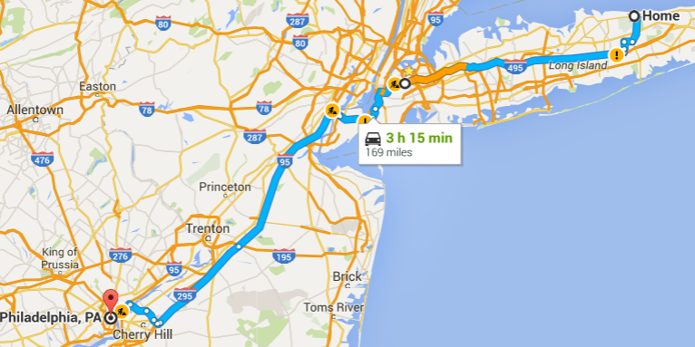
How network packets travel
If you are a car driver and want to go from one place to another, you usually have some idea how to get to your destination.
When I drive from my home to Philadelphia, I know how to get there.
This is not how a network packet travels!
From my house
-> LIE (Lonhg Island Expressway)
->278W
->I95S
->NJ Turnpike
->Exit 4 Camden
->Bridge
->Philadelphia

Slide 12
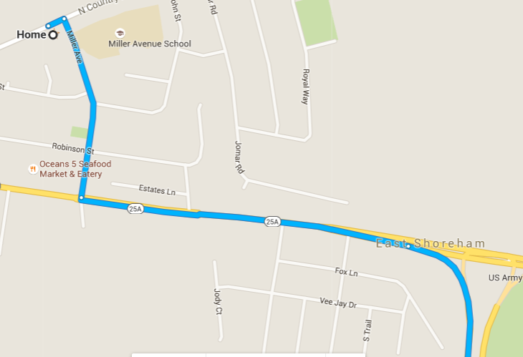
How network packets travel
The network packet has NO IDEA how to get to Philadelphia
At every turn there is “someone” standing saying
“Philadelphia? Make a right”. “Make a left”. And so on
Two packets to the same destination
do not need to take the same path!

Slide 13
Going from Vietnam -> www.bnl.gov
But what is with www.bnl.gov (130.199.3.21)
Traceroute will show you the path
$ traceroute www.bnl.gov
traceroute to cache3.bnl.gov (130.199.3.21), 64 hops max, 52 byte packets
1 vigor.router (192.168.2.1) 1.291 ms 0.752 ms 1.758 ms
2 192.168.93.253 (192.168.93.253) 21.509 ms 9.787 ms 7.499 ms
3 123.21.240.1 (123.21.240.1) 17.003 ms 21.830 ms 19.799 ms
4 172.17.32.66 (172.17.32.66) 11.929 ms 6.681 ms 3.333 ms
5 localhost (113.171.17.121) 2.688 ms 3.019 ms
localhost (113.171.31.105) 14.617 ms
6 * * *
7 localhost (113.171.14.130) 10.099 ms
vdc.vn (123.29.10.238) 9.953 ms
localhost (113.171.14.62) 7.262 ms
8 203.131.252.21 (203.131.252.21) 31.731 ms 29.689 ms 49.016 ms
9 ae-9.r22.tkokhk01.hk.bb.gin.ntt.net (129.250.2.122) 169.338 ms 31.765 ms 36.917 ms
10 ae-16.r30.tokyjp05.jp.bb.gin.ntt.net (129.250.5.133) 81.544 ms 83.560 ms 92.222 ms
11 ae-4.r23.snjsca04.us.bb.gin.ntt.net (129.250.5.78) 176.699 ms 173.570 ms 173.948 ms
12 ae-41.r02.snjsca04.us.bb.gin.ntt.net (129.250.6.119) 183.971 ms 179.105 ms 185.893 ms
13 eqx-sj.es.net (206.223.116.137) 194.576 ms 201.395 ms 193.408 ms

