Slide 1

A quick introduction to shell basics
Martin L. Purschke

Slide 2
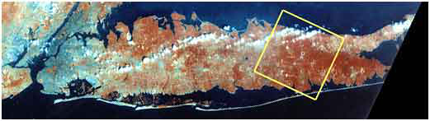
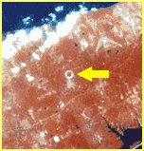
About me
Studied nuclear physics at the University of Muenster, Germany
WA80 - WA93 – WA98 Experiments at CERN
Graduated in 1990
Spent 11 years at CERN with the SPS Heavy-Ion Program until it ended in 1996
Moved to Brookhaven National Laboratory to work with the Relativistic Heavy Ion Collider
Am the DAQ coordinator for the PHENIX Experiment
Manhattan
Long Island, NY
RHIC from space

Slide 3
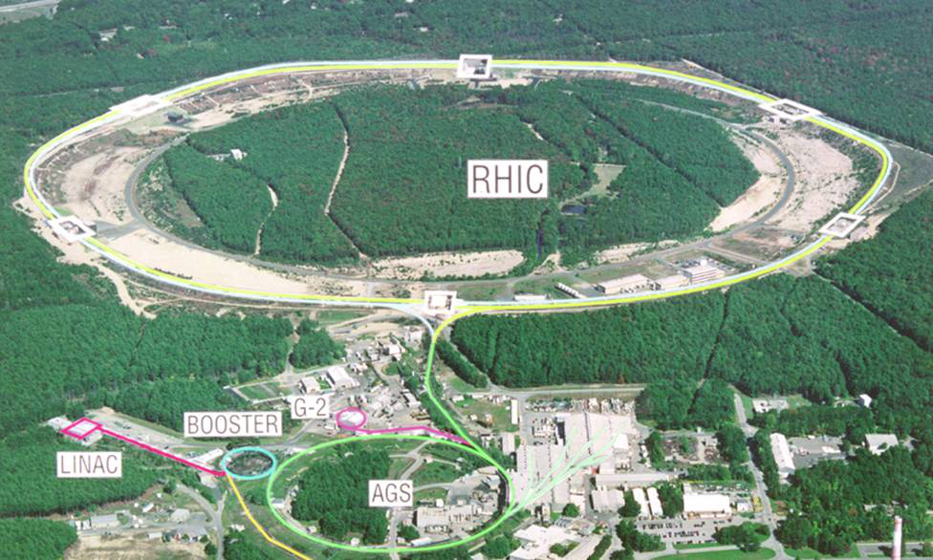
RHIC and PHENIX
The Relativistic Heavy Ion Collider
Huge variety of ions possible - Au, Cu, ³He so far, but pretty much anything is possible
Polarized protons – a unique facility
500GeV/proton -> 200GeV/N for Au
Dedicated HI and p facility
PHENIX – high-rate heavy-ion experiment
Electromagnetic probes - Photons, electrons, muons
Heavy quarks & quarkonia

Slide 4
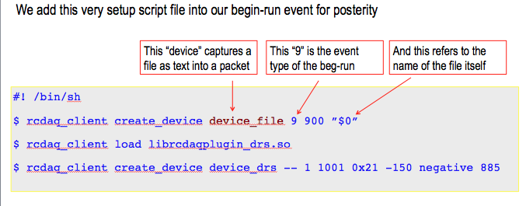
Yesterday in my RCDAQ presentation I showed this
… and some of you were confused.
Today I will show a few things about the shell that will make you life easier
In general and also during the exercises!

Slide 5
Why you need to know the shell.
You usually spend a lot of time using the shell
If not so far, then you will during the exercises
The shell is the “face” of any Unix system, all attempts to make it like Windows aside
You can do magic with a few lines of script that would take hours otherwise
You can automate complex tasks with ease
You can even automate your job to a large extent
Let me show you in a few minutes.

Slide 6
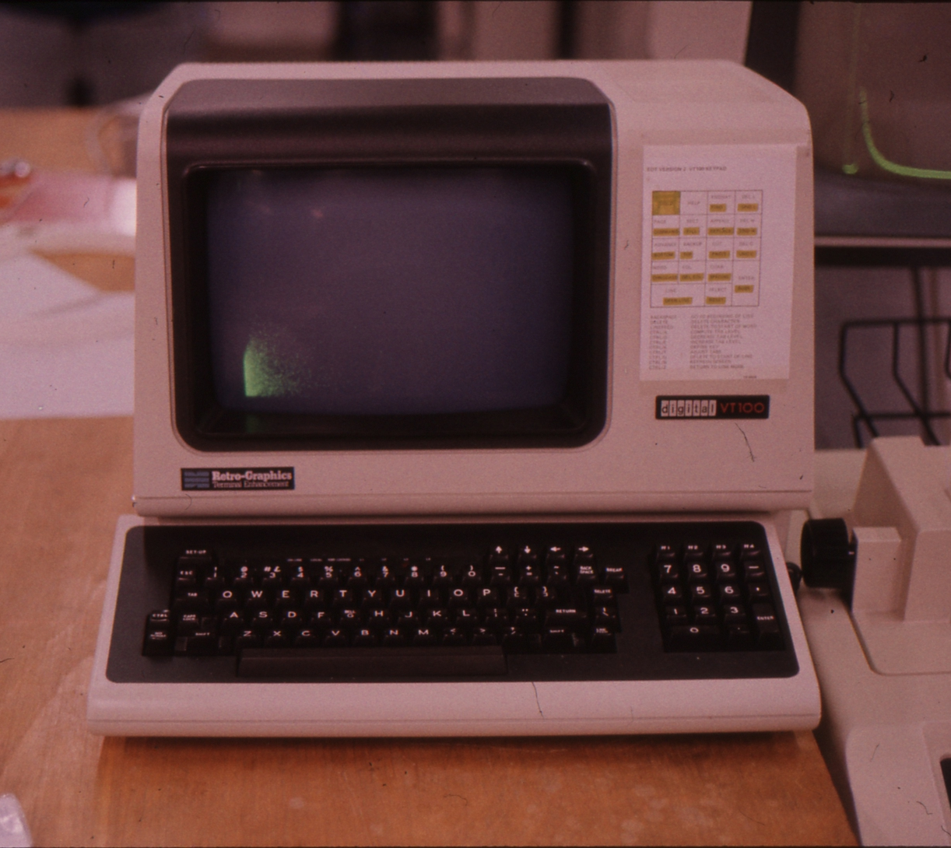
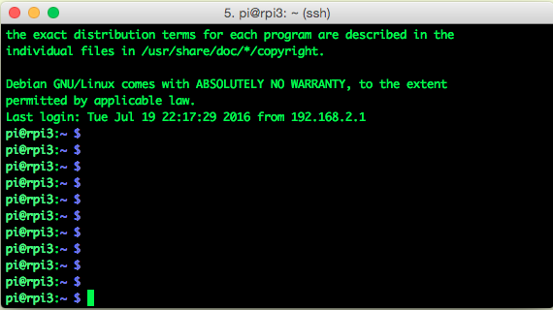
What the shell looks like
Normally you see a shell within a terminal window
In my younger days, a terminal was a big piece of hardware
Prompt Cursor (and here you can type things)

Slide 7
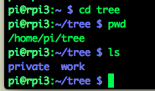

Directories and files
Directories == known as “folders” on other operating systems
We call them directories, sometimes also call “path”
Just a way to organize your work
Like “private” and “work”
Use cd to navigate directories (“change directory”)
Use pwd to show where you are (“print work directory”)

Slide 8

Directories and files
Use pwd to show where you are (“print work directory”)
Most shell users picture the “pwd” as a physical place (“I am in the so-and-so directory”)
The current directory acts like it is prepended to a file path
I only typed “myfile”
The default directory acts as if it is prepended to the file name
myfile -> /home/pi/tree + myfile -> /home/pi/tree/myfile
It is an easy way to save a lot of typing
But you can still refer to the file by its full name /home/pi/tree/myfile

Slide 9


Commands Utilities Programs
On a Unix system, they all mean pretty much the same
For everything you do, you execute a new program that does what you tell the shell to do
All the shell does is to call up those programs based on what command you type
We have seen the pwd command – print work directory
We can use the which command to find out what happens
So if you type “pwd”, the shell executes a program /bin/pwd that prints the current directory

Slide 10
Navigating
Imagine a data format where one bit error, or one error in some length field, in the data renders the entire file unreadable
Obviously not a good design – you will have such errors, corrupt tapes, recovered disk files, and you cannot allow to lose a significant portion of your statistics
Corrupt data is far more common than you think!
Data can be corrupted by the storage medium
Data structures can also be corrupt from the get-go by some bug in the DAQ
“Resilience in depth” – any corrupt entity must be able to be skipped, the remainder of the data recovered
You must also be able to account for what was lost
“You must be able to erroneously feed your mail file to your analysis. It shouldn’t find events, but it shouldn’t crash, either.”

Slide 11
A directory tree
./
“up”
“down”
work
private
contracts
customers
letters
pictures
2014
2015
2016
customer1
customer2
customer3
customer4
customer5
invoices
offers
invoices
offers

Slide 12
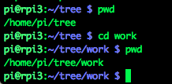
Navigating
We start out here
cd work
./
work

Slide 13
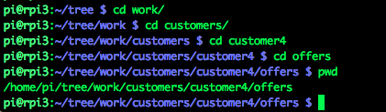

Navigating
We start out here
cd work
./
work
cd customers
private
contracts
customers
letters
pictures
cd customer4
2014
2015
2016
customer1
customer2
customer3
customer4
customer5
invoices
offers
invoices
offers
cd offers

Slide 14
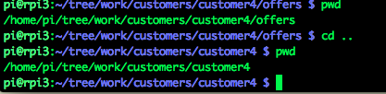
Navigating: . and ..
“.” is a shorthand for “here”
“..” is “one level up”
./
work
private
contracts
customers
letters
pictures
2014
2015
2016
customer1
customer2
customer3
customer4
customer5
invoices
offers
invoices
offers
You are here… and want to go here:
cd ..

Slide 15
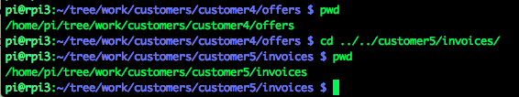
Navigating: combining “up” and “down”
./
work
private
contracts
customers
letters
pictures
2014
2015
2016
customer1
customer2
customer3
customer4
customer5
invoices
offers
invoices
offers
You are here… and want to go here:

Slide 16
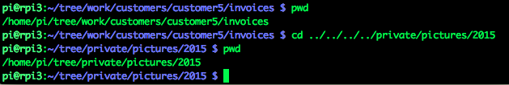
Navigating: combining “up” and “down”
./
You must think that this is really complicated, counting the number of “..” required. The shell makes this easy
work
private
contracts
customers
letters
pictures
2014
2015
2016
customer1
customer2
customer3
customer4
customer5
invoices
offers
invoices
offers
You are here… and want to go here:

Slide 17

The tab key is your best friend
When you type something, the tab key will expand this as
much as possible
It saves you tons of typing! And saves mistakes!
You will see seasoned shell users hit tab all the time
Let’s say you have a file called
Invoice_March27_2016_work_done_inFebruary_by_Martin_version7
Here I hit tab

Slide 18
ls –l
“ls” lists the files in a directory
ls –l adds more information “ls dash ell”
mlpmac:tree purschke$ ls
private work
mlpmac:tree purschke$ ls -l
total 0
drwxr-xr-x 3 purschke staff 102 Jul 17 22:49 private
drwxr-xr-x 5 purschke staff 170 Jul 17 23:24 work

Slide 19
Command options
Many commands have a large number of options that modify the behavior
As we have seen with ls –l
Commands can have “short” (one-letter) options and “long options”
For example ls –group-directories-first
Long options should start with two dashes, but many utilities don’t adhere to that

Slide 20
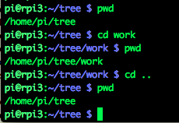

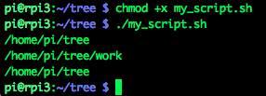
Scripts
We have so far executed each of our commands by typing it
Now I put those exact commands in a file, one line after the
other. I call this file my_script.sh
The file can have any name, but the .sh extension is a good
convention
Now I can execute those commands in one fell swoop:
pwd
cd work
pwd
cd ..
pwd
We add one more line
#! /bin/sh
pwd
cd work
pwd
cd ..
pwd

Slide 21
Some useful programs “wc” – “word count”
wc counts lines, words, and characters in a file
5 l;ines, 8 words, 41 characters
Just count the lines:
$ wc script.sh
5 8 41 script.sh
$ wc -l script.sh
5 script.sh

Slide 22
Pipes
Whatever one command “prints to the screen” can be “piped” to another program with the | symbol
So, how many files/directories do I have here? As many as I have lines:
This is a fantastically powerful concept
$ ls -l
total 26184
-rw-r--r--@ 1 purschke staff 12092605 Jul 17 21:11 RCDAQ.pptx
drwxr-xr-x 16 purschke staff 544 Jul 17 21:57 pictures
drwxr-xr-x 21 purschke staff 714 Jul 17 22:18 pictures2
-rwxr-xr-x 1 purschke staff 41 Jul 17 20:57 script.sh
-rwxr-xr-x 1 purschke staff 154 Jul 17 21:00 script2.sh
-rw-r--r-- 1 purschke staff 41 Jul 17 20:58 script2.sh~
-rw-r--r--@ 1 purschke staff 1297508 Jul 17 23:57 shell.pptx
drwxr-xr-x 4 purschke staff 136 Jul 18 00:13 tree
$ ls -l | wc -l
9

Slide 23
Some useful programs: “awk” – what does that even mean?
It is a utility named after the initials of the authors
It is a swiss army knife for text parsing.
My full desktop at BNL is called “mlp.rhic.bnl.gov”. What if I want just the “mlp” name?
Sum something per-line up:
$ hostname
mlp.rhic.bnl.gov
$hostname | awk -F. '{print $1}’
mlp
$ ls -l | awk '{sum+=$5} END {print sum}'
13391743

Slide 24
sort
We list our files sorted by file size ( numerically sort by the 5th column):
$ ls -l | sort -n -k 5
total 26184
-rw-r--r-- 1 purschke staff 41 Jul 17 20:58 script2.sh~
-rwxr-xr-x 1 purschke staff 41 Jul 17 20:57 script.sh
drwxr-xr-x 4 purschke staff 136 Jul 18 00:13 tree
-rwxr-xr-x 1 purschke staff 154 Jul 17 21:00 script2.sh
drwxr-xr-x 16 purschke staff 544 Jul 17 21:57 pictures
drwxr-xr-x 21 purschke staff 714 Jul 17 22:18 pictures2
-rw-r--r--@ 1 purschke staff 1297508 Jul 17 23:57 shell.pptx
-rw-r--r--@ 1 purschke staff 12092605 Jul 17 21:11 RCDAQ.pptx

Slide 25
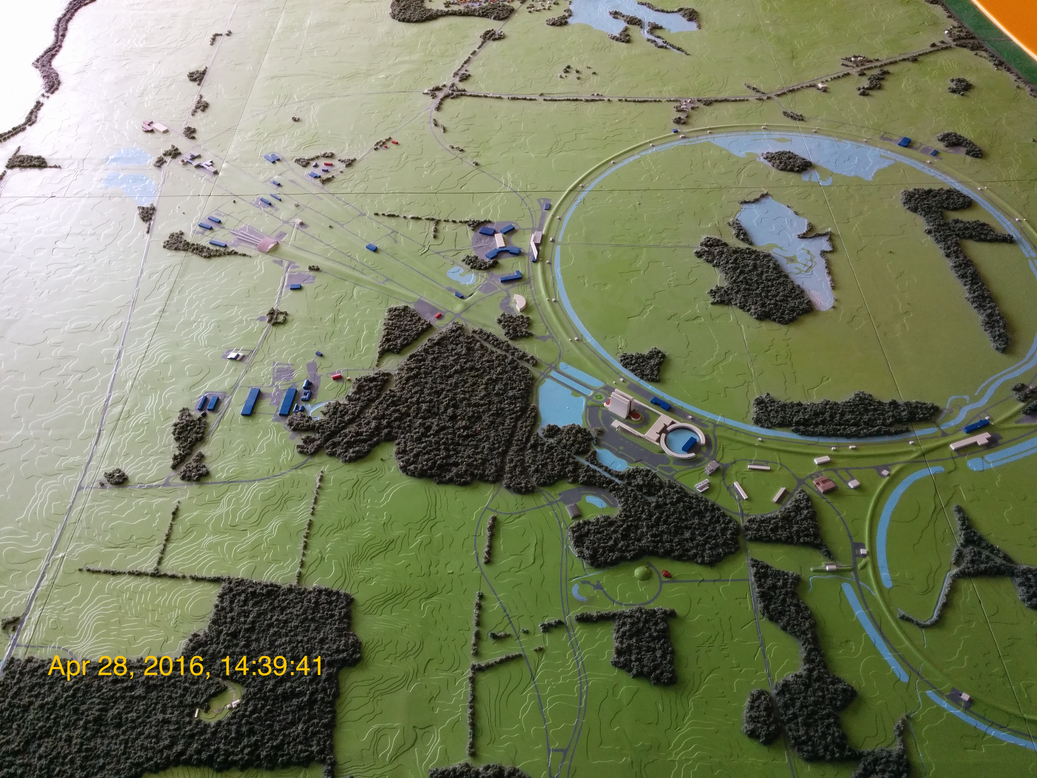
An Example: Catalog your vacation pictures
Let’s say you have 900 vacation pictures.
Now you want to add a date stamp to them so you can see when they were taken
If you do this manually, you will not see the end of it
If it takes you 1 minute per picture, you will be at it for 15 hours straight

Slide 26
Of course there are tools to do that…
Here is no shortage of tools to automate that.
Go through your pictures, and add a yellow time stamp on the left lower corner.
But wait! Maybe I want a red timestamp!
Maybe I want it on the right corner!
Maybe I want a different font!
Maybe I don’t want a time stamp at all, but something else
If your tool supports all those options, its interface is getting incredibly complicated
Bring in the shell
String together a set of tools which are excellent at one thing
They don’t need concern themselves with the other aspects of the task at hand

Slide 27
My timestamp script…
#! /bin/sh
for pic in *.jpg; do
D=$(exiftool -createdate $pic | awk '{print $4, $NF}')
mogrify -fill white -pointsize 64 -undercolor '#00000080' -annotate +200+2220 "$D" $pic
done

Slide 29
Navigating
./
work
private
contracts
customers
letters
pictures
2014
2015
2016
customer1
customer2
customer3
customer4
customer5
invoices
offers
invoices
offers

