Slide 1


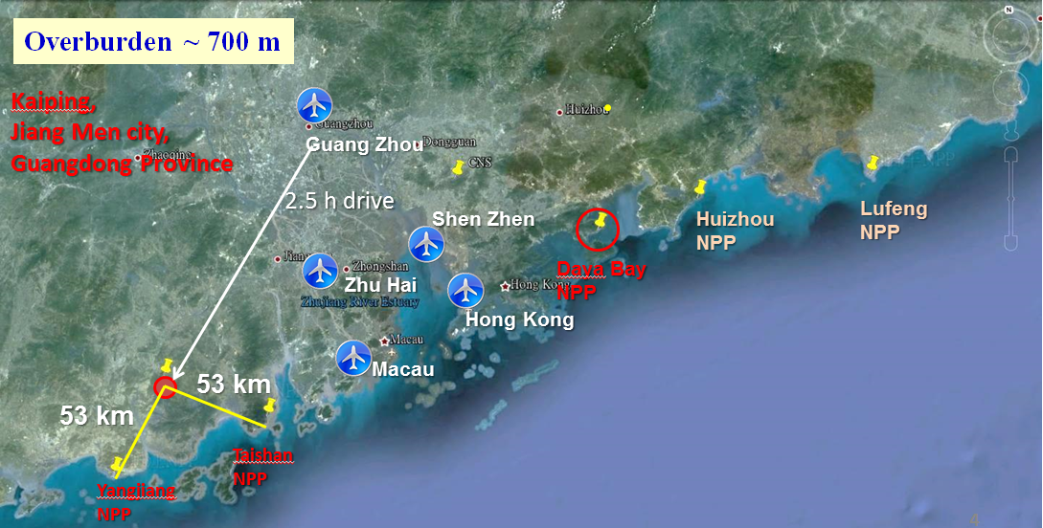
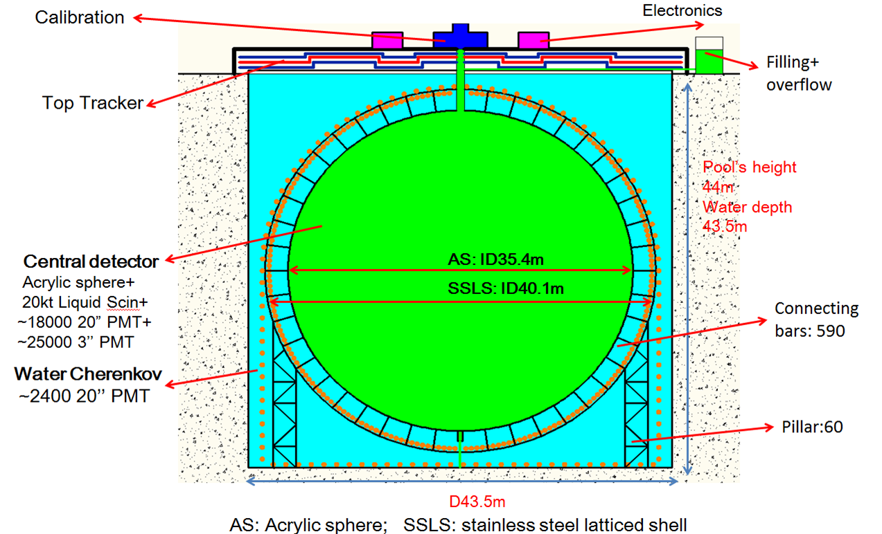
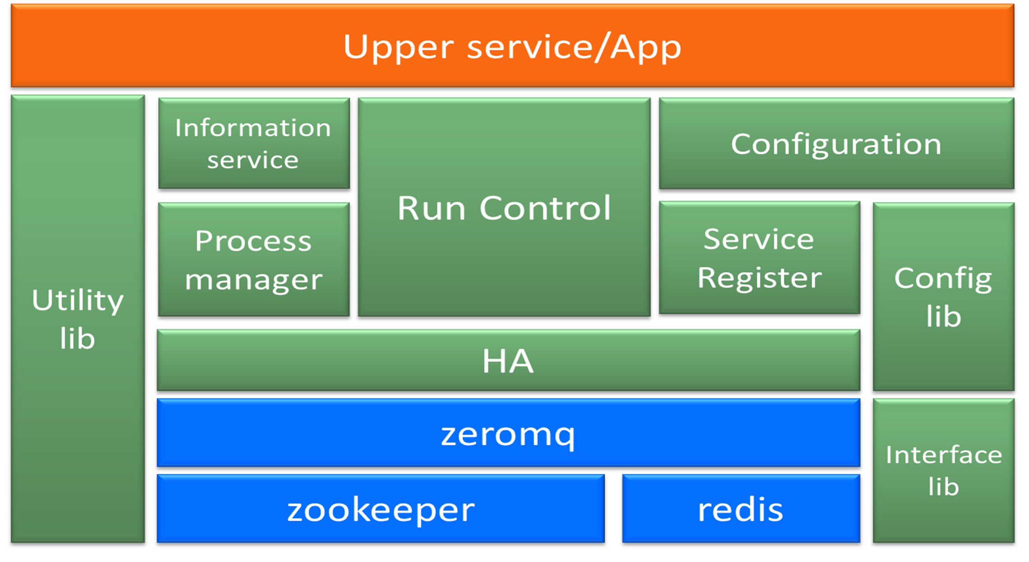




A SOA Based Design of JUNO DAQ
Online Software
On behalf of the JUNO collaboration
#431
JUNO：
The Jiangmen Underground Neutrino Observatory
Online Software：A distributed system including configuring, monitoring, controlling, multi-processes management, information sharing…
SOA :
Service Oriented Architecture
messages exchange
Technical tools:
Features:
1.Provides service for Dataflow or DCS
2.loosely-coupled and modular
3.Multi DAQs could run concurrently
4.High availability

Slide 2
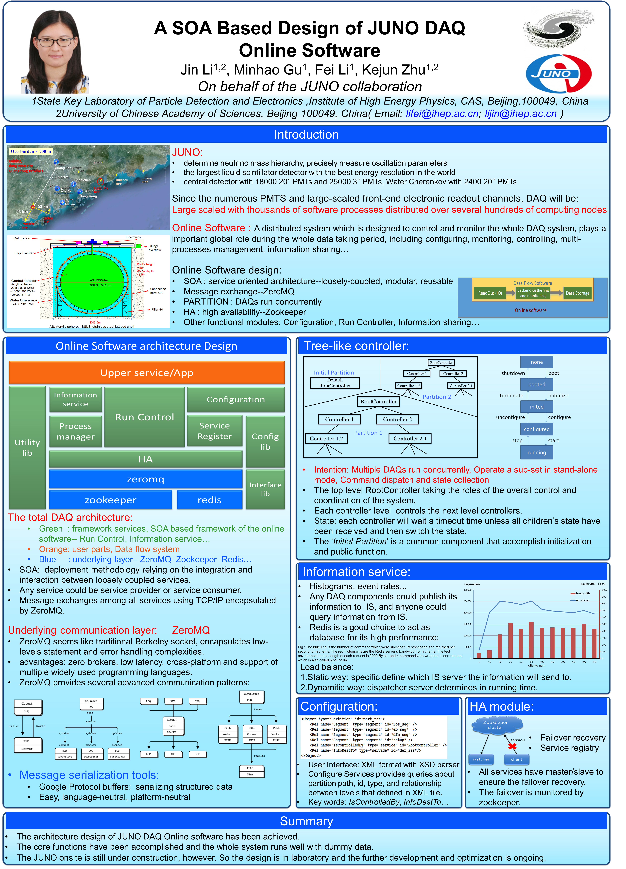
Poster
#431
introduction
architecture design
core services

