Slide 1
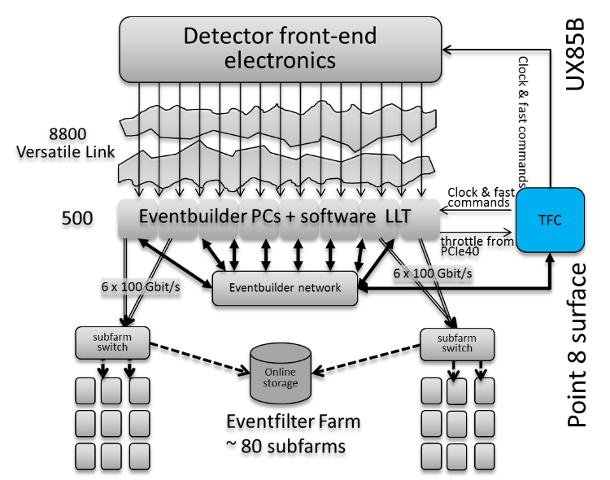
Timing and clocking scheme in the
upgraded LHCb detector
Complex upgrade of the LHCb detector in 2019-2020
replace all Front-End and Back-End electronics
replace >90% of the detector channels
trigger-less data taking at full LHC frequency
run at x10 more instantaneous luminosity for the next 10 years
~40 Tbps data acquisition system
→ The upgraded LHCb readout system will be centrally controlled by a single Readout Supervisor
Clocking scheme is centrally manager by TFC system:
Respect partitioning of sub-detectors
Scalability in case of expanding the system
Point-to-point and Optical splitters
  10G-PON SFP+ as Tx/Rx medium
Possibility of profiting from the uplink as well
Interface to the LHC clock
Fixed latency commands distribution
Deterministic and reproducible clock phase

