Slide 1
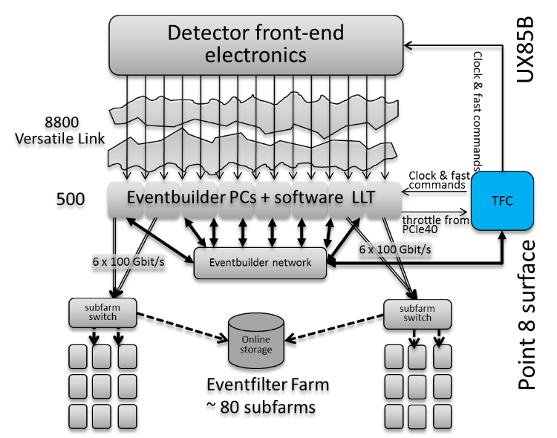
The Readout Supervisor firmware for controlling the upgraded LHCb detector and readout system
Complex upgrade of the LHCb detector in 2019-2020
replace all Front-End and Back-End electronics
replace >90% of the detector channels
trigger-less data taking at full LHC frequency
run at x10 more instantaneous luminosity for the next 10 years
~40 Tbps data acquisition system
→ The upgraded LHCb readout system will be centrally controlled by a single Readout Supervisor
Centralized supervision in a single VHDL firmware:
· coverage of all specifications
· generic code
· high level of programmability
· real-time monitoring and control
· fixed latency with respect to the passage of the beam
· generation of an event description (data bank) for each “non-rejected” event
Come to see the poster if you are interested in knowing how this has been done!

