Slide 1

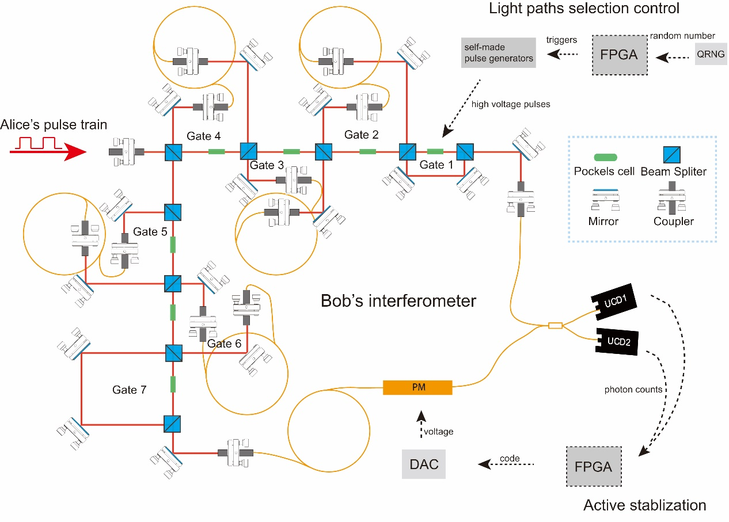
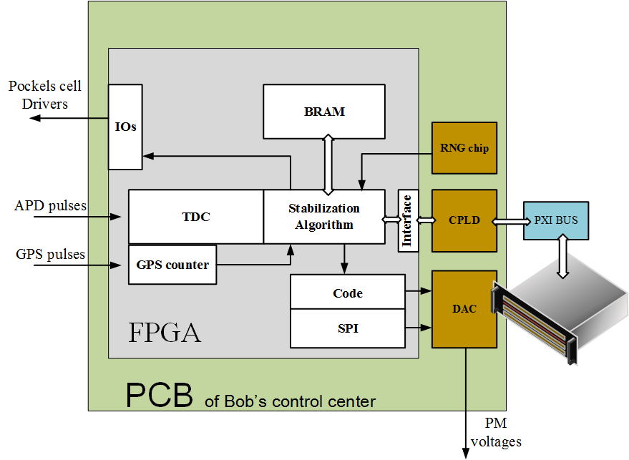
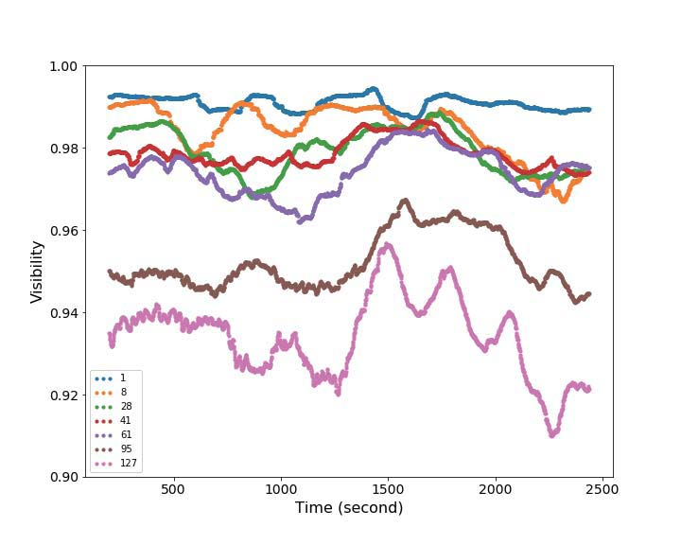
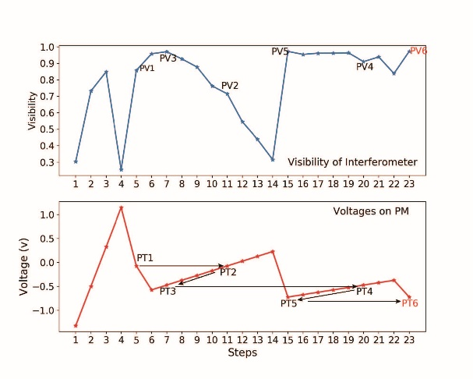
Mini Oral
Technique of active phase stabilization for the interferometer with 128 actively selectable paths
arXiv submission identifier: submit/2291976
Yu Xu

Slide 2
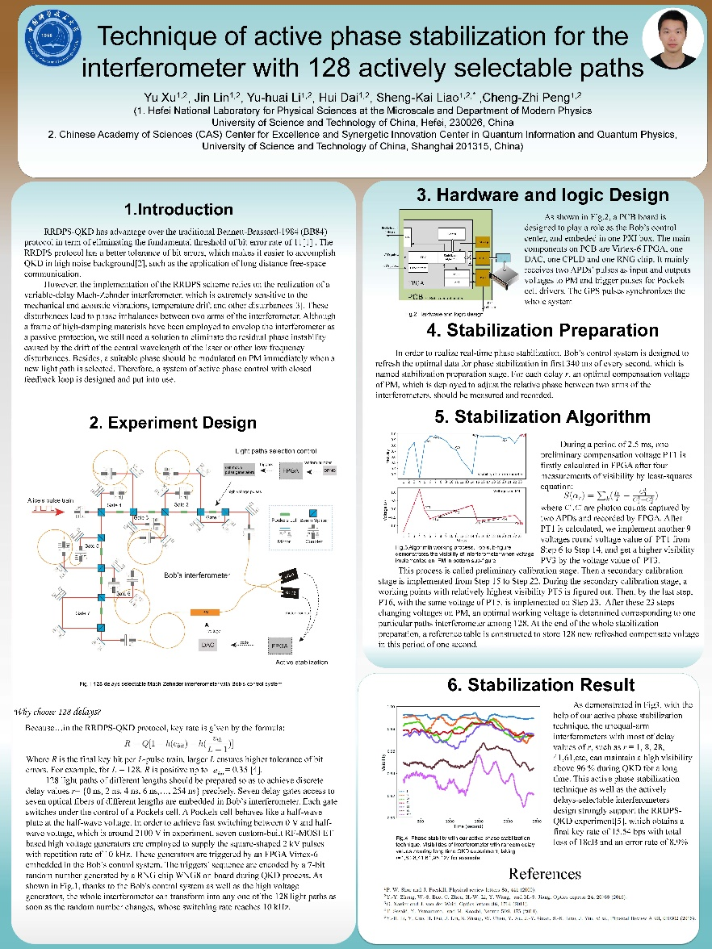
Mini Oral
No.468 Poster
Introduction
Hardware and algorithm design
Application
Results
Yu Xu

