Slide 1
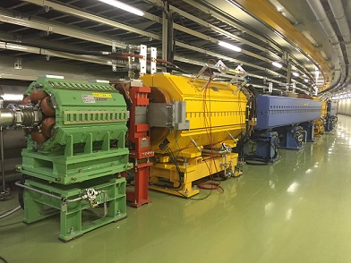
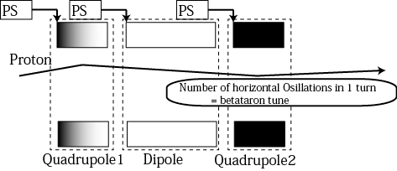
Real-Time Betatron Tune Correction with the Precise Measurement of Magnet Current
Yoshi Kurimoto, Tetsushi Shimogawa and Daici Naito for the J-PARC accelerator groups
Magnets in Accelerator Tunnel
How to control the transverse motion
Dipole
Quadrupole
Sextupole
PS : Power Supplies for the magnets

Slide 2
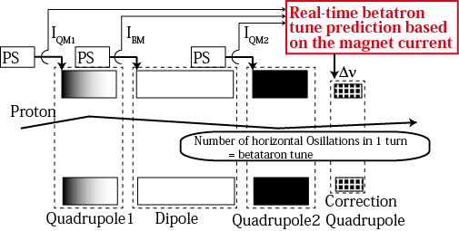
Real-Time Betatron Tune Correction with the Precise Measurement of Magnet Current
Yoshi Kurimoto, Tetsushi Shimogawa and Daici Naito for the J-PARC accelerator groups
Magnets in Accelerator Tunnel
How to control the transverse motion
Dipole
Quadrupole
Sextupole
PS : Power Supplies for the magnets

