Slide 1


Configuration Redundancy for Enhanced Reliability in SRAM-based FPGAs
Raffaele Giordano^{1,2}, Sabrina Perrella^{1,2},
Dario Barbieri^{1,2}, Vincenzo Izzo² , and Alberto Aloisio^{1,2}
¹ Università degli Studi di Napoli “Federico II”, I-80126, Italy
² INFN Sezione di Napoli, I-80126, Italy
Presenter email: rgiordano@na.infn.it

Slide 2
Overview
Motivation
TMR-based redundant configuration
Novel redundant configuration generation methods
Test setup
Proton irradiation test results
Summary

Slide 3
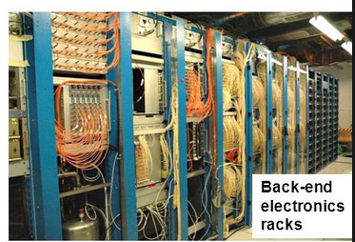

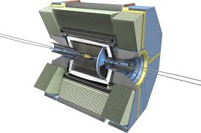


Motivation
Counting room
SRAM-based FPGAs widely adopted in TDAQ systems for HEP, mostly off-detector
Limited usage on-detector, commercial grade FPGAs sensitive to radiation
Rad-hard SRAM-based FPGAs do exist but
  very expensive (~10k$ per unit), unpractical for HEP (>1 kunits needed per experiment)
  Latest generations normally not available as rad-hard (today V5 is available)
Characterize and protect commercial grade devices from radiation effects
off-detector
readout
electronics
10 - 100 m

Slide 4
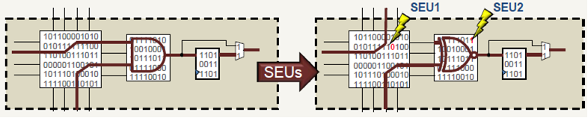
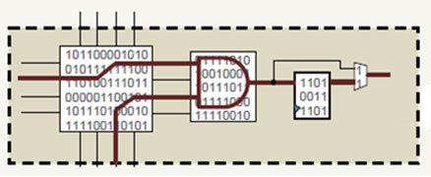
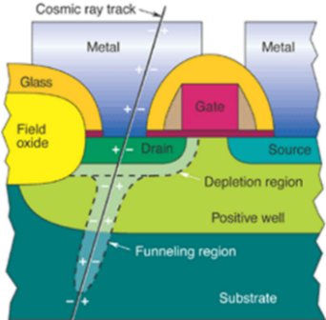

Configuration vs Radiation
SRAM-based FPGAs are the most powerful and the most used but
  Radiation may induce upsets in the SRAM altering the functionality
Classic correction (“scrubbing”) methods:
  Vendor-provided error correcting codes, add few parity bits, can correct 1 upset in few kb of configuration data
  External radiation hardened memory with golden configuration => 100% correction, but system more complex, expensive
Generate redundant configuration
  High correction capability (100%, when no homologous bits are hit at the same time)
  No external memory needed !

Slide 5
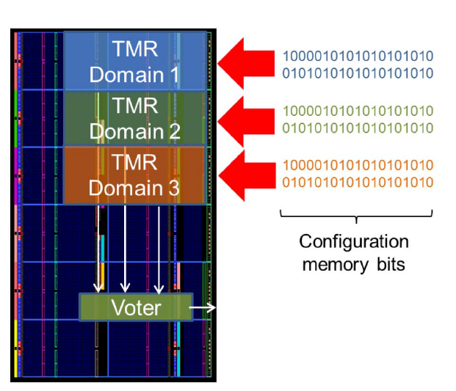

TMR-based Redundant Configuration
Redundant FPGAs with identical designs [1,2]
Redundant designs in the same FPGA [3]
Pros
  Very high correction capability
  No additional devices
Configuration Scrubbing
FPGA 2
Voter
FPGA 2
FPGA 1
Configuration
Readback
FPGA 1
FPGA 0
Pros
  Very high correction capability
Cons
  TMR to generate redundant configuration
  3x cost and power
Cons
  3x dynamic power wrt unprotected design
  Requires third party layout tools (not available for latest devices)
How to exploit redundant configuration and…
  …avoid usage of dedicated layout tools?
  …decouple scrubbing from TMR?
  …minimize dynamic power increase?
[1] P. H. Alfke, U.S. Patent 6,104,211A, Aug. 15, 2000.
[2] I. Herrera-Alzu et al.,” Lect. Not. Comput. Sci., vol. 6951, pp. 133–142, 2011, LNCS.
[3] J. Tonfat et al.,” IEEE Trans. Nucl. Sci., vol. 62, no. 6, pp. 3080–3087, Dec. 2015

Slide 6
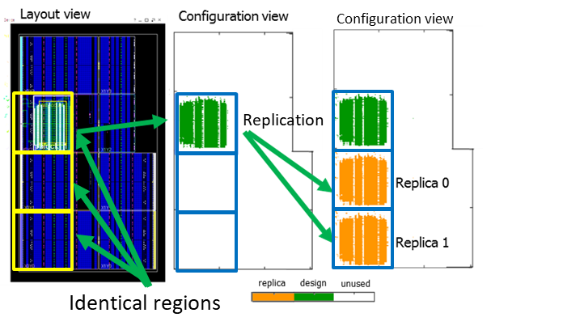
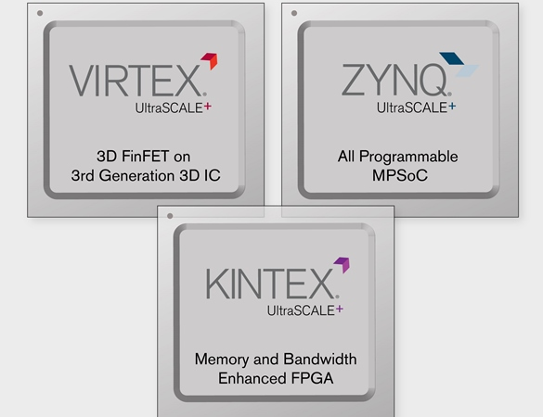



Pure Redundant Configuration - Basic
Prepare a design in a sub-region of the FPGA
Generate redundant configuration (replicas) in identical regions
Generate list of redundant frame sequences to be compared during operation
Configuration replicas do not receive clock => no additional dynamic power consumption
Based on configuration access port ( e.g. ICAP or JTAG), supported by several FPGA families
No special design tools needed
No TMR needed
JTAG
[1] R. Giordano et al. “Redundant-Configuration Scrubbing of SRAM-Based FPGAs," in IEEE Trans. on Nucl. Sci., vol. 64, no. 9, pp. 2497-2504, Sept. 2017. Open Access http://ieeexplore.ieee.org/document/7990155/

Slide 7
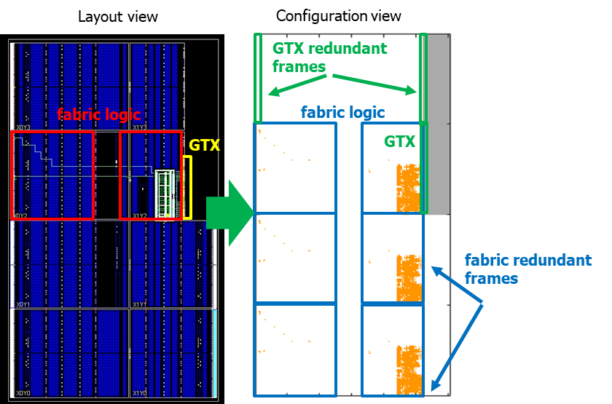
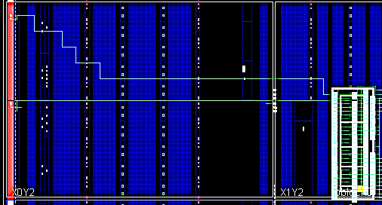
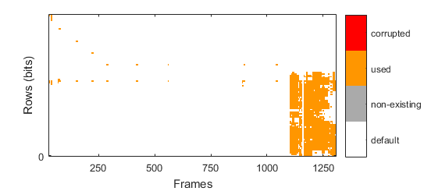
Pure Redundant Configuration - Enhanced
Generate replicas on a frame basis rather than region basis
Advantages w.r.t basic mode
  no need for identical subsets of the device for redundant copies
  Usable for hard macros (e.g. GTXes) and in general for elements which are not available with a sufficient multiplicity
Disavantages w.r.t. basic mode
  Produces more complex list of redundant & empty frame sequences
  Need to validate frame copy, destination frames might not be compatible with content

Slide 8
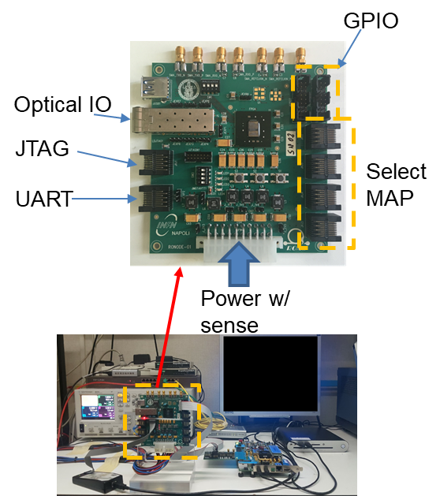
Beam and Fault Injection Tests
Custom designed DUT board for tests based on Xilinx Kintex-7 70T FPGA
  24 Mb configuration, 7431 frames (5640 CRAM + 1791 BRAM), 3232 b per frame
FPGA is the only active component
Power and configuration provided from external systems
Supports UART, JTAG, GPIO and high-speed serial IO up to 10 Gbps [optical (SFP) and copper (SMAs)]

Slide 9

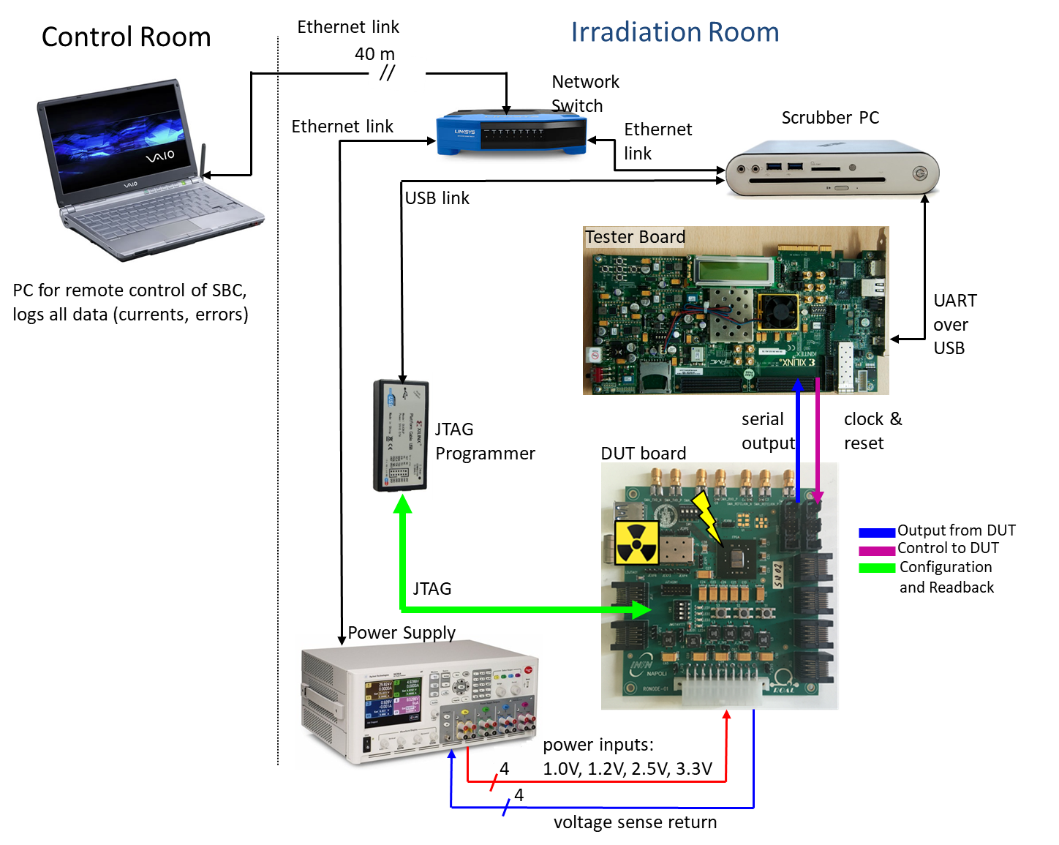

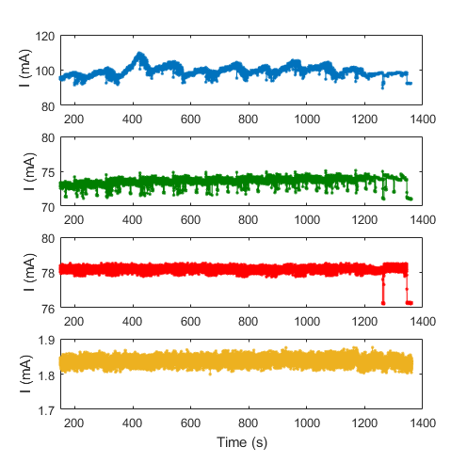
Test Setup
DUT board FPGA loaded with a benchmark design
Tester board (Xilinx KC705) runs same design as DUT and verifies output
Multichannel power supply provides power to DUT board
configuration and functionality logs
Dedicated PC
  Generates configuration redundancy (JTAG)
  Performs scrubbing (JTAG)
  Logs upset details
  Logs functionality test results from tester board
FPGA current trends
1.0 V
1.8 V
beam
2.5 V
3.3 V

Slide 10
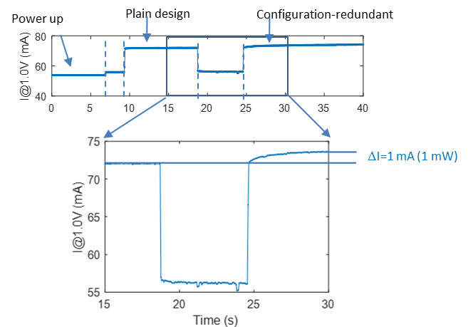
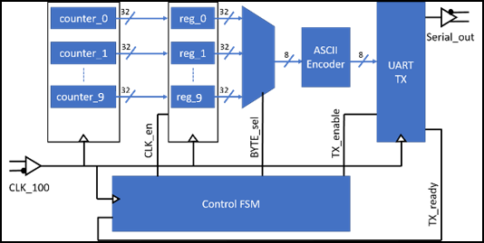
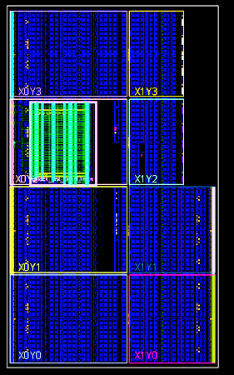
Benchmark Designs (1)
32b counters @ 200 MHz
  Mixture of sequential and combinational logic
Fully contained in a single clock region
  604 frames (10.7%)
Redundant configuration generated in “Basic Mode”
Power Consumption vs. Config. Redundancy
Layout
9
Logic Resources | Used/Available | %
Slices: overall | 1061/10250 | 10.3
Slices: FFs | 2208/82000 | 2.7
Slices: LUTs | 4100/41000 | 10.0
BUFRs | 1/24 | 4.2
IOs | 6/285 | 2.1
Minimal impact on VCCINT (1.0V) power consumption due to configuration redundancy

Slide 11
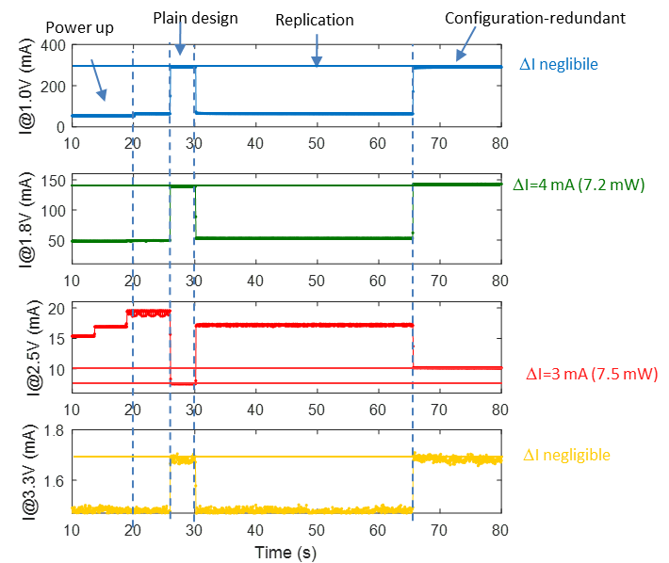
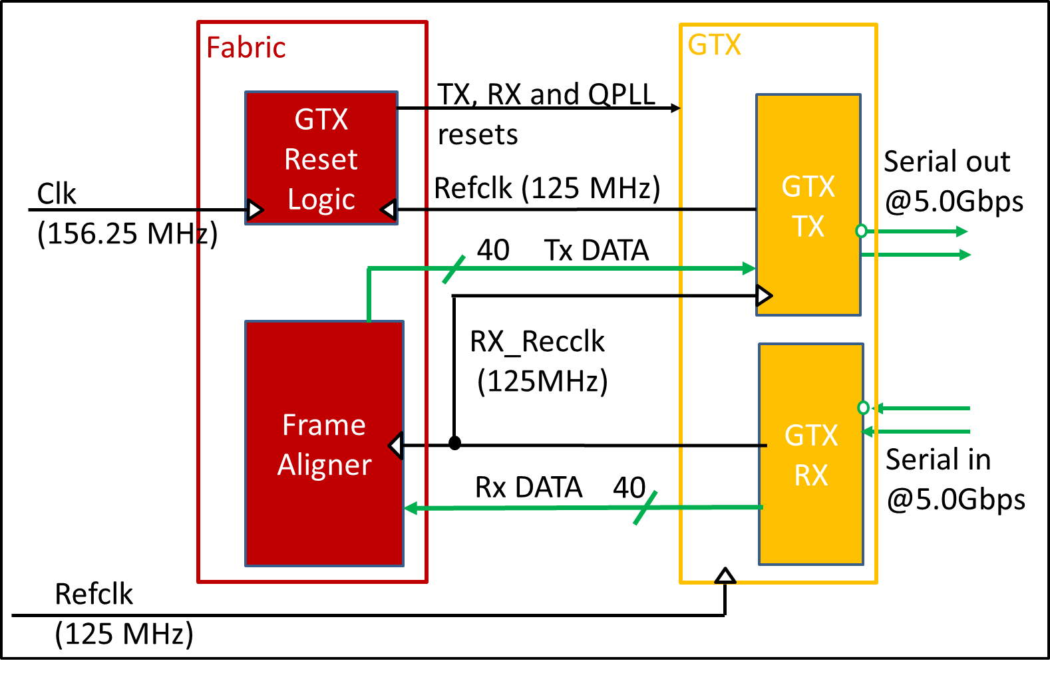
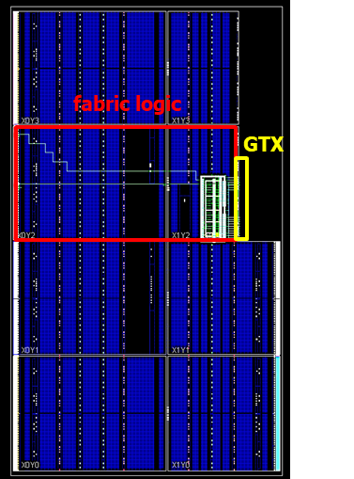
Benchmark Designs (2)
High-speed serial link node running @ 5 Gbps
  Implements loop back via fabric
  Based on GTX transceiver (which cannot be tripled)
Redundant configuration generated in Enhanced Mode
  564 protected frames (10%)
Power Consumption vs. Configuration Redundancy
Layout
Logic Resources | Used/Available | %
Slices: overall | 177/10250 | 1.7
Slices: FFs | 678/82000 | 0.8
Slices: LUTs | 263/41000 | 0.6
BUFHs | 3/96 | 3.0
IOs | 3/285 | 1.0
GTX_QUAD | 1/1 | 100

Slide 12
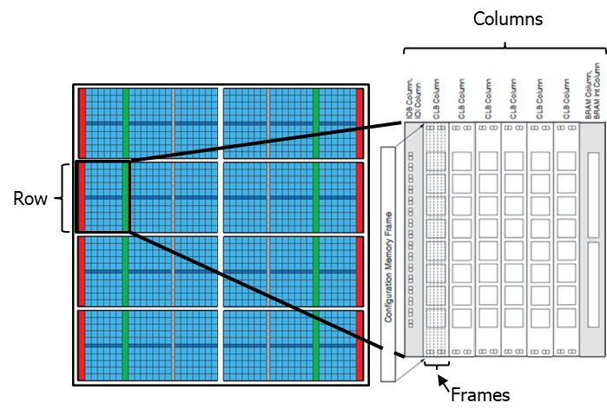
Upset Logs
Operating circuit,
replica 0 or 1
Extract from upset logs
frame address
Configuration memory
layout
Upset polarity
…
1481256356 CORR_CLONE0 0x0040059A 2 0314:1->0 2012:1->0
1481256356 OVERALL 338 371
1481256356 CORR_OPERAT 0x000005A0 1 0396:1->0
1481256356 OVERALL 339 372
1481256357 CORR_OPERAT 0x000005A1 1 0396:1->0
1481256357 CORR_CLONE1 0x004205A1 1 0324:1->0
1481256357 OVERALL 342 374
1481256357 CORR_OPERAT 0x000005A2 3 0111:0->1 0333:1->0 1175:0->1
1481256357 OVERALL 343 377
1481256357 CORR_OPERAT 0x000005A3 1 0110:0->1
…
MCU
Bit offset
MCU
detection time stamp (unix time)
For each detected upset we log
  time stamp, frame address, bit offset, polarity
  tag for operative circuit, replica or unused frames
Irradiation tests can be repeated as a fault injection with same sequence and same timing of detected upsets, very similar conditions
Frame # N
Frame # N+1
Due to frame interleaving in K7,
some MCUs appear as SBUs
[4] M J Wirthlin et al., 2014 JINST 9 C01025

Slide 13
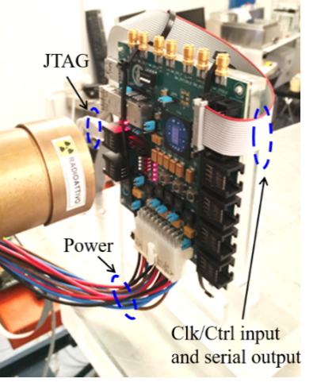
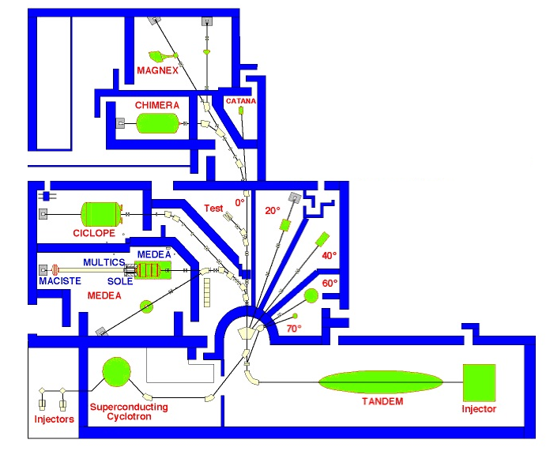

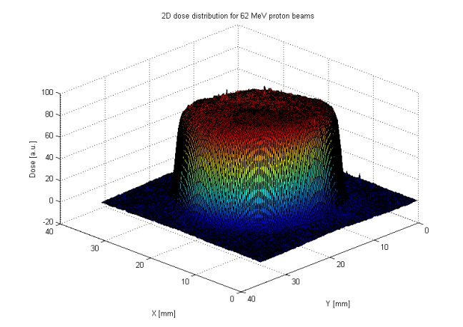
Proton Beam Test
Experimental
setup
Superconducting cyclotron at Laboratori Nazionali del Sud – Catania, Italy
62-MeV proton beam
Fluxes tunable from 10⁷ cm⁻²s⁻¹ to 10⁸ cm⁻²s⁻¹
Uniform beam intensity on sample (5%)
48h test: 4.1∙10¹² p∙cm⁻² fluence
  24h: 50 runs, 2.9∙10¹² p∙cm⁻² total fluence
  24h: 11 runs, 1.2∙10¹² p∙cm⁻² total fluence
LNS accelerator PLAN
Beam spot
20 mm
3D Beam profile
Notes:
Gafcromico per beamspot

Slide 14
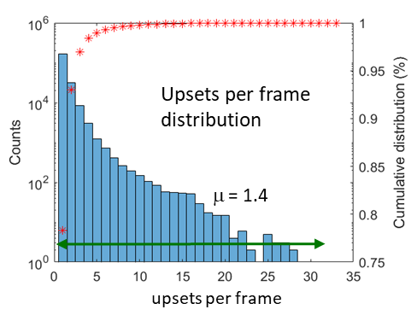
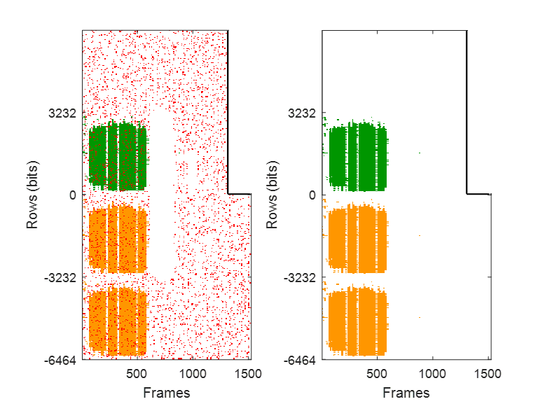
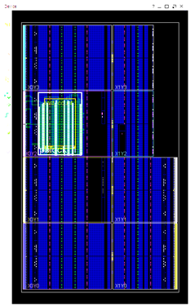

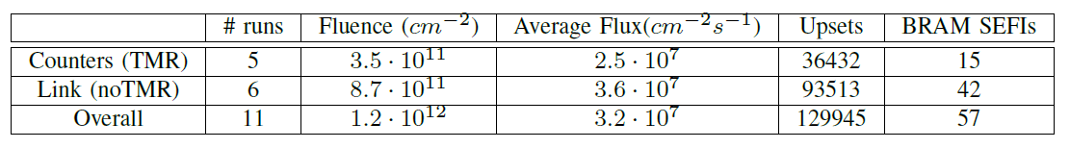
Beam Test Results: Upset Distribution
Configuration
(detected upsets)
Configuration
(after irradiation)
Layout
No residual
upsets
Number of upsets per frame up to ~ 30
BRAM SEFIs (σ_{BRAM}): fake upsets in 128 b bunches, no impact on functionality, > 10³ times less likely than upsets
JTAG SEFIs (σ_{JTAG}): memory unreadable, need power power cycle, > 10⁵ times less likely than upsets
Correction method very effective, full configuration corrected in 100% of test runs
Configuration clustered
in 64bits x 10 frames
σ_{DEV} | σ_{BRAM} | σ_{JTAG} | σ_{BIT}
1.0∙10⁻⁷ cm² | 4.6∙10⁻¹¹ cm² | 3.5∙10⁻¹³ cm² | 4.4∙10⁻¹⁵ cm² bit⁻¹
2° 24h test

Slide 15
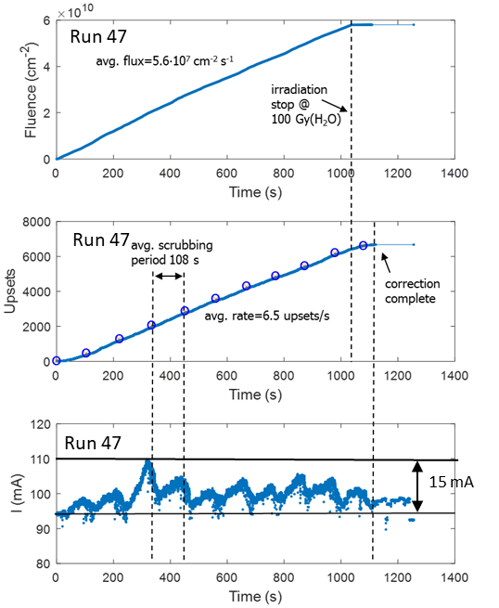
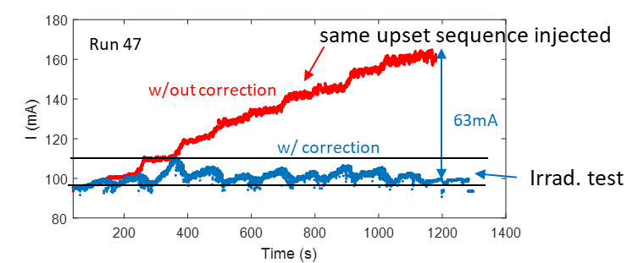
Beam Test Results: Real-time Scrubbing
# upsets follow fluence very linearly
  1.1 10⁻⁷ upsets/(p∙cm-²)
Core power domain (1.0 V): current ripples with scrubbing period
  keeps current within 17% from initial value
Fault-injection tests show 4x power increase w/out correction
Avg. frame read time | Avg. Scrub cycle duration | Scanned Frames per cycle | Avg. frame repaired per cycle | Avg. frame repair time
16 ms | 108 s | 5640 | 542 | 33 ms

Slide 16
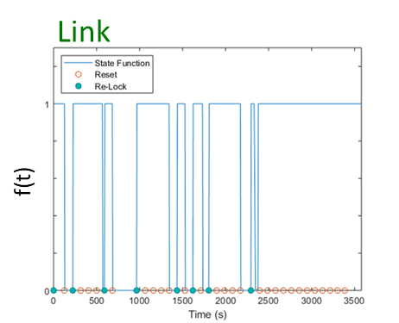
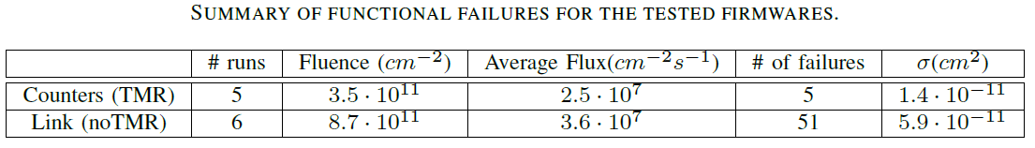
Beam Test Results: Functionality
State function
f(t) =
1, if benchmark circuit operates correctly
0, otherwise
Benchmark circuit fails due to upsets (logic and configuration)
Functionality is always restored as soon as configuration is restored and a reset is asserted
100% of the failures have been recovered
= 1.35 ∙ 10¹⁰ p∙cm-²
σ = 1.33 ∙ 10¹⁰ p∙cm-²
failures
Fluence (p∙cm⁻²)

Slide 17
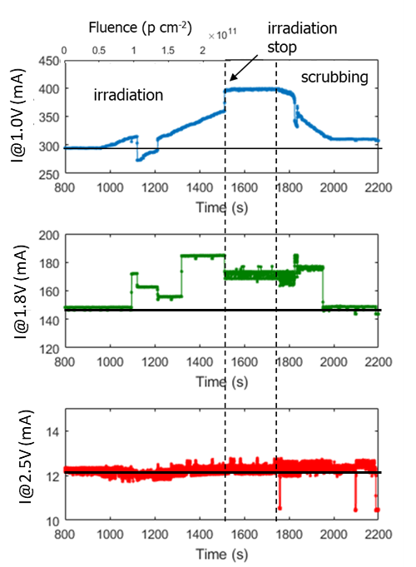
Beam Test Results: Upset Accumulation
Test the robustness of scrubbing against accumulation of upsets
Disabled the scrubber and re-enabled it after a certain target fluence has been reached
  2.3 10¹¹ p∙cm⁻² (nearly 25k upsets)
Scrubber restores the initial configuration (no residual upsets) and (almost) power consumption

Slide 18
Summary and…
We investigated two variants of a scrubbing technique based on redundant configuration
  it makes self-contained scrubbing possible
  mild impact on power consumption
  supports multiple Xilinx families
Tests on Kintex-7 70T FPGA w/ 62-MeV protons (4.1∙10¹² p∙cm⁻²) show technique is
  very efficient against MBUs, even for very large upset multiplicity per frame (30!)
  robust against upset accumulation, corrects configuration, power consumption (within 3%), and functionality

Slide 19
…Acknowledgment
We wish to thank
  A. Boiano, A. Anastasio from INFN Sezione di Napoli for their technical support
  G.A.P. Cirrone from Laboratori Nazionali del Sud for their support during irradiation tests
This work is part of the ROAL project (grant no. RBSI14JOUV) funded by the 2014 SIR program of the Italian Ministry of Education, University and Research (MIUR)
  More info at:
Poster by S. Perrella about “Radiation-Tolerant, High-speed Serial Link Design with SRAM-based FPGAs” – contribution no. 562
www.roalproject.it

Slide 20
Backup

Slide 21
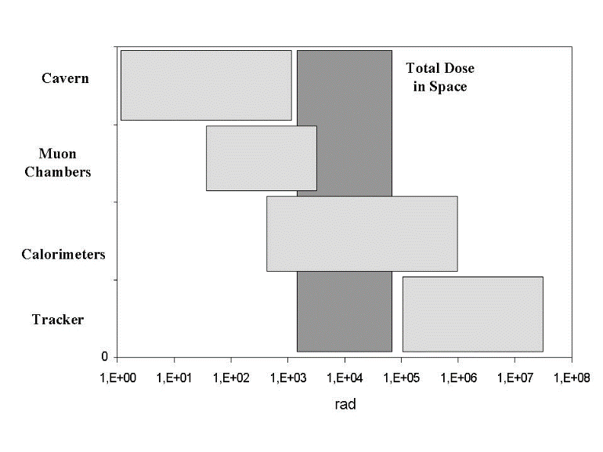
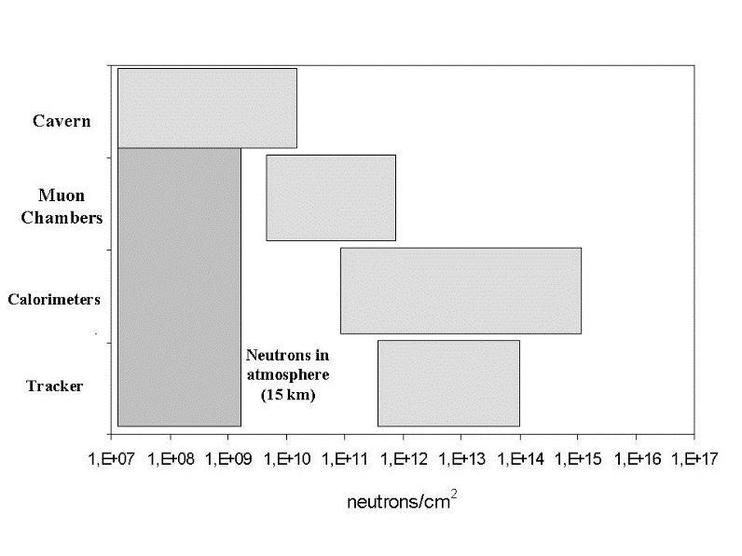
Radiation environment
Comparison between Space environment and the CMS at the LHC
Source: F. Guistino’s PhD thesis

Slide 22
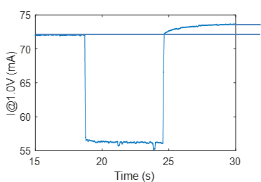
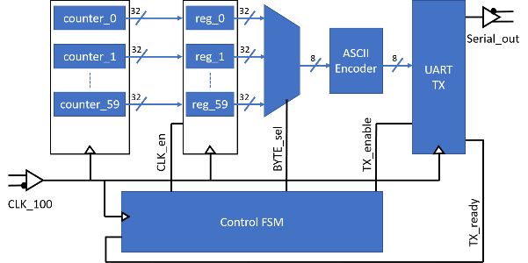
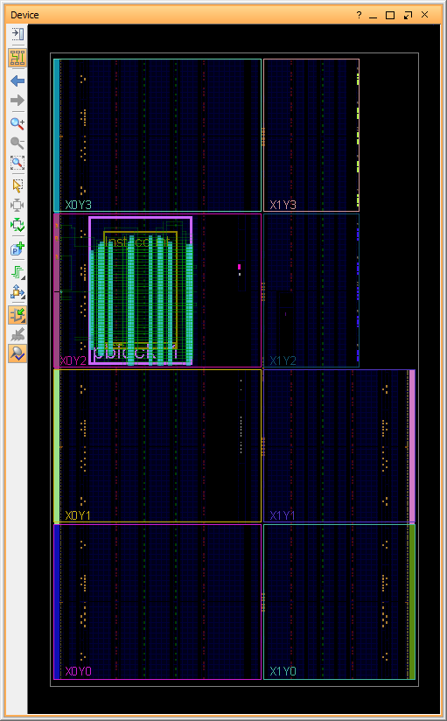
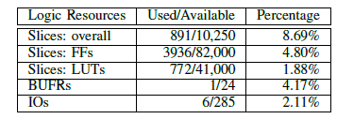
Benchmark Designs
Power consumption analysis
Dummy logic: 60 32b counters @ 200 MHz
Readout logic to sample output periodically (1s) via UART
Fully contained in a single clock region
  604 frames (8%)
Redundant configuration generated in Basic Mode
Power up
Plain design
Configuration-redundant
ΔI=1 mA
Minimal impact on core power consumption due to configuration replication

Slide 23
Fabric
GTX
TX, RX and QPLL resets
GTX
Reset Logic
GTX
TX
Serial out
@5.0Gbps
Clk
(156.25 MHz)
Refclk (125 MHz)
40
Tx DATA
Frame Aligner
RX_Recclk
(125MHz)
GTX
RX
Serial in @5.0Gbps
Rx DATA
40
Refclk
(125 MHz)

Slide 24
Configuration Redundancy vs Power Consumption
Dummy logic firmware
Power up
Plain design
Configuration-redundant
ΔI=1 mA
Minimal impact on VCCINT power (1.0V) consumption of redundant configuration
Power consumption on IO (2.5V) and at VCCAUX (1.8V)

Slide 25
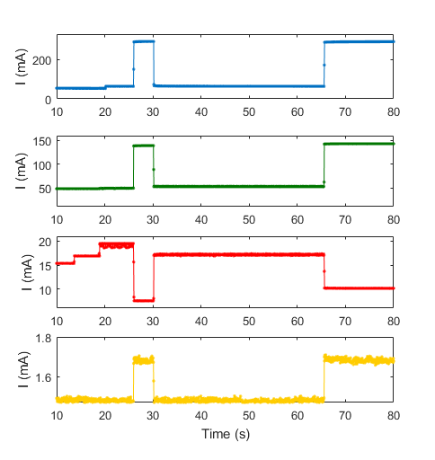
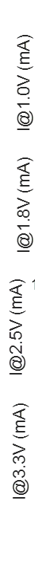

Slide 26



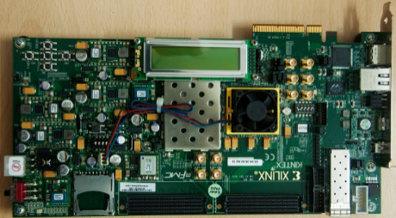
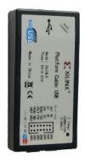
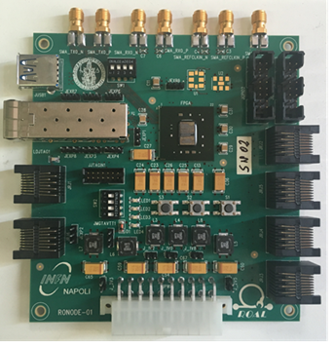

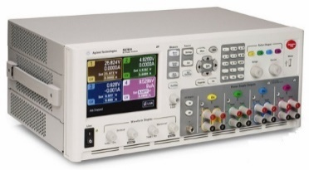
Control Room
40 m
Irradiation Room
Ethernet link
//
Network
Switch
Ethernet link
Ethernet link
Scrubber PC
USB link
Tester Board
PC for remote control of SBC, logs all data (currents, errors)
UART
over USB
JTAG Programmer
serial
output
clock &
reset
DUT board
Output from DUT
Control to DUT
JTAG
Configuration
and Readback
Power Supply
power inputs:
1.0V, 1.2V, 2.5V, 3.3V
4
4
voltage sense return

Slide 27
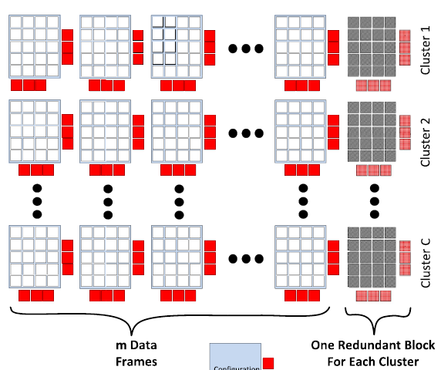
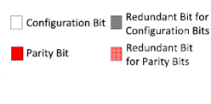

Redundant-Configuration Scrubbing Techniques
Erasure codes: Clustering frames and adding parity bits to each cluster
Redundant FPGAs with identical designs
Very high correction capability
Low repair latency
3x quiescent power
3x dynamic power
Configuration Scrubbing
FPGA 2
MajorityVoting
Minimal power consumption increase
Repair requires readback of whole cluster, latency depends on cluster size
Correction capability depends on number of parity bits
FPGA 1
Configuration
Readback
FPGA 0
Redundant designs in the same FPGA
TMR to generate redundant configuration
Low repair latency
Very high correction capability
Requires third party layout tools (RapidSmith)
3x dynamic power wrt unprotected design
How to exploit redundant-configuration and…
  …achieve very high correction capability?
  …avoid usage of dedicated layout tools?
  …decouple scrubbing from TMR?
  …minimize dynamic power increase?

Slide 28
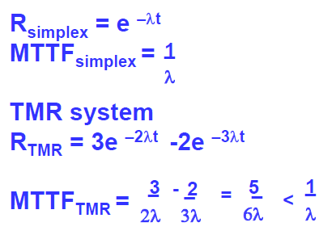
Modular Redundancy and Scrubbing
MTTF in TMR systems is worse than MTTF for each module
Reliability needs to stay high
Triple Modular Redundancy (TMR) needs scrubbing of configuration to be effective

Slide 29
Macro
Option Explicit
Public Sub ChangeSpellCheckingLanguage()
Dim j As Integer, k As Integer, scount As Integer, fcount As Integer
scount = ActivePresentation.Slides.Count
For j = 1 To scount
fcount = ActivePresentation.Slides(j).Shapes.Count
For k = 1 To fcount
If ActivePresentation.Slides(j).Shapes(k).HasTextFrame Then
ActivePresentation.Slides(j).Shapes(k) _
.TextFrame.TextRange.LanguageID = msoLanguageIDEnglishUS
End If
Next k
Next j
End Sub

