Slide 1


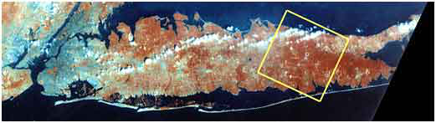
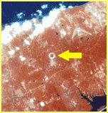
Streaming Readout of the Tracking System
Streaming Readout of the sPHENIX Tracking System
Martin L. Purschke
Manhattan
Long Island, NY
RHIC from space

Slide 2
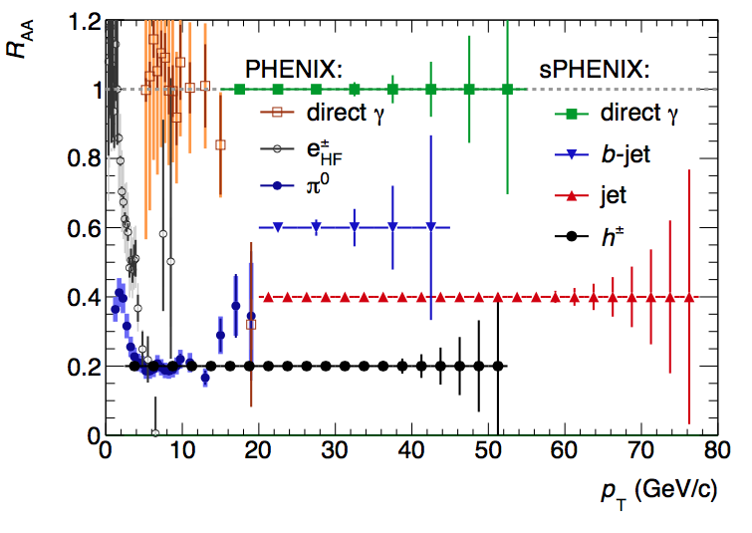
T-Shirt Plot: Statistical Reach for some probes
The way PHENIX gets to high PT is through π⁰s
That reaches to ~20GeV/c
In sPHENIX, we can get to
4x that with jets
Limit of PHENIX’s statistical reach
sPHENIX’s statistical reach

Slide 3
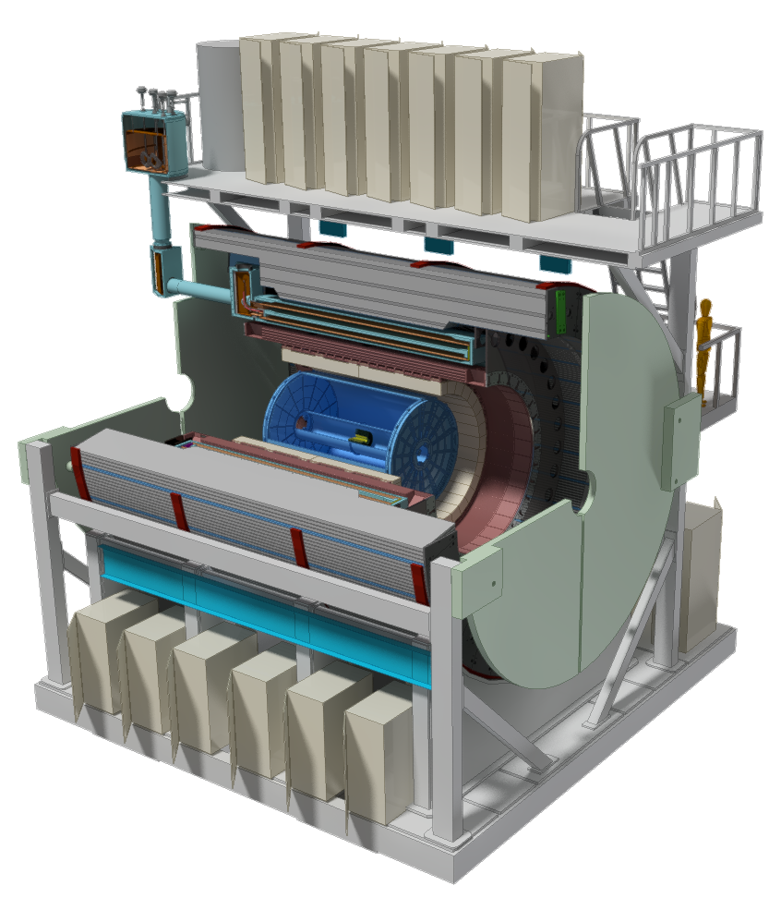
sPHENIX – the Concept
Hadronic Calorimeter(s)
Electromagnetic Calorimeter
Time Projection Chamber (TPC)
Minimum Bias Detector (MDB)
Intermediate Tracker (INTT)
MicroVertex Detector (MVTX)

Slide 4
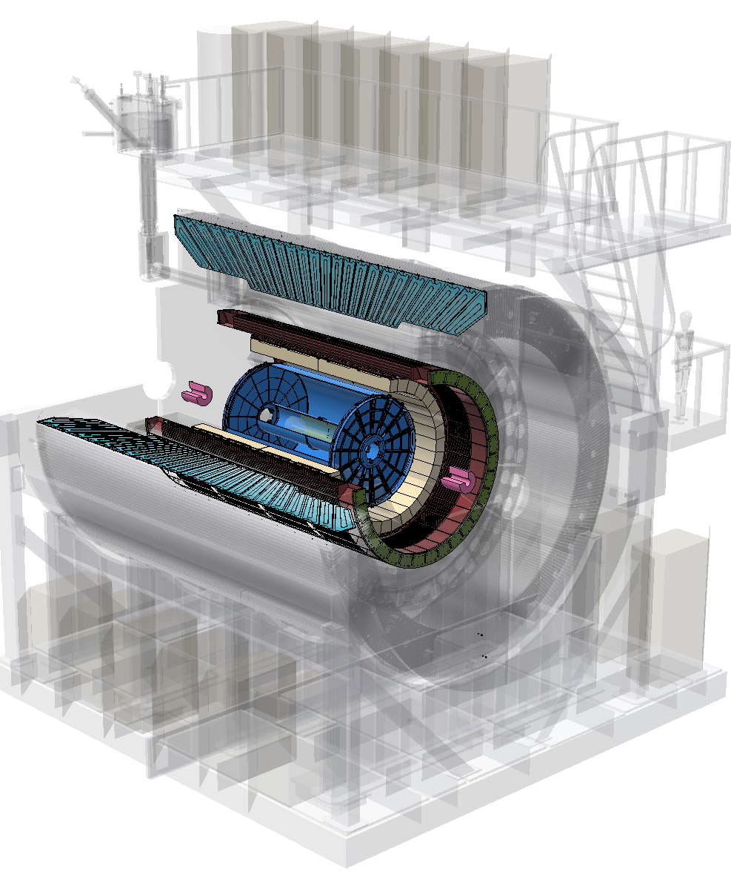
sPHENIX – the Concept
Hadronic Calorimeter(s)
Electromagnetic Calorimeter
Time Projection Chamber (TPC)
Minimum Bias Detector (MDB)
Intermediate Tracker (INTT)
MicroVertex Detector (MVTX)

Slide 5
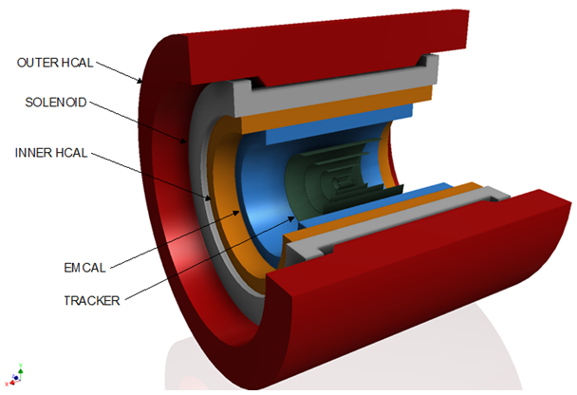
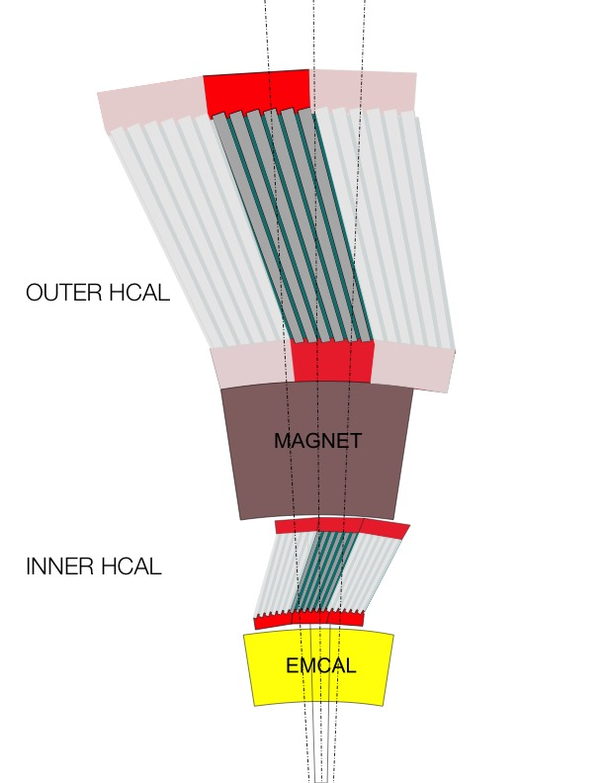
sPHENIX – Calorimetry
We have already presented the calorimeters last time, I’ll focus on the tracking (and the TPC) today
HCAL steel and scintillating tiles with wavelength shifting fiber
  2 longitudinal segments.
  An Inner HCal inside the solenoid.
  An Outer HCal outside the solenoid.
  Δη x Δφ ≈ 0.1 x 0.1
  2 x 24 x 64 readout channels
  σ_{E}/E < 100%/√E (single particle)
SiPM Readout
Outer HCAL ≈3.5λ_{I}
Magnet ≈1.4X₀
Inner HCAL ≈1λ_{I}
EMCAL ≈18X₀≈1λ_{I}

Slide 6
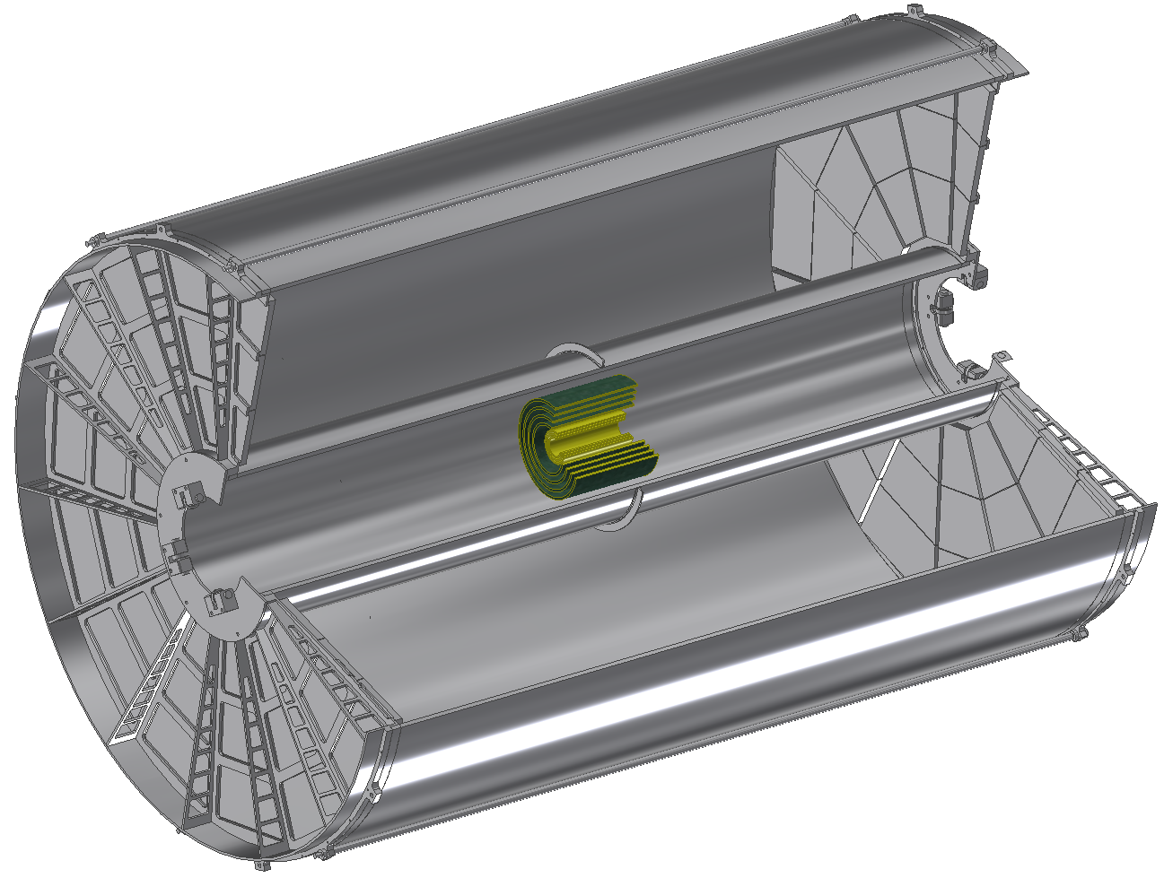
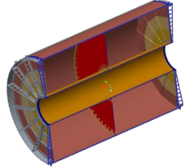
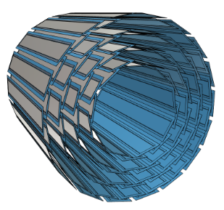
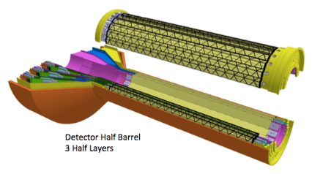
Three Tracker Components
Micro-Vertex Detector (MVTX) Three-layers identical to Inner ALICE ITS ( r = 2.3cm, 3.1 cm, 3.9 cm)
Intermediate Silicon Strip Tracker (INTT) Four layer Si strip detector. (r = 6 cm, 8 cm, 10 cm, 12 cm)
Compact Time Projection Chamber (TPC) (20 cm < r < 78 cm)
All cover at minimum | η | < 1.1 and 2π in azimuth
TPC
INTT
MVTX

Slide 7
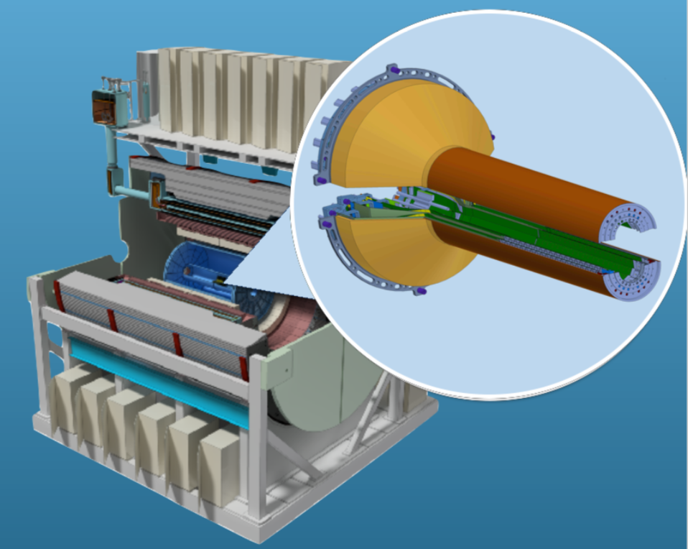
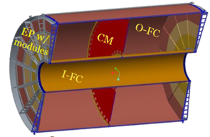
Streaming Readout Detectors
TPC
MVTX
I will mostly concentrate on the TPC.
This is a next-gen “gate-less” TPC design
7

Slide 8
Data and more data
This number is still changing and depends on our noise levels (and a successful change in the front-end ASIC). Could be more!
MVTX (MAPS) ~ 20GBit/s
Intermediate Silicon Strip Tracker (INTT) ~ 7GBit/s
Compact Time Projection Chamber (TPC) ~ 100Gbit/s
Calorimeters (primarily Emcal, hadronic cal.) ~ 8GBit/s
____________
135GBit/s
Makes for an event size of about 1MByte (or more)

Slide 9
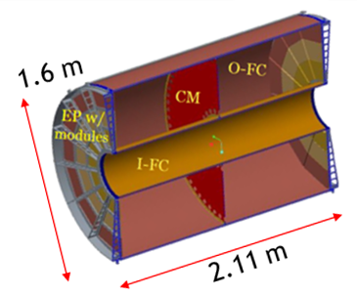
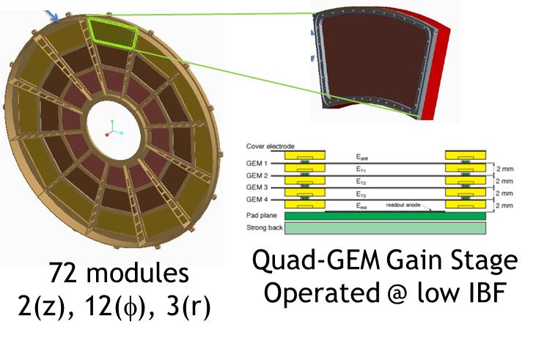
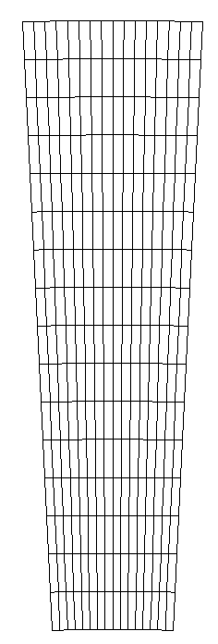
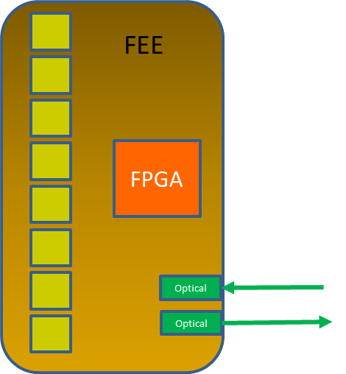
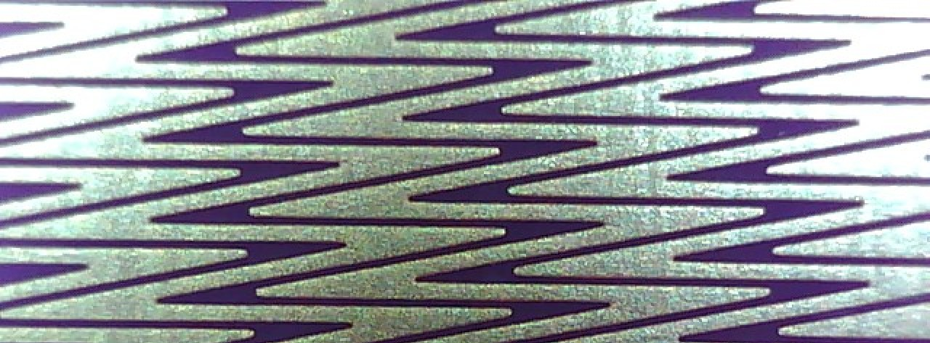
The TPC
16 rows ~1.25 cm
“Wedge”
“Wedge”
EBDC 1/DAM
256 pads/FEE
25 FEE/sector
Storage
charge
Digitized
DAM Cards
Clustered
Zig-Zag
Pads
9
DAM = “Data Aggregation Module” EBDC – “Event Buffer and Data Compression”

Slide 10
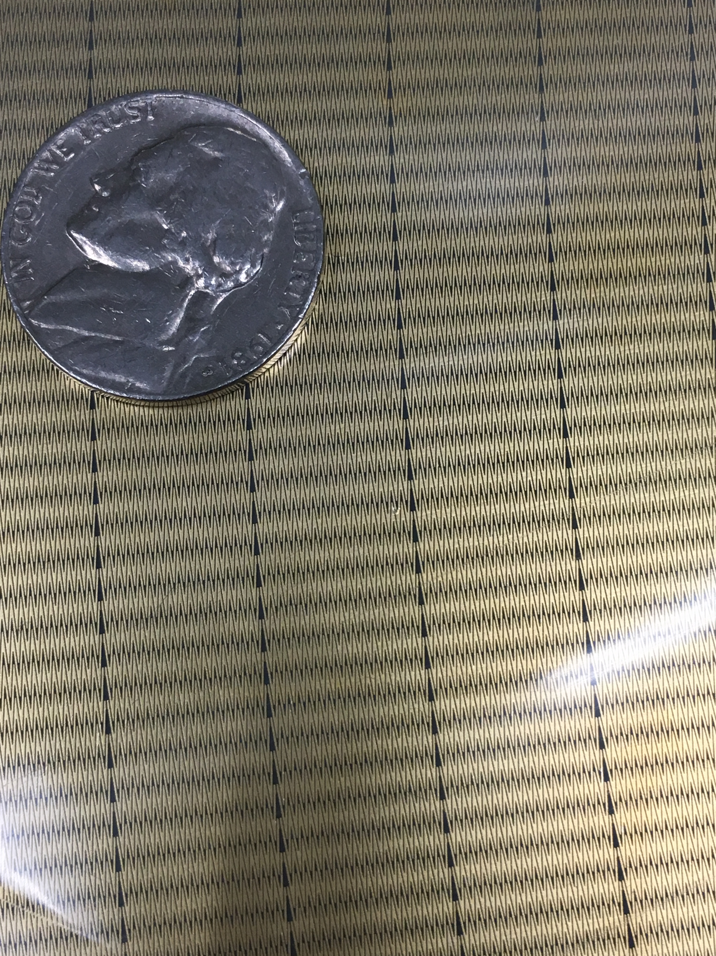
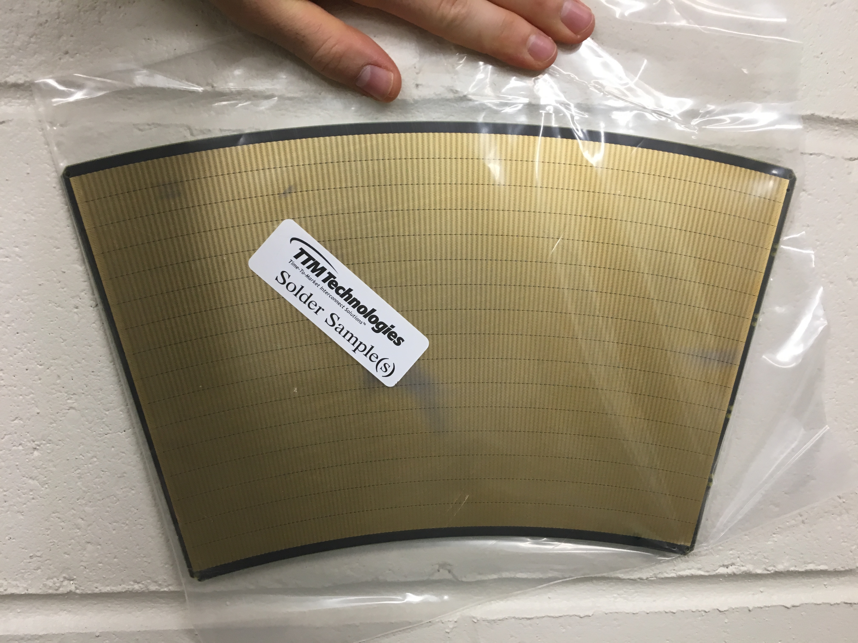
The ZigZag Pads
12.5mm resolution in r
150 μm in phi
~160,000 ADC channels
Zig-Zag
Pads

Slide 11
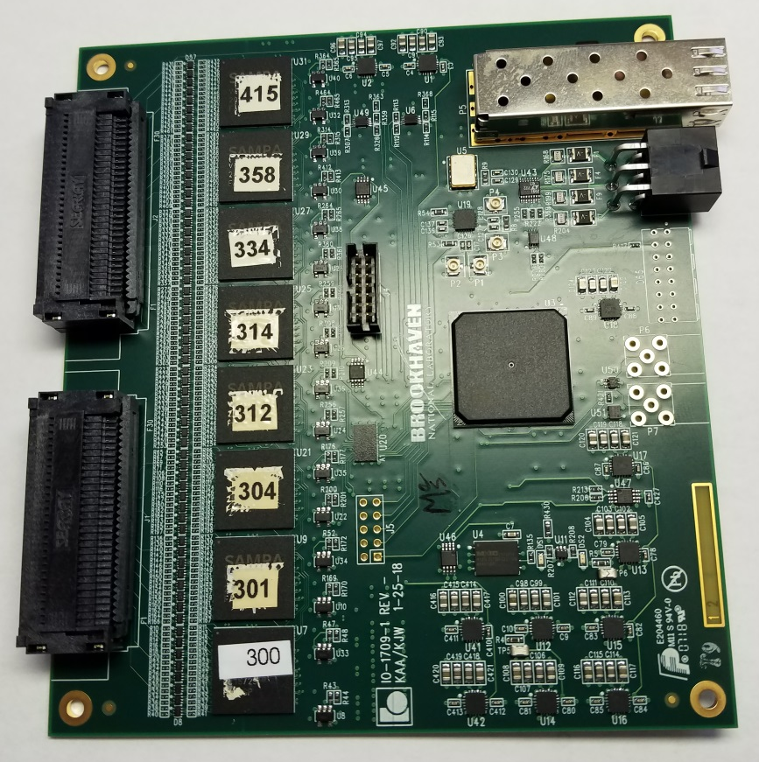
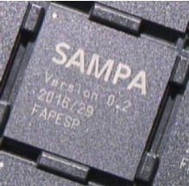
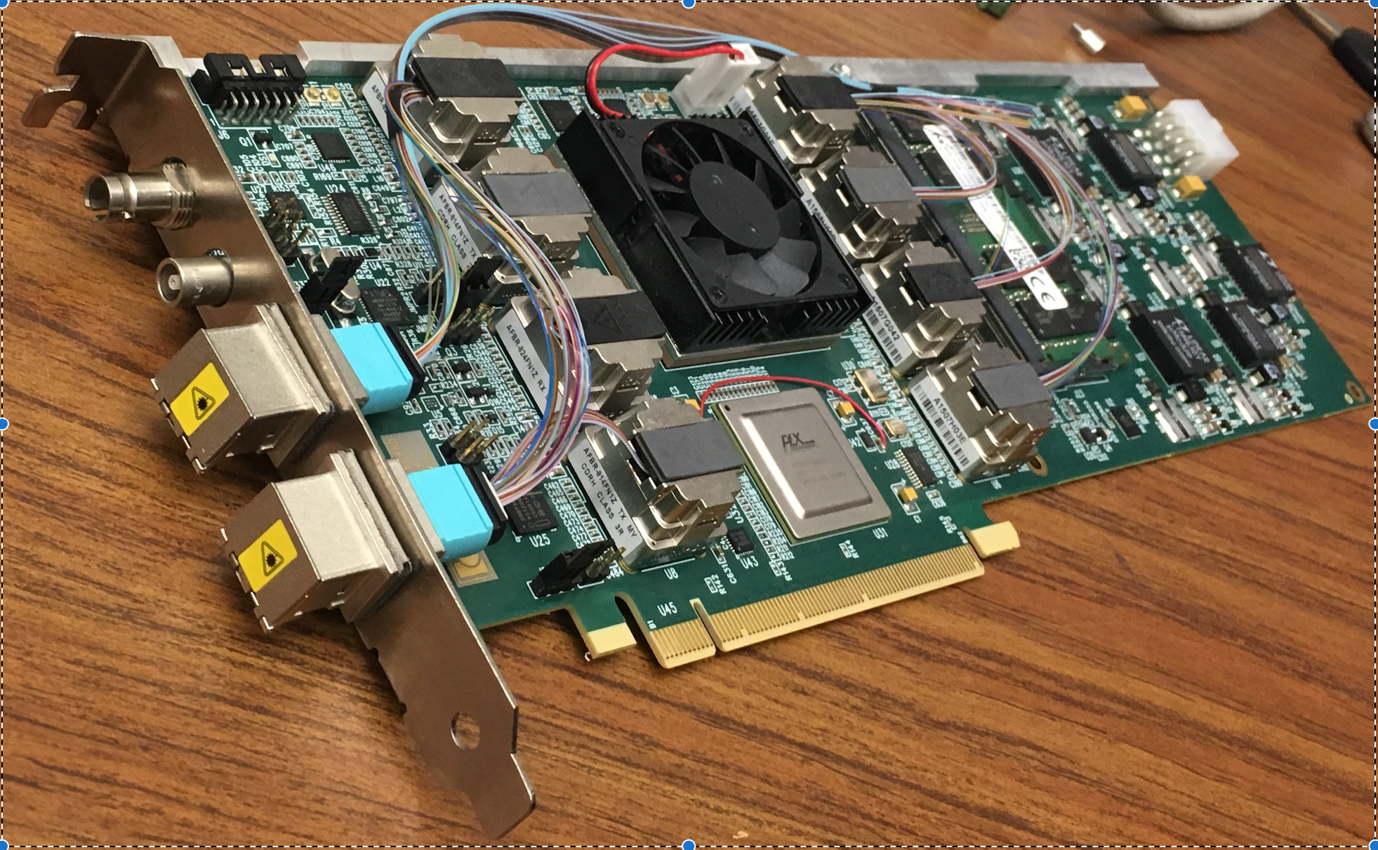
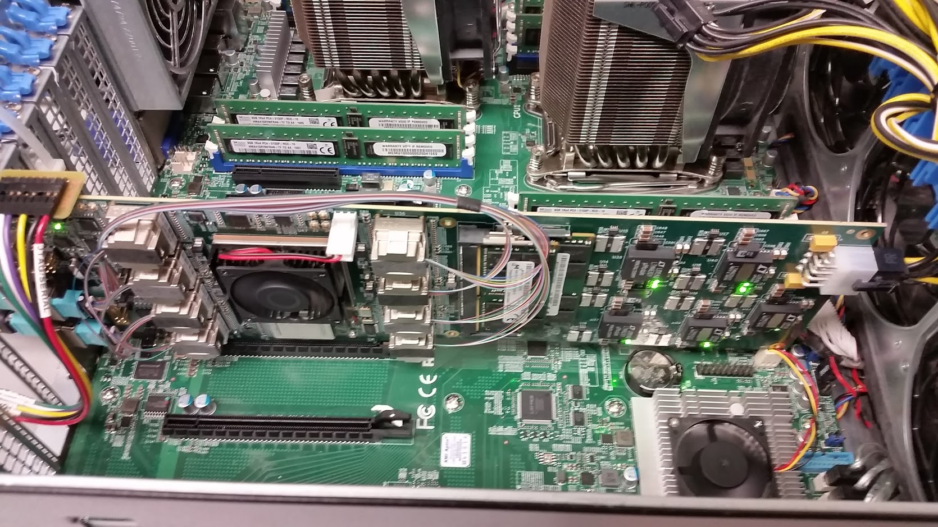
The Readout
ALICE SAMPA chip
32 channels 10bit sampling ASIC
Preamp/shaper, ADC
Optional DSP functions
5GBit/s fiber link
256 pads/FEE
25 FEE/sector
FEE with 8 SAMPAs
256 channels
ATLAS FELIX Card (“DAM”) – 24 FEE’s
FELIX Card in a standard PC (“EBDC”)

Slide 12
DAQ Overview
Event Builder
FEM
10+ Gigabit
Network
Switch
DCM
DCM2
Buffer Box
DCM
DCM
DCM
DCM
ATP
FEM
DCM
SEB
DCM
ATP
Buffer Box
DCM
DCM2
DCM
DCM
ATP
DCM
FEM
DCM
SEB
DCM
ATP
Buffer Box
DCM
DCM
DCM2
ATP
DCM
SEB
DCM
DCM
ATP
Buffer Box
FEE
ATP
DCM
DCM
DAM
EBDC
ATP
DCM
Buffer Box
FEE
ATP
DCM
DCM
DAM
EBDC
ATP
Buffer Box
DCM
FEE
ATP
DCM
DAM
EBDC
DCM
ATP
Buffer Box
DCM
Data Concentration
Computing
Facility
Interaction Region
Rack Room
Rack Room
Rack Room
DCM-2 receives data from digitizer, zero-suppresses and packages
SEB collects data from a DCM group (~35)
EBDC Event Buffer and Data Compressor
ATP Assembles events and compresses data (~60)
Buffer Box data interim storage before sending to the computing center (7)

Slide 13
How I explain Streaming Readout to the Public Affairs guys
Think of the recordings of a shopping mall’s security cameras
You keep, say, a month worth of video
Most of the time, absolutely nothing of interest happens
But when there’s something going on, a burglary or so, you go back and cut out the 15 minutes of video in question for the cops
Think of those 15 minutes as the long-term stored data
Translate to sPHENIX…
We record the arrival of charge continuously
But at the end, we are really only interested of the piece of “recording” at the time we triggered an actual event
So stored “events” for the TPC will be a series of short “charge recording segments” covering the times when we triggered the rest of the experiment.

Slide 14
Event Building – or not?
If we stay with the “security camera” paradigm for a moment, that works nicely for events that are far apart – 15mins video at 3pm, another 15 mins at 5:30, and so on.
But if the events become so frequent that many of them are closer together than those 15 mins, the video clips now have a lot of overlap.
Then you might as well keep one continuous “movie”. Segmenting not only offers no longer any savings, but even increases your storage demands due to overlap.
We are preparing for both scenarios.

Slide 15
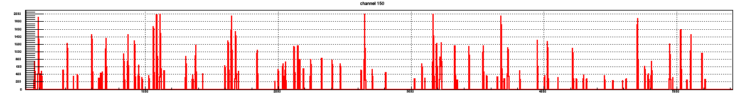



TPC streaming readout + triggered events
The streaming data are recorded all the time, and broken up in chunks above threshold
Only chunks correlated with triggered events are then kept
✖
✖
✖
✖
This results in a greatly reduced data stream
Would allow to reduce the streaming output to a classic event-building problem
“late-stage triggered mode”
Caveat: if the accepted events’ waveforms overlap too much, we incur a partial data replication
Ok up to ~15%...

Slide 16
TPC Continuous readout
We are designing a “hybrid” DAQ back-end that combines trigger and continuous readout
Capable of catering to the “classic” triggered detectors (chiefly the calorimeters)
At the same time, we read the streaming detectors
Event Builder
FEM
10+ Gigabit
Network
Switch
DCM
DCM2
Buffer Box
DCM
DCM
DCM
DCM
ATP
FEM
DCM
SEB
ATP
DCM
Buffer Box
Can we
afford to
run the TPC
in “late stage
triggered”
mode?”
DCM
DCM2
DCM
DCM
ATP
DCM
FEM
DCM
SEB
DCM
ATP
Buffer Box
DCM
DCM
DCM2
ATP
DCM
SEB
DCM
yes
DCM
ATP
Buffer Box
FEE
ATP
DCM
DCM
DAM
EBDC
ATP
DCM
Buffer Box
FEE
ATP
DCM
DCM
DAM
EBDC
ATP
Buffer Box
DCM
no
FEE
ATP
DCM
DAM
EBDC
DCM
ATP
Buffer Box
DCM
(next Slide)
Reduction to a classic event building problem as shown before

Slide 17
If we cannot do it…
We would then not assemble events fully and log the individual data streams
Shift the event building to a semi-offline process
Assemble some 10% of events for online monitoring
Easier to implement than a full event builder!
But “verification” plays a much larger role
“no event mixing at the DAQ level”
This has been discussed for some time, and we have no doubt it would work
Event Builder
FEM
10+ Gigabit
Crossbar
Switch
DCM
DCM2
Buffer Box
DCM
DCM
DCM
DCM
FEM
DCM
SEB
DCM
Buffer Box
DCM
DCM2
DCM
DCM
DCM
FEM
DCM
SEB
DCM
Buffer Box
DCM
DCM
DCM2
DCM
SEB
DCM
DCM
Buffer Box
FEE
DCM
DCM
DAM
EBDC
DCM
Buffer Box
FEE
DCM
DCM
DAM
EBDC
Buffer Box
DCM
FEE
DCM
DAM
EBDC
DCM
Buffer Box
DCM
No ATP’s!

Slide 18
Envisioned Data Rates
Streaming TPC is the 800-pound gorilla in the room – 140 peak, ~100Gbit/s average
Could be more, time will tell
Other systems –> 135Gbit/s total average
Still some front-end design considerations to be worked out – none of them will decrease the rate, on the contrary..
“Average” vs “really long-term average” rates may help
Still, we expect some 50PB of data volume in our first physics run.

Slide 19
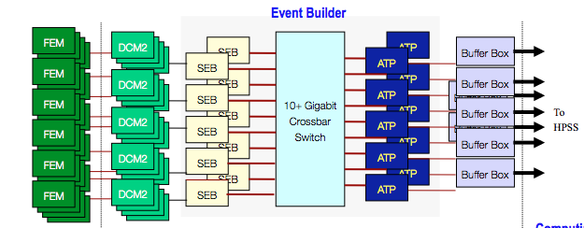
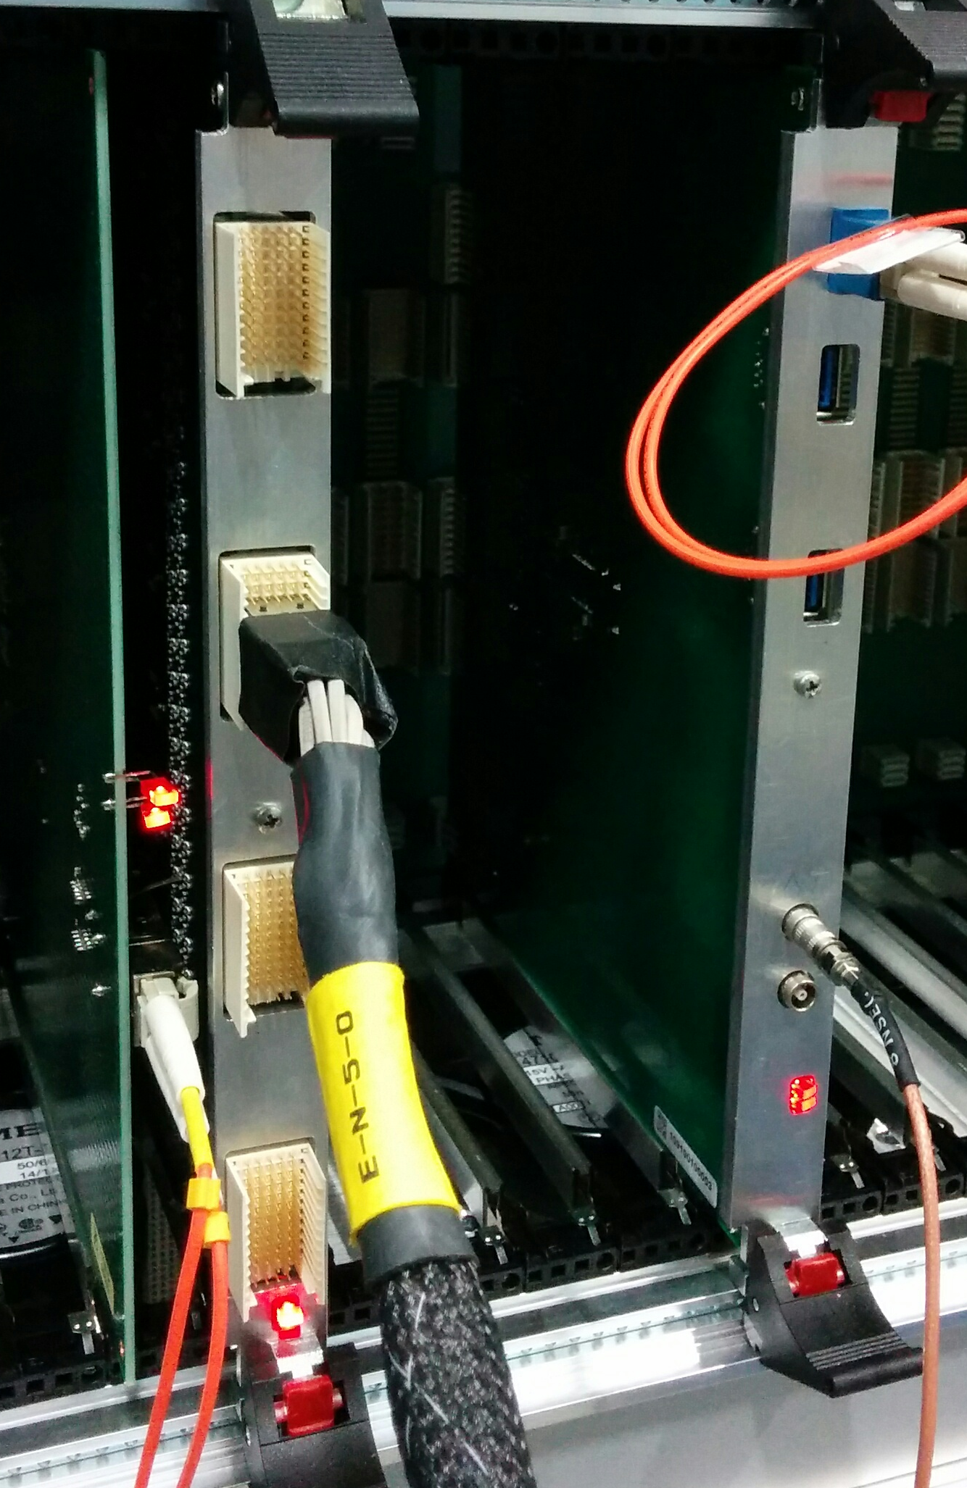
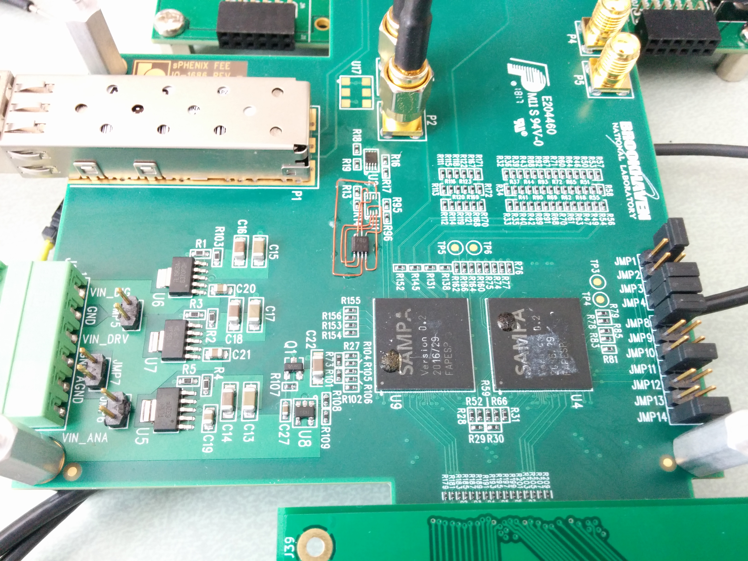
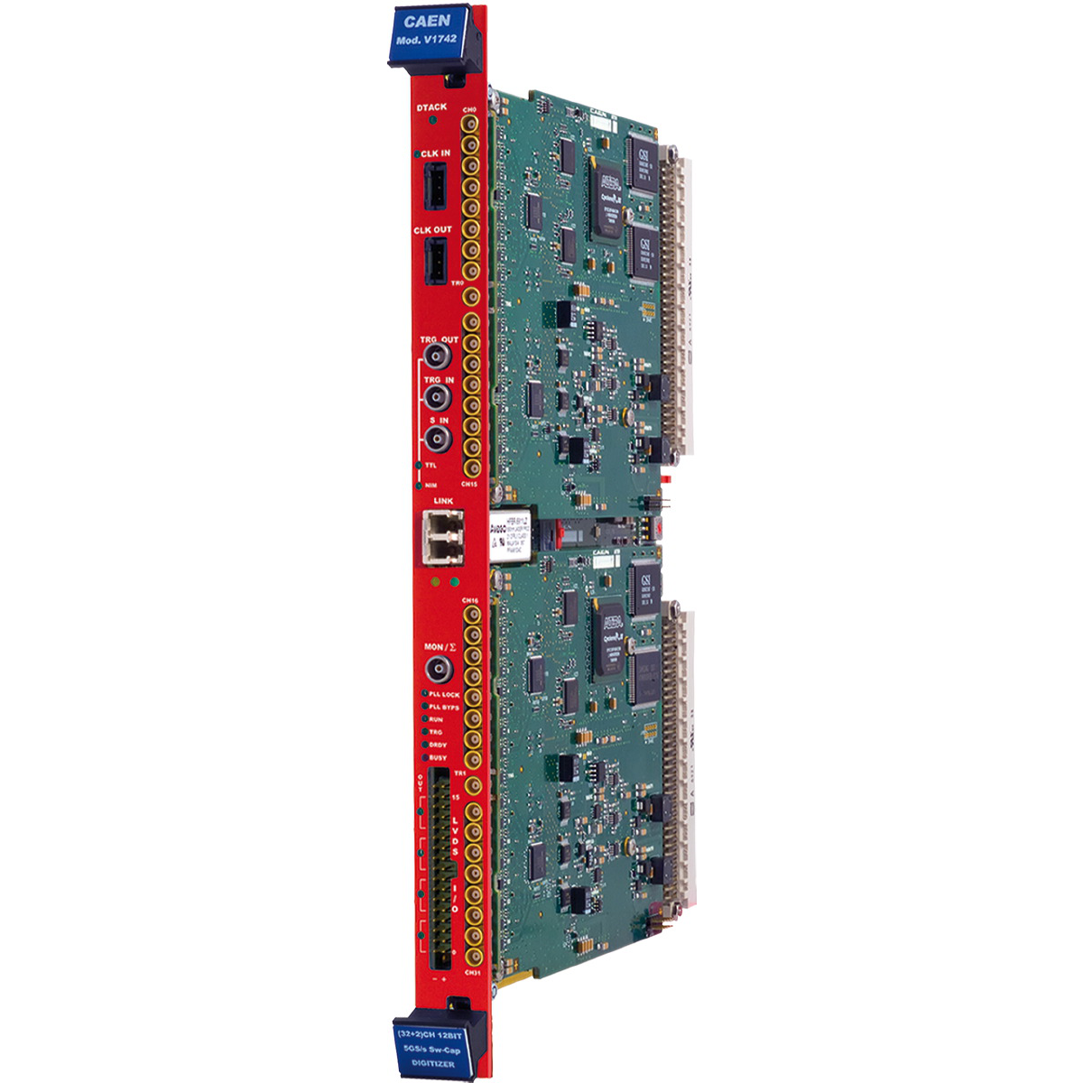
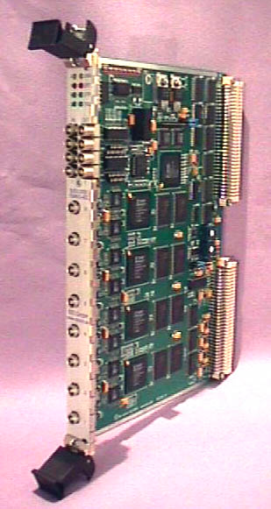
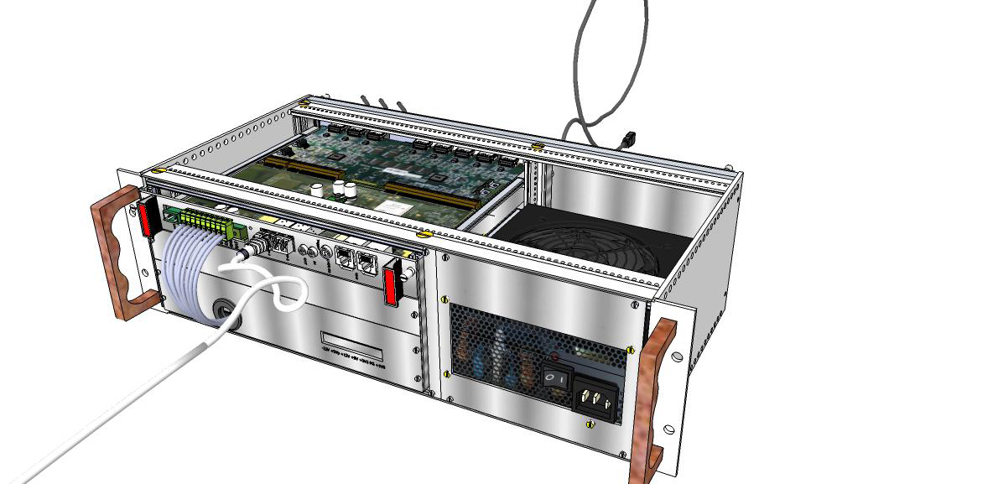
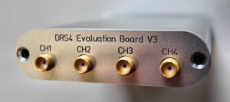
RCDAQ - R&D-themed part of the system
sPHENIX Calorimeter electronics
The RCDAQ DAQ System
Cut out the event builder (not much need right now)
Log data at the EVB “input point” instead
Same technology, reading out our front-end here will seamlessly integrate into the big thing
Powerful scripting/automation features
“Real” online monitoring often has it roots in test beam code
Addt’l support for a large variety of non-sPHENIX gear
~20 RCDAQ copies around in the sPHENIX orbit
About a dozen more systems in use by external groups
Supported on high-end 32core PC to Raspberry Pi
FEM
DCM
DCM
PC
DCM
DCM
TPC SAMPA Chip and ATLAS Felix Board
DAM
PC
PC
RD51 SRS, DRS4, VME gear…
some 40 supported devices

Slide 20
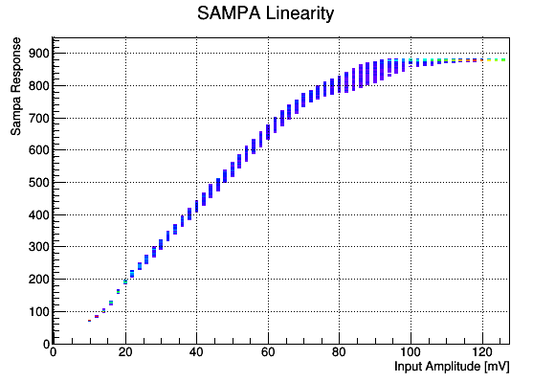
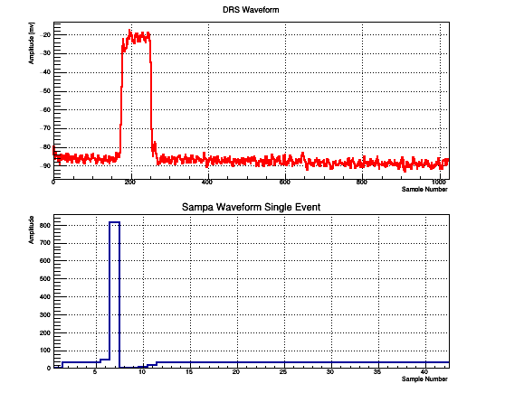
FEE R&D and DAQ integration
Each new piece of readout electronics gets its readout implemented in RCDAQ
Completely reusable in the “Big DAQ”
Use RCDAQ’s amenities for otherwise tedious tasks
This early setup uses the full FELIX readout chain
Example: Gain linearity measurements
Script it! Humans will make mistakes w/ repetitive tasks
Step through some 60 2mV steps in a pulse generator
Measure SAMPA response together with a DRS4 measurement
TPC SAMPA Chip and ATLAS Felix Board
DAM
PC
for amplitude in $(seq 10 2 130)
do
$PULSER_EXEC write $amplitude
rcdaq_client daq_begin
wait_for_run_end.sh
done

Slide 21
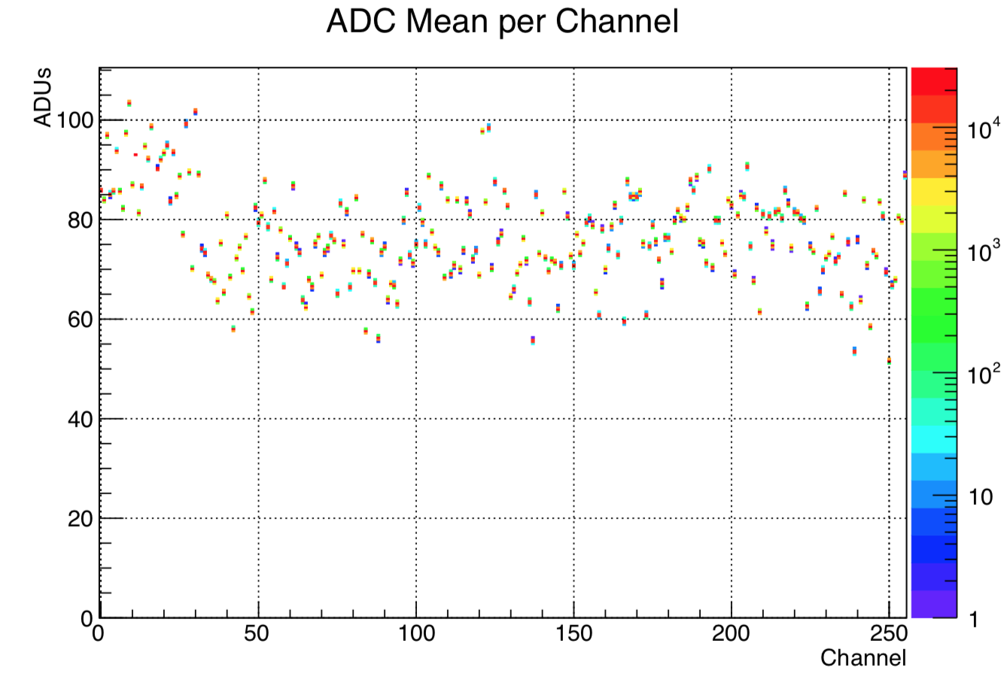
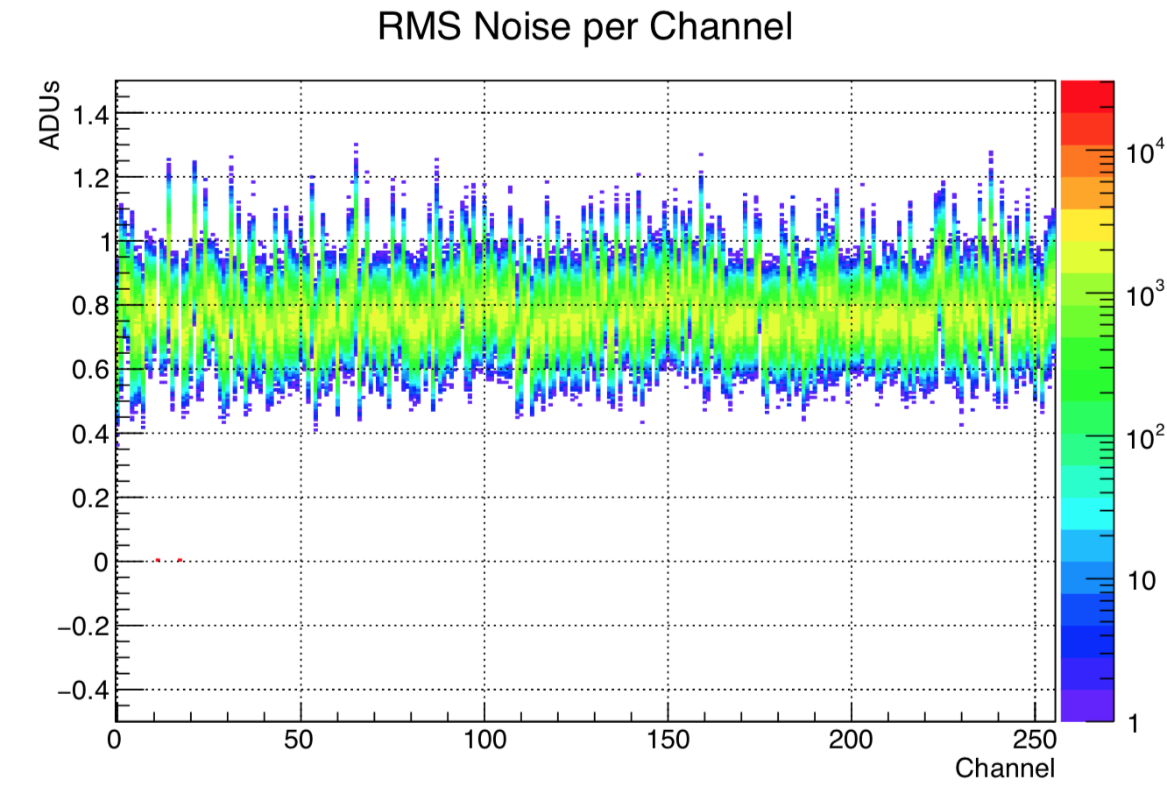
Hot off the press…
This is from Friday Evening
The first full readout chain data from the 8-chip card
Looks good so far, but the main point here is that we can actually read the card 10 days after it was delivered

Slide 22
Summary
Current focus on understanding the total data rate and reduction strategies
Actual GEM data and simulated data in hand to understand the tracking performance
Ability to read all flavors of sPHENIX detector electronics (some are prototypes)
Most electronics has withstood the “strain of a testbeam” (TPC to go there next week)
Solid concept and simulations with streaming readout
Streaming-supporting data formats etc in place
We also have data from the MicroVertex detector, no time to show more today

Slide 23
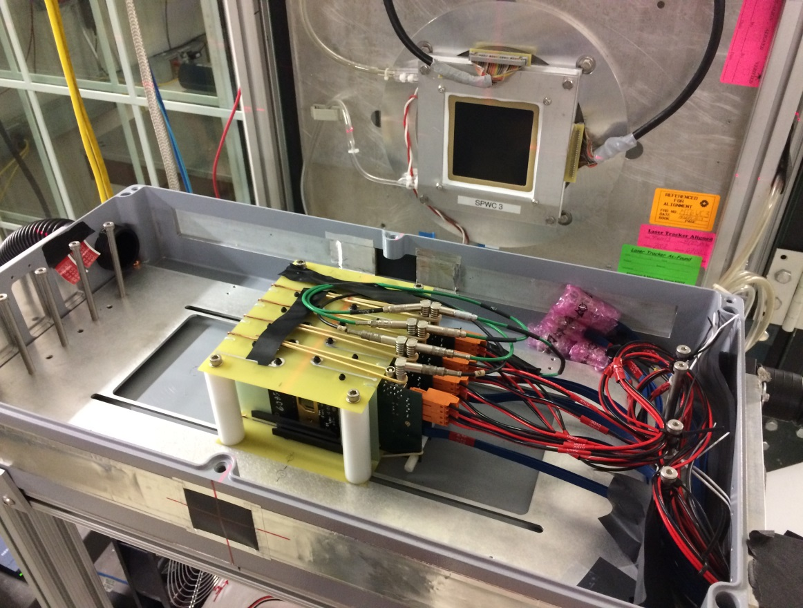
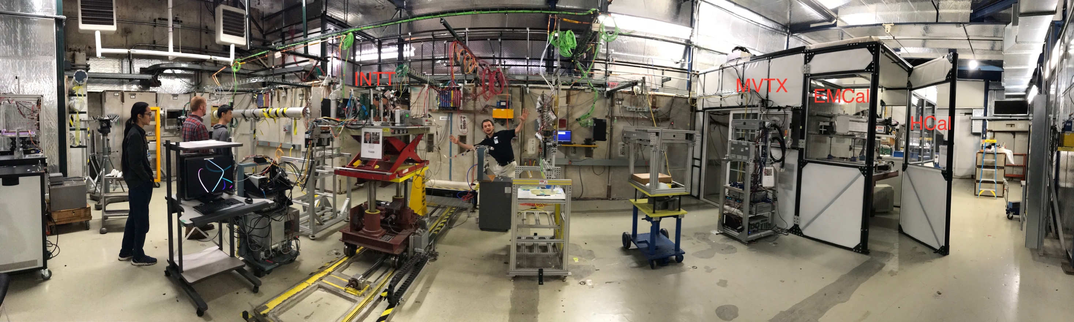
MVTX, briefly
The MVTX prototype was taken to the FermiLab test beam
ALICE “ALPIDE cards”
MVTX also uses the FELIX card (and RCDAQ)
4-layer “MAPS telescope”
4-ALPIDE Telescope;
5m long SamTec cables

Slide 24
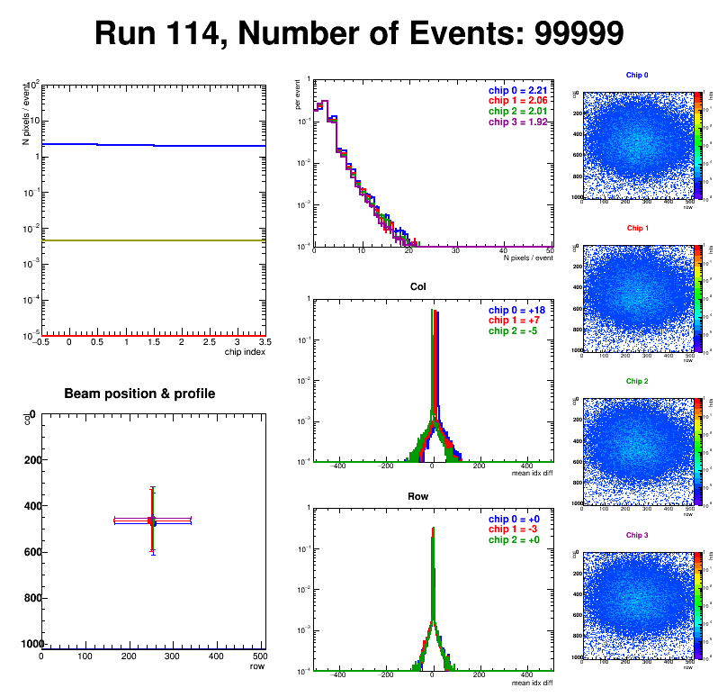
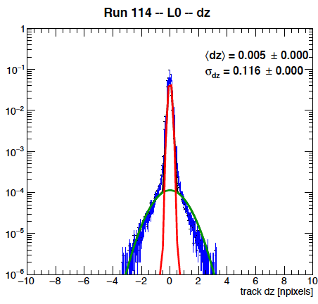
And it worked…
Successfully operated the full readout chain
  RU Configured and readout 4 ALPIDEs
  FELIX successfully integrated into RCDAQ
Sensor Performance
  Cluster Size
  Threshold parameters
  trigger delay
High multiplicity events
  ALPIDE occupancy runs with 10cm lead bricks
Online Monitoring
  Hit distribution, relative alignment
Analysis confirmed telescope performance
  Hit resolution < 5 um

Slide 25
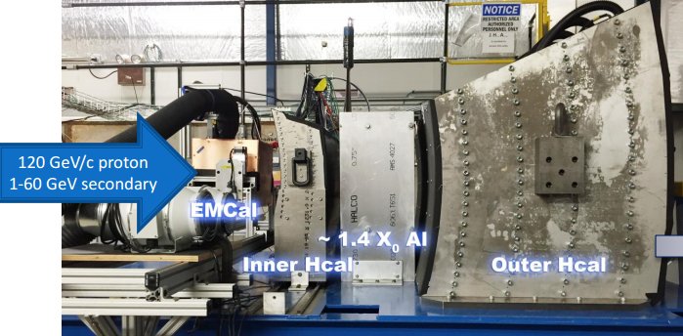
The last Test Beam

Slide 26
Data compression
Buffer Boxes (7)
After all data reduction techniques (zero-suppression, bit-packing, etc) are applied, you typically find that your raw data are still gzip-compressible to a significant amount
Introduced a compressed raw data format that supports a late-stage compression
This is what a file normally looks like
buffer
buffer
buffer
buffer
buffer
buffer
LZO
algorithm
Add new
buffer hdr
New buffer with the
compressed one as payload
This is what a file then looks like
On readback:
LZO
Unpack
Original uncompressed buffer restored
All this is handled completely in the I/O layer, the higher-level routines just receive a buffer as before.

Slide 27
Switch to distributed compression
The compression is handled in the “Assembly and Trigger Processors” (ATP’s) and can so be distributed over many CPU’s -- that was the breakthrough
The Event builder has to cope with the uncompressed data flow, e.g. 1200MB/s … 2500MB/s
Event Builder
Buffer Box
10Gigabit
Crossbar
Switch
ATP
The buffer boxes and storage system see the compressed data stream, 700MB/s … 1300MB/s
SEB
Buffer Box
SEB
ATP
SEB
ATP
Buffer Box
SEB
ATP
SEB
ATP
Buffer Box
To
HPSS
SEB
ATP
SEB
ATP
Buffer Box
SEB
ATP
Current compression levels:
100G become ~55G
→ 45%
SEB
ATP
Buffer Box
SEB
ATP
Buffer Box

Slide 28
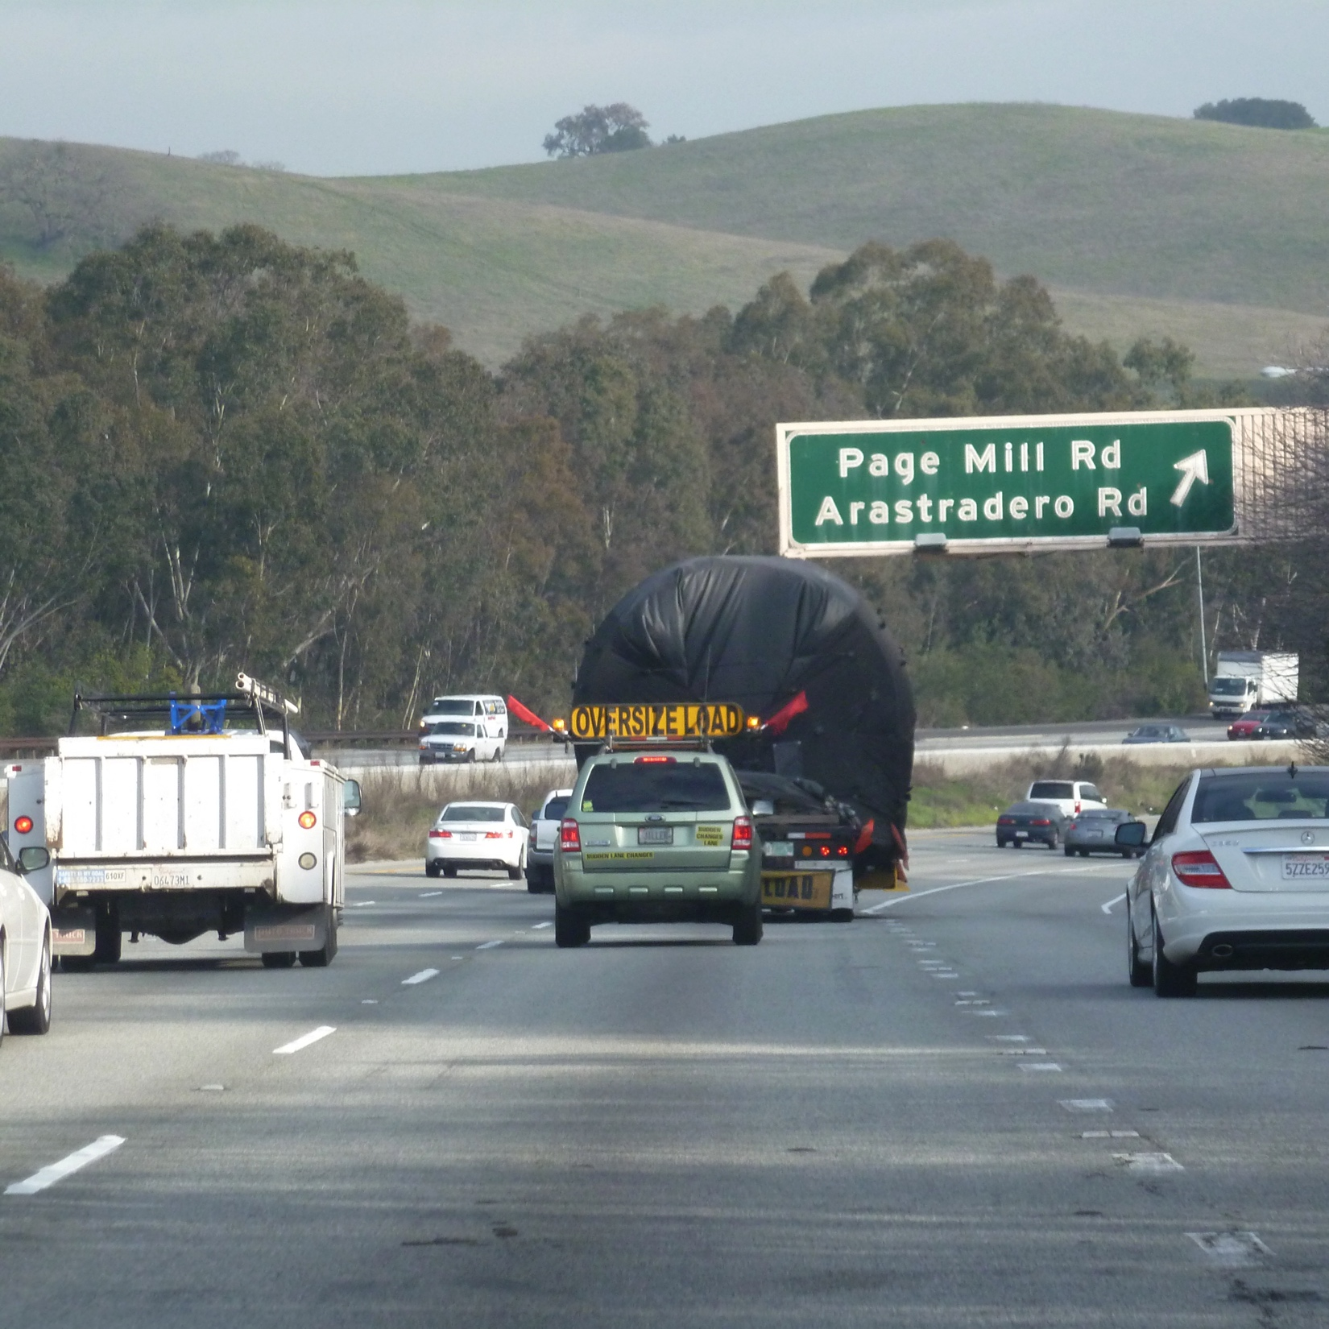
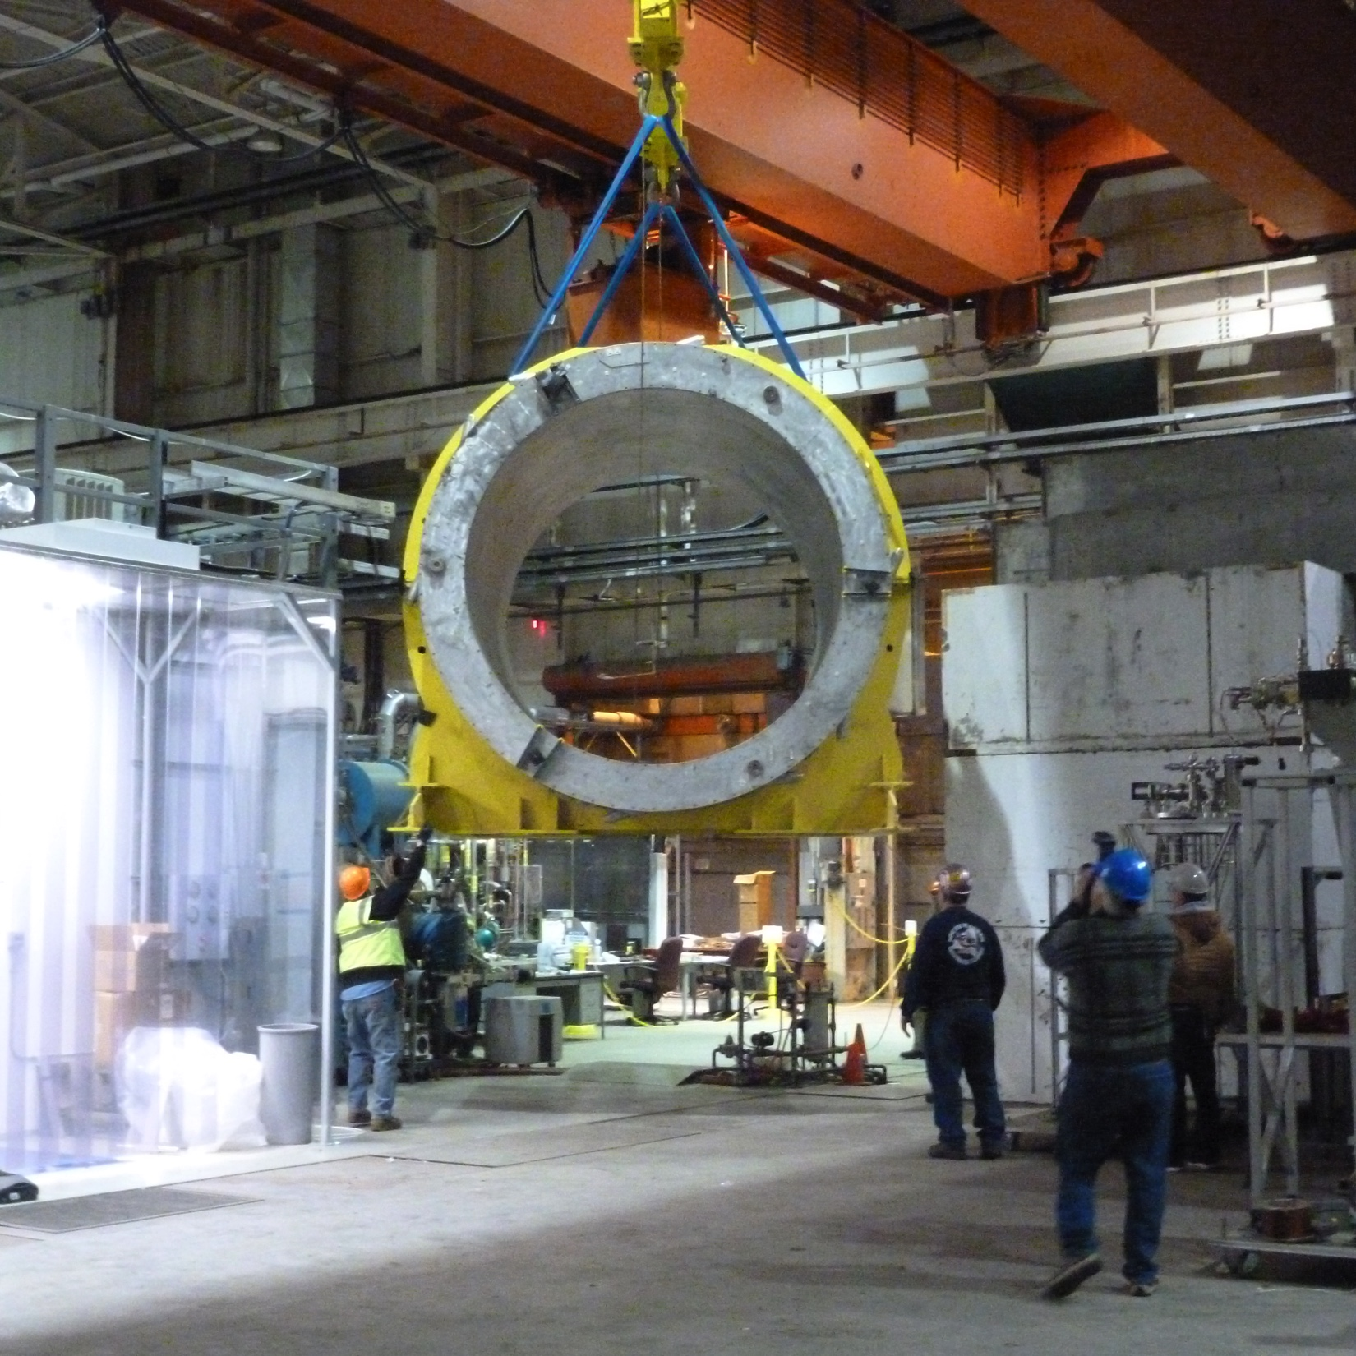
The BaBar Magnet
We had looked at magnets, but none of the available ones were quite right, then --
The BaBar magnet secured from SLAC after SuperB canceled, arrived at BNL in February 2015
Considerable additional equipment also acquired (power supplies, dump resistor, quench protection, cryogenic equipment)
Already passed a 100A low power cold test
Well suited to our needs without compromises
  1.5 T central field
  2.8 m diameter bore
  3.8 m long
  1.4X₀ coil+cryostat
This really gave a tremendous boost to this project!

Slide 29
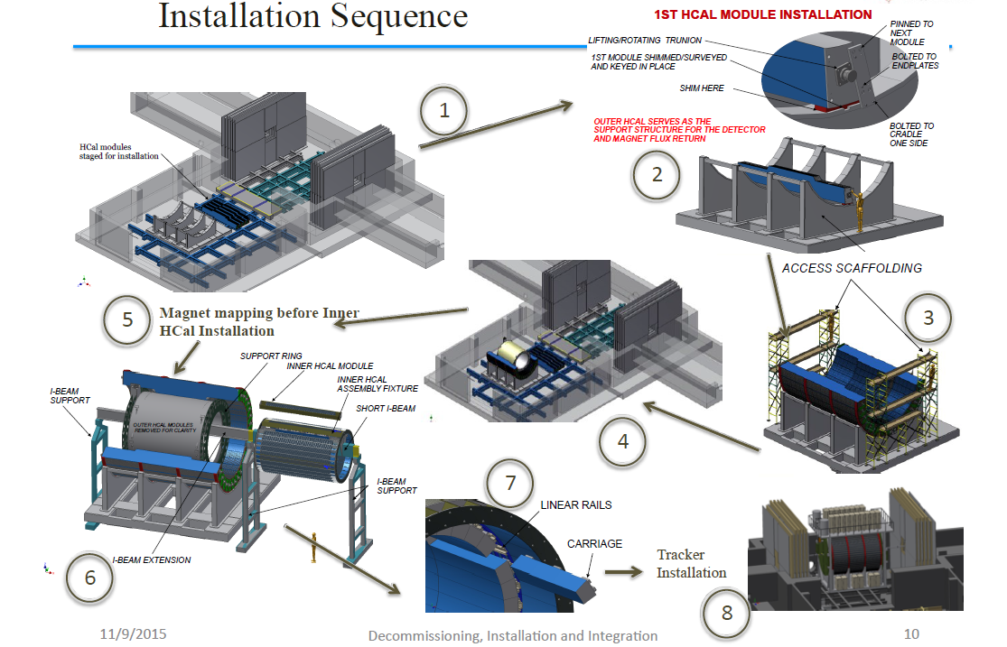
Assembly Instructions ☺
sPHENIX Monteringsföljd
Första HCal-modulinstallationen
Lyftande svängtapp
Första modulen shimsad
undersökt och injusterad.
Fastsatt med
nästa modul
Bultad till
ändplattorna
Yttre HCal fungerar som stödstruktur för detektorn och retur av magnetiskt flöde
Bultad till
hållaren en sida
HCal-moduler
förberedda
för installation
Byggnadsställningar
Kartläggning av magnetflöden
innan inre HCal-installationen
Stödring
Inre HCal-modul
I-balkstöd
monteringsfixtur
Kort I-balk
I-balkstöd
Linjärskenor
Vagn
I-balkförlängning
Detektorinstallation

