Slide 1
Pulsar3a: Next Generation ATCA Full Mesh General Purpose FPGA Based Processing Board
J. Olsen¹, T. Liu¹, Z. Xu², Z. Hu¹, C. Edwards³
¹ Fermi National Accelerator Laboratory, Batavia, Illinois, U.S.A
² Peking University, Beijing, CHINA
³ Northern Illinois University, Dekalb, Illinois, USA

Slide 2
Outline
Motivation and general R&D goals
ATCA background
Pulsar2a and Pulsar2b
New Pulsar3a
  Motivation and challenges
  Hardware subsystem changes
  Preliminary results
Conclusion and next steps

Slide 3
Pulsar Board R&D Goals
The Pulsar is a custom ATCA full mesh enabled FPGA-based processor board which has been designed with the goal of creating a scalable architecture abundant in flexible, non-blocking, high bandwidth interconnections. Initially motivated by silicon-based tracking trigger R&D needs for LHC experiments, the Pulsar is uniquely positioned as a flexible general-purpose platform ideally suited to situations where multiple processing engines need to be tightly coupled.
ATCA platform, full mesh backplane
Scalable, flexible, interconnected
High bandwidth interconnects
FPGA based, general purpose
Multiple processors, tightly coupled
Blur the distinction between FPGAs

Slide 4
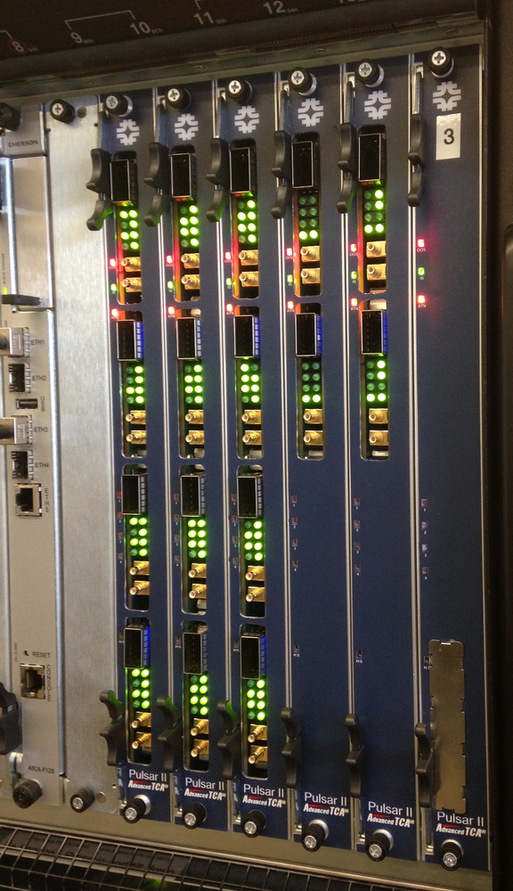
ATCA Background
Advanced Telecommunications Computing Architecture
  High availability
  Redundant 48V power
  Redundant control
  Hot swap everything
Unique full mesh backplane
  4 lanes between all slots
  10G – 40G – 100G
Large 8U x 280mm form factor
High power 300W+ per slot
IPMI management of intelligent field replaceable units

Slide 5
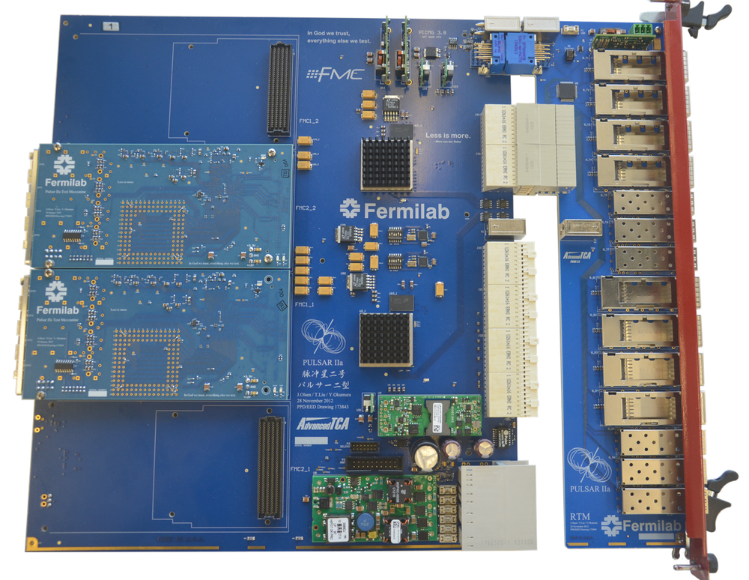
Pulsar2a (2012-2013)

Slide 6
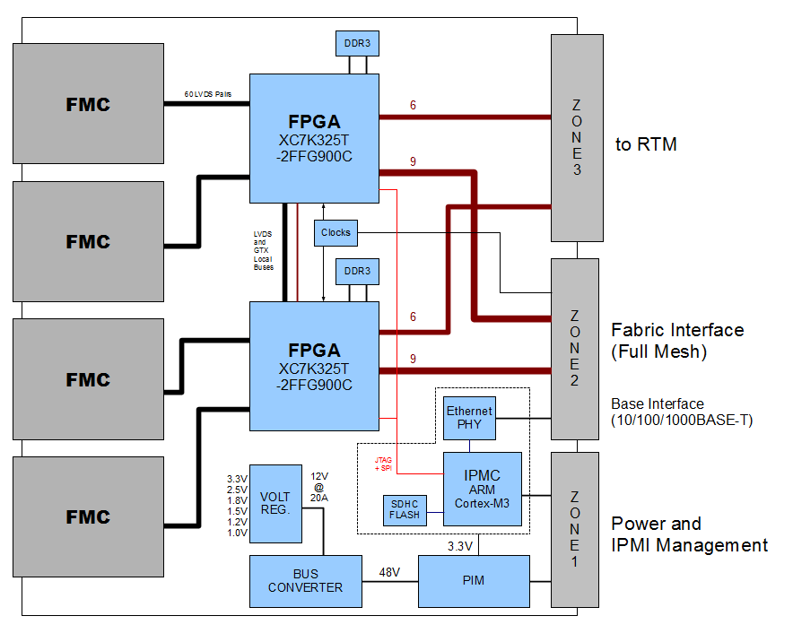
Pulsar2a Results
R&D goals met:
  First experience with 7 series FPGAs and Vivado toolchain
  Backplane and RTM GTX links working at 6Gbps
  LVDS working at 400MHz / 800Mbps DDR
  Switching regulators working OK
  Basic IPMC software working with shelf manager
  No mechanical issues

Slide 7
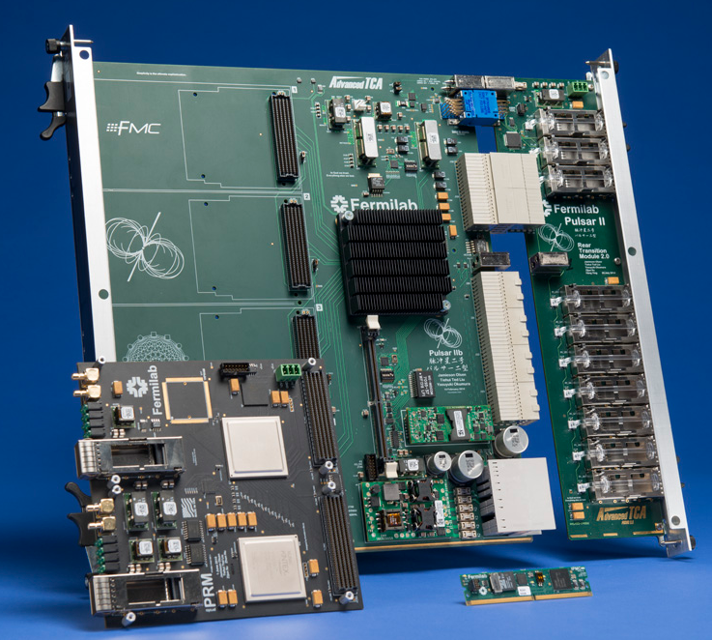
Pulsar2b (2014)

Slide 8
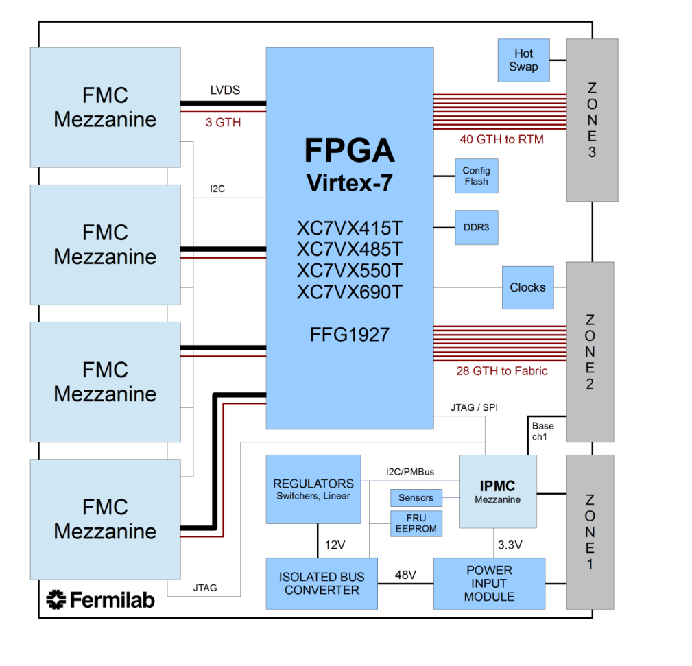
Pulsar2b Results
Gained experience with a large Virtex-7 FPGA (690T)
Successfully tested GTH transceivers to 10Gbps
  RTM optics
  Full Mesh Backplane (many different vendors!)
  FMC Mezzanines
New IPMC module
  Continue developing IPMI software
  Network interface (telnet, ftp, etc.)
  Xilinx Virtual Cable protocol

Slide 9
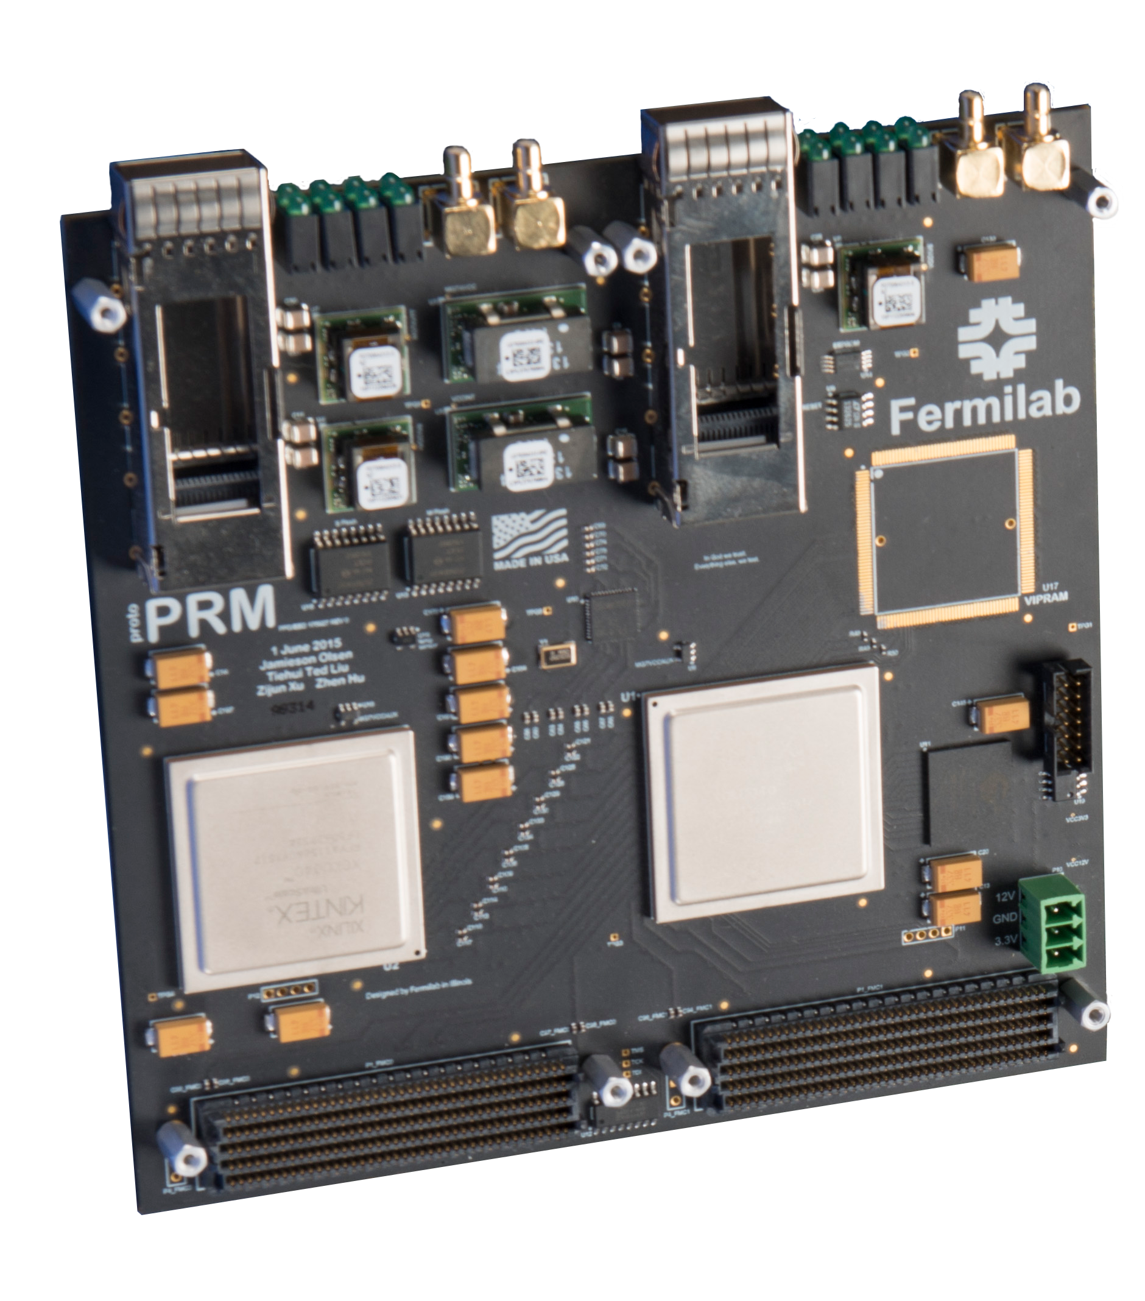
Pulsar2a/2b Expansion: Mezzanine Cards
Single and Double wide FMC mezzanine cards
Test high speed interfaces (LVDS, MGT) to Pulsar boards
Expand processing power (2 x KU060 FPGAs)
Standalone test platform for Pattern Recognition Associative Memory Devices
  ASIC
  FPGA
Track finder board in the
demonstration system
  Zhen’s talk on Monday

Slide 10
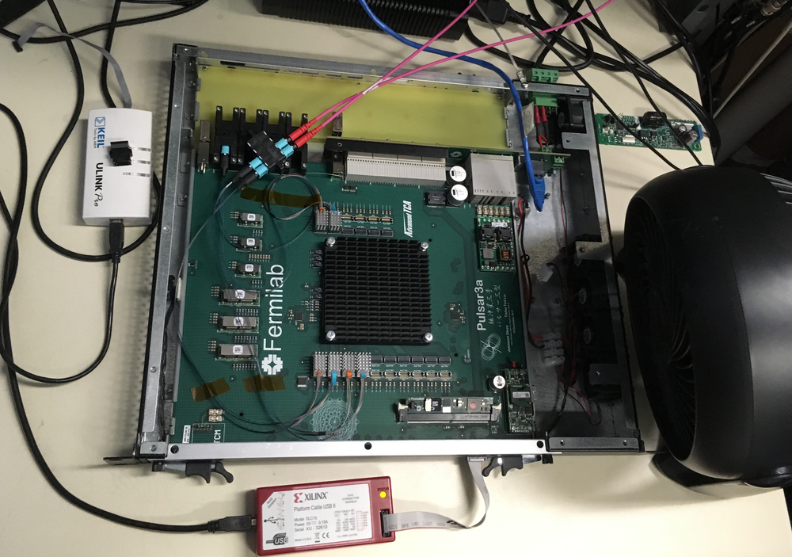
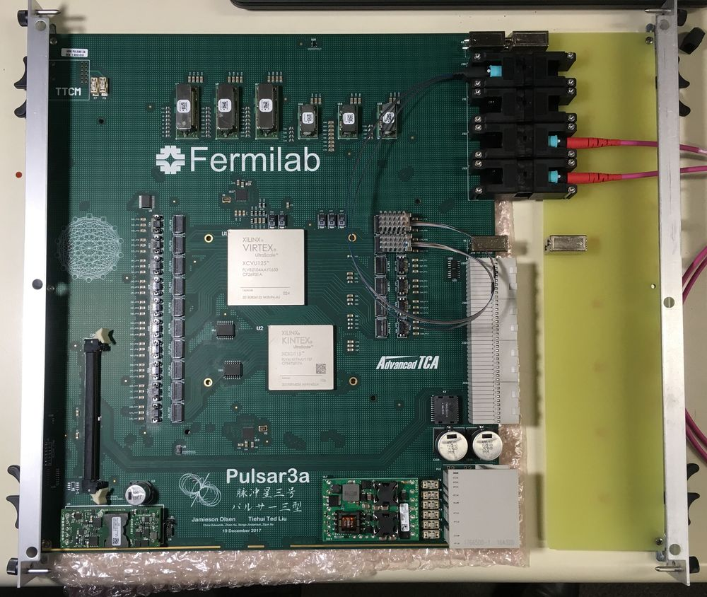
Pulsar3a (2017-2018)
CMS L1 tracking trigger R&D

Slide 11
Pulsar3a: Improvements over Pulsar2b
Fiber I/O bandwidth
  40 → 96 links
  10G → 16G/25G
Full mesh backplane bandwidth
  10G → 16G
Increased overall bandwidth
  1Tbps → 2Tbps
LVDS local bus
Logic resources
  690k LC → up to 5M LC
Board simplification
  Passive RTM
  Mezzanines removed

Slide 12
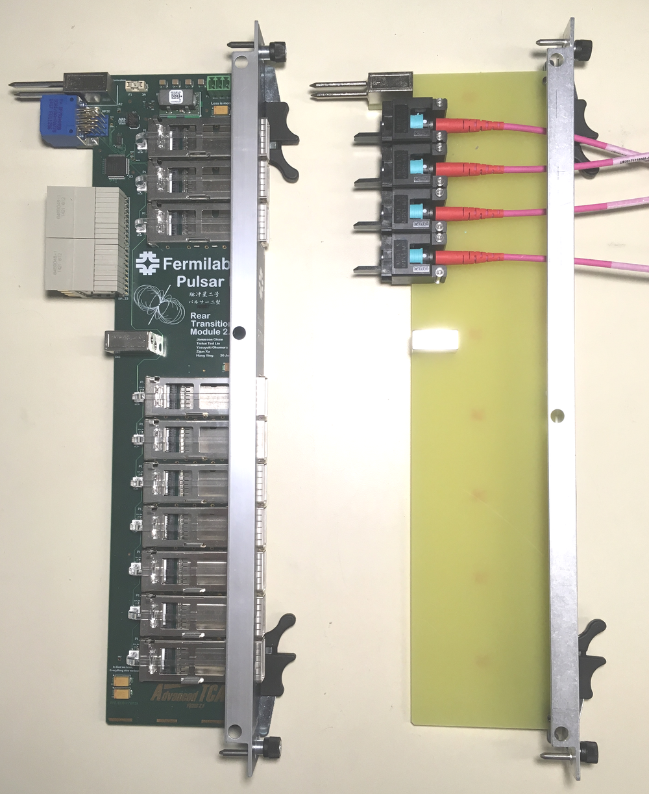
Pulsar3a: Rear Transition Module
Pulsar2a and Pulsar2b: optics on RTM
  SFP+ and QSFP+ modules up to 10Gbps per lane
  MMC microcontroller required
  Hot swap, e-keying, other misc.
  IPMI stuff
  Added complexity to IPMC software
  Long high speed traces + Zone-3 connectors
Pulsar3a: optics move inboard
  Passive optical RTM uses Molex blind mate MTP connectors
  Much shorter traces on Pulsar3a

Slide 13
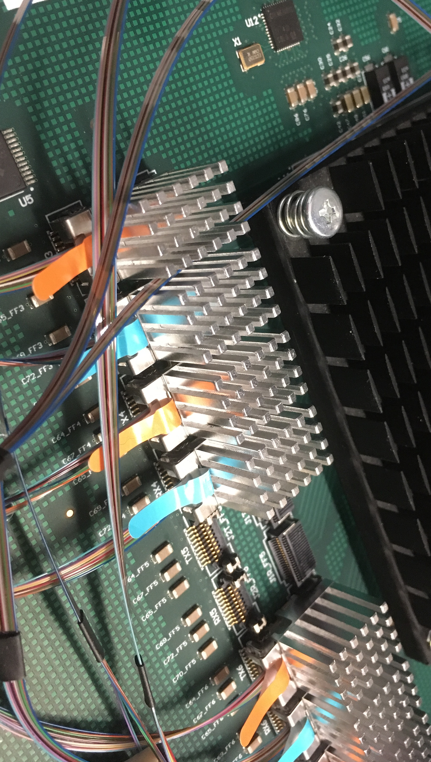
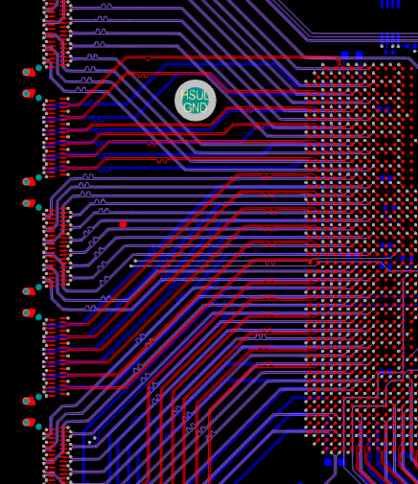
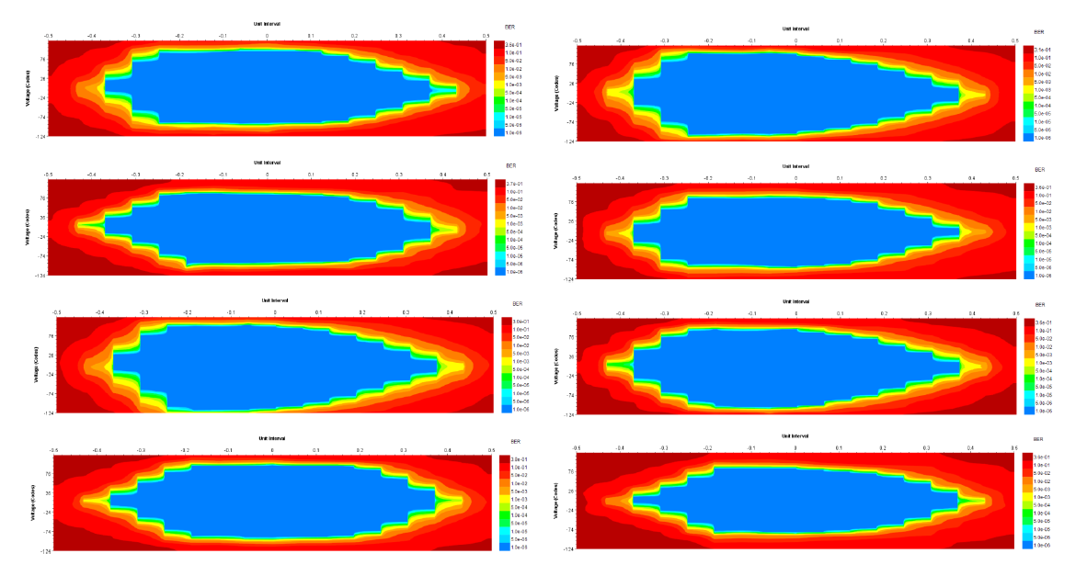
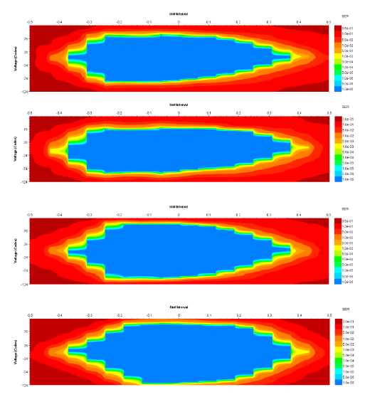
Pulsar3a: Optics
SAMTEC Firefly x12 optical modules
Up to 14Gbps per lane
Preliminary results show RX margin looks good at 12.5Gbps PRBS7 with default settings
BER <10⁻¹⁴
Ready for 28Gbps Firefly modules
  36 GTY transceivers up to 25Gbps
Optical full mesh with external passive mixer box / patch panel

Slide 14
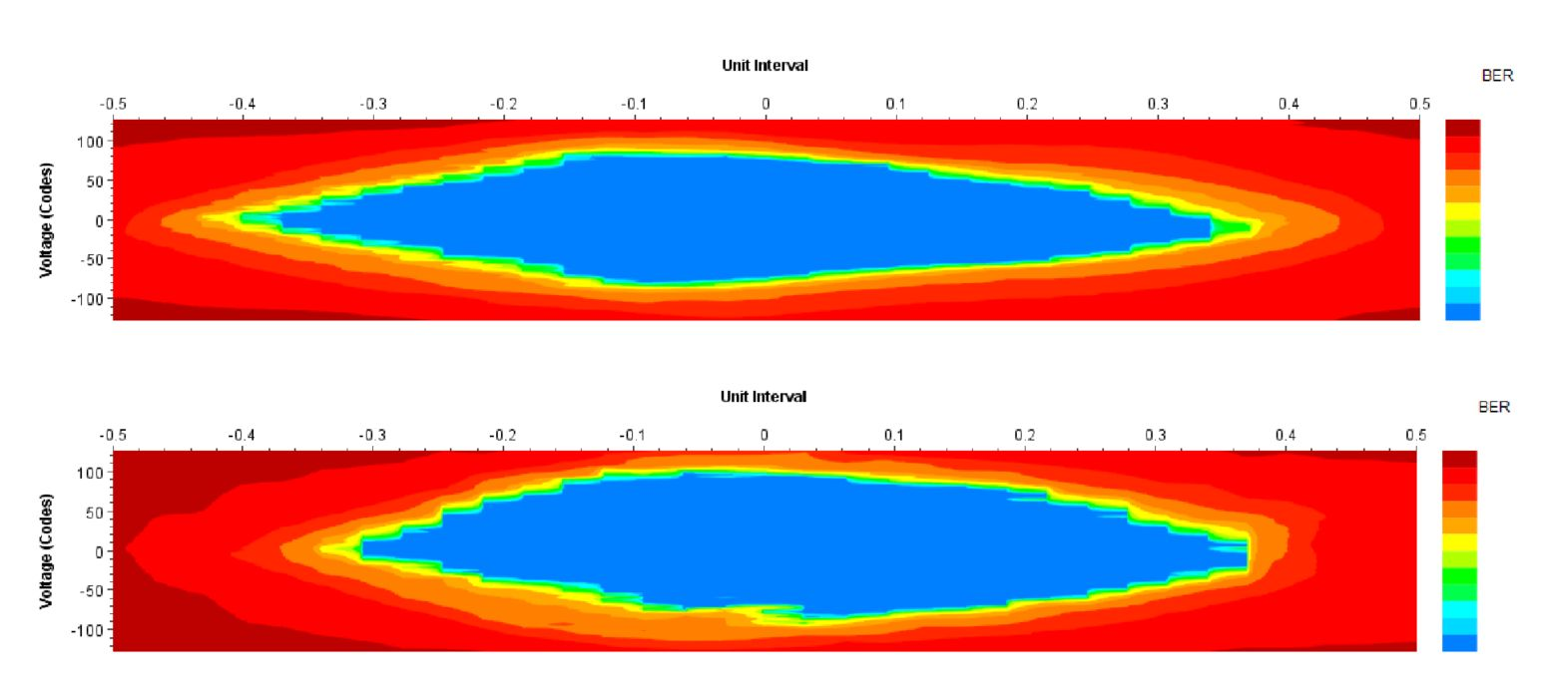
Pulsar3a: Backplane Fabric Interface
Slave FPGA drives most full mesh channels
  GTH transceivers up to 16Gbps in KU115 -2 speed grade
Preliminary results look promising at 15.625Gbps
  Loopback with Mini-backplane
  Tests Pulsar3a PCB traces and backplane connectors
Start backplane testing as soon as board #2 is ready

Slide 15
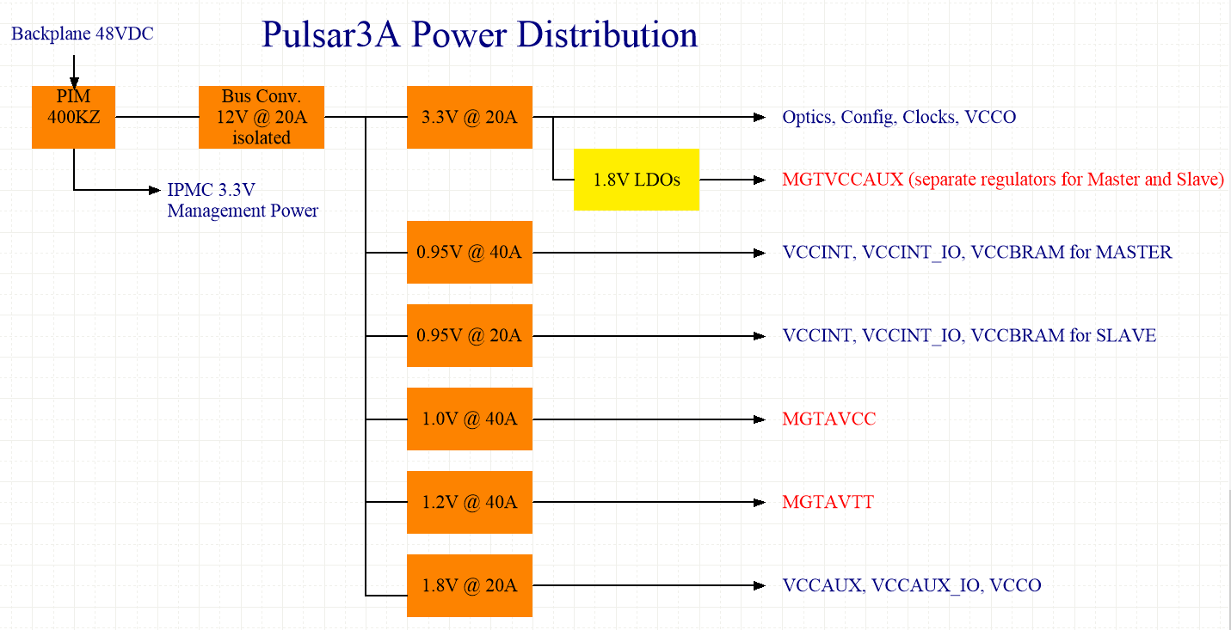
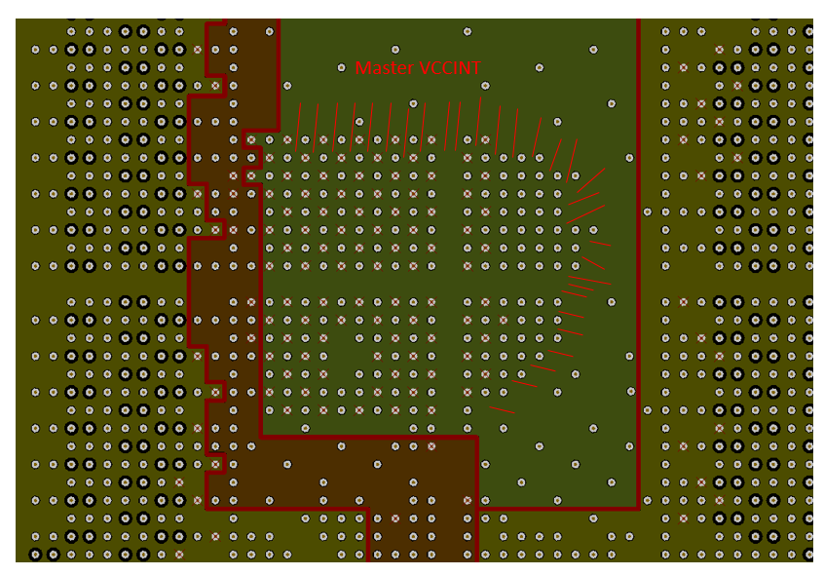
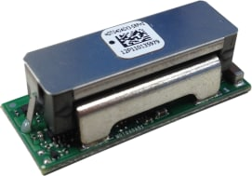
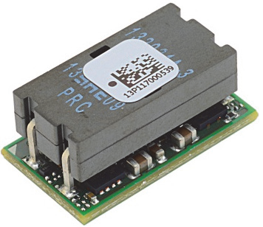
Pulsar3a: Power Distribution
Many high current power rails converge under the BGA. Split planes and lots of vias present challenges routing power to the FPGAs:
High efficiency non-isolated point of load switching regulators (40A and 20A)

Slide 16
Pulsar3a: Telemetry
Sensors all over the board
  PMBus regulators report temperature, voltage, current
  FPGA core temperature
Firefly modules
  Pages of status and control bits
Programmable low jitter clock synthesis chips for MGT reference clocks
All of these peripherals are I2C and connect to IPMC
Continuously scanned by IPMC
IPMI Sensor Data Records to Shelf Manager

Slide 17
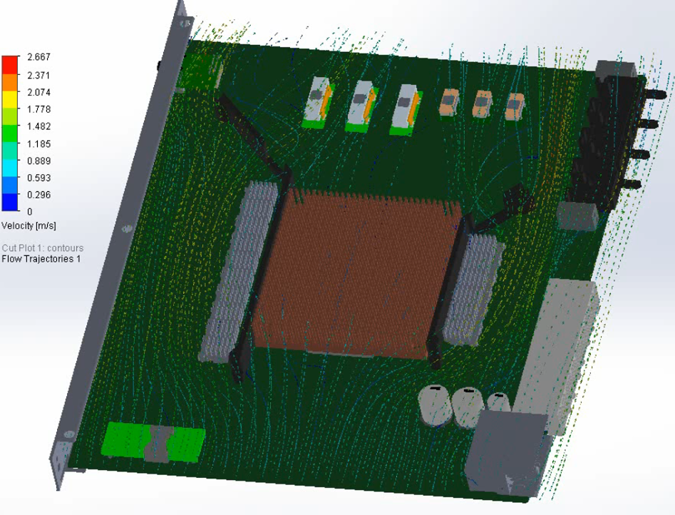
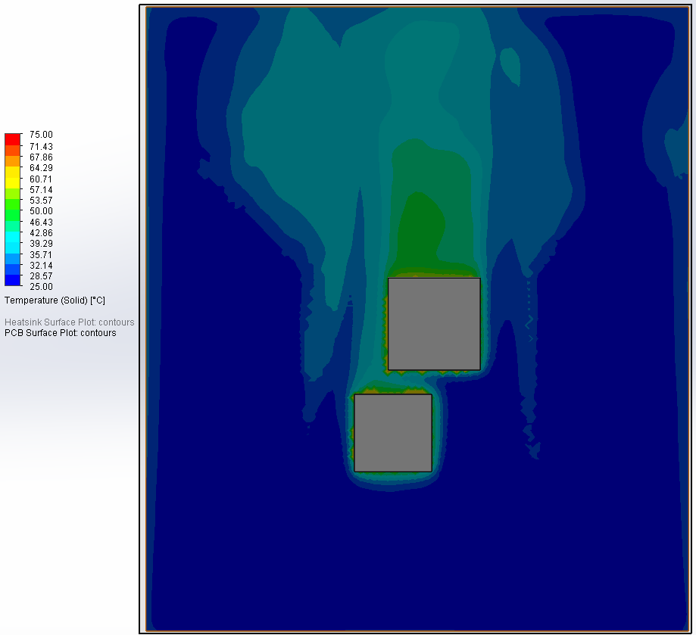
Pulsar3a: Thermal
Master FPGA: 60W
Slave FPGA: 30W
Airflow and heatsink modeling in Solidworks
Improve airflow with 3D printed air baffles
Several different heat sink designs ready for testing

Slide 18
Conclusion
Pulsar3a was initially motivated by CMS L1 tracking trigger R&D and builds upon the experience gained from Pulsar2b and Pulsar2a
Continue to pursue our design goals
  General purpose FPGA platform
  Scalable, flexible, interconnected
  High bandwidth interconnects
Presented a first look at the new Pulsar3a hardware testing
Next steps:
  More boards, more testing!
  Future board revision: precision clock distribution

