Slide 1
Implementation of a High-Performance Pattern Recognition Associative Memory in an FPGA
J. Olsen¹, J. Hoff¹, Z. Hu¹, S. Jindariani¹, T. Liu¹, J. Wu¹, Z. Xu²
¹ Fermi National Accelerator Laboratory, Batavia, Illinois, U.S.A
² SLAC National Accelerator Laboratory, Menlo Park, California USA

Slide 2
Outline
RAM and CAM
Pattern Recognition Associative Memory (PRAM)
Using PRAM
PRAM implementation in an FPGA
Performance and resource utilization
Pattern density optimization
Demonstration hardware
Conclusion

Slide 3
Intro: RAM vs CAM
Random Access Memory
  Address in, data out
  Simple architecture: registers + output mux
Content Addressable Memory (CAM)
  Inverse of RAM: data in, address out
  High performance, parallel lookup operation
  Complex + resource intensive
  Width and depth of memory array
  Matching options complicate design
  Output options complicate design

Slide 4
Intro: PRAM
Road!
A pattern
Described as a “CAM of CAMs”
Match on a multi-word pattern
  Multiple input buses (layers)
  Majority logic (perfect match, missing 1, missing 2, etc.)
Words may include ternary ‘X’ bits
Output the address of the
matching pattern (road)
PRAM is well suited for high bandwidth, low latency pattern recognition systems
  Brute force parallel
  No time for CPU iteration
Match
Match
Match
Match
Match
Match
Match
Match
Match
Match
Match

Slide 5
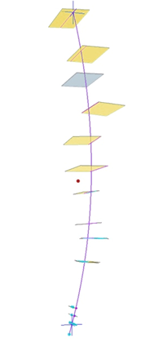
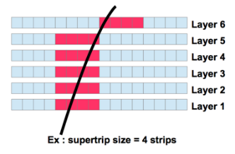
Example: L1 Silicon Track Trigger
Silicon Tracker
  ~10k modules
  ~10M pixels/strips
  ~100 Tbps data rate
  40MHz event rate
  ~4us latency
PRAM and FPGA work together
  Modules report hit coordinates (stubs)
  Store the full resolution hits in FPGA RAM (data organizer)
  Form superstrips and send to PRAM
  PRAM finds the coarse roads
  Roads are used to quickly recall full resolution hits (from data organizer)
  Full resolution hits used by the track fitter logic
  Output track parameters

Slide 6
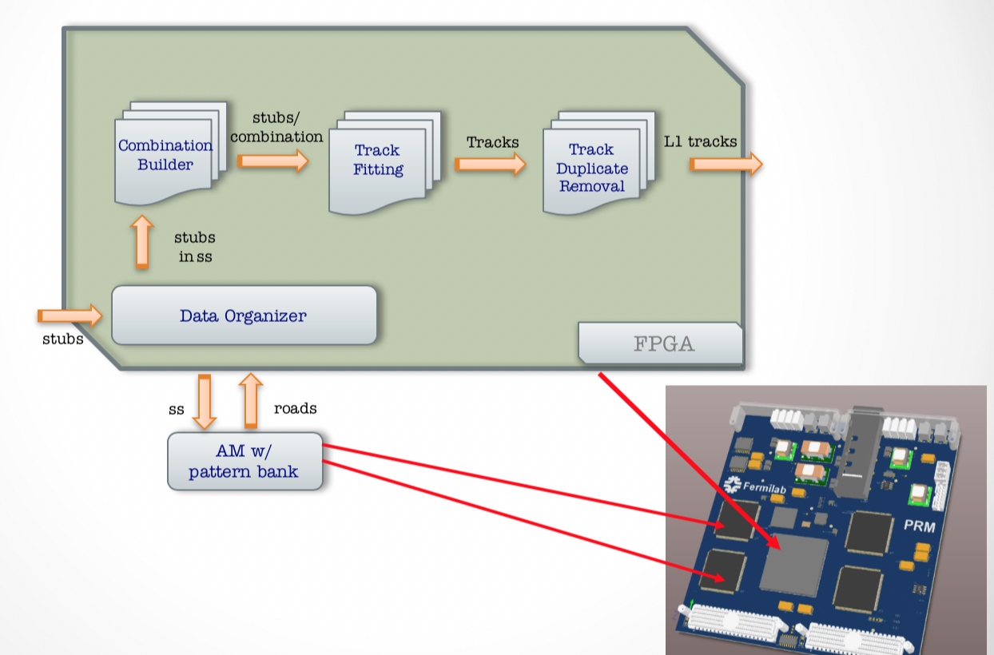
L1 Silicon Track Trigger

Slide 7
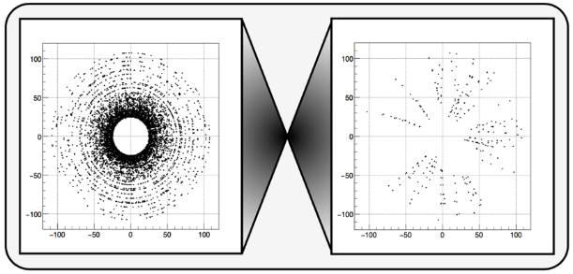
L1 Silicon Track Trigger
Before
After AM
Roads found

Slide 8
PRAM Implementations
ASIC
  High pattern density, high performance
  Predictable timing allows for some clever asynchronous logic structures
  Expensive and time consuming development cycles
  Difficult to change the system interface
    High speed serial transceivers, etc.
FPGA
  Pattern density and performance challenges
  Super flexible; quick development cycles
  Design, test, evaluate new PRAM-FPGA interfaces, priority encoder logic, sorting, etc.

Slide 9
FPGA PRAM Architecture
Functionally matches our ASIC implementation
Fully pipelined operation
  PRAM cells process the current event while previous event is read out
Front End: system interface + array of PRAM cells
Back End: capture road flags and serialize for readout

Slide 10
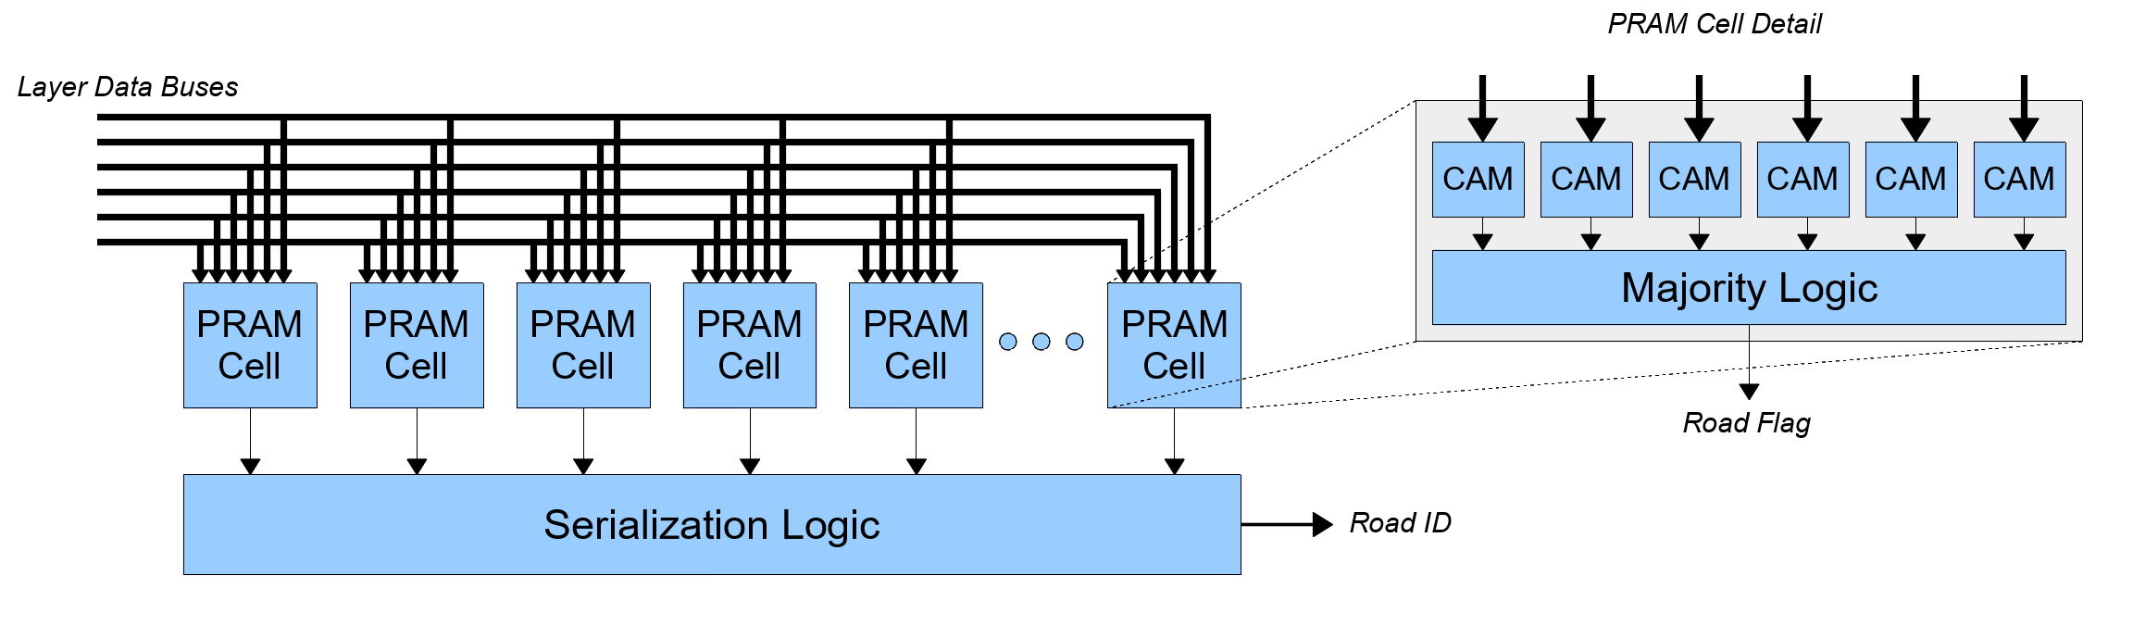
PRAM Cell
PRAM cell = CAMs + majority logic
CAM is 8~15 bits wide, 1 word deep
CAM match output latches until reset by next event
May support ternary logic (‘X’) in certain bit positions
Majority logic (6/6, 5/6, 4/6) set globally

Slide 11
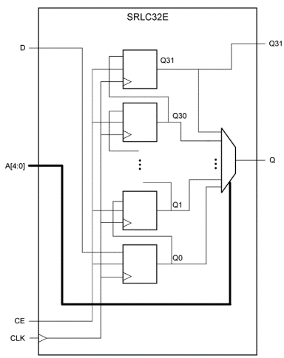
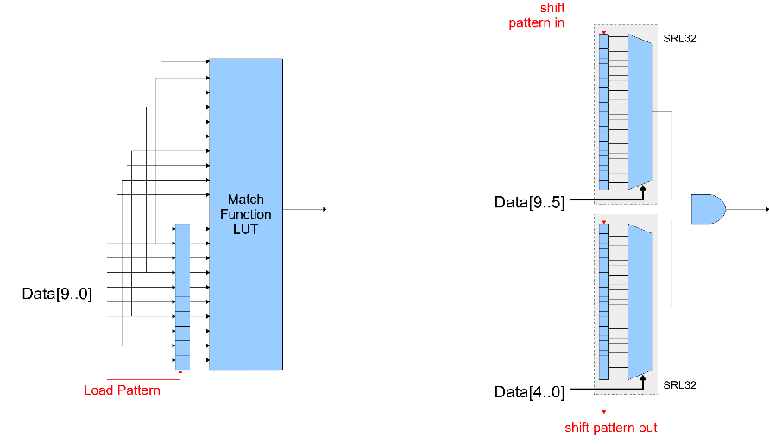
CAM Cell
The key is to make it COMPACT
Xilinx SRLC32E primitive in 7-series and Ultrascale architectures (SLICEM)
  Intended for variable length shift registers
Load pattern bits post-configuration
No extra logic required to support ‘X’ bits in pattern

Slide 12
Backend Serialization
LARGE array of road flags, sparsely populated
Challenge is to determine the address of each road in the array
  High speed readout
  Low latency
  Zero suppressed
Pipelined operation
  Serialization logic copies road flag bits at end of event
Multiple levels of priority encoders are typically used
ASIC and FPGA designs are cycle accurate, but internally very different
  ASIC binary “Fischer Tree”
  FPGA pipelined buffered merge…

Slide 13
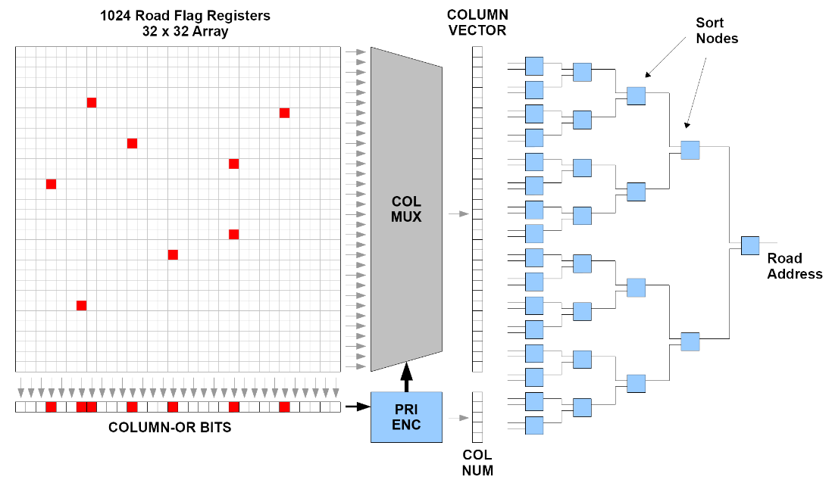
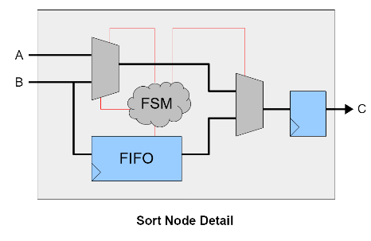
Backend Serialization

Slide 14
Implementation Summary
1k to 16k patterns tested
  6 layers
  9 or 10 bits per layer
  Global majority logic controls (6/6, 5/6, 4/6)
Pattern is loaded into PRAM cells serially
Input and output buses are DDR parallel
Meets timing with 240MHz clock
CLB SLICEM resources limit PRAM size (KU060)
  1k patterns = 8%
  4k patterns = 33%
  8k patterns = 65%
4k~8k patterns is still useful for proof of concept demo
  Carefully choose which patterns are loaded

Slide 15
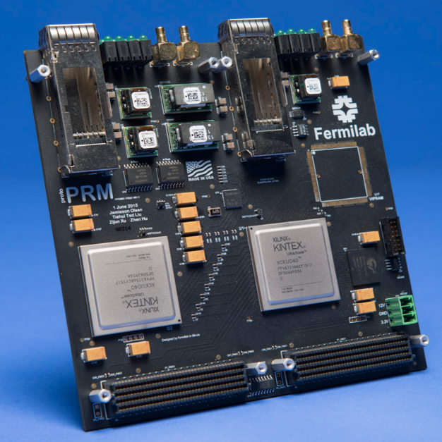
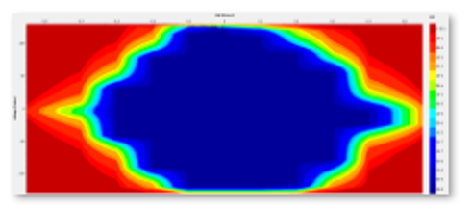
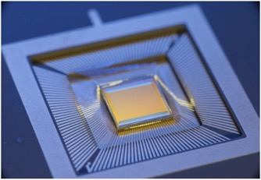
FMC Mezzanine Card
GTH Transceiver local bus @ 16Gbps
The double-wide FMC mezzanine supports both ASIC and FPGA PRAMs for direct side by side evaluation in hardware.
Socket for the 3D vertically integrated VI-PRAM ASIC

Slide 16
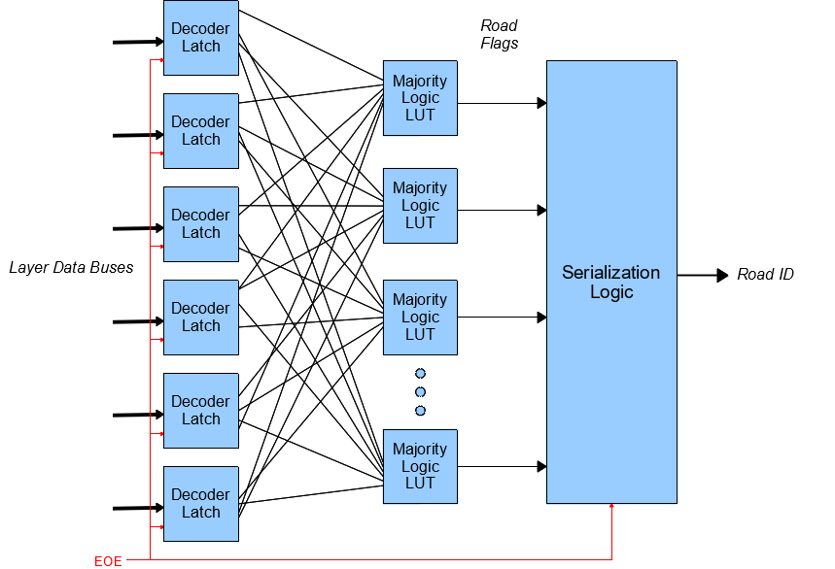
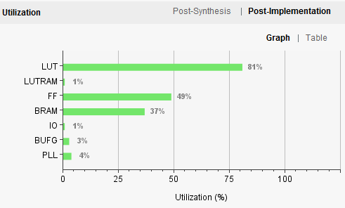
Increasing Pattern Density
Hard code patterns in HDL
Front end latching superstrip ID decoder
Pattern stored in the internal routing
Ternary bits are not free
Serialization logic dominates resource usage
Designs with 128k random patterns have been synthesized and fit into KU060 FPGA
Serialization logic optimization may allow for up to 256k patterns in KU060 (or larger device)

Slide 17
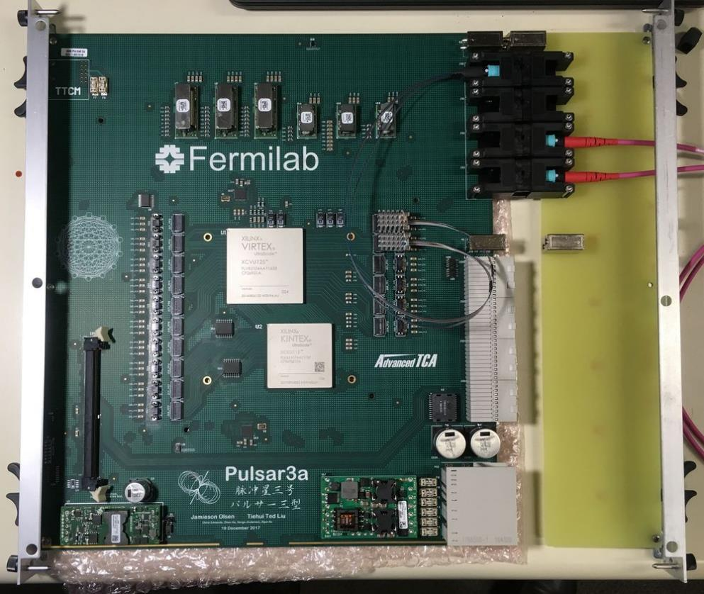
Pulsar3a
First board arrived May 2018!
Master FPGA (VU125)
Routing event data and track fitting
Slave FPGA (KU115)
PRAM!
For more information about Pulsar boards coming up!
Vertical Slice Tracking Trigger Demo System see Zhen’s talk from Monday.

Slide 18
Conclusion
PRAM builds on CAM and is well suited for high bandwidth, low latency pattern recognition systems
A usable PRAM can be realized in modern FPGAs
FPGA flexibility allows us to try out new ideas
  System interface
  Pattern loading / storage
  Backend sorting logic
We have designed and successfully implemented a few types of PRAM
  ~10k patterns loaded at runtime
  ~100k patterns hardcoded
Optimization studies continuing
New hardware for testing

Slide 19
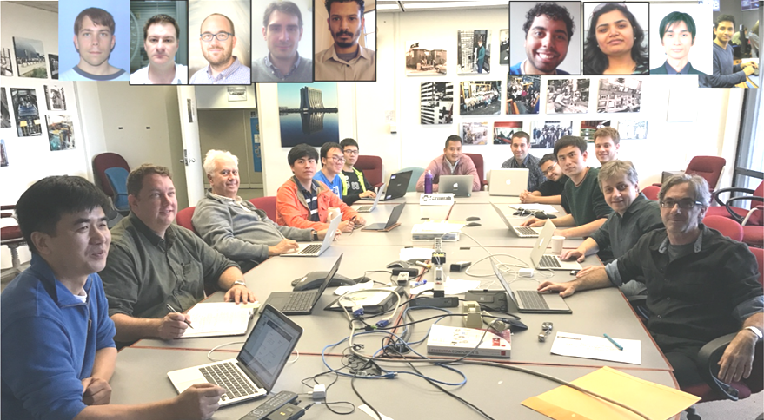
Thanks!

