Slide 1









System Demonstration of a Tracking Trigger using an Associative Memory Approach
Zhen Hu on behalf of Fermilab/LPC
Tracking Trigger R&D group, in collaboration with
21st IEEE Real Time Conference
Colonial Williamsburg, Virginia - USA

Slide 2
Contents
Motivation
System overview
  Multiplex in space and time
  Associative Memory (AM) introduction
System demonstration
  Hardware introduction
  Demonstrator at Fermilab
  Performance
Summary

Slide 3
History
Over the past few years, Fermilab in close collaboration with CMS institutions has established a generic R&D program
  Silicon-based Tracking Trigger based on Associative Memory approach
  The initial R&D concept was presented at Real Time 2012
  The initial hardware development was presented at Real Time 2014
Real Time 2018： excellent prototype results
  Allowed us to demonstrate at system level towards a working solution for the L1 tracking system in HL-LHC environment
  The techniques developed are rather generic and could have other applications far beyond tracking trigger, both within and outside HEP

Slide 4
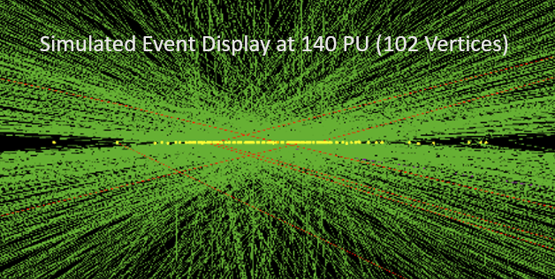
Physics Motivation: HL-LHC Trigger Upgrade
High Luminosity LHC in 2026
  40 MHz bunch crossing
  Up to 200 pileup (high occupancy)
  Tons of data
Current Level-1 Trigger will not work
  Current maximum bandwidth
    only 100 kHz (L1 output rate)
  For HL-LHC, current trigger system would give
    EG rate @25 GeV → 100 kHz
    Overall Trigger Rate → > > 1000 kHz (unsustainable) to reach physics goals
  Increasing trigger threshold → lose the opportunity of new physics with low threshold
Upgrade trigger system
  Must increase total bandwidth
  Must increase trigger capabilities
  Level-1 Tracking is a completely NEW handle
Notes:
Competition between accelerator and detector

Slide 5
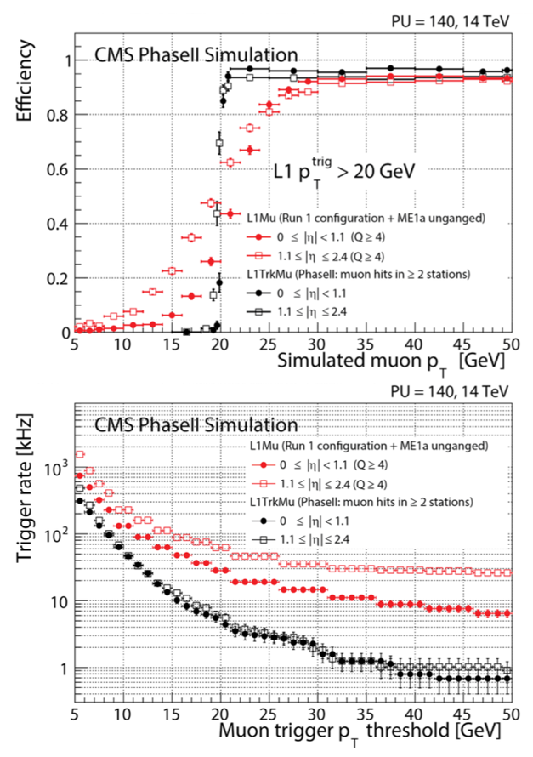
Track trigger advantage and challenge
Silicon based tracking trigger is crucial for CMS Phase2 upgrade
  Sharp turn-on efficiency curve
  Background rate reduction → allows for low object threshold
Huge challenges
  How to handle readout of the entire tracker?
    260 M channel, 40 MHz, 100 Tbps data (after on-detector suppression using pT-modules), 2e4 hits
  4 μs latency:
    Data distribution, track reconstruction, track fitting …
  Silicon-based L1 tracking trigger has never been realized under these conditions
Red： without L1 tracking
Black: with L1 tracking
TP for Phase-II Upgrade
Notes:
Competition between accelerator and detector

Slide 6
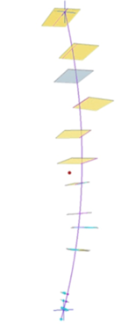
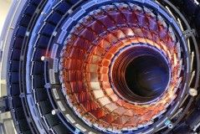
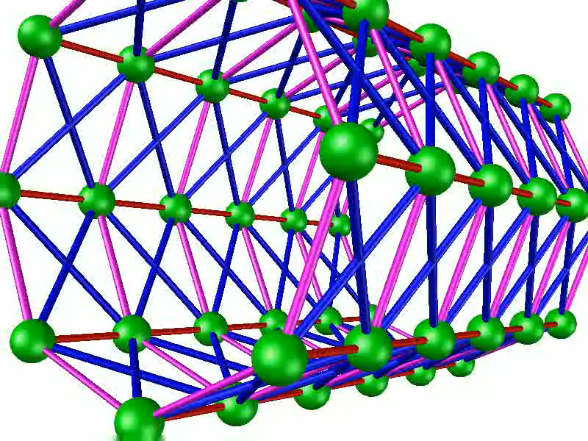
Solution : divide and conquer
Data
Data Formatting
/Delivery
Pattern Recognition
Track
Fitting
CMS Tracker
Space parallel
  6*8 trigger tower
  100 Tbps → ~2 Tbps per tower

Slide 7
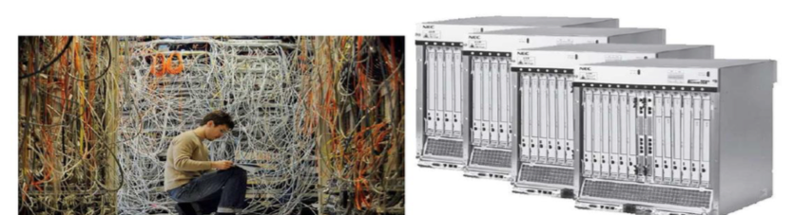
Solution : divide and conquer
Data
Data Formatting
/Delivery
Pattern Recognition
Track
Fitting
Associative Memory,
Hough Transform,
Tracklet,
… …
CMS Tracker
Space parallel
  6*8 trigger tower
  100 Tbps → ~2 Tbps per tower
Time parallel
  8x time multiplexing
  25 ns → 200 ns
Conventional
ATCA full mesh
Huge amount of cabling work without ATCA

Slide 8
Solution : Associative Memory
Data
Data Formatting
/Delivery
Pattern Recognition
Track
Fitting
Associative Memory
  Based on CAM cells to match and majority logic to associate hits with a set of pre-determined hit patterns that represent allowed track trajectories (massively parallel, finishes right after all hits arrive)
Road!
A pattern
Layer 1
Address 4
Layer 1
Address 4
Match
Match
Match
Match
Match
Match
Match
Match
Match
Match
Match
Match
Match
Match
Match
Match
Match
Layer 2
Address 1
Layer 2
Address 1
Layer 2
Address 4
Layer 2
Address 4
Match
Match
Match
Match
Match
Match
Match
Match
Match
Match
Match
Match
Match
Match
Match
Match
Match
Match
Match
Match
Layer 3
Address 7
Layer 3
Address 7
Layer 3
Address 9
Layer 3
Address 9
Match
Match
Match
Match
Match
Match
Match
Match
Match
Match
Match
Match
Match
Match
Match
Match
Match
Match
Match
Match
Match
Match
Match
Match
Match
Match
Match
Match
Match
Match
Match
Match
Match
Match
Match
Implementation of a High-Performance Pattern Recognition Associative Memory in an FPGA
Jun 12, 2018, 09:30
Jamieson Olsen (Fermilab)
Match
Layer 4
Address 4
Layer 4
Address 4
Match
Match
Match
Match
Match
Match
Match
Match
Match
Match
Match
Match
Match
Match
Match

Slide 9
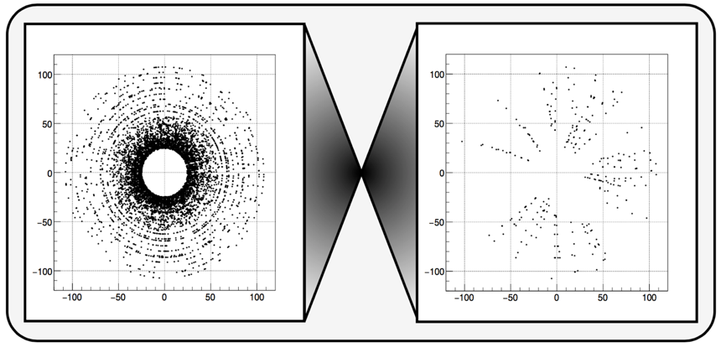
Solution : Associative Memory
Data
Data Formatting
/Delivery
Pattern Recognition
Track
Fitting
Associative Memory (AM)
  Based on CAM cells to match and majority logic to associate hits with a set of pre-determined hit patterns that represent allowed track trajectories (massively parallel, finishes right after all hits arrive)
Perfect tool to mediate the high pileup effect
  Avoiding the typical power law dependence of execution time on occupancy
Road!
A pattern
Layer 1
Address 4
Layer 1
Address 4
Match
Match
Match
Match
Match
Match
Match
Match
Match
Match
Match
Match
Match
Match
Match
Match
Match
Layer 2
Address 1
Layer 2
Address 1
Layer 2
Address 4
Layer 2
Address 4
Match
Match
Match
Match
Match
Match
Match
Match
Match
Match
Match
Match
Match
Match
Match
Match
Match
Match
Match
Match
Layer 3
Address 7
Layer 3
Address 7
Layer 3
Address 9
Layer 3
Address 9
Match
Match
Match
Match
Match
Match
Match
Match
Match
Match
Match
Match
Match
Match
Match
Match
Match
Match
Match
Match
Match
Match
Match
Match
Match
Match
Match
Match
Match
Match
Match
Match
Match
Match
Match
Match
Layer 4
Address 4
Layer 4
Address 4
Match
Match
Match
Match
Match
Match
Match
Match
Match
Match
Match
Match
Match
Match
Match
Before AM
After AM
time
Without AM
Roads found
With AM
occupancy

Slide 10
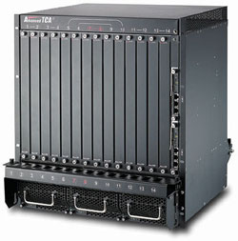
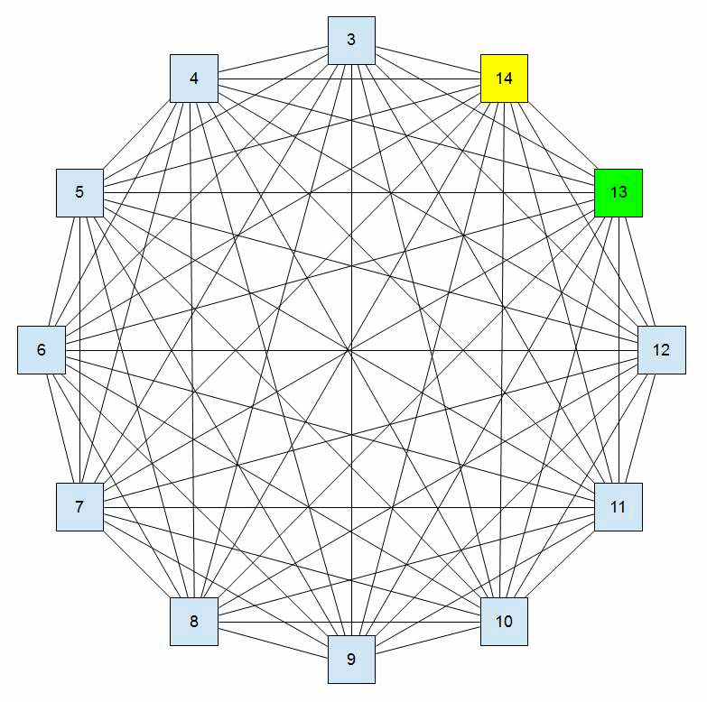
FNAL based hardware R&D
ATCA shelf
The full mesh backplane interconnections effectively blur the distinction between FPGAs, and allow data sharing in both space and time

Slide 11
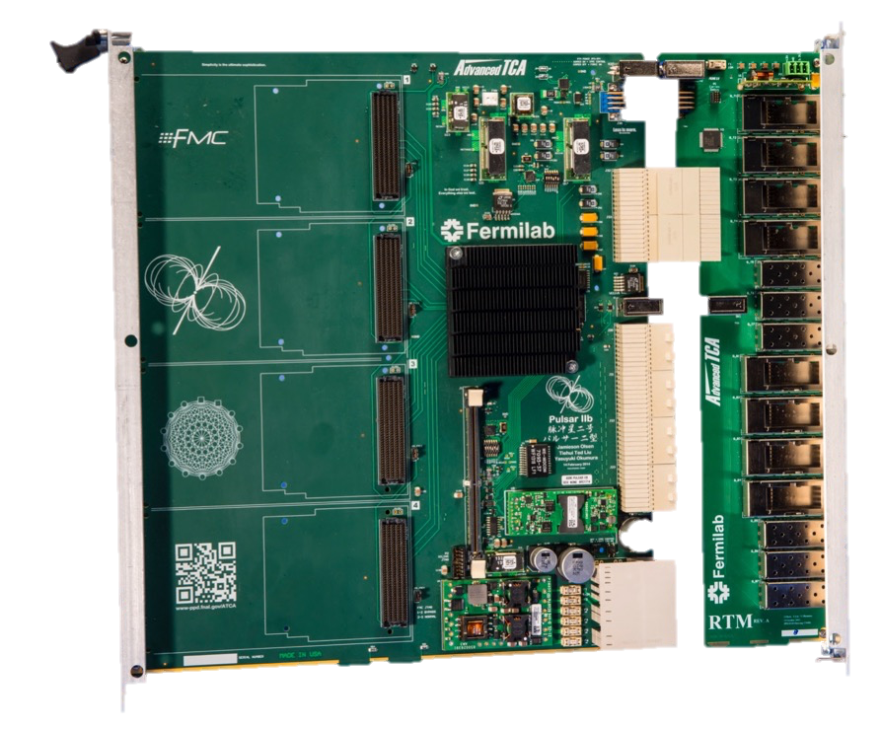
FNAL based hardware R&D
ATCA shelf
Pulsar2b
Pulsar2b RTM (Rear Transition Module)
We tested the data transfer performance for the full mesh back plan, Pulsar2b and RTM (10 Gbps)
Pulsar3a: Next Generation ATCA Full Mesh General Purpose FPGA Based Processing Board
Jun 12, 2018, 10:10
Jamieson Olsen (Fermilab)
A custom ATCA full mesh enabled FPGA-based processor board
Designed with the goal of creating a scalable architecture abundant in flexible, non-blocking, high bandwidth interconnections

Slide 12
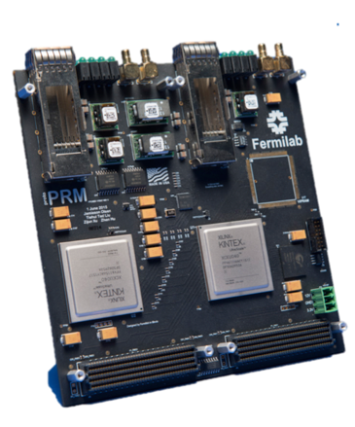

FNAL based hardware R&D
ATCA shelf
ATCA Processing Blade: Pulsar2b
Pulsar2b RTM (Rear Transition Module)
We tested the data transfer performance between PRM and Pulsar2b (10 Gbps) and the interconnection between two FPGAs in PRM (16 Gbps)
PRM (Pattern Recognition Mezzanine Card)
IPMC (Intelligent platform management controller)

Slide 13
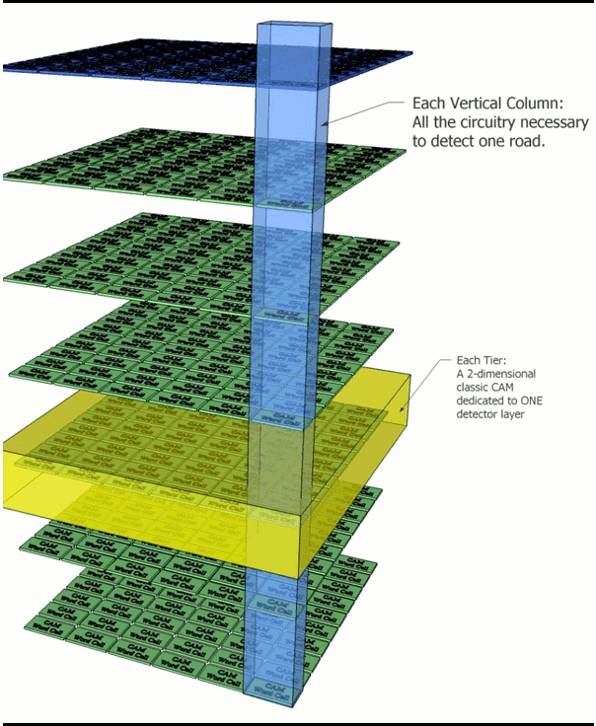
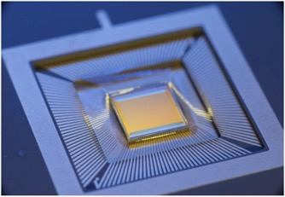
FNAL based hardware R&D
ATCA shelf
ATCA Processing Blade: Pulsar2b
Pulsar2b RTM (Rear Transition Module)
VIPRAM ASIC
(Vertically Integrated Pattern Recognition Associative Memory)
PRM (Pattern Recognition Mezzanine Card)
IPMC (Intelligent platform management controller)
Currently we emulate AM with FPGA

Slide 14
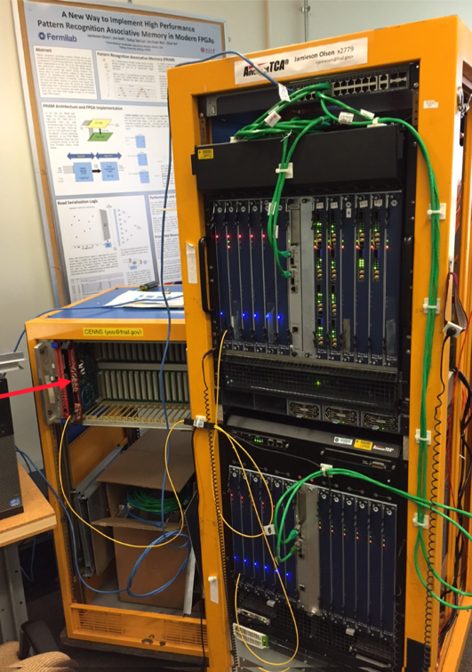
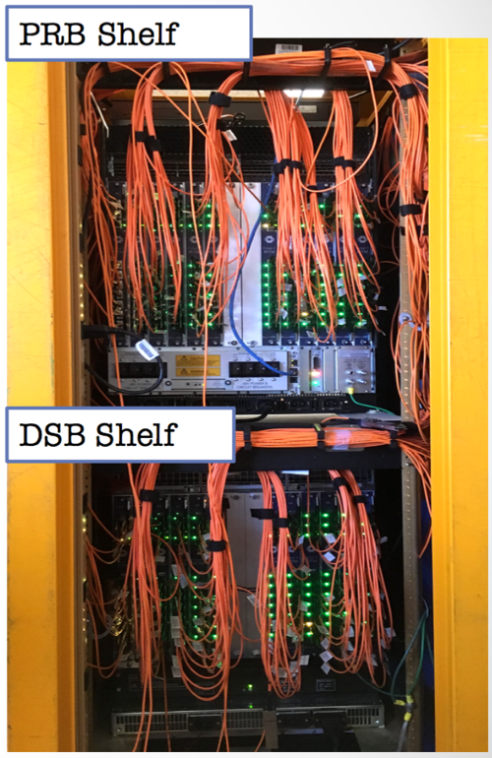
Full system demonstration at Fermilab
Using the technology today to demonstrate tracking trigger feasibility
For one Trigger Tower: two shelves fully loaded with Pulsar2b boards
Pattern Recognition Board (PRB) shelf
12 Pulsar2b with PRM Mezzanines
Bandwidth between any pair of Pulsars is 20Gbps
Data Source Board (DSB) shelf
12 Pulsar2b to Emulates the detector output of ~400 modules
120 QSFP+ fibers
Each with 4 bidirectional lanes each running at 10Gbps
Capable of sourcing up to 4.8 Tbps data with full shelf
Front view
Back view

Slide 15
Full system demonstration at Fermilab
All Pulsar2b boards in the system are synchronized to a common master clock optical link
  Provided by a CERN TTCcx board that encodes a simulated LHC 40MHz bunch crossing clock and various control signals
  This optical link is received by one Pulsar2b board in each shelf
  From this Pulsar2b board the master clock and other control bits are distributed to other Pulsar2b boards in the shelf over dedicated clocks on the ATCA backplane

Slide 16
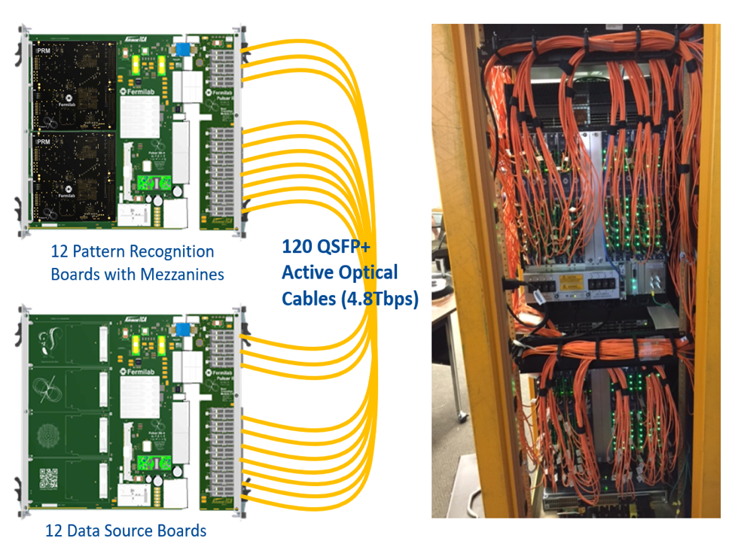
Full system demonstration at Fermilab
Simulated event data is first loaded into the DSB FPGAs
When triggered by bunch crossing signal, data is transmitted over the 120 QSFP+ optical links at full speed to the PRBs in the upper shelf
The 12 PRBs receive the incoming data, perform sophisticated time multiplexed data transfers over the full mesh ATCA backplane
Finally the event data sent to the FMC Pattern Recognition Mezzanine (PRM) cards
(PRB)
(DSB)

Slide 17
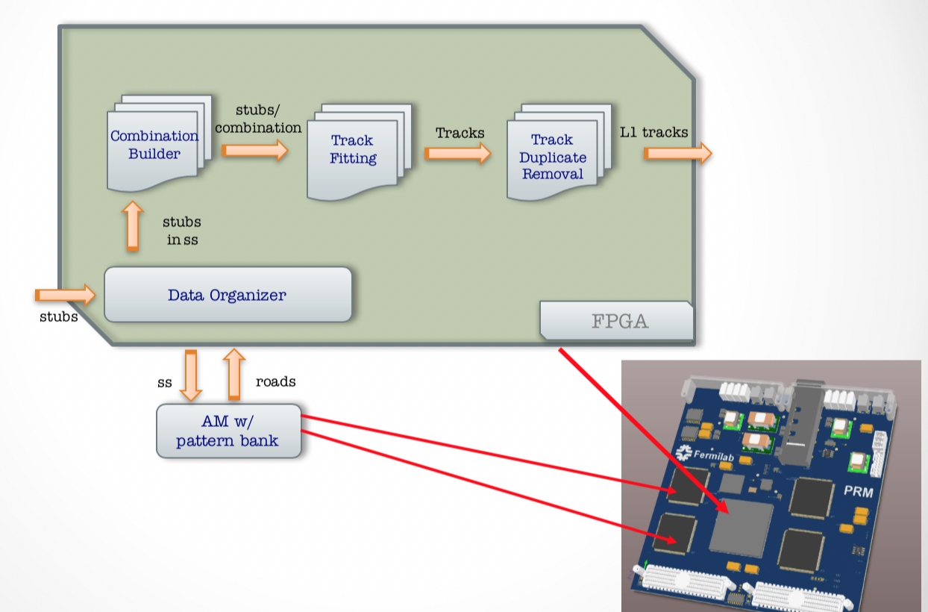
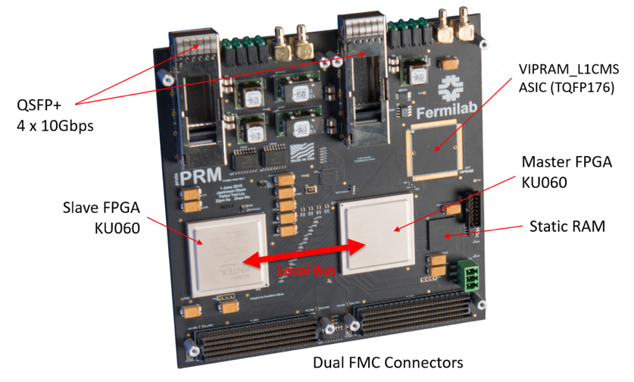
PRM firmware design
Implementation of a High-Performance Pattern Recognition Associative Memory in an FPGA
Jun 12, 2018, 09:30
Jamieson Olsen (Fermilab)
(hits)
Slave FPGA is used to emulate associative memory
  Enables us to quickly evaluate and optimize the performance of the AM-FPGA interface and internal AM logic features

Slide 18
Demonstrator validation
Full simulation & emulation software
Data
Sourcing
(DS)
Data Formatting
/Delivery
Pattern Recognition
(PR)
Track
Fitting
(TF)
DS.txt
PRBF2.txt
FiredRoads.txt
DS.txt
DS Firmware
PRB Firmware
PRM Firmware
TF Firmware
Firmware in hardware demonstrator
Hardware and emulator perfectly matched
  Output from each stage validated bit-by-bit
With the full chain demonstrator, we have measured
  Latency, FGPA resource usage, efficiency, resolution

Slide 19
Latency well within specs
Data
Sourcing
Data Formatting
/Delivery
Pattern Recognition
Track
Fitting
950ns
250ns
642ns
25ns
175ns
Data delivered to PRM starts/ends: @1.20 – 1.70 μs
Pattern Recognition output starts/ends: @1.84 – 2.34 μs
Track Fitting output starts/ends: @2.04 – 3.04 μs
3042 ns
DD
950 ns
250 ns
500 ns
PR
642 ns
500 ns
TF
175 ns
1000 ns
2542 ns (PU250)

Slide 20
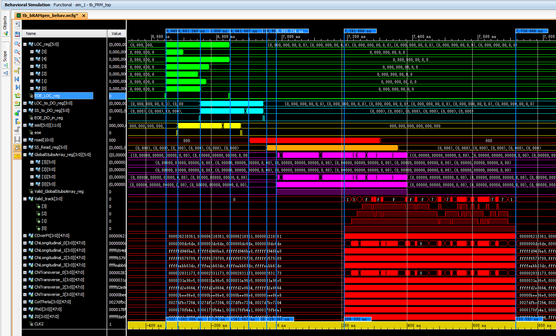
An example event in Vivado
A) Input Stubs
Confirmed on Hardware
B) DO Stubs Input
C) PRM SSID Input
D) PRAM Road Output
E) DO SSID Input
F) Global Stubs
G) Track Candidate
4xTF, 7191.666 ns to 7716.666ns = 525ns, 126 clk @240MHz
This is with a selected ttbar + PU200 event with high tail of combinations

Slide 21
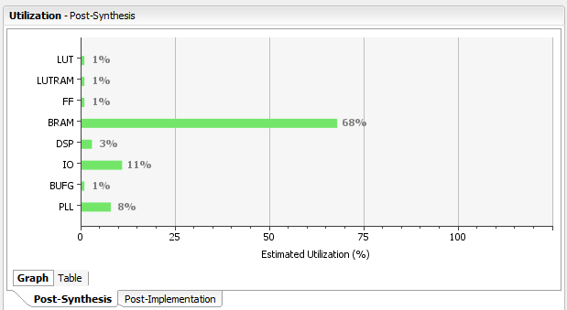
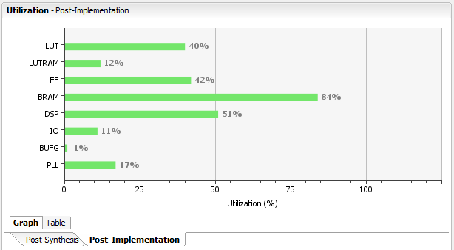
FPGA Resource Utilization (KU060)
Data Organizer only
Data Organizer and 8 Tracker Fitters
Very light weighted design
BlockRAM mainly used for DO
  TF does not increase BlockRAM usage, leaving enough room for TF
TF: modest increase in registers and DSP blocks
  Plenty of room for parallel copies of the fitter

Slide 22
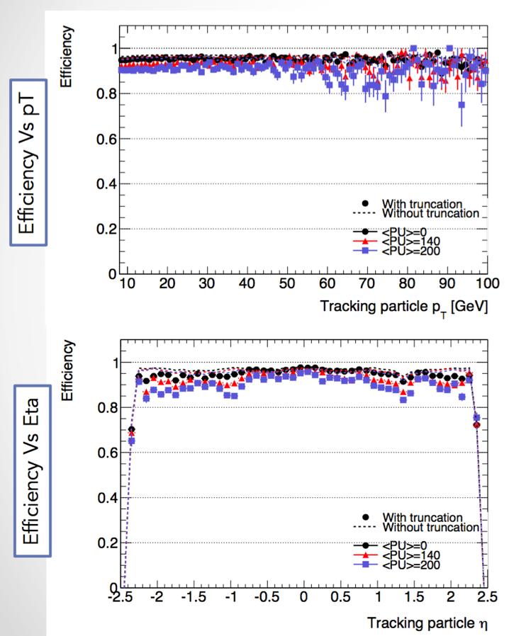
High efficiency up to PU250
System is robust against higher luminosity or increase in stub occupancy
  We demonstrate that the system reconstructs all tracks for events with PU250 within 2.5 μs (no truncation needed)
  Only for very high pT jet, truncation needed to meet the pipeline window
Tracking efficiency in ttbar+PU jets

Slide 23
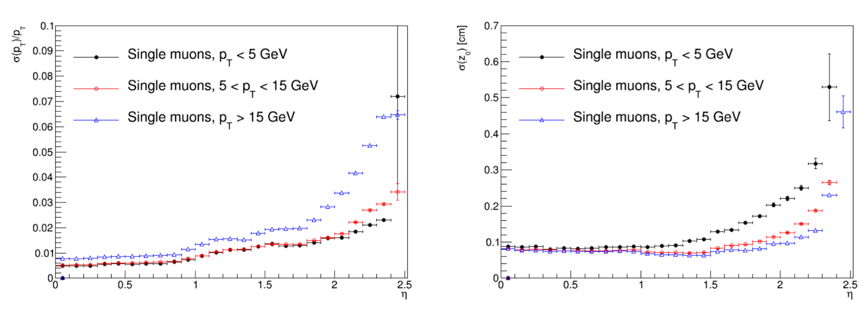
Resolution
Excellent performance for L1 trigger application
p_{T} resolution
z₀ resolution

Slide 24
Summary
Demonstrated with a vertical slice
  Achieved excellent performance in terms of tracking efficiency and momentum resolution
  Very low total latency (2.5 μs): data dispatch to the trigger towers, pattern recognition, track fitting
The success of the demonstration system
  An existence proof of fast data delivery, fast pattern recognition and track fitting implemented using the full mesh ATCA and associative memory approach
  Technology advancements could lead to reduced size of the system in the future

Slide 25
Backup

Slide 26
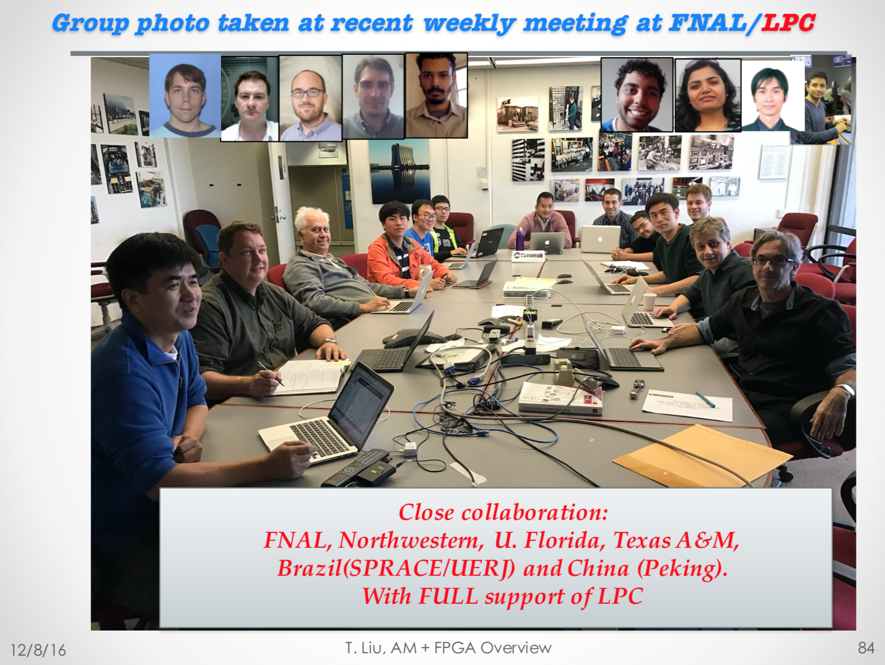

Slide 27
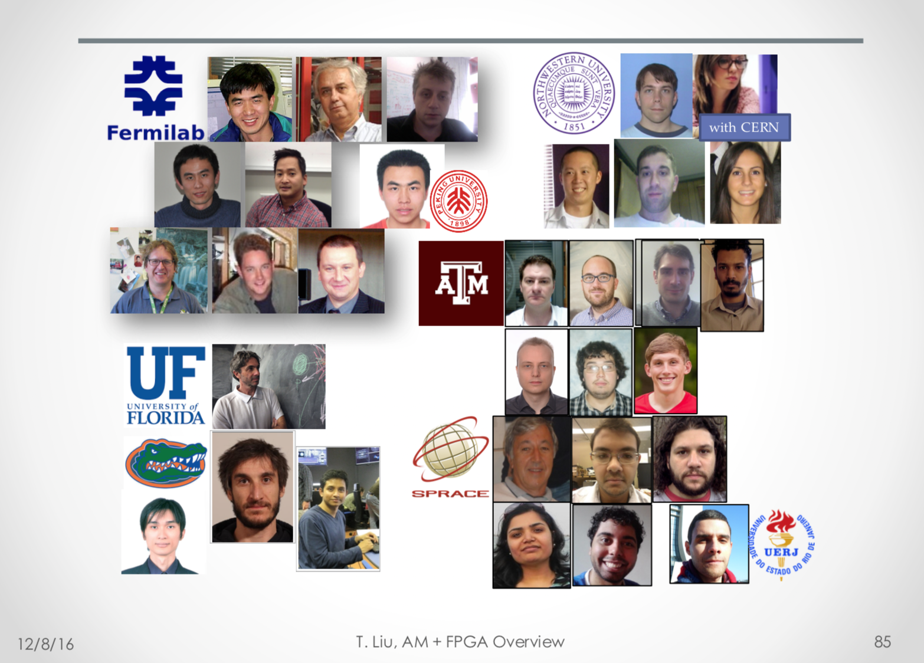

Slide 28
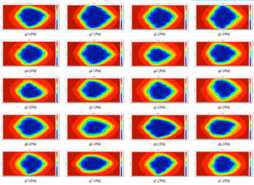

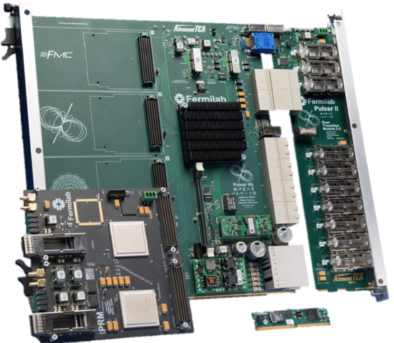
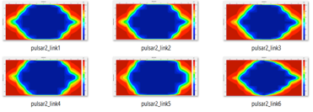
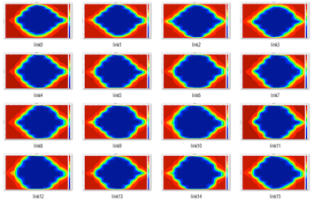
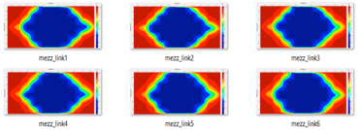
Excellent hardware performance
ATCA shelf
  10 blades for parallel processing
  Full mesh backplane is a natural solution for time multiplexing
    All of the 56 bidirectional links among 8 Pulsar2b boards were tested at 10Gbps
Rear Transition Module
  10 QSFP bidirectional links
    10 Gbps per link achieved
PRM performance
  Communication between Pulsar2b and PRM FPGAs
    10 Gbps achieved
  Two latest generation of Xilinx FPGAs
    Interconnection achieved 16.3 Gbps
Notes:
What is time multiplexing scheme

Slide 29
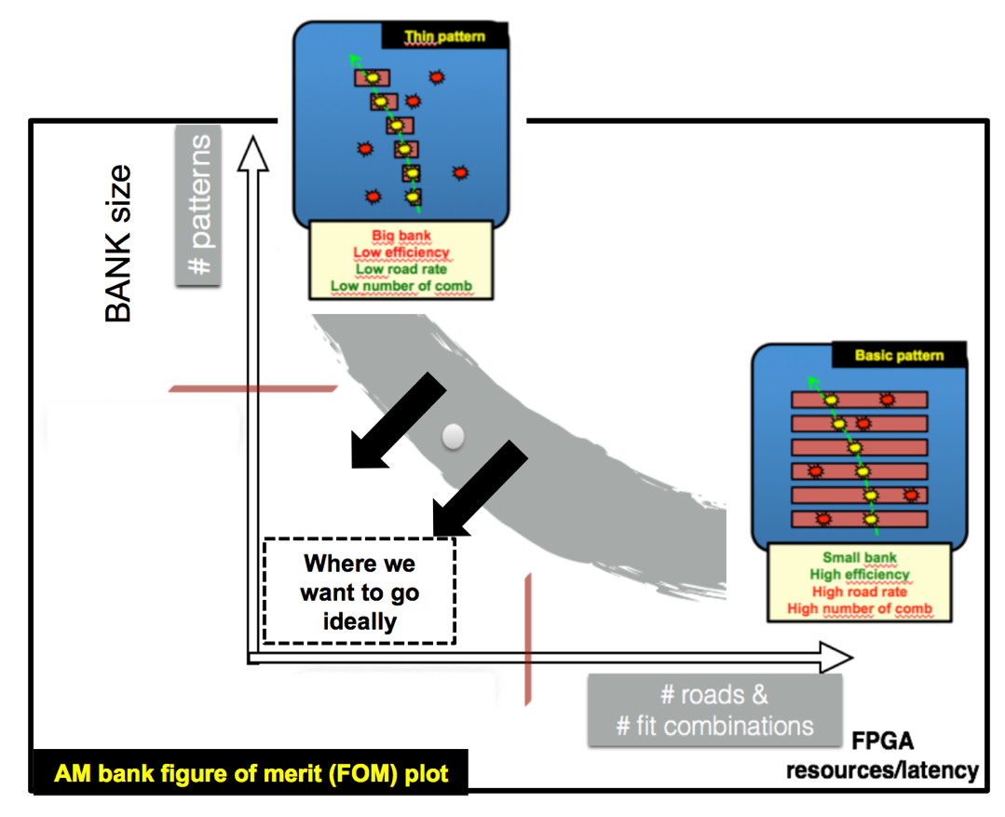
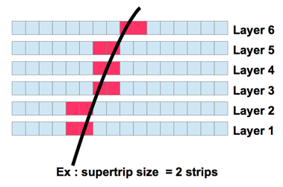
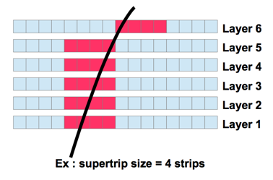
AM Pattern and Bank
A pattern is a low resolution track
  Made of 1 superstrip (SS) per layer
    A SS is a group of adjacent strips
More powerful AM => less demand on the FPGA
More powerful FPGA => less demand on the AM
Fountain SS

Slide 30
AM in FPGA: Overview
AM in FPGA: very closely follows the AM ASIC (chip) design
  Match two silicon tiers in ASIC with two modules in FPGA firmware
    CAM Tier -> a 2D array of Pattern Modules
    I/O Tier -> fired roads serialization and output
  Pipelined operation
    CAM tier: processes pattern matching with stubs for current event N
    I/O tier: outputs road addresses for event N-1 at the same time
CAM tier logic is optimized for
7-Series/UltraScale FPGA architecture

Slide 31
Latency well within specs
Data
Sourcing
Data Formatting
/Delivery
Pattern Recognition
Track
Fitting
950ns
250ns
642ns
25ns
175ns
Data delivered to PRM starts/ends: @1.20 – 1.70 μs
Pattern Recognition output starts/ends: @1.84 – 2.34 μs
Track Fitting output starts/ends: @2.04 – 3.04 μs
3042 ns
DD
950 ns
250 ns
500 ns
PR
642 ns
500 ns
TF
175 ns
1000 ns
2542 ns (PU250)

Slide 32
Demo with FPGA
Full pattern bank in ASIC (for a trigger tower)
Pattern 1
Pattern 2
Event 1
fire
Pattern 3
Pattern 4
Pattern 5
Event 2
Pattern 6
… …
Pattern 7
… …
… …
Pattern 1M
Partial pattern bank demo in FPGA
Event 2
Pattern 6
Pattern 7
Test ~10-20 events at a time
  more than 1-2 bunch train worth, the rest is repeating
  only need ~1K patterns loaded at a time
… …
… …
~ 100 patterns fired per event

